Slide 1
Scientific-Abstract-GPT
A Decoder-Only Transformer for Scientific Abstract Generation
PyTorch · GPT · arXiv · BPE · Gradio
Presented by: Satya Bharath Reddy Duvvi
Master of Science in Data Science
1/15

Slide 2
Problem Statement
Input
Research paper title + research subject
GPT Model
Decoder-only Transformer trained for next-token prediction
Output
Scientific abstract
Motivation: scientific abstracts require concise technical writing
Goal: demonstrate GPT internals by building and training from scratch
Application: early-stage research writing assistance
2/15

Slide 3
Dataset & Preprocessing
Dataset
arXiv research papers from Hugging Face
Selected Categories
cs.AI · cs.LG · cs.CL
Split
Train · Validation · Test
Structural Tokens Added
<TITLE>
<SUBJECT>
<ABSTRACT>
<END>
Cleaned missing and noisy records
Standardized text structure so the model learns section boundaries
3/15

Slide 4
Project Pipeline
Raw
Dataset
Data
Preprocessing
BPE
Tokenization
GPT
Architecture
Model
Training
Text
Generation
Evaluation
Gradio
Demo
End-to-end workflow: raw research metadata → deployed generation demo
Reusable src/gpt_components.py avoids duplicating model architecture across notebooks
4/15

Slide 5
GPT Architecture Diagram
Structured Prompt
<TITLE> + <SUBJECT> + <ABSTRACT>
BPE Tokenizer
Text → token IDs
Inside each Transformer Block
Token + Positional Embeddings
Represent tokens and order
LayerNorm
Masked Multi-Head Self-Attention
Transformer Blocks × 6
Masked multi-head attention + feed-forward
Residual Add
LayerNorm
Linear Output Head
Logits over vocabulary
Feed-Forward Network
Residual Add
Autoregressive Generation
Next token → abstract
5/15

Slide 6
Tokenization
Byte-Level BPE
Learns frequent subword units from scientific text
Why not character-level?
Character models learn letters first and require much longer training
Why BPE?
Handles rare terms and reduces
sequence length
<TITLE> Transformer Models for Medical Imaging
→ ['<TITLE>', ' Transformer', ' Models', ' for', ' Medical', ' Imaging']
Structural tokens remain atomic during tokenization
6/15

Slide 7
Model Training
Objective
Next-token prediction
Loss
Cross-entropy
Optimizer
AdamW
Learning-rate warmup + cosine decay improves stability
Mixed precision improves GPU memory usage and training speed
Gradient clipping prevents unstable updates
Best checkpoint saved using validation loss
7/15

Slide 8
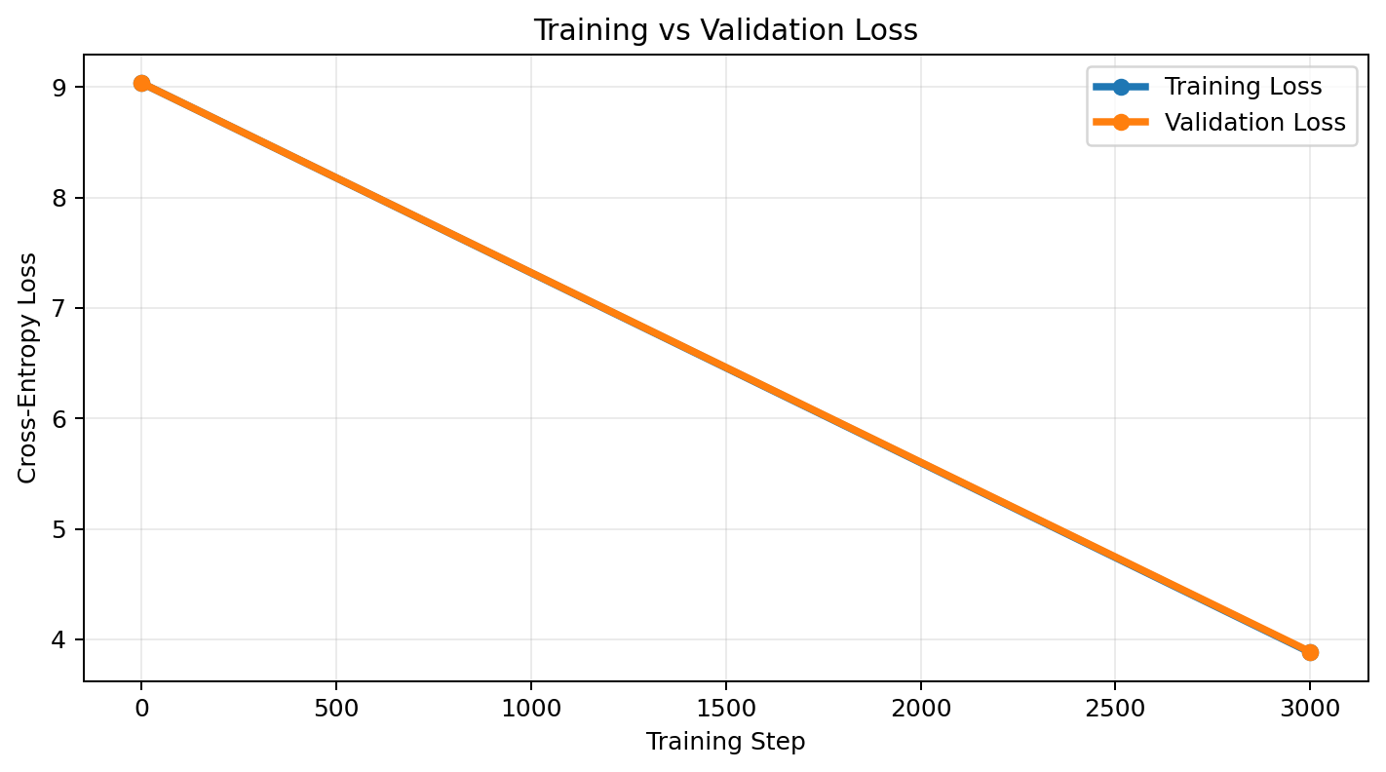
Training & Validation Loss
Initial Loss
≈ 9.036
Final Train Loss
3.8820
Final Validation Loss
3.8883
Tiny Gap
0.0062 → no clear overfitting
8/15

Slide 9
Evaluation Results
Training Loss
3.8820
Validation Loss
3.8883
Test Loss
3.8807
Test Perplexity
48.46
Structural Compliance
95.83%
END-token Completion
83.33%
Avg Abstract Length
130 words
Trigram Repetition
0.0083
Training, validation, and test losses are closely aligned
Generation follows the expected scientific format with low repetition
9/15

Slide 10
Example Generation
Input
Title: Transformer Models for Medical Image Analysis Subject: Machine Learning
Output
Generated scientific abstract
The model generates an abstract autoregressively. Meaningful scientific titles produce better topic relevance, while random titles still produce generic scientific-style abstracts.
10/15

Slide 11
Interactive Demo
Built with Gradio
User enters a research title and subject
Controls: temperature, top-k, top-p, maximum tokens, repetition penalty
Displays generated abstract, structured output, and generation status
Scientific Paper Title
Research Subject
Generation Controls
Generated Abstract
Generate Abstract
11/15

Slide 12
Challenges & Solutions
GPU Memory
Challenge
Mixed precision + gradient accumulation
Solution
Repetitive Text
Challenge
Top-k/top-p + repetition penalty
Solution
Structure Learning
Challenge
<TITLE>, <SUBJECT>, <ABSTRACT>, <END>
Solution
Notebook Consistency
Challenge
Reusable src/gpt_components.py
Solution
12/15

Slide 13
Limitations
Small GPT trained from scratch; not comparable to production-scale LLMs
Generated abstracts can be scientifically styled but may not be factually correct
Limited context window restricts long-document generation
Perplexity and structural compliance do not fully measure scientific correctness
13/15

Slide 14
Future Work
Scale Data
Train on larger and more diverse scientific corpora
Scale Model
Increase context length and model capacity
Fine-Tune LLMs
Compare from-scratch GPT with pretrained models
Generate Sections
Introduction, Methods, Results, Conclusion
RAG Grounding
Use real papers to improve factual reliability
Human Evaluation
Assess coherence, relevance, and factuality
14/15

Slide 15
Conclusion
Built decoder-only GPT from scratch
Trained custom Byte-Level BPE tokenizer
Added structural tokens for scientific document format
Trained, generated, evaluated, and deployed an interactive demo
Demonstrated end-to-end understanding of generative language models
Thank you — Questions?
15/15

