Slide 1




CREATING THE FUTURE
YOUR WAY
www.viettel.com.vn

Slide 2



Đại hội Đoàn TNCS HCM Tập đoàn Công nghiệp Viễn thông Quân đội lần thứ VI
high tech
THAM LUẬN
Khóa học chuyên đề
Phát triển giao thức mạng 5G
GIẢI PHÁP XÂY DỰNG MÔI TRƯỜNG VĂN HÓA GẮN KẾT, SÁNG TẠO GÓP PHẦN GÌN GIỮ VÀ THU HÚT NGUỒN NHÂN LỰC TRẺ CHẤT LƯỢNG CAO
Hà Nội 08/2024

Slide 3
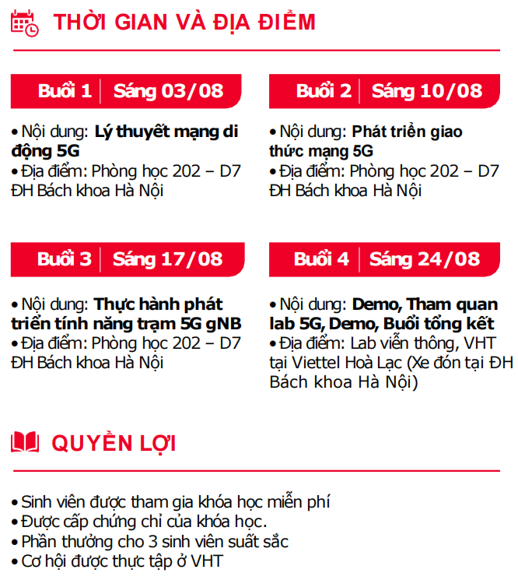
Course

Slide 4
Summary – Session 1
I. 5G Introduction
II. 5G Protocol Stack
III. Paging call flow and feature
IV. Mini-project

Slide 5


I. 5G Introduction

Slide 6
I. 5G Introduction
1. 5G
2. ITU
3. 3GPP
4. Network Architecture Overview
5. 4G/5G Non-standalone Architecture (NSA)
6. 5G Standalone Architecture (SA)
7. 5G in Vietnam

Slide 7
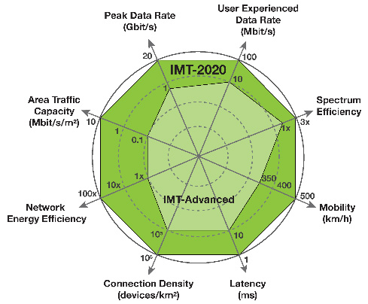
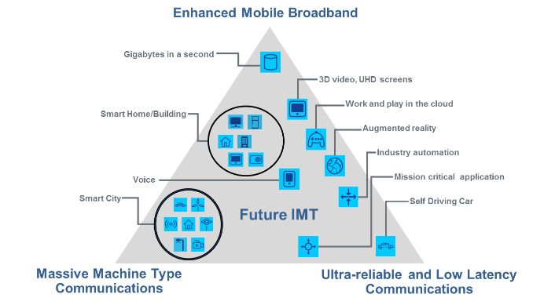
1. 5G
Object
EMBB
URLLC
Mass type connections
Network Elements
UE,
Radio Access Network
Transport Network
Core Network
Key Technology ?
Massive MIMO
Beamforming
Network slicing
Network flexibility – Virtualization

Slide 8

2. ITU – International Telecommunication Union
ITU
Founded 1985
Agency of United Nation (UN)
193 member states + 900 companies, universities and organization
Coordinates the global use of the radio spectrum and defines requirements for next-generation mobile communication technologies.
3 main sectors
ITU-R Radio Communication
ITU-T Standardization (called Recommendation)
ITU-D Development
Committed to connecting the world
Output document
IMT-2000: define “3G”; year of release: 2000
IMT-Advanced: define “4G”; year of release: 2010
IMT-2020: define “5G”; year of release 2020

Slide 9

3. 3GPP – 3rd Generation Partnership Project
3GPP
1998
Is an standard organization
From 7 regional organization partners (ARIB, ATIS, CCSA, ETSI, TSDSI, TTA, TTC) + 700 companies
Create & maintain technical standard for global mobile communication technologies as GSM, UMTS, LTE, NR
3 main group
Radio Access Network
Service & System Aspects
Core Network & Terminal
Output document
Release 99: “3G” UMTS standard
Release 8: “first 4G” LTE standard; year of release: 2008
Release 15: “first 5G”; NR standard; year of release: 2018

Slide 10
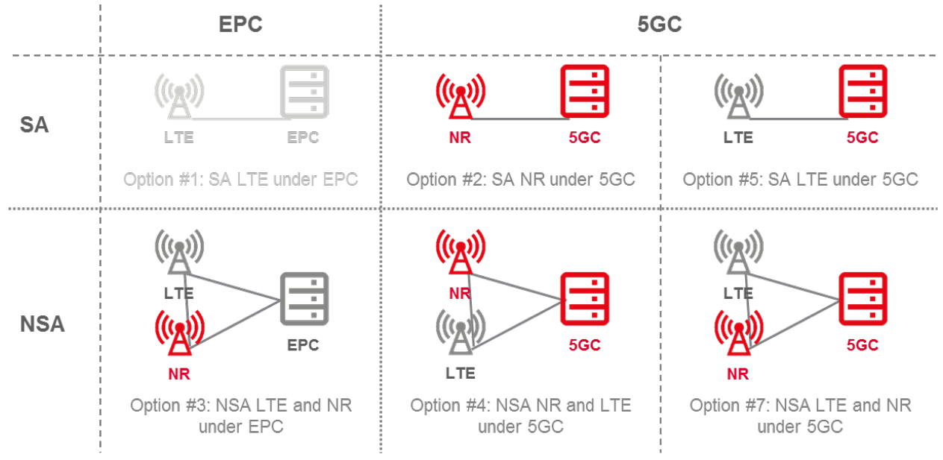
4. 4G/5G Network Architecture Overview
4G LTE option 1
4G/5G NSA option 3
5G SA option 2
https://www.digi.com

Slide 11
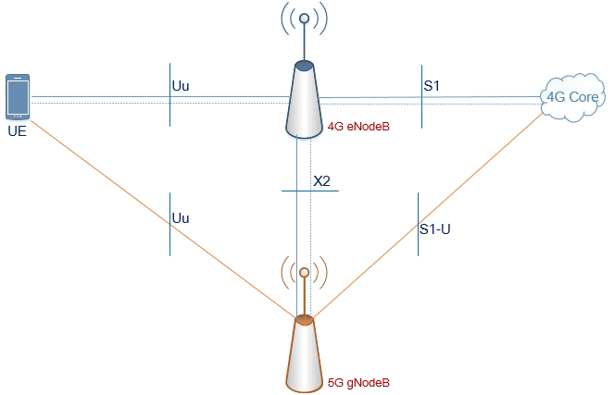
5. Non-standalone Architecture (NSA)
NSA option 3
Radio access network is composed of
4G eNodeB as master node
5G gNodeB as secondary node
Core is 4G core
Advance
Quickly deploy
Add only 5G gNodeB
Increase throughput
Dis-advance
Adapt only MBB
Complex operation

Slide 12
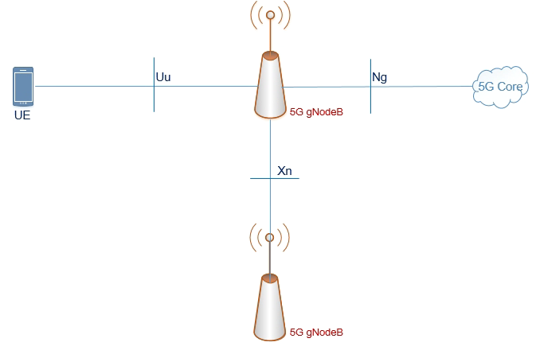
6. 5G Standalone Architecture (SA)
SA option 2
Radio Access Network
5G gNodeB
Core Network:
5G Core
Advance
Full 5G technology to achieve: MBB, ULLC, Mass types of connection
Simple operation:

Slide 13
Student work
Why 5G throughput is higher than 4G throughput ?
Calculation the peak 5G throughput

Slide 14
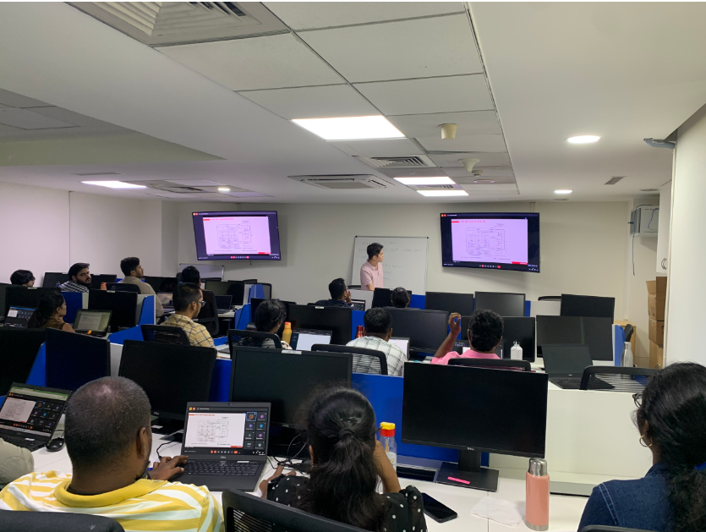
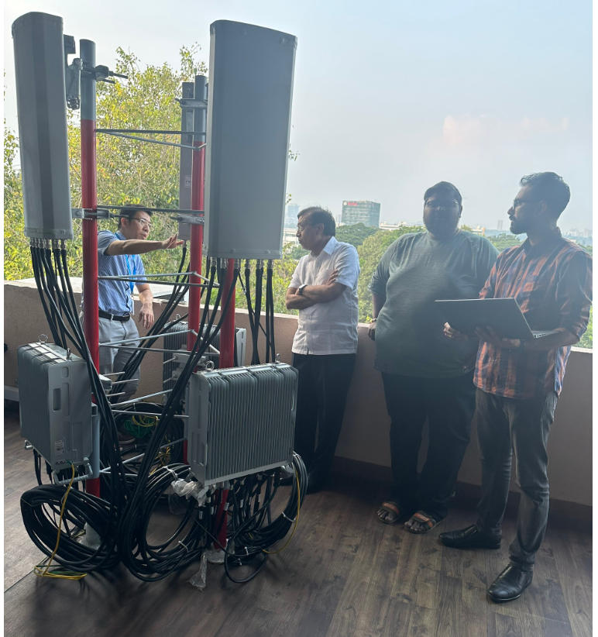
8. 5G in Vietnam
Viettel 5G trail spectrum license :
Deploy 5g service 63/63 provinces
NSA mode
5G spectrum license for 15 year
Viettel: 2500-2600 MHz ; March 2024
VNPT: 3700-3800; April 2024
Big 4G/5G vendor
Ericsson
Nokia
VHT ( Viettel High Tech)
VHT exported 5G Private Network to India in August 2023

Slide 15
II. 5G Protocol Stacks –
overview

Slide 16
II. 5G Protocol Stack - gNodeB
1. Definition
2. gNodeB Interface
3. gNodeB Protocol Stack – Control Plane
4. gNodeB Protocol Stack – User Plane
5. 5G NR Layer 3
6. 5G NR Layer 2
7. 5G NR Layer 1

Slide 17
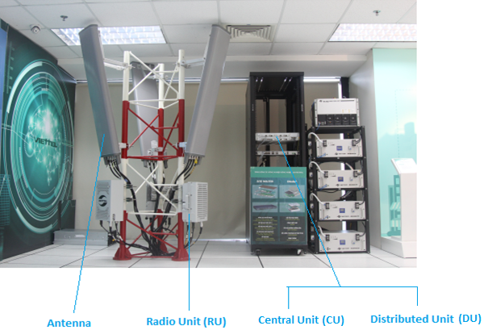

5G gNB Viettel
Chỉ tiêu kỹ thuật:
Dung lượng: 3600 user/gNB
Băng tần: 2496-2690/3600-3800 (FR1-N41, N78- 3GPP)
Băng thông: 20-100MHz, IBW 100MHz
Tốc độ (DL/UL): hỗ trợ tối đa 1.8 Gbps/380 Mbps per cell in 8T8R
Công nghệ điều chế: QPSK, 16QAM, 64QAM, 256QAM.
Thu phát đa ăng ten: 8T8R, 32T32R, 64T64R
Hỗ trợ: 3GPP Release 15, 16
RRU
BBU

Slide 18
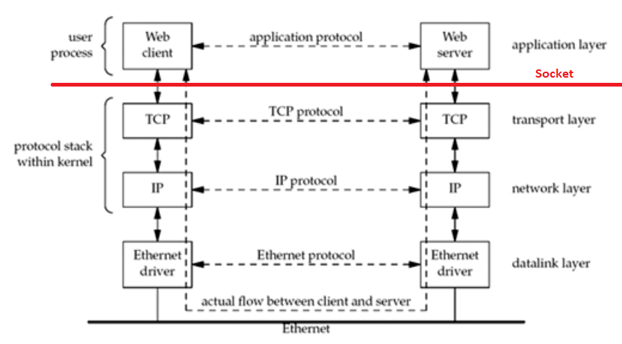
1. Definition
Protocol
A set of rules or procedures for transmitting data between electronic devices
Protocols in Transport layer: ?
Interface
A shared boundary across which two or more components
Protocol Stack
A set of protocols used in communication network --- ?

Slide 19
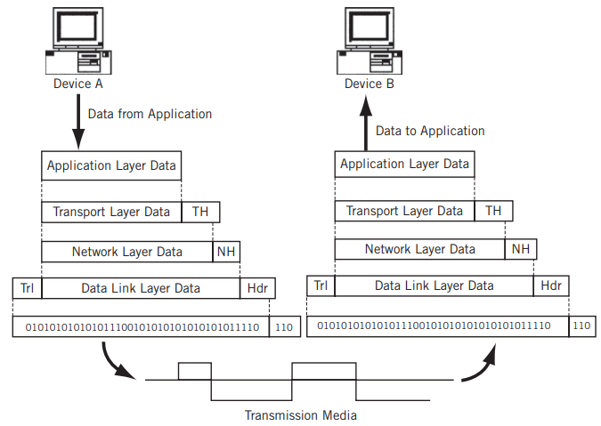
Transmission

Slide 20
2. gNodeB Interfaces
Uu Interface or Radio Interface
interface between UE and 5G gNodeB
Ng Interface or N2 Interface
Interface between gNodeB and 5G Core network
Ng-C interface for control plane
Ng-U interface for user plane
Ref: from TS 38.401 to TS 38.414
Xn Interface
Interface between gNodeb and gNodeB
Xn-C interface for control plane
Xn-U interface for user plane
Ref: from TS 38.420 to TS 38.424

Slide 21
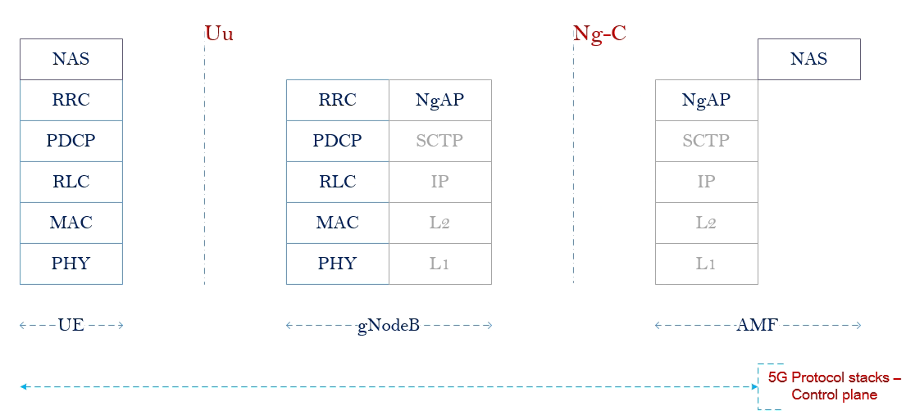
3. gNodeB Protocol Stack - Control plane

Slide 22
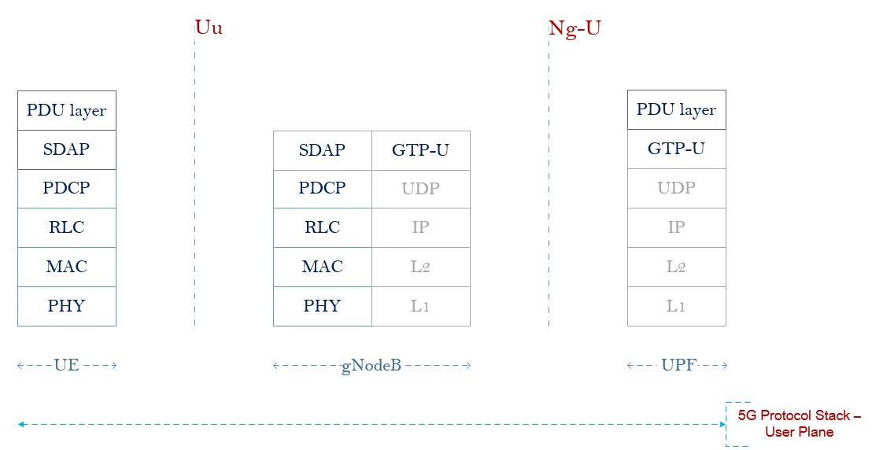
4. gNodeB Protocol Stack - User plane

Slide 23
4. Student work
Show the gNodeB Protocol Stack for Xn Interface – Control Plane & User Plane
5 minutes

Slide 24
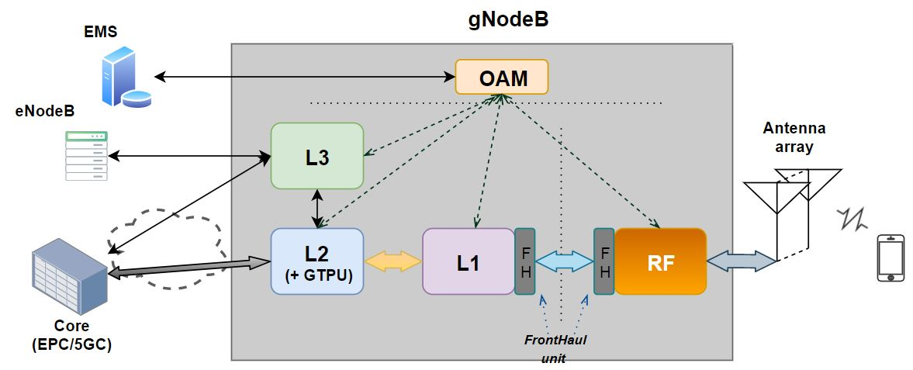
5G GNODEB ARCHITECTURE & SW PROTOCOL STRUCTURE
Where is the interface NG-C ?
GNODEB ARCHITECTURE
GNODEB SOFTWARE PROTOCOL
24

Slide 25
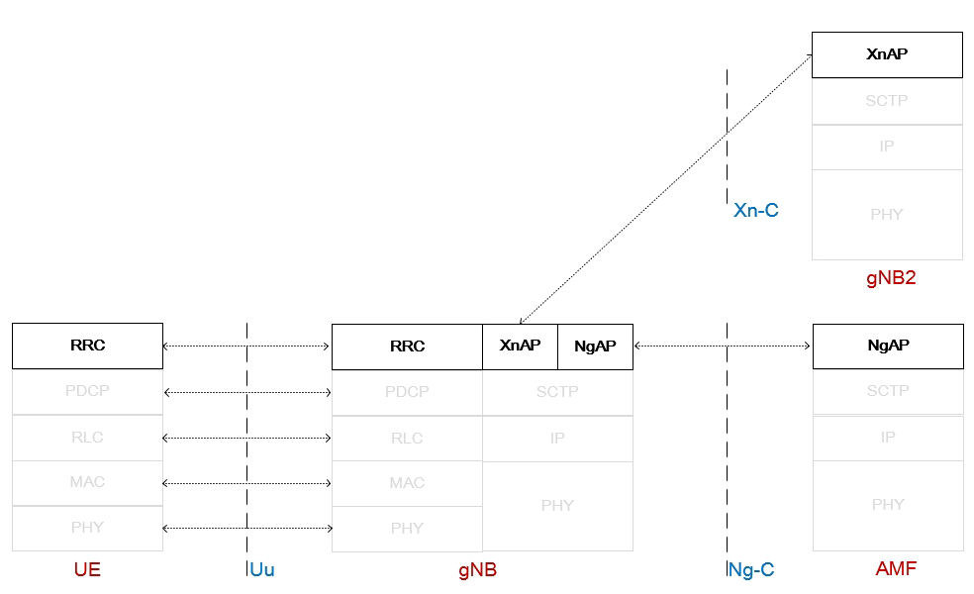
5. 5G NR Layer 3
Protocol
Radio Resource Control - RRC
Ng Application Protocol – NgAP
Xn Application Protocol – XnAP
F1 Application Protocol – F1AP
Main function
Broadcast of system information
Manage RRC connection (establish, maintain, release)
Manage Data Radio Bearer – DRB (establish, configuration, maintain, release)
Mobility function & QoS management
Manage the procedures between gNB and 5GC
Manage the procedures among gNBs

Slide 26
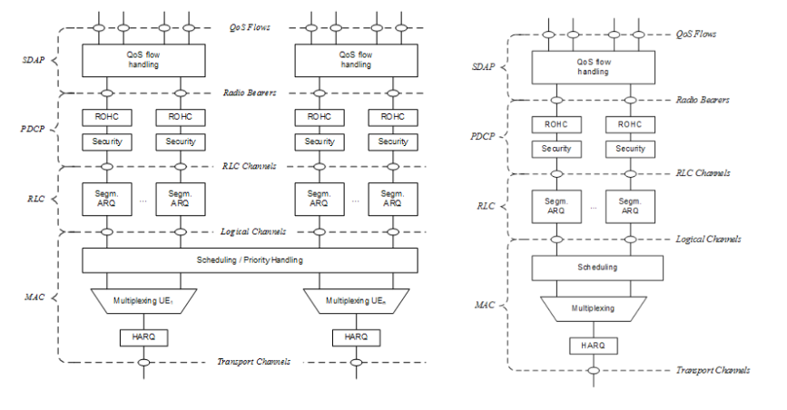
6. 5G NR Layer 2
Service Data Application Protocol - SDAP
Package Data Convengence Protocol – PDCP
Sequence numbering
Ciphering & integrity
Header compression
Radio Link Control – RLC
3 mode of transfer: UM, AM, TM
Segmentation and re-segmentation
Error correction through ARQ
Medium Access Control – MAC
Mapping logical-transport channels
Multiplexing/ de-multiplexing.
Scheduling
Error correction through HARQ

Slide 27
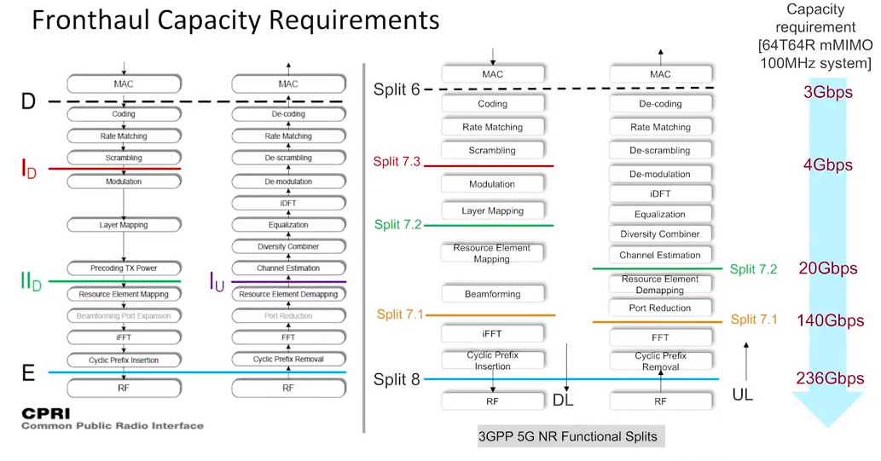
7. 5G NR Layer 1

Slide 28
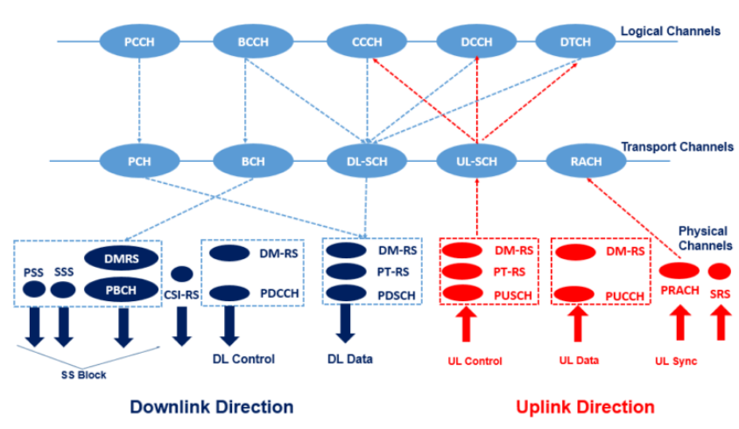
8. Channel mapping
MIB (RRC messages) - ~ 24bit
RLC mode: TM
Logical channel: BCCH
Transport channel: BCH
Physical channel: PBCH
576 Resource Elements (240*2 + 48*2)
Coding: polar coding
Modulation: QPSK
antenna transmission scheme: single
MIB message

Slide 29
III. 5G NR Paging Feature

Slide 30
III. 5G NR Paging Feature
1. What - Requirement
2. Paging Call Flow
3. 3GPP – document
4. Paging Occasion
5. Calculate the Paging Occasion at UE
6. Select the best Paging Occasion at gNB
7. Simulation
8. Mini-project

Slide 31




1. What - Requirement
AMF
Purpose of Paging Procedure:
Triggering mobile terminated connections setup (RRC Setup Request/ RRC Resume Request)
Informing UE of the System Information Modification
Notifying UE of incoming ETWS/CMAS message
NGAP Paging
RRC Paging
TA1
TA2
Notes:
- ETWS: Earthquake and Tsunami Warning System - CMAS: Commercial Mobile Alert System

Slide 32
2. Paging Call Flow
UE
gNB
AMF
DRX Cycle
Paging Occasion
NgAP Paging
T3513
Start
PDCCH with P-RNTI
Paging Occasion
RRC: Paging
(PCCH/PCH/PDSCH)
Random Access Procedure
RRC Setup Request
(CCCH/UL-SCH/PUSCH)
RRC Setup
(CCCH/DL-SCH/PDSCH)
RRC Setup Complete
(DCCH/UL-SCH/PUSCH)
NGAP: Initial UE Message / Service Request
T3513
Stop

Slide 33
3. 3GPP – Paging document
TS 38.331 | 5G; NR; Radio Resource Control (RRC); Protocol specification | RRC Paging Procedure
TS 38.413 | 5G; NG-RAN; NG Application Protocol (NGAP) | NGAP Paging Procedure
TS 38.423 | 5G; NG-RAN; Xn Application Protocol (XnAP) | XnAP Paging Procedure
TS 38.304 | 5G; NR; User Equipment (UE) procedures in idle mode and in RRC Inactive state | Discontinuous Reception for paging
TS 38.213 | 5G; NR; Physical layer procedures for control | PDCCH Paging Search Space

Slide 34
3. 3GPP – NgAP Paging message
NGAP: Paging <TS 38.413>
UE Paging Identity (Mandatory) | 5G-S-TMSI |  | AMF Set ID & AMF Pointer & 5G-TMSI
Paging DRX | 32, 64, 128, 256
TAI List for Paging (Mandatory) | SEQUENCE {1 to 16 instances}
 | Tracking Area ID |  | PLMN Id & Tracking Area Code (TAC)
Paging Priority | 1, 2, 3, 4, 5, 6, 7, 8
UE Radio Capability for Paging | Capability for NR | List of Supported NR Bands | List of Supported NR Bands | SEQUENCE {1 to 1024 instance}
 |  |  |  | 1-1024
 | Capability for E-UTRA | List of Supported E-UTRA Bands | List of Supported E-UTRA Bands | SEQUENCE {1 to 64 instance}
 |  |  |  | 1-256
Assistance Data for Paging | Recommended Cells
 | Paging Attempt Info
Paging Origin | Non-3GPP

Slide 35
3. 3GPP – RRC Paging message
RRC Paging <3GPP TS 38.331>
Paging Record List | SEQUENCE {1 to 32 instances}
 | PagingRecord | ue-Identity | CHOICE
 |  |  | ng-5G-S-TMSI | Full I-RNTI
 |  |  | BIT STRING {48 bit} | BIT STRING {40 bit}
 |  | accessType | non3GPP

Slide 36
4. Paging Occasion
Paging Occasion (PO)
A Subframe when UE switch to active mode to check for Paging message
Paging Frame (PF)
A Radio Frame may contain one or multiple PO(s)
DRX Cycle
Period between two Paging Occasion (UE sleep mode duration)
DRX Cycle
0
1
2
3
4
5
6
7
8
.
.
.
28
29
30
31
32
33
34
35
36
…
PF
PF
0
1
12
13
0
1
12
13
…
…
PO
PO

Slide 37
5. Calculate the Paging Occasion at UE
According to 3GPP TS 38.304:
Paging Frame:
(SFN + PF_offset) mod T = (T div N)*(UE_ID mod N)
Paging Occasion:
i_s = floor (UE_ID/N) mod Ns
T: DRX cycle of the UE
N: Number of total paging frames in T
Ns: number of paging occasions for a PF
PF_offset: offset used for PF determination
UE_ID: 5G-S-TMSI mod 1024
Note: All Parameters except for UE_ID are signaled in SIB1.

Slide 38
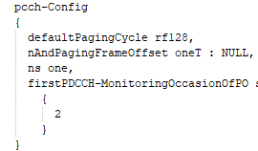
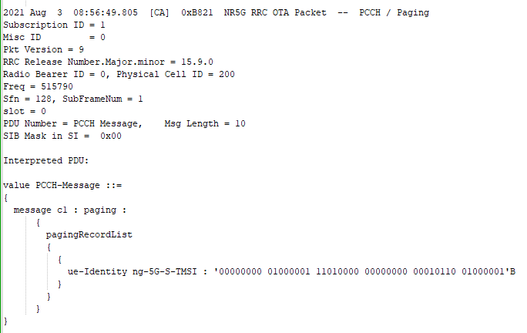
6. Example: calculation the PF/PO at UE
SIB1
Paging
PF/PO of this UE ???

Slide 39
7. Example- Select the best Paging Occasion at gNB
gNodeB receives the NgAP Paging message
At current gNB_SFN : 100 // [0-1023]
5G-S-TMSI:
PF/PO that gNodeB Should be sent to this UE ???

Slide 40
Mini-project

Slide 41
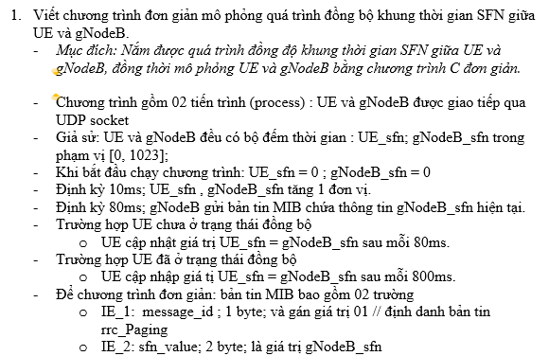
1. Exercise 1

Slide 42
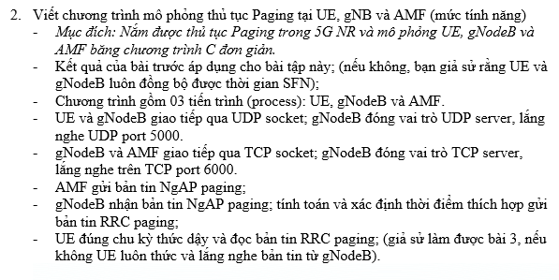
2. Exercise 2

Slide 43
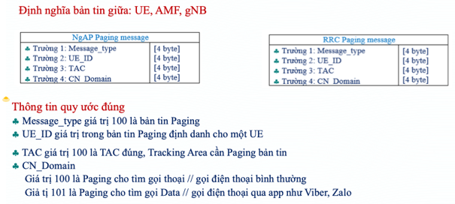
2. Exercise 2

Slide 44
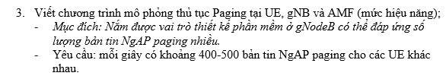
3. Exercise 3

Slide 45
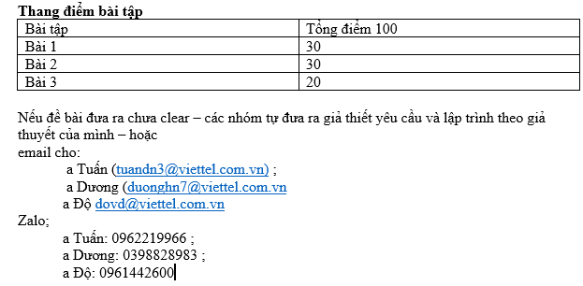
3. Note

Slide 46
THANK YOU

Slide 47
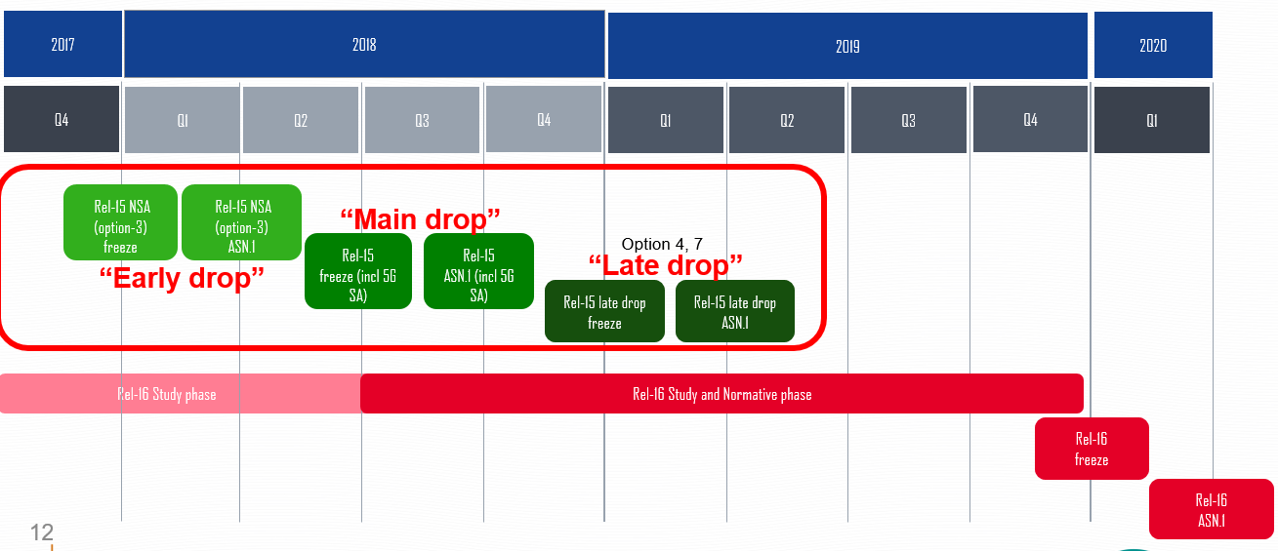
3GPP release

Slide 48
8. 3GPP Release
TS 38.401 | NG-RAN; Architecture description
TS 38.410 | NG-RAN; NG general aspects and principles
TS 38.411 | NG-RAN; NG layer 1
TS 38.412 | NG-RAN; NG signalling transport
TS 38.413 | NG-RAN; NG Application Protocol (NGAP)
TS 38.414 | NG-RAN; NG data transport
TS 38.415 | NG-RAN; PDU Session User Plane protocol
TS 38.420 | NG-RAN; Xn general aspects and principles
TS 38.421 | NG-RAN; Xn layer 1
TS 38.422 | NG-RAN; Xn signalling transport
TS 38.423 | NG-RAN; Xn Application Protocol (XnAP)
TS 38.424 | NG-RAN; Xn data transport
TS 38.425 | NG-RAN; NR user plane protocol
TS 38.455 | NG-RAN; NR Positioning Protocol A (NRPPa)
TS 38.460 | NG-RAN; E1 general aspects and principles
TS 38.461 | NG-RAN; E1 layer 1
TS 38.462 | NG-RAN; E1 signalling transport
TS 38.463 | NG-RAN; E1 Application Protocol (E1AP)
TS 38.470 | NG-RAN; F1 general aspects and principles
TS 38.471 | NG-RAN; F1 layer 1
TS 38.472 | NG-RAN; F1 signalling transport
TS 38.473 | NG-RAN; F1 Application Protocol (F1AP)
TS 38.474 | NG-RAN; F1 data transport
TS 38.475 | NG-RAN; F1 interface user plane protocol
TS 38.104 | NR; Base Station (BS) radio transmission and reception
TS 38.201 | NR; Physical layer; General description
TS 38.202 | NR; Services provided by the physical layer
TS 38.211 | NR; Physical channels and modulation
TS 38.212 | NR; Multiplexing and channel coding
TS 38.213 | NR; Physical layer procedures for control
TS 38.214 | NR; Physical layer procedures for data
TS 38.215 | NR; Physical layer measurements
TS 38.321 | NR; Medium Access Control (MAC) protocol specification
TS 38.322 | NR; Radio Link Control (RLC) protocol specification
TS 38.323 | NR; Packet Data Convergence Protocol (PDCP) specification
TS 38.331 | NR; Radio Resource Control (RRC); Protocol specification
TS 38.340 | NR; Adaptation layer (SDAP)
TS 38.141-1 | NR; Base Station (BS) conformance testing Part 1: Conducted conformance testing
TS 38.141-2 | NR; Base Station (BS) conformance testing Part 2: Radiated conformance testing
TR 38.810 | NR; Study on test methods
TS 38.133 | NR; Requirements for support of radio resource management

