Slide 1
Linux Debugging
Chason Du
2016.1.28

Slide 2
Agenda
Kernel and File System
Processes and Threads
Compile and Debugging
Process memory
<number> | Presentation Title | Month 2009

Slide 3
Kernel and File System

Slide 4
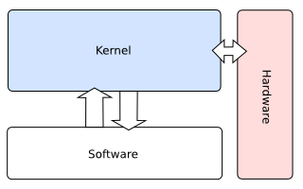
Kernel
Function:
  Main component of OS (Kernel + libraries (.so files))
  Controls all interaction with hardware
  Provides services to user mode programs (system calls)
  Controls access to the two main resources: CPU and RAM
  Features
  Monolithic: efficiency and practical
  Threading: execution unit (task)
  Preemptive: real-time and SMP support
  Small Foot Print: 1-2MB
  Modularity: run-time linking of modules into the Kernel
<number> | Presentation Title | Month 2009
Notes:
http://blog.csdn.net/deyili/article/details/6456127
http://blog.csdn.net/silentpebble/article/details/7941025
通常，一个程序会跨越两个空间。当执行到内核空间的一段代码时，我们称程序处于内核态，而当程序执行到外部空间代码时，我们称程序处于用户态。
Linux是一个单内核（或宏内核），也就是说，Linux内核运行在单独的内核地址空间。
不过，Linux汲取了微内核的精华：其引以为豪的是模块化设计、抢占式内核、支持内核线程以及动态装载内核模块的能力。
不仅如此，Linux还避其微内核设计上性能损失的缺陷，让所有事情都运行在内核态，直接调用函数，无需消息传递。
至今，Linux是模块化的、多线程的以及内核本身可调度的操作系统。实用主义再次占了上风。
SMP（Symmetric Multi-Processing），对称多处理结构的简称，是指在一个计算机上汇集了一组处理器(多CPU),各CPU之间共享内存子系统以及总线结构。在这种技术的支持下，一个服务器系统可以同时运行多个处理器，并共享内存和其他的主机资源。

Slide 5
Kernel
Version
  Old: 2.4 (obsolete - like Windows 95)
  Common: 2.6 (old, but stable) (2.6.0-2.6.35)
  Modern: 3.x (3.0-3.19)
  New: 4.0 (= 3.20)
  Obtain version of running Kernel by “uname -r”
<number> | Presentation Title | Month 2009

Slide 6
Kernel
Task Scheduling
  O(1) scheduler
  One run queue per processor and each run queue contains two priority arrays(active array and expired array)
  IO
  Buffer/Page/Swap cache
  Deadline/Anticipatory/CFQ/NoOp
  Device
  Character/Block(buffered)/Network
  File Systems
  Ext2, ext3 …
<number> | Presentation Title | Month 2009
Notes:
Buffer cache: used for block device IO, non file-based. Example: cat /dev/sda1
Page cache: used for file based IO. Example: cat /boot/vmlinuz*
Swap cache: used for virtual memory disk backing. Example: memory consumer program
Viewable in “top” and “vmstat”

Slide 7
The /proc File System
A virtual file system representing process, and each process has its own subdirectory, by PID.
Useful features:
  Kernel and HW diagnostics, in the root of /proc
  Process diagnostics(/proc/$pid)
  Kernel tunable parameters(/proc/sys)
    Eg: two methods to turning on IPv4 ICMP echo request
    echo 1 > /proc/sys/net/ipv4/icmp_echo_ignore_all
    sysctl -w net.ipv4.icmp_echo_ignore_all=1
<number> | Presentation Title | Month 2009

Slide 8
/proc/sys/kernel/core*
core-
dump.c
  core_pattern: control core filename
  Tip: set to some common directory prefix, maybe over NFS
  %p(id), %g(id), %u(id), %t(imestamp), %h(ost), %e(xe)
  Consider piping (by setting|/path/to/binary) if possible
  core_user_pid: append pid to core
  Not necessary if using a pattern (use %p instead)
  core_pipe_limit: max number of active core pipes
  Used only when core pattern contains a |, default value is 4
  Also use coredump_filter (per-process, inherited)
  customize which memory segments will be dumped when the PID process is dumped.
<number> | Presentation Title | Month 2009
Notes:
Remember that no core is generated unless ulimit(1) is used to set the core size (-c) to be greater than 0.
# ulimit –c unlimited
# ulimit –a
Coredump_Filter:
When a process is dumped, all anonymous memory is written to a core file as long as the size of the core file isn't limited. But sometimes we don't want to dump some memory segments, for example, huge shared memory. Conversely, sometimes we want to save file-backed memory segments into a core file, not only the individual files. /proc/PID/coredump_filter allows you to customize which memory segments will be dumped when the PID process is dumped. coredump_filter is a bitmask of memory types. If a bit of the bitmask is set, memory segments of the corresponding memory type are dumped, otherwise they are not dumped. The following 7 memory types are supported:
- (bit 0) anonymous private memory
- (bit 1) anonymous shared memory
- (bit 2) file-backed private memory
- (bit 3) file-backed shared memory
- (bit 4) ELF header pages in file-backed private memory areas (it is effective only if the bit 2 is cleared)
- (bit 5) hugetlb private memory
- (bit 6) hugetlb shared memory
Note that MMIO pages such as frame buffer are never dumped and vDSO pages are always dumped regardless of the bitmask status. When a new process is created, the process inherits the bitmask status from its parent. It is useful to set up coredump_filter before the program runs. For example: $ echo 0x7 > /proc/self/coredump_filter

Slide 9
/proc/meminfo
  Contains complete memory statistics for entire system
  Singal process statistics are in /proc/…/status
  Read only statistics (still useful)
  Similar statistics in /proc/vmstat
  … But in kernel variable format
  Change by /proc/sys/vm settings
<number> | Presentation Title | Month 2009

Slide 10
/proc/sysrq-trigger
  The only writable file in /proc root (rest are diagnostics)
  Use to emulate system requests (SysRQ key on console)
SysRQ | Used for
B | Immediate system boot (dangerous!)
K | Kill (-TERM) all tasks
L | List stack trace of all currently executing tasks
S | Emergency sync
T | List stack trace of all tasks
<number> | Presentation Title | Month 2009

Slide 11
/proc/sys/kernel/randomize-va-space
  Control Linux user mode ASLR
  Default (2) is most secure
  But use 0 for debugging, to reproduce cores
  Runtime effectively
Value | Denates
0 | No randomization
1 | Stack randomization
2 | Stack + Heap randomization
<number> | Presentation Title | Month 2009
Notes:
$./mem-layout
pid: 4008
#cat /proc/4008/maps
003ec000-003ed000 r-xp 00000000 00:00 0 [vdso]
00625000-00643000 r-xp 00000000 fd:00 1704941 /lib/ld-2.12.so
00643000-00644000 r--p 0001d000 fd:00 1704941 /lib/ld-2.12.so
00644000-00645000 rw-p 0001e000 fd:00 1704941 /lib/ld-2.12.so
00647000-007d7000 r-xp 00000000 fd:00 1704961 /lib/libc-2.12.so
007d7000-007d8000 ---p 00190000 fd:00 1704961 /lib/libc-2.12.so
007d8000-007da000 r--p 00190000 fd:00 1704961 /lib/libc-2.12.so
007da000-007db000 rw-p 00192000 fd:00 1704961 /lib/libc-2.12.so
007db000-007de000 rw-p 00000000 00:00 0
08048000-08049000 r-xp 00000000 fd:00 2229905 /home/chasond/linux-debug/other/mem-layout
08049000-0804a000 rw-p 00000000 fd:00 2229905 /home/chasond/linux-debug/other/mem-layout
09ce7000-09d08000 rw-p 00000000 00:00 0 [heap] # if no heap randomization, 0804a000
b76f5000-b76f6000 rw-p 00000000 00:00 0
b7716000-b7719000 rw-p 00000000 00:00 0
bf883000-bf898000 rw-p 00000000 00:00 0 [stack] # if no stack randomization, c0000000

Slide 12
Dmesg(8)
  Print or control the kernel ring buffer
  -c: clear ring buffer
  -s: query with buffer size
  -n: set logging level
  Kernel messages may be rerouted to user mode via klogd (passed through to syslogd)
<number> | Presentation Title | Month 2009
Notes:
The kernel maintains a ring buffer for error messages and miscellaneous outputs from the printk() kernel function.
The dmesg(8) command may be used to read this information, or modify the buffer size/logging level:

Slide 13
Processes and Threads

Slide 14
Processes & Threads
Process
  Instance of running program
  Has at least ONE thread called the MAIN THREAD
Thread
  Instance of running execution unit(task)
  For a given time, all register state of the CPU belongs to thread
      Kernel - when it does scheduling - sees ONLY threads. NOT processes.
<number> | Presentation Title | Month 2009

Slide 15
Daemons
A daemon is a user mode process running as part of operating system, usually maintaining some type of networking service or housekeeping chore.
Daemons are characterized by:
  No controlling terminal
  No direct user input/output
  No STDIN/STDOUT/STDERR
  Working directory is root
  chkconfig: updates and queries runlevel information for system services
  service svnserve restart, /etc/init.d/svnserve
  /etc/rc, /etc/rc.d, /etc/rc?.d
  /etc/profile -> (~/.bash_profile, /.bash_login, /.profile)
<number> | Presentation Title | Month 2009
Notes:
/etc/sysconfig/selinux
# SELINUX= can take one of these three values:
# enforcing - SELinux security policy is enforced.
# permissive - SELinux prints warnings instead of enforcing.
# disabled - SELinux is fully disabled.
SELINUX=disabled
Example:
If you have it enabled, you need to starte service using: service httpd start
Once changed then you will be able to start httpd using: /etc/init.d/httpd start
chkconfig命令主要用来更新（启动或停止）和查询系统服务的运行级信息。
谨记chkconfig不是立即自动禁止或激活一个服务，它只是简单的改变了符号连接。
on和off分别指服务被启动和停止，reset指重置服务的启动信息，无论有问题的初始化脚本指定了什么。
on和off开关，系统默认只对运行级3，4，5有效，但是reset可以对所有运行级有效。
--level<等级代号> 指定读系统服务要在哪一个执行等级中开启或关毕。（Who –r:查看当前的运行级别）
等级0表示：表示关机
等级1表示：单用户模式
等级2表示：无网络连接的多用户命令行模式
等级3表示：有网络连接的多用户命令行模式
等级4表示：不可用
等级5表示：带图形界面的多用户模式
等级6表示：重新启动
需要说明的是，level选项可以指定要查看的运行级而不一定是当前运行级。对于每个运行级，只能有一个启动脚本或者停止脚本。当切换运行级时，init不会重新启动已经启动的服务，也不会再次去停止已经停止的服务。
chkconfig --list #列出所有的系统服务
chkconfig --add httpd #增加httpd服务
chkconfig --del httpd #删除httpd服务
chkconfig --level httpd 2345 on #设置httpd在运行级别为2、3、4、5的情况下都是on（开启）的状态
chkconfig --list #列出系统所有的服务启动情况
chkconfig --list mysqld #列出mysqld服务设置情况
chkconfig --level 35 mysqld on #设定mysqld在等级3和5为开机运行服务，--level 35表示操作只在等级3和5执行，on表示启动，off表示关闭
chkconfig mysqld on #设定mysqld在各等级为on，“各等级”包括2、3、4、5等级

Slide 16
IPC – Inter-Process Communication
Environment variable, Command-line argument, File
Pile(FIFO)
Signal
Message queue
Shared memory
Socket
ipcs
signal.c
<number> | Presentation Title | Month 2009
Notes:
http://www.cnblogs.com/skyofbitbit/p/3651750.html

Slide 17
Compile and Debugging

Slide 18
Compiling – Overview
Preprocessing: cpp, or gcc –E, 预处理
  Analyze c #defines and #include
  -D –U –I -M
Compilation: cc1, or gcc –S, 汇编
  From c/c++ objective-c to processor-readable ASM
  -[O0],-O1(-O),-O2,-O3,-Os, #pragma optimize() to disable optimixstion
  -g[0123], “strip –d” when moving to production
  -gdwarf-2: output in dwarf-2
Assembly: as, or gcc –c, 编译
  From asm to actual machine opcodes
  Croess compile: -m64; inline assembly __asm
<number> | Presentation Title | Month 2009

Slide 19
Compiling - Overview
Linkage: ld, or gcc with none if the above, 链接
  Insertion of libraries (static) or references (dynamic)
  -l, lxxx=libxxx.so, e.g. –lc=libc.so.6, -lpthread=libpthread.so.1
  -L,library search path (LD_LIVRARY_PATH)
  -shared, shared library (use with -fPIC)
  -static, static compilation
  *Makefile
  $@ $< $^
target: dependencies
Tab ↹ system command(s)
<number> | Presentation Title | Month 2009
Notes:
$@: 目标的完整名称
$*: 不包含扩展名的目标文件名称
$<: 第一个依赖文件的名称
$^: 所有的依赖文件，以空格分开，不包含重复的依赖文件
$+: 所有的依赖文件，以空格分开，并以出现的先后为序，可能包含重复的依赖文件
$?: 所有的依赖文件，以空格分开，这些依赖文件的修改日期比目标的创建日期晚

Slide 20
Compiling – Error Checking (static-check.c)
-Wall: warning
  #warning
  -Werror: converting warnings into errors, stopping the compilation
__attribute__((attribute-list)): valid for declaration
  __attribute__((format (archetype, string-index, first-to-check)))
  __attribute__((constructor(PRIORITY))), __attribute__((destructor))
  __attribute__((const)) : for optimizing
  __attribute__((aligned(8))), __attribute__((__packed__))
Static assert
  #ifndef __GNUC__
  # define __attribute__(x)/*NOTHING*/
  #endif
static-
check.c
<number> | Presentation Title | Month 2009
Notes:
__attribute__((constructor(PRIORITY)))
constructor priorities from 0 to 100 are reserved for the implementation
-w 关闭所有告警提示
-Wall 虽然是-Wall但是不是打开所有告警提示而是大部分，但下面的-W开头的告警需要单独打开。
-W 对某些告警显示更详细的信息
-Wfloat-equal 浮点数直接使用==判断是否相等时告警
-Wtraditional 如果使用了原始C语言里有而C标准化后被废弃的特性就告警
-Wshadow 对shadow变量进行告警。比如：
有个全局变量nCount，这时你写的函数有个参数也叫nCount。编译器就会告警提示你，说局部参数nCount起作用而全局nCount不起作用。如果你用意不是如此就需要修改代码了。
-Werror 把所有的告警都转化为编译错误。只要有告警就停止编译。

Slide 21
Binary and object management
The compiled binary is an “ELF” file
  Executable & Library Format
  Native format of most UNIX, especially on x86(magic:\x7fELF)
  Many tools exist to parse ELF files
  Objdump: generic object dump utility (like windows “dumpbin”)
  Readelf: parse and display ELF header
  Nm: list symbols
  Ldd: resolve shared library dependencies
  File: determine file type
<number> | Presentation Title | Month 2009
Notes:
$hexdump -Cv static-check -n 64
00000000 7f 45 4c 46 01 01 01 00 00 00 00 00 00 00 00 00 |.ELF............|
00000010 02 00 03 00 01 00 00 00 60 83 04 08 34 00 00 00 |........`...4...|
00000020 14 13 00 00 00 00 00 00 34 00 20 00 08 00 28 00 |........4. ...(.|
00000030 26 00 23 00 06 00 00 00 34 00 00 00 34 80 04 08 |&.#.....4...4...|
00000040
hexdump命令一般用来查看“二进制”文件的十六进制编码，但实际上它能查看任何文件，而不只限于二进制文件。
-n length 只格式化输入文件的前length个字节。
-C 输出规范的十六进制和ASCII码。
-b 单字节八进制显示。
-c 单字节字符显示。
-d 双字节十进制显示。
-o 双字节八进制显示。
-x 双字节十六进制显示。
-s 从偏移量开始输出。
-e 指定格式字符串，格式字符串包含在一对单引号中，格式字符串形如：'a/b "format1" "format2"'。

Slide 22
Shared Libraries
Libraries are “.so” (shared object) files
Created by:
Library has predefined:
  Entry point: void _init(void)
  Unload point: void _fini(void)
$gcc –fPIC –c mylib.c
$ld –shared –soname mylib.so.1 –o mylib.so.1.0 –lc mylib.o
<number> | Presentation Title | Month 2009

Slide 23
Tracing LD
LD_LIBRARY_PATH
  Serves as a PATH variable for library loading
  Debug libraries may be loaded into process by tweaking path
  System file: /etc/ld.so.conf
LD_PRELOAD
  Force library loading even if library isn’t need
  Library entry point is automatically called
  System file: /etc/ld.so.preload
LD_DEBUG
  Trace the working of LD
  LD_DEBUG=libs
preload-
test.c
libmy_
wrap.c
<number> | Presentation Title | Month 2009
Notes:
1. LD_LIBRARY_PATH
Linux 运行的时候，是如何管理共享库(*.so)的？
在 Linux 下面，共享库的寻找和加载是由 /lib/ld.so 实现的。 ld.so 在标准路经(/lib, /usr/lib) 中寻找应用程序用到的共享库。
但是，如果需要用到的共享库在非标准路经，ld.so 怎么找到它呢？
目前，Linux 通用的做法是将非标准路经加入 /etc/ld.so.conf，然后运行 ldconfig 生成 /etc/ld.so.cache。 ld.so 加载共享库的时候，会从 ld.so.cache 查找。
传统上，Linux 的先辈 Unix 还有一个环境变量：LD_LIBRARY_PATH 来处理非标准路经的共享库。ld.so 加载共享库的时候，也会查找这个变量所设置的路经。
LD_LIBRARY_PATH=$LD_LIBRARY_PATH:./lib
export LD_LIBRARY_PATH
2. LD_PRELOAD
http://blog.csdn.net/haoel/article/details/1602108
劫持strncmp，getuid，getgid
11 // $export MALLOC_TRACE=./mtrace.log
12 // $export LD_PRELOAD=./preload-test.so
13 // $ldd /bin/ls
14 // $ls
15 // $more ./mtrace.log
16 // $unset LD_PRELOAD
17 // $unset MALLOC_TRACE
3. LD_DEBUG
http://www.linuxidc.com/Linux/2010-12/30726.htm
使用ldd命令可以知道程序依赖于哪些库,在找不到这些库的时候,使用LD_DEBUG可以知道系统在哪些路径下进行了尝试。
#ldd newapp
libtux.so => not found
libbuft.so => not found
libfml.so => not found
LD_DEBUG 是 glibc 中的 loader 为了方便自身调试而设置的一个环境变量。通过设置这个环境变量，可以方便的看到 loader 的加载过程。
#LD_DEBUG=libs ls
23217: find library=libselinux.so.1 [0]; searching
23217: search cache=/etc/ld.so.cache
23217: trying file=/lib/libselinux.so.1
23217:
23217: find library=librt.so.1 [0]; searching
23217: search cache=/etc/ld.so.cache
23217: trying file=/lib/librt.so.1

Slide 24
Tracing RUN
ltrace
  Trace the library calls
strace
  Trace the system calls and signals
  Using the kernel ptrace function
get-ip.c
<number> | Presentation Title | Month 2009

Slide 25
Profiling
gprof
  Allows you to learn where your program spent its time and which functions called which other functions while it was executing
  Compile program with “-pg”
  Execute normally
  Run gprof on binary
oprof
  a system-wide statistical profiling tool for Linux
  Clockwork ？？？
prof-
test.c
<number> | Presentation Title | Month 2009
Notes:
http://www.ibm.com/developerworks/cn/linux/l-gnuprof.html
http://www.ibm.com/developerworks/cn/linux/l-oprof/
http://www.cnblogs.com/raymondshiquan/articles/3351625.html --Linux平台性能分析工具vtune and Google Perf Tools
http://my.oschina.net/wxfvm/blog/467974 --Linux系统性能分析工具图解读
http://www.infoq.com/cn/articles/linux-networking-performance-analytics --性能之巅：Linux网络性能分析工具
So while gprof only needs access to a particular program for which you as a user might have permissions,
OProfile monitors not only every user program running but the entirety of the kernel as well. That's why you'd need to be root to run it.
简单来说，gprof简单，适合于查找用户级程序的瓶颈，
而oprofile稍显复杂，但是得到的信息更多，更适合调试系统软件。

Slide 26
Process Memory

Slide 27
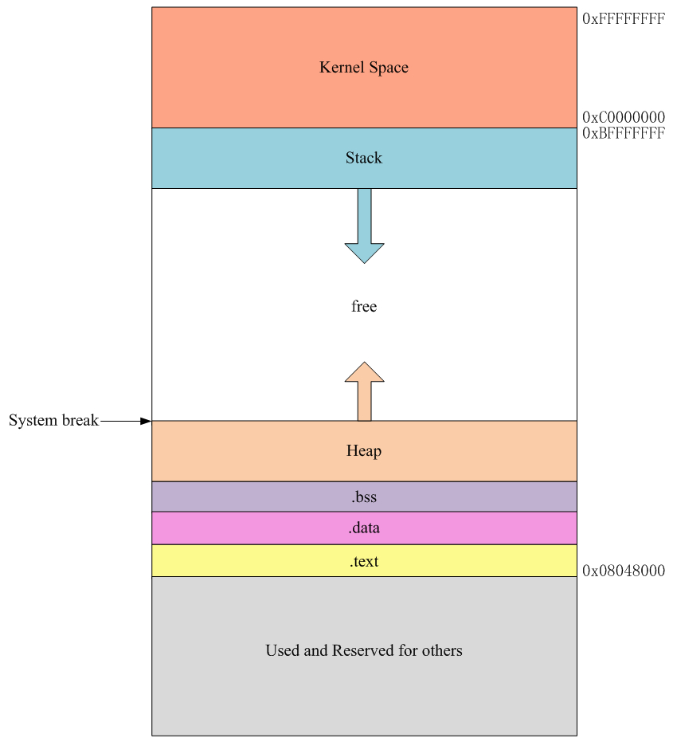
Process Memory Layout
32-bit addressing allows for 4 GB:
  Kernel reserved 0xC0000000 and above
  Binary usually loaded at 0x08048000
  Data and BSS loaded near binary (rw-p)
  Stack starts at 0xBFFFFFFF or nearby*
  Heap starts at dynamic location
  Shared objects usually loaded lower
  ESP/RSP points to top of stack(lowest address)
Viewable in file form as /proc/…/maps
*-Randomized VA Space may change some values
mem-layout.c
<number> | Presentation Title | Month 2009
Notes:
http://blog.chinaunix.net/uid-23069658-id-3959636.html
Segmentation fault到底是何方妖孽
root@centos_12 /home/chasond/linux-debug
#./mem-layout &
[1] 17862
main start = 0x8048424
bss end = 0x8049740
current brk = 0x804a000
Segment fault: access following segment: kernel space, free segment(begin with program break) and below 0x08048000
root@centos_12 /home/chasond/linux-debug
#cat /proc/17862/maps
Legend: r-xp always indicates a text (executable, read-only) segment
rw-p is a data (writable, but not executable) segment
00110000-00111000 r-xp 00000000 00:00 0 [vdso]
002f6000-00314000 r-xp 00000000 fd:00 1724219 /lib/ld-2.12.so
00314000-00315000 r--p 0001d000 fd:00 1724219 /lib/ld-2.12.so
00315000-00316000 rw-p 0001e000 fd:00 1724219 /lib/ld-2.12.so
0031c000-004a8000 r-xp 00000000 fd:00 1724220 /lib/libc-2.12.so
004a8000-004aa000 r--p 0018c000 fd:00 1724220 /lib/libc-2.12.so
004aa000-004ab000 rw-p 0018e000 fd:00 1724220 /lib/libc-2.12.so
004ab000-004ae000 rw-p 00000000 00:00 0
08048000-08049000 r-xp 00000000 fd:00 2229871 /home/chasond/linux-debug/mem-layout [CODE SEGMENT]
08049000-0804a000 rw-p 00000000 fd:00 2229871 /home/chasond/linux-debug/mem-layout [BSS SEGMENT]
b7fdc000-b7fdd000 rw-p 00000000 00:00 0
b7ffe000-b8000000 rw-p 00000000 00:00 0
bffeb000-c0000000 rw-p 00000000 00:00 0 [stack]

Slide 28
OOM: Out Of Memory
Physical memory and swap
  /proc/meminfo, /proc/swaps
  top, free
  delay allocation: malloc + memset
  VmRSS & VmSize: /proc/…/status
  RSS: Resident Set Size
  VmRSS: the actual memory size for process
  VmSize: virtual memory size
  Oom-killer
  No available page in VM
  Don't have enough user address space (for 32 machine)
mem-
exhaust.c
<number> | Presentation Title | Month 2009
Notes:
http://blog.csdn.net/huaishu/article/details/8762957
http://blog.csdn.net/ly_feng/article/details/7868525
#free –m (displays it in megabytes)
total used free shared buffers cached
Mem: 499 180 318 0 13 59 --物理内存
-/+ buffers/cache: 107 391
Swap: 2463 156 2307 --交换分区
So:
# ./mem-exhaust-oom
…
currently allocating 2640 MB
currently allocating 2656 MB
currently allocating 2672 MB (318 + 2307 = 2625)
[1]+ Killed ./mem-exhaust-oom ➔ 触发OOM kill机制，该进程被kill掉
And from the kernel trace log, we also can get the detail info:
mem-exhaust-oom invoked oom-killer: gfp_mask=0x280da, order=0, oom_adj=0, oom_score_adj=0
mem-exhaust-oom cpuset=/ mems_allowed=0
Pid: 23883, comm: mem-exhaust-oom Not tainted 2.6.32-279.el6.i686 #1
Call Trace:
[<c04e39f4>] ? dump_header+0x84/0x190
…
Out of memory: Kill process 23883 (mem-exhaust-oom) score 876 or sacrifice child
Killed process 23883, UID 0, (mem-exhaust-oom) total-vm:2755052kB, anon-rss:403172kB, file-rss:8kB
=============================================
But:
# ./mem-exhaust
…
currently allocating 2992 MB
currently allocating 3008 MB
currently allocating 3024 MB
currently allocating 3040 MB
malloc: Cannot allocate memory ➔ 优雅的退出
用户地址空间不足，这种情况在32bit机器上及user space超过了3GB，在64bit机器上不太可能发生。

Slide 29
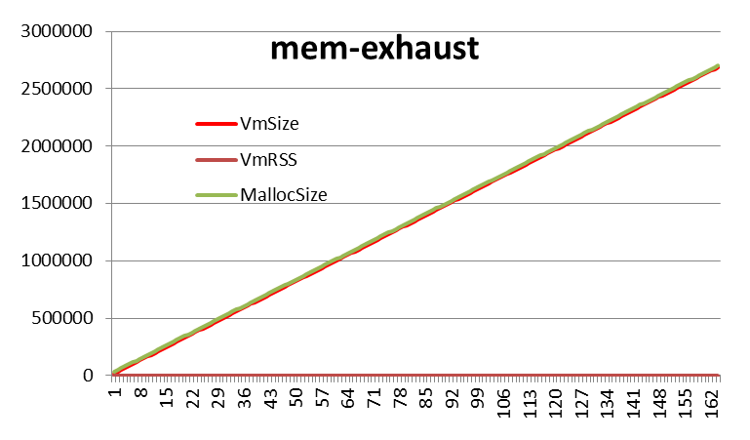
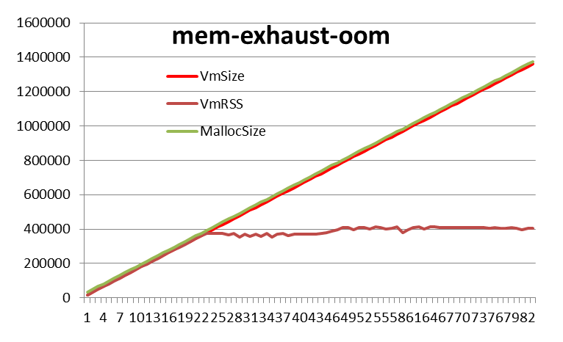
OOM: Out Of Memory
<number> | Presentation Title | Month 2009

Slide 30
The Stack
The stack is an implementation of LIFO structure
  Stack grows downwards in memory, max size: ulimit -s
  ESP/RSP points to top of stack(lowest address)
Used for:
  Allocating automatic, local variables, arguments, environment variables
  Implementing function calls
To read from the stack:
  POPL reg instruction moves to register, increments ESP accordingly
  MOVL %esp, reg reads without adjustment
To push values onto the stack:
  PUSHL instruction decrements ESP
<number> | Presentation Title | Month 2009
Notes:
http://insecure.org/stf/smashstack.html
linux系统下默认栈大小是10M,windows系统下默认栈大小是1M.
windows下用vs2010编译C++程序时,编译属性中可以重新设定栈大小.
Keep in mind we are using a Intel based Linux system.
The syscall details will change from OS to OS, and from CPU to CPU.
Some will pass the arguments on the stack, others on the registers.
Some use a software interrupt to jump to kernel mode, others use a far call.
Linux passes its arguments to the system call on the registers, and uses a software interrupt to jump into kernel mode.

Slide 31
Stack Frame
Each function call sets up a frame on the stack
Frame setup is usually manual, but can use ENTER/LEAVE
Stack frame data(local variables and arguments) may be referenced:
  Relative to the stack frame pointer (BP)
    BP is initialized with every function call
    Previous value of BP stored at current BP
    Arguments: BP + …, locals: BP - …
  Relative to the stack pointer (SP)
    BP is left unused
    “Frame Pointer Optimization”
    Both arguments and locals: SP - …
stack-
example.c
+8
Arguments, if any
Return Address
Old Frame Pointer
Exc. Handler, if any
Automatic variables …
Saved Registers
+4
EBP
stack-
example-FPO.c
-4
-8
<number> | Presentation Title | Month 2009
Notes:
x86中EBP寄存器相当于ARM中的FP寄存器
How to relative to the stack pointer (SP)?
-fomit-frame-pointer
Don't keep the frame pointer in a register for functions that don't need one. This avoids the instructions to save, set up and restore frame pointers; it also makes an extra register available in many functions. It also makes debugging impossible on some machines.
On some machines, such as the VAX, this flag has no effect, because the standard calling sequence automatically handles the frame pointer and nothing is saved by pretending it doesn't exist. The machine-description macro "FRAME_POINTER_REQUIRED" controls whether a target machine supports this flag.
/Oy[-]
This option speeds function calls, because no frame pointers need to be set up and removed. It also frees one more register, (EBP on the Intel 386 or later) for storing frequently used variables and sub-expressions.
/Oy enables frame-pointer omission and /Oy- disables omission. /Oy is available only in x86 compilers.

Slide 32
Calling Conventions
  Linux uses the C calling convention for functions: __cdecl__
  Arguments get pushed on the stack in reverse order, right-to-left
  But stack is LIFO – so they are popped in order
  Caller also cleans up stack after function returns
char c;
memset(&c, 'x', 240);
0x080483cd <+9>: movl $0xf0,0x8(%esp) ; argv 3, pushl 240
0x080483d5 <+17>: movl $0x78,0x4(%esp) ; argv 2, pushl ‘x’
0x080483dd <+25>: lea 0x1f(%esp),%eax
0x080483e1 <+29>: mov %eax,(%esp) ; argv 1, pushl &c
0x080483e4 <+32>: call 0x80482e4 <memset@plt> ; pushl EIP(RET)
<number> | Presentation Title | Month 2009
Notes:
The default calling convention, C, is the classic method of calling functions in C and C++:
The caller pushes the arguments in reverse order, right-to-left, on to the stack, and is also
responsible for clearing the stack space upon function return – usually by adding the stack
space value to ESP using an assembly “add” instruction (in fact, deferred to leave + ret [n] instructions).
(gdb) disassemble /m main
Dump of assembler code for function main:
4 {
0x080483c4 <+0>: push %ebp
0x080483c5 <+1>: mov %esp,%ebp
0x080483c7 <+3>: and $0xfffffff0,%esp
0x080483ca <+6>: sub $0x20,%esp
5 char c;
6 memset(&c, 'x', 240);
0x080483cd <+9>: movl $0xf0,0x8(%esp)
0x080483d5 <+17>: movl $0x78,0x4(%esp)
0x080483dd <+25>: lea 0x1f(%esp),%eax
0x080483e1 <+29>: mov %eax,(%esp)
0x080483e4 <+32>: call 0x80482e4 <memset@plt>
7 return 0;
0x080483e9 <+37>: mov $0x0,%eax
8 }
0x080483ee <+42>: leave =========================➔ Mov ebp, esp(clean up stack); pop ebp
0x080483ef <+43>: ret =========================➔ deferred to here: pop eip;
End of assembler dump.

Slide 33
Calling Conventions
Instruction | ASM Note
Call | Push eip; jmp
Ret | Pop eip
Ret n | Pop eip; add esp, n
Enter | Push ebp; mov esp, ebp
Leave | Mov ebp, esp; pop ebp
Protocol | Push Stack | Stack Clean | Function Name | Usage
Cdecl | right-to-left(←) | Caller, ret | _funcname | Default
Stdcall/ Pascal | right-to-left(←) | Callee, ret n | _funcname@argsize | Windows
Fastcall | Register(→) & stack (←) | Callee, ret n | @funcname@argsize | x64
<number> | Presentation Title | Month 2009
Notes:
http://www.cnblogs.com/dennisOne/archive/2012/10/23/2735247.html
http://www.codeproject.com/Articles/1388/Calling-Conventions-Demystified
http://blog.csdn.net/kaiwii/article/details/8500686
关于函数的调用规则（调用约定），大多数时候是不需要了解的，但是如果需要跨语言的编程，比如VC写的dll要delphi调用，则需要了解。
microsoft的vc默认的是__cdecl方式，而windows API则是__stdcall，如果用vc开发dll给其他语言用，则应该指定__stdcall方式。
http://blog.sina.com.cn/s/blog_701526f40100lcy6.html
调用协议常用场合
__stdcall：Windows API默认的函数调用协议。
__cdecl：C/C++默认的函数调用协议。
__fastcall：适用于对性能要求较高的场合。
函数参数入栈方式
__stdcall：函数参数由右向左入栈。
__cdecl：函数参数由右向左入栈。
__fastcall：从左开始不大于4字节的参数放入CPU的ECX和EDX寄存器，其余参数从右向左入栈。
问题一：__fastcall在寄存器中放入不大于4字节的参数，故性能较高，适用于需要高性能的场合。
栈内数据清除方式
__stdcall：函数调用结束后由被调用函数清除栈内数据。
__cdecl：函数调用结束后由函数调用者清除栈内数据。
__fastcall：函数调用结束后由被调用函数清除栈内数据。
问题一：不同编译器设定的栈结构不尽相同，跨开发平台时由函数调用者清除栈内数据不可行。
问题二：某些函数的参数是可变的，如printf函数，这样的函数只能由函数调用者清除栈内数据。
问题三：由调用者清除栈内数据时，每次调用都包含清除栈内数据的代码，故可执行文件较大。
(GCC由于编译器的优化延时清除堆栈，使得stdcall的可执行文件反而更大些)
C语言编译器函数名称修饰规则
__stdcall：编译后，函数名被修饰为“_functionname@number”。
__cdecl：编译后，函数名被修饰为“_functionname”。
__fastcall：编译后，函数名给修饰为“@functionname@nmuber”。
注：“functionname”为函数名，“number”为参数字节数。
注：函数实现和函数定义时如果使用了不同的函数调用协议，则无法实现函数调用。
C++语言编译器函数名称修饰规则
__stdcall：编译后，函数名被修饰为“?functionname@@YG******@Z”。
__cdecl：编译后，函数名被修饰为“?functionname@@YA******@Z”。
__fastcall：编译后，函数名被修饰为“?functionname@@YI******@Z”。
注：“******”为函数返回值类型和参数类型表。
注：函数实现和函数定义时如果使用了不同的函数调用协议，则无法实现函数调用。
C语言和C++语言间如果不进行特殊处理，也无法实现函数的互相调用。
http://blog.sina.com.cn/s/blog_7195909a0101a6v7.html
__cdecl -vs- __stdcall
__stdcall约定主要被Windows API使用. 它比__cdecl更简洁一些. 主要区别是对于__stdcall任何函数的参数是不可变得(hard-coded).
正由于参数数量是固定的,清理堆栈参数的工作就可以由caller转交给callee.这就导致以下几点影响:
1.代码变得稍微少一些, 这是因为参数清理工作只在一处--在被调函数中(callee)--而不是任何调用函数的地方. 这大概只有几个bytes,但是对于广泛使用的函数,迭加起来就比较多了. 可以推测这样的code执行也会快那么一点点.(GCC由于编译器的优化延时清除堆栈，使得stdcall的可执行文件反而更大些)
2.在调用函数的时候,如果准备了错误数量的参数,结果会是灾难性的,因为堆栈将不再对齐.
3.作为第二点的补充, Microsoft Visual C 给予__stdcall特别的关注. 由于调用参数数量在编译期可知, 编译器将参数数量编码进符号名(symbol name)中,这就意味着错误参数的函数调用将导致链接错误.
举例来说,函数 int foo(int a, int b)将生成符号 "_foo@8", 这里"8"就是期望的参数所占byte数, 这意味着不仅是1个或者3个参数的调用会失败(由于大小不匹配),而且__cdecl方式编译的函数调用也不会去选择调用__stdcall方式编译的函 数(__cdecl需要寻找的是类似_foo的符号).这是一个聪明的机制,可以避免不少问题.
x86架构提供了一些内建的机制来帮助栈帧的管理,但是它们并没有被普遍使用在c编译器中.其中特别有趣的是ENTER指令, 它可以作为大部分函数的前缀.
ENTER 10,0 == PUSH ebp
MOV ebp, esp
SUB esp, 10
可以肯定,从功能上来说,上述两者是等价的, 80386处理器文档告之,ENTER更加简洁(6 bytes -vs- 9)*,但是更慢(15cycles -vs - 6). [*注:这里原文有错误,ENTER占3bytes,而另三条指令的实现占6bytes]

Slide 34
Calling Conventions – x64
  In x64, only one calling convention is used: __fastcall__
  Up to 6 integer/pointer arguments passed in registers
  RDI, RSI, RDX, RCX (used as 32-bits if possible), R8, R9
  Reset passed on stack
  Floating point arguments passed in XMM registers
<number> | Presentation Title | Month 2009
Notes:
X64 simplify the calling conventions, by using one standard convention: arguments are passed left to right (in order, unlike the 32-bit conventions).
Since 64-bit architectures have many more registers, up to four arguments may be passed at a time in the registers. Different registers are used for
Different types: for integers and aggregates (structs) the RCX, RDX, R8 and R9 registers are used, in said order. Floats are passed in the SSE
registers, XMM0 through XMM3.

Slide 35
Stack Overflow and Fighting Code Injection
stack-
overflow.c
stack-
jump.c
Stack Overflow
  No boundary checking for string operator (e.g. strcpy)
  Shell Code
Compile time: -f[no]stack-protector
  Stack canaries
  Stack Guard, Stack-smashing Protection(SSP，also called ProPolice)
/proc/sys/kernel/randomize_va_space=[0|1|2]
stack-
shellcode.c
<number> | Presentation Title | Month 2009
Notes:
http://www.ibm.com/developerworks/cn/linux/l-cn-gccstack/index.html
GCC 中的编译器堆栈保护技术
http://blog.chinaunix.net/uid-20321537-id-3437124.html
linux进程内存布局－－randomize_va_space
“Canaries” 探测：
要检测对函数栈的破坏，需要修改函数栈的组织，在缓冲区和控制信息（如 EBP 等）间插入一个 canary word。
这样，当缓冲区被溢出时，在返回地址被覆盖之前 canary word 会首先被覆盖。通过检查 canary word 的值是否被修改，就可以判断是否发生了溢出攻击。
GCC 4.1 中三个与堆栈保护有关的编译选项
-fstack-protector：
启用堆栈保护，不过只为局部变量中含有 char 数组的函数插入保护代码。
-fstack-protector-all：
启用堆栈保护，为所有函数插入保护代码。
-fno-stack-protector：
禁用堆栈保护。
由于绝大多数的溢出漏洞都是由那些不做数组越界检查的 C 字符串处理函数引起的
如果/proc/sys/kernel/randomize_va_space
为0则表示，进程每次启动运行时，其虚拟地址空间里的值就是它在ELF文件里所指定的值；
为1, 则每次启动时只有栈的装载地址做随机保护；
为2，表示进程每次启动时，进程的装载地址、brk和堆栈地址都会随机变化。

Slide 36
Heap Bugs
char *c = (char *)malloc(10);
strcpy(c, argv[1]);
Heap Overflows
  Like stack overflows, but very hard to detect
Double Free
  Pointer is freed twice, messing up heap allocator
Free Unallocated Memory
  Free a char* to read only data
Use After Free
  Freed pointer may be reclaimed by other allocation
char *c = (char *)malloc(10);
free(c); free(c);
char *c = “hello”;
free(c);
char *c = (char *)malloc(10);
free(c);
memcpy(c, argv[1], …);
<number> | Presentation Title | Month 2009

Slide 37
Heap Debugging
Memwatch – open source memory tracer
  http://www.linkdata.se/sourcecode/memwatch/
  Outputs to a memwatch.log, and detects most bugs
YAMD (Yet Another Malloc Debugger)-LD_PRELOAD
  https://www.cs.hmc.edu/~nate/yamd/
  Just gcc –g and run-yamd <binary>
Glibc offers Mtrace API
  export MALLOC_TRACE=filename
heap-
debug.c
#include “memwatch.h”
$gcc –DMEMWATCH –DMW_STDIO memwatch.c –o …
#include “mcheck.h”
Void mtrace(void);
Void muntrace(void);
<number> | Presentation Title | Month 2009
Notes:
Memwatch:
underflow: <3> heap-debug.c(14), 100 bytes alloc'd at <2> heap-debug.c(12)
unfreed: <1> heap-debug.c(10), 200 bytes at 0x80501e0 {FE FE FE FE FE FE FE FE FE FE FE FE FE FE FE FE ................}
YAMD:
WARNING: Memory leak
Address 0xb7ffcf38, size 200
Allocated by malloc at
/lib/libc.so.6(__libc_malloc+0x17e)[0x38f01e]
./heap-debug[0x8048419]
/lib/libc.so.6(__libc_start_main+0xe6)[0x332ce6]
./heap-debug[0x8048361]
WARNING: Total memory leaks:
1 unfreed allocations totaling 200 bytes
Mtrace:
= Start
@ ./heap-debug-mtrace:[0x804847e] + 0x804a378 0xc8
@ ./heap-debug-mtrace:[0x804848e] + 0x804a448 0x64
@ ./heap-debug-mtrace:[0x80484a8] - 0x804a448
= End

Slide 38
Heap Debugging
Glibc also offers a malloc() hook API
Link with Wrap
  gcc wrap.c -o wrap -Wl,-wrap,malloc -Wl,-wrap,free -Wl,-wrap,realloc
malloc-
hook.c
#include <malloc.h>
Void *(*__malloc_hook)(size_t size, const void* caller);
Void *(*__realloc_hook)(void* ptr, size_t size, const void* caller);
Void *(*__memalign_hook)(size_t align, size_t size, const void* caller);
Void (*__free_hook)(void *ptr, const void* caller);
Void (*__malloc_initialize_hook)(void);
Void (*__after_morecore_hook)(void);
malloc-
wrap.c
<number> | Presentation Title | Month 2009
Notes:
Malloc-hook:
适用于单线程，不是线程安全的
Wrap:
-Wl选项告诉编译器将后面的参数传递给链接器

Slide 39
Heap Debugging
malloc-
stats.c
Other APIs for debugging malloc() calls include:
  Malloc_info(3)
  Mallinfo(3)：per thread ？？used to test a function if has memory leak
  Malloc_stats(3)
  The valgrind family is used for dynamic analysis:
  valgrind --tool=memcheck ./heap-debug
Tool | Checks/Profiles
Memcheck | Memory errors
Callgrind | Call graph generator
Helgrind | Thread profiling
Ptrcheck | Buffer overrun detector
DHAT | Dynamic Heap Analysis
<number> | Presentation Title | Month 2009
Notes:
Mallinfo:
#include <malloc.h>
struct mallinfo mallinfo(void);
This function returns information about the current dynamic memory usage in a structure of type struct mallinfo.
struct mallinfo {
int arena; /* Non-mmapped space allocated (bytes) */
int ordblks; /* Number of free chunks */
int smblks; /* Number of free fastbin blocks */
int hblks; /* Number of mmapped regions */
int hblkhd; /* Space allocated in mmapped regions (bytes) */
int usmblks; /* Maximum total allocated space (bytes) */
int fsmblks; /* Space in freed fastbin blocks (bytes) */
int uordblks; /* Total allocated space (bytes) */
int fordblks; /* Total free space (bytes) */
int keepcost; /* Top-most, releasable space (bytes) */
};
Malloc_stats:
Prints on stderr the amount of space obtained from the system (both via sbrk and mmap),
the maximum amount (which may be more than current if malloc_trim and/or munmap got called),
and the current number of bytes allocated via malloc (or realloc, etc) but not yet freed.
Note that this is the number of bytes allocated, not the number requested.
Arena 0:
system bytes = 135168
in use bytes = 104
Total (incl. mmap):
system bytes = 135168
in use bytes = 104
max mmap regions = 0
max mmap bytes = 0
Malloc_info()
#include <malloc.h>
int malloc_info(int options, FILE *stream);
exports an XML string that describes the current state of the memory-allocation implementation in the caller.
The string is printed on the file stream stream. The exported string includes information about all arenas.
=================================
$valgrind --tool=memcheck ./heap-debug
==23215== Memcheck, a memory error detector
==23215== Copyright (C) 2002-2010, and GNU GPL'd, by Julian Seward et al.
==23215== Using Valgrind-3.6.0 and LibVEX; rerun with -h for copyright info
==23215== Command: ./heap-debug
==23215==
==23215== Invalid write of size 1
==23215== at 0x8048434: main (heap-debug.c:16)
==23215== Address 0x403111f is 1 bytes before a block of size 100 alloc'd
==23215== at 0x400682F: malloc (vg_replace_malloc.c:236)
==23215== by 0x8048428: main (heap-debug.c:15)
==23215==
==23215==
==23215== HEAP SUMMARY:
==23215== in use at exit: 200 bytes in 1 blocks
==23215== total heap usage: 2 allocs, 1 frees, 300 bytes allocated
==23215==
==23215== LEAK SUMMARY:
==23215== definitely lost: 200 bytes in 1 blocks
==23215== indirectly lost: 0 bytes in 0 blocks
==23215== possibly lost: 0 bytes in 0 blocks
==23215== still reachable: 0 bytes in 0 blocks
==23215== suppressed: 0 bytes in 0 blocks
==23215== Rerun with --leak-check=full to see details of leaked memory
==23215==
==23215== For counts of detected and suppressed errors, rerun with: -v
==23215== ERROR SUMMARY: 1 errors from 1 contexts (suppressed: 12 from 8)

Slide 40
Thanks
<number> | Presentation Title | Month 2009

Slide 41
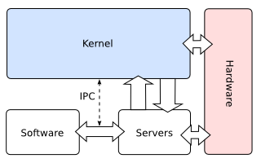
Appendix 1
http://wiki.osdev.org/Monolithic_Kernel
http://wiki.osdev.org/Microkernel
<number> | Presentation Title | Month 2009

Slide 42
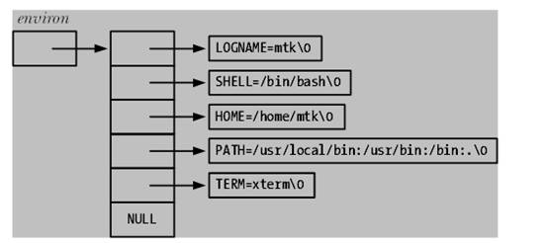
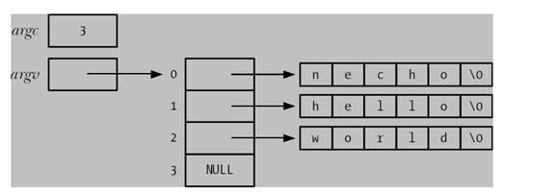
Appendix 2
#cat /proc/PID/environ | tr "\0" "\n"
extern char **environ;
char *getenv(const char *name);
int putenv(char *name_value);
setenv, unsetenv
位于栈的底部，argv位置前后
<number> | Presentation Title | Month 2009
Notes:
进程环境变量位于栈的最底部

Slide 43
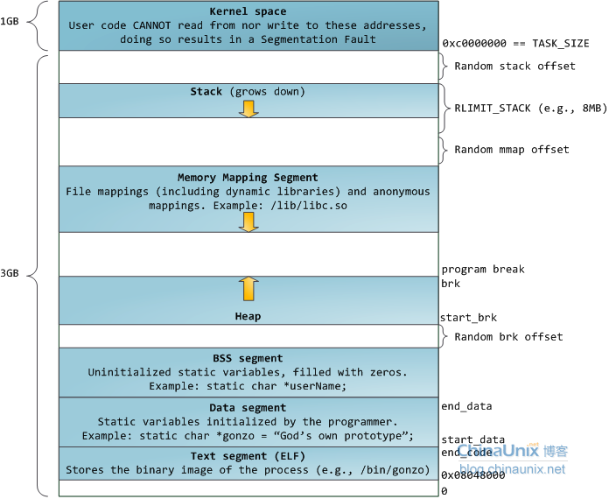
Appendix 3
<number> | Presentation Title | Month 2009

Slide 44
Appendix 4: System Call
  Traditional: INT 0x80; Modern: Sysenter
  EAX: input: command number, output: return value, like errno
  /usr/include/asm/unistd_32.h, #define _NR_exit 1 …
  EBX,ECX,EDX,ESI,EDI,EBP: max 6 arguments
  More arguments can be stored into stack, and use a register to store the address.
  time consuming, so use it as little as possible
  Interrupt; register save and restore
  VS. User space function call
  Use stack to pass the arguments, and use EAX to store the return value
<number> | Presentation Title | Month 2009

Slide 45
Appendix 5: Shellcode
  A small piece of code used as the payload in the exploitation of a software vulnerability.
  Vulnerable process usually has SUID property.
  +s, strcpy, sprintf
  sudo find / -perm +4000 –type f -ls
  Null byte free
  mov 0x0, eax <==> xor eax,eax
  NOP method inject
<number> | Presentation Title | Month 2009
Notes:
http://blog.csdn.net/raintungli/article/details/43865041
栈溢出攻击系列：shellcode在linux x86 64位攻击获得root权限（二）
In computer security, a shellcode is a small piece of code used as the payload in the exploitation of a software vulnerability.
It is called "shellcode" because it typically starts a command shell from which the attacker can control the compromised machine,
but any piece of code that performs a similar task can be called shellcode.

