Slide 1
Road and snow condition prediction using micro-macro-weather data
October 7th, 2017
Team Wapicean
Wapice Ltd.
Duy Nguyen
Vinh Vo
Binh Nguyen

Slide 2
Overview
Problem description
Technical solution
Key findings / results
Conclusion & Further implementation

Slide 3
Problem Description
Objective
Stara problems / concepts
Predict road condition (slippery, surface temperature)
Predict snow condition
Provide API for fetch predition data based on timestamp
Present data in Google Map
Street maintenance
Snow plowing & antiskid treatment performed in groups
Fleet telemetric, surface level of silos & other operative data
City maintenance related real time logistic examinations

Slide 4
Technical Solution
Data is aggregated from FMI and Teconer
Divide Helsinki city into many small-sub regions
Run training model for each sub-area with different tune parameters and classify data
Data is collected from FMI with 2-hours step
Data from Teconer is pre-processed to group the collections of lat-long into sub-area and also with 2-hours time-step
API to show prediction data in Google Map
All source codes and data are available at GitHub.

Slide 5
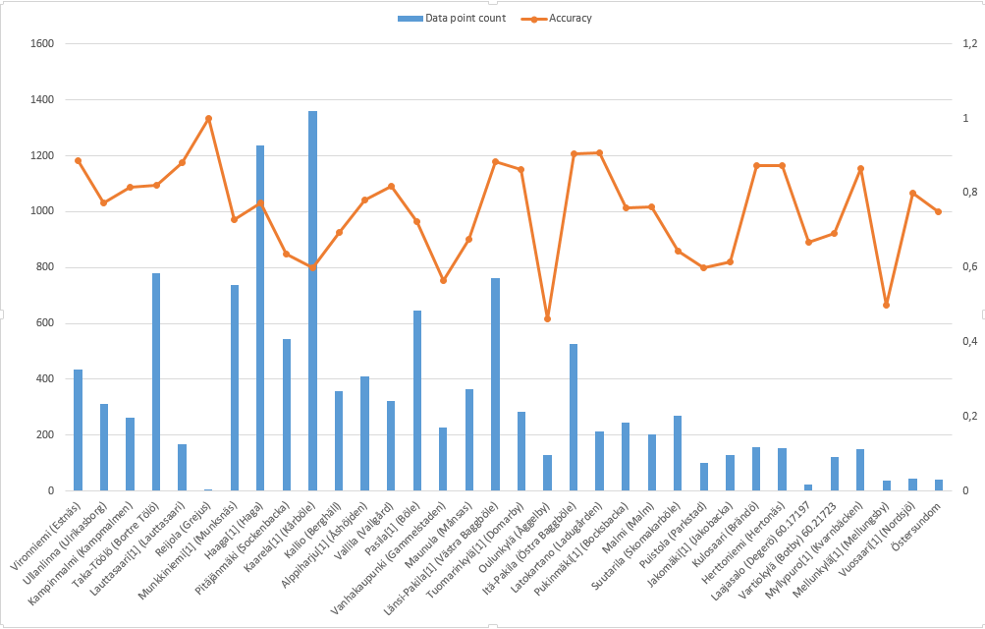
Key Findings / Results 1
Training model for predicting friction (slippery) for each sub-regions

Slide 6
Key Findings / Results 2
Surface temperature prediction

Slide 7
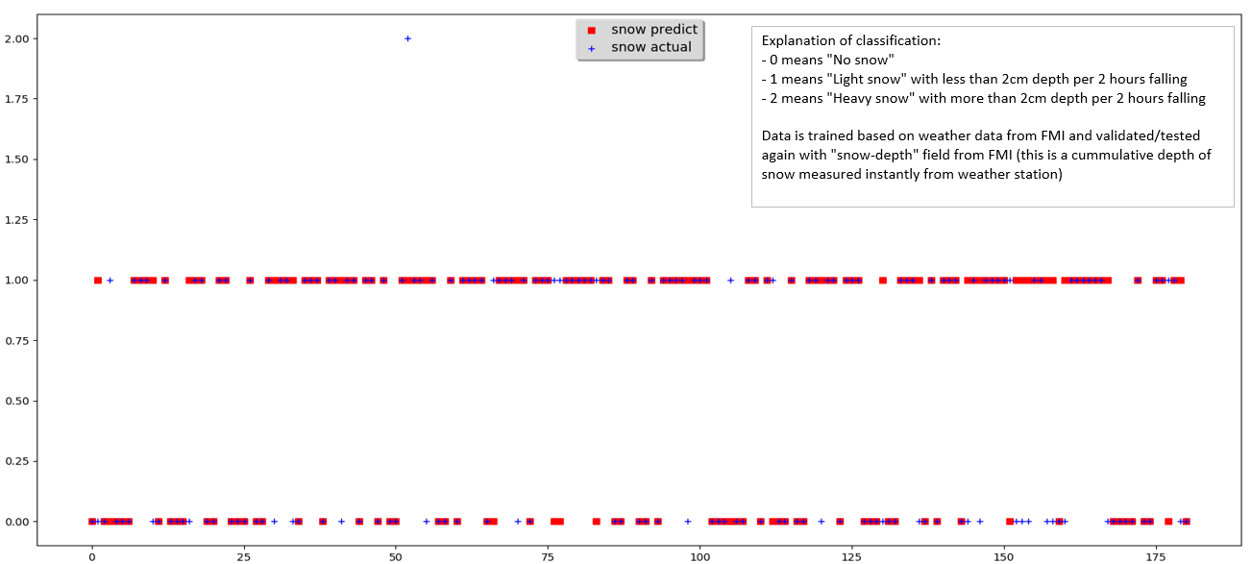
Key Findings / Results 3
Snow condition prediction

Slide 8
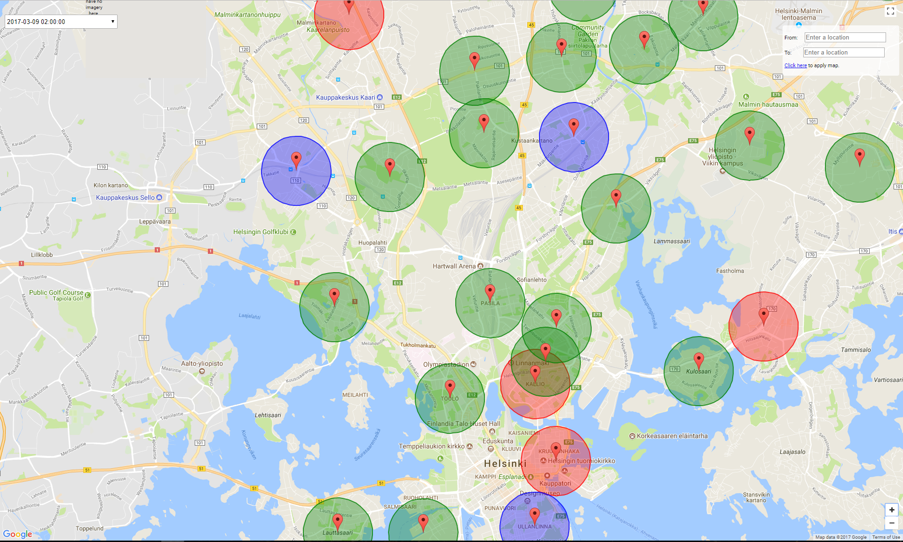
Key Findings / Results 4

Slide 9
Conclusion & Further Implementation
Quite accurate prediction for friction (slippery) and surface temperature
Snow condition prediction is good but the data is not meaningful when collecting from FMI. Better data collection technique and (maybe) aggregate data with other weather forcase sources would be needed to improve the data model
Our model can be improved by ”giving higher weight to slippery condition”
Combine with data from Living Lab Bus when the API is ready
Develop a bot to get / send user-feedback about driving condition and road condition to help re-train the model weekly.

Slide 10
Questions & Discussion

