Slide 1

SIMULATE
M/M/1/B=n QUEUE
Students: Hoang Tran Viet Long - 1652350
Ngo Tu Duy - 1752133
Notes:
<number>

Slide 2
CONTENTS
1
INTRODUCTION
Topic and Simpy
2
PE SYSTEM SELECTION
Performance Evaluation Steps
3
IMPLEMENTATION
Generator and Server processing
4
ANALYSIS & RESULTS
Testing , Result and Discussion

Slide 3
INTRODUCTION
Topic and Simpy

Slide 4
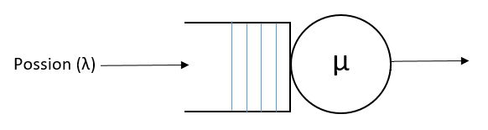
TOPIC
M/M/1/B=n queue: simplest queue model, with arrival rate (λ) follow Poisson distribution
and service rate (µ) follow exponential distribution and in this assignment, select FCFS

Slide 5
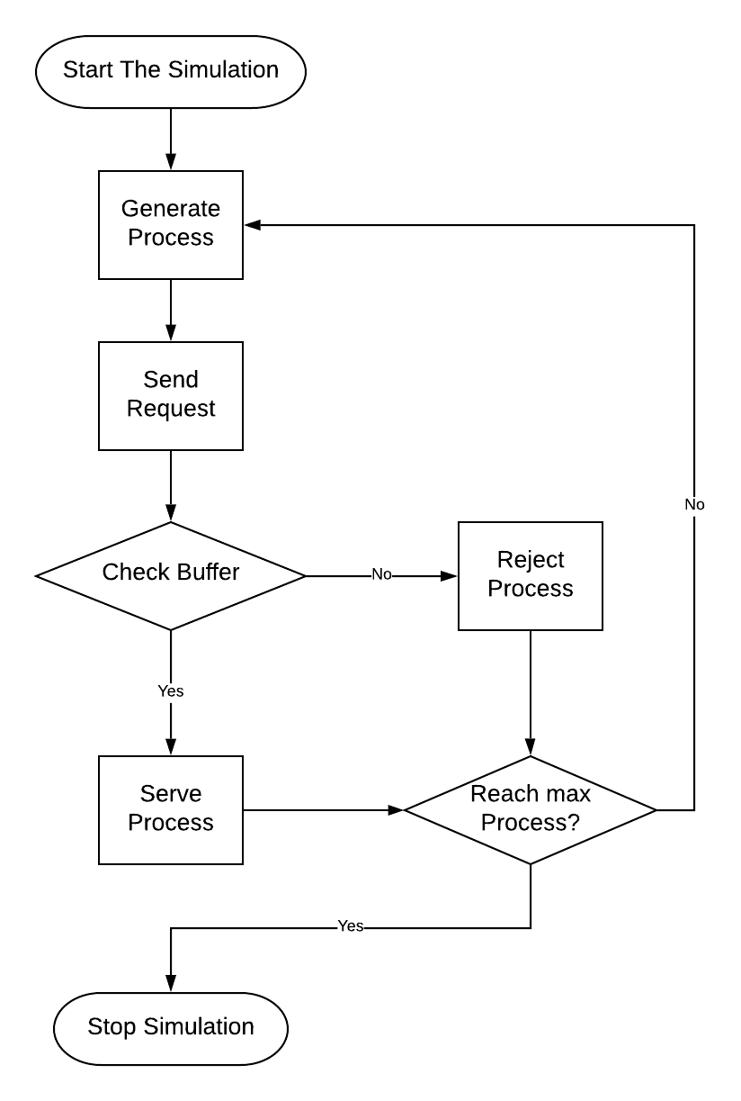
TOPIC
Build a model to simulate the M/M/1 Queue

Slide 6
SIMPY
01
Python’s base framework
02
Python generator function
Simpy is a process-based discrete-event simulation framework based on standard Python
Simpy is defined be Python generator function and may be used to model active component
03
Shared Resource
Providing various types of share resources to model limited capacity congestion points

Slide 7
PE SYSTEM SELECTION
Performance Evaluation Steps

Slide 8
GOALS, SERVICE & OUTCOME
Goals:
- Simulate a simple queue that can be using in real life base on M/M/1/B = n
queuing technique.
- The affect of service rate and arrival rate with the number of buffer is limited
Service and Outcome:
-Service: Provide a job generator and a processing server.
- Output: A job rejected or served

Slide 9
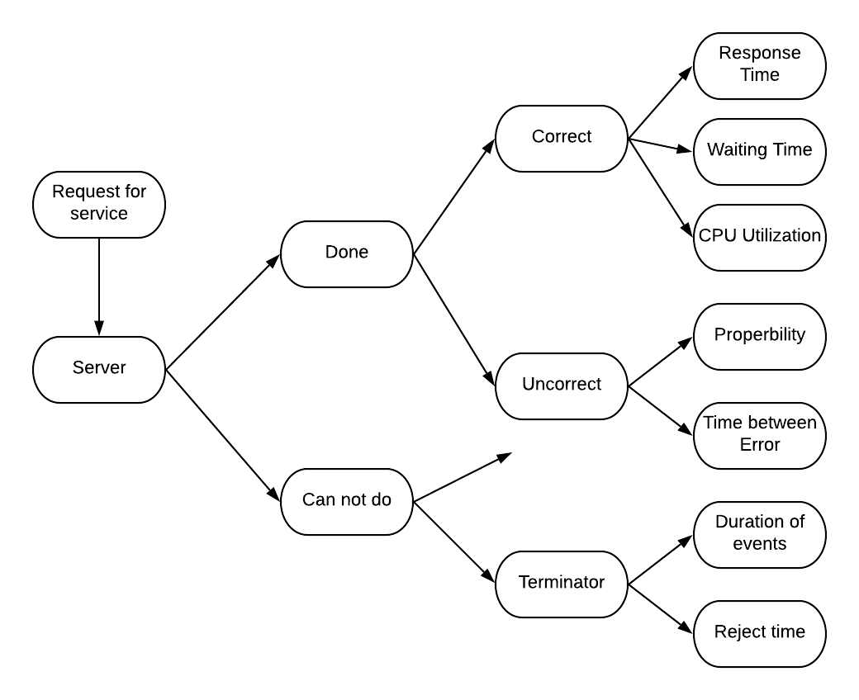
METRIC
}
Considered Variables

Slide 10
PARAMETER, FACTORS & WORKLOAD
Parameter:
+ Average waiting time
+ Average Service time
+ Average response time,
+ CPU Utilization
Factors:
+ Service rate
+ Arrival rate
+ Jobs properties
+ Number of jobs
+ Number of buffer
Workload: Addition instruction

Slide 11
ANALYSIS METHOD
Walk-Through Structure
Top-Down Modular Design
Run simplified cases
Structured walk-through consist of explaining the code to another person or a group
Modularity requires that the model be structured in modules that
communicate with each other via well-defined interfaces .
The model may be run with simple cases

Slide 12
IMPLEMENTATION
Generator and Server processing

Slide 13
GENERATOR
Create jobs: arrival time, service time and ID number
Effect by service rate and arrival rate

Slide 14
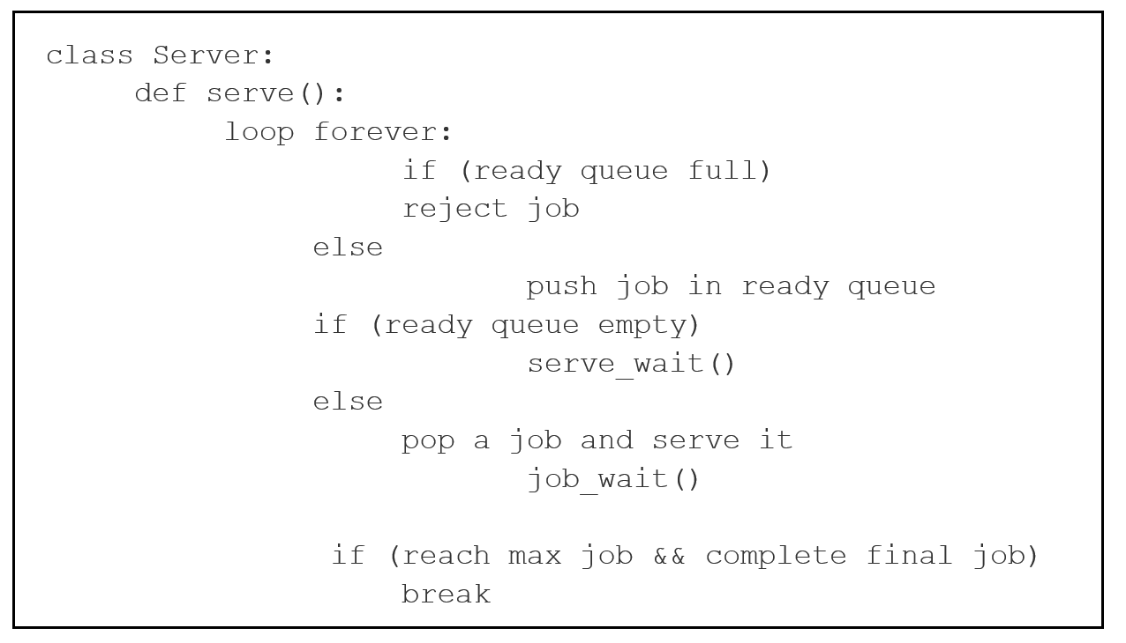
SERVER
Ready queue function:
PUSH
02
POP
01
Take the lowest ID number jobs to serve and eliminate it from the queue
Push a new job into the ready queue
Waiting:
System wait: waiting until next job come
Job wait: Wait for other process be served. Only one can be served

Slide 15
ANALYSIS & RESULT
Testing , Result and Discussion

Slide 16
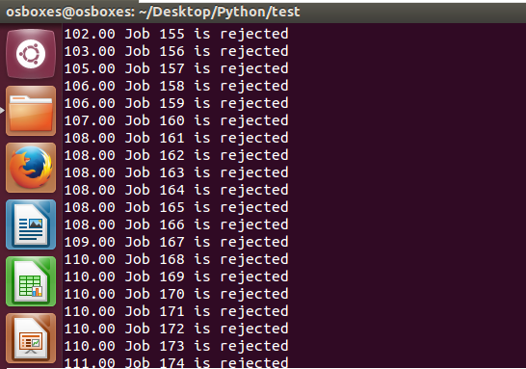
Degeneracy Test
Definition: consist of checking that the model works for extreme values of system,
configuration, or workload parameters → discover bugs that the analyst would not
have thought of otherwise (arrival rate >> service rate)

Slide 17
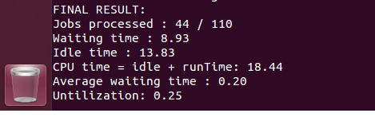
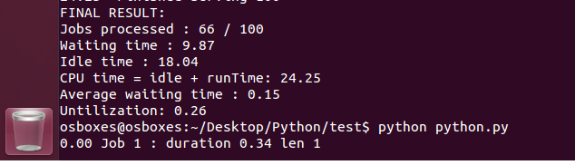
Continuity Test
Definition: consist of running the simulation several times for slightly different
values of input parameters. For any one parameter, a slight change in input
should generally produce only a slight change in the output
100 jobs
110 jobs
Notes:
<number>

Slide 18
RESULT
Terminating simulation: Calculate mean waiting time, mean response time
Result: CPU Utilization, completed jobs/total,..
Advantage: simple, easy to implement and easy to control, use less resource, high CPU Utilization because it’s limit the number of buffers
Disadvantage:
- High rate of rejected jobs
- Because using FCFS, high average waiting time than other algorithm
Notes:
<number>

Slide 19
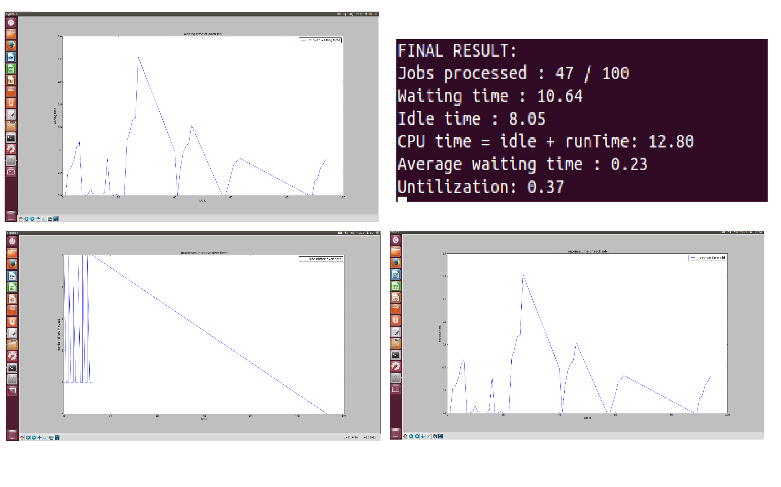
RESULT
100 jobs, 5 buffers, µ = λ = 0,1
Notes:
<number>

Slide 20
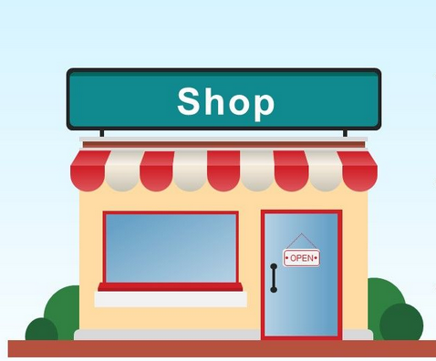

CONCLUSION
From theory to real life problem
Assume that we have a retail store and this store has the some operation like this model. The question is “how we can maximize the profit of our store? “
Only one cashier
BUFFER_SIZE
Notes:
<number>

Slide 21
CONCLUSION
To do that, We need to consider the number of jobs come in and come out per day
From that we can get the service rate(the duration that the cashier need to serve one customer ) and arrival rate of our customer
If service rate << arrival rate => we have to increase the size of our store or hire more cashier
If service rate >> arrival rate => idle time exist we need to post advertising on network or televisions to increase the number of customer who comes to our store.
Or may be we will find another way to do make money.
Notes:
<number>

Slide 22
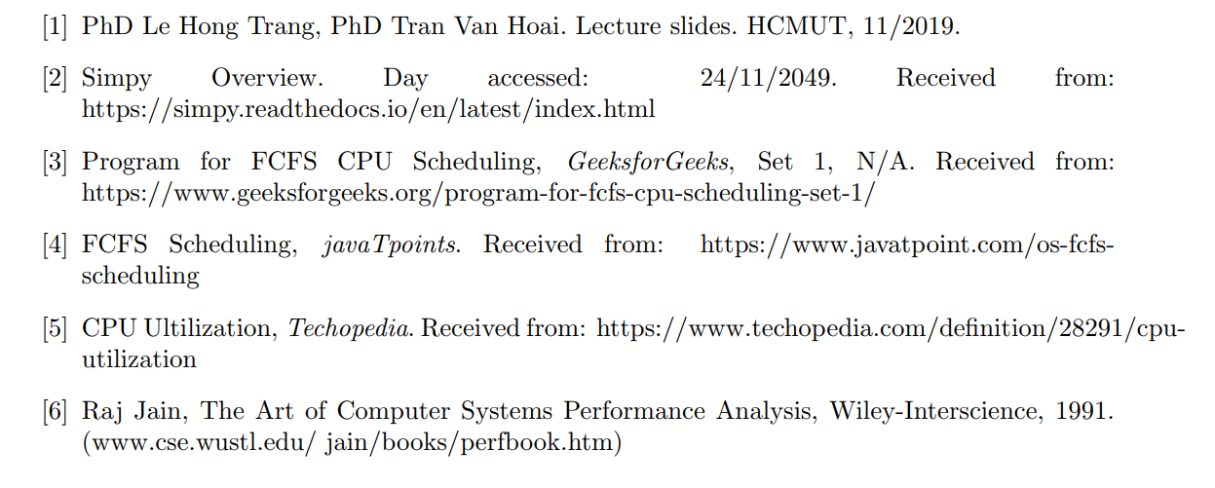
REFERENCE
Notes:
<number>

Slide 23
Thank you

