Slide 1

Online Sales Analysis
Prateek Singh/ 6th May, 2025

Slide 2
Agenda
Introduction
Data Source
Data cleaning and manipulation
Recommendations
Summary of Analysis
Detailed Analysis

Slide 3
Introduction
This is a transactional data set which contains all the transactions occurring between 01/12/2010 and 09/12/2011 for a UK-based and registered non-store online retail.
.The company mainly sells unique all-occasion gifts. Many customers of the company are wholesalers.
The aim of the analysis is to explore key trends, uncover opportunities for growth, identify strengths and make data driven decision to optimize the online sales.

Slide 4
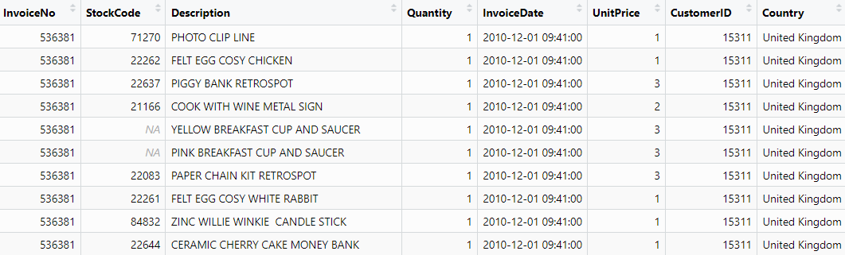
Data Source
The data sourced used was Online Sales, https://archive.ics.uci.edu/dataset/352/online+retail ., by Daqing Chen. The dataset has 8 citations.
The dataset is licensed under the Creative Commons Attribution 4.0 Internation license.
The dataset includes

Slide 5
Data Cleaning
Converted the datatype of Invoice number and Stock code from character to integer; Standardized the Invoice format to ensure its consistency across the dataset.
Created new columns for weekday, date, time, month and total amount for in-depth analysis of the data.
Then eliminated the duplicate values by using the distinct function, then assessed the dataset for missing values in key fields. Observed that several important values were missing from the dataset. Hence used the omit function to remove the missing rows from the dataset.
Then made the column names more intuitive by using the rename function.

Slide 6
Summary of the Analysis
Company had the highest sales in Netherlands, followed by EIRE, Germany, France and Australia(excluding UK). Company had the lowest sales in Saudi Arabia, Bahrain, Brazil, RSA and Lebanon in ascending order.
One of the key insights are that Thursday has dramatically more sales than other days of the week, due to Stock code 22423, followed by Tuesday. In the last 3 months of the year, days other than Thursdays had more sales.
Stock code 23843 generated the most revenue for the company, followed by 22423, 23166, 47566, 84879.
The last 2 months i.e. December and November of the year the most revenue generating while the February and April are the least revenue generating.

Slide 7
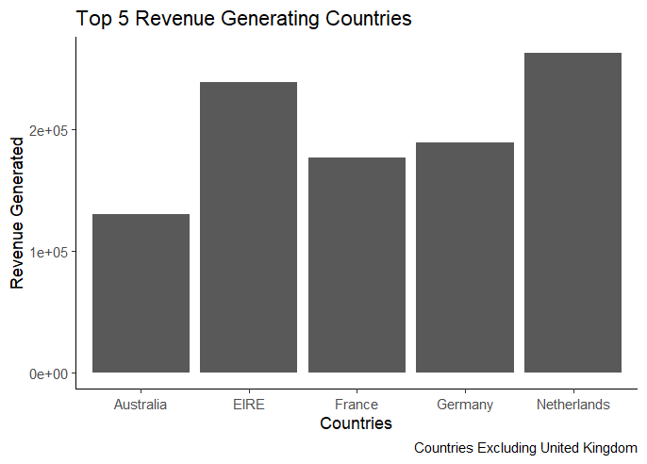
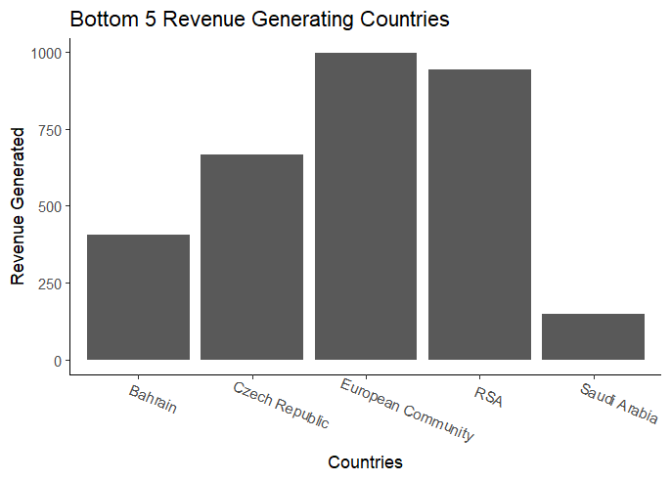
The Analysis

Slide 8
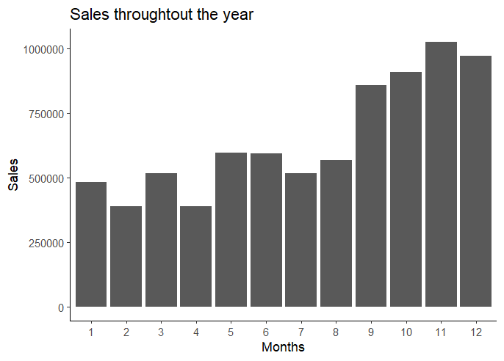
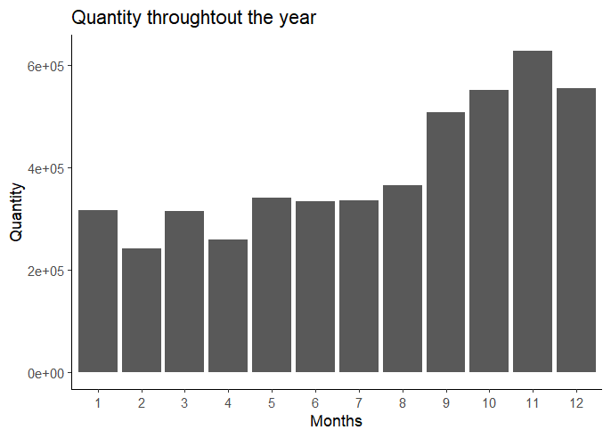
The Analysis

Slide 9
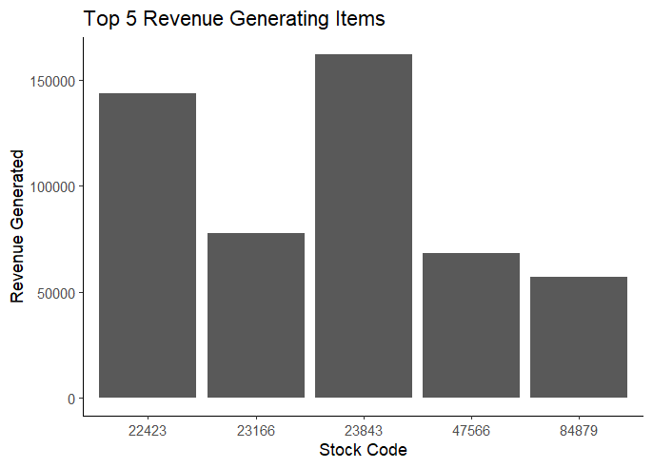
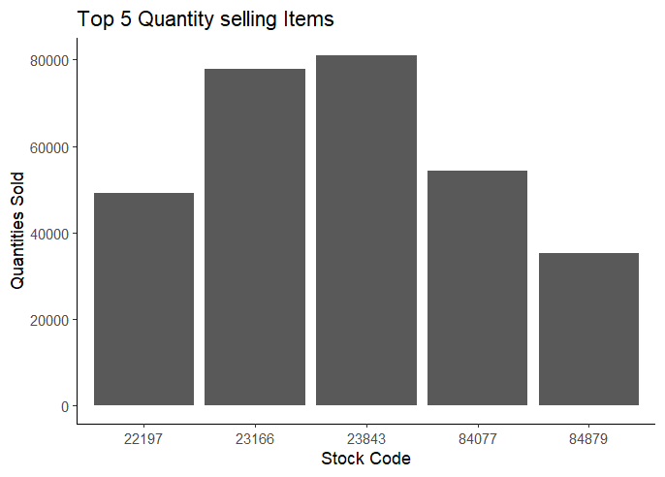
The Analysis

Slide 10
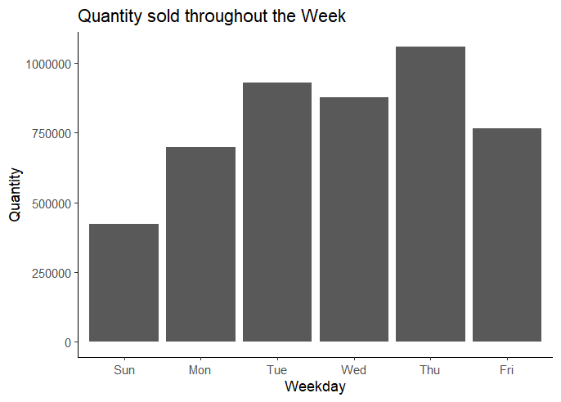
The Analysis

Slide 11
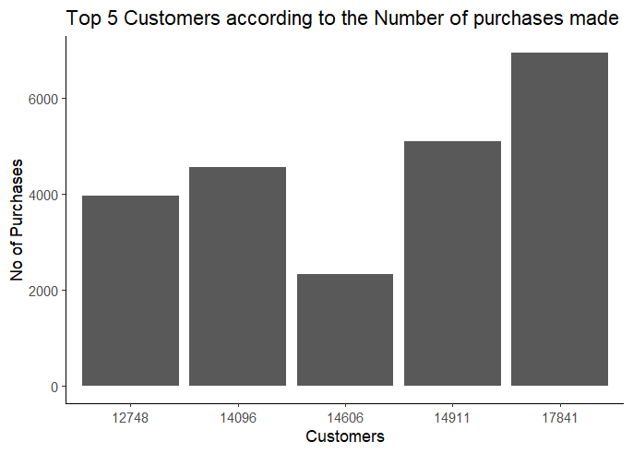
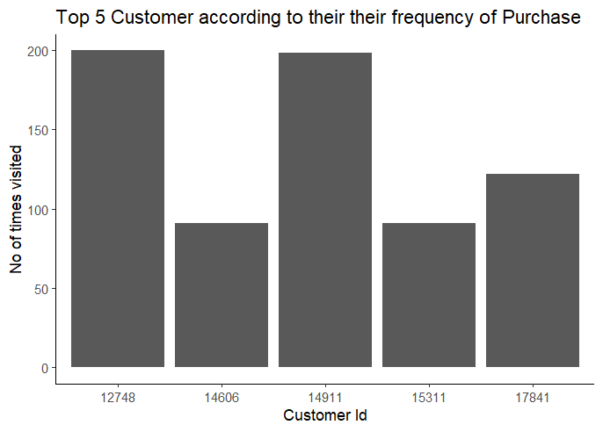
The Analysis

Slide 12
Questions

Slide 13
Thank You

