Slide 1


Recommender Systems For Group of Users (Instead of Individual Users)
Anna Myöhänen
Duy Nguyen

Slide 2
Assignment 2
In the A part of the assignment, we implemented AVERAGE and LEAST MISERY methods for group recommending
In the B part, the task was to design a recommending method, that takes the disagreement between group members into account
We used user Id’s 1, 2 and 3 as the group

Slide 3
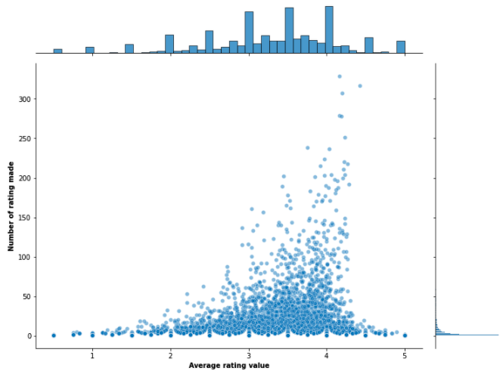
The practical side
Python
Libraries used in the project: pandas, NumPy
We accepted only such movies that nobody of the group had rated, for recommending
Excluded movies with 10 or less ratings to avoid prediction bias
Number of the movies that passed our criteria: 1871 movies
More than 10 ratings has to be made

Slide 4
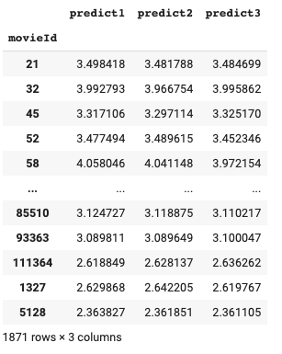
User 1 User 2 User 3
We constructed a table of individual group
members and computed their individual
predictions for all users

Slide 5

How to measure disagreement
We considered sample variance of the individual predictions for each item
That is a scaled average of the squared differences of each prediction from mean
Square root of that is sample standard deviation, which is on same scale as the original predictions
We ended up in using the difference between the highest and the lowest prediction among the group

Slide 6
Method_AD
Group prediction = average – a * (max prediction – min prediction)
We produced a penalizing term of the maximum difference by multiplying by a scalar a
a should be set on such a level that all group predictions remain within the limits of acceptable ratings, 0.5…5.0
In our experiment, we used a = 0.5
The higher a, the more value on the disagreement

Slide 7
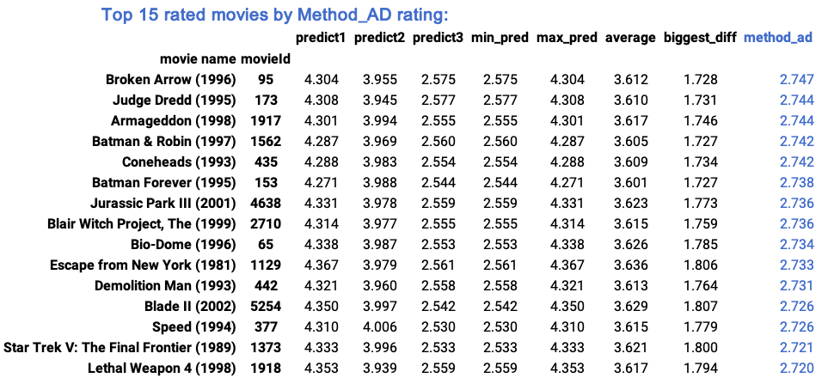
Result of Method_AD
Group prediction = average – a * (max prediction – min prediction)​

Slide 8
Fine-tuning of method_ad
If we had more time for this project, we could study in more detail how the different a values affect the result
Now we know, that it should be tested on the group with the highest possible disagreement to find out what is the highest a that is acceptable

Slide 9
Assignment 3
The task was to design our own method for producing sequential recommendations for the group​
Taking advantage of our method in assignment 2​​
We should formulate five sequences for the group, four movies per each iteration​

Slide 10


Modifying Sequential Hybrid Aggregation
Algorithm 1 from: Stratigi, M; Pitoura, E; Nummenmaa, J; Stefanidis, K. 2020. Fair Sequential Group Recommendations.

Slide 11
Motivation&Main goals of the approach
There are weaknesses in both average and least misery methods
Idea of the hybrid model is to get a better compromise of getting all group members satisfied enough, and taking into account the opinion of the possible disagreeing member

Slide 12

Assumptions
We kept the same idea of method_ad that we recommend only such movies that nobody of the group has rated
We assumed, that the group watches the movies as we recommend a sequence, and the once recommended movies are removed from the movie storage
The iterations are indexed j = 1, 2, …, 5

Slide 13

Algorithm for one iteration
A <- the individual recommendation lists for all test users using method_ad, from pool unseen_movies
Gl <- null (Gl: a set to store members’ preference lists)
For ui in G do:
Get the individual recommendations from A and storage them into a pool Gl
End
Measure the user satisfaction
If j = 1:
alpha_j = 0 (alpha_j is an optimizing factor that depends on j
else:
alpha_j = highest satisfaction – lowest satisfaction among users, in the previous j
end
For movie dz in set Gl:
compute score(G, dz, j) according to the formula in the paper, but replacing average by method_ad
Grj <- add scores for items dz in Gl, the set of all recommended items for any user
(Grj : group recommendation list )
End
Sort Grj
Report top k items for this j
Remove the recommended movies from unseen_movies
(1-alpha)*Method_ad + alpha*LeatScore

Slide 14
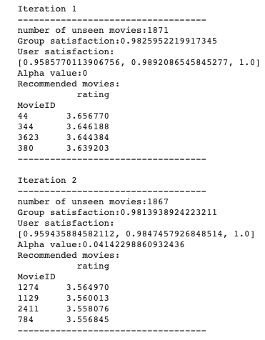
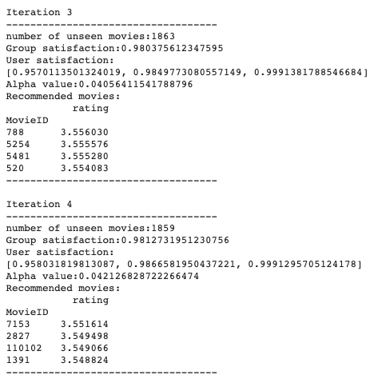
The first 4 iterations

Slide 15
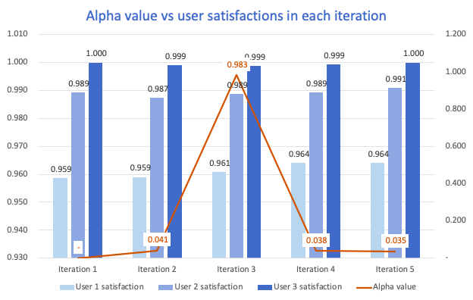
Experiment with 5 iteration
Alpha value has dynamically changed to optimize the user satisfaction
After 5 iteration, the overall user satisfaction has increased, compared to the first iteration

