Slide 1

Golang分享
by duyanghao

Slide 2
目录
一、Golang概述
二、Golang数据类型
三、Golang控制语句
四、Golang高级特性
五、Golang工具
六、Golang优缺点
七、附件

Slide 3
Golang概述
The Go programming language is an open source project to make programmers more productive.
Go is expressive, concise, clean, and efficient. Its concurrency mechanisms make it easy to write programs that get the most out of multicore and networked machines, while its novel type system enables flexible and modular program construction. Go compiles quickly to machine code yet has the convenience of garbage collection and the power of run-time reflection. It's a fast, statically typed, compiled language that feels like a dynamically typed, interpreted language.

Slide 4
Golang概述
1、语法简单，特性少：入门快且足够强大
2、将所有依赖包编译成一个二进制文件：减少部署和运维成本（支持多种OS与processor architectures）
3、标准库强大：满足大多数组件
4、支持包管理：可以很容易地获取第三方包以及发布自己的包
5、静态编译性语言
6、语言级很好的支持并发，能最大可能利用机器资源：goroutines&channels
7、测试工具支持：go本身支持单元测试、性能测试（按照规范）
8、go编译器支持垃圾回收
9、语言本身开源，且鼓励更多开源第三方库
10、自动类型判断（类似于动态语言）
11、自动文档生成
12、强编译检查：没有使用的package与变量都无法编译通过
13、Cross platform跨平台
14、工具完善：支持格式化工具、包管理工具、编译工具以及测试工具等

Slide 5
目录
一、Golang概述
二、Golang数据类型
三、Golang控制语句
四、Golang高级特性
五、Golang工具
六、Golang优缺点
七、附件

Slide 6
Golang数据类型
基础类型
布尔
true or false
数字
整形、浮点型、复数
字符串
UTF-8 编码标识 Unicode 文本

Slide 7
Golang数据类型
派生类型
数组
切片
Map
函数
管道
结构化
指针
接口

Slide 8
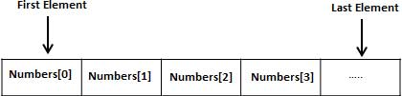
Golang数据类型——数组
数组是具有相同唯一类型的一组已编号且长度固定的数据项序列，这种类型可以是任意的原始类型例如整形、字符串或者自定义类型
Here we create an array a that will hold exactly 5 ints. The type of elements and length are both part of the array’s type. By default an array is zero-valued, which for ints means 0s.
var a [5]int
Go's arrays are values. An array variable denotes the entire array; it is not a pointer to the first array element (as would be the case in C). This means that when you assign or pass around an array value you will make a copy of its contents. (To avoid the copy you could pass a pointer to the array, but then that's a pointer to an array, not an array.) One way to think about arrays is as a sort of struct but with indexed rather than named fields: a fixed-size composite value.

Slide 9
Golang数据类型——切片
Slices are a key data type in Go, giving a more powerful interface to sequences than arrays.
A slice literal is declared just like an array literal, except you leave out the element count:
letters := []string{"a", "b", "c", "d"}
1
Slices底层数据结构是Arrays
A slice is a descriptor of an array segment. It consists of a pointer to the array, the length of the segment, and its capacity (the maximum length of the segment).
SlicesVS
Arrays
2
Slicing is done by specifying a half-open range with two indices separated by a colon
For example, the expression b[1:4] creates a slice including elements 1 through 3 of b (the indices of the resulting slice will be 0 through 2).
re-slicing a slice doesn't make a copy of the underlying array. The full array will be kept in memory until it is no longer referenced
3
Slices长度在运行时可以动态变化，而数组是编译时就指定了，且不能修改
The append function appends the elements x to the end of the slice s, and grows the slice if a greater capacity is needed.
4
the zero value of a slice (nil) acts like a zero-length slice

Slide 10
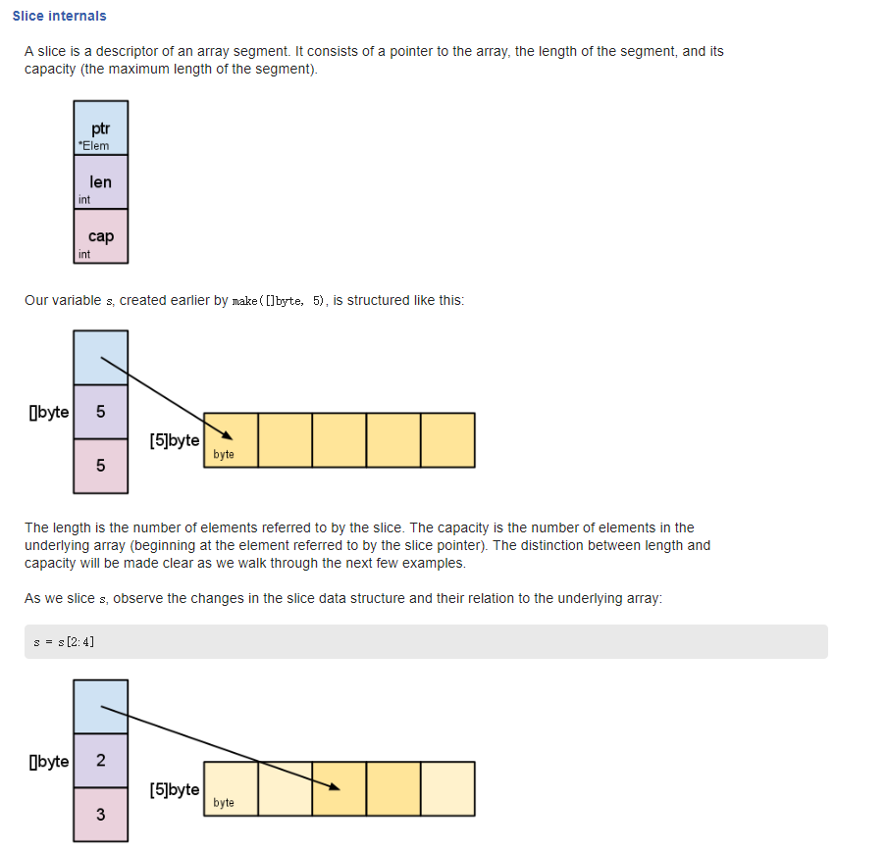
Golang数据类型——切片

Slide 11
Golang数据类型——Map
Maps are Go’s built-in associative data type (sometimes called hashes or dicts in other languages).
To create an empty map, use the builtin make: make(map[key-type]val-type).
m := make(map[string]int)
Set key/value pairs using typical name[key] = val syntax.
m["k1"] = 7
Printing a map with e.g. fmt.Println will show all of its key/value pairs.
fmt.Println("map:", m)
map: map[k1:7 k2:13]
The builtin delete removes key/value pairs from a map.
delete(m, "k1")
The optional second return value when getting a value from a map indicates if the key was present in the map. This can be used to disambiguate between missing keys and keys with zero values like 0 or "". Here we didn’t need the value itself, so we ignored it with the blank identifier _.
if value, ok := m1[2]; ok {
fmt.Println(value)
} else {
fmt.Println("no exists")
}
1
2
3
4
5

Slide 12
Golang数据类型——函数
Functions are central in Go. We’ll learn about functions with a few different examples.
Here’s a function that takes two ints and returns their sum as an int.
func plus(a int, b int) int {
return a + b
}
When you have multiple consecutive parameters of the same type, you may omit the type name for the like-typed parameters up to the final parameter that declares the type.
func plusPlus(a, b, c int) int {
return a + b + c
}
Go has built-in support for multiple return values. This feature is used often in idiomatic Go, for example to return both result and error values from a function.
func vals() (int, error) {
return 3, nil
}
1
2
3

Slide 13
Golang数据类型——函数
Variadic functions can be called with any number of trailing arguments. For example, fmt.Println is a common variadic function.
func sum(nums ...int) {
fmt.Print(nums, " ")
total := 0
for _, num := range nums {
total += num
}
fmt.Println(total)
}
Variadic functions can be called in the usual way with individual arguments.
sum(1, 2)
If you already have multiple args in a slice, apply them to a variadic function using func(slice...) like this.
nums := []int{1, 2, 3, 4}
sum(nums...)
4

Slide 14
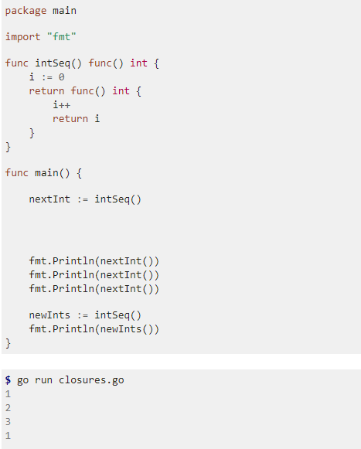
Golang数据类型——函数
Go supports anonymous functions, which can form closures. Anonymous functions are useful when you want to define a function inline without having to name it.
This function intSeq returns another function, which we define anonymously in the body of intSeq. The returned function closes over the variable i to form a closure.
We call intSeq, assigning the result (a function) to nextInt. This function value captures its own i value, which will be updated each time we call nextInt.
See the effect of the closure by calling nextInt a few times.
5

Slide 15
Golang数据类型——函数
closures：In programming languages, a closure (also lexical closure or function closure) is a technique for implementing lexically scoped name binding in a language with first-class functions. Operationally, a closure is a record storing a function[a] together with an environment.[1] The environment is a mapping associating each free variable of the function (variables that are used locally, but defined in an enclosing scope) with the value or reference to which the name was bound when the closure was created.[b] Unlike a plain function, a closure allows the function to access those captured variables through the closure's copies of their values or references, even when the function is invoked outside their scope.
Golang闭包的本质源自两点，词法作用域和函数当作值传递
词法作用域，就是，按照代码书写时的样子，内部函数可以访问函数外面的变量
函数当作值传递，即所谓的“first-class functions“ 。就是可以把函数当作一个值来赋值，当作参数传给别的函数，也可以把函数当作一个值 return。一个函数被当作值返回时，也就相当于返回了一个通道，这个通道可以访问这个函数词法作用域中的变量，即函数所需要的数据结构保存了下来，数据结构中的值在外层函数执行时创建，外层函数执行完毕时理因销毁，但由于内部函数作为值返回出去，这些值得以保存下来。而且无法直接访问，必须通过返回的函数。
闭包不是“封闭内部状态”而是“封闭外部状态”，当外部状态的scope失效的时候，还有一份保留在“内部状态”里面

Slide 16
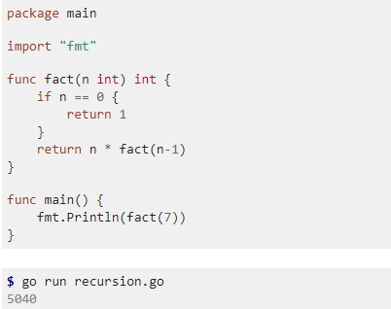
Golang数据类型——函数
Go supports recursive functions. Here’s a classic factorial example.
This fact function calls itself until it reaches the base case of fact(0).
6

Slide 17
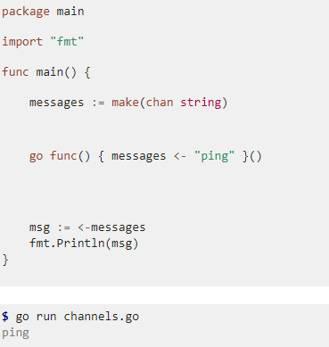
Golang数据类型——管道
Channels are the pipes that connect concurrent goroutines. You can send values into channels from one goroutine and receive those values into another goroutine.
* Create a new channel with make(chan val-type). Channels are typed by the values they convey.
* Send a value into a channel using the channel <- syntax.
Here we send "ping" to the messages channel we made above, from a new goroutine.
* The <-channel syntax receives a value from the channel.
Here we’ll receive the "ping" message we sent above and print it out.
When we run the program the "ping" message is successfully passed
from one goroutine to another via our channel.
* By default sends and receives block until both the sender and receiver are ready.
This property allowed us to wait at the end of our program for the "ping" message
without having to use any other synchronization.

Slide 18
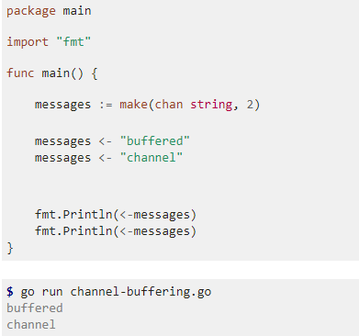
Golang数据类型——管道
Channel Buffering
By default channels are unbuffered, meaning that they will only accept sends (chan <-) if there is a corresponding receive (<- chan) ready to receive the sent value. Buffered channels accept a limited number of values without a corresponding receiver for those values.
Here we make a channel of strings buffering up to 2 values.
Because this channel is buffered, we can send these values into the channel without a corresponding concurrent receive.
Later we can receive these two values as usual.
常用于异步任务处理框架：
https://github.com/duyanghao/GSEAsyncServer

Slide 19
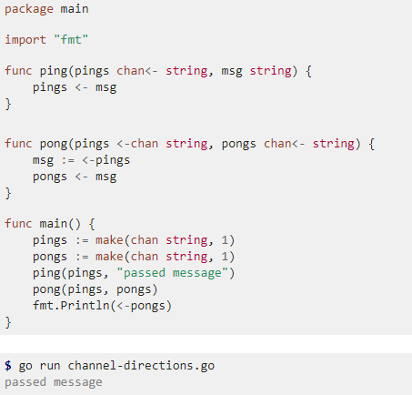
Golang数据类型——管道
Channel Directions
When using channels as function parameters, you can specify if a channel is meant to only send or receive values. This specificity increases the type-safety of the program.
This ping function only accepts a channel for sending values.
It would be a compile-time error to try to receive on this channel.
The pong function accepts one channel for receives (pings)
and a second for sends (pongs).

Slide 20
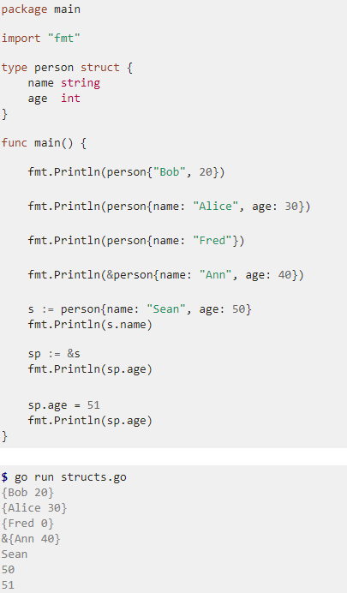
Golang数据类型——Structs
Go’s structs are typed collections of fields. They’re useful for grouping data together to form records.
This person struct type has name and age fields.
An & prefix yields a pointer to the struct.
Access struct fields with a dot.
You can also use dots with struct pointers - the pointers
are automatically dereferenced.

Slide 21
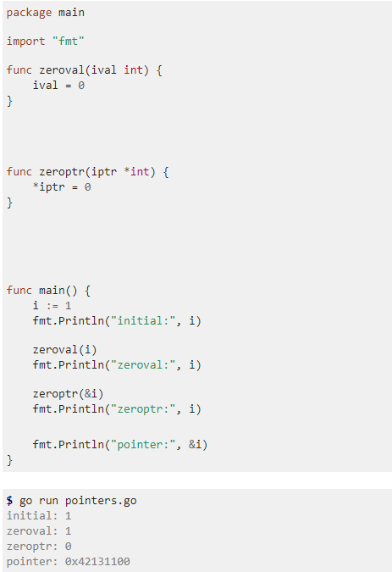
Golang数据类型——指针
Go supports pointers, allowing you to pass references to values and records within your program.
We’ll show how pointers work in contrast to values with 2 functions: zeroval and zeroptr. zeroval has an int parameter, so arguments will be passed to it by value. zeroval will get a copy of ival distinct from the one in the calling function.
zeroptr in contrast has an *int parameter, meaning that it takes an int pointer. The *iptr code in the function body then dereferences the pointer from its memory address to the current value at that address. Assigning a value to a dereferenced pointer changes the value at the referenced address.
The &i syntax gives the memory address of i, i.e. a pointer to i.
Pointers can be printed too.
zeroval doesn’t change the i in main,
but zeroptr does because it has a reference to the memory address for that variable.

Slide 22
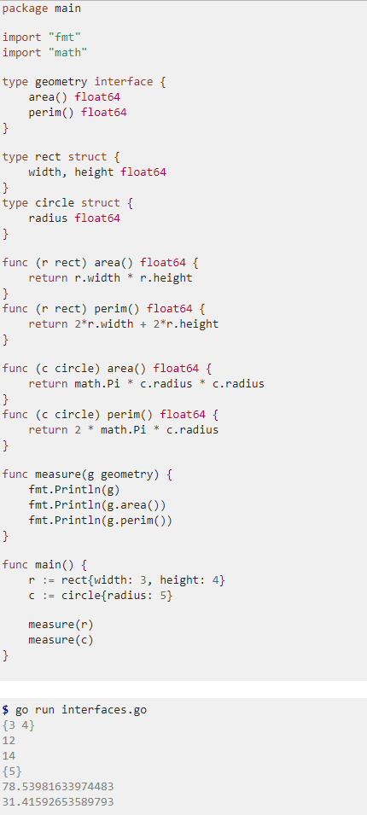
Golang数据类型——接口
Interfaces are named collections of method signatures.
Here’s a basic interface for geometric shapes.
For our example we’ll implement this interface on rect and circle types.
To implement an interface in Go, we just need to implement all the methods in the interface.
If a variable has an interface type, then we can call methods that are in the named interface.
Here’s a generic measure function taking advantage of this to work on any geometry.
The circle and rect struct types both implement the geometry interface
so we can use instances of these structs as arguments to measure.

Slide 23
Golang数据类型——接口
Golang实现面向对象：
一、封装
Go将封装简化为2层（不光是类，对Go语言中任何标识符都生效）：
包范围内：通过标识符首字母小写，变量和方法都只能在包内可见
可导出的：通过标识符首字母大写，变量和方法在包以外也可见
二、继承
Go不直接支持继承，不过可以通过组合来间接实现：内嵌一个或多个（多重继承）其它类型（包含变量和方法）
三、多态
用接口实现：某个类型的实例可以赋给它所实现的任意接口类型的变量，类型和接口是松耦合的（这里涉及一个value method VS pointer method）
这里参考我的文章：https://duyanghao.github.io/go-class_interface/

Slide 24
目录
一、Golang概述
二、Golang数据类型
三、Golang控制语句
四、Golang高级特性
五、Golang工具
六、Golang优缺点
七、附件

Slide 25
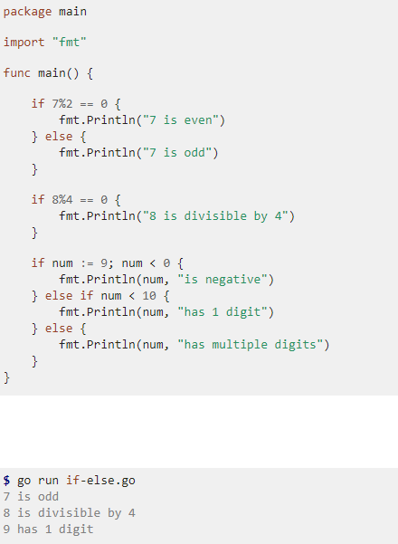
Golang控制语句
If/Else
Branching with if and else in Go is straight-forward.
You can have an if statement without an else.
A statement can precede conditionals;
any variables declared in this statement are available in all branches.
Note that you don’t need parentheses around conditions in Go,
but that the braces are required.
There is no ternary if in Go,
so you’ll need to use a full if statement even for basic conditions
（无三目运算符）.

Slide 26
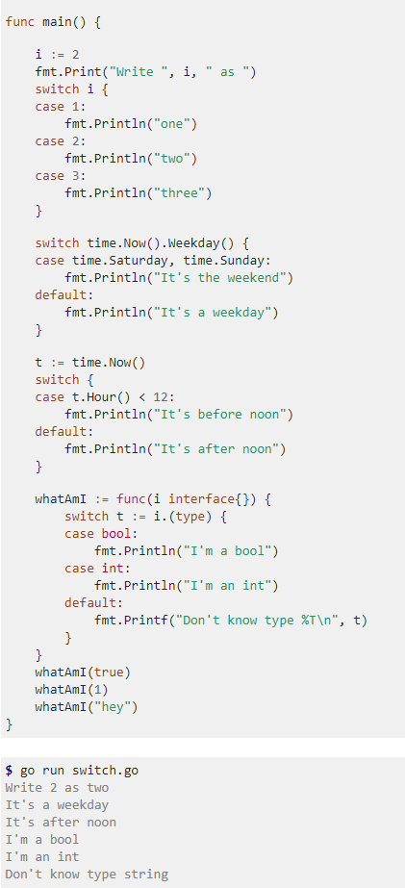
Golang控制语句
Switch
Switch statements express conditionals across many branches.
You can use commas to separate multiple expressions in the same case statement.
We use the optional default case in this example as well.
switch without an expression is an alternate way to express if/else logic.
Here we also show how the case expressions can be non-constants.
A type switch compares types instead of values. You can use this to discover
the type of an interface value. In this example,
the variable t will have the type corresponding to its clause.

Slide 27
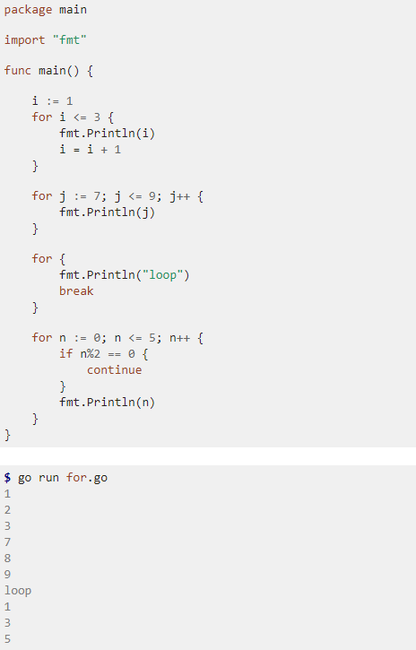
Golang控制语句
For
for is Go’s only looping construct. Here are three basic types of for loops.
The most basic type, with a single condition(no while).
A classic initial/condition/after for loop.
You can also continue to the next iteration of the loop.
for without a condition will loop repeatedly
until you break out of the loop or return from the enclosing function.
the variable t will have the type corresponding to its clause.

Slide 28
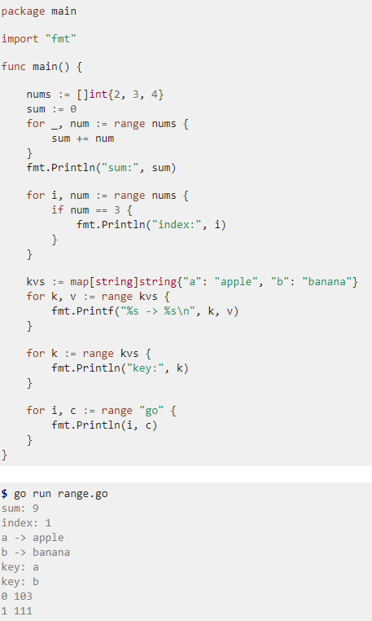
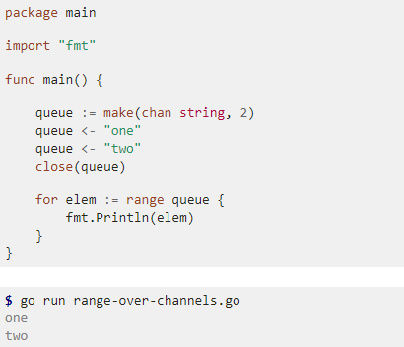
Golang控制语句
Range
range iterates over elements in a variety of data structures.
Let’s see how to use range with some of the data structures we’ve already learned.
range on arrays and slices provides both the index and value for each entry.
Above we didn’t need the index, so we ignored it with the blank identifier _.
Sometimes we actually want the indexes though.
range on map iterates over key/value pairs.
range can also iterate over just the keys of a map.
We can also use this syntax(for … range) to iterate over values received from a channel
This range iterates over each element as it’s received from queue.
Because we closed the channel above,
the iteration terminates after receiving the 2 elements.

Slide 29
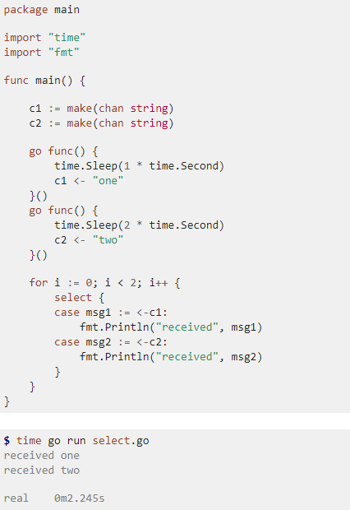
Golang控制语句
Select
Go’s select lets you wait on multiple channel operations. Combining goroutines and channels with select is a powerful feature of Go.
For our example we’ll select across two channels.
Each channel will receive a value after some amount of time,
to simulate e.g. blocking RPC operations executing in concurrent goroutines.
We’ll use select to await both of these values simultaneously,
printing each one as it arrives.
We receive the values "one" and then "two" as expected.
Note that the total execution time is only ~2 seconds
since both the 1 and 2 second Sleeps execute concurrently.

Slide 30
目录
一、Golang概述
二、Golang数据类型
三、Golang控制语句
四、Golang高级特性
五、Golang工具
六、Golang优缺点
七、附件

Slide 31
Golang高级特性
Go Language Mechanics On Escape Analysis
go在一定程度消除了堆和栈的区别，因为go在编译的时候进行逃逸分析，来决定一个对象放栈上还是放堆上，不逃逸的对象放栈上（随栈帧销毁），可能逃逸的放堆上（Go GC回收）
什么时候逃逸，什么时候不逃逸？
The basic rule is that if a reference to a variable is returned from the function where it is declared, it “escapes” - it can be referenced after the function returns, so it must be heap-allocated.
简单来讲，如果变量可能会被函数以外的程序访问到就会逃逸，分配到heap；否则分配到stack
逃逸分析参数
we can run the compiler with -gcflags '-m', which will print verbose escape analysis information

Slide 32
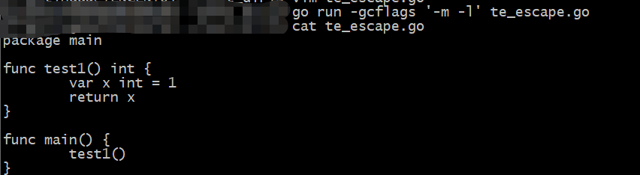
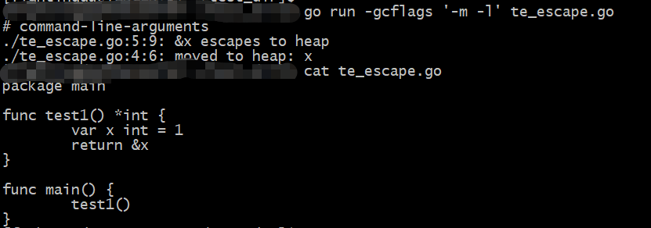
Golang高级特性
Go Language Mechanics On Escape Analysis
No Escape Escape

Slide 33
Golang高级特性
Golang Garbage collection
内存管理是程序员开发应用的一大难题。传统的系统级编程语言（主要指C/C++）中，
程序员必须对内存小心的进行管理操作，控制内存的申请及释放。稍有不慎，就可能产生内
存泄露问题，这种问题不易发现并且难以定位，一直成为困扰开发者的噩梦。
如何解决这个头疼的问题呢？过去一般采用两种办法：
内存泄露检测工具。这种工具的原理一般是静态代码扫描，通过扫描程序检测可能出现内存泄露
的代码段。然而检测工具难免有疏漏和不足，只能起到辅助作用。
智能指针。这是 c++ 中引入的自动内存管理方法，通过拥有自动内存管理功能的指针对象来引
用对象，是程序员不用太关注内存的释放，而达到内存自动释放的目的。这种方法是采用最广泛的做法
但是对程序员有一定的学习成本（并非语言层面的原生支持），而且一旦有忘记使用的场景依然无法
避免内存泄露。
为了解决这个问题，后来开发出来的几乎所有新语言（java，python，php等等）都引入了语
言层面的自动内存管理 – 也就是语言的使用者只用关注内存的申请而不必关心内存的释放，内存释放由
虚拟机（virtual machine）或运行时（runtime）来自动进行管理。而这种对不再使用的内存资源进行自
动回收的行为就被称为垃圾回收

Slide 34
Golang高级特性
Golang Garbage collection（常见的垃圾回收方法）
一、引用计数（reference counting）
这是最简单的一种垃圾回收算法，和智能指针异曲同工。对每个对象维护一个引用计数，当引用该对象的对象被销毁或更新时被引用对象的引用计数自动减一，当被引
用对象被创建或被赋值给其他对象时引用计数自动加一。当引用计数为0时则立即回收对象。这种方法的优点是实现简单，并且内存的回收很及时。这种算法在内存比较
紧张和实时性比较高的系统中使用的比较广泛，如ios cocoa框架，php，python等。简单引用计数算法也有明显的缺点：
频繁更新引用计数降低了性能。一种简单的解决方法就是编译器将相邻的引用计数更新操作合并到一次更新；还有一种方法是针对频繁发生的临时变量引用不进行计 数，而是在引用达到0时通过扫描堆栈确认是否还有临时对象引用而决定是否释放等。
循环引用问题。当对象间发生循环引用时引用链中的对象都无法得到释放。最明显的解决办法是避免产生循环引用，如cocoa引入了strong指针和weak指针两种指针 类型。或者系统检测循环引用并主动打破循环链。当然这也增加了垃圾回收的复杂度。
二、标记-清除（mark and sweep）
该方法分为两步，标记从根变量开始迭代遍历所有被引用的对象，对能够通过应用遍历访问到的对象都标记为“被引用”；标记完成后进行清除操作，对没有标记过
的内存进行回收（回收同时可能伴有碎片整理操作）。这种方法解决了引用计数的不足，但是也有比较明显的问题：每次启动垃圾回收都会暂停当前所有的正常代码执
行，回收使系统响应能力大大降低！当然后续也出现了很多mark&sweep算法的变种（如三色标记法）优化了这个问题
三、分代收集（generation）
经过大量实际观察得知，在面向对象编程语言中，绝大多数对象的生命周期都非常短。分代收集的基本思想是，将堆划分为两个或多个称为 代（generation）的空间。新
创建的对象存放在称为 新生代（young generation）中（一般来说，新生代的大小会比 老年代小很多），随着垃圾回收的重复执行，生命周期较长的对象会被 提升
（promotion）到老年代中。因此，新生代垃圾回收和老年代垃圾回收两种不同的垃圾回收方式应运而生，分别用于对各自空间中的对象执行垃圾回收。新生代垃圾回收
的速度非常快，比老年代快几个数量级，即使新生代垃圾回收的频率更高，执行效率也仍然比老年代垃圾回收强，这是因为大多数对象的生命周期都很短，根本无需提
升到老年代

Slide 35
Golang高级特性
Golang Garbage collection
Garbage collection is a convenient feature of Go - automatic memory management makes code cleaner and memory leaks less likely. However, GC also adds overhead as the program periodically needs to stop and collect unused objects
Golang各版本GC延迟（Twitter）及优化：
1.4-1.5——300~400ms
Prior to Go 1.5, Go has used a parallel stop-the-world (STW) collector. While STW collection has many downsides, it does at least have predictable and controllable heap growth behavior
1.5——30~40ms
Go 1.5 introduces a concurrent collector. Go's new garbage collector is a concurrent, tri-color, mark-sweep collector
1.6——0~50ms
The improvement was largely due to systematically eliminating all the O(heap) things we were doing during the stop the world time
1.7——0~5ms
Again we kept knocking off these O(heap size) stop the world processes. We had much larger heaps and as we knocked off these O(heap size) stop the world pauses, the size of the heap could obviously grow considerable without impacting latency. So this was a bit of a help in 1.7.
1.8-1.9——0~1.5ms
We had the last of our large latency drops which was due to figuring out how to avoid the stop the world stack scanning at the end of the GC cycle. That dropped us into the sub-millisecond range.

Slide 36
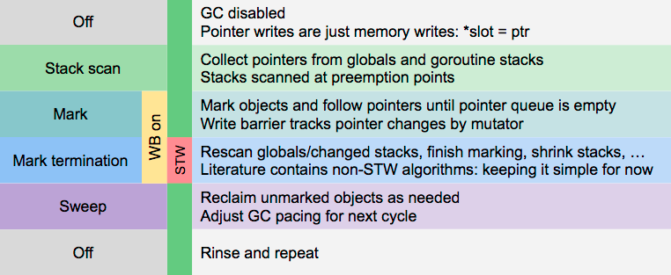
Golang高级特性
Golang Garbage collection
Go 1.5 introduces a concurrent collector. Go's new garbage collector is a concurrent, tri-color, mark-sweep collector
Go1.5的垃圾回收是一个非分代，非移动的，并发的，三色的标记清扫垃圾回收
In a tri-color collector, every object is either white, grey, or black and we view the heap as a graph of connected objects. At the start of a GC cycle all objects are white. The GC visits all roots, which are objects directly accessible by the application such as globals and things on the stack, and colors these grey. The GC then chooses a grey object, blackens it, and then scans it for pointers to other objects. When this scan finds a pointer to a white object, it turns that object grey. This process repeats until there are no more grey objects. At this point, white objects are known to be unreachable and can be reused.
这里参考我的文章： https://duyanghao.github.io/golang/

Slide 37
Golang高级特性
三色标记算法
三色标记算法是对标记阶段的改进，原理如下：
起初所有对象都是白色
从根出发扫描所有可达对象，标记为灰色，放入待处理队列
从队列取出灰色对象，将其引用对象标记为灰色放入队列，自身标记为黑色
重复 3，直到灰色对象队列为空。此时白色对象即为垃圾，进行回收
可视化如下：

Slide 38
Golang高级特性
Golang 线程和协程的区别
进程、线程 和 协程 之间概念的区别
对于 进程、线程，都是有内核进行调度，有 CPU 时间片的概念，进行 抢占式调度（有多种调度算法）；对于 协程
(用户级线程)，这是对内核透明的，也就是系统并不知道有协程的存在，是完全由用户自己的程序进行调度的，因为
是由用户程序自己控制，那么就很难像抢占式调度那样做到强制的 CPU 控制权切换到其他进程/线程，通常只能进
行 协作式调度，需要协程自己主动把控制权转让出去之后，其他协程才能被执行
goroutine 和协程区别
本质上，goroutine 就是协程。 不同的是，Golang 在 runtime、系统调用等多方面对 goroutine 调度进
行了封装和处理，当遇到长时间执行或者进行系统调用时，会主动把当前 goroutine 的CPU (P) 转让出
去，让其他 goroutine 能被调度并执行，也就是 Golang 从语言层面支持了协程。Golang 的一大特色就
是从语言层面原生支持协程，在函数或者方法前面加 go关键字就可创建一个协程
其他方面的比较
1、内存消耗方面：每个 goroutine (协程) 默认占用内存远比 Java 、C 的线程少
goroutine：2KB
线程：8MB
2.、线程和 goroutine 切换调度开销方面：goroutine 远比线程小
线程：涉及模式切换(从用户态切换到内核态)、16个寄存器、PC、SP…等寄存器的刷新等
goroutine：只有三个寄存器的值修改 - PC / SP / DX.

Slide 39
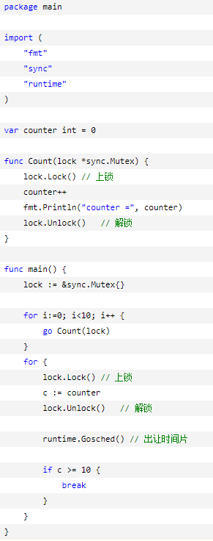
Golang高级特性
Golang Goroutines并发通信机制
共享内存——锁
下面的例子，使用了互斥锁变量来同步协程：
https://golang.org/pkg/sync/#Mutex

Slide 40
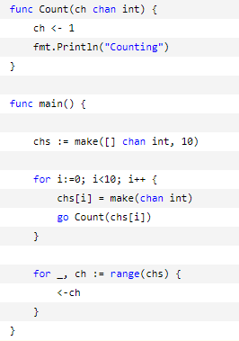
Golang高级特性
Golang Goroutines并发通信机制
消息机制——channel
channel 是 Go 语言在语言级别提供的 goroutine 间的通信方式，我们可以使用 channel 在多个 goroutine 之间传递消息，另外：channel 是类型相关的，一个 channel 只能传递一种类型的值，这个类型需要在声明 channel 时指定
下面的例子，使用了channel来同步协程：

Slide 41
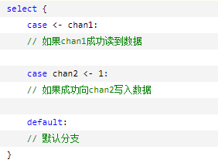
Golang高级特性
Golang Goroutines并发通信机制
select
在UNIX中，select()函数用来监控一组描述符，该机制常被用于实现高并发的socket服务器程序。Go语言直接在语言级别支持select关键字，用于处理异步IO问题，大致结构如下：
select默认是阻塞的，只有当监听的channel中有发送或接收可以进行时才会运行，当多个channel都准备好的时候，select随机选择一个执行

Slide 42
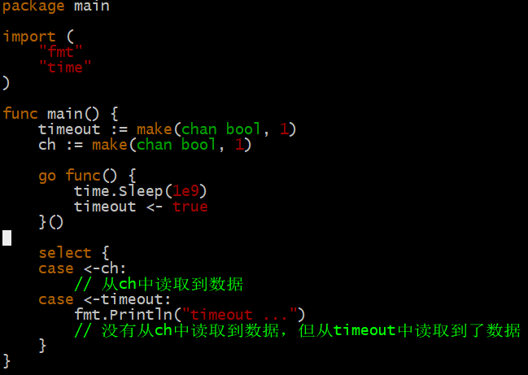
Golang高级特性
Golang Goroutines并发通信机制
select
Go语言没有对channel提供直接的超时处理机制，但我们可以利用select来间接实现，例如：
这样使用select就可以避免永久等待的问题，因为程序会在timeout中获取到一个数据后继续执行，而无论对ch的读取是否还处于等待状态

Slide 43
目录
一、Golang概述
二、Golang数据类型
三、Golang控制语句
四、Golang高级特性
五、Golang工具
六、Golang优缺点
七、附件

Slide 44
Golang工具
一、格式化
gofmt –w xxx.go
二、测试
单元测试
1、创建测试文件夹xxx，文件夹下的go文件的packag必须与文件夹名一致（不然会识别不到）
2、创建需要测试的文件xxx.go
3、创建单元测试用例文件xxx_test.go(文件名必须是*_test.go的类型，*代表要测试的文件名，函数名必须以Test开头如：TestXxx或
Test_xxx)
4、测试所有的文件go test，将对当前目录下的所有*_test.go文件进行编译并自动运行测试
5、测试某个文件使用”-file”参数。go test -file *.go 。例如：go test -file xxx_test.go，"-file“参数不是必须的，可以省略，如果你输入
go test xxx_test.go也会得到一样的效果
性能测试
1、创建benchmark性能测试用例文件xxx_b_test.go(文件名必须是*_b_test.go的类型，*代表要测试的文
件名，函数名必须以Benchmark开头如：BenchmarkXxx或Benchmark_xxx)
2、进行所有go文件的benchmark测试 go test -bench=".*" 或 go test . -bench=".*“
3、对某个go文件进行benchmark测试 go test xxx_b_test.go -bench=".*“

Slide 45
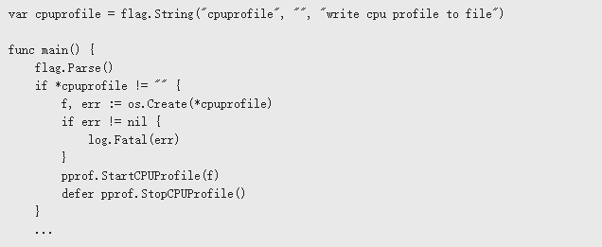
Golang工具
三、性能监控工具——pprof
standalone program
1、添加如下代码：
2、使用-cpuprofile参数运行
./havlak1 -cpuprofile=havlak1.prof
3、使用go tool pprof查看CPU占用情况
go tool pprof havlak1 havlak1.prof

Slide 46
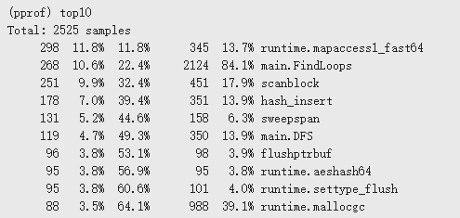
Golang工具
三、性能监控工具——pprof
standalone program
3、topN命令
Go每10ms记录一次CPU使用情况
第一列：函数CPU使用计数（不包含等待其它函数所占CPU）
第二列：函数CPU使用比例（占总数）
第三列：函数CPU累计比列（占总数）
第四列：函数CPU使用计数（包含等待其它函数所占CPU）
第五列：函数CPU使用比例（对应第四列CPU计数）

Slide 47
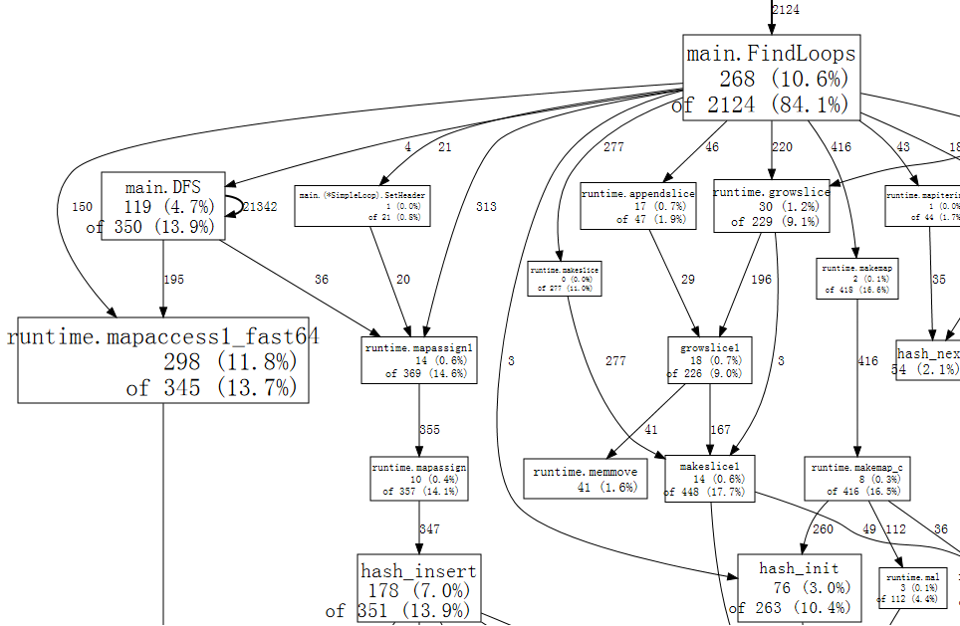
Golang工具
三、性能监控工具——pprof
standalone program
3、web命令查看CPU调用图（需要安装graphviz）

Slide 48
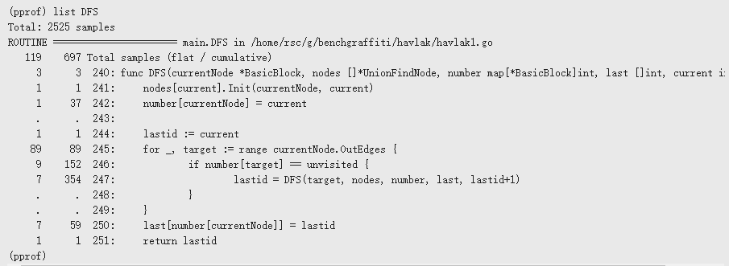
Golang工具
三、性能监控工具——pprof
standalone program
4、list命令
List命令查看一个具体函数的CPU使用情况
第一列：运行那一行代码所占用CPU
第二列：运行那一行代码以及被那行代码调用所占CPU
第三列：行号

Slide 49
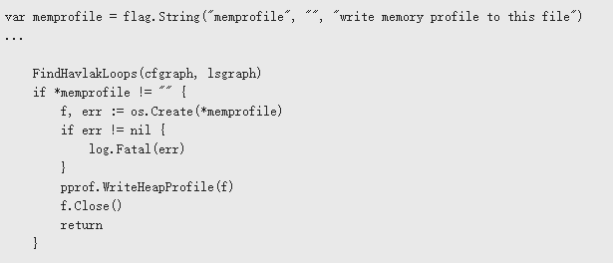
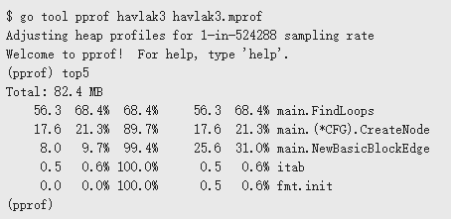
Golang工具
三、性能监控工具——pprof
standalone program
5、topN查看内存
6、使用-memprofile参数运行
./havlak1 -cmemprofile=havlak3.mprof
7、使用go tool pprof查看CPU占用情况
go tool pprof havlak3 havlak3.mprof

Slide 50
Golang工具
三、性能监控工具——pprof
服务器
需要导入包：net/http/pprof，之后直接通过如下地址：http://localhost:port/debug/pprof/
，访问web页面，查看CPU和Memory信息
性能测试
go test -bench=".*" -cpuprofile=cpu.prof –c
go test –bench=“.*” –memprofile=memory.mprof -c
go tool pprof xxx.test cpu.prof
go tool pprof xxx.test memory.mprof

Slide 51
Golang工具
四、Golang IDE
1、Visual Studio Code
由Microsoft创建的Visual Studio Code是一个功能齐全的开源IDE和代码编辑器，支持各种各样的编程语言。它的特点是智能完成；使用断点调用、调用堆栈和交互式控制台调试；内
置Git集成；以及分层文件夹和文件浏览器
作为另一个流行的IDE，Visual Studio Code有一个Go开发人员定期贡献的支持社区。使用Visual Studio Code，你可以使用可用插件数组来扩展功能
2、GoLand
软件开发公司JetBrains发布了另一个可靠的IDE，这次是针对Golang发布的。GoLand一个商业IDE，为Go开发人员提供了一个强大的人机工程学环境。它还具有编码协助、调试器和集
成终端的功能
由于GoLand是由一家已成立的公司创建的，所以它拥有广泛的IntelliJ插件生态系统，让你可以在需要更多工具的时候获得更多
3、LiteIDE
LiteIDE是五年多前创建的首个以Golang为中心的开源IDE。作为具有独特外观的C ++ Qt应用程序，LiteIDE提供代码管理、可配置构建命令、gdb和Delve调试器，使用
WordApi——基于MIME类型的系统——自动完成和创建等等。它还提供JSON和Golang支持
4、Wide
Wide是Golang程序员使用的基于Web的IDE。它专为协作开发而设计，适用于团队和Web开发机构。Wide功能包括代码高亮、调试、Git集成等
因为Wide是由一名中国开发者创建和维护的，所以其大部分文档和支持是中文的
5、带有GoClipse的Eclipse
由于Eclipse是广受欢迎的IDE，因此我们为其创建了许多插件。GoClipse针对Golang的Eclipse插件，提供Go源代码编辑，具有可配置的语法高亮和自动缩进以及大括号完成功能
GoClipse还可以作为项目向导和构建器来立即报告语法和构建错误。GoClipse的其他功能包括调试功能和代码辅助
6、带有Vim-Go插件的Vim
Vim是一个免费的开源IDE，可以定制和配置各种插件。如果你是Golang程序员，那么你可以使用Vim中由Fatih Arslan创建的vim-go插件。Vim-go自动安装所有必需
的二进制文件，为Golang提供平滑的Vim集成
Vim-go是一款功能强大的插件套件，用于撰写和开发Go。其功能包括高级源代码分析，添加和删除导入路径，多次第三方支持，goto定义，快速文件执行等等
Vim-go是高度可定制的，可以根据你的需要启用或禁用各种功能

Slide 52
目录
一、Golang概述
二、Golang数据类型
三、Golang控制语句
四、Golang高级特性
五、Golang工具
六、Golang优缺点
七、附件

Slide 53
Golang优缺点
1
语法简单、容易上手
优点
2
工具链完整，格式化+包管理+编译+测试
3
语言级支持GC+Goroutine，多核时代语言
4
开源，具有良好的社区环境

Slide 54
Golang优缺点
1
由于语法比较简单，很多时候操作不如其他语言灵活，例如：golang slice VS c++ vector，而且golang slice容易踩坑（典型的删除中间元素）
缺点
2
GC在1.5版本之前延时太大，在1.5之后延时控制的比较好了
3
Golang语言级支持Goroutine，但是操作不当也容易造成Goroutine泄露

Slide 55
目录
一、Golang概述
二、Golang数据类型
三、Golang控制语句
四、Golang高级特性
五、Golang工具
六、Golang优缺点
七、附件

Slide 56
附件
1、go发布包
https://stackoverflow.com/questions/43716691/how-to-publish-a-go-package
https://aggarwalarpit.wordpress.com/2017/07/08/creating-your-own-package-in-go/
https://github.com/golang/go/wiki/PackagePublishing
2、go测试
https://studygolang.com/articles/2491
3、go语言特点
https://www.quora.com/What-are-some-unique-features-of-Golang
4、go数据类型
https://gobyexample.com/arrays
http://www.runoob.com/go/go-arrays.html
slices vs arrays
https://blog.golang.org/go-slices-usage-and-internals
闭包：
https://www.zhihu.com/question/34210214
go接口：
https://gobyexample.com/interfaces
http://jordanorelli.tumblr.com/post/32665860244/how-to-use-interfaces-in-go
https://duyanghao.github.io/go-class_interface/

Slide 57
附件
5、流程性控制语句
https://gobyexample.com/goroutines
6、golang 逃逸分析
https://gocn.vip/article/355
http://www.agardner.me/golang/garbage/collection/gc/escape/analysis/2015/10/18/go-escape-analysis.html
7、golang garbage collection(gc)
https://golang.org/doc/faq#garbage_collection
https://blog.golang.org/ismmkeynote
https://blog.csdn.net/u010649766/article/details/80582153
https://segmentfault.com/a/1190000012597428
go 1.5gc
https://docs.google.com/document/d/1wmjrocXIWTr1JxU-3EQBI6BK6KgtiFArkG47XK73xIQ/edit#
https://stackoverflow.com/questions/7823725/what-kind-of-garbage-collection-does-go-use
8、golnag goroutine间通信
https://www.cnblogs.com/liang1101/p/7285955.html
9、golang 工具：
https://blog.golang.org/profiling-go-programs
golang IDE
https://www.itcodemonkey.com/article/1053.html

