Slide 1


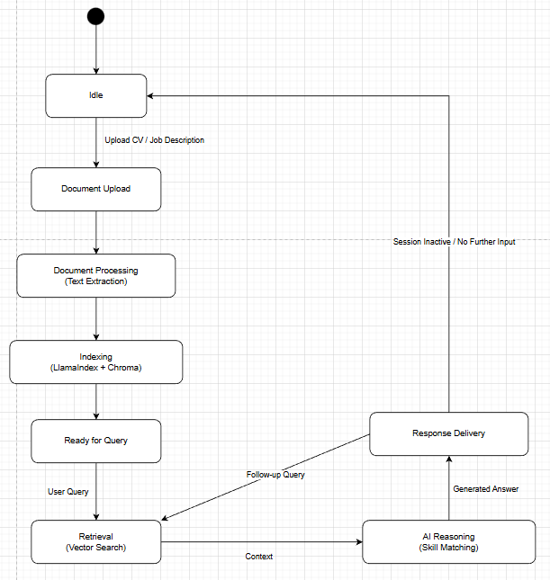
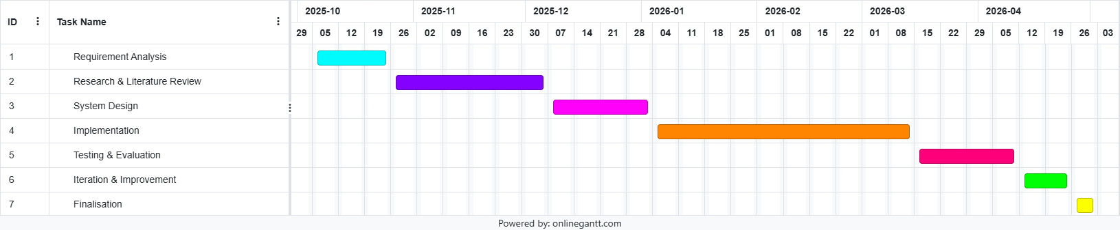
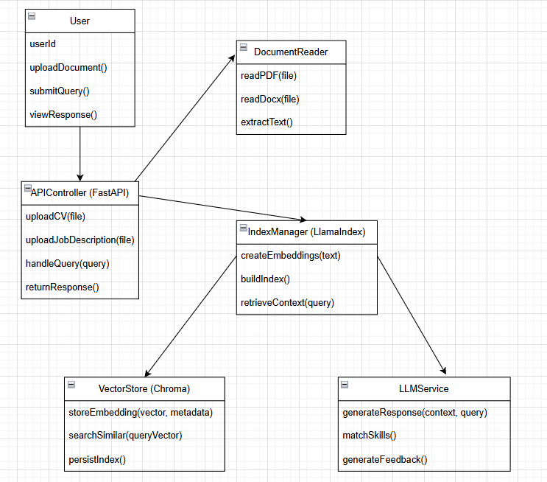
Research: Automated recruitment and CV screening systems are often criticised for limited transparency, fairness and accountability. While traditional ML models perform well in document classification, they typically operate as black boxes, reducing interpretability and trust. Recent advances in RAG address these issues by grounding model outputs in retrieved documents. Frameworks such as LlamaIndex support structured document ingestion and retrieval, enabling more transparent and data driven recruitment systems
UFCFXK-30-3: Digital Systems Project
Student name: Tran Duy Anh
Project Title: An AI Agent for Job Application Support Using CV Analysis and Retrieval-Augmented Generation
A QR Code link to my video submission
Abstract:
This project presents an AI agent that support job seekers by analysing CVs and job descriptions to provide feedback, skill matching and application guidance. Using Retrieval-Augmented Generation (RAG), the system grounds language model outputs in user documents to improve accuracy and reduce hallucinations. The project demonstrates AI agents in recruitment related applications
Design, Implementation & Testing
Key requirements:
Functional
The system must allow users to upload CVs and job descriptions
The system must extract and index relevant document content
The system must match CV skills against job requirements
The system should generate tailored feedback and suggestions
The system should support conversational interaction with the AI agent
Non-functional
The system must ensure data privacy for uploaded documents
The system must provide responses grounded in retrieved documents
The system should be modular and extensible
The system should produce responses within reasonable time limits
State Diagram
Aims and objectives:
Aim:
Design and develop an AI Agent that support job seekers by analysing CVs and job description, providing feedback, skill matching, and application recommendations using LLM
Objectives:
Analyse existing AI based recruitment and CV screening approaches
Design a RAG-based system architecture for CV and job description analysis
Implement document ingestion, embedding, and retrieval using a vector database.
Develop an AI agent capable of generating grounded recommendations
Evaluate system accuracy, relevance, and usability
Testing
Testing includes unit testing of document ingestion and retrieval components, integration testing of RAG pipeline, and qualitive evaluation of AI responses for relevance and correctness. Sample CVs and job descriptions are used to compare AI outputs with and without retrieval grounding
Planning and Management: The project follows milestones: requirements analysis, research, system design, implementation, testing, and evaluation. Progress is traced using a project timeline and weekly objectives to manage and ensure deliverables are met within the schedule
Implementation artefacts
Class Diagram
References: Anon (2025) Proceedings of the 2025 ACM Conference on Fairness, Accountability, and Transparency. Association for Computing Machinery. Cios, K. & Shields, M. (1997) Advances in neural information processing systems 7. Neurocomputing (Amsterdam). [Online] 16 (3), 263. Gheorghiu, A. (2024) Building Data-Driven Applications with LlamaIndex: A practical guide to retrieval-augmented generation (RAG) to enhance LLM applications. 1st edition. [Online]. Birmingham, England: Packt Publishing.

