Slide 1

Movie recommendation engine with content-based & collaborative filtering
Big Data Algorithm
Group 4: Xuelian Jia, Duyen Doan, Srivardhan Mhetre
Dec 9, 2021

Slide 2
1. Overview
movies_metadata.csv credits.csv ratings.csv
ID
MovieID
Title
ID
MovieID
MovieID
UserID
Rating
Words
Cast
Crew
Adult
Popularity
vote_average
vote_count
Small:
700 users
9,000 movies
Numerical
Full:
270,000 users 45,000 movies
Words
Genres
≈45,000 movies
Goal: Recommend movies based on:
the movie a user watched
the ratings of many users for many movies
Movie profile
Content-based filtering
Collaborative filtering

Slide 3
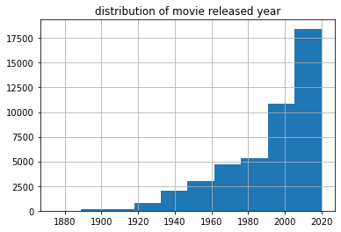
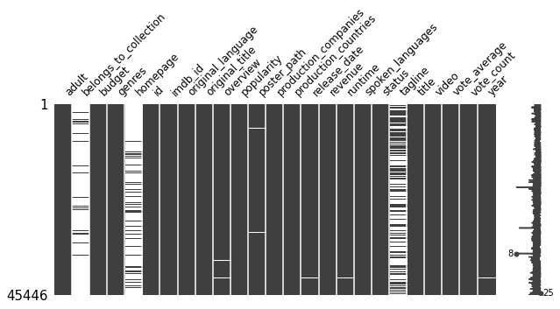
Basic analysis
Plot of missing data in each column

Slide 4
Top 10
Rank by popularity
Rank by similarity
2.1 Content-based Filtering - Movie Profile
Given a movie, recommend movies based on similarity
Genres +
cast (first 3) +
crew (director)
Bucket 1: movie 1,
movie 2
…
CountVectorizer
Bucket 2
Combined info
Movie-word binary matrix
LSH cosine
Bucket 3
….
MinMaxScaler
Normalized matrix movie profile
Movie similarity matrix
Adult
Popularity
vote_average
vote_count
 | M1 | M2 | M3 | …
M1 | 1 | .4 | .01 | …
M2 | .4 | 1 | .2 | …
M3 | .01 | .2 | 1 | …
… | … | … | …
Cosine
Top 10 Rank by similarity

Slide 5
Tips
When dealing with the cast and crew columns:
Remove the space between first and last name, so that two person with same first name and different last name won’t be treated as same person.
Only include the first three actors, the full list will dramatically increase vector dimensions and less meaningful data
Limit the number of features in CountVectorizer to control the dimensinality

Slide 6
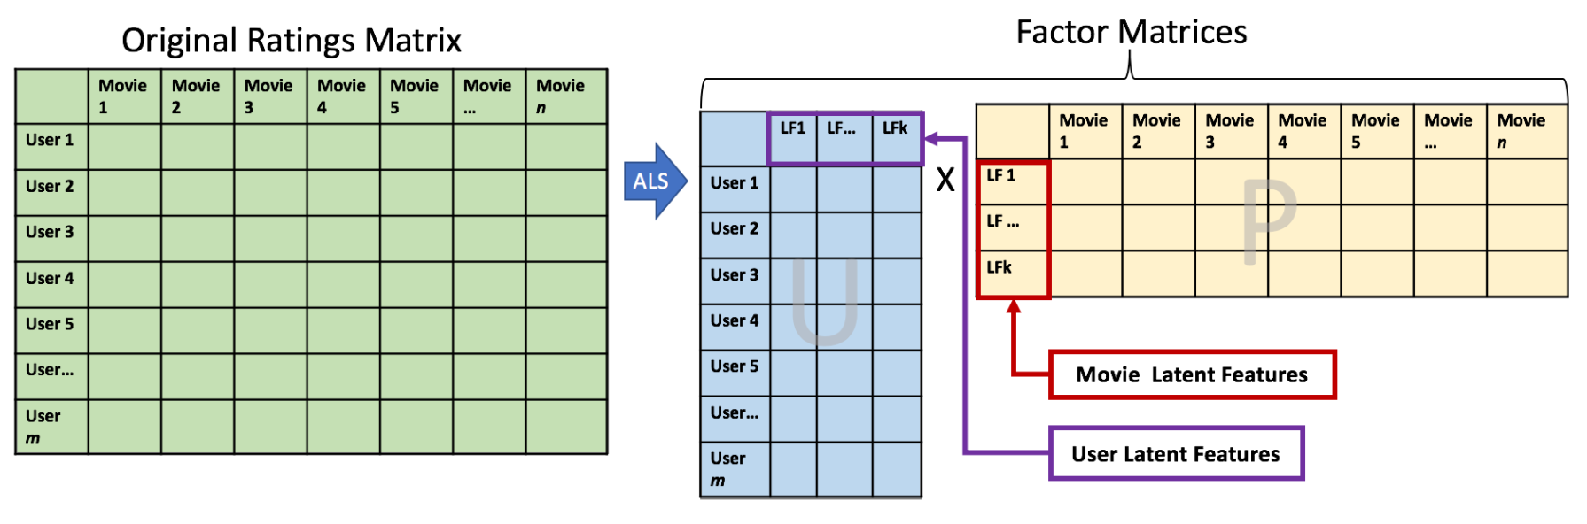
2.2. Collaborative Filtering – Rating Matrix
- Using the SVD matrix factorization algorithm
M
U
I
SVD
≈
k x n
Scikit-surprise package
m x n
m x k
GridSearchCV
Small
Rating
SVD
Model
Predictions &
Recommendations
Optimal algorithm parameters
Full
Rating
Query
e.g., a User ID

Slide 7


2.3. GCP resources
Train model
Storage
bucket
Virtual machine
Request data
Run python scripts to get recommended movies
Return data
Potential Application: API
8vCPU, 64 GB, Windows Server
Deployed Python code
Auto-scaling, security
99.9% uptime

Slide 8
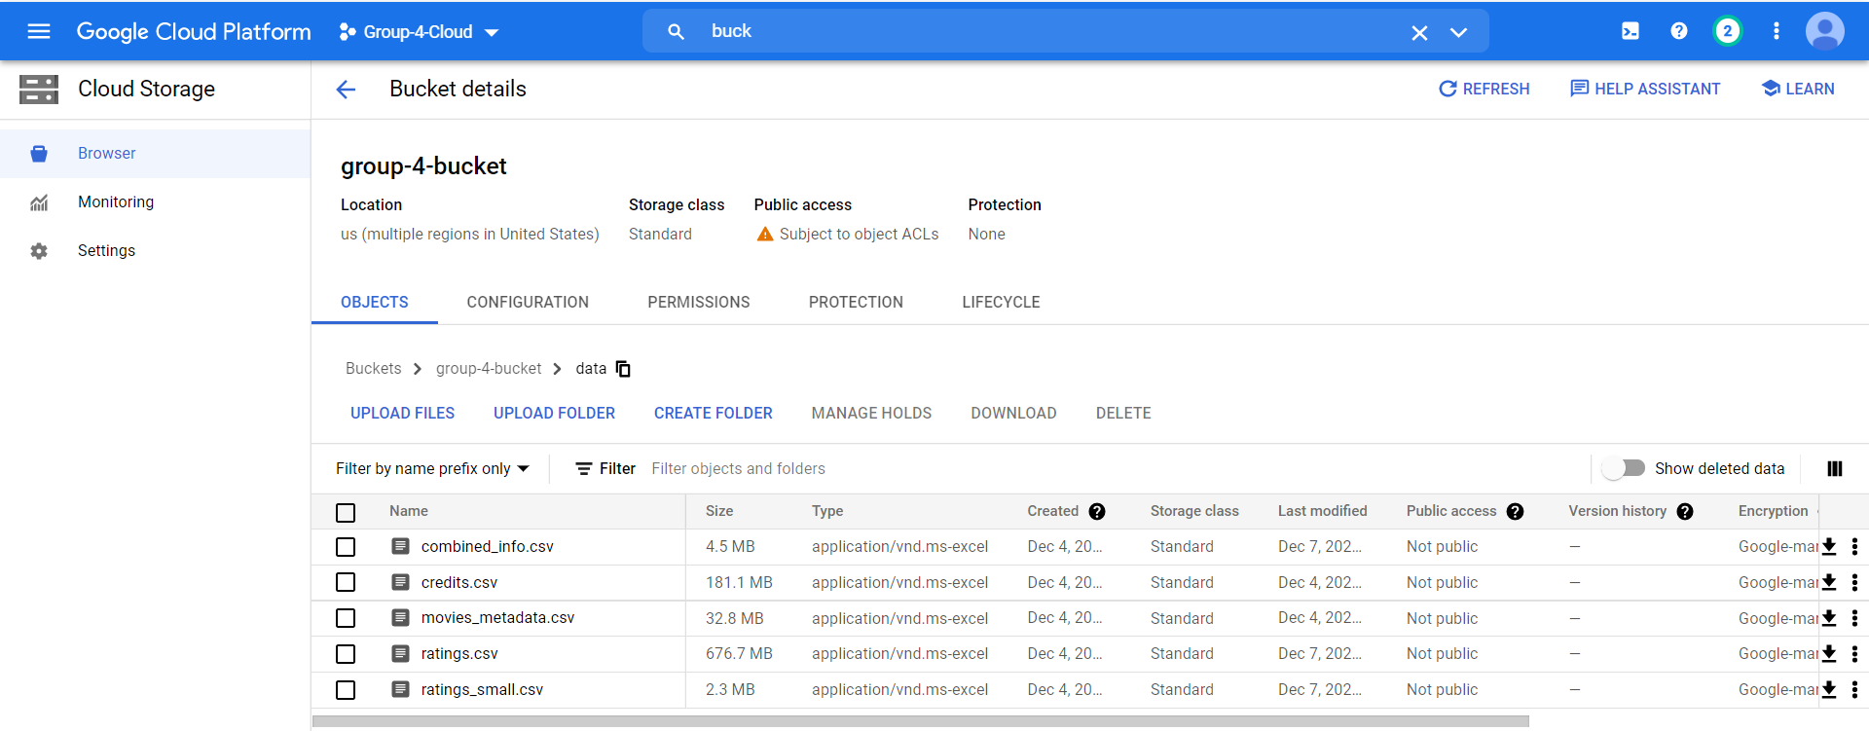
3. Project Interface

Slide 9
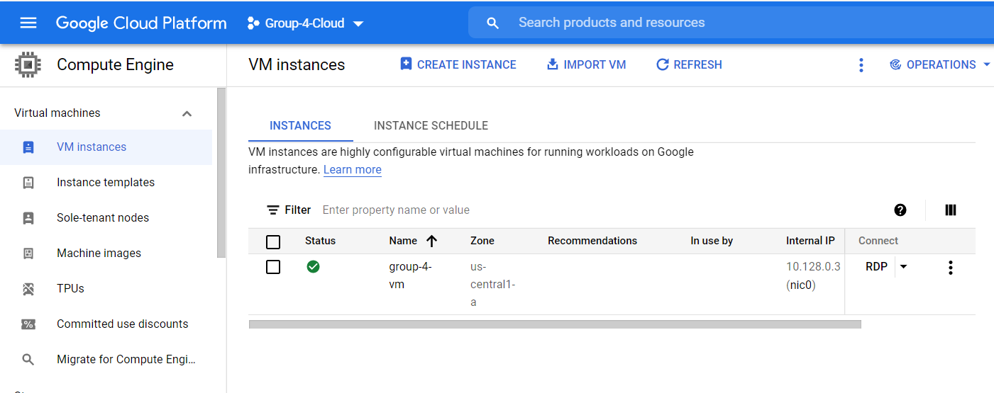
3. Project Interface

Slide 10
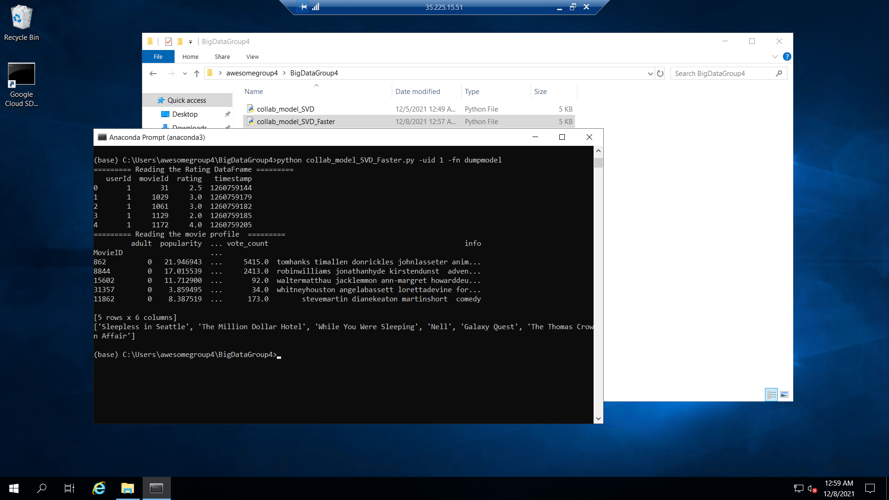
3. Project Interface

Slide 11
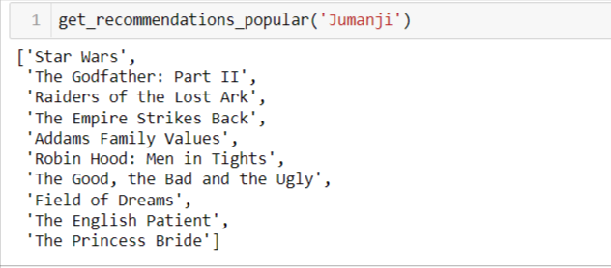
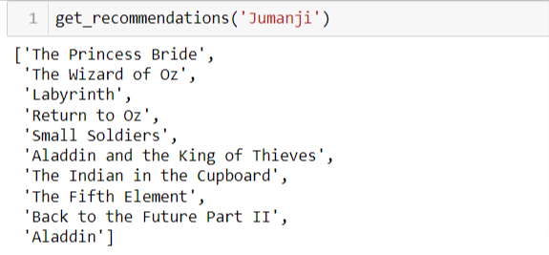
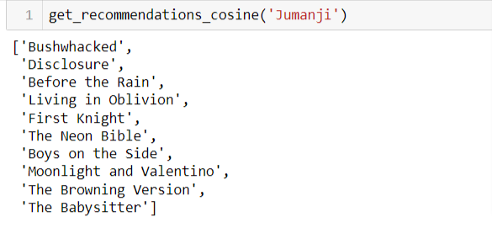
4. Results
LSH cosine
4.1 Contend-based filtering recommendations
Using a sample
Cosine similarity

Slide 12
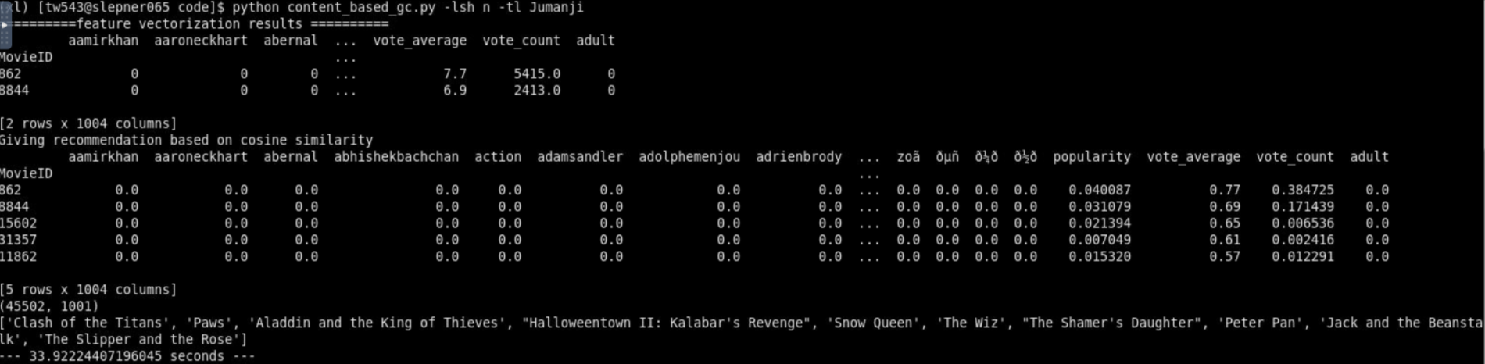
Using the full dataset
Cosine similarity

Slide 13
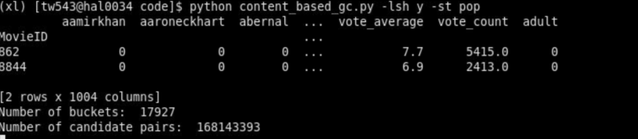
Pitfalls of LSH
Forming candidate pairs of movies in the same bucket are time-consuming for very large dataset.
Find the buckets a movie falls in and search candidate pairs is complex, an item can fall into many buckets (the number of bands used in LSH)

Slide 14
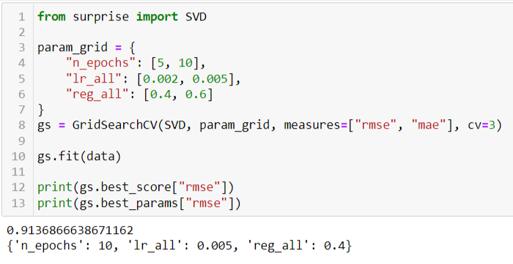
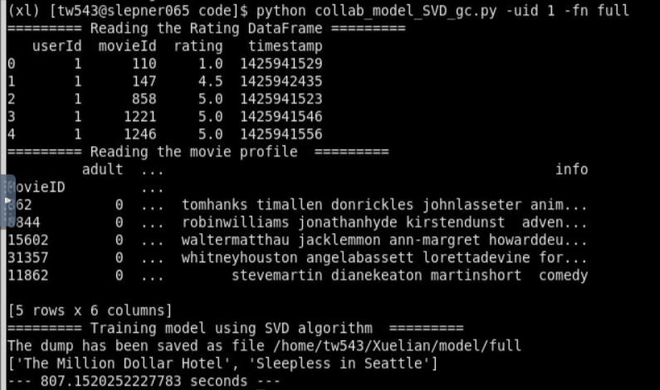
4.2 Collaborative filtering recommendations
Finding optimal parameter using GridSearchCV and small rating dataset
Training model for full rating dataset

Slide 15
4.3 Comparison of Content-based & Collaborative filtering
Our project includes both Collaborative filtering and Content-based filtering. Each of them has their own advantages in some situations. Most of the modern recommender systems combine both of these approaches to make a robust hybrid recommender.
The greatest advantage of Collaborative Filtering is that it does not suffer from cold start problems because the features are based on the characteristics of the data. But the model has limited ability to expand on the user’s existing interests.
On the other hand, Collaborative Filtering has an advantage over the quality of recommendation results because the model can help users discover new interests. However, it suffers from cold-start problem because it requires the data from the users.
So, the best approach is to combine both these methods. However, we have implemented it separately because of huge size of the dataset which greatly eliminates the cold-start problem in Collaborative filtering.

Slide 16
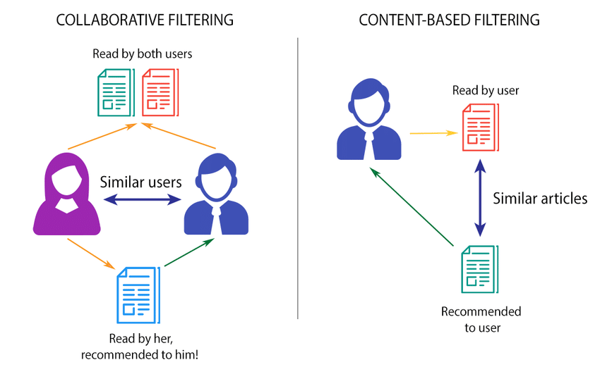


Slide 17

Thank you
https://github.com/duyendoan/BigDataAlgGroup4

