Slide 1
Clothes Store Information Management System

Slide 2
Group 1: - Lê Duy - Phạm Ngọc Mai Lâm - Đào Trọng Lê Thái - Phạm Tuấn Thành - Phạm Chí Trung

Slide 3
Contents
1. Introduction
2. Structure
3. Demo
4. Conclusion

Slide 4
1. Introduction
Description
- Software used to manage clothing store data:
+ Customers information
+ Employees information
+ Items
+ Transaction history

Slide 5
1. Introduction
Reason
The amount of data is too large

Slide 6
2. Structure
▲
Packages:
+ Model: data storage classes
+ View: GUI classes
+ Controller: classes that work with databases

Slide 7
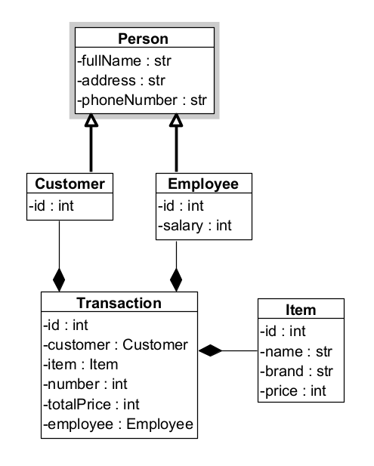
2. Structure
Model:

Slide 8
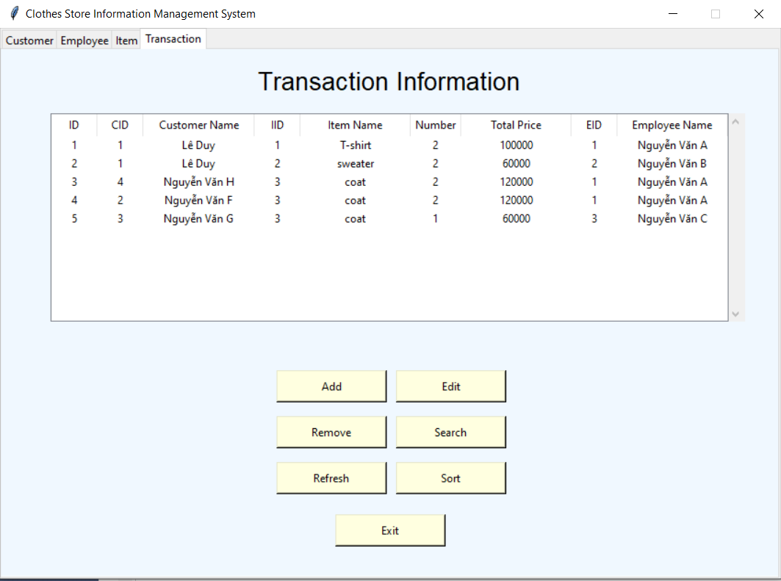
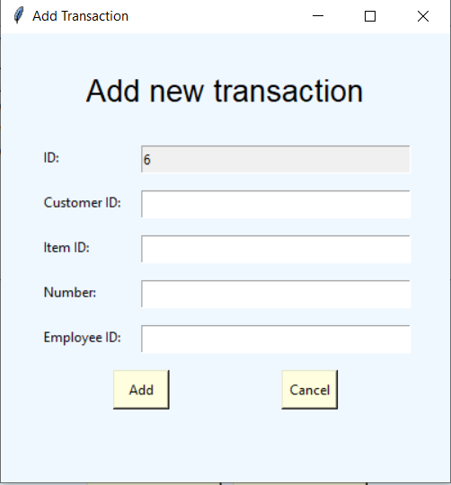
2. Structure
View:
Dialog
HomeFrm

Slide 9
2. Structure
Controller:
SQLConnection

Slide 10
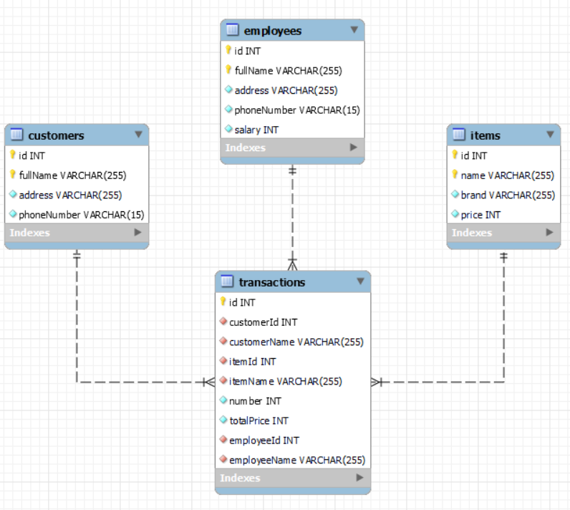
2. Structure
Database diagram:

Slide 11
3. Demo

Slide 12
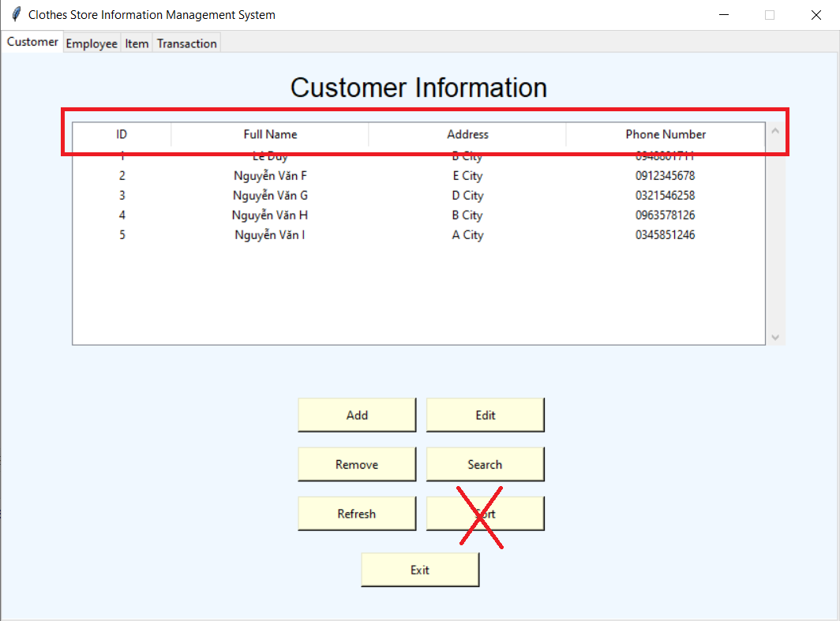

4. Conclusion
This program is not completed yet
Input match
Bad design

Slide 13
Thank you for listening

