Slide 1



Final Project
View in Power BI
Cansu Kartal 211005025
Duygu Hilal Çetin 211005002
Ayşe Melek Uzun 211005036
Beyzanur Kanbay 211005053

Slide 2
Objective Goals
1)We had 4 tables named sales, orders, customers and product. Our main goal was to establish relationships between these tables with primary keys and foreign keys.
2)Later, we added the columns requested from us to the tables and made data edits.
3) We have written formulas in the dax section to create these new columns.
4) Finally, we created a dashboard by visualizing these tables we created.

Slide 3
Project Questions
Calculating Total Sales Amount:
Determining the total revenue from sales is crucial for evaluating business performance
Calculating Profit Margin:
Profit margin determines how much profit the business makes from each sale and is critical for measuring financial performance.
Calculating Order Processing Time:
Order processing time is important for evaluating customer satisfaction and the effectiveness of logistical processes.
Categorizing Customers by Order Frequency:
Understanding customer behavior and increasing loyalty are important.
Identifying High-Value Customers:
Identifying high-value customers helps better understand the customer base and focus on valuable customers.

Slide 4
Project Questions
Calculating Discounted Price:
Offering discounted prices is a common strategy to attract customers and boost sales.
Determining Seasonality:
Recognizing seasonal trends is crucial for inventory management, marketing strategies, and revenue forecasting.
Calculating Product Profitability:
Product profitability analysis helps understand which products yield higher profits and which ones may be less profitable.
Calculating Average Order Value:
Determining the average order value helps understand customer spending habits and optimize marketing strategies.
Identifying Best-Selling Products:
Identifying top-selling products helps understand demand trends and optimize inventory management

Slide 5
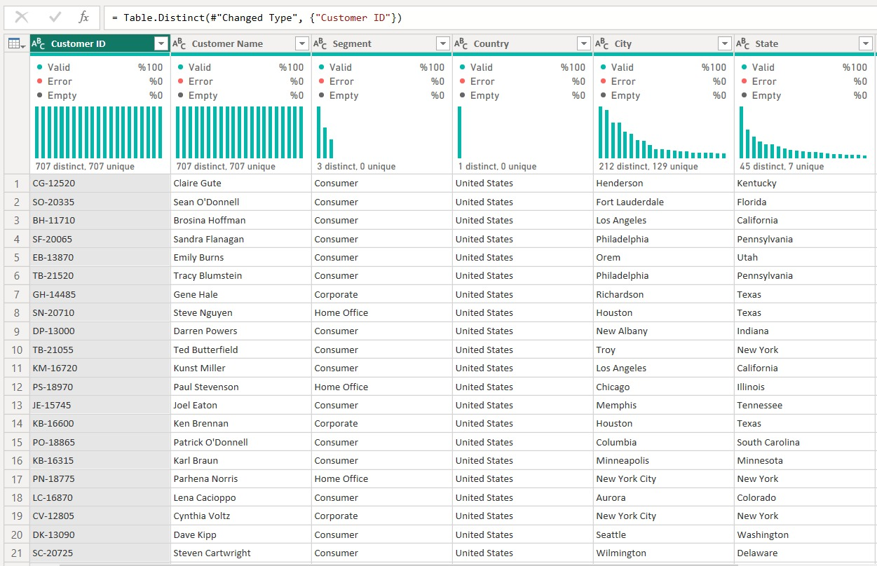
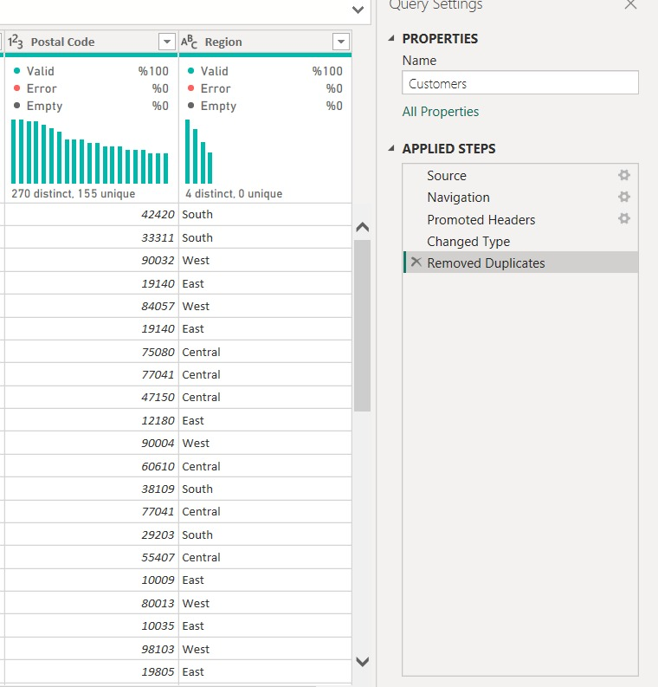
Visualizations
Customers Table

Slide 6
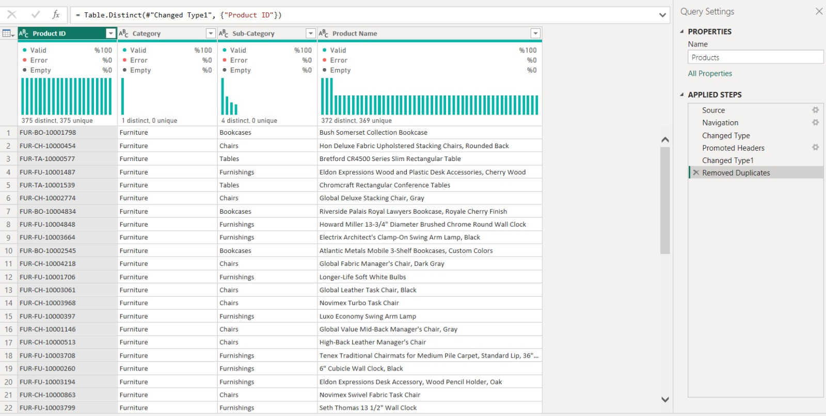
Visualizations
Products Table

Slide 7
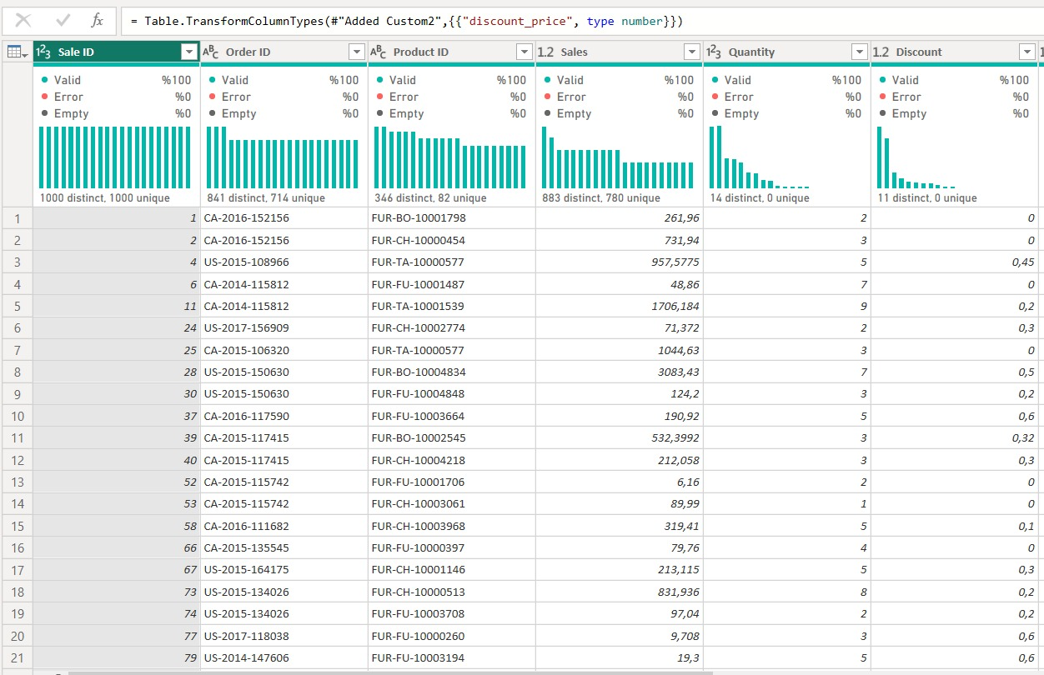
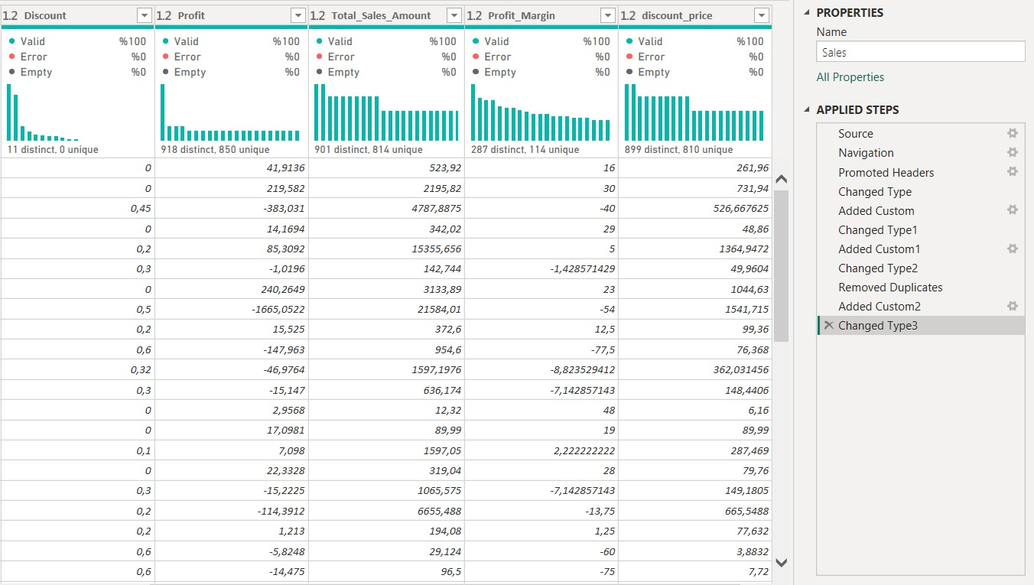
Visualizations
Sales Table

Slide 8
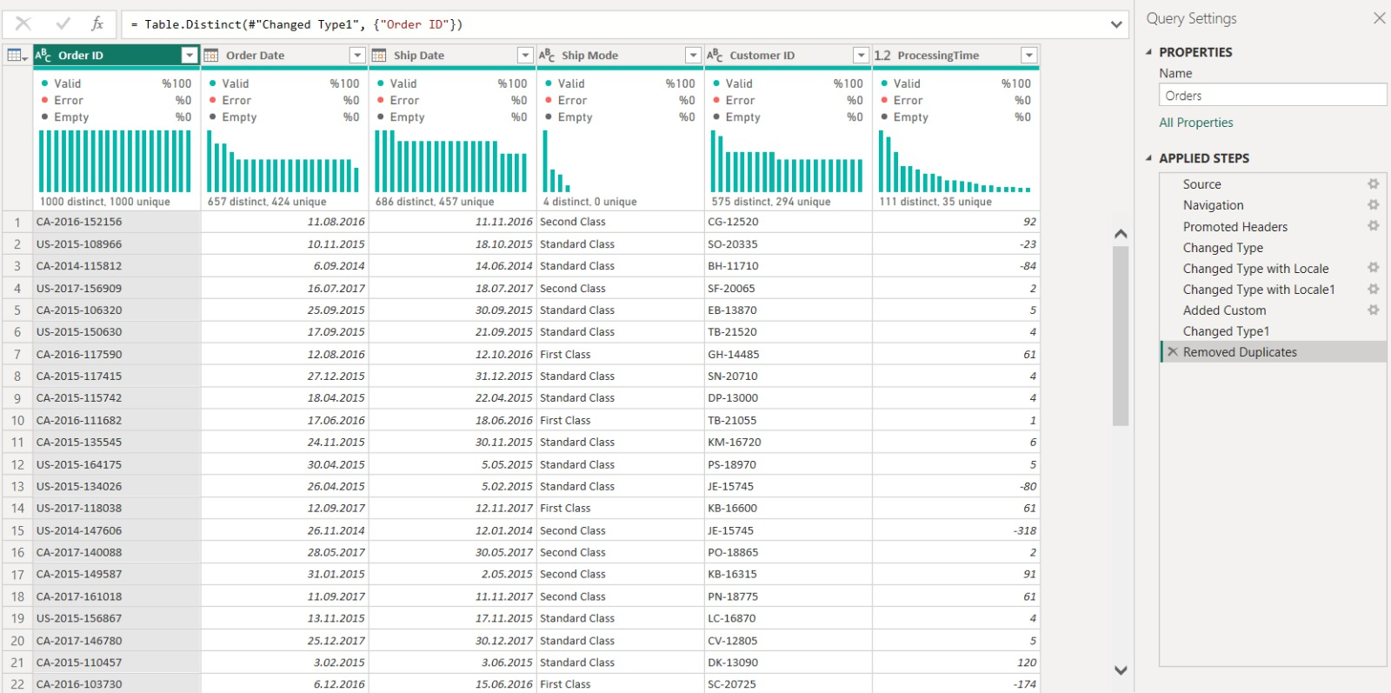
Visualizations
Orders Table

Slide 9
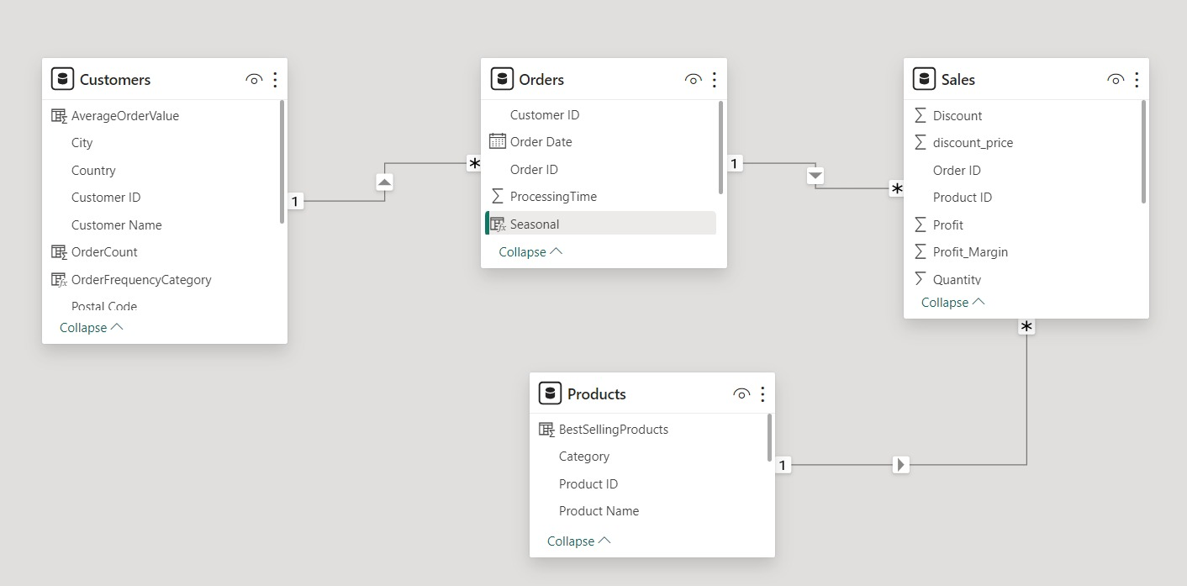
Visualizations
Relationship Table

Slide 10
Data Analysis
Sales decrease in the summer months and increase in the spring months.
The "Chairs" category was determined as the best-selling product category, and it was determined that customers showed more interest in these products.
The "Consumer" customer segment was determined as the customer segment with the highest value for the company. It was observed that customers in this segment generally made purchases of higher amounts and contributed significantly to the company's revenues.
According to the data analysis results, when the company's profit margin trend was examined, it was determined that the highest profit margin was in the "fall" season. This finding shows that the company earned higher profits in the autumn season and its business performance increased during this period. The company's ability to better adapt its sales strategies and inventory management to this season's demand could present a potential opportunity to increase profit margins.
According to the results of the profitability analysis, it was determined that the company's most profitable product categories were "chairs" and "furnishings". This finding suggests that these product categories are particularly profitable for the company and generate significant profits. It may be important for the company to develop strategies to increase profitability by focusing on these product categories and further promote the sales of these products.

Slide 11
Conclusion
In light of these findings, it can be recommended that the company adjust its sales strategies according to seasonal trends, focus on profitable product categories, and strengthen customer relations by offering special services to the most valuable customer segments. Implementing these steps can improve the company's performance and strengthen its competitive advantage.

Slide 12
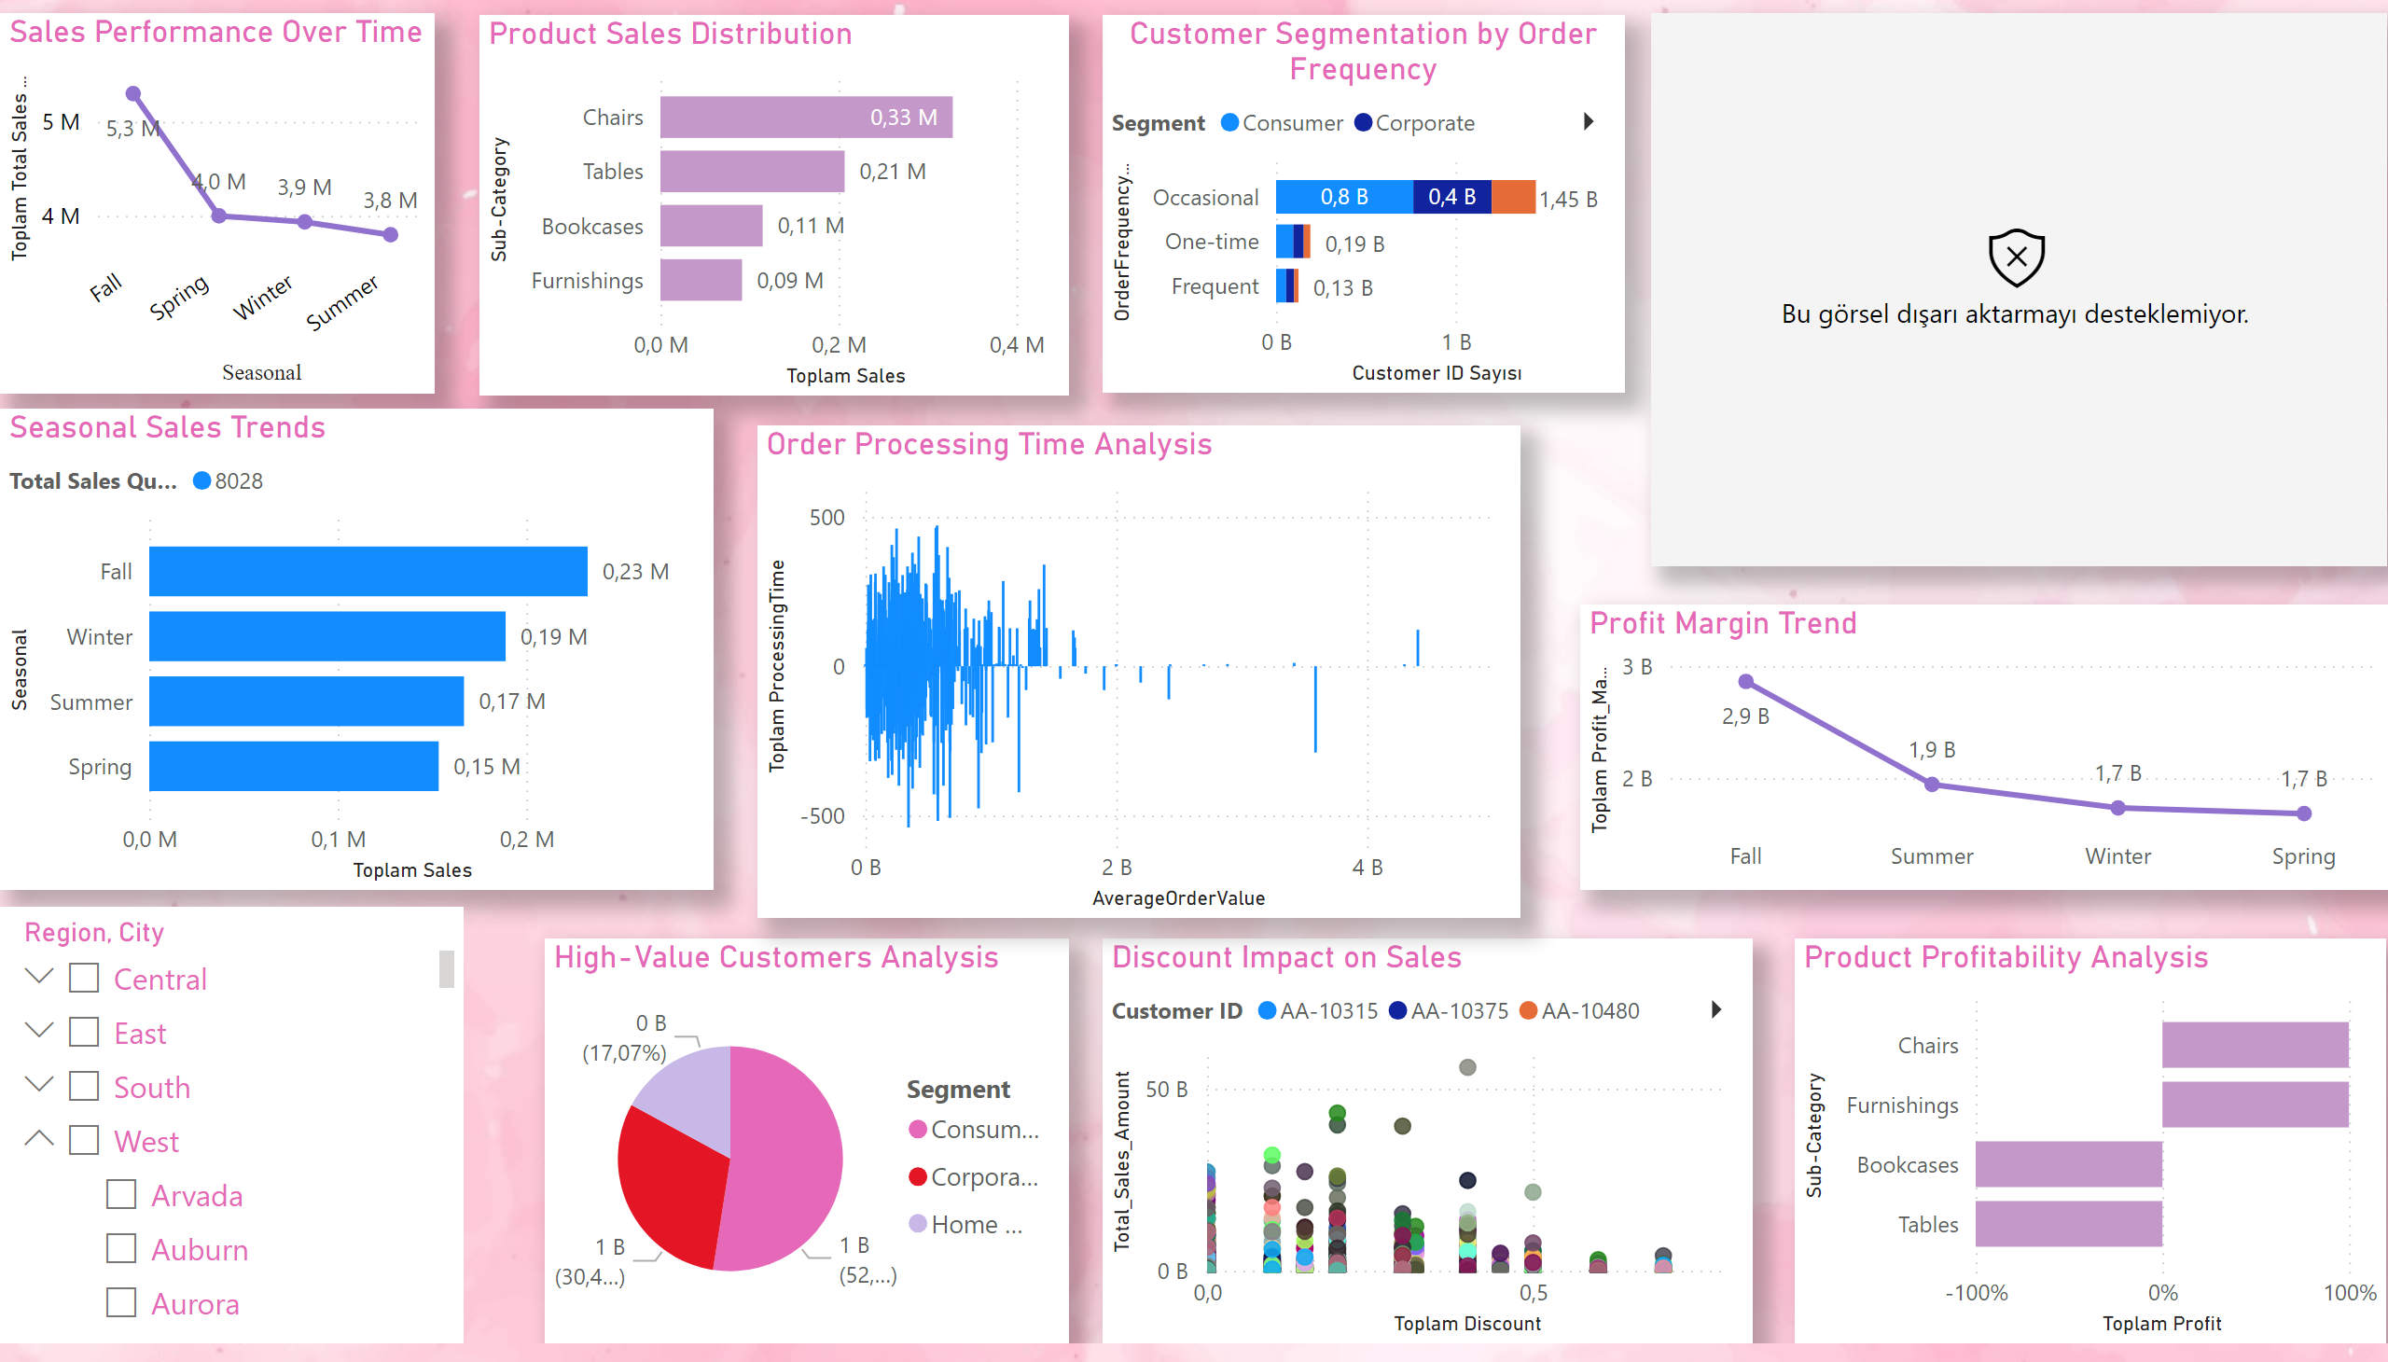
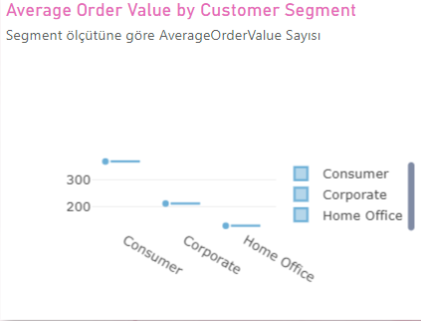
Page 1
Notes:
Sales Performance Over Time
No alt text provided
Profit Margin Trend
No alt text provided
Customer Segmentation by Order Frequency
No alt text provided
High-Value Customers Analysis
No alt text provided
Product Sales Distribution
No alt text provided
Seasonal Sales Trends
No alt text provided
Discount Impact on Sales
No alt text provided
Product Profitability Analysis
No alt text provided
Average Order Value by Customer Segment
No alt text provided
Order Processing Time Analysis
No alt text provided
slicer
No alt text provided

