Slide 1
NIGTH JUNGLE
Elif Duygu PETENKAYA
Elif Berna KURU
Melike ERDEMİR
Çağatay YALÇIN

Slide 2
Overview
Night Jungle is an application that provides its users to find the appropriate entartainment facility.The project based on a mobile application in Android platform and developed in Flutter..There are two types of registiration as customer and venue.
The customer interface has the following properties; reservation, event checking, online payment.
The venue interface has the folowing properties; event add/drop, photo sharing, online payment, campaign sharing, reservation admit/remove. Venue interface will be used by venue owner, business manager and accountant.

Slide 3
Functional Requirements
The system should show information about the venue likewise menu, location, concept, campaigns and contact details.
The system should allow to user booking and paying.
The system should share the comments about the venue that are provided by the users.
The system should provide an event calendar on the main page.
The system should have two types of registration as venue owner and user.
The system should allow the user to share photos and videos from the venue.
The system should register users using their name, surname and e-mail information.
The system should register venue owners using tax plate number, business name and business e- mail information.

Slide 4
Non-Functional Requirements
The system should disallow to spam comments.
The system should make the payment with two-step verification.
The system should refresh itself when an event starts and remove the corresponding announcement about that event from the dashboard.
The system should allow the user to change his contacts information whenever it is necessary.
The system should provide to sign up the venue owners via the system.
The system should show the comment owner’s name as X*** Y***.

Slide 5
Stakeholders
Development team
Customers
Venue Staff

Slide 6
Project Staffing
Software Project Manager: He will have the responsibility of planning and scheduling the project, assessing risks, managing the team members, organizing tool selection and etc.
Requirements Engineer: He will be responsible for identifying the stakeholders getting the requirements from the customers, analyzing and documenting the software requirements.
Lead Designer: He is responsible for understanding the business requirements and designing a solution that will meet the business needs. There are many potential solutions that will meet the client’s needs. The designer determines the best approach.
Database Administrator: He is a specialist that models, designs and creates the databases and tables used by a software solution.
Flutter Developer: He is the developer that provides the needed software applications.
Test Administrator: He ensures that the solution meets the business requirements and that it is free of errors and defects.

Slide 7
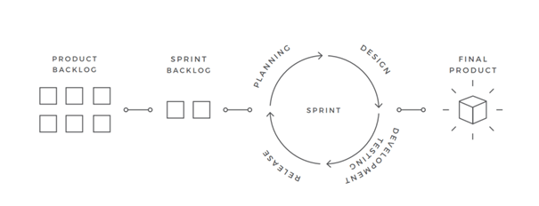
Software Process Model

Slide 8
Scrum Model
The Scrum model suggests that projects progress via a series of sprints. In keeping with an agile methodology, sprints are timeboxed to no more than a month long, most commonly two weeks.
Scrum methodology advocates for a planning meeting at the start of the sprint, where team members figure out how many items they can commit to, and then create a sprint backlog – a list of the tasks to perform during the sprint.
The primary artifact in Scrum development is, of course, the product itself. The Scrum model expects the team to bring the product or system to a potentially shippable state at the end of each Scrum sprint.
The product backlog is another artifact of Scrum. This is the complete list of the functionality that remains to be added to the product. The product owner prioritizes the backlog so the team always works on the most valuable features first.

Slide 9
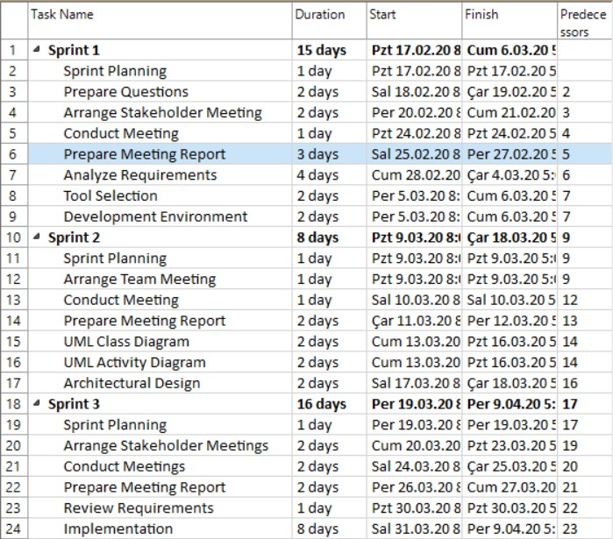
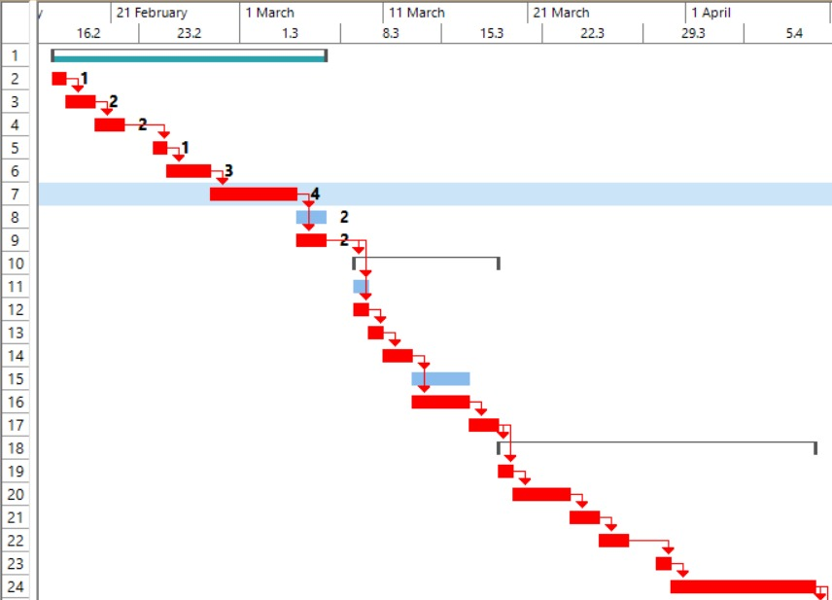
Project Schedule and Effort

Slide 10
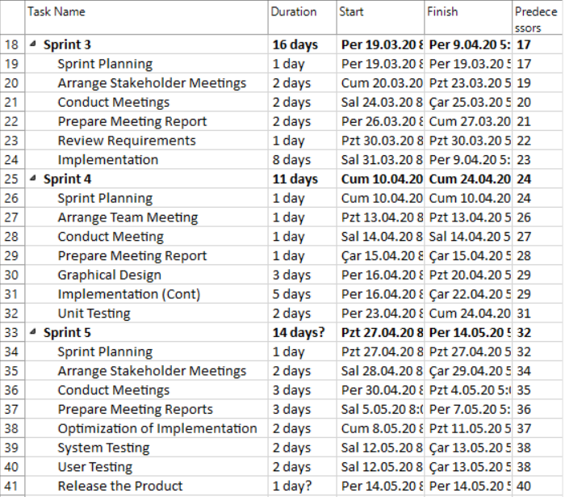
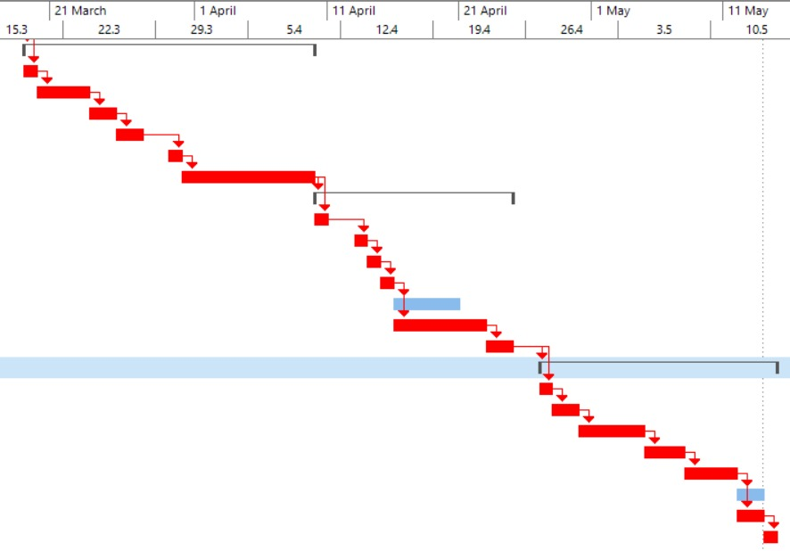

Slide 11
Measurements
Schedule and Effort: This is given in detail at schedule and efforts section already.
Number of Changes: Requirements and some design properties may change during the development process. It is needed to be tracked to measure the quality of the work.
Defect Count: Defects are natural consequences of all projects. Defects should be fixed whenever they are found in the system. The number of these defects will show how robust the system.

Slide 12
Project Risks
LIKELIHOOD RANK | RISK DESCRIPTION
1 | Schedule- the project schedule is too constricted to develop such a project
2 | Design Complexity - the team has little experience with the deployment platform and communication protocol
3 | Requirements Volatility - requirements canbe changed during the development cycle when requested from customer.
4 | Tools - the team must learn about new configuration management tools
5 | Acquisition of Hardware - deployment hardware must be purchased and installed to test the software product
6 | Size Underestimation – the size of the system may be larger than the planned.

Slide 13
IMPACT RANK | RISK DESCRIPTION
1 | Acquisition of Hardware -deployment hardware must be purchased and installed to test the software product
2 | Requirements Volatility - requirements can be changed during the development cycle when requested from customer.
3 | Tools - the team must learn about new configuration management tools
4 | Design Complexity - the team has little experience with the deployment platform and communication protocol
5 | Size Underestimation – the size of the system may be larger than the planned.
6 | Schedule - the project schedule is too constricted to develop such a project

Slide 14
LIKELIHOOD RANK | IMPACT RANK | COMBINED RANK | RISK DESCRIPTION
3 | 2 | 5 | Requirements Volatility - requirements can be changed during the development cycle when requested from customer.
5 | 1 | 6 | Acquisition of Hardware – deployment hardware must be purchased and installed to test the software product.
4 | 2 | 6 | Design Complexity - the team has little experience with the deployment platform and communication protocol.
4 | 3 | 7 | Tools - the team must learn about new configuration management tools.
1 | 6 | 7 | Schedule - the project schedule is too constricted to develop such a project.
6 | 5 | 11 | Size Underestimation – the size of the system may be larger than the planned.

Slide 15
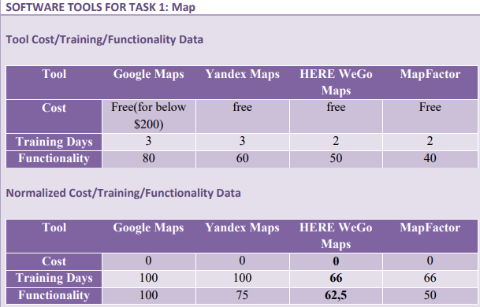
Software Tools
MAP
Tool Cost/Training/Functionality Data
Normalized Tool Cost/Training/Functionality Data

Slide 16
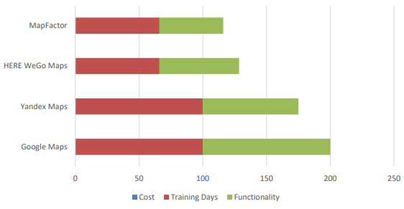
Normalized Tool Graph
The selected tool for map is Google Maps because even all of the options are cost free but Google Maps band widht is larger than the others. Therefore, this functionality can make easier for us to use it, especially on android and web platforms.

Slide 17
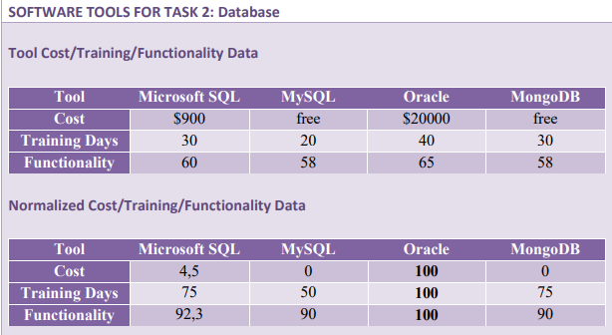
Database
Tool Cost/Training/Functionality Data
Normalized Tool Cost/Training/Functionality Data

Slide 18
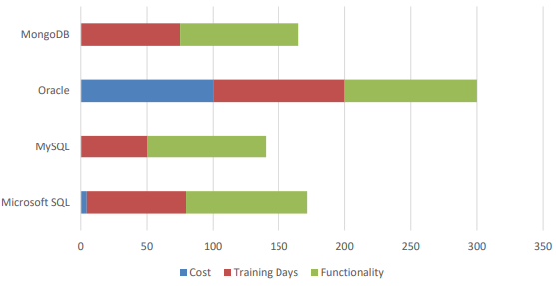
Normalized Tool Graph
The selected tool is MySQL because it is cost free, we dont need to spent money from our limited budget. It has less training days even the functionality are the same with another tool, and this will save us time.

Slide 19
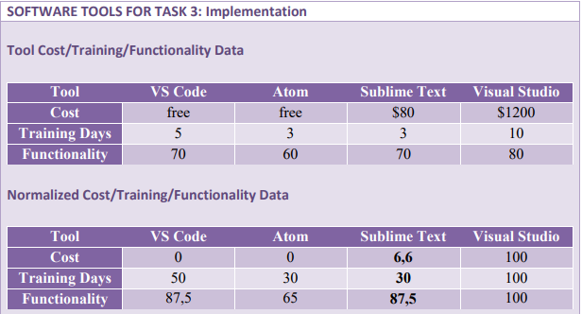
Implementation
Tool Cost/Training/Functionality Data
Normalized Tool Cost/Training/Functionality Data

Slide 20
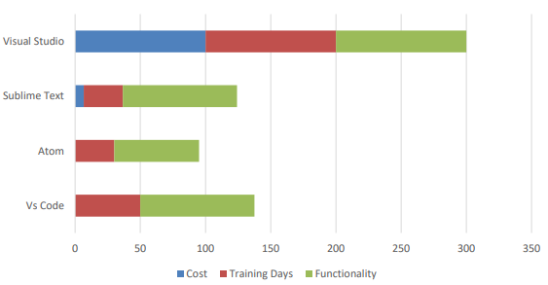
Normalized Tool Graph
The selected tool is VS Code because it is cost free, so we can save money. Also it has highest functionality. Besides, although it is not the tool with the least training days, it will not force us.

Slide 21
Project Needs
Hardware Needs
• Mobile Phone: Since the project is a mobile application, we need an Android mobile phone to implement our codes. Mobile phone should have developer option, at least 4” screen, and Android 4.0.0 and later versions.
• Computer: To implement the project code, we need a computer which has at least i5 model CPU, 13” screen, 8 GB RAM.
• Cash Register
• Pos Device

Slide 22
Software Needs
• Flutter: Since the product is going to be a mobile application, flutter is the best alternative to create it.
• VS Code: To implement flutter, the latest version of VS Code is used.
• MySQL & MySQL Workbench: To keep database information and to work on it, MySQL products have been choosen.
• Mobile Payment API

Slide 23
Support Needs
• Bank’s Technical Staff: For synchronization of pos device in its every update, we need the technical staff from the bank.
• Maintenance Team: The system may give errors and to fix them we provide a maintenance service.
• Configuration Team: To follow up the new versions of tools and to make the system current we need a configuration team.

Slide 24
GRAPHICAL USER INTERFACE

Slide 25
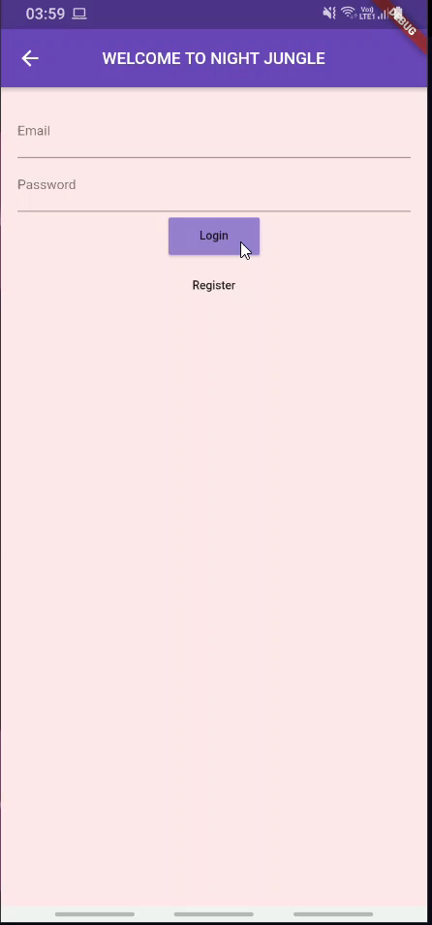

Slide 26
Thank You For Listening
Any Questions?

