Slide 1




Analysis
Report
Duygu Unaldi

Slide 2

Agenda
Festival ’99 (Overview)
Customer: Purchase History
Customer: Repeat Purchase
Customer: Age Distribution
Recommendation

Slide 3



Festival ‘99
433
447
200
YoY -2%
Unique Customers
Festival Attendees
Transactions per Year
49.310
246.6
YoY +7%
Pounds Revenue
Transactions Value

Slide 4
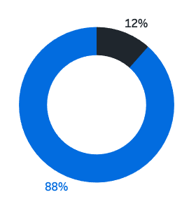



Customer:
Purchase History
What % of the customers purchased both music and festival event tickets?
Festival
Music
Sport
Theatre
Have the customers purchased ticket(s) for another event before this festival?
Which events did the customers purchase ticket(s) for?

Slide 5
Customer:
Purchase History
36%
What % of the customers purchased both music and festival event tickets?
Event vs Event | Festival | Music | Sport | Theatre
Festival | 100% | 36% | 2% | 2%
Music |  | 100% | 3% | 2%
Sport |  |  | 100% | %1
Theatre |  |  |  | 100%
Have the customers purchased ticket(s) for another event before this festival?

Slide 6
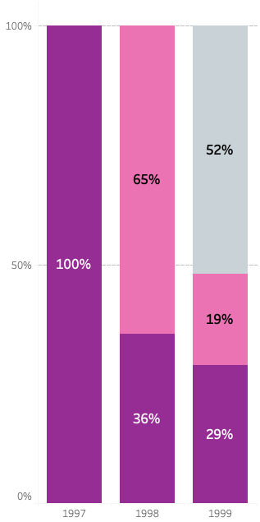
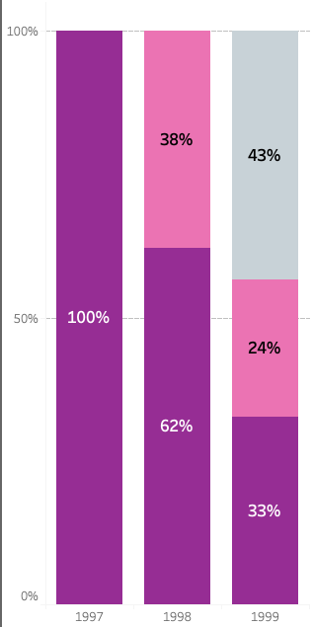

Customer:
Repeat Purchase
+50%
Customer
Revenue
What year did the customers purchase ticket(s) for the first time?
What is the repeat purchase rate?
What is the impact of the repeat customers on revenue?
Repeat Purchase Rate
36%
In 1998
48%
In 1999
+50%

Slide 7
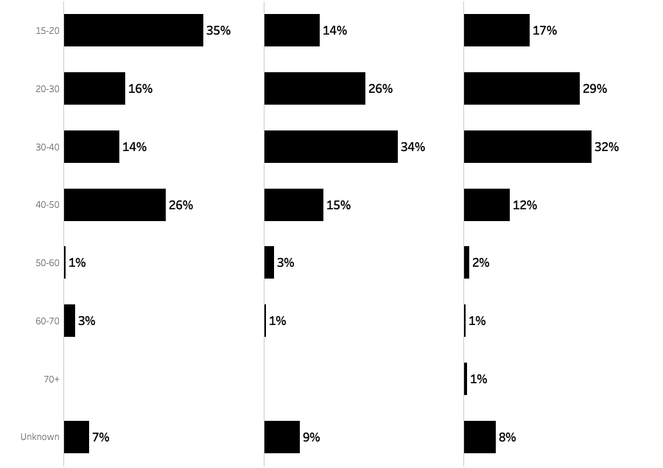
Customer:
Age Distribution
1997
1998
1999
How is the age distribution of the customers who have purchased ticket(s) to the festival?
Has this distribution changed over the years?
What % of the customers,
who had purchased ticket(s) for 1998,
also have purchased ticket(s) next year?

Slide 8
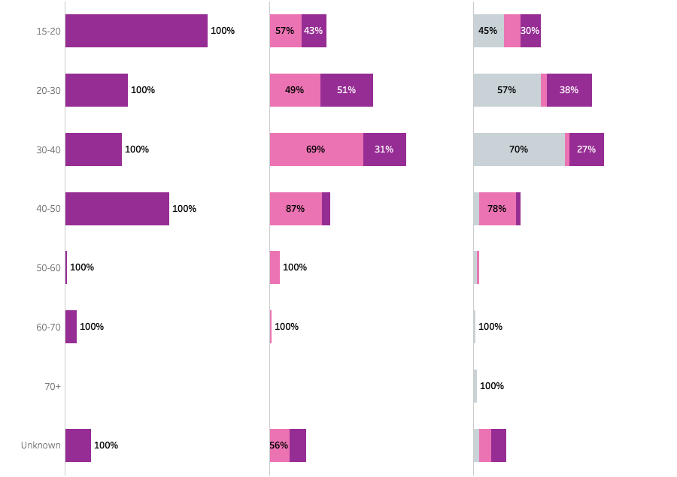
Customer:
Age Distribution
1997
1998
1999
How is the age distribution of the customers who have purchased ticket(s) to the festival?
Has this distribution changed over the years?
What % of the customers,
who had purchased ticket(s) for 1998,
also have purchased ticket(s) next year?

Slide 9
Recommendation
1997
1998
1999
2 Focus Groups
What do they love?
Why didn't they purchase again?
What are the reasons for dissatisfaction?

Slide 10
Recommendation
Effect of change in ticket prices
Ticket type preferences according to the age band of the target audience
For Further Analysis
Why are Daily VIP Tickets under-sold?

Slide 11
Thanks!

