Slide 1
Welcome to My Essay
Presenter : Phạm Đức Duy
Topic : Explore some Design Patterns.
Class: 66IT5

Slide 2
Catalogue
Chapter 1 : Overview about Design Patterns
Definition and History
Characterists & Structure of a DP
Types of Design Patterns
Pros and Cons
Issues when learning
Chapter 2 : Code Example
Implement of Factory and MVC
Link of some references

Slide 3
Chapter 1
1. Definition and History
- First, let back to the past, when programming is only inceptive structure. Our forerunners in the profession has developed many typical app, in many language several time.
They meet the same problem, follow a conception and work in the same solution.
Noone make it more standardized and public it, or make it more 'easy-access' for other developers and juniors.

Slide 4
Result: the software development process became longer, caused many negative impacts
Consuming a lot of time, effort and money of customers, reducing the credibility of the business.
Decreasing the product lifespan.
Easy lead to potential vulnerabilities or overlooked issues.
Make difficulties in maintaining and upgrading the project in the future.
Causing challenges for developers to unify common conventions.
Libraries and frameworks appeared, supported much for making faster software development process. But... they don't help us structure our own applications in ways that are easier to understand, more maintainable and flexible. That’s where Design Patterns come in.

Slide 5
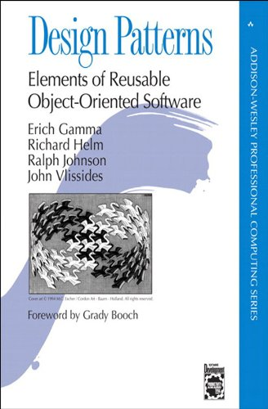
Books : Design Patterns: Elements Of Reusable Object-Oriented Software
In 1995, there are 4 senior developers who aggregate and write to this book - one of the "bible" of many software developer over time (The authors is call `"Gang of Four"` - aka “GoF”).
23 "forms" to solve certain problems in OOP
languages.
Encouraged the software engineers should
study and structure the product in a more
effective way.
Get supported from the language’s corporation.

Slide 6
Definition :
In software engineering, a design pattern is a general repeatable solution to a commonly occurring problem in software design. It offer a best practice approach to support object-oriented software design, which is easier to design, implement, change, test and reuse.
- Wikipedia -

Slide 7
Chapter 1
2. Characterist & Structure of a DP
- Like data structures and algorithms, it isn't in a special programming language.
- Each design patterns just is the pattern for one or some problem which it can solve effectively, in both conception and implementation.
- Structure of a Design Pattern :
+ Problem : "What's it solve?"
+ UML : "How's it solve?"
+ Code example : "How to implement it?"

Slide 8
Chapter 1
3. Types of Design Patterns
Creational Patterns : Singleton, Factory Method, Abtract Factory, Builder, Prototype
Structural Patterns : Adapter, Facade, Decorator, Flyweight, Proxy, Composite, Bridge
Behavior Patterns : Interpreter, Template Method, Chain of Responsibility, Command, Iterator, Mediator, Memento, Observer, Stategy, State, Visitor
Architect/Structture Pattern : MVC, MVP, MVVM, ...

Slide 9
Chapter 1
4. Pros and Cons
a, Advantage :
Solve the problem you meet effectively
Improve your code’s readability, maintainability and reusability
Less errors and less costing time for test
Better communitcation
If used well, DP can speed up your development process and reduce the chance of errors.

Slide 10
b, Disadvantages :
Target wrong problem.
Require extensive knowledge.
Limit creativity and power of programming language.
Lack of formal foundations.
Differ unsignificantly from other abstractions.

Slide 11
Chapter 1
5. Issues when learning
Learn quickly, learrn fast, not learn deep
Show off coding skill by using so many design patterns into a project.
Design patterns are created to solve the complex problem, not to make the problem more complex.

Slide 12
Chapter 2
1. Implement of Factory , MVC :
a, Factory Pattern - return one object as your requirement :
Definition :
Factory (or Factory Method) is a creational design pattern that Define an interface for creating an object, but let subclasses decide which class to instantiate. Factory Method lets a class defer instantiation to subclasses.

Slide 13
Which’s problem it solve?
- In creational patterns group
It provide a flexible way to initiantiate a object without keyword “new”.
- It help your code become more flexible, readable and easy to maintain - which is need in the “microservice” trending now.
For understand , try my example in setup a CoffeeShop :

Slide 14
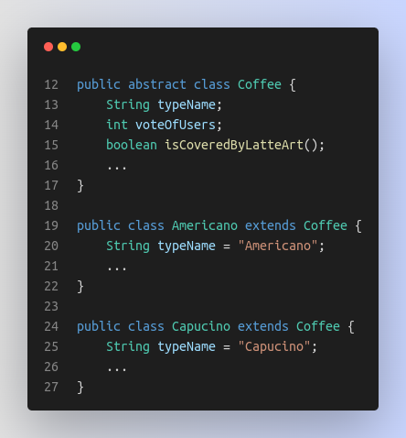
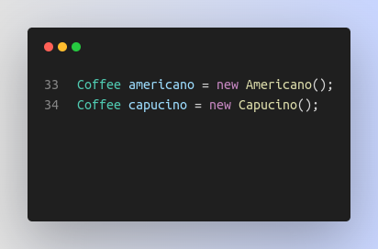

Slide 15
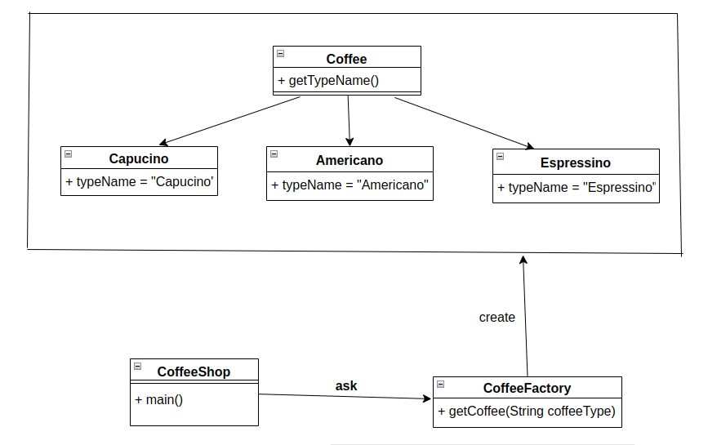
But, your sir want to add Espressino.
How to extend? Now you need Factory Pattern.
UML

Slide 16
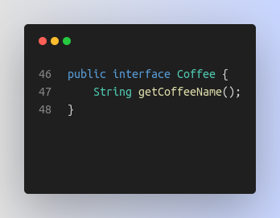
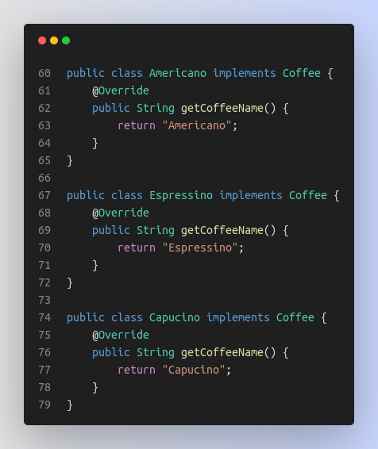
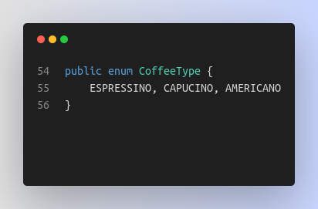

Slide 17
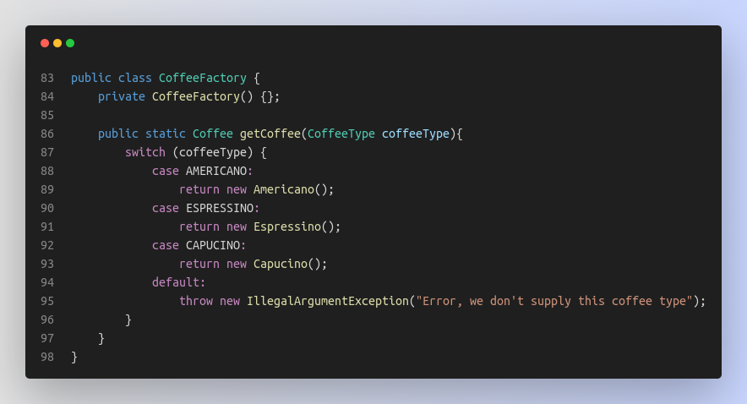

Slide 18
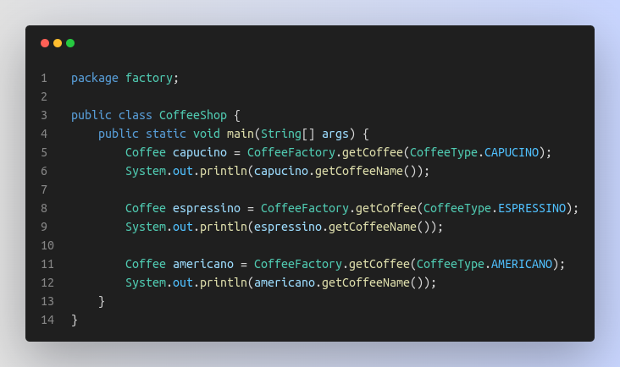

Result

Slide 19
Where should I use it?
Reduce dependability among modules (loose coupling)
Create a "easy-to-scale" and hide-logic application.
Manage life cycle of objects created by Factory.
Follow “naming convention” easier in team.
Where used it?
JDK : util.Calendar, NumberFormat,...
BeanFactory in Spring Framework, SessionFactory in Hibernate
Refinement of it : Dependency Injection (Spring, .Net, Django, ...)

Slide 20
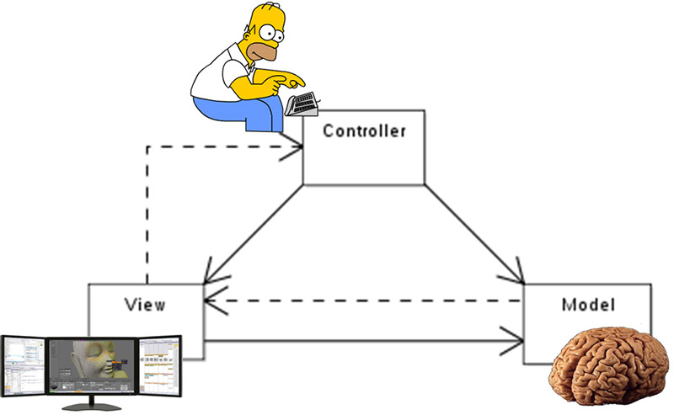
b, MVC - the “legendary” architectural pattern
- DEF : Model-View-Controller is a software architecture pattern for creating user interfaces on computers.
- Advantage :
+ Faster development, easy reuse/maintain/testing
+ Maxium usage of Server, framework
+ Support SEO
- Disadvantage :
+ Durable maintaince (Controller)
+ Tight coupling (View-Controller)
+ Product’s life cycle in small prjoject
+ Know multii technologies

Slide 21
Code example :
https://github.com/duyhelloworld/java-learning/tree/main/DesignPatterns/mvc
2. Link some references :
- https://gpcoder.com/4164-gioi-thieu-design-patterns/
- https://www.red-gate.com/simple-talk/blogs/why-following-design-patterns-is-a-bad-idea/
- https://sourcemaking.com/design_patterns
- https://github.com/ajitpal/BookBank (Head First Design Pattern)

Slide 22


Thank you for listening!

