Slide 1

PRJ301 VnFlight Java Web
Subject: Java Web
Class: SE1753
Group: 1

Slide 2

Team Presentation
Nguyễn Hưng Hải JOB TITLE
SE173100
Nguyễn Thanh Duy JOB TITLE
SE173204
Nguyễn Bá Huy Leader
SE173020
Lê Trung Đức JOB TITLE
SE173043

Slide 3

What is VnFlight?
1

Slide 4

A website that provides the service for booking domestic flight tickets.

Slide 5
Functions
2

Slide 6
Two Roles for login
User
Manage their accounts.
Search flights.
Book ticket for one or many passenger and select their seats.
Add flight to cart or purchase immediately.
View their booking history and decide to purchase saved ticket.
Admin
Manage flights, users, invoices:
View
Sort and filter
Calculate Revenue
Add
Edit
Delete

Slide 7
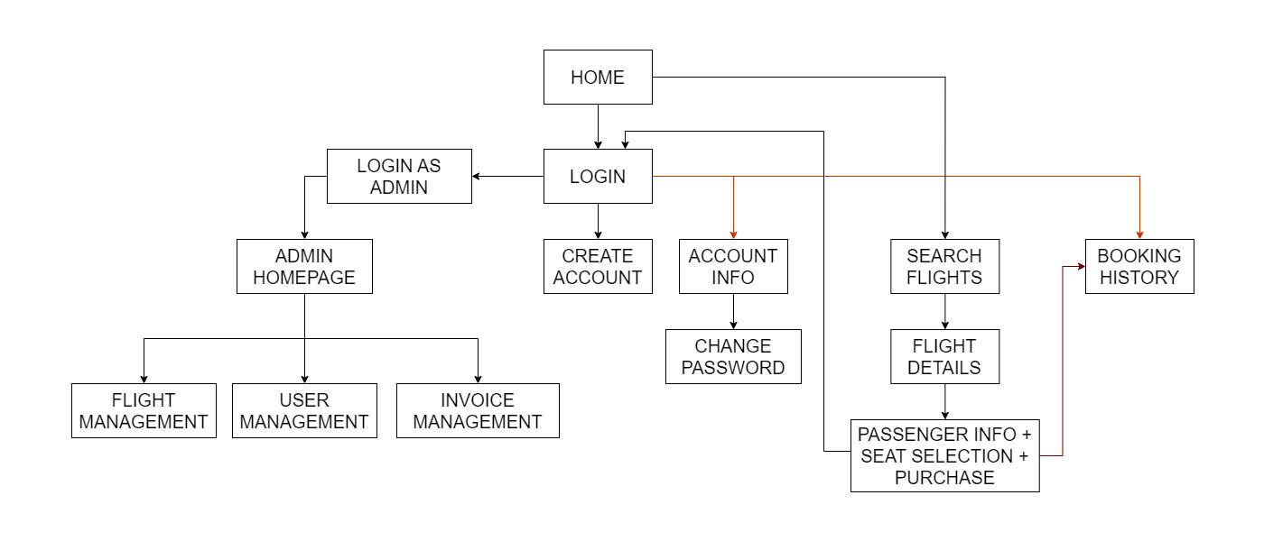
Site Map

Slide 8
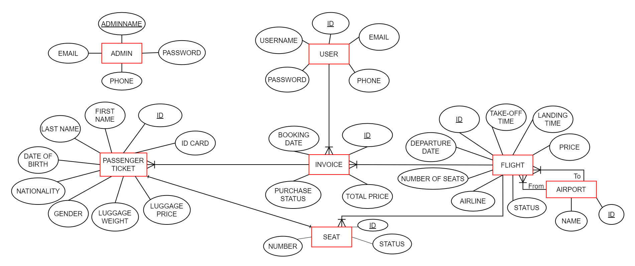
Entity Relation Diagram (ERD)

Slide 9
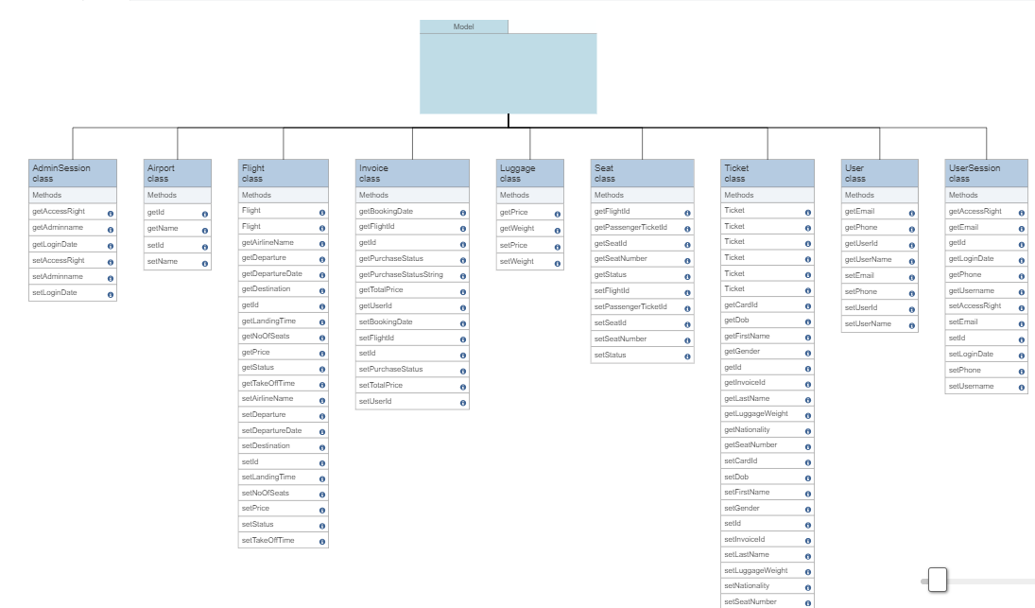
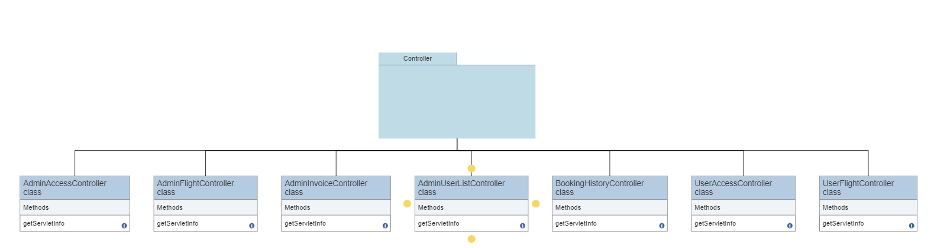
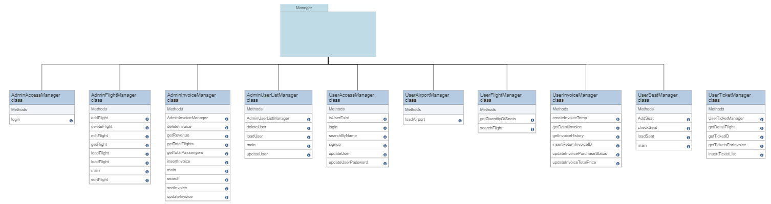

System Design

Slide 10

Visualize VnFlight
Now let’s look at the real web page!

Slide 11

Conclusion
Project organization
Teamwork
Github
Booking ticket management
Seat selection process
Generate invoices for customers
1
4
User experience design
Create user-friendly interface
Enhance the overall user experience
2
3
Database management and handle volumes of data
MVC2 model
Connect database using JDBC and manage data using SQL.

Slide 12

Thank you for your listening !
Q&A
I am Jayden Smith
I am here because I love to give presentations.
You can find me at @username

Slide 13




Team Presentation
Nguyễn Hưng Hải JOB TITLE
SE173100
Nguyễn Thanh Duy JOB TITLE
SE173204
Nguyễn Bá Huy Leader
SE173020
Lê Trung Đức JOB TITLE
SE173043

