Slide 1
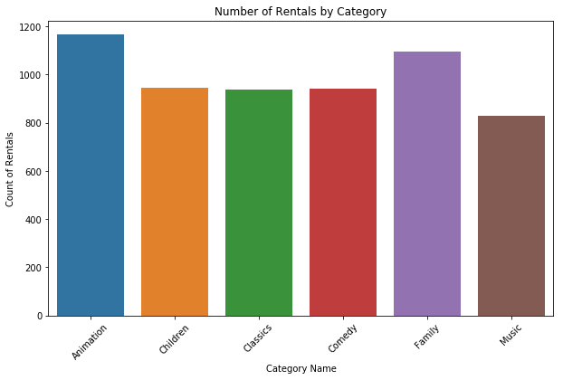
1. What are the movies that families watching?
The Animation category also sees a significant number of rentals, suggesting strong interest in animated films for family entertainment

Slide 2
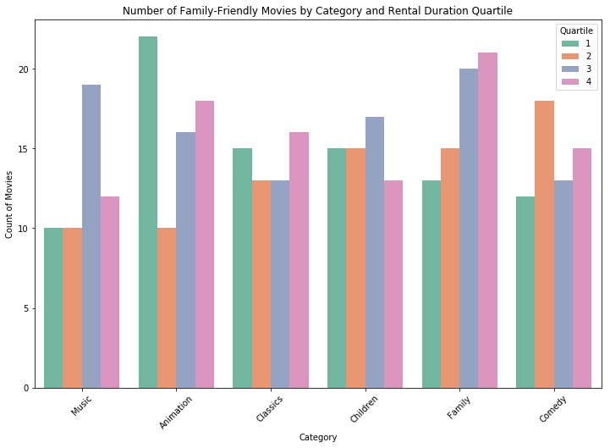
2. Can you provide a table with the movie titles and divide them into 4 levels (first_quarter, second_quarter, third_quarter, and final_quarter) based on the quartiles (25%, 50%, 75%) of the average rental duration(in the number of days) for movies across all categories?
The bar plot demonstrates that family-friendly movies are distributed across all four quartiles of rental duration. However, there is a noticeable concentration of films in the first and fourth quartiles, suggesting that these movies are either rented for very short or very long durations, with fewer movies falling in the mid-range quartiles. This distribution indicates diverse viewing habits for family-friendly movies, where some are rented frequently for shorter periods, while others maintain longer rental durations.

Slide 3
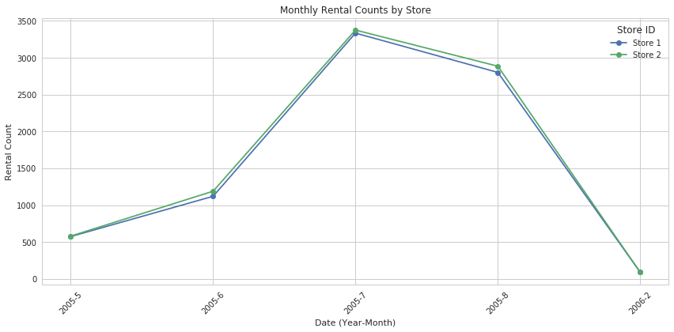
3. How do the two stores compare in their count of rental orders for each month across all available years in the dataset?
The chart indicates that both Store 1 and Store 2 had their highest rental counts in July 2005, with a marked decline in rentals during early 2006. Despite some fluctuations, the overall rental trends are quite similar for both stores.

Slide 4
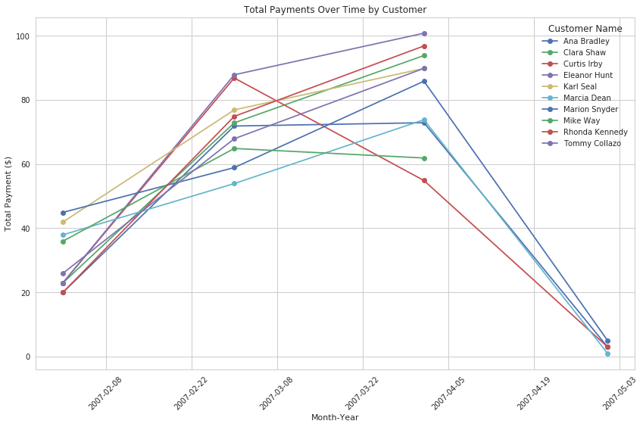
4. What are the customer names, the month and year of payment, and the total payment amount for each month for the top 10 paying customers?
The visualization of total payments over time for each customer reveals distinct spending patterns across the customer base. For instance, some customers, like Eleanor Hunt, demonstrate a consistent increase in total payments over the observed months, reflecting a steady rise in expenditure. Conversely, others, such as Marcia Dean, exhibit more fluctuation in their payments, with noticeable drops and peaks. Overall, the plot highlights varying payment behaviors, which could be valuable for identifying key customer trends and tailoring financial strategies accordingly

