Slide 1
Project Report Web programming – Team 3

Slide 2
Introduction
Notes:
In today world, there a lot of events or parties for people to participate. In order to organize that we decide to make an event management application.

Slide 3





Our process is easy:
Define Request
Testing
Publish
Design DB/UI/Class
Implement/ Coding

Slide 4
Define Request
1
Let’s start with the first set of slides

Slide 5
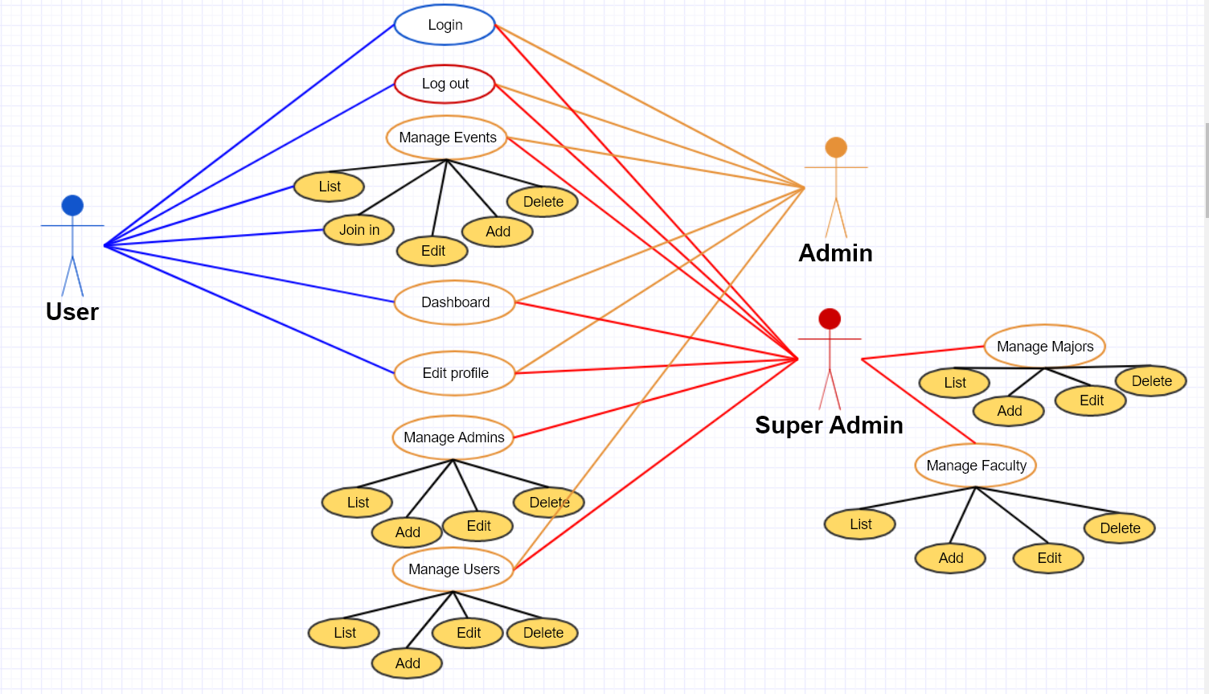
UseCase

Slide 6
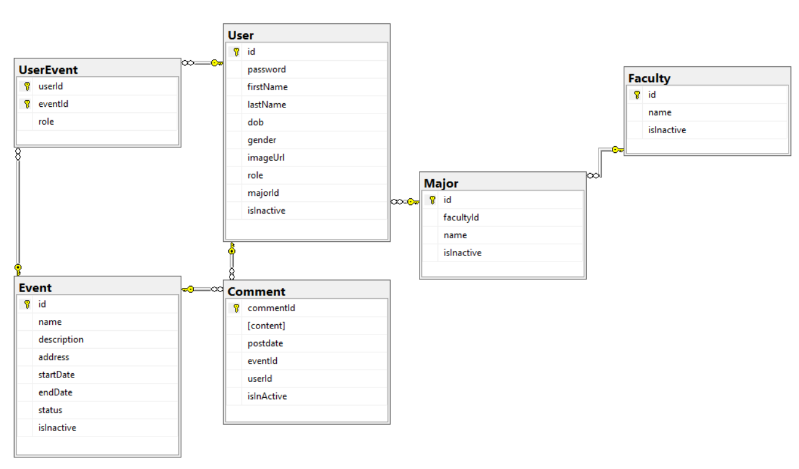
ERD Diagram

Slide 7
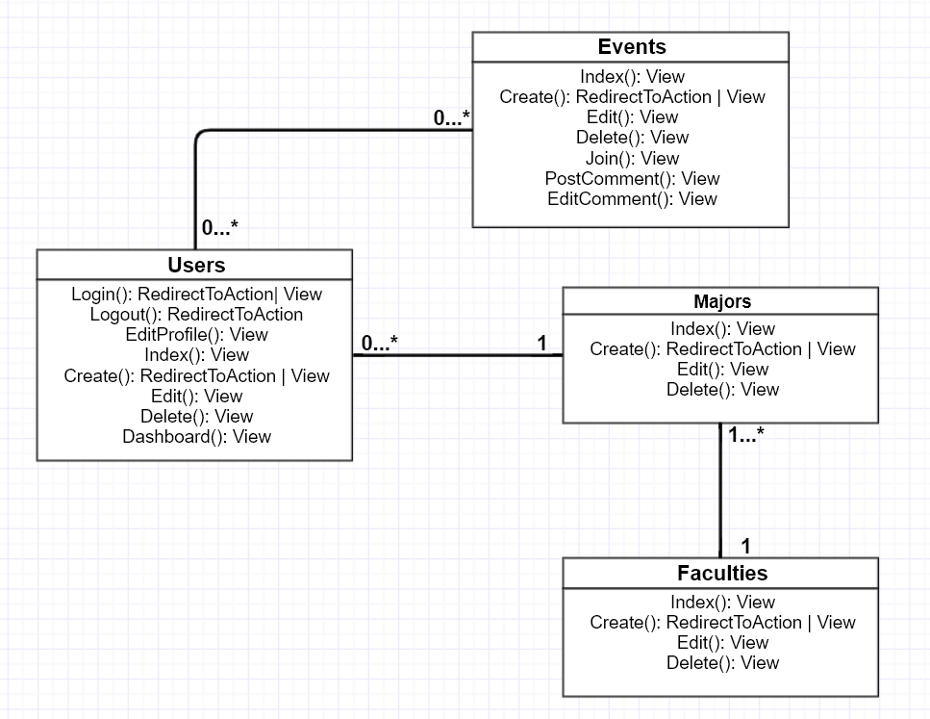
Class Diagram

Slide 8
Tr.Ng. Minh Quan
Ng. Huu Quyen
M.Ng. Anh Duy
Write function in superAdmin &login
Write functoin in Admin & report
Write function in User & supAdmin

Slide 9
UI Design

Slide 10

Login Form

Slide 11
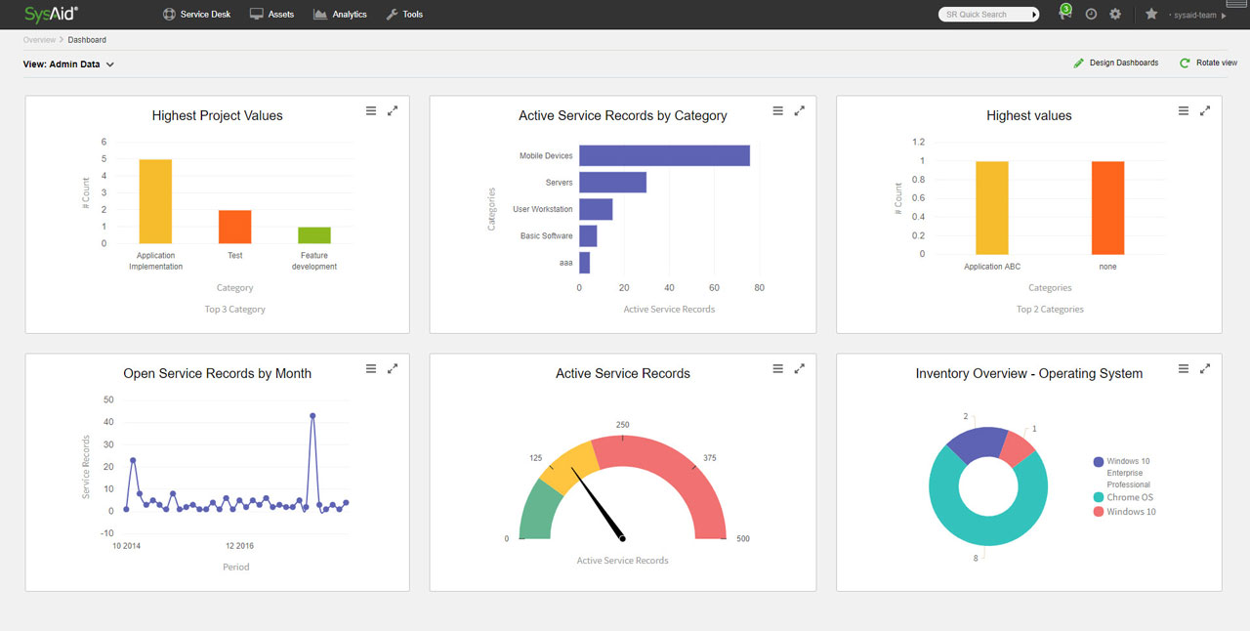
Dashboard

Slide 12
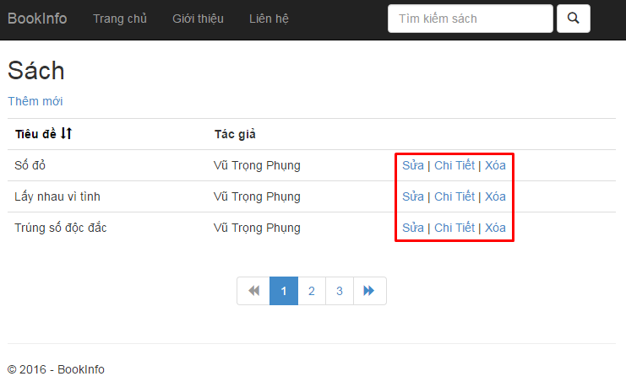

Slide 13
Coding***
Notes:
We using the DataAnnotation attributes in MVC .NET and javascript(to custom any validate) for validation
Like Required, StringLength ,Range, CustomValidation, EmailAddress, MaxLength, MinLength, Phone

Slide 14
Testing<>

Slide 15
Demonstration
15

Slide 16

Thank you for listening
Any question?

