Slide 1


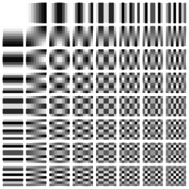
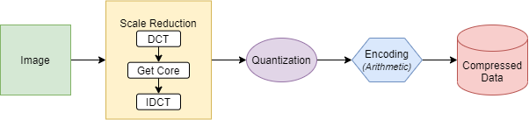
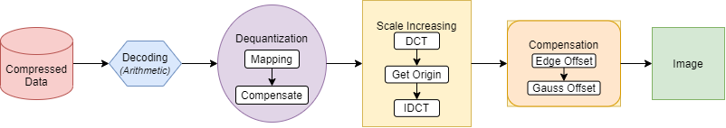
VIETNAM NATIONAL UNIVERSITY
UNIVERSITY OF ENGINEERING AND TECHNOLOGY
Our Image Compression and Decompression Model
Bui, Duy Nam and Duong, Thi Thuy Ngan and Do, Tuan Anh
core
Compression
2d-DCT frequency
Decompression

Slide 2
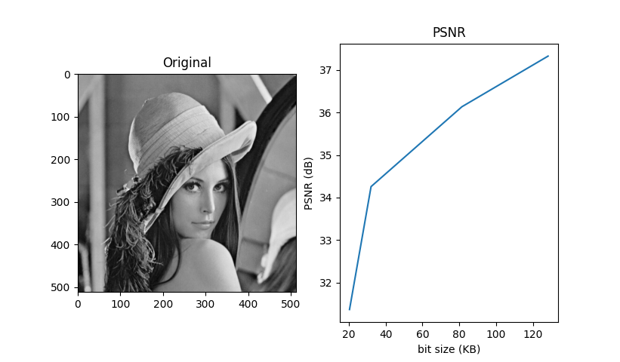
The MSE and PSNR
Compress Volumn (KB) | PSNR (dB) | Ratio
128.125 | 37.325 | 1.998
81.406 | 36.135 | 3.145
32.125 | 34.257 | 7.969
20.445 | 31.368 | 12.521

Slide 3
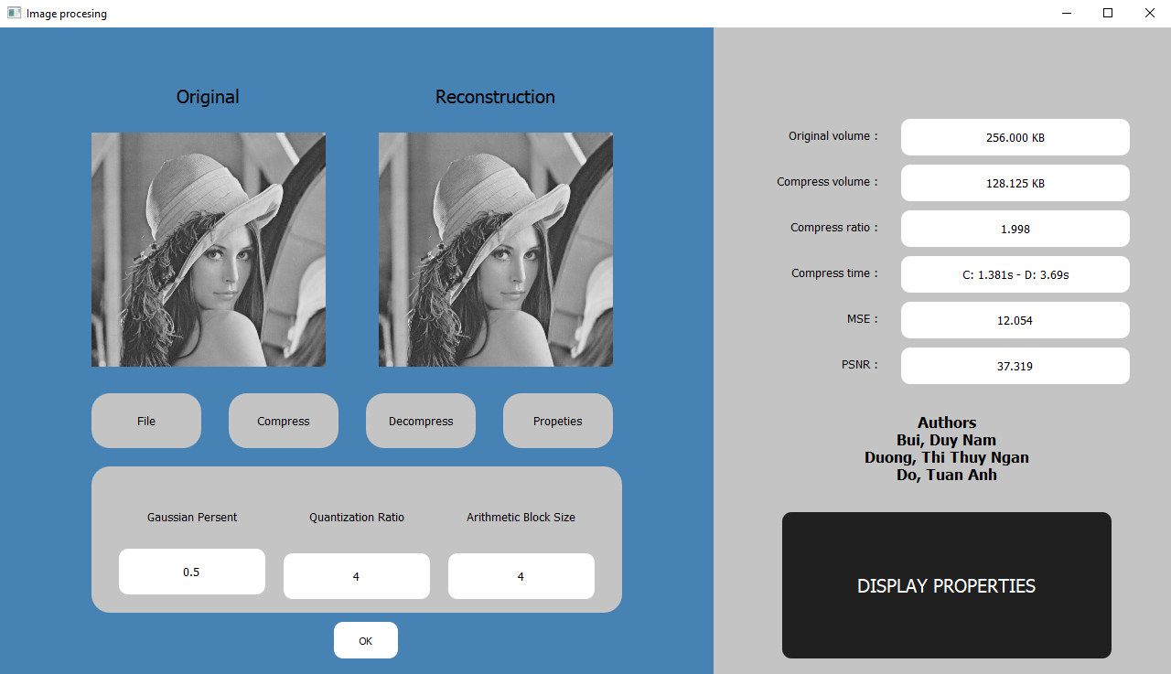
Our display interface

