Slide 1


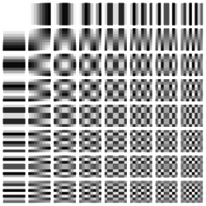
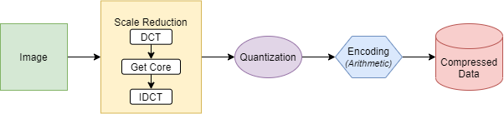
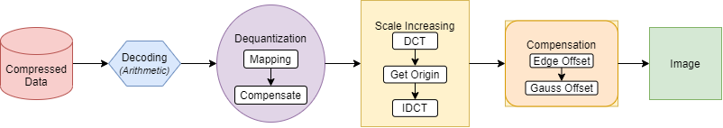
VIETNAM NATIONAL UNIVERSITY
UNIVERSITY OF ENGINEERING AND TECHNOLOGY
Our Image Compression and Decompression Model
Bui, Duy Nam and Duong, Thi Thuy Ngan and Do, Tuan Anh
Compression
2d-DCT frequency
Decompression

Slide 2
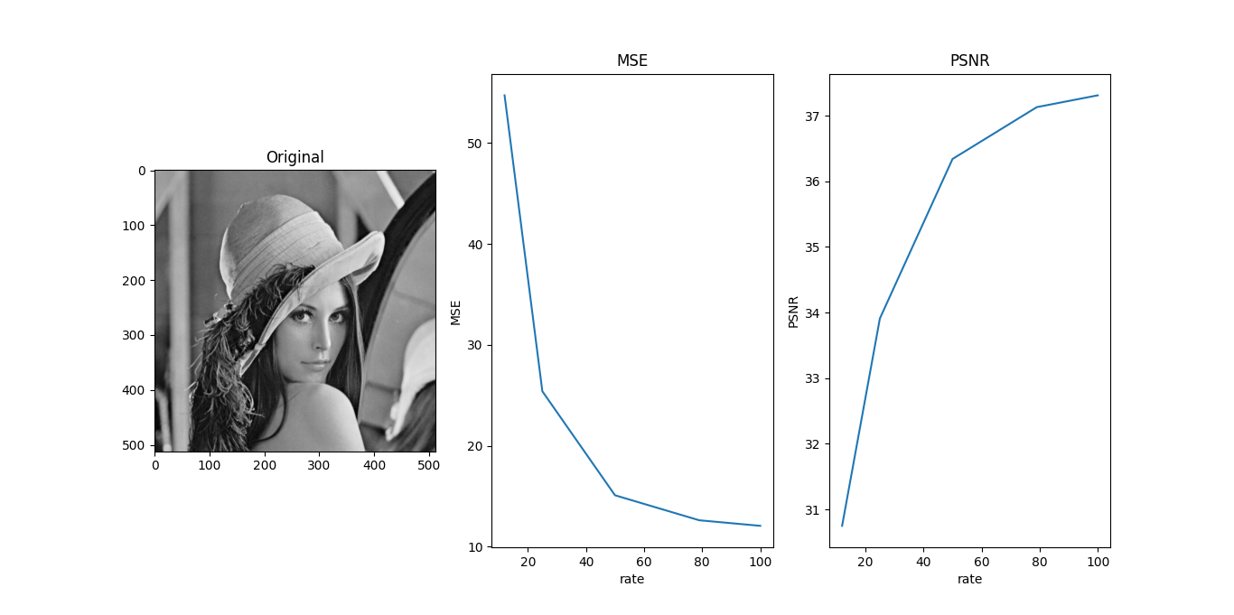
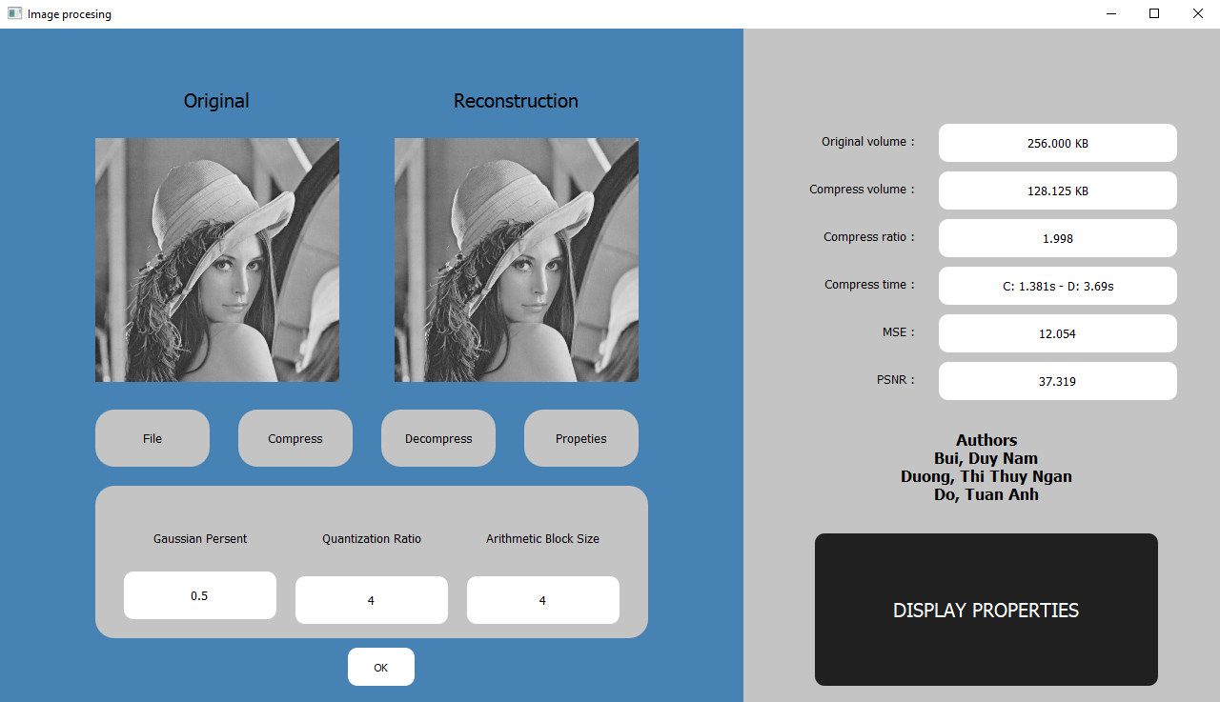
The MSE and PSNR graph
(gaussian percent = 50%,
arithmetic block = 4)
Our display interface

