Slide 1


VIETNAM NATIONAL UNIVERSITY
UNIVERSITY OF ENGINEERING AND TECHNOLOGY
Laboratory 2
Inverted Pendulum Cart
Pham, Quang Hung
Nguyen, Quang Minh
Dam, Phuong Nam
Bui, Duy Nam
Duong, Thi Thuy Ngan

Slide 2
Contents
01
Introduction
02
The Mathetical model
03
MATLAB Simulation
04
Implementation
05
Results

Slide 3
Contents
01
Introduction
02
The Mathetical model
03
MATLAB Simulation
04
Implementation
05
Results

Slide 4
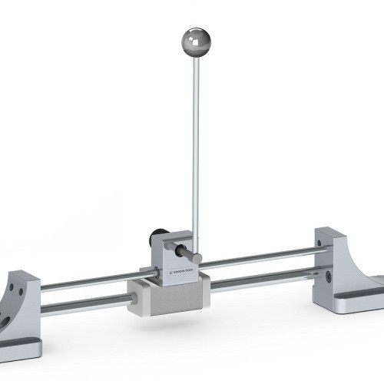
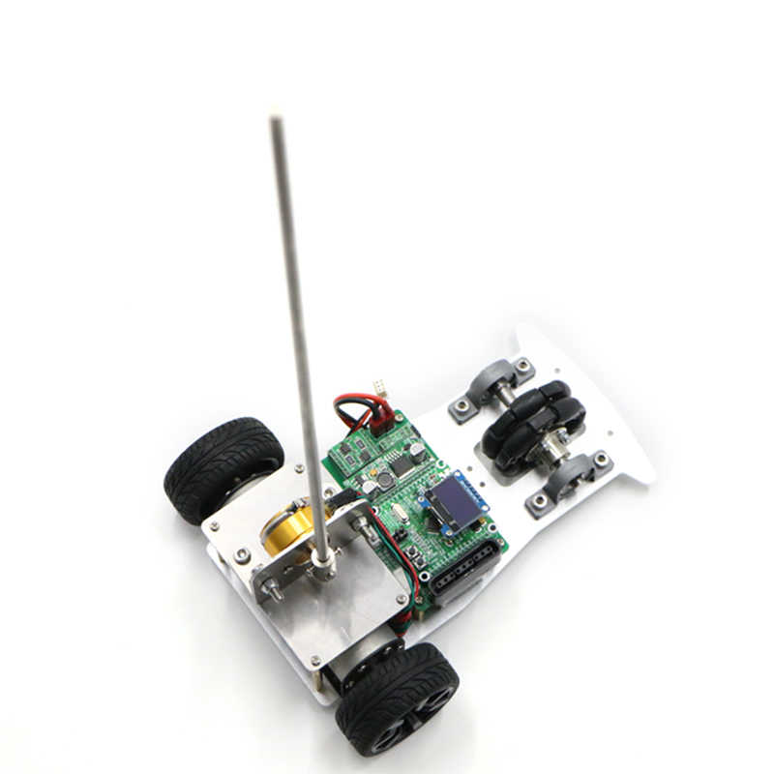
01. Introduction
+ The inverted pendulum system is a classic control system, it is used in teaching and research in almost all universities around the world.
+ The inverted pendulum system is a suitable model to test the high nonlinearity control algorithm back to stability.
Some inverted pendulum cart models

Slide 5
Contents
01
Introduction
02
The Mathetical model
03
MATLAB Simulation
04
Implementation
05
Results

Slide 6
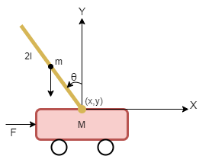
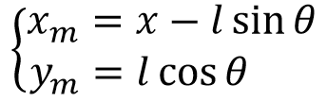
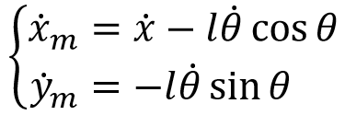

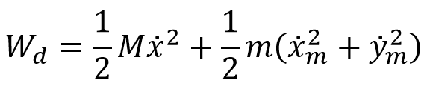
02. The Mathetical model
Kinematic
The mathetical model of Inverted pendulum cart
Potential energy
Kinetic energy

Slide 7
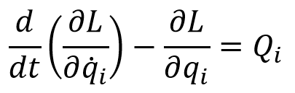
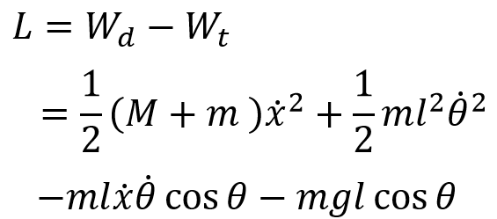
02. The Mathetical model
Lagrange equation
where
and with q_{i} = x, θ

Slide 8

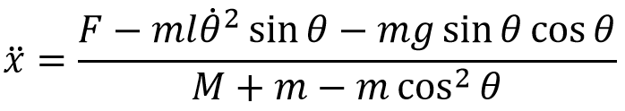
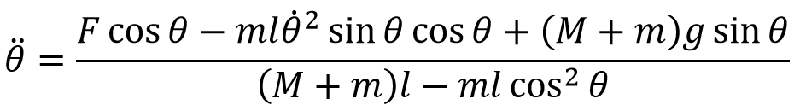
02. The Mathetical model
Equations of motion

Slide 9
Contents
01
Introduction
02
The Mathetical model
03
MATLAB Simulation
04
Implementation
05
Results

Slide 10
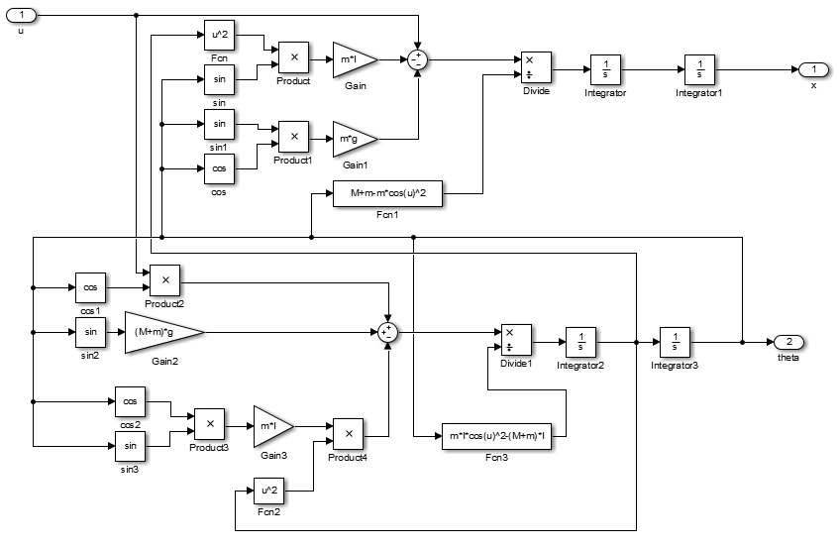
03. MATLAB Simulation
Inverted Pendulum model

Slide 11
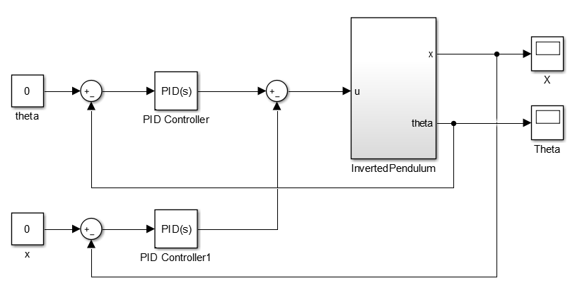
03. MATLAB Simulation
Inverted Pendulum model
We are using 2 PID controllers:
+ The 1st PID controller to control the angle of inverted pedulum
+ The 2nd PID controller to controller the position of the cart

Slide 12
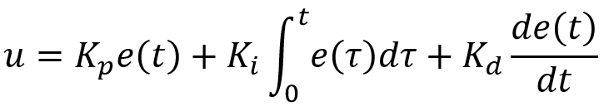
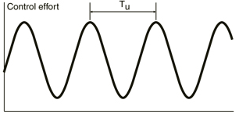
03. MATLAB Simulation
PID Tuning using Ziegler-Nichols method
Procedures to get the PID parameters:
+ Set Ki = Kd = 0. Kp small
+ Increase Kp until neutral stability
+ Record the Ku = Kp at neutral stability and Tu is the period oscillation
+ Compute the PID parameters follow table below
Output signal in neutral stability
Controller Type | Kp | Ki | Kd
PID | 0.6Ku | 1.2Ku/Tu | 3KuTu/40

Slide 13
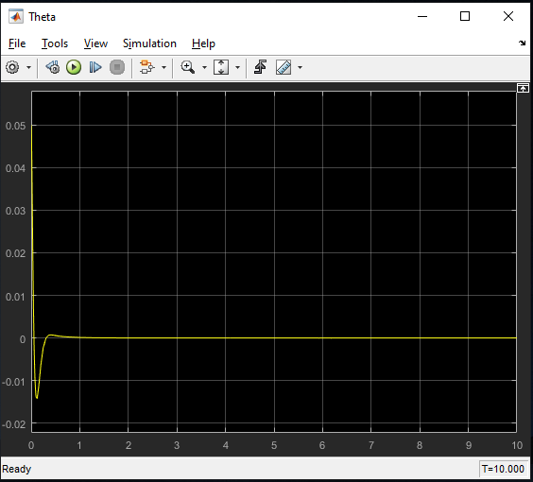
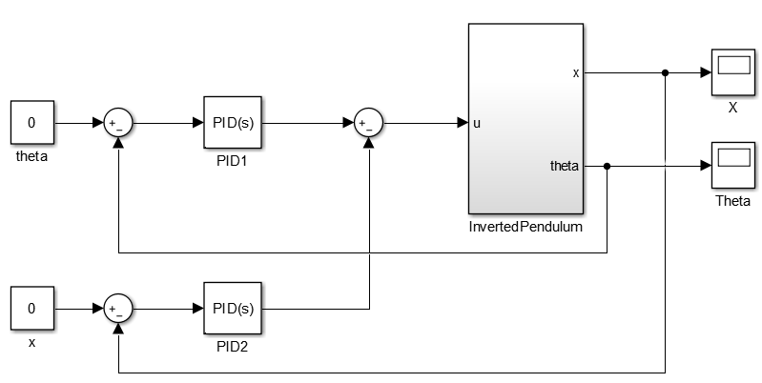
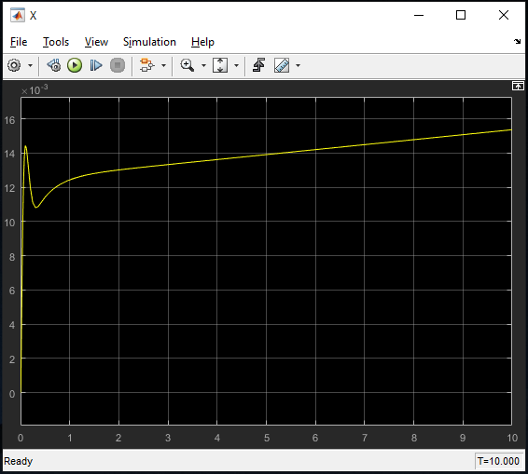
03. MATLAB Simulation
PID Tuning using Ziegler-Nichols method
Using Ziegler-Nichols method for PID1:
Ku = -50, Tu = 0.8
PID controller | Kp | Ki | Kd
PID1 | -30 | -75 | -3
PID2 | 0 | 0 | 0
Simlar for PID2 controller
Output signal after apply PID1

Slide 14
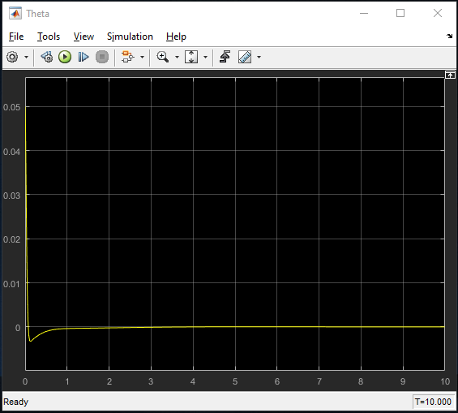
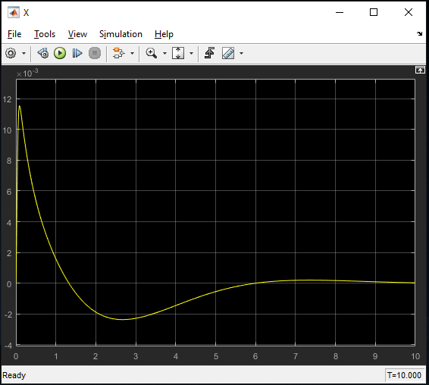
03. MATLAB Simulation
Results
PID controller | Kp | Ki | Kd
PID1 | -30 | -75 | -3
PID2 | -9 | -5 | -4.05
Theta angle
X position

Slide 15
Contents
01
Introduction
02
The Mathetical model
03
MATLAB Simulation
04
Implementation
05
Results

Slide 16
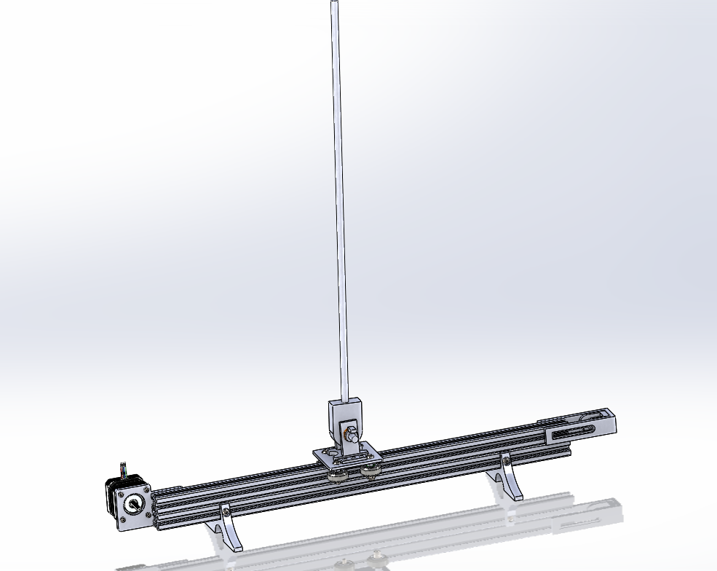
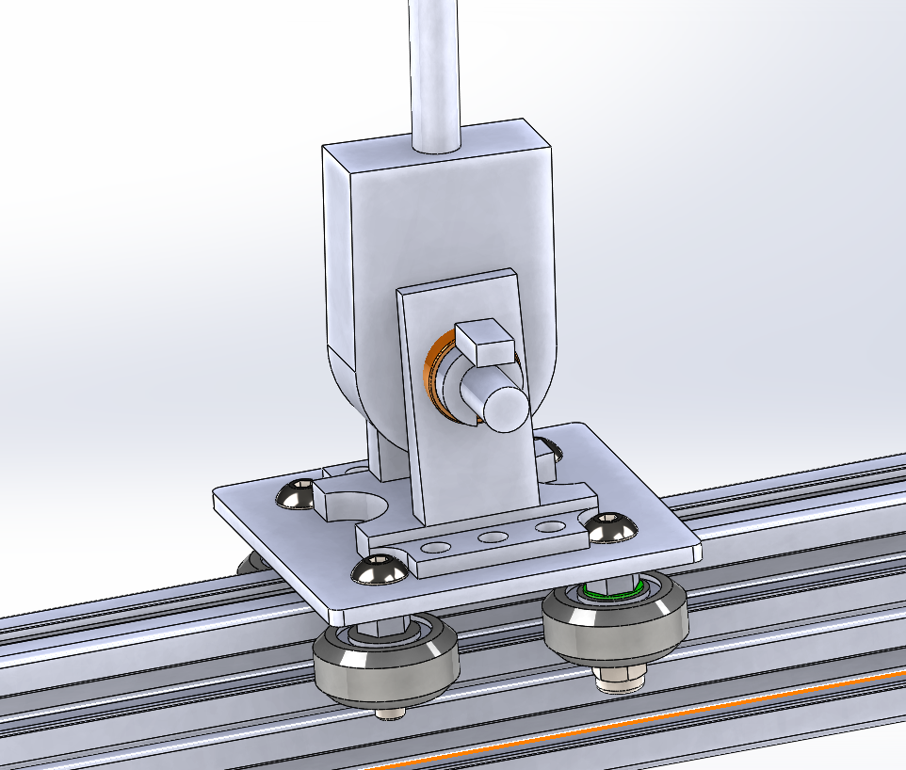
04. Implementation
Design 3D model
Information | Value | Information | Value
Pendulum mass | 0.1 kg | Pendulum length | 0.5 m
Cart mass | 0.4 kg | Guide rail length | 1 m
3D simulation model of Inverted Pendulum

Slide 17
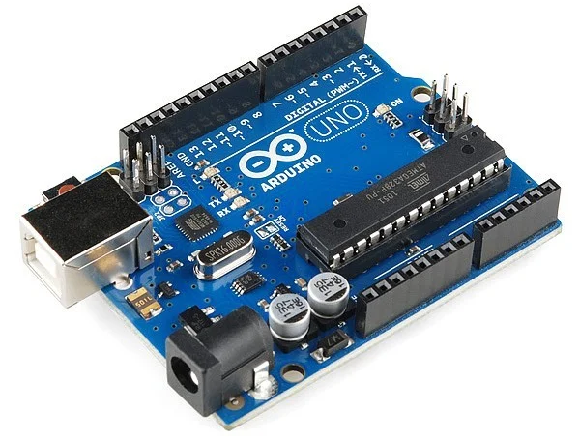
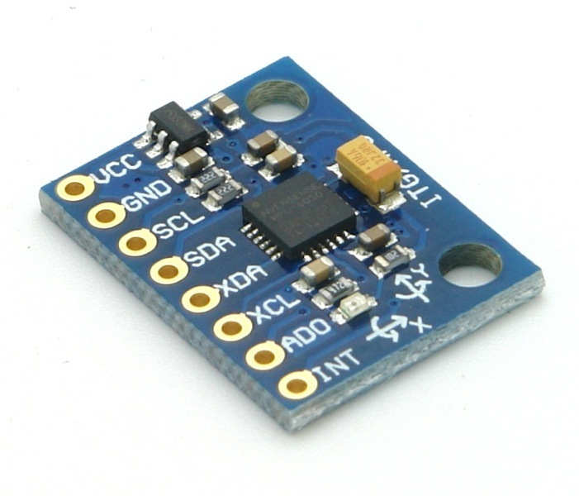
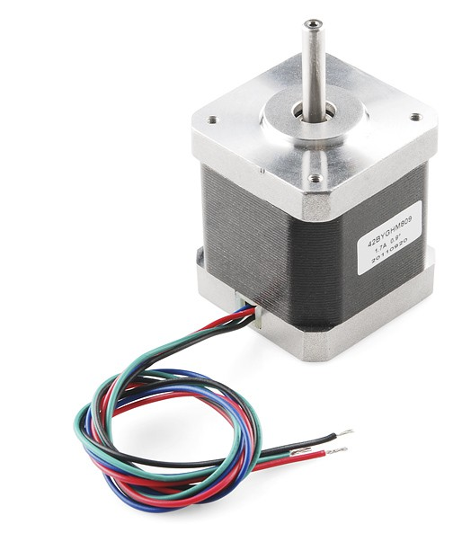
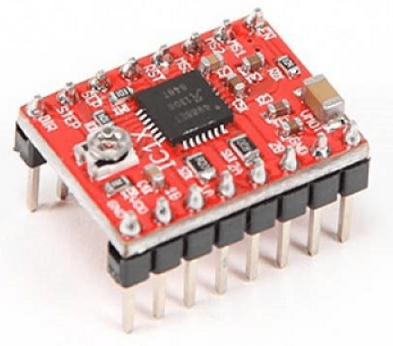
04. Implementation
Hardware
Controller
Arduino Uno
Inverted Pendumlum
Sensor
MPU 6050
Actuator
Stepper motor + drive

Slide 18
Contents
01
Introduction
02
The Mathetical model
03
MATLAB Simulation
04
Implementation
05
Results

Slide 19
THANKS FOR ATTENTION!

