Slide 1
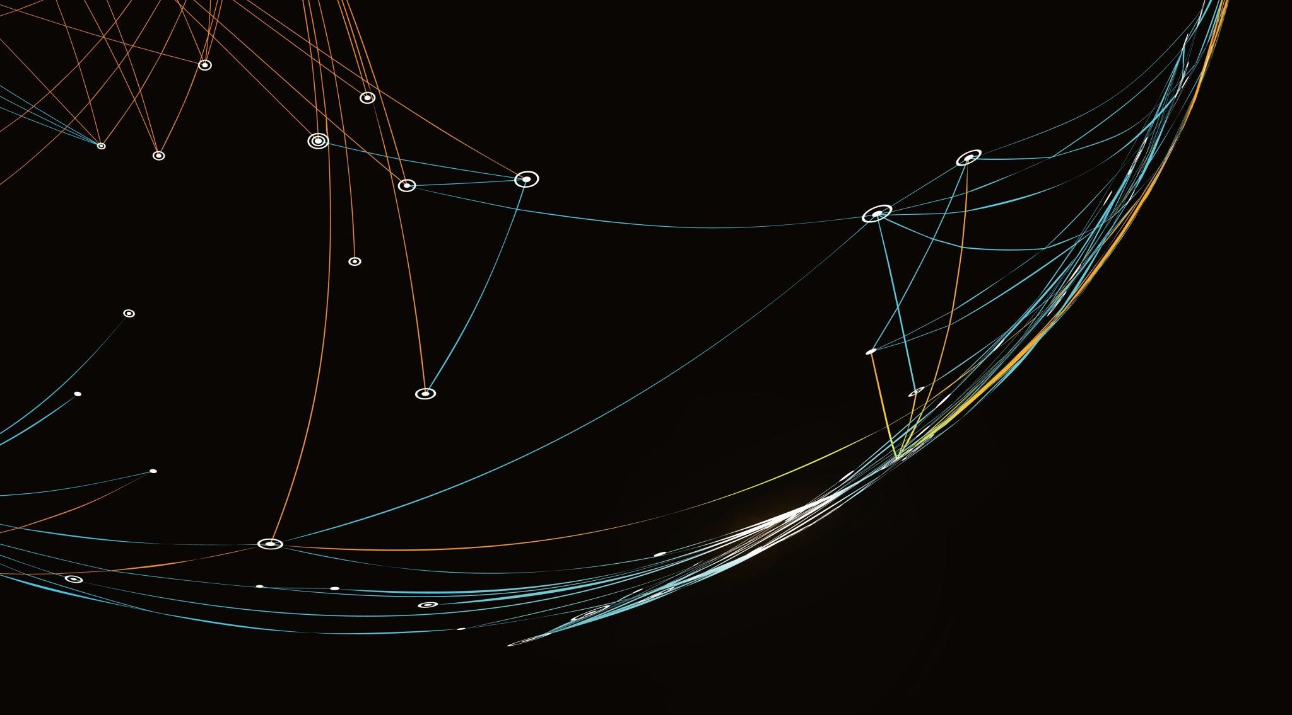
Donors Project v2 (Logistic, LDA, QDA, KNN, SVM, Naive Bayes, Decision Tree)
Duy Nguyen

Slide 2

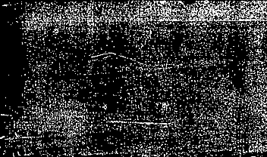
Goal of the project
The outcome variable is respondedMailing, which is binary:
TRUE = donor responded
FALSE = donor did not respond
The objective is to build models that can rank or classify donors so that we can target likely responders more efficiently.

Slide 3
Data exploration and preprocessing
Main preprocessing steps:
Convert the target into a factor with levels FALSE and TRUE.
Convert categorical predictors like state, gender, urbanicity, socioeconomic status into factors.
Handle missing values:
Numeric variables: replaced missing values with the median
Categorical variables: replaced missing values with "Unknown"
Split the data into 70% training and 30% testing, using a stratified approach to maintain the class ratio.
A key issue was unseen factor levels in the test set, like states “AS” and “GU”. To fix this, I used a safer approach: build the design matrix from training terms, then apply that same structure to the test set. This prevents factor-level prediction errors.

Slide 4


Models implemented
Models for implementation:
Logistic Regression
LDA
QDA
KNN
SVC / Linear SVM
SVM with RBF kernel
SVM with polynomial kernel
Naive Bayes
Decision Tree

Slide 5

Why some accuracies misleading?
A model that predicts ‘no one responds’ will still achieve high accuracy.
Therefore, we focused on:
Sensitivity (Recall)
Balanced Accuracy
AUC
Balanced Accuracy is especially important in imbalanced classification problems.”

Slide 6
Adding svm models
I then added new models:
Linear Support Vector Classifier
SVM with RBF kernel
SVM with Polynomial kernel
Naive Bayes
Decision Tree
To reduce computation time, I used stratified sampling for SVM training while evaluating on the full test set.

Slide 7
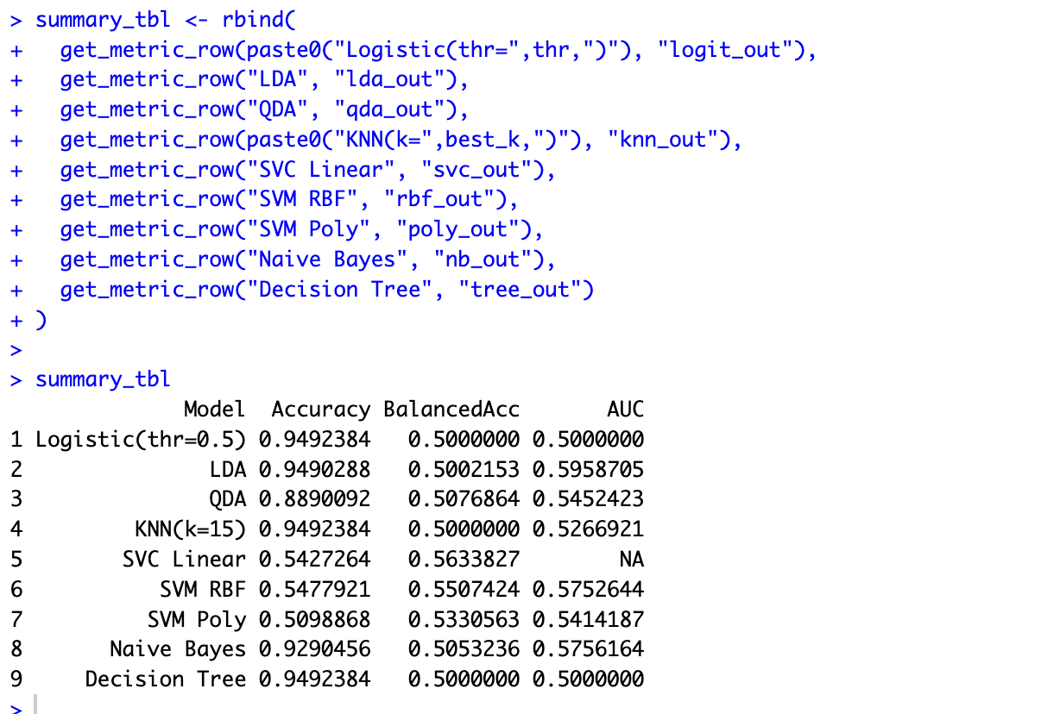

Summarized table for implementation:

Slide 8
Results from tables
Here are the key findings:
Logistic, KNN, and Decision Tree had balanced accuracy of 0.50, meaning random-level performance.
LDA had the highest AUC at 0.596 but very low recall at threshold 0.5.
The Linear SVC achieved the highest balanced accuracy at 0.564.
The RBF SVM performed slightly worse at 0.551.
The Polynomial SVM performed the weakest among SVM variants.

Slide 9
Interpretation
The Linear Support Vector Classifier was the most practically useful model.
It correctly identified approximately 59% of actual responders, which is a substantial improvement over other models.
The nonlinear kernels did not improve performance, suggesting that the decision boundary between responders and non-responders is approximately linear.

Slide 10
Conclusion
This project demonstrates that proper evaluation metrics are more important than model complexity when dealing with imbalanced classification problems.
Accuracy is misleading in imbalanced datasets.
Balanced accuracy and recall provide better evaluation.
The Linear SVC provided the best overall performance.
Increasing model complexity through nonlinear kernels did not improve results
.

