Slide 2
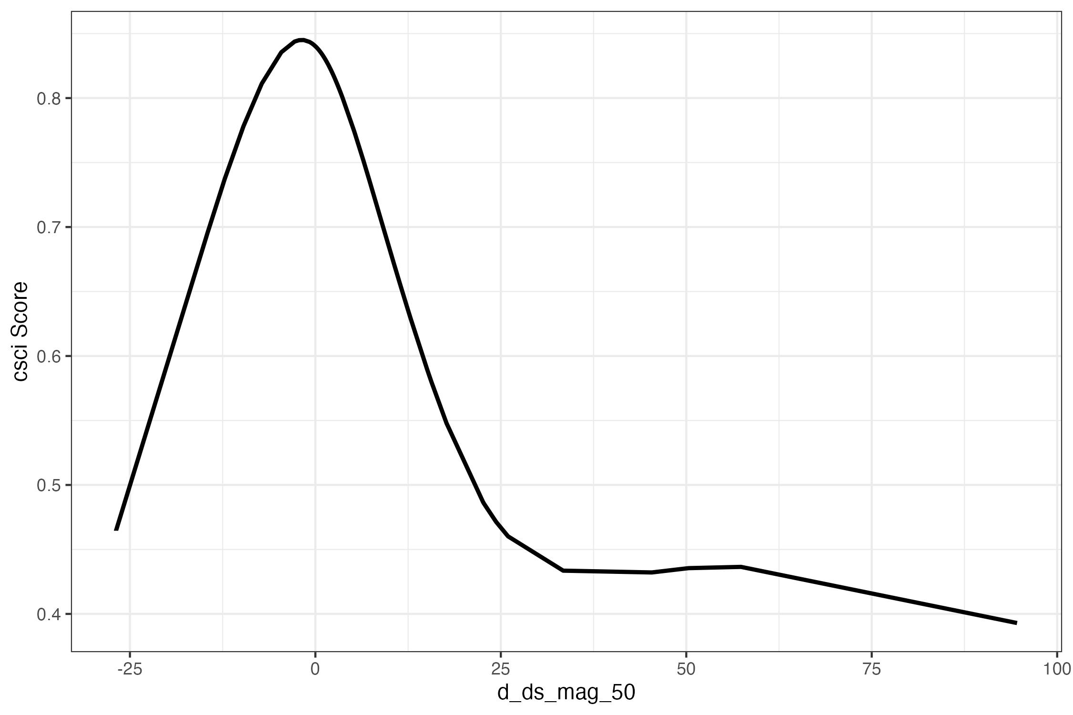
RC
Amount of change in flow required to meet CSCI goal
BO
INC
CSCI Score
Site
Dry Season Baseflow (delta)
Notes:
We can use the flow ecology curve to evaluate a set of targets to figure out a site’s potential to meet certain conditions
This is a flow ecology curve, we have the csci score on the y and the change in flow metric (from reference conditions to current condtions, our measure of alteration)
on the x. this is summer baseflow which is modelled flow data.
This dot is a site, so we can evaluate this site to find the best conditions it could meet
First we see how far it needs to go to meet reference conditions. So the 0.79 is up here, here is the change in flow assocated with it,
so we would need to reduce the flow by this much to get to that score
We can then look at the best observed target, which is here so we need this much change in flow to improve the csci enough
Then we can also look at a incremental increase by 0.1, this 0.1 is arbitrary but is sufficient improvement over what we would expect in terms of variability

Slide 3
Type X
Amount of change in flow required to meet CSCI goal
RC
Type A
Type B
Amount of change in CSCI score to meet CSCI goal
BO
Type C
Alignment of CSCI goal to delta FFM
CSCI Score
INC
Type D
Type E
Depleted
Augmented
Functional Flow Metric (FFM, Delta)
Notes:
We can use the flow ecology curve to evaluate a set of targets to figure out a site’s potential to meet certain conditions
This is a flow ecology curve, we have the csci score on the y and the change in flow metric (from reference conditions to current condtions, our measure of alteration)
on the x. this is summer baseflow which is modelled flow data.
This dot is a site, so we can evaluate this site to find the best conditions it could meet
First we see how far it needs to go to meet reference conditions. So the 0.79 is up here, here is the change in flow assocated with it,
so we would need to reduce the flow by this much to get to that score
We can then look at the best observed target, which is here so we need this much change in flow to improve the csci enough
Then we can also look at a incremental increase by 0.1, this 0.1 is arbitrary but is sufficient improvement over what we would expect in terms of variability

