Slide 1
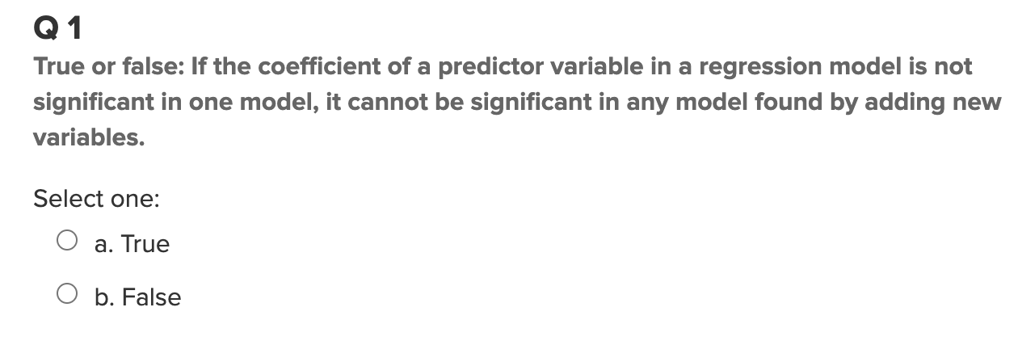
Quick Quiz Questions

Slide 2
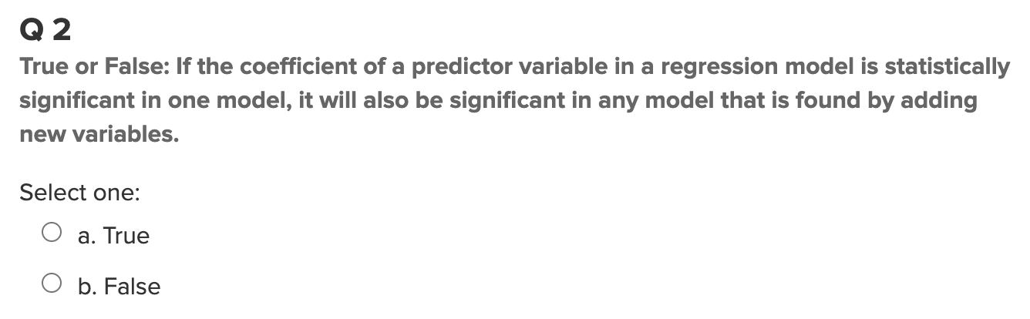
Quick Quiz Questions

Slide 3
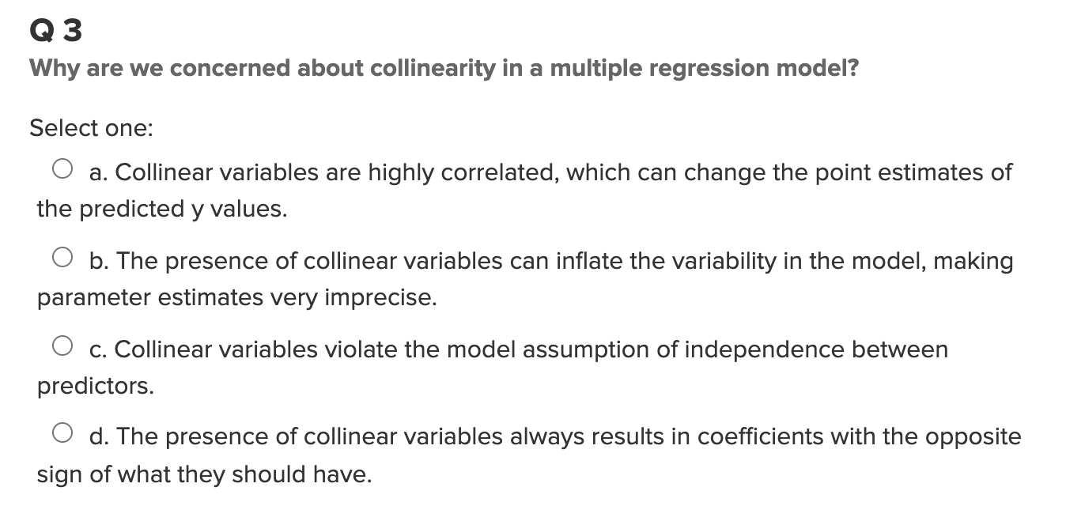
Quick Quiz Questions

Slide 4
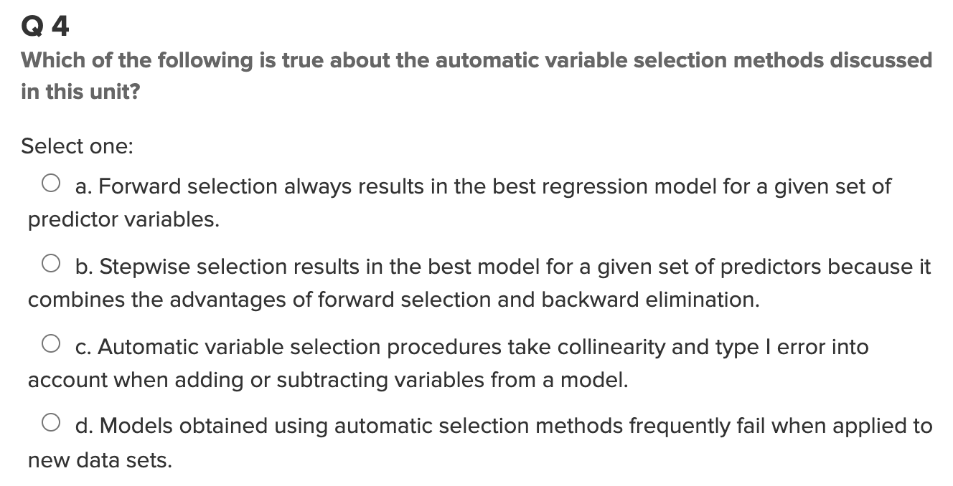
Quick Quiz Questions

Slide 5
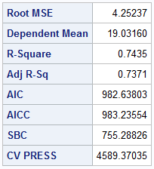
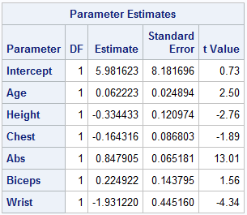
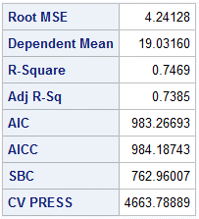
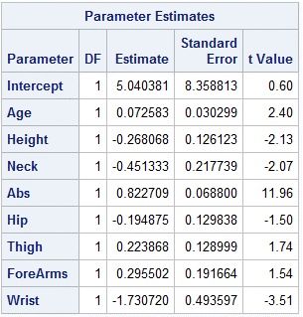
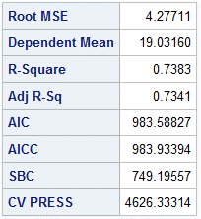
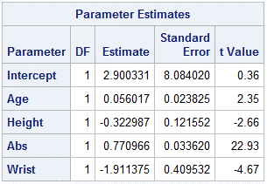
Forward
Backward
Stepwise
Looking at all three selection methods, Backward has the highest adjusted R-squared compared to the two others despite having the highest CV PRESS. Therefore Backward is the best selection method to predict the body fat of our population.

Slide 6
Takeaways!
Forward selection starts with a null model and continuously add the most contributive predictors to the equation, looking for the lower CV PRESS with the next predictors, and stops when CV PRESS is greater than the previous.
Backward selection is similar but in the opposite direction, starting with the full model that we give it and continuously remove the the least contributive predictors from the equation, and stops when CV PRESS doesn’t get too low.
Stepwise selection is a combination of both, starting with no predictors and continuously add the most contributive predictors, while removing any variables that don’t improve fit of the model.
Stepwise is most useful for data with lots of predictor variables, as forward and backward techniques for judging the fit of model is done simutaenously.

Slide 7
Questions!
No questions!

