Slide 1
Chapter 9. Up and Running with TensorFlow

Slide 2
Open source Deep Learning libraries
Library | API | Platforms | Started by | Year
Caffe | Python, C++, Matlab | Linux, macOS, Windows | UC Berkely | 2013
Deeplearning4j | Java, Scala, Clojure | Linux, macOS, Windows, Android | A. Gibson, J.Patterson | 2014
H2O | Python, R | Linux, macOS, Windows | H2O.ai | 2014
MXNet | Python, C++, others | Linux, macOS, Windows, Android, iOS | DMLC | 2015
TensorFlow | Python, C++ | Linux, macOS, Windows, Android, iOS | Google | 2015
Theano | Python | Linux, macOS, iOS | University of Montreal | 2010
Torch | C++, Lua | Linux, macOS, Android, iOS | R. Collobert, K. Kavukcuoglu, C. Farabet | 2002

Slide 3
Highlights of TensorFlow
Runs not only on Windows, Linux, and macOS, but also on iOS and Android
Provides very simple APIs called TF.Learn and TF-slim
Other high-level APIs have been built on top of TensorFlow, such as Keras or Pretty Tensor
Easy computation of the gradients of the functions called automatic differentiating (or autodiff)
Comes with a great visualization tool called TensorBoard
Google also launched a cloud service to run TensorFlow graphs

Slide 4
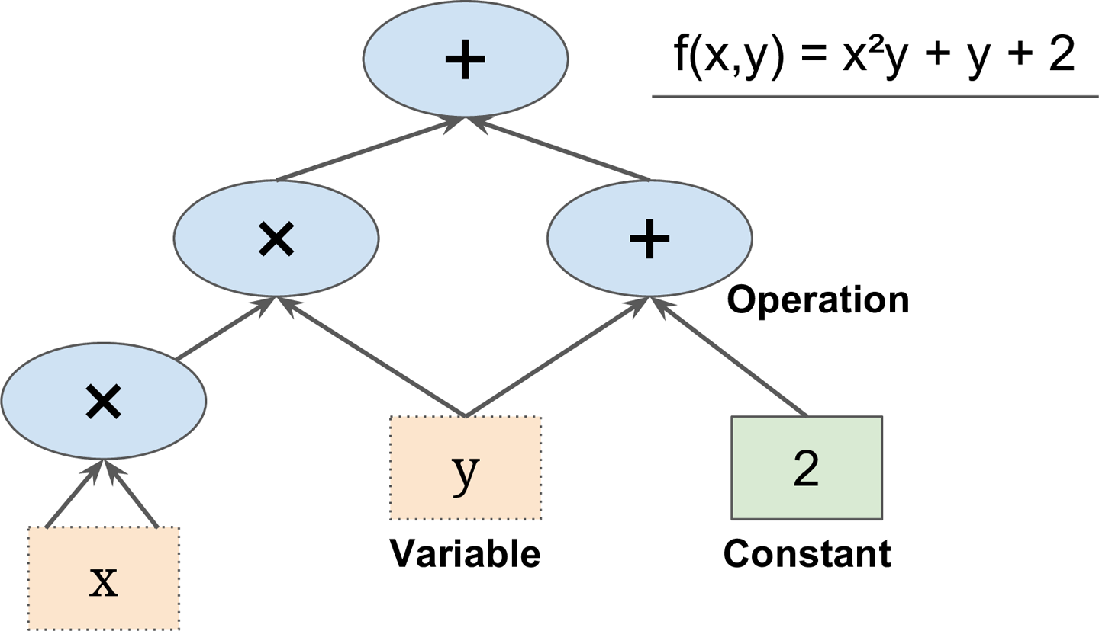
Basic Principle of TensorFlow
Define in Python a graph of computations to perform
TensorFlow takes that graph and runs it efficiently using optimized C++ code.

Slide 5
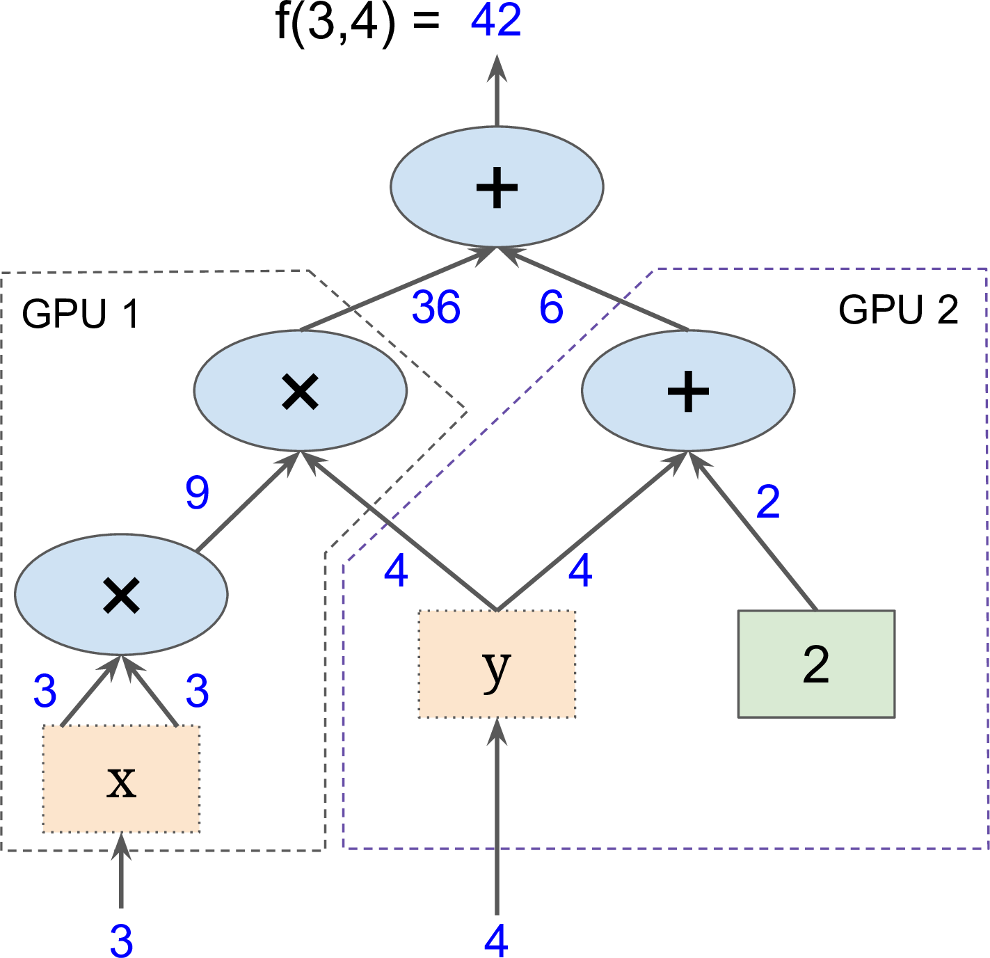
Basic Principle of TensorFlow
Parallel computation on multiple CPUs/GPUs/servers

Slide 6
Creating a Graph and Running it
1. Create a graph
import tensorflow as tf
x = tf.Variable(3, name=“x”)
y = tf.Variable(4, name=“y”)
f = x*x*y + y + 2
sess = tf.Session()
sess.run(x.initializer)
sess.run(y.initializer)
result = sess.run(f)
print(result)
sess.close
2. Run the graph in a Session

Slide 7
Creating a Graph and Running it
1. Create a graph
import tensorflow as tf
x = tf.Variable(3, name=“x”)
y = tf.Variable(4, name=“y”)
f = x*x*y + y + 2
sess = tf.Session()
sess.run(x.initializer)
sess.run(y.initializer)
result = sess.run(f)
print(result)
sess.close
Construction phase
Execution phase
2. Run the graph in a Session

Slide 8
Creating a Graph and Running it
1. Create a graph
import tensorflow as tf
x = tf.Variable(3, name=“x”)
y = tf.Variable(4, name=“y”)
f = x*x*y + y + 2
with tf.Session() as sess:
x.initializer.run()
y.initializer.run()
result = f.eval()
print(result)
Construction phase
Execution phase
2. Run the graph in a Session
f.eval() is just syntactic sugar for sess.run(f) in the currently active session!

Slide 9
Creating a Graph and Running it
1. Create a graph
import tensorflow as tf
x = tf.Variable(3, name=“x”)
y = tf.Variable(4, name=“y”)
f = x*x*y + y + 2
init = tf.global_variables_initializer()
with tf.Session() as sess:
init.run()
result = f.eval()
print(result)
Construction phase
Execution phase
2. Run the graph in a Session

Slide 10
Example
1. Create a graph
import tensorflow as tf
w = tf.constant(3)
z
y
Construction phase
x
+
3
x
5
Execution phase
+
Use eval() to run the graph
w = 3
2
2. Run the graph in a Session

Slide 11
Example
1. Create a graph
import tensorflow as tf
w = tf.constant(3)
x = w + 2
y = x + 5
z = x + 3
with tf.Session() as sess:
print(y.eval())
print(z.eval())
z
y
Construction phase
x
+
3
x
5
Execution phase
+
w = 3
2
2. Run the graph in a Session

Slide 12
Example
1. Create a graph
import tensorflow as tf
w = tf.constant(3)
x = w + 2
y = x + 5
z = x + 3
with tf.Session() as sess:
print(y.eval())
print(z.eval())
z
y
Construction phase
x
+
3
x
5
Execution phase
+
w = 3
2
2. Run the graph in a Session

Slide 13
Example
1. Create a graph
import tensorflow as tf
w = tf.constant(3)
x = w + 2
y = x + 5
z = x + 3
with tf.Session() as sess:
print(y.eval())
print(z.eval())
z
y
Construction phase
x
+
3
x
5
Execution phase
+
w = 3
2
2. Run the graph in a Session

Slide 14
Example
1. Create a graph
import tensorflow as tf
w = tf.constant(3)
x = w + 2
y = x + 5
z = x + 3
with tf.Session() as sess:
y_val, z_val = sess.run([y, z])
print(y_val)
print(z_val)
z
y
Construction phase
x
+
3
x
5
Execution phase
+
w = 3
2
2. Run the graph in a Session

Slide 15
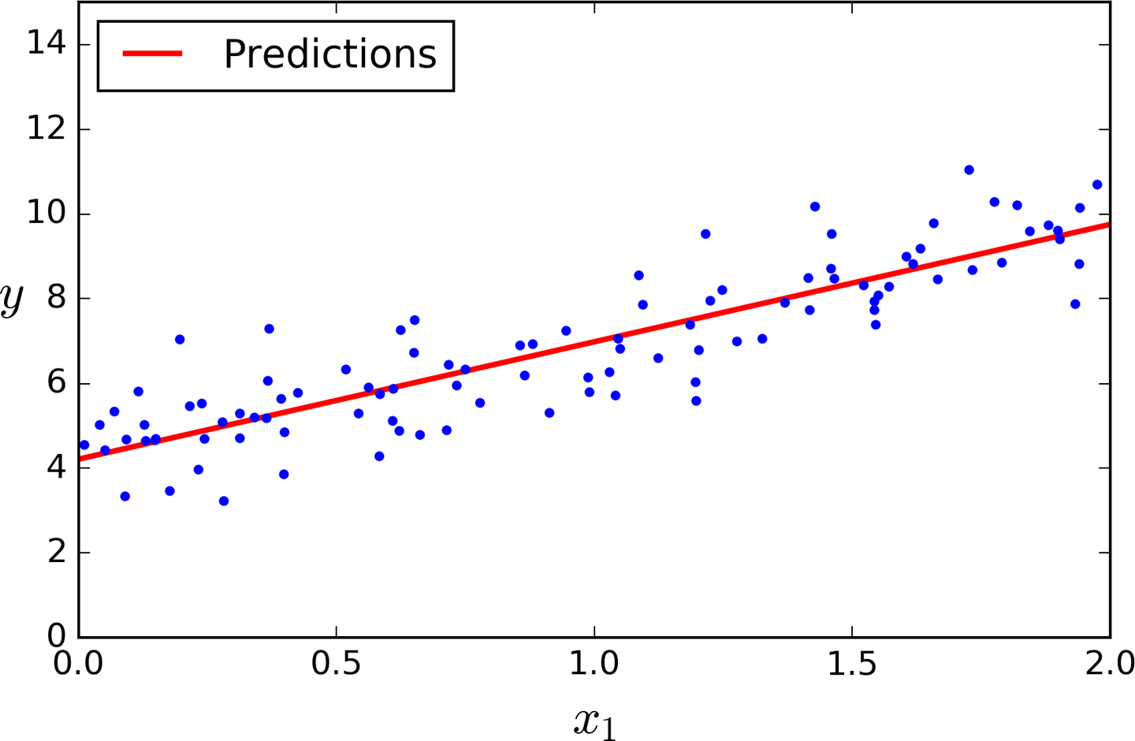





Linear Regression using the Normal Equation with numpy, scikit-learn and TensorFlow
For n dimensions with 1 instance:
$y=θ_{0}+θ_{1}x_{1}+θ_{2}x_{2}$+…+$θ_{n}x_{n}$
For n dimensions with m instances:
$$y=Xθ$$
$$X=\left[\begin{matrix}\begin{matrix}1 & x_{1}^{1} \\ 1 & x_{1}^{2}\end{matrix} & ⋯ & \begin{matrix}x_{n}^{1} \\ x_{n}^{2}\end{matrix} \\ ⋮ & ⋯ & ⋮ \\ \begin{matrix}1 & x_{1}^{m}\end{matrix} & ⋯ & x_{n}^{m}\end{matrix}\right]$$
$$y=\left[\begin{matrix}\begin{matrix}y^{1} \\ y^{2}\end{matrix} \\ \begin{matrix}⋮ \\ y^{m}\end{matrix}\end{matrix}\right]$$
$$θ=\left[\begin{matrix}\begin{matrix}θ_{0} \\ θ_{1}\end{matrix} \\ \begin{matrix}⋮ \\ θ_{n}\end{matrix}\end{matrix}\right]$$
The Normal Equation – a closed-form solution
$$\hat{θ}={\left(X^{T}X\right)}^{−1}X^{T}y$$

Slide 16
Linear Regression using the Normal Equation with numpy, scikit-learn and TensorFlow
For n dimensions with 1 instance:
Linear Regression with Numpy
$y=θ_{0}+θ_{1}x_{1}+θ_{2}x_{2}$+…+$θ_{n}x_{n}$
For n dimensions with m instances:
Hints:
Inverse of matrix:
np.linalg.inv()
Dot product of two array:
a.dot(b)
Transpose of matrix:
a.T
$$y=Xθ$$
$$X=\left[\begin{matrix}\begin{matrix}1 & x_{1}^{1} \\ 1 & x_{1}^{2}\end{matrix} & ⋯ & \begin{matrix}x_{n}^{1} \\ x_{n}^{2}\end{matrix} \\ ⋮ & ⋯ & ⋮ \\ \begin{matrix}1 & x_{1}^{m}\end{matrix} & ⋯ & x_{n}^{m}\end{matrix}\right]$$
$$y=\left[\begin{matrix}\begin{matrix}y^{1} \\ y^{2}\end{matrix} \\ \begin{matrix}⋮ \\ y^{m}\end{matrix}\end{matrix}\right]$$
$$θ=\left[\begin{matrix}\begin{matrix}θ_{0} \\ θ_{1}\end{matrix} \\ \begin{matrix}⋮ \\ θ_{n}\end{matrix}\end{matrix}\right]$$
The Normal Equation – a closed-form solution
$$\hat{θ}={\left(X^{T}X\right)}^{−1}X^{T}y$$

Slide 17
Linear Regression using the Normal Equation with numpy, scikit-learn and TensorFlow
For n dimensions with 1 instance:
Linear Regression with Scikit-learn
$y=θ_{0}+θ_{1}x_{1}+θ_{2}x_{2}$+…+$θ_{n}x_{n}$
For n dimensions with m instances:
Hints:
Use LinearRegression from sklearn.linear_model
$$y=Xθ$$
$$X=\left[\begin{matrix}\begin{matrix}1 & x_{1}^{1} \\ 1 & x_{1}^{2}\end{matrix} & ⋯ & \begin{matrix}x_{n}^{1} \\ x_{n}^{2}\end{matrix} \\ ⋮ & ⋯ & ⋮ \\ \begin{matrix}1 & x_{1}^{m}\end{matrix} & ⋯ & x_{n}^{m}\end{matrix}\right]$$
$$y=\left[\begin{matrix}\begin{matrix}y^{1} \\ y^{2}\end{matrix} \\ \begin{matrix}⋮ \\ y^{m}\end{matrix}\end{matrix}\right]$$
$$θ=\left[\begin{matrix}\begin{matrix}θ_{0} \\ θ_{1}\end{matrix} \\ \begin{matrix}⋮ \\ θ_{n}\end{matrix}\end{matrix}\right]$$
The Normal Equation – a closed-form solution
$$\hat{θ}={\left(X^{T}X\right)}^{−1}X^{T}y$$

Slide 18
Linear Regression using the Normal Equation with numpy, scikit-learn and TensorFlow
For n dimensions with 1 instance:
Linear Regression with TensorFlow
$y=θ_{0}+θ_{1}x_{1}+θ_{2}x_{2}$+…+$θ_{n}x_{n}$
For n dimensions with m instances:
Hints:
Inverse of matrix:
tf.matrix_inverse()
Dot product of two array:
tf.matmul(a, b)
Transpose of matrix:
tf.transpose(a)
$$y=Xθ$$
$$X=\left[\begin{matrix}\begin{matrix}1 & x_{1}^{1} \\ 1 & x_{1}^{2}\end{matrix} & ⋯ & \begin{matrix}x_{n}^{1} \\ x_{n}^{2}\end{matrix} \\ ⋮ & ⋯ & ⋮ \\ \begin{matrix}1 & x_{1}^{m}\end{matrix} & ⋯ & x_{n}^{m}\end{matrix}\right]$$
$$y=\left[\begin{matrix}\begin{matrix}y^{1} \\ y^{2}\end{matrix} \\ \begin{matrix}⋮ \\ y^{m}\end{matrix}\end{matrix}\right]$$
$$θ=\left[\begin{matrix}\begin{matrix}θ_{0} \\ θ_{1}\end{matrix} \\ \begin{matrix}⋮ \\ θ_{n}\end{matrix}\end{matrix}\right]$$
The Normal Equation – a closed-form solution
$$\hat{θ}={\left(X^{T}X\right)}^{−1}X^{T}y$$

Slide 19
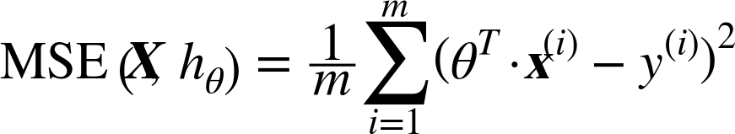
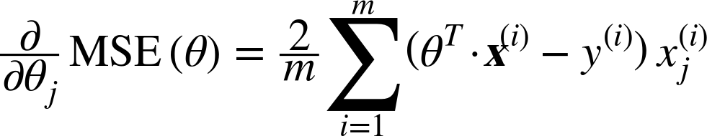
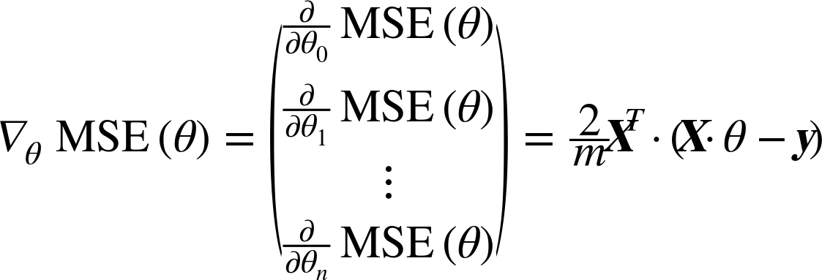
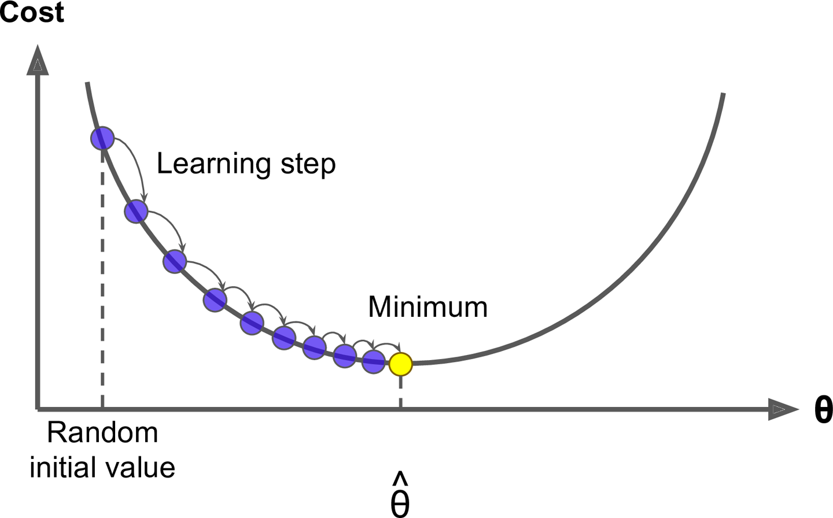

Implementing Batch Gradient Descent
TODO:
Do batch gradient descent by manually computing the gradients
Use TesorFlow’s autodiff feature to let TensorFlow compute the gradients automatically
Use TensorFlow’s out-of-the-box optimizers
Cost:

Slide 20
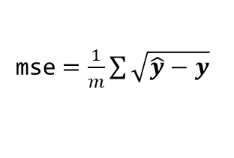
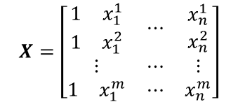

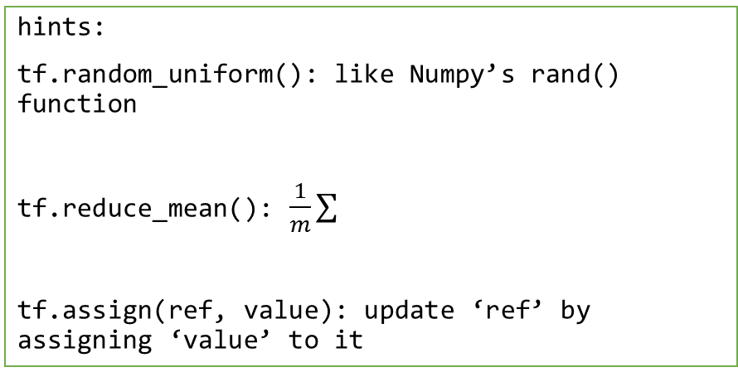

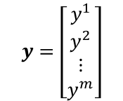

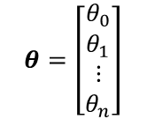

Implementing Batch Gradient Descent
Do batch gradient descent by manually computing the gradients
$$X=\left[\begin{matrix}\begin{matrix}1 & x_{1}^{1} \\ 1 & x_{1}^{2}\end{matrix} & ⋯ & \begin{matrix}x_{n}^{1} \\ x_{n}^{2}\end{matrix} \\ ⋮ & ⋯ & ⋮ \\ \begin{matrix}1 & x_{1}^{m}\end{matrix} & ⋯ & x_{n}^{m}\end{matrix}\right]$$
$$y=\left[\begin{matrix}\begin{matrix}y^{1} \\ y^{2}\end{matrix} \\ \begin{matrix}⋮ \\ y^{m}\end{matrix}\end{matrix}\right]$$
Constant:
Variable with random uniform distribution from -1 to 1 :
$$θ=\left[\begin{matrix}\begin{matrix}θ_{0} \\ θ_{1}\end{matrix} \\ \begin{matrix}⋮ \\ θ_{n}\end{matrix}\end{matrix}\right]$$
hints:
tf.random_uniform(): like Numpy’s rand() function
tf.reduce_mean(): $\frac{1}{m}\sum{}$
tf.assign(ref, value): update ‘ref’ by assigning ‘value’ to it
$$\hat{y}=Xθ$$
error$= \hat{y}−y$
mse$=\frac{1}{m}\sum{\sqrt{\hat{y}−y} }$
gradients$=\frac{2}{m}X^{T}\left(\hat{y}−y\right)$
training_op$=θ≔θ−η$gradients
Run the graph on the session

Slide 21

Implementing Batch Gradient Descent
Use TesorFlow’s autodiff feature to let TensorFlow compute the gradients automatically
$$X=\left[\begin{matrix}\begin{matrix}1 & x_{1}^{1} \\ 1 & x_{1}^{2}\end{matrix} & ⋯ & \begin{matrix}x_{n}^{1} \\ x_{n}^{2}\end{matrix} \\ ⋮ & ⋯ & ⋮ \\ \begin{matrix}1 & x_{1}^{m}\end{matrix} & ⋯ & x_{n}^{m}\end{matrix}\right]$$
$$y=\left[\begin{matrix}\begin{matrix}y^{1} \\ y^{2}\end{matrix} \\ \begin{matrix}⋮ \\ y^{m}\end{matrix}\end{matrix}\right]$$
Constant:
Variable with random uniform distribution from -1 to 1 :
$$θ=\left[\begin{matrix}\begin{matrix}θ_{0} \\ θ_{1}\end{matrix} \\ \begin{matrix}⋮ \\ θ_{n}\end{matrix}\end{matrix}\right]$$
$$\hat{y}=Xθ$$
error$= \hat{y}−y$
mse$=\frac{1}{m}\sum{\sqrt{\hat{y}−y} }$
hints:
tf.gradients(op, x_list): creates a list of gradients of ops w.r.t. x in x_list
gradients$=$ autodiff
training_op$=θ≔θ−η$gradients
Run the graph on the session

Slide 22


Implementing Batch Gradient Descent
Use TensorFlow’s out-of-the-box optimizers
$$X=\left[\begin{matrix}\begin{matrix}1 & x_{1}^{1} \\ 1 & x_{1}^{2}\end{matrix} & ⋯ & \begin{matrix}x_{n}^{1} \\ x_{n}^{2}\end{matrix} \\ ⋮ & ⋯ & ⋮ \\ \begin{matrix}1 & x_{1}^{m}\end{matrix} & ⋯ & x_{n}^{m}\end{matrix}\right]$$
$$y=\left[\begin{matrix}\begin{matrix}y^{1} \\ y^{2}\end{matrix} \\ \begin{matrix}⋮ \\ y^{m}\end{matrix}\end{matrix}\right]$$
Constant:
Variable with random uniform distribution from -1 to 1 :
$$θ=\left[\begin{matrix}\begin{matrix}θ_{0} \\ θ_{1}\end{matrix} \\ \begin{matrix}⋮ \\ θ_{n}\end{matrix}\end{matrix}\right]$$
$$\hat{y}=Xθ$$
error$= \hat{y}−y$
mse$=\frac{1}{m}\sum{\sqrt{\hat{y}−y} }$
hints:
optimizer = tf.train.GradientDescentOptimizer(…)
training_op = optimizer.minimize(mse)
gradients$=$ autodiff
training_op$=$TF optimizer
Run the graph on the session

Slide 23
Mini-batch Gradient Descent
Batch Gradient Descent
Stochastic Gradient Descent
Mini-batch Gradient Descent
A | B
A | B
A | B

Slide 24
Placeholder
B
A = tf.constant([1, 2, 3], dtype=tf.float32)
B = A + 5
with tf.Session() as sess:
B_val = sess.run(B)
+
A = [1,2,3]
5
B
A = tf.placeholder(tf.float32, shape=(None, 3))
B = A + 5
with tf.Session() as sess:
B_val1 = sess.run(B, feed_dict={A: [[1, 2, 3]]})
B_val2 = sess.run(B, feed_dict={A: [[1, 2, 3], [4, 5, 6]]})
+
A
5
feed array from session

Slide 25
Implementing mini-batch gradient descent
X = tf.constant(data)
y = tf.constant(label)
.
.
.
with tf.Session() as sess:
…
sess.run(training_op)
X = tf.placeholder(tf.float32, shape=(None, n + 1))
y = tf.placeholder(tf.float32, shape=(None, 1))
.
.
.
def fetch_batch(…):
…
return X_batch, y_batch
with tf.Session() as sess:
…
X_batch, y_batch = fetch_batch(…)
sess.run(training_op, feed_dict={X: X_batch, y: y_batch})

Slide 26
Saving and Restoring Models
<Saving Models>
<Restoring Models>
import tensorflow as tf
…
…
saver = tf.train.Saver()
import tensorflow as tf
…
…
saver = tf.train.Saver()
Construction phase
Construction phase
Execution phase
Execution phase
with tf.Session() as sess:
…
save_path = saver.save(sess, “./model.ckpt”)
with tf.Session() as sess:
saver.restore(sess, “./model.ckpt”)
…

Slide 27
Restoring Models without Graphs
<Restoring Models with Graph>
<Restoring Models without Graphs>
import tensorflow as tf
…
…
saver = tf.train.Saver()
import tensorflow as tf
Construction phase
Construction phase
saver = tf.train.import_meta_graph(“./model.ckpt.meta")
theta =
tf.get_default_graph().get_tensor_by_name(..)
Execution phase
Execution phase
with tf.Session() as sess:
saver.restore(sess, “./model.ckpt")
with tf.Session() as sess:
saver.restore(sess, “./model.ckpt”)
…

Slide 28
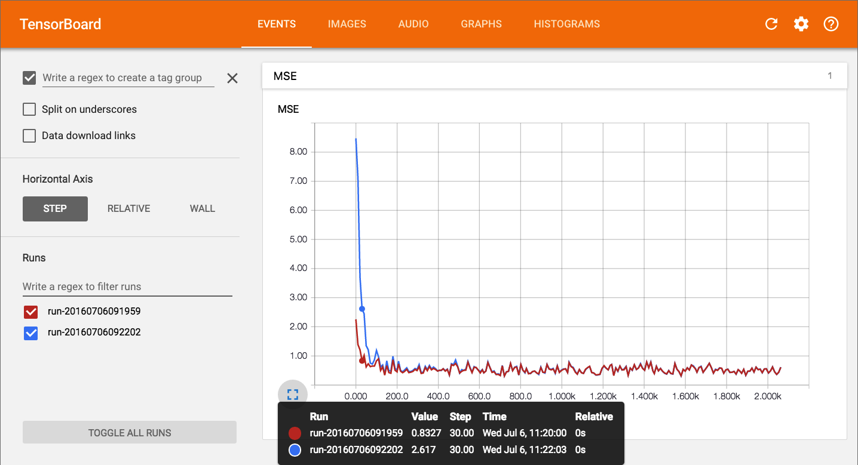
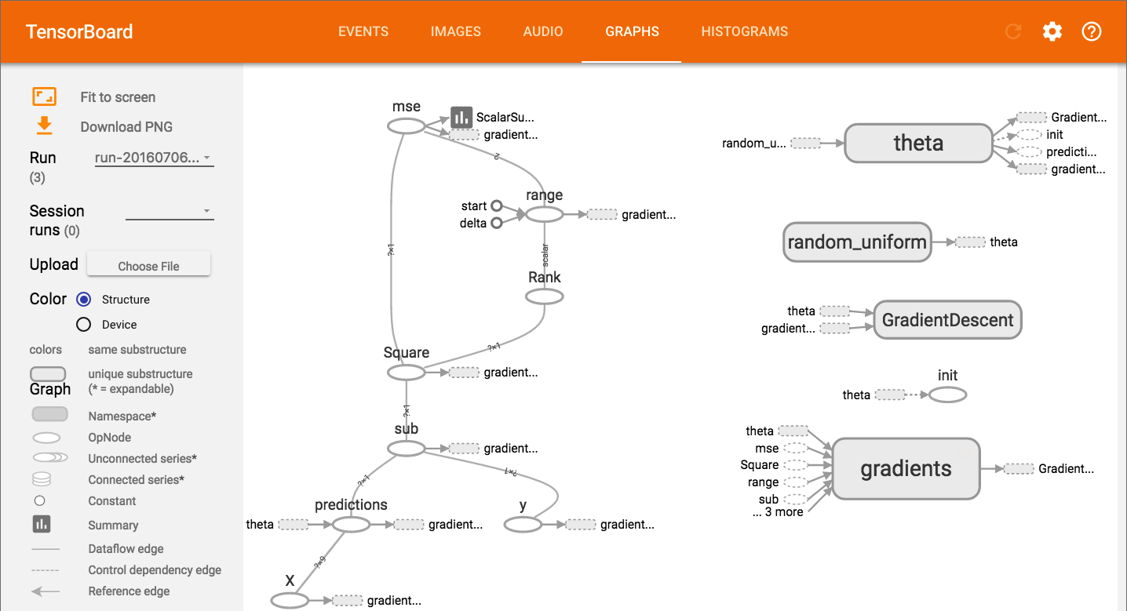
TensorBoard
TF logging/debugging tool
Visualize the TF graph
Plot quantitative metrics
Show additional data

Slide 29
TensorBoard
…
…
mse_summary = tf.summary.scalar(‘MSE’, mse)
file_writer = tf.summary.FileWriter(“./tf_logs/run1”, tf.get_default_graph())
Construction phase
Execution phase
with tf.Session() as sess:
…
summary_str = sess.run(mse_summary, feed_dict={X: X_batch, y: y_batch})
file_writer.add_summary(summary_str, step)
…
file_writer.close()

Slide 30
TensorBoard
from datetime import datetime
now = datetime.utcnow().strftime(“%Y%m%d%H%M%S”)
root_logdir = "./tf_logs"
logdir = "{}/run-{}/".format(root_logdir, now)
…
…
mse_summary = tf.summary.scalar(‘MSE’, mse)
file_writer = tf.summary.FileWriter(logdir, tf.get_default_graph())
Construction phase
Execution phase
with tf.Session() as sess:
…
summary_str = sess.run(mse_summary, feed_dict={X: X_batch, y: y_batch})
file_writer.add_summary(summary_str, step)
…
file_writer.close()

Slide 31
To launch TensorBoard
open terminal and type:
$ tensorboard --logdir=your root log directory such as ./tf_logs/
then open a browser and go to http://localhost:6006/

Slide 32
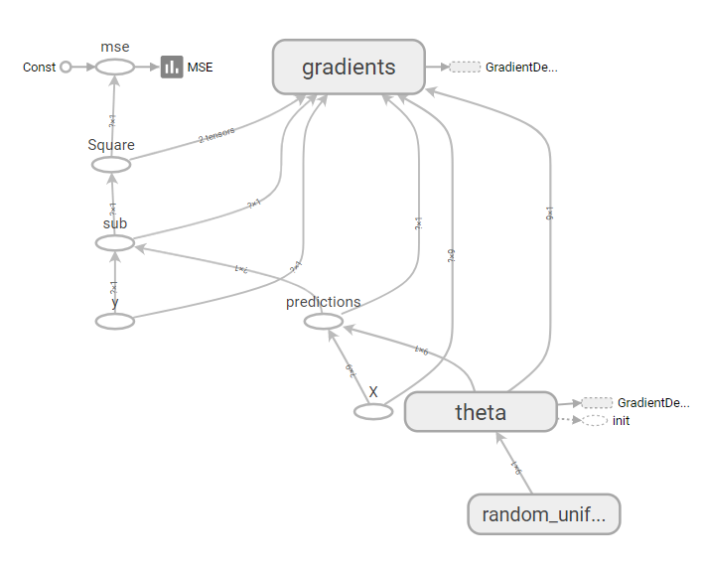
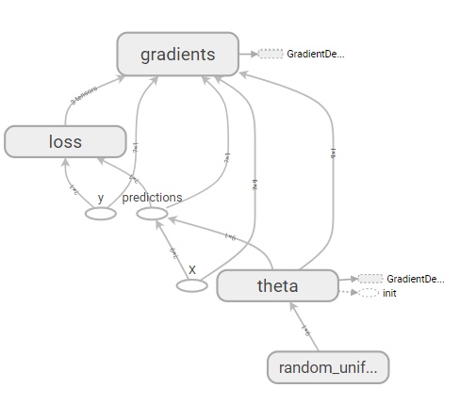
Name Scopes
error = y_pred - y
mse = tf.reduce_mean(tf.square(error), name="mse")
with tf.name_scope(“loss”) as scope:
error = y_pred – y
mse = tf.reduce_mean(tf.square(error), name=“mse”)

Slide 33
To launch TensorBoard
open terminal and type:
$ tensorboard --logdir=your root log directory such as ./tf_logs/
then open a browser and go to http://localhost:6006/

Slide 34
Name Scopes
error = y_pred - y
mse = tf.reduce_mean(tf.square(error), name="mse")
with tf.name_scope(“loss”) as scope:
error = y_pred – y
mse = tf.reduce_mean(tf.square(error), name=“mse”)

