Slide 1
Chapter 7. Ensemble Learning and Random Forests

Slide 2
Tree-based Models
Decision Tree
Random Forest
Gradient Boosting
Tree#1
Tree#2
Tree#3
Tree#1
Tree#2
Tree#4
Tree#k
Tree#k
……
……
Prone to over-fitting
Ensemble parallel trees
Random sampling of data
(Bagging)
Random sampling of features
Slow to score
Only one parameter to tune
(number of samples)
Ensemble consecutive trees
Optimize cost function (gradient decent)
Update weights based on the net loss of the prior trees

Slide 3
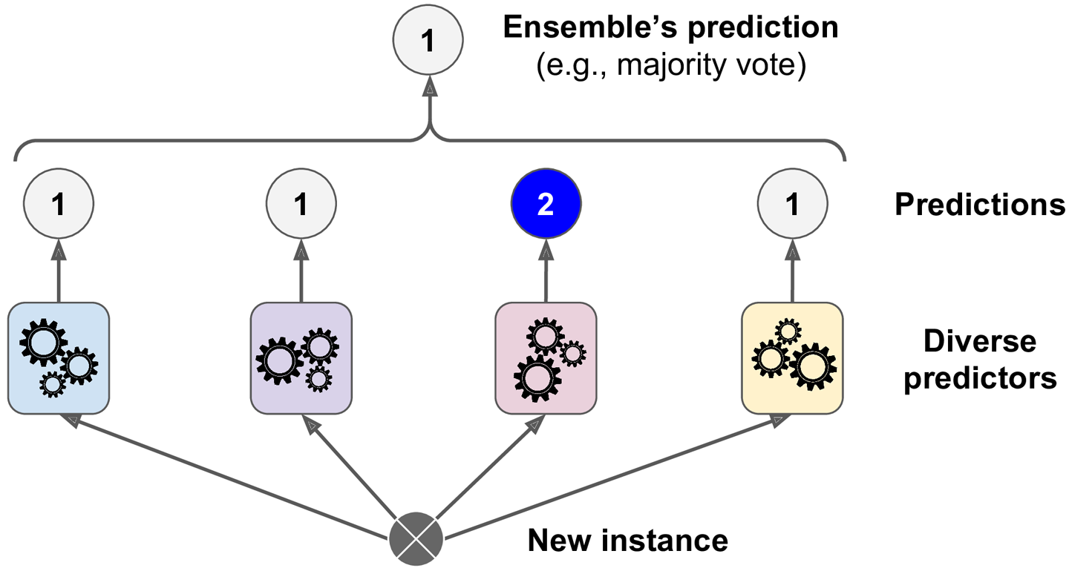
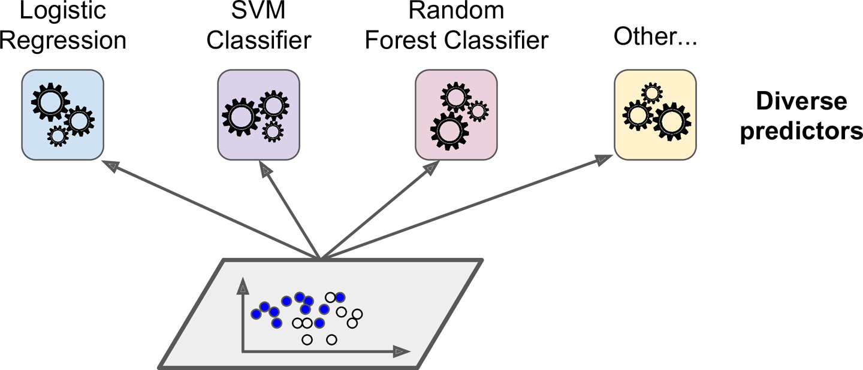
Voting Classifiers
Training diverse classifiers
Hard voting classifier predictions

Slide 4
Voting Classifiers
Hard voting classifier predictions
Soft voting classifier predictions
[0.475, 0.525]
[0.6, 0.4]
[0.6, 0.4]
[0.1, 0.9]
[0.6, 0.4]

Slide 5
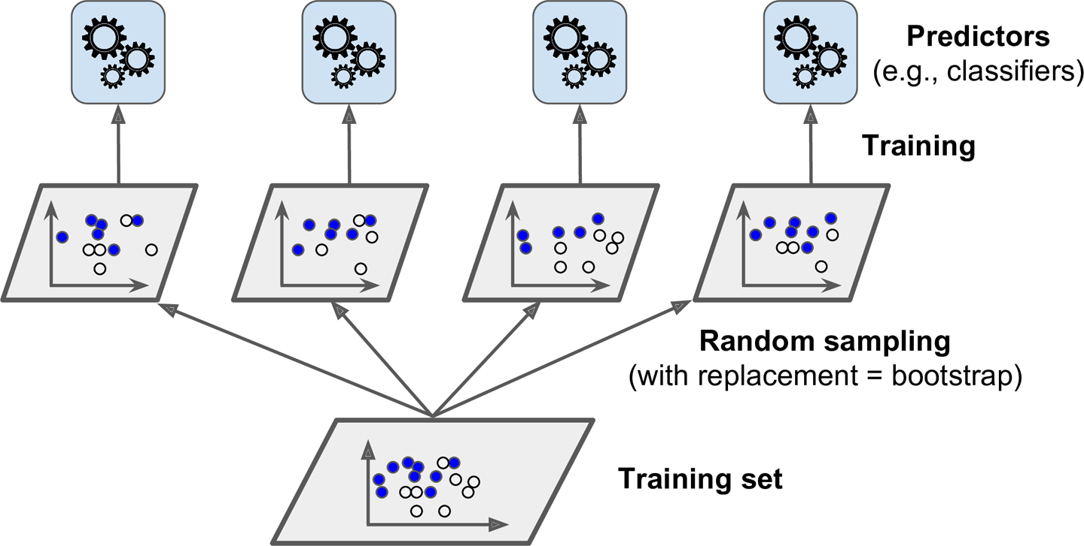
Bagging vs. Pasting
Bagging (boostrap aggregating): samples are drawn with replacement
Pasting: samples are drawn without replacement

Slide 6
Random Forests
➔ Soft or hard voting
Decision Tree Classifiers:
➔Instances and/or features

Slide 7
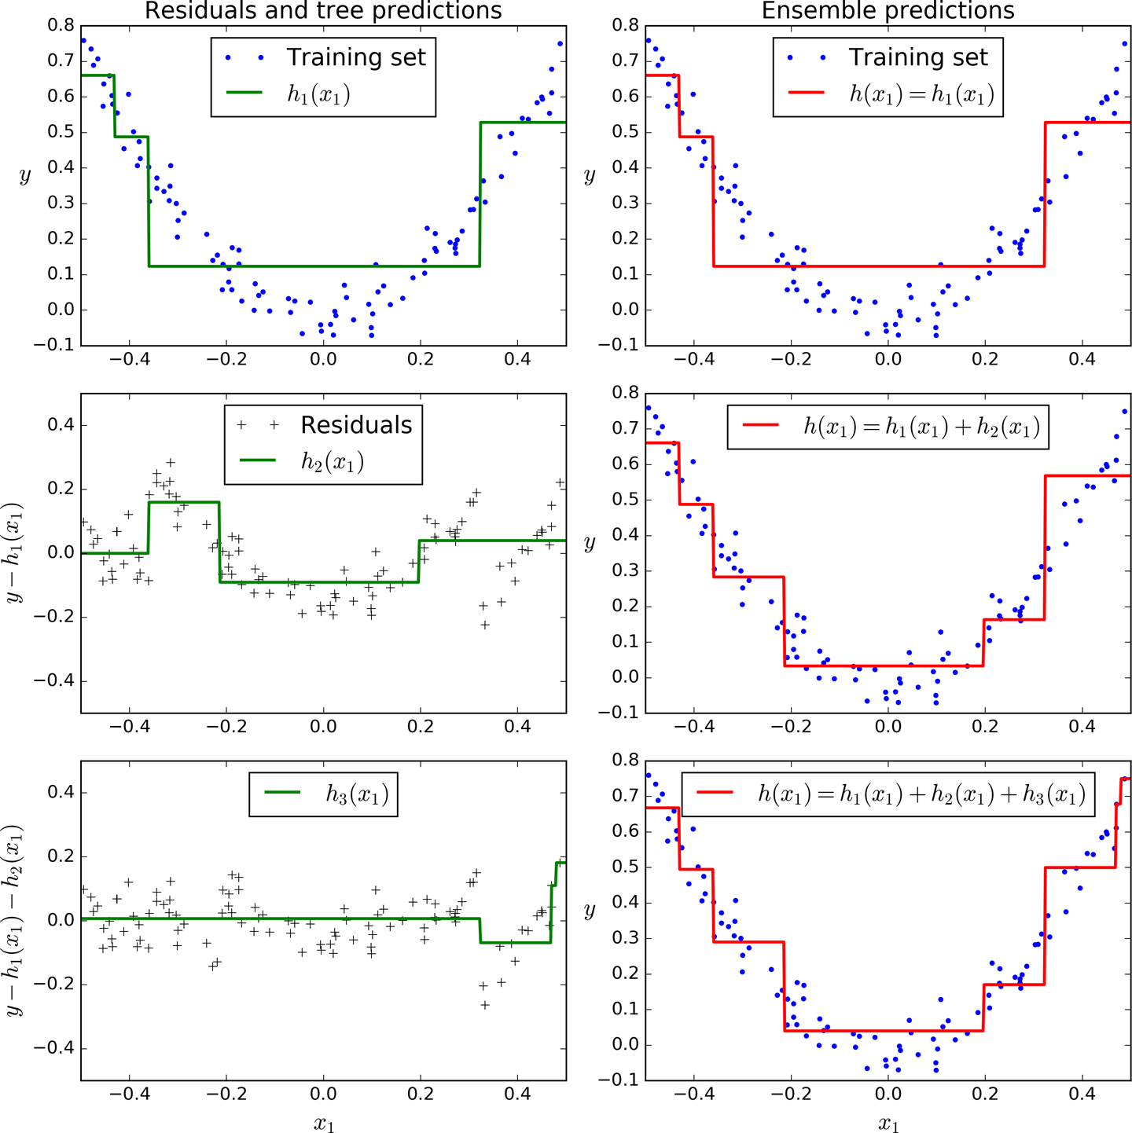
Gradient Boosting
GBRT(Gradient Boosted Regression Trees) Algorithm:
Fit a first DecisionTreeRegressor to the training set
for loop
Calculate residual error
Train a regressor on the residual errors
Adding up the predictions of all the trees

Slide 8
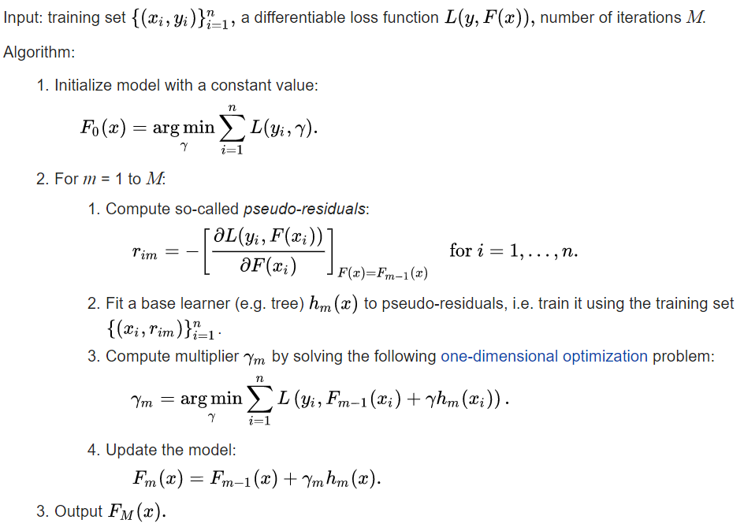
Gradient Boosting

Slide 9
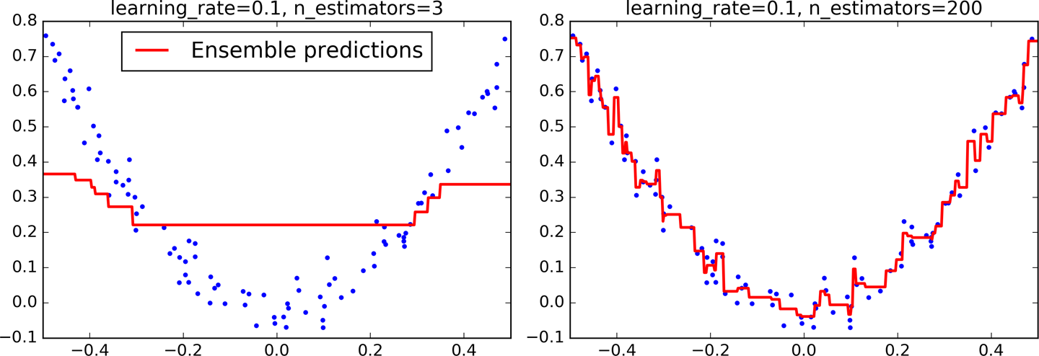
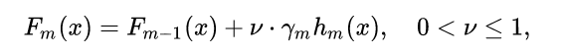
Shrinkage Regularization
Learning rate
the smaller, the better generalization

