Slide 1
Chapter 4. Training Models

Slide 2
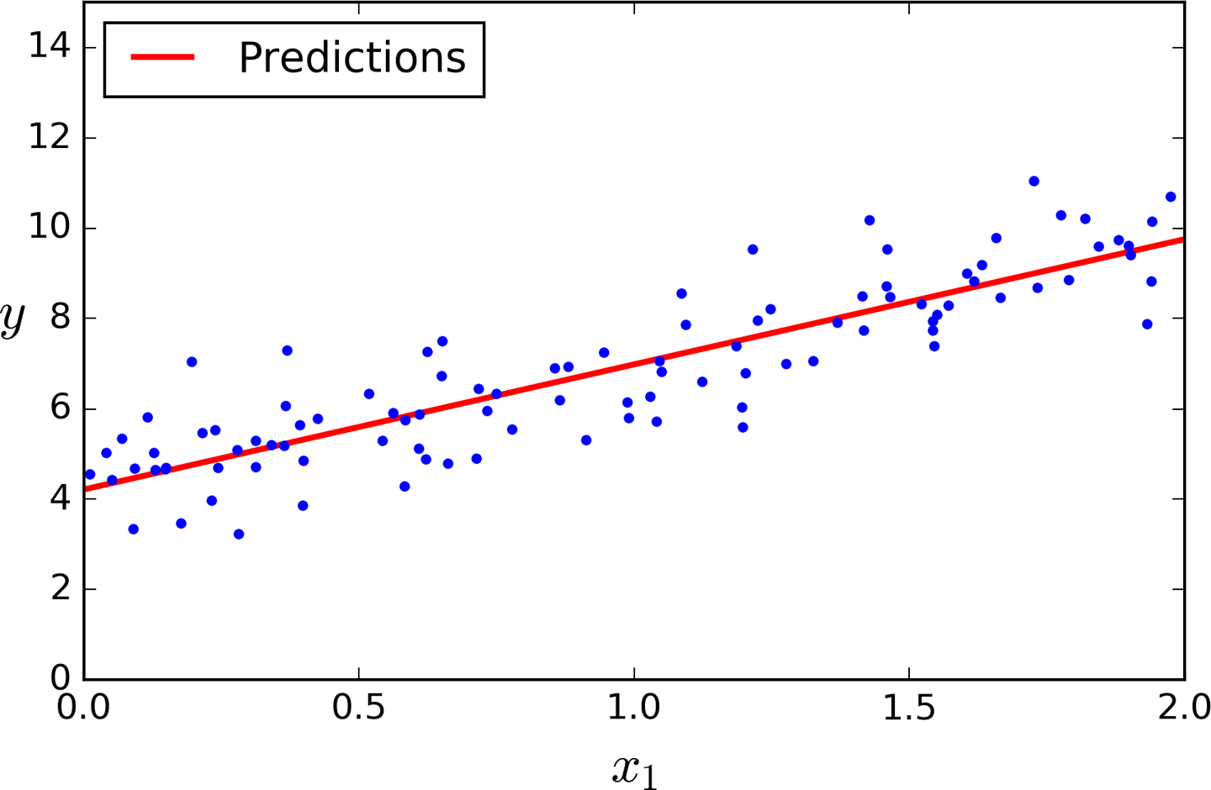
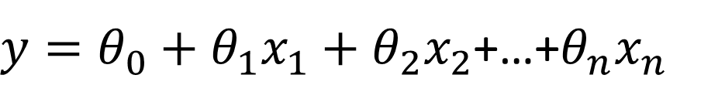


Linear Regression
$y=θ_{0}+θ_{1}x_{1}+θ_{2}x_{2}$+…+$θ_{n}x_{n}$
$$y=Xθ$$
The Normal Equation – a closed-form solution
$$\hat{θ}={\left(X^{T}X\right)}^{−1}X^{T}y$$

Slide 3
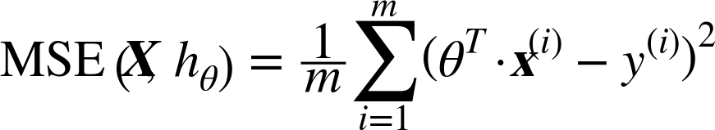
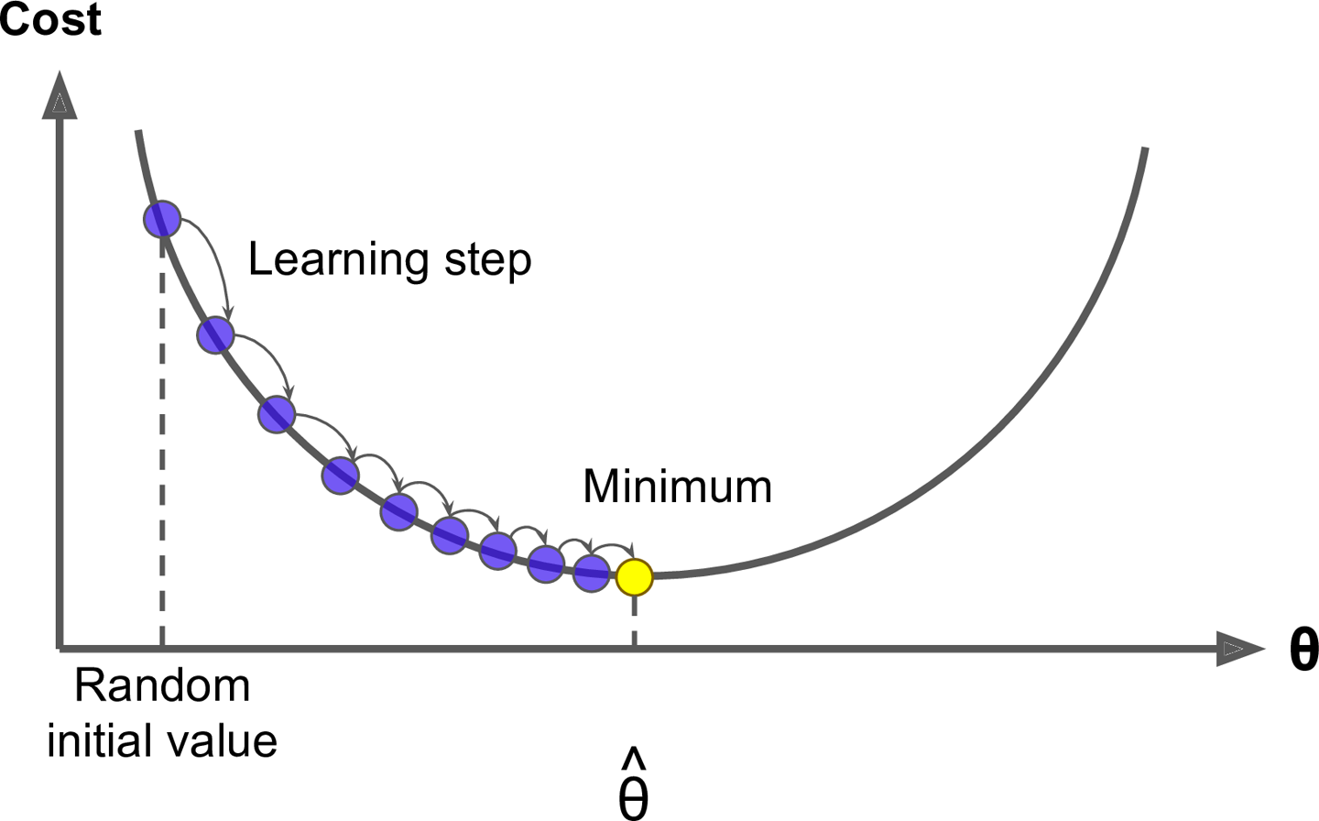
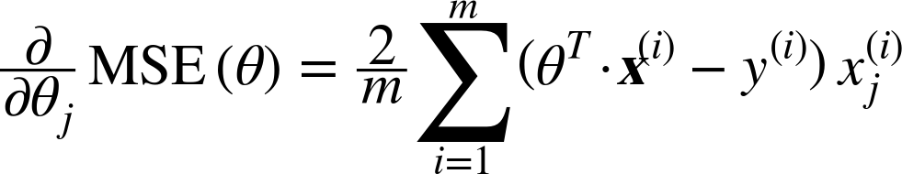
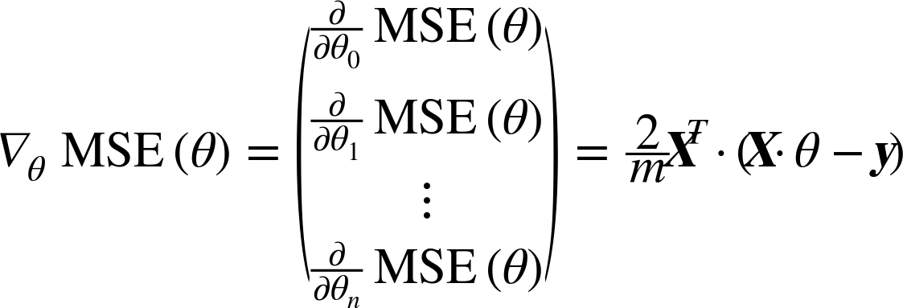

Gradient Descent
Cost:

Slide 4
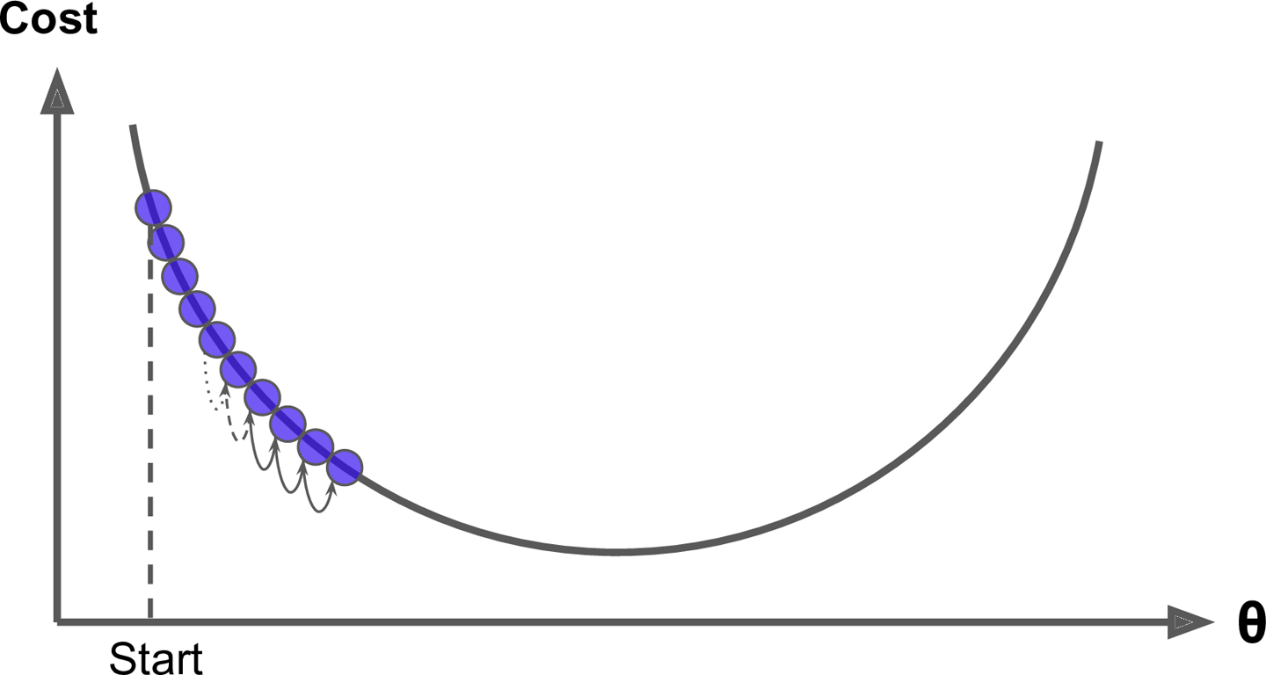
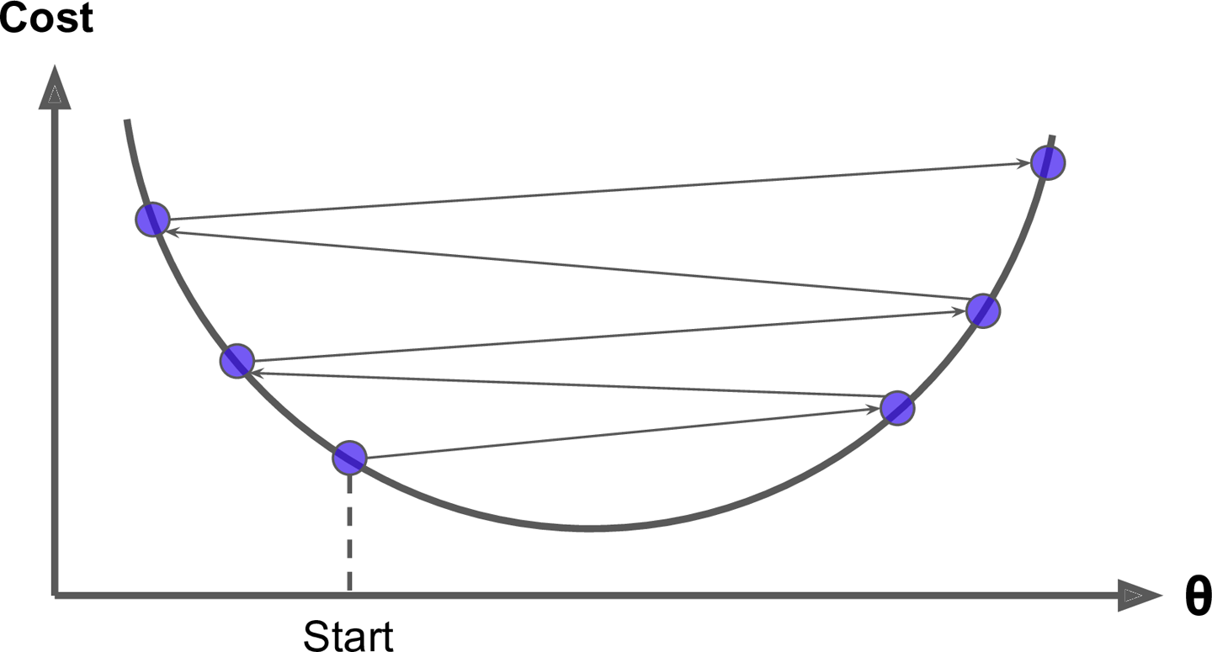
Gradient Descent
Small learning rate
Large learning rate

Slide 5
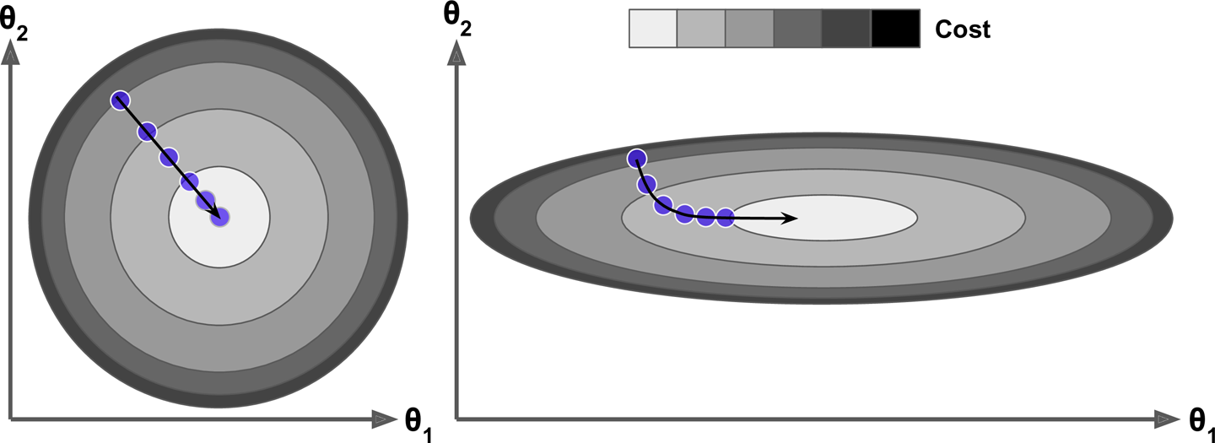
Gradient Descent
Gradient Descent with and without feature scaling

Slide 6
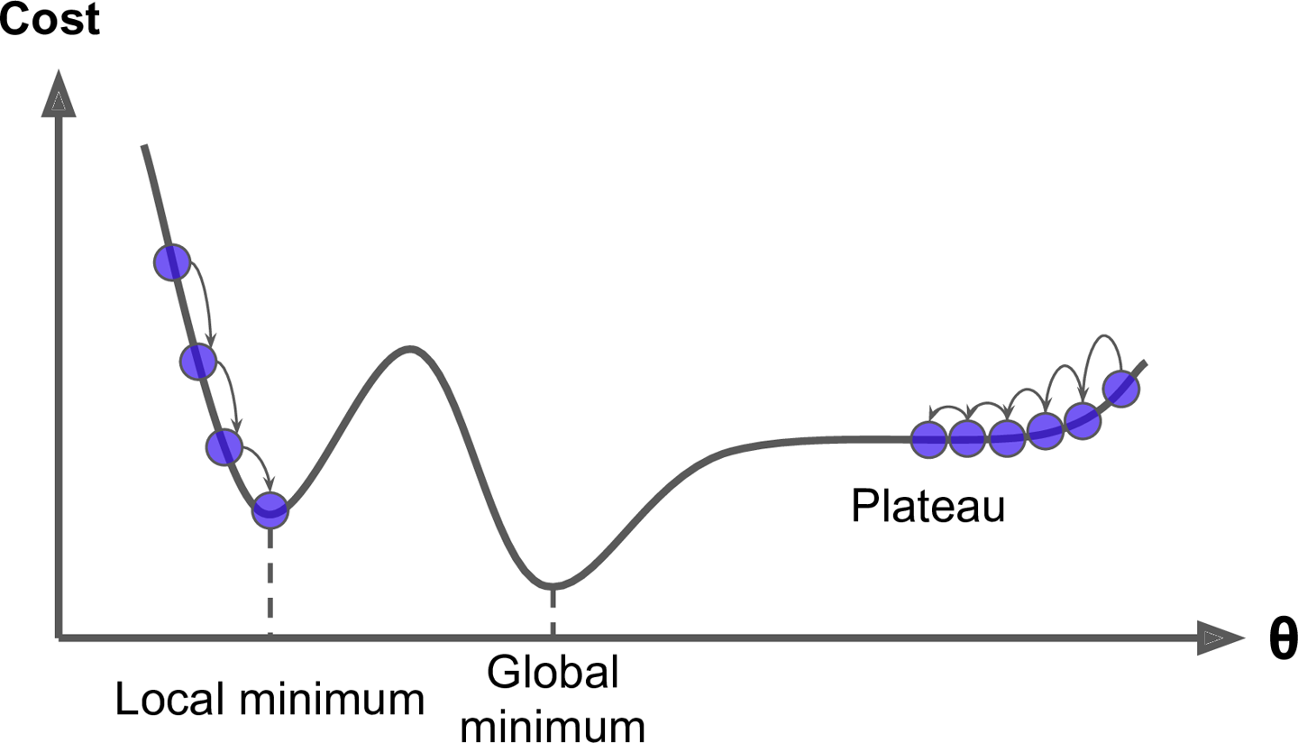
Gradient Descent

Slide 7
Types of Gradient Descent
Batch Gradient Descent
Stochastic Gradient Descent
Mini-batch Gradient Descent
A | B
A | B
A | B

Slide 8
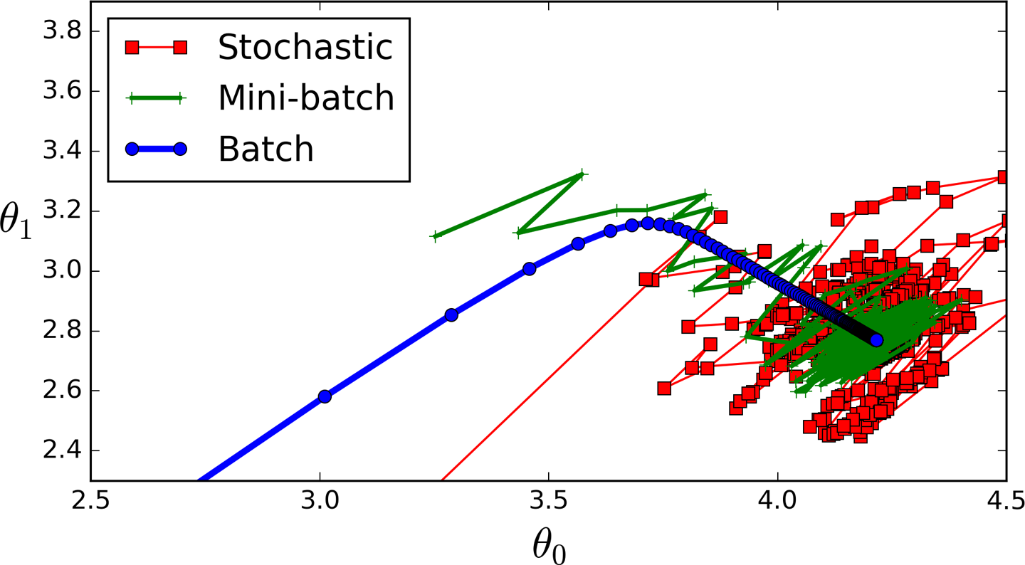
Types of Gradient Descent

Slide 9
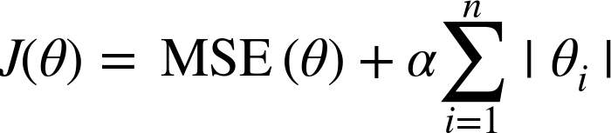
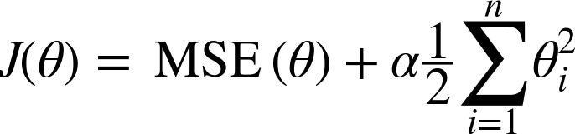
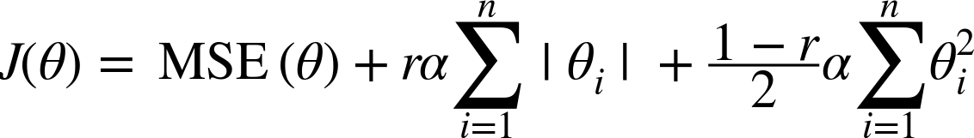
Regularization
Lasso Regression:
Ridge Regression:
Elastic Net:

Slide 10
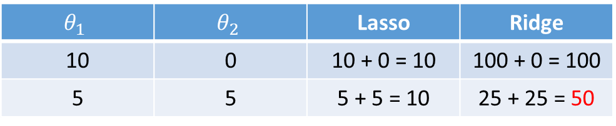
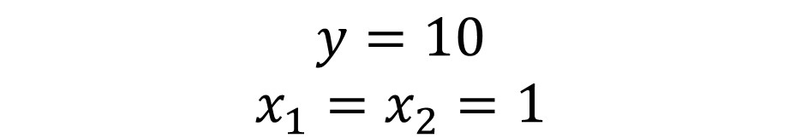
Lasso vs. Ridge
$$y=θ_{1}x_{1}+θ_{2}x_{2}$$
$$y=10$$
$$x_{1}=x_{2}=1$$
Lasso:
$$θ_{1}$$ | $$θ_{2}$$ | Lasso | Ridge
10 | 0 | 10 + 0 = 10 | 100 + 0 = 100
5 | 5 | 5 + 5 = 10 | 25 + 25 = 50
Ridge:
Lasso results in sparse solutions – vector with more zero coordinates
➔Dimension reduction, save memory

Slide 11
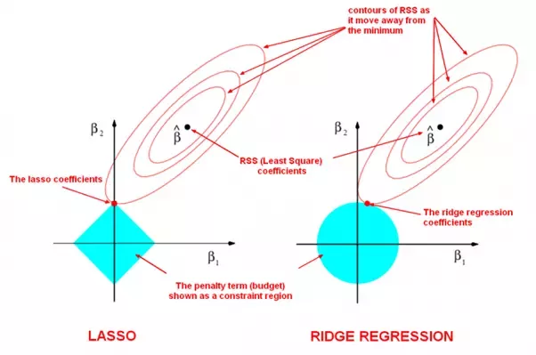
Lasso vs. Ridge
Lasso:
Ridge:
Lasso results in sparse solutions – vector with more zero coordinates
➔Dimension reduction, save memory

Slide 12
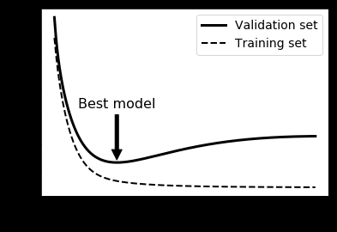
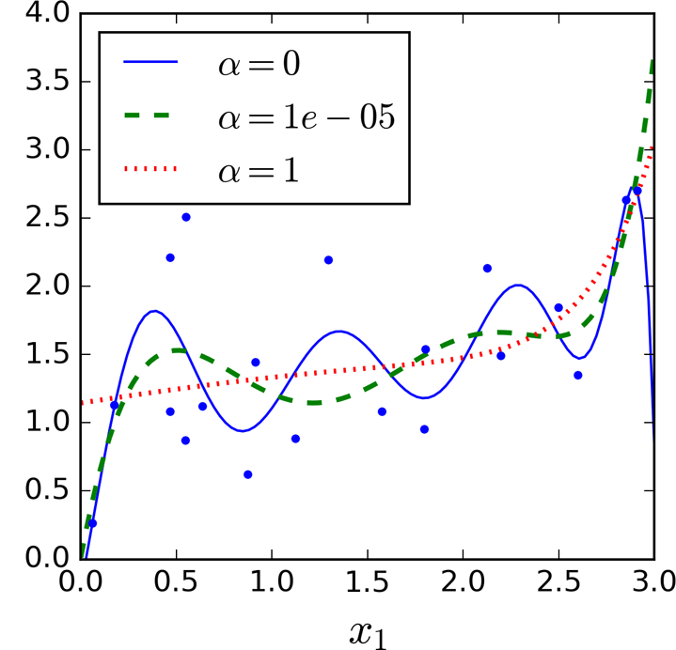
Overfitting & Underfitting

Slide 13
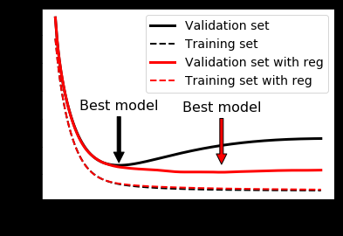
Overfitting & Underfitting

