Slide 1
Chapter 5. Support Vector Machines

Slide 2
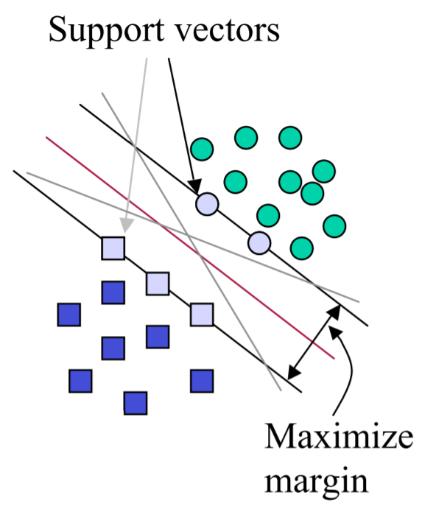
Support Vector Machine (SVM)
SVMs maximize the margin (called ‘street’) around the separating hyperplane.
The decision boundary is fully determined (or “supported”) by the instances located on the edge of the street.
These instances are called support vectors.

Slide 3
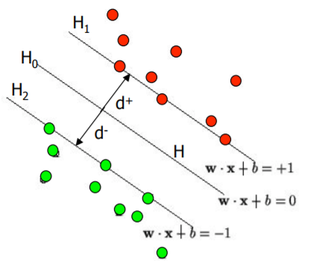
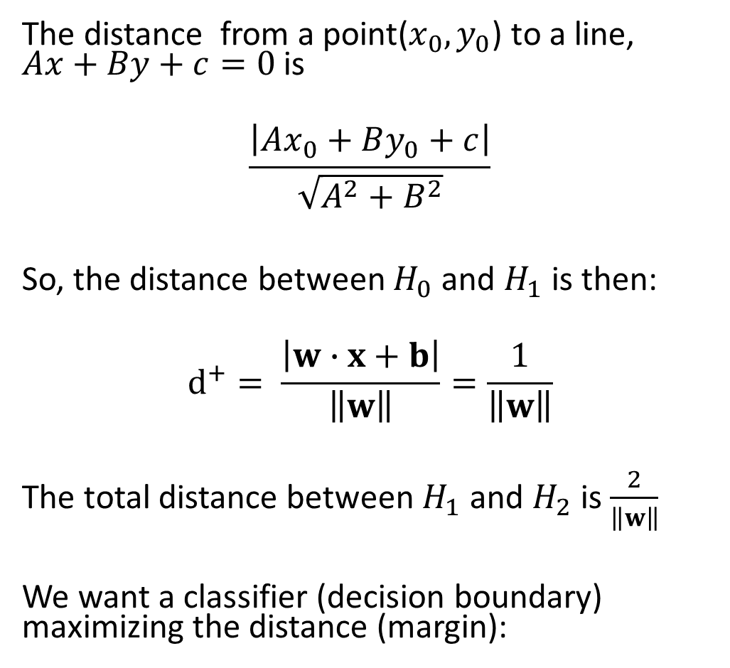
Maximizing the margin (aka street width)
The distance from a point($x_{0}, y_{0}$) to a line, $Ax+By+c=0$ is
$$\frac{\left|Ax_{0}+By_{0}+c\right|}{\sqrt{A^{2}+B^{2}}}$$
So, the distance between $H_{0}$ and $H_{1}$ is then:
$$d^{+}= \frac{\left|w∙x+b\right|}{\left\|w\right\|}=\frac{1}{\left\|w\right\|}$$
The total distance between $H_{1}$ and $H_{2}$ is $\frac{2}{\left\|w\right\|}$
We want a classifier (decision boundary) maximizing the distance (margin):

Slide 4
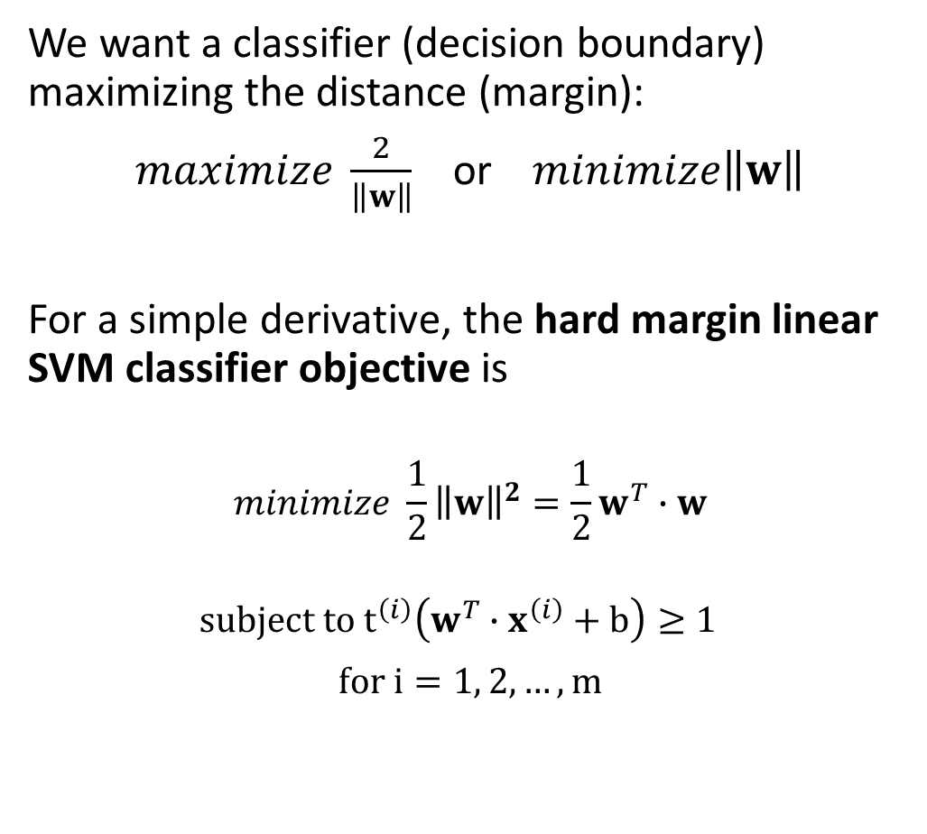


Maximizing the margin (aka street width)
We want a classifier (decision boundary) maximizing the distance (margin):
$maximize \frac{2}{\left\|w\right\|}$ or $minimize\left\|w\right\|$
For a simple derivative, the hard margin linear SVM classifier objective is
$$minimize \frac{1}{2}{\left\|w\right\|}^{2}=\frac{1}{2}w^{T}∙w$$
$$subject to t^{\left(i\right)}\left(w^{T}∙x^{\left(i\right)}+b\right)≥1$$
$for i=1, 2, …, m$
$t^{\left(i\right)}$=1
$t^{\left(i\right)}$=-1

Slide 5
Margin Violations

Slide 6
Margin Violations
Outlier

Slide 7
Margin Violations
??
Outlier

Slide 8

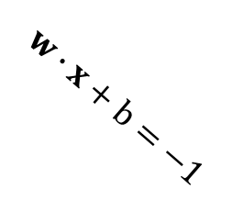
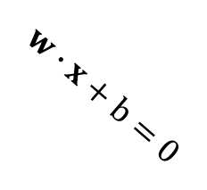
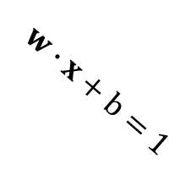

Maximizing the margin (aka street width)
Soft margin linear SVM classifier objective:
$$minimize \frac{1}{2}w^{T}∙w+C\sum_{i=1}^{m}{η^{(i)}}$$
$subject to t^{\left(i\right)}\left(w^{T}∙x^{\left(i\right)}+b\right)≥1−η^{(i)}$ and $η^{(i)}≥0$
$for i=1, 2, …, m$
➔ Quadratic Programming Problem
$$H_{0}$$
$$w∙x+b=1$$
$$w∙x+b=0$$
$$w∙x+b=−1$$

Slide 9
Maximizing the margin (aka street width)
Soft margin linear SVM classifier objective:
$$minimize \frac{1}{2}w^{T}∙w+C\sum_{i=1}^{m}{η^{(i)}}$$
$subject to t^{\left(i\right)}\left(w^{T}∙x^{\left(i\right)}+b\right)≥1−η^{(i)}$ and $η^{(i)}≥0$
$for i=1, 2, …, m$
➔ Quadratic Programming Problem
$$H_{0}$$
$$w∙x+b=1$$
$$w∙x+b=0$$

Slide 10
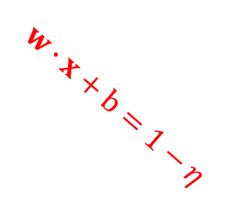

Maximizing the margin (aka street width)
Soft margin linear SVM classifier objective:
$$minimize \frac{1}{2}w^{T}∙w+C\sum_{i=1}^{m}{η^{(i)}}$$
$subject to t^{\left(i\right)}\left(w^{T}∙x^{\left(i\right)}+b\right)≥1−η^{(i)}$ and $η^{(i)}≥0$
$for i=1, 2, …, m$
➔ Quadratic Programming Problem
$$H_{0}$$
$$η^{(i)}$$
$$w∙x+b=1$$
$$w∙x+b=1−η$$
$$w∙x+b=0$$

Slide 11
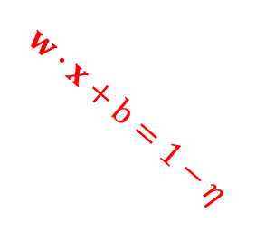
Maximizing the margin (aka street width)
Soft margin linear SVM classifier objective:
$$minimize \frac{1}{2}w^{T}∙w+C\sum_{i=1}^{m}{η^{(i)}}$$
$subject to t^{\left(i\right)}\left(w^{T}∙x^{\left(i\right)}+b\right)≥1−η^{(i)}$ and $η^{(i)}≥0$
$for i=1, 2, …, m$
➔ Quadratic Programming Problem
$$H_{0}$$
$$η^{(i)}$$
$$w∙x+b=1$$
$$w∙x+b=0$$
$$w∙x+b=1−η$$

Slide 12
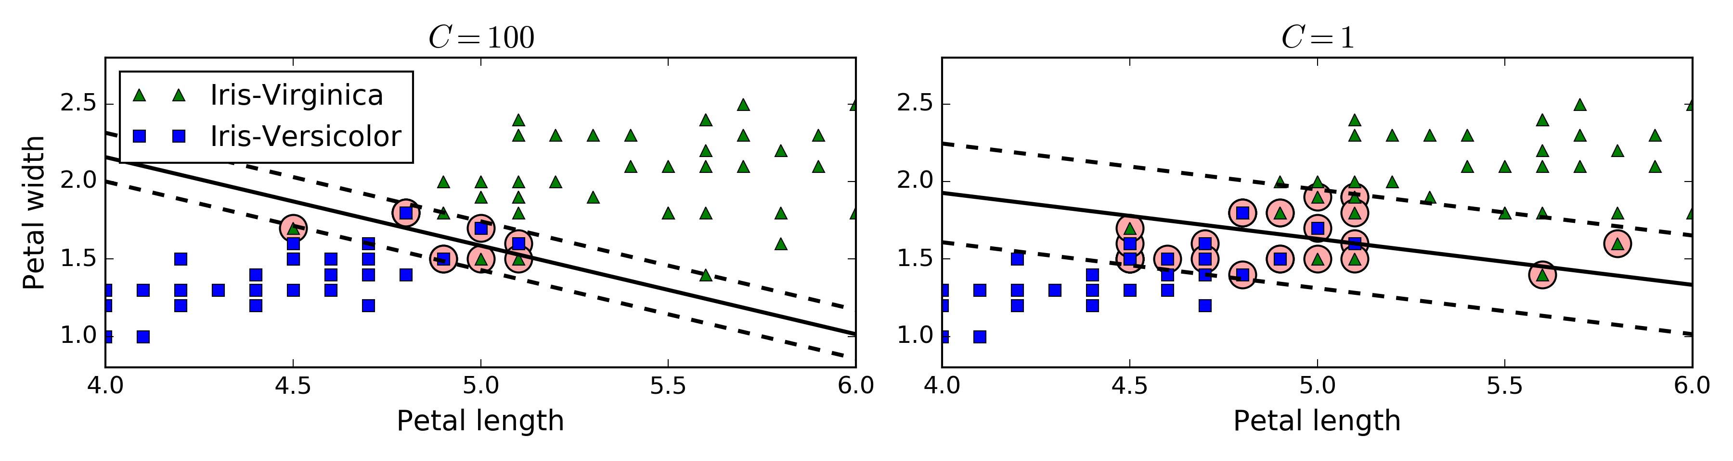

Maximizing the margin (aka street width)
Soft margin linear SVM classifier objective:
$$minimize \frac{1}{2}w^{T}∙w+C\sum_{i=1}^{m}{η^{(i)}}$$
$subject to t^{\left(i\right)}\left(w^{T}∙x^{\left(i\right)}+b\right)≥1−η^{(i)}$ and $η^{(i)}≥0$
$for i=1, 2, …, m$
➔ Quadratic Programming Problem

Slide 13
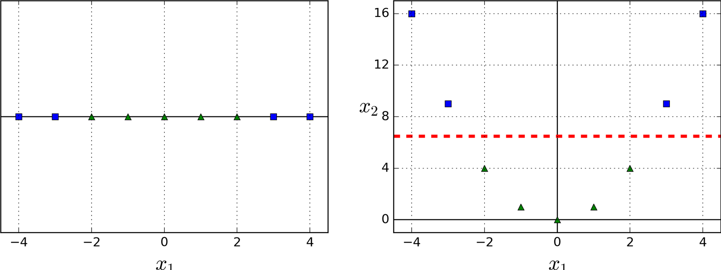
Nonlinear SVM Classification
Adding Polynomial features

Slide 14
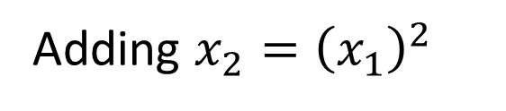
Nonlinear SVM Classification
Adding Polynomial features
Adding $x_{2}={\left(x_{1}\right)}^{2}$

Slide 15
Nonlinear SVM Classification
Adding Polynomial features
Adding $x_{2}={\left(x_{1}\right)}^{2}$
At a low polynomial degree it cannot deal with very complex datasets, and
with a high polynomial degree it creates a huge number of features, making the model too slow ➔ Kernel Trick!!

Slide 16
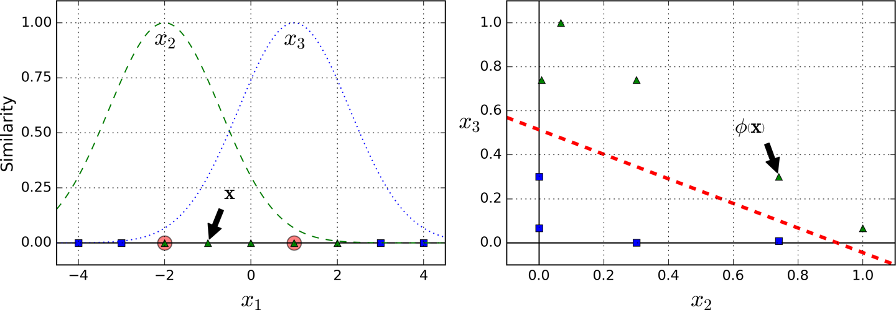
Nonlinear SVM Classification
Landmark
Adding Similarity Features
Gaussian Radial Basis Function (RBF)

Slide 17
Nonlinear SVM Classification
Landmark
Adding Similarity Features
Gaussian Radial Basis Function (RBF)
Creating a landmark at the location of each and every instance in the dataset increase many dimensions and thus creates a huge number of features ➔ Kernel Trick!!

Slide 18
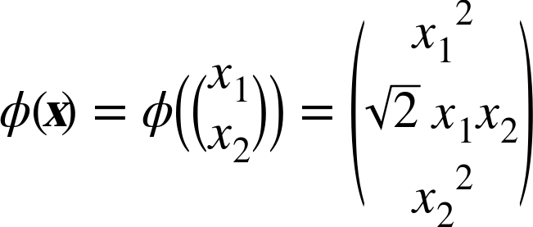
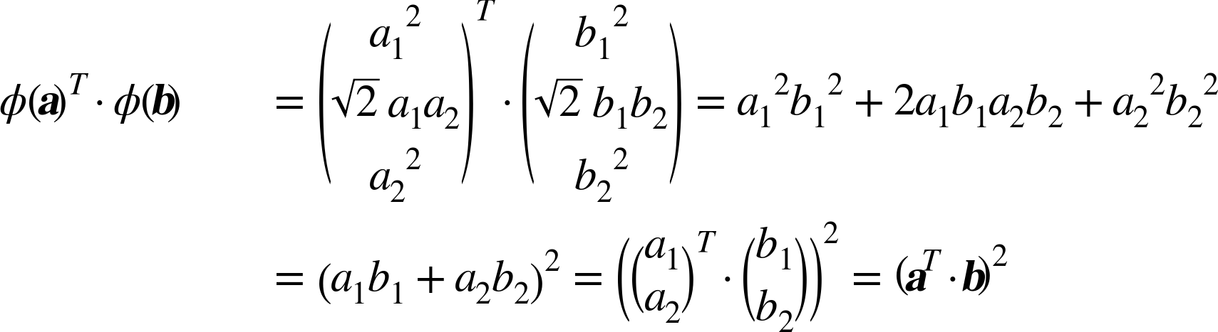
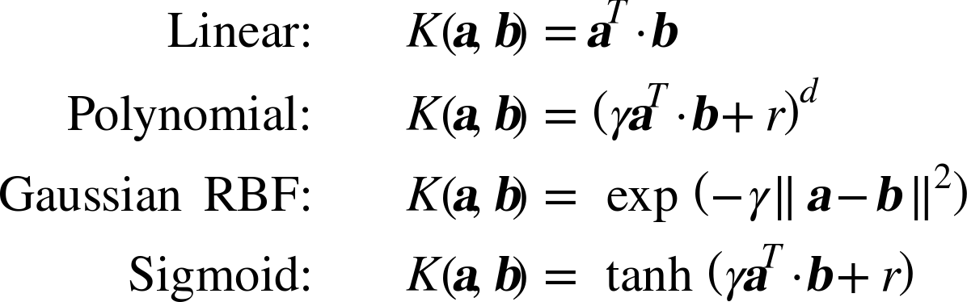
Kernel Trick
2nd-degree polynomial kernel:
Kernel trick for a 2nd-degree polynomial mapping:

Slide 19
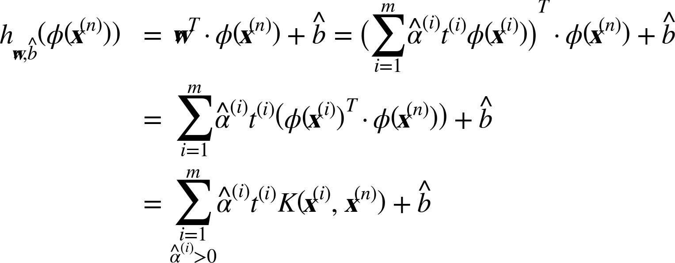
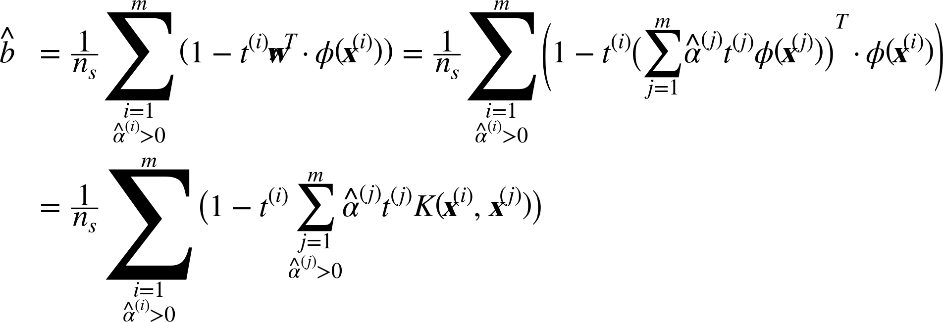
Kernel Trick
Making predictions with a kernelized SVM:

Slide 20
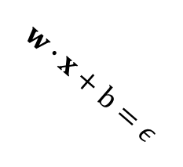
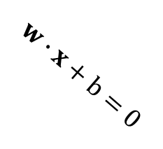

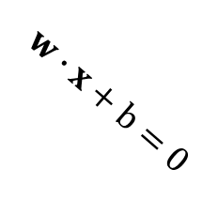
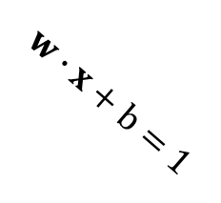
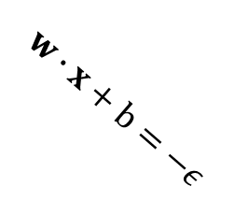

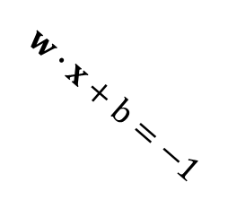
SVM Regression
instead of trying to fit the largest possible street between two classes while limiting margin violations, SVM Regression tries to fit as many instances as possible on the street while limiting margin violations
Classification
Regression
$$H_{0}$$
$$H_{0}$$
$$w∙x+b=1$$
$$w∙x+b=ε$$
$$w∙x+b=0$$
$$w∙x+b=0$$
$$w∙x+b=−1$$
$$w∙x+b=−ε$$

Slide 21
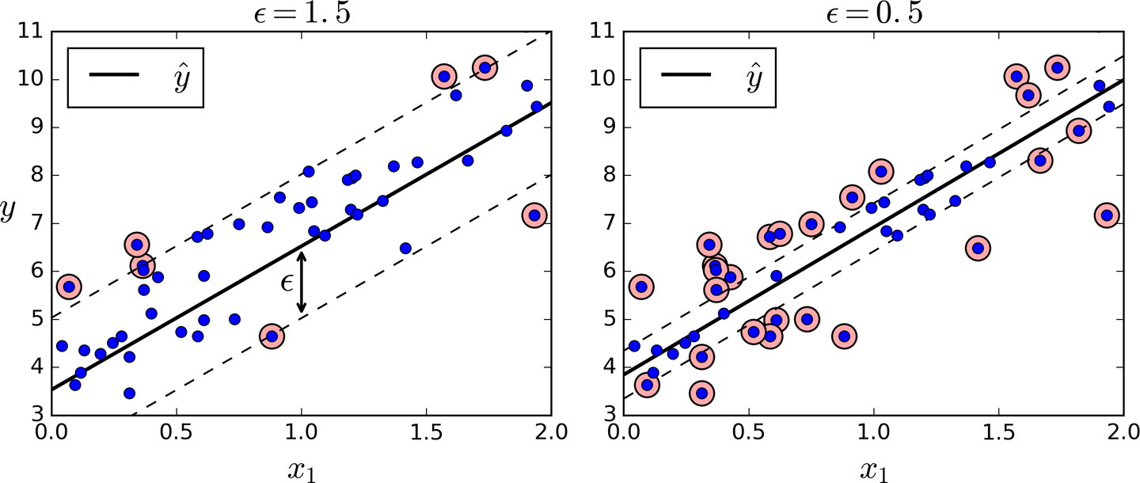
SVM Regression
instead of trying to fit the largest possible street between two classes while limiting margin violations, SVM Regression tries to fit as many instances as possible on the street while limiting margin violations

