Slide 1
Chapter 3. Classification

Slide 2
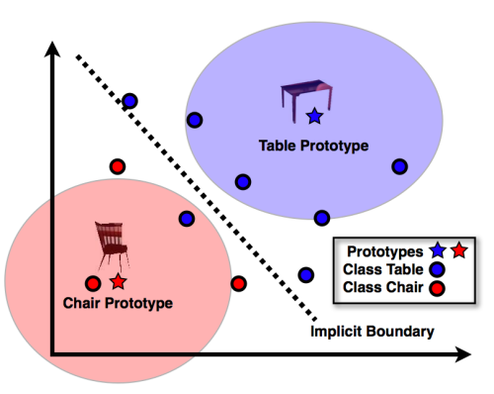
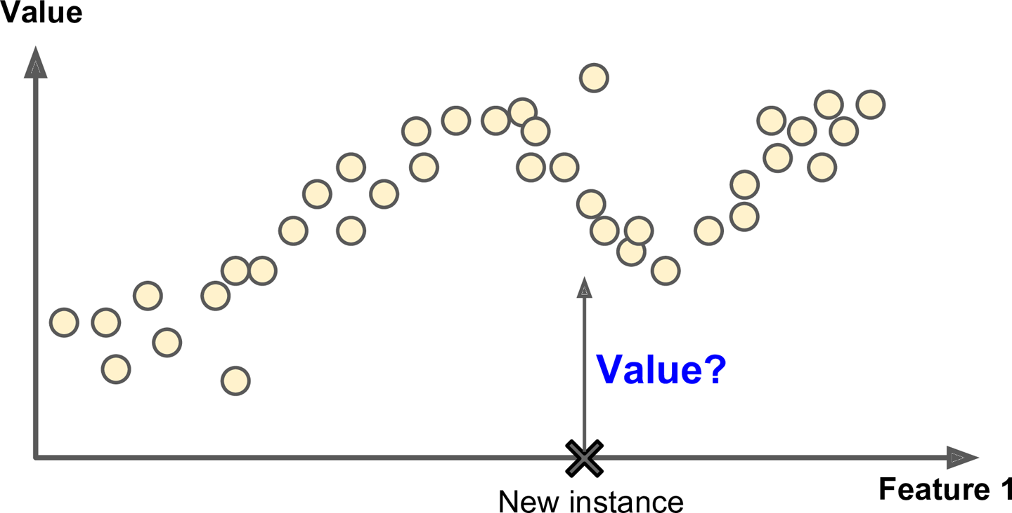
Regression vs. Classification

Slide 3
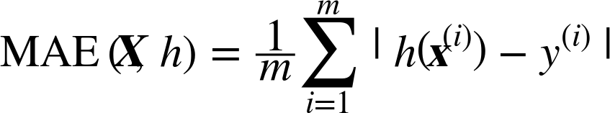
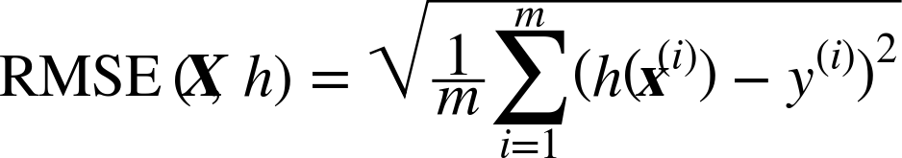
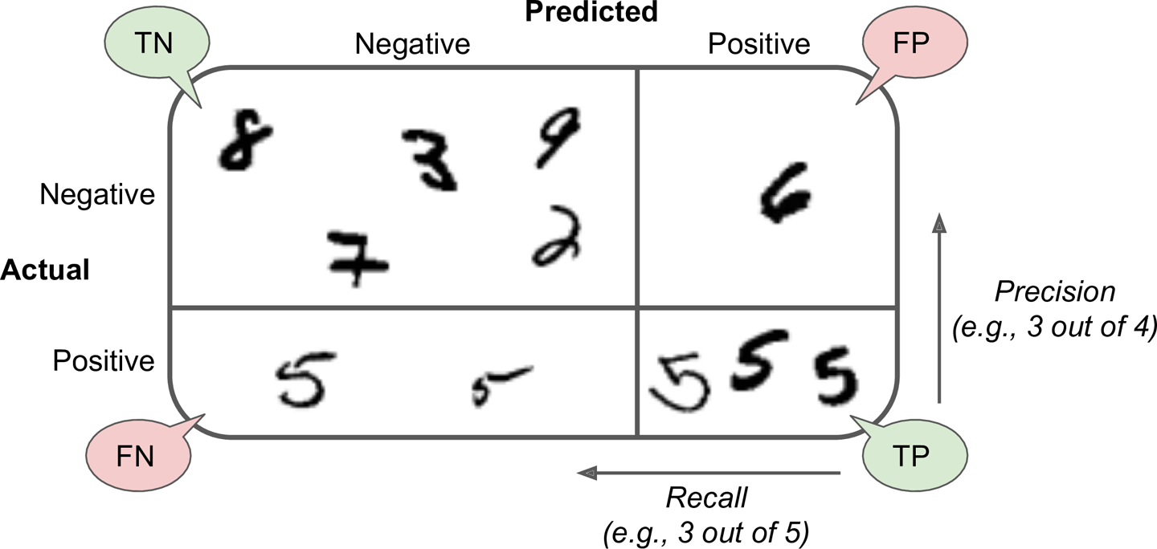
Performance Measure
Regression:
Mean Absolute Error:
Root Mean Square Error:
…
Confusion Matrix
Classification:
Accuracy
Precision
Recall
F1 Score

Slide 4
Confusion Matrix
질문) 그림의 숫자가 5 입니까?
True Negative:
아니요(Negative) ➔ 딩동댕!(True)
False Positive:
네 (Positive) ➔ 땡!(False)
False Negative:
아니요(Negative) ➔ 땡! (False)
True Positive:
네 (Positive) ➔ 딩동댕! (True)

Slide 5
Confusion Matrix
True Negative:
아니요(Negative) ➔ 딩동댕!(True)
False Positive:
네 (Positive) ➔ 땡!(False)
False Negative:
아니요(Negative) ➔ 땡! (False)
True Positive:
네 (Positive) ➔ 딩동댕! (True)
Accuracy: 예측이 얼마나 정확한가?
(TP + TN)/total
Precision: “네”라고 했을 때, 예측이 얼마나 정확한가?
TP/(TP + FP)
Recall: 실제 그림이 5일때, 예측이 얼마나 정확한가?
TP/(TP + FN)
F1 Score: recall과 precision의 조화평균
2*(Recall*Precision)/(Recall + Precision)

Slide 6
Confusion Matrix Example
환자 100명 중 암환자 4 명
Total = 100 | Predicted: NO | Predicted: YES
Actual: NO | TN 96 | FP 0
Actual: YES | FN 4 | TP 0
Total = 100 | Predicted: NO | Predicted: YES
Actual: NO | TN 91 | FP 5
Actual: YES | FN 0 | TP 4
Total = 100 | Predicted: NO | Predicted: YES
Actual: NO | TN 93 | FP 3
Actual: YES | FN 1 | TP 3
Accuracy | 96%
Precision | 0%
Recall | 0%
F1 score | 0%
Accuracy | 95%
Precision | 44%
Recall | 100%
F1 score | 62%
Accuracy | 96%
Precision | 50%
Recall | 75%
F1 score | 60%

Slide 7
Precision vs. Recall
아이들을 위한 동영상 추천
Total = 100 | Predicted: NO | Predicted: YES
Actual: NO | TN 93 | FP 3
Actual: YES | FN 0 | TP 4
Total = 100 | Predicted: NO | Predicted: YES
Actual: NO | TN 96 | FP 0
Actual: YES | FN 3 | TP 1
Not Safe
Not Safe
Safe
Safe
Accuracy | 97%
Precision | 57%
Recall | 100%
Accuracy | 97%
Precision | 100%
Recall | 25%

Slide 8
Precision vs. Recall
감시카메라에서의 예상 범죄자 사진 보여주는 모델
Total = 100 | Predicted: NO | Predicted: YES
Actual: NO | TN 93 | FP 3
Actual: YES | FN 0 | TP 4
Total = 100 | Predicted: NO | Predicted: YES
Actual: NO | TN 96 | FP 0
Actual: YES | FN 3 | TP 1
범죄자 아님
범죄자 아님
범죄자
범죄자
Accuracy | 97%
Precision | 57%
Recall | 100%
Accuracy | 97%
Precision | 100%
Recall | 25%

Slide 9
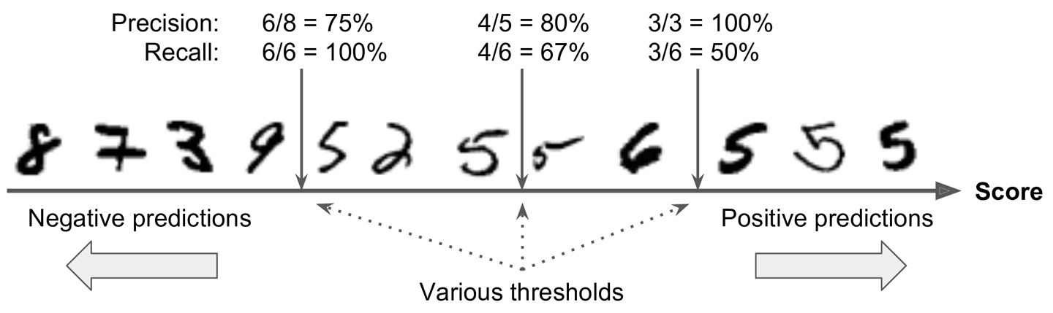
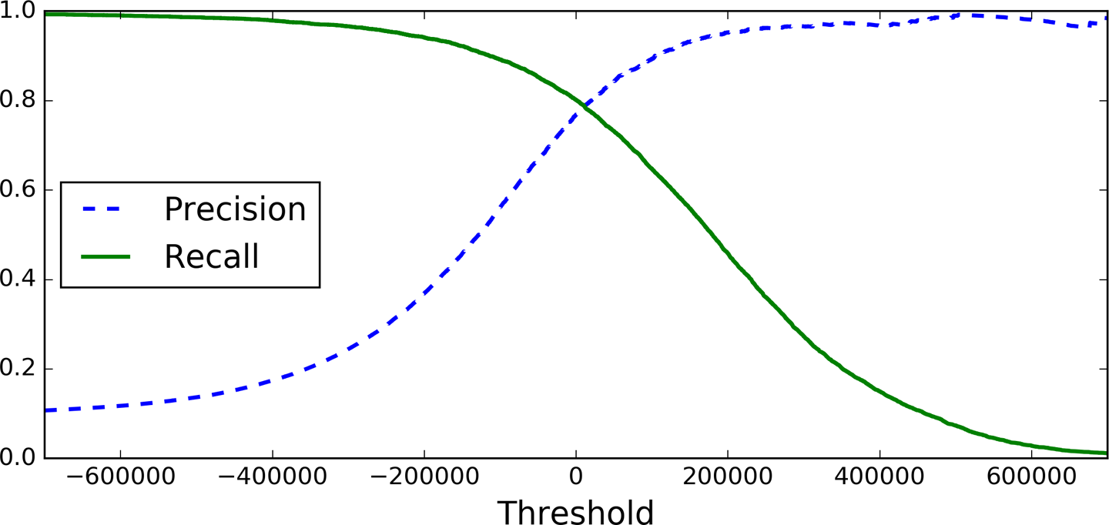
Precision/Recall Tradeoff

Slide 10

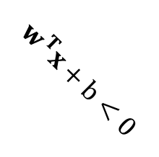
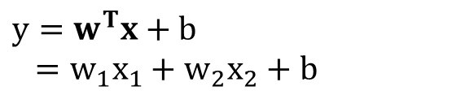
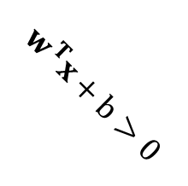
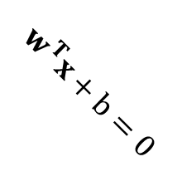

Linear Classifier
Optimize some “loss function”
Determine coefficients(w) and bias(b)
Get the signed distance(y) to the hyperplane(or line in 2D) w.r.t data sample (x)
Determine threshold (default: threshold=0)
If the distance, y, is larger than the threshold, the x is true.
$y=w^{T}x+b$
$=w_{1}x_{1}+w_{2}x_{2}+b$
$$x_{2}$$
$$w^{T}x+b>0$$
$$w^{T}x+b=0$$
$$w^{T}x+b<0$$
$$x_{1}$$

Slide 11
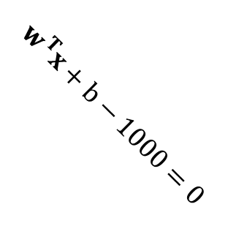
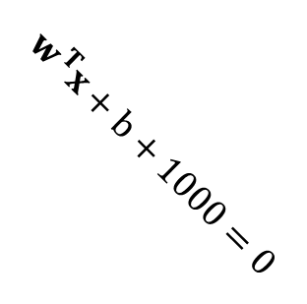
Linear Classifier
Optimize some “loss function”
Determine coefficients(w) and bias(b)
Get the signed distance(y) to the hyperplane(or line in 2D) w.r.t data sample (x)
Determine threshold (default: threshold=0)
If the distance, y, is larger than the threshold, the x is true.
$y=w^{T}x+b$
$=w_{1}x_{1}+w_{2}x_{2}+b$
$$x_{2}$$
$$w^{T}x+b+1000=0$$
$$w^{T}x+b=0$$
$$w^{T}x+b−1000=0$$
$$x_{1}$$
threshold

Slide 12


Linear Classifier
$$x$$
$$w$$
0 | 211 | 12 | … | 234 | 1 | 0
1 | 231 | 12 | … | 231 | 223 | 0
… | … | … | … | … | … | …
… | … | … | … | … | … | …
… | … | … | … | … | … | …
… | … | … | … | … | … | …
… | … | … | … | … | … | …
… | … | … | … | … | … | …
… | … | … | … | … | … | …
… | … | … | … | … | … | …
0.1
0.32
-21
…
…
…
…
…
…
…
…
200000
…
…
…
600000
…
…
-623019
…
.
=

Slide 13
Precision/Recall Tradeoff

Slide 14
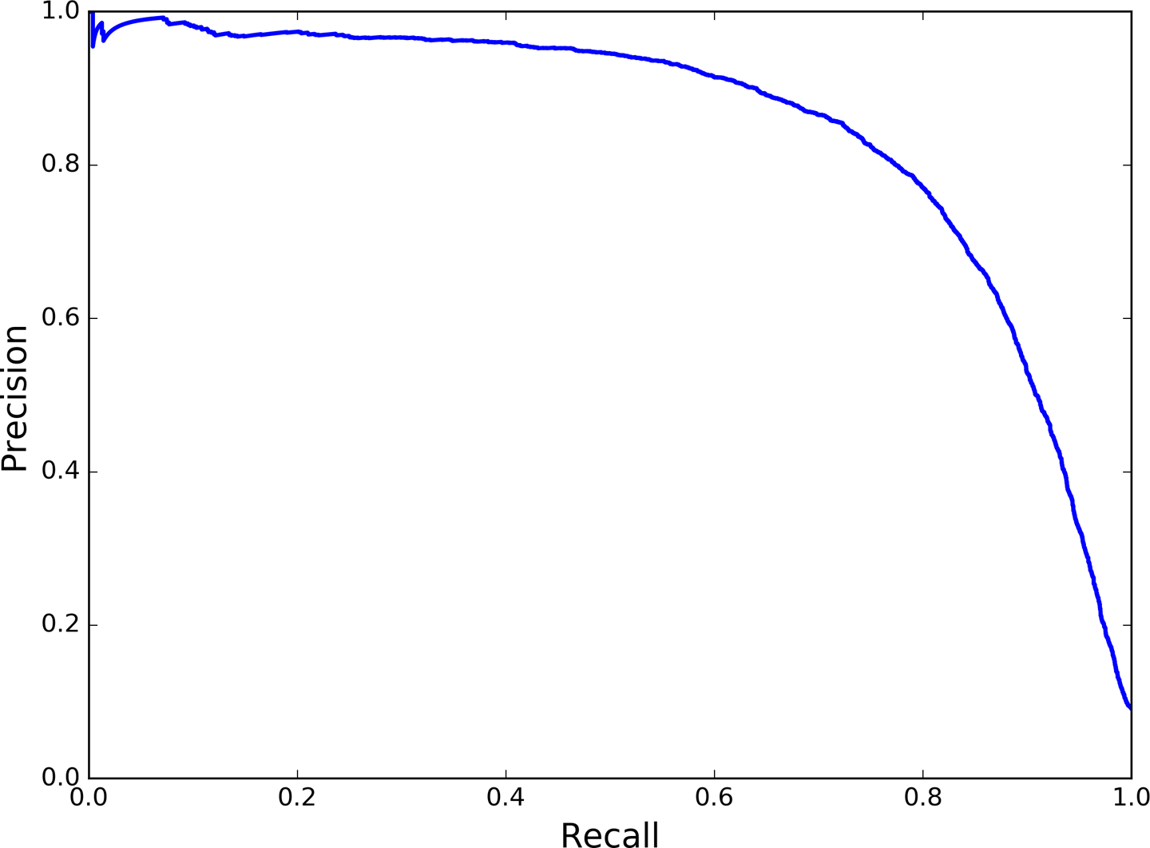
Precision vs. Recall

Slide 15
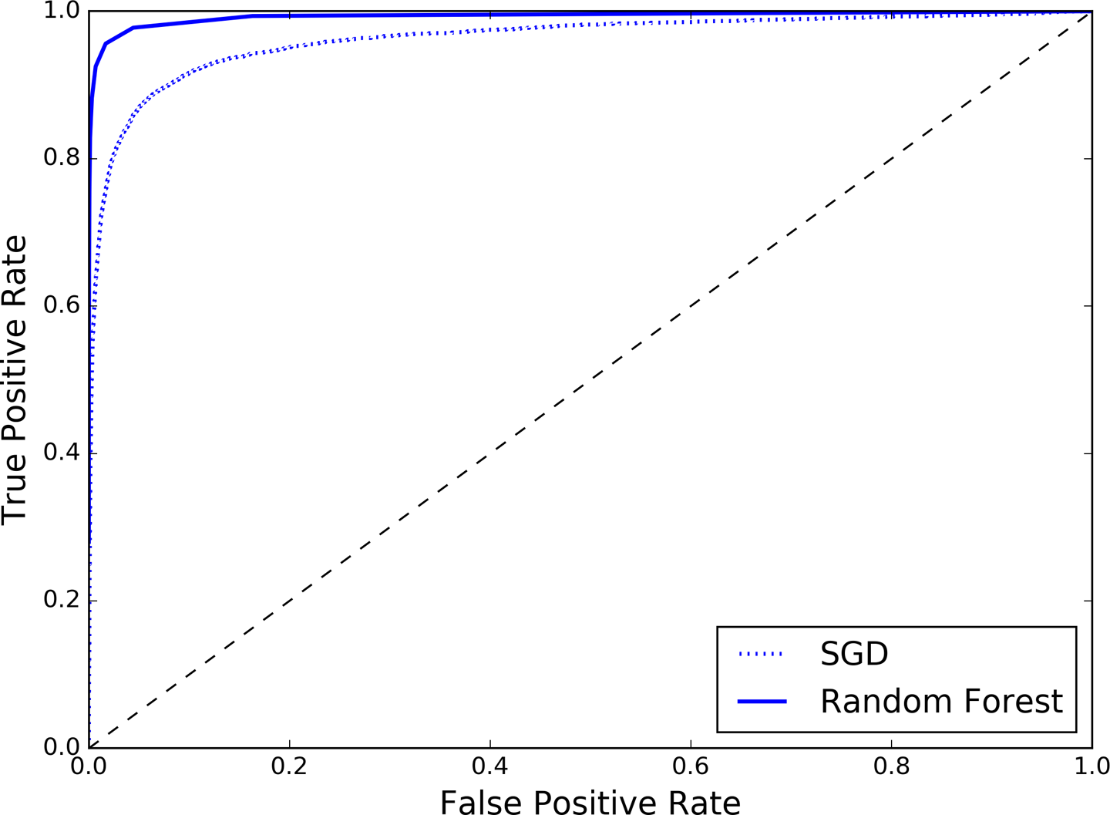
The ROC Curve
Random classifier
Area Under the Curve (AUC)
True Positive Rate(TPR) – recall
False Positive Rate(FPR) = FP/(FP + TN)

