Slide 1
Chapter 6. Decision Trees

Slide 2
Tree-based Models
Decision Tree
Random Forest
Gradient Boosting
Tree#1
Tree#2
Tree#3
Tree#1
Tree#2
Tree#4
Tree#k
Tree#k
……
……
Prone to over-fitting
Ensemble parallel trees
Random sampling of data
(Bagging)
Random sampling of features
Slow to score
Only one parameter to tune
(number of samples)
Ensemble consecutive trees
Optimize cost function (gradient decent)
Update weights based on the net loss of the prior trees

Slide 3
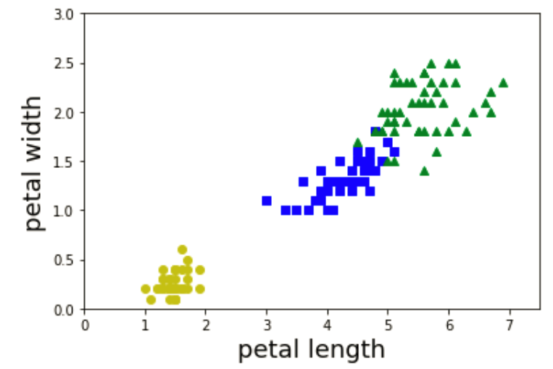
Training Decision Tree

Slide 4
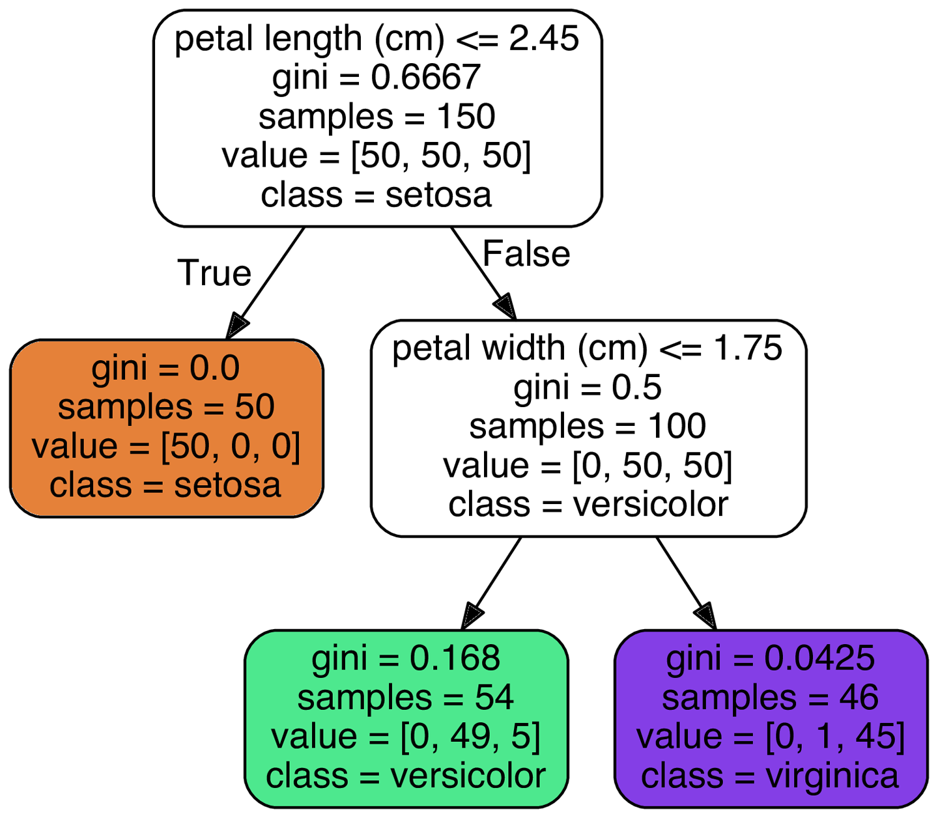
Training Decision Tree
Depth=0
Depth=0

Slide 5
Training Decision Tree
Depth=0
Depth=0

Slide 6
Training Decision Tree
Depth=0
Depth=0
Depth=1
Depth=1

Slide 7
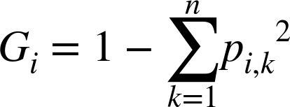
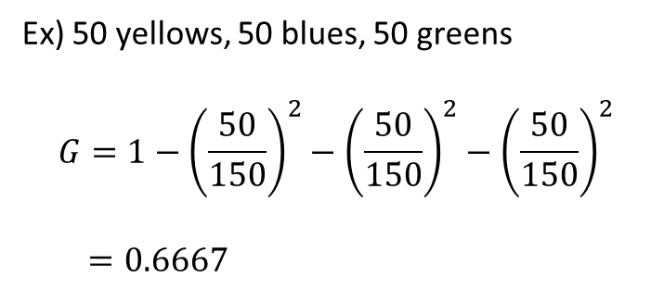
Training Decision Tree
Gini Impurity:
Depth=0
p_{i,k} is the ratio of class k instances among the training instances in the i^{th} node.
Depth=1
Ex) 50 yellows, 50 blues, 50 greens
$$G=1−{\left(\frac{50}{150}\right)}^{2}−{\left(\frac{50}{150}\right)}^{2}−{\left(\frac{50}{150}\right)}^{2}$$
$$=0.6667$$

Slide 8
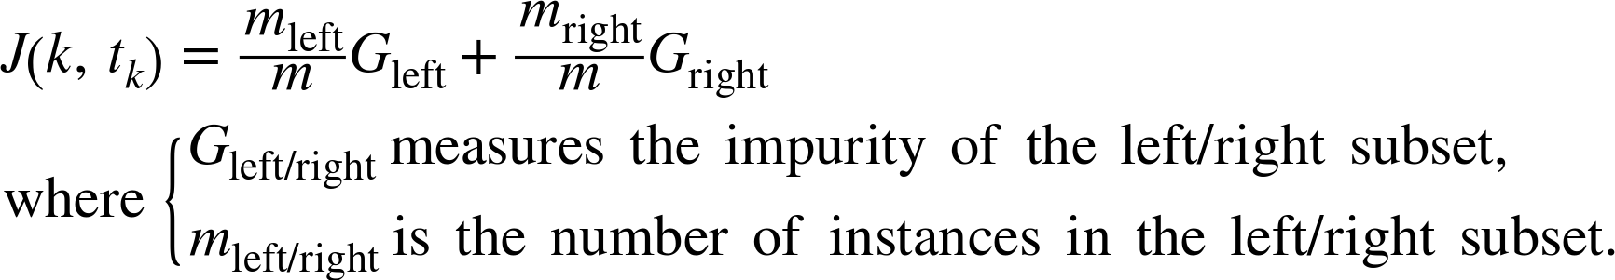
Training Decision Tree
CART (Classification And Regression Tree) algorithm:
splits the training set in two subsets using a single feature k and a threshold t_{k}
Depth=0
Cost function:
Depth=1
➔ minimize

Slide 9
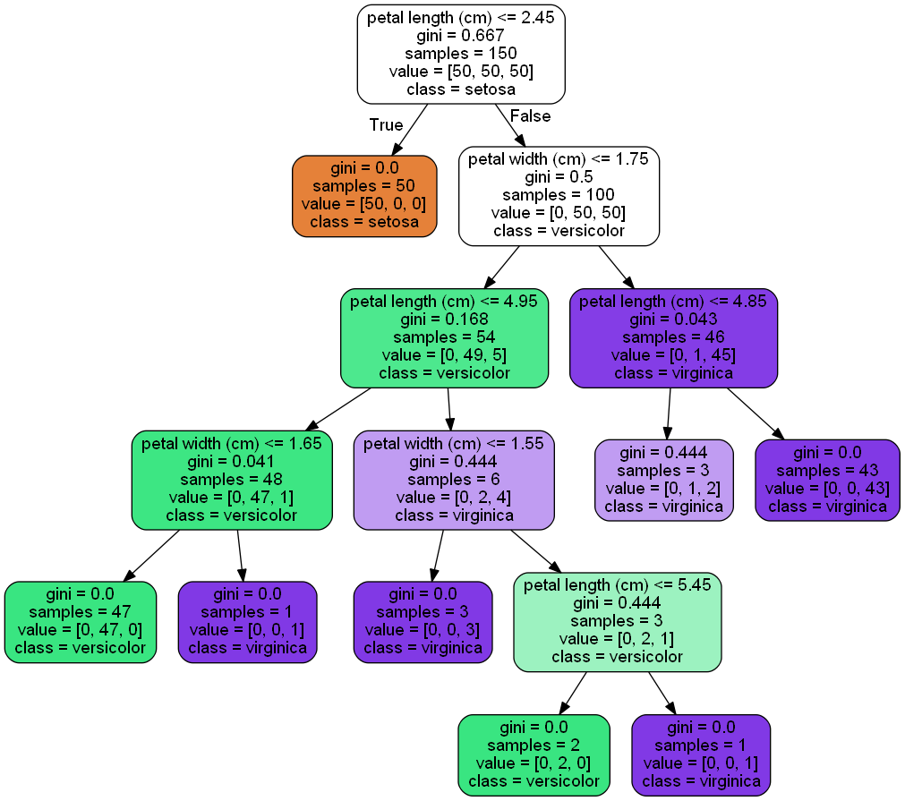
Regularization Hyperparameters
max_depth
the maximum depth of the Decision Tree
min_samples_split
the minimum number of samples a node must have before it can be split
min_samples_leaf
the minimum number of samples a leaf node must have
min_weight_fraction_leaf
same as min_samples_leaf but expressed as a fraction of the total number of weighted instances
max_leaf_nodes
maximum number of leaf nodes
max_features
maximum number of features that are evaluated for splitting at each node
➔ Increasing min_* or reducing max_* hyperparameters will regularize the model

Slide 10
Regularization Hyperparameters
max_depth = 2
the maximum depth of the Decision Tree
min_samples_split
the minimum number of samples a node must have before it can be split
min_samples_leaf
the minimum number of samples a leaf node must have
min_weight_fraction_leaf
same as min_samples_leaf but expressed as a fraction of the total number of weighted instances
max_leaf_nodes
maximum number of leaf nodes
max_features
maximum number of features that are evaluated for splitting at each node
➔ Increasing min_* or reducing max_* hyperparameters will regularize the model

Slide 11
Regularization Hyperparameters
max_depth = None
the maximum depth of the Decision Tree
min_samples_split = 10
the minimum number of samples a node must have before it can be split
min_samples_leaf
the minimum number of samples a leaf node must have
min_weight_fraction_leaf
same as min_samples_leaf but expressed as a fraction of the total number of weighted instances
max_leaf_nodes
maximum number of leaf nodes
max_features
maximum number of features that are evaluated for splitting at each node
➔ Increasing min_* or reducing max_* hyperparameters will regularize the model

Slide 12
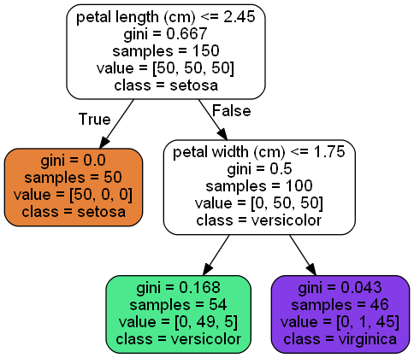
Feature Importance ??????????
It is sometimes called "gini importance" or "mean decrease impurity" and is defined as the total decrease in node impurity (weighted by the probability of reaching that node (which is approximated by the proportion of samples reaching that node)) averaged over all trees of the ensemble.
Breiman, Friedman, "Classification and regression trees", 1984.
Gini importance
Every time a split of a node is made on variable m the gini impurity criterion for the two descendent nodes is less than the parent node. Adding up the gini decreases for each individual variable over all trees in the forest gives a fast variable importance that is often very consistent with the permutation importance measure.
Feature importance
Petal length: 0.56199095
Petal width: 0.43800905

Slide 13
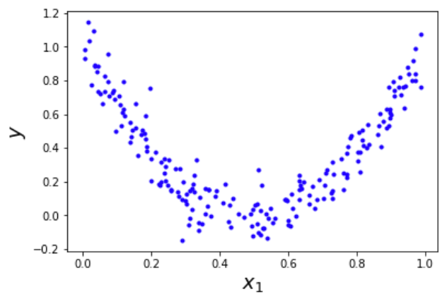
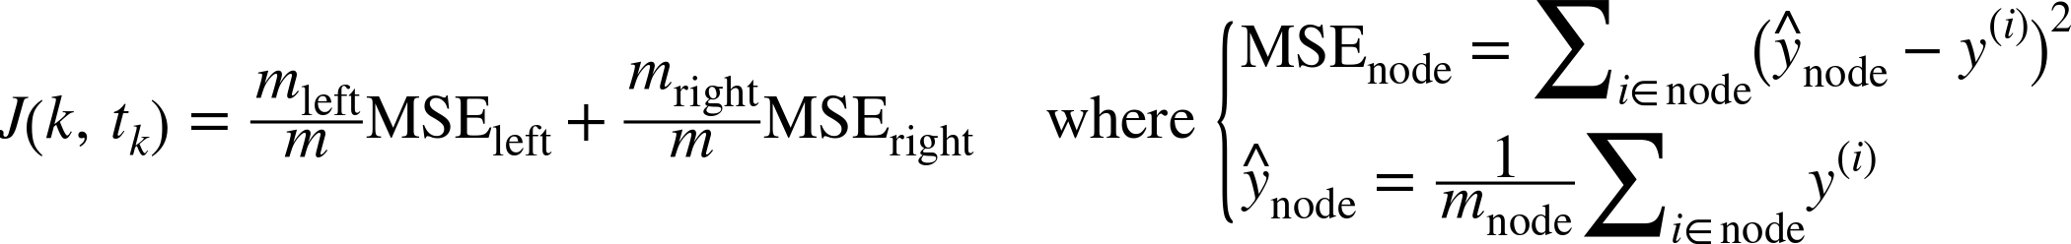
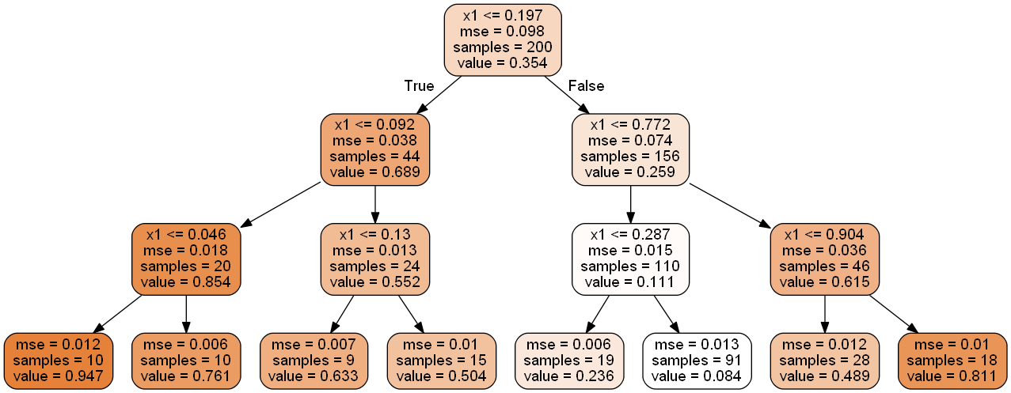
Regression
CART cost function for regression
Depth=0

Slide 14
Regression
CART cost function for regression
Depth=1
Depth=1

Slide 15
Regression
CART cost function for regression

