Slide 1

Shortest Job First (SJF) Non-Preemptive Scheduling
OPERATING SYSTEM REPORT
Operating Systems Report
Group: 3

Slide 2
01
Overview
03
Pros & Cons
Basic introduction to CPU Scheduling and SJF
Main strengths and weaknesses.
PART
PART
CONTENT
02
Working Principle
04
Prediction
05
Description
How SJF Non-Preemptive works
How to predict CPU burst time.
Steps to implement the algorithm.
PART
PART
PART

Slide 3

01
Overview
Basic introduction to CPU Scheduling and SJF
PART

Slide 4
CPU Scheduling
When scheduling decisions occur
1
Organizing the ready queue and distributing CPU time to processes based on priority to optimize CPU usage.
Process moves from running → waiting state
Process moves from running → ready state
Process moves from waiting → ready state
Process terminates
2
Objectives
Maximize CPU utilization – keep CPU busy, avoid idle time
Minimize waiting time (WT) – reduce queue wait before execution
Minimize turnaround time (TAT) – shorten total completion time
Minimize response time – improve responsiveness for interactive programs
Ensure fairness – every process gets CPU access
Avoid starvation – prevent low-priority processes from waiting indefinitely
In cases 1 and 4, the next process is selected automatically
In cases 2 and 3, the scheduler chooses.

Slide 5
Overview
Shortest Job First (SJF)
Selects the process with the shortest CPU burst time first
Goal: Minimize average WT and improve system efficiency
Two forms: Non-preemptive and Preemptive (SRTF)
Arrival Time (AT): Time process enters ready queue
Burst Time (BT): CPU execution time needed
Waiting Time (WT): Time spent waiting before execution
Turnaround Time (TAT): Total time from arrival to completion
Key SJF term

Slide 6
02
Working Principle
How the Shortest Job First (SJF) Non-Preemptive algorithm works.
PART

Slide 7
Definition
Selects the process with the shortest CPU burst time from the ready queue.
Once execution starts, it runs until completion without interruption.
Characteristics:
Non-preemptive: No process switching until the current one finishes.
Selection Rule: Always choose the shortest burst time when CPU is free.
Efficiency: Fewer context switches improve CPU utilization.
Limitation: Possible starvation if short jobs keep arriving.
Suitability: Simple to implement but not ideal for real-time or interactive systems.

Slide 8
Main Operations
Process Arrival: Processes arrive at different times and are placed into the ready queue.
CPU Scheduling: When CPU is idle, select the process with the shortest burst time.
Process Execution: Run selected process until it finishes, reducing context switching.
Process Completion: After finishing, select the next shortest job. If no process is ready, CPU remains idle.
Handling New Arrivals: New processes are added to the queue but do not preempt the current job.

Slide 9
Main Operations
Process | Arrival Time | CPU Burst
P1 | 0 | 8
P2 | 2 | 6
P3 | 4 | 23
P1 | P2 | P3
0 | 8 | 14 37

Slide 10
03
Pros & Cons
Strengths, weaknesses, and comparison with other scheduling algorithms.
PART

Slide 11
Pros & Cons
Advantages
Shorter waiting time: Running the shortest job first reduces average waiting time compared to FCFS.
Better CPU utilization: Short processes finish quickly, allowing the CPU to handle more jobs in the same time.
Simple concept: Easy to understand – just pick the shortest job.
Disadvantages
Starvation: Long processes may wait indefinitely if short ones keep arriving.
Requires burst time knowledge: Exact or estimated burst times are needed, which may not be available in real systems.
Not ideal for real-time systems: May not respond quickly to urgent tasks.

Slide 12
Comparison
Criteria | SJF Non-preemptive | SJF Preemptive (SRTF) | FCFS
Operation | Shortest burst time, run to finish | Shortest remaining time, can preempt | First come, run to finish
Advantages | Low avg. wait time, few context switches | Lowest avg. wait time, fast response | Simple, fair by arrival order
Disadvantages | Starvation, needs burst estimate | Starvation, high context switch cost | Convoy effect, high avg. wait time
Best Use | Batch jobs with known lengths | Interactive & time-sharing systems | Simple, predictable workloads

Slide 13
Conclusion
SJF Preemptive (SRTF) → lowest average waiting time but more CPU overhead and possible starvation.
SJF Non-preemptive → simpler, fewer context switches, but long jobs may starve.
FCFS → easiest to implement, fair by arrival order, but poor with varied job lengths.

Slide 14
04
Prediction
Predicting CPU burst time using exponential averaging.
PART

Slide 15
Why prediction is needed
In real systems, exact CPU burst time is often unknown before execution.
Prediction helps choose the shortest job more accurately in SJF scheduling.Exponential Averaging
Formula:
𝜏𝑛+1=𝛼𝑡𝑛+(1−𝛼)𝜏𝑛
𝜏𝑛+1​: Predicted burst time for the next execution.
𝑡𝑛​: Actual burst time of the last execution.
𝜏𝑛​: Previous predicted burst time.
𝛼: Weight factor (0 < α < 1).
Application to SJF Non-Preemptive:
Initialize τ₀ for each process.
After execution, update using actual burst time.
Sort ready queue by predicted burst times.
Run process with the shortest predicted burst time.

Slide 16

Meaning of α:
𝛼≈1 → Trust the most recent burst time more.
𝛼≈0 → Trust historical average more.
Typical choice:
𝛼=0.5 → Equal weight to latest actual and past prediction.
Special cases:
𝛼=0α=0 → 𝜏𝑛+1=𝜏𝑛 → Prediction never changes.
𝛼=1α=1 → 𝜏𝑛+1=𝑡𝑛​ → Prediction depends entirely on latest burst
Expanded formula:
​
→ Older burst times have exponentially less influence.

Slide 17
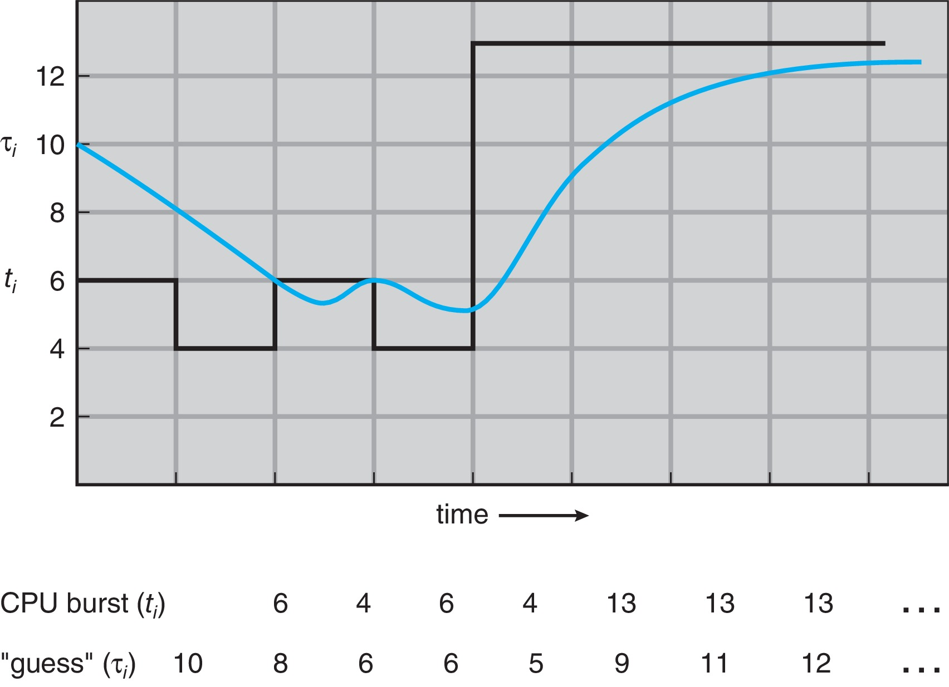

Slide 18
05
Description
Implementation of SJF Non-Preemptive in Python..
PART

Slide 19

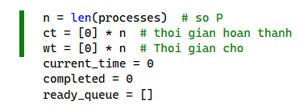
Purpose: Implement SJF Non-Preemptive scheduling to calculate Completion Time (CT), Waiting Time (WT).
Process Input:

Slide 20
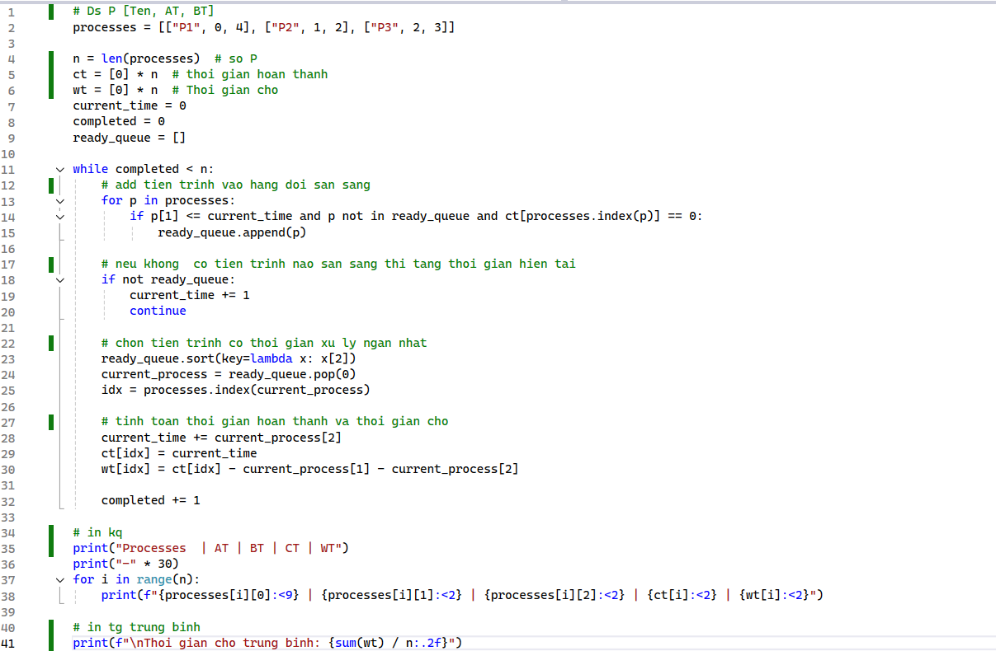
Scheduling Loop

Slide 21
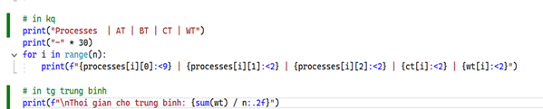
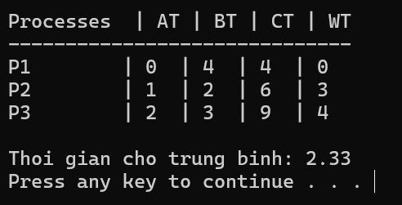
Display Results

Slide 22
THANK YOU
THANKS
DO YOU HAVE ANY QUESTIONS

