Slide 1
Introduction

Slide 2
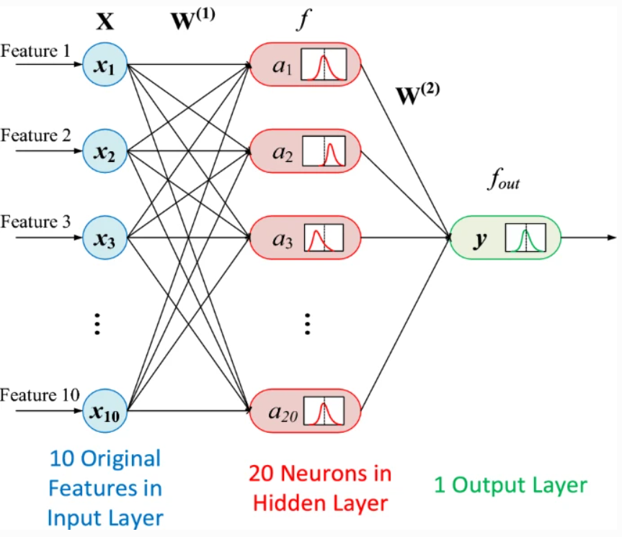
Fully Connected Neural Network
My Journal Paper: https://link.springer.com/article/10.1007/s00542-020-05149-1

Slide 3
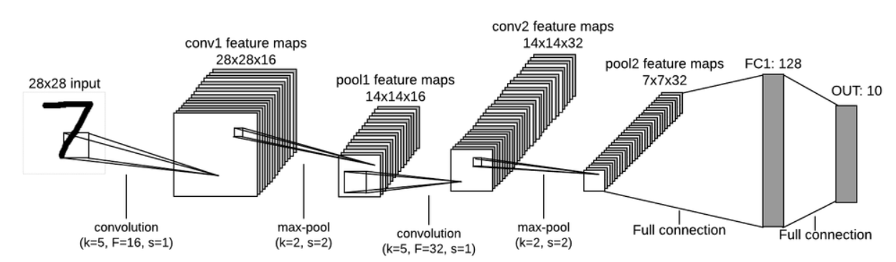
Convolutional Neural Network

Slide 4
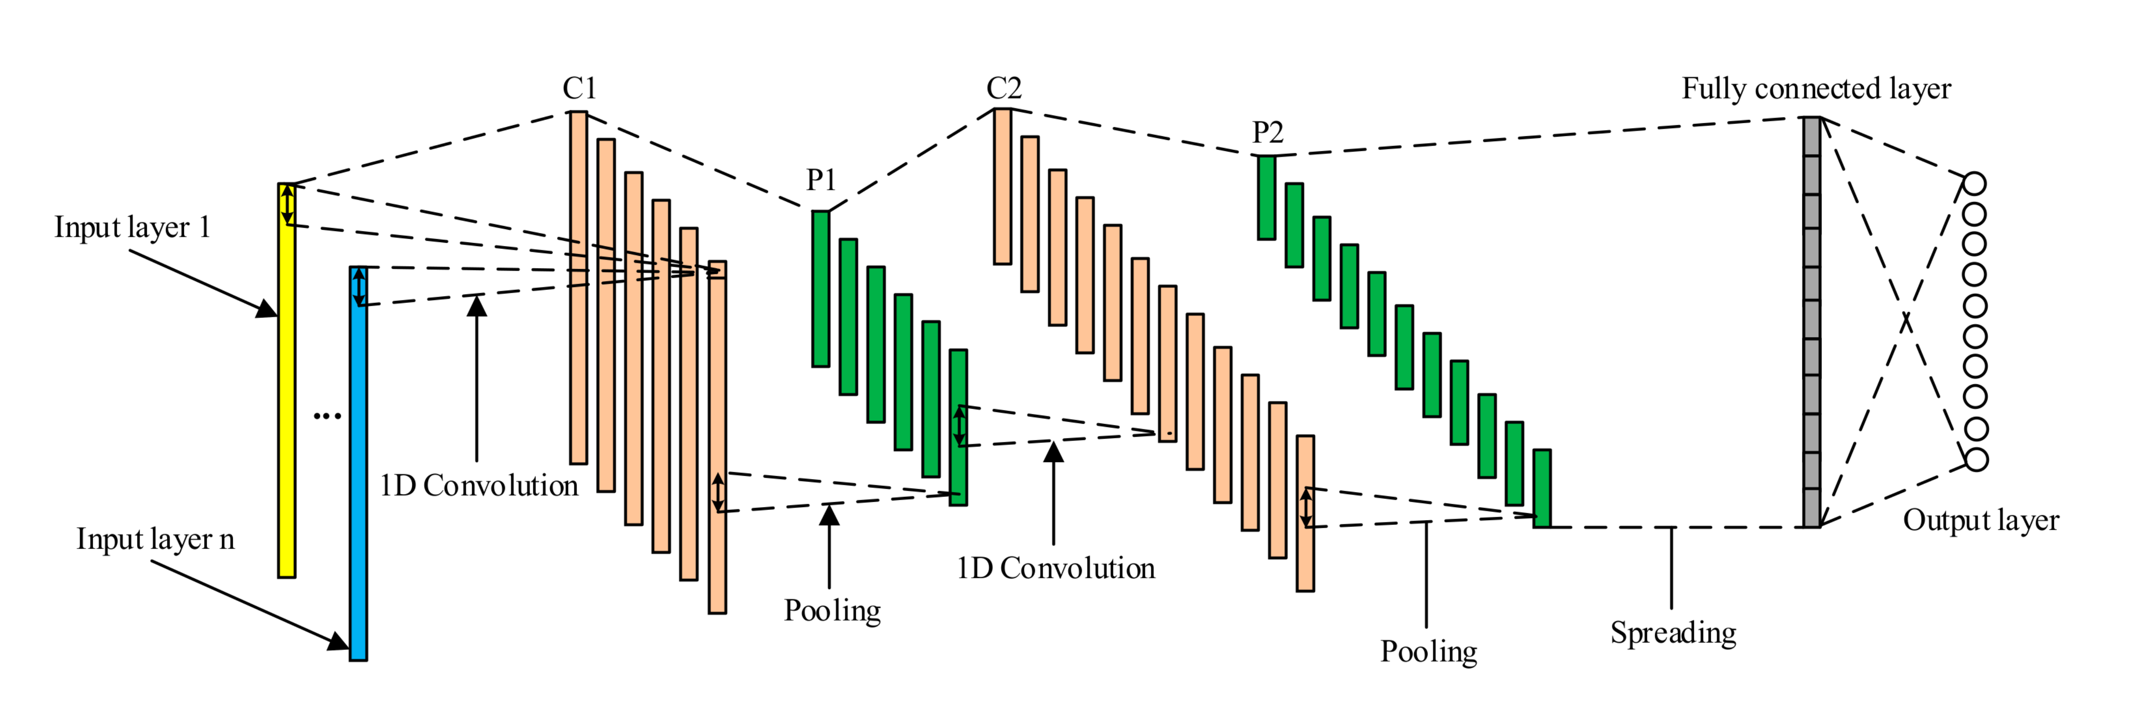
1 Dimensional Convolutional Neural Network

Slide 5
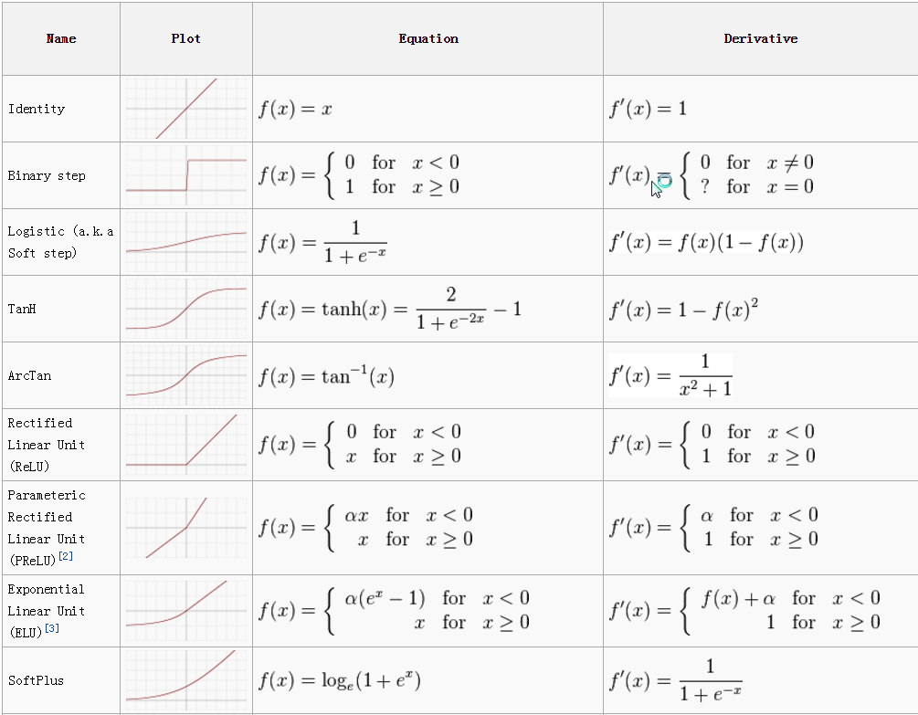
Activation Function

Slide 6
Why do we have to derivative?

Slide 7
RNN & LSTM

Slide 8
The long short-term memory and other gated RNNs
• The most effective sequence models used in practical applications are called gated RNNs. These include the long short-term memory (LSTM) and networks based on the gated recurrent unit (GRU). • Like leaky units, gated RNNs are based on the idea of creating paths through time that have derivatives that neither vanish nor explode. • Leaky units did this with connection weights that were either manually chosen constants or were parameters. • Gated RNNs generalize this to connection weights that may change at each time step

Slide 9
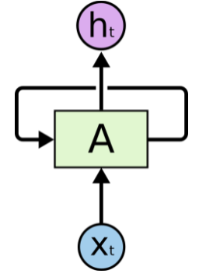
RNNs
Why we call it RNN?

Slide 10
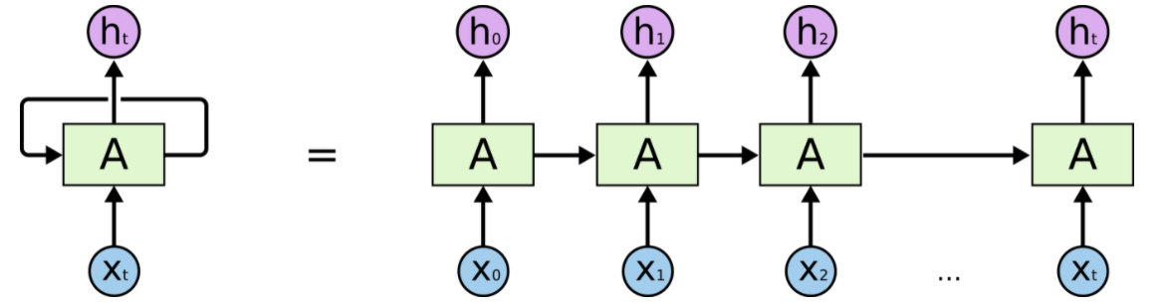
RNNs

Slide 11
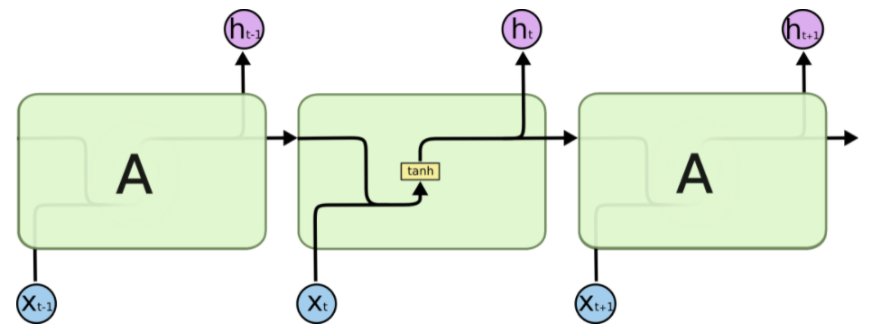
RNNs
The repeating module in a standard RNN contains a single layer.

Slide 12
The long short-term memory and other gated RNNs
• Leaky units allow the network to accumulate information (such as evidence for a particular feature or category) over a long duration. However, once that information has been used, it might be useful for the neural network to forget the old state. • For example, if a sequence is made of subsequences and we want a leaky unit to accumulate evidence inside each sub-subsequence, we need a mechanism to forget the old state by setting it to zero. • Instead of manually deciding when to clear the state, we want the neural network to learn to decide when to do it. This is what gated RNNs do

Slide 13
The long short-term memory and other gated RNNs
• The LSTM model makes the weight on this self-loop conditioned on the context, rather than fixed. By making the weight of this self-loop gated (controlled by another hidden unit), the time scale of integration can be changed dynamically based on the input sequence, because the time constants are output by the model. • LSTM recurrent networks have “LSTM cells” that have an internal recurrence (a self-loop), in addition to the outer recurrence of the RNN. • Each cell has the same inputs and outputs as an ordinary recurrent network, but also has more parameters and a system of gating units that controls the flow of information.

Slide 14
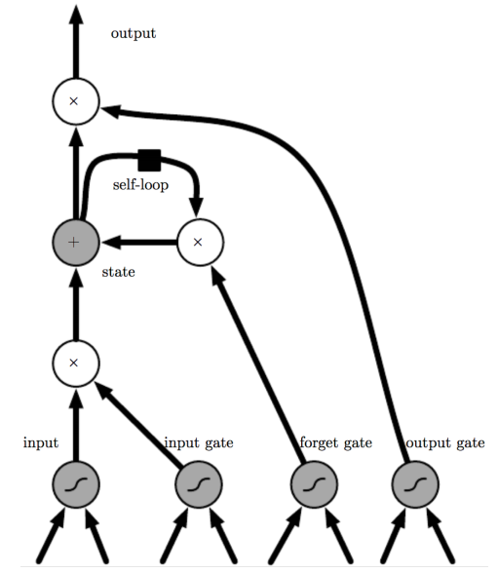
The long short-term memory

Slide 15
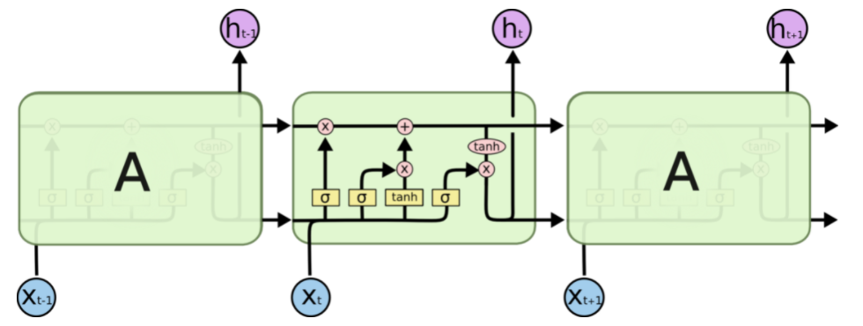
The long short-term memory
The repeating module in an LSTM contains four interacting layers.

Slide 16

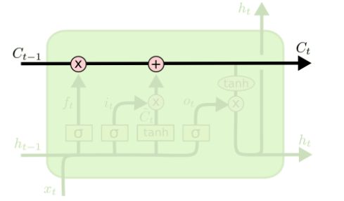
The long short-term memory

Slide 17
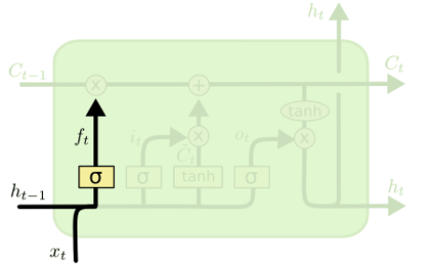
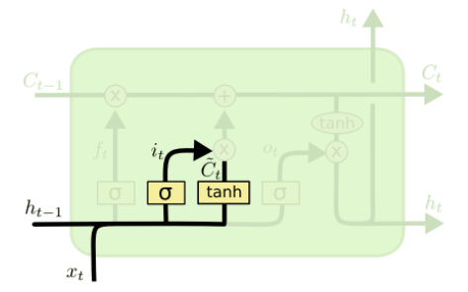
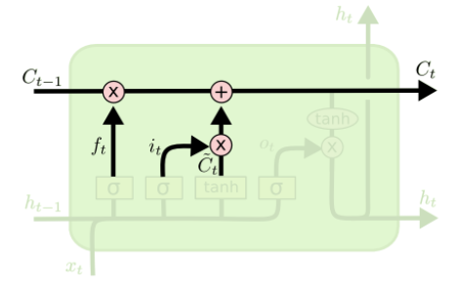
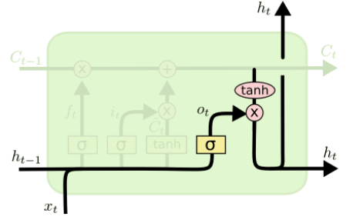
The long short-term memory

Slide 18
The long short-term memory
Forget gate:
Input gate:
Output gate:

Slide 19
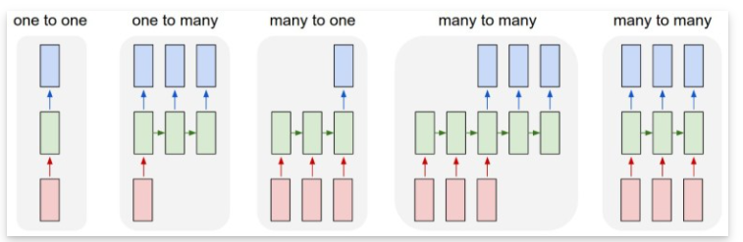
LSTM Types

Slide 20
LSTM Types
One to one: Such as NN/CNN, there is a input and a output. For instance CNN input is image while output is segmented image.
One to many: the input is an image and the output is many descriptive words for that image, in the form of a sentence. E.g: Image Captioning, e.t.c.
Many to one: For example, the problem of classifying actions in a video. Input contains many images (frames) separated from a video while output is an action in a video.
Many to many: For example, the problem of translating from English to Vietnamese, the input is a sentence with many words: “I am a software engineer" and the output is also a sentence with many words “Tôi là một kỹ sư phần mềm".

Slide 21
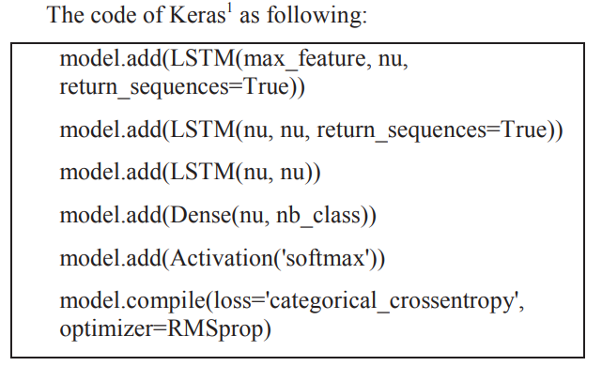
LSTM Types
LSTM-BASED METHOD FOR STOCK RETURNS PREDICTION: A CASE STUDY OF CHINA STOCK MARKET (IEEE BIGDATA 2015)

Slide 22
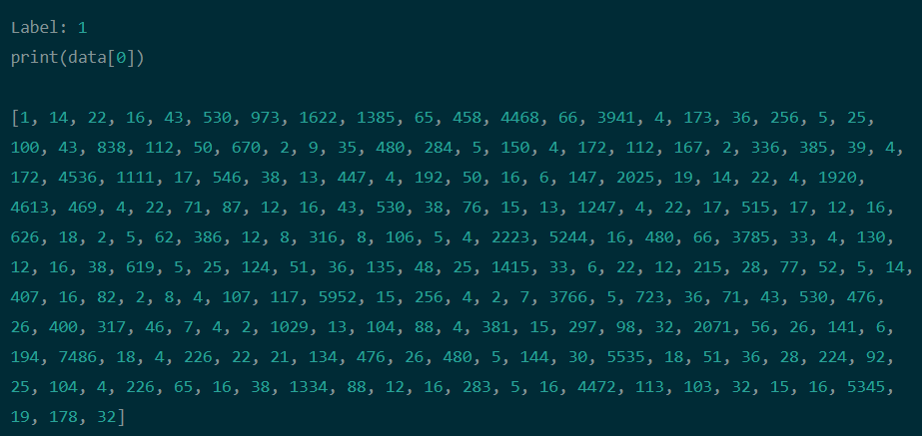
Lab 1
Neural Network/LSTM will predict the sentiment of user reviews in the famous IMDB dataset

Slide 23
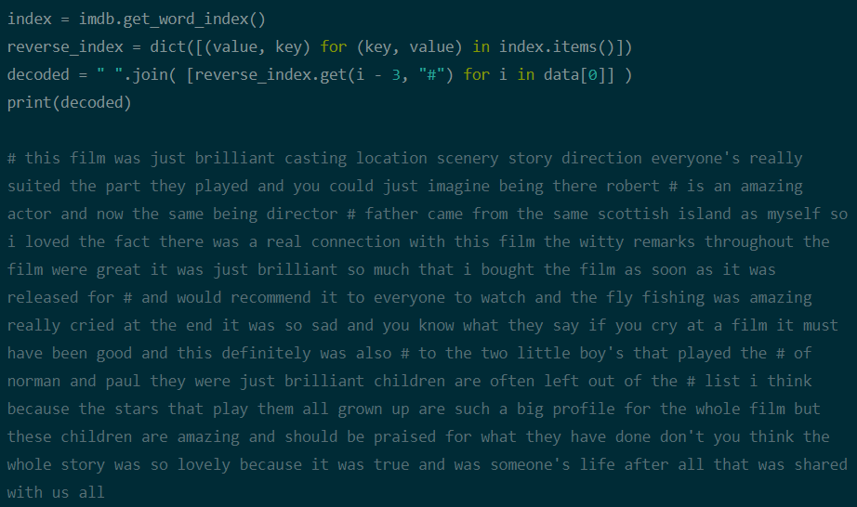
Lab 1

Slide 24
Pre-Processing for NLP
Word Embedding
Word Embedding được phân chủ yếu thành 2 loại:
Frequency-based embedding
Count Vector.
tf-idf Vector.
Co-occurrence Matrix.
Prediction-based embedding
Word2vec. Có 2 cách xây dựng word2vec:
Sử dụng ngữ cảnh để dự đoán mục tiêu(CBOW).
Sử dụng một từ để dự đoán ngữ cảnh mục tiêu(skip-gram)(cho kết quả tốt hơn với dữ liệu lớn).
Phương pháp giảm chiều trong tiền xử lý (Pre-processing) của Native Language Processing
Stop words
Singular Value Decomposition

Slide 25
GAN (Generative Adversarial Network)

Slide 26
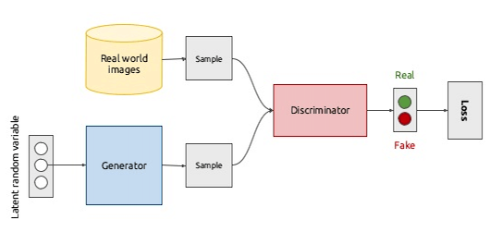
GAN
Generative Adversarial Networks, or GANs for short, are an approach to generative modeling using deep learning methods, such as convolutional neural networks.

Slide 27
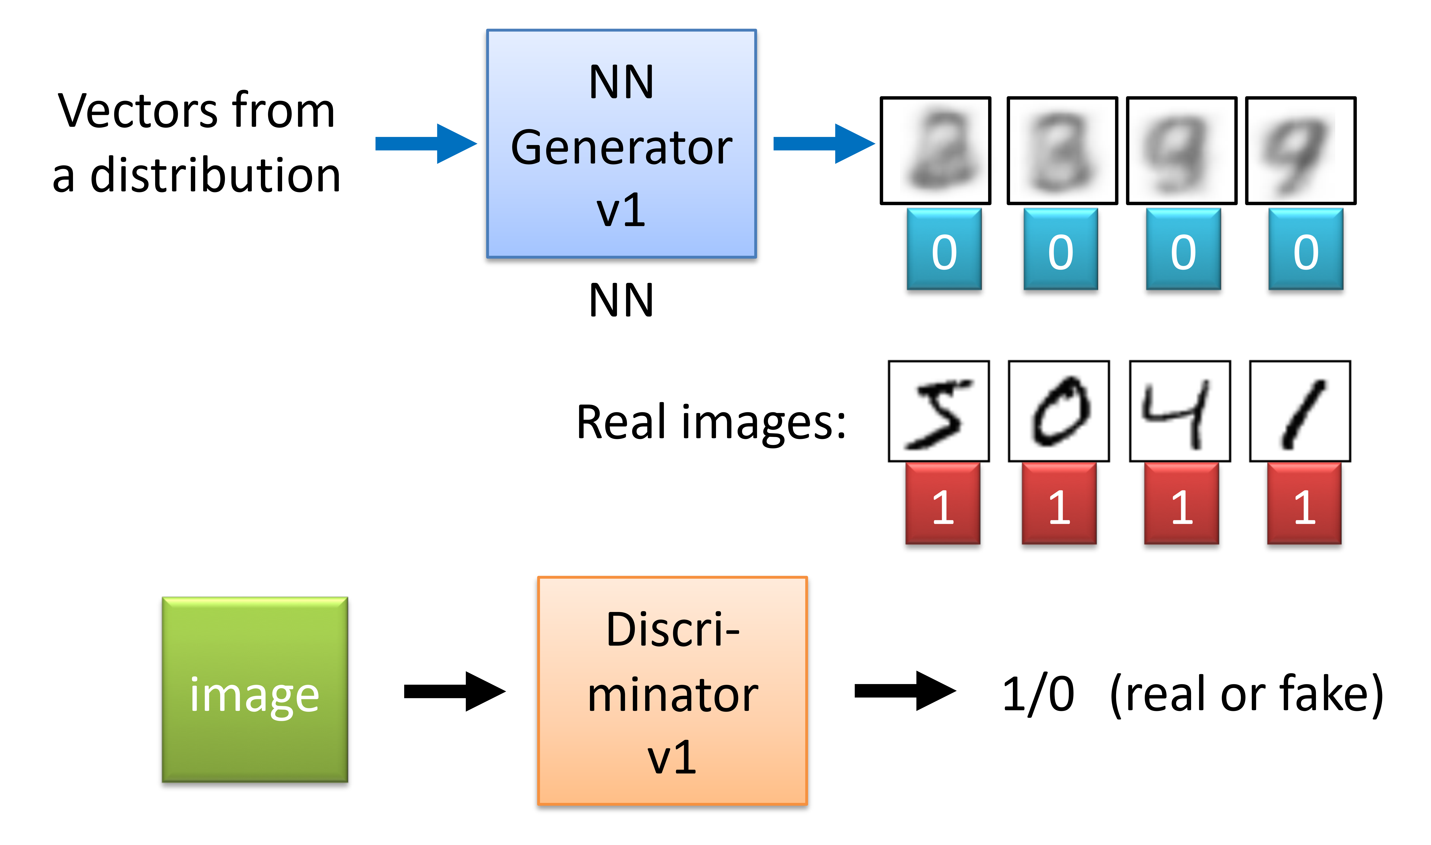
GAN

Slide 28
THANKS FOR YOUR ATTENTION

