Slide 1






Project 1
Deign 4-bit CPU Datapath

Slide 2

Trinh Duy Tien
Roll number: HE204958
Design 4-bit CPU Datapath

Slide 3
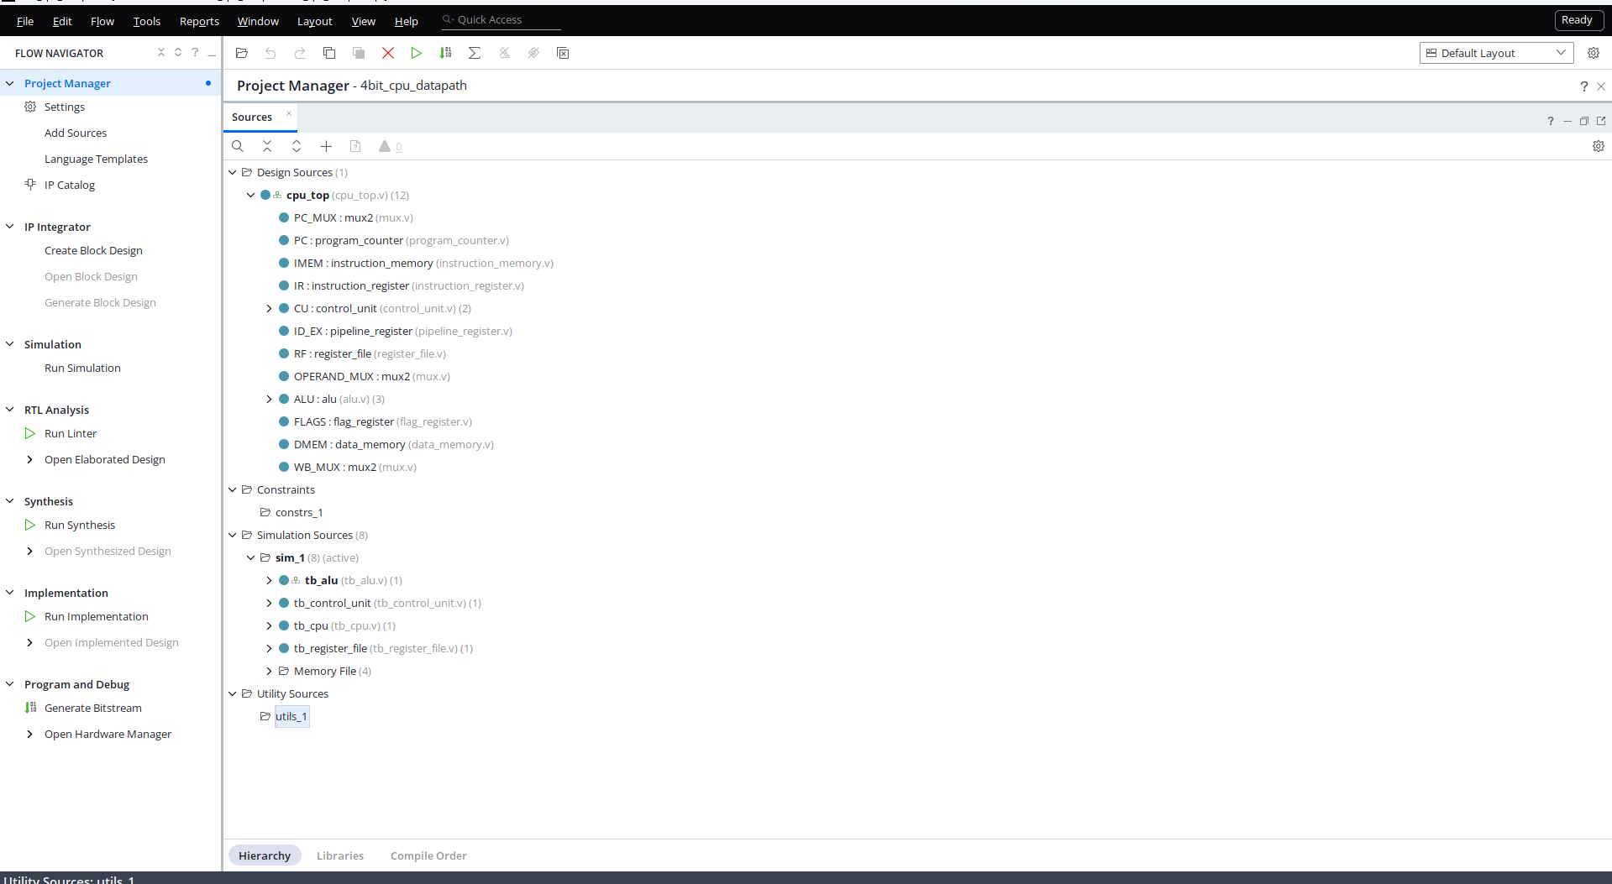

Slide 4
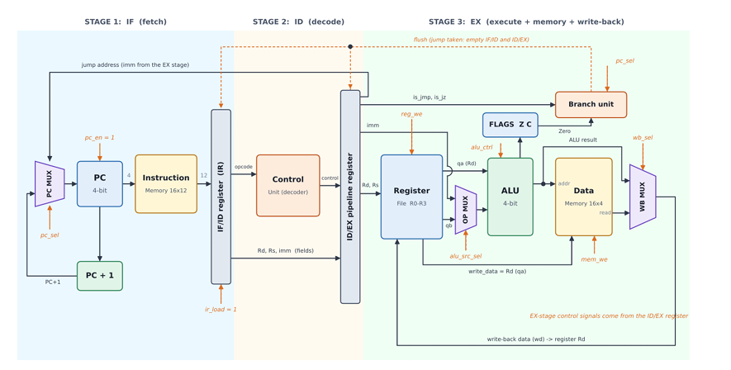
Architecture & Datapath Flow.

Slide 5
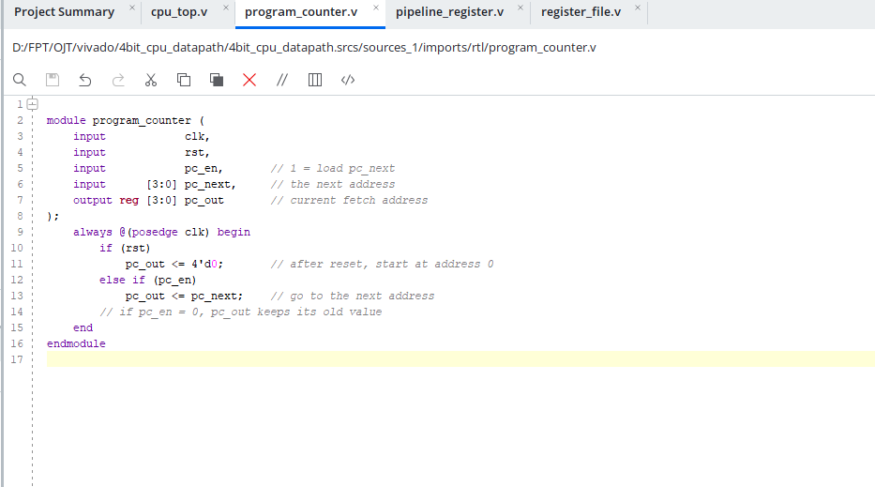
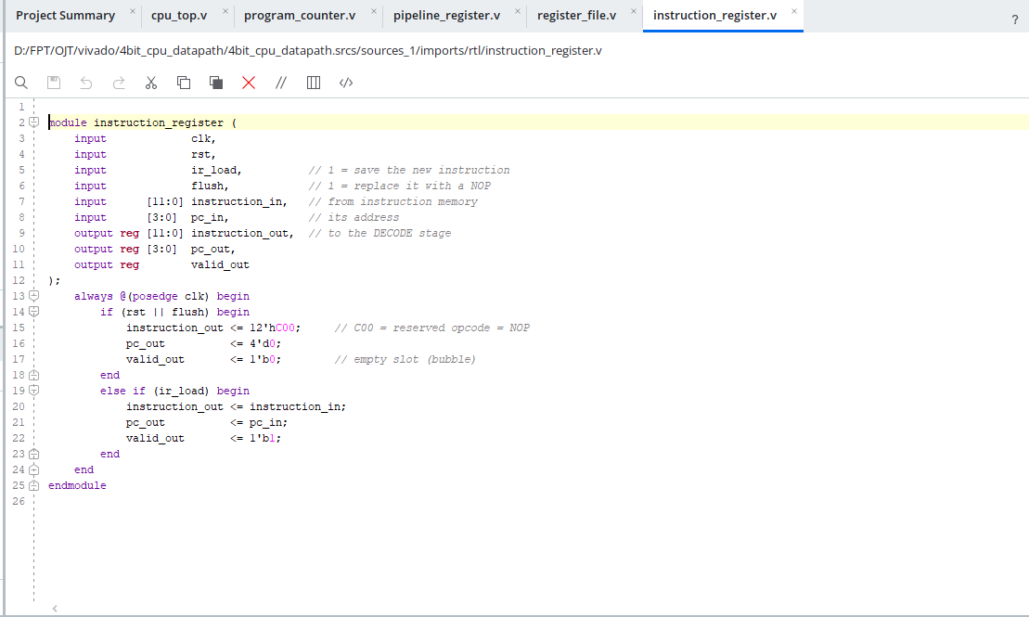
Fetch Stage

Slide 6
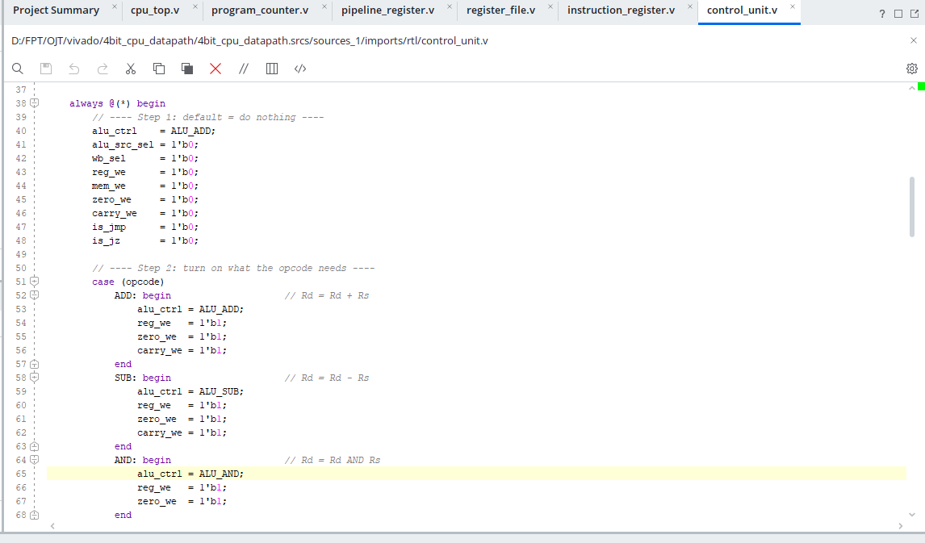
Decode Stage

Slide 7
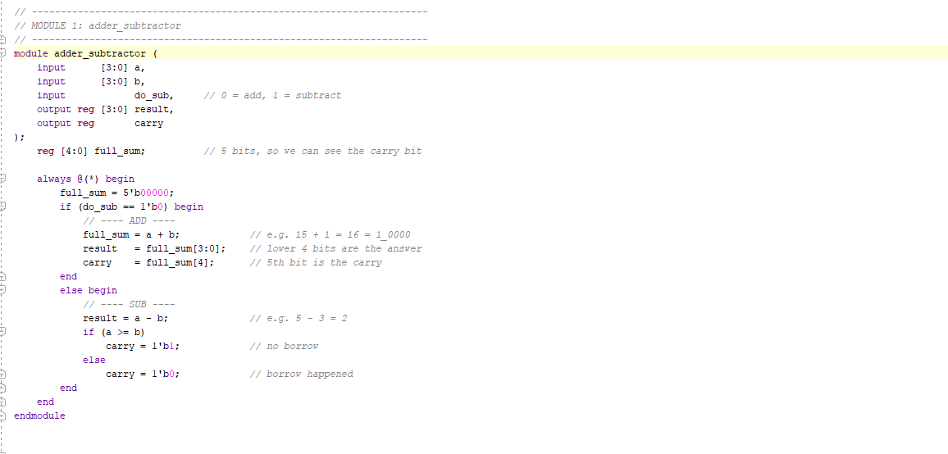
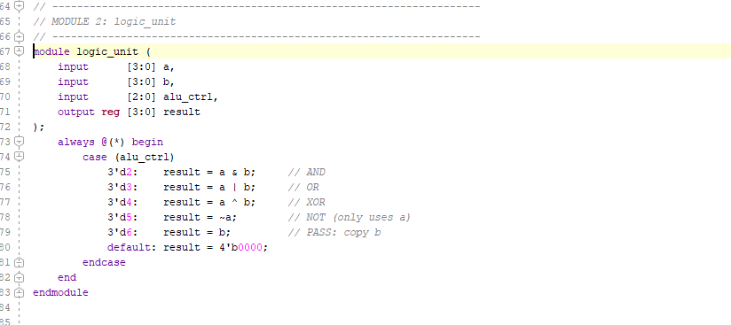
Execute Stage

Slide 8
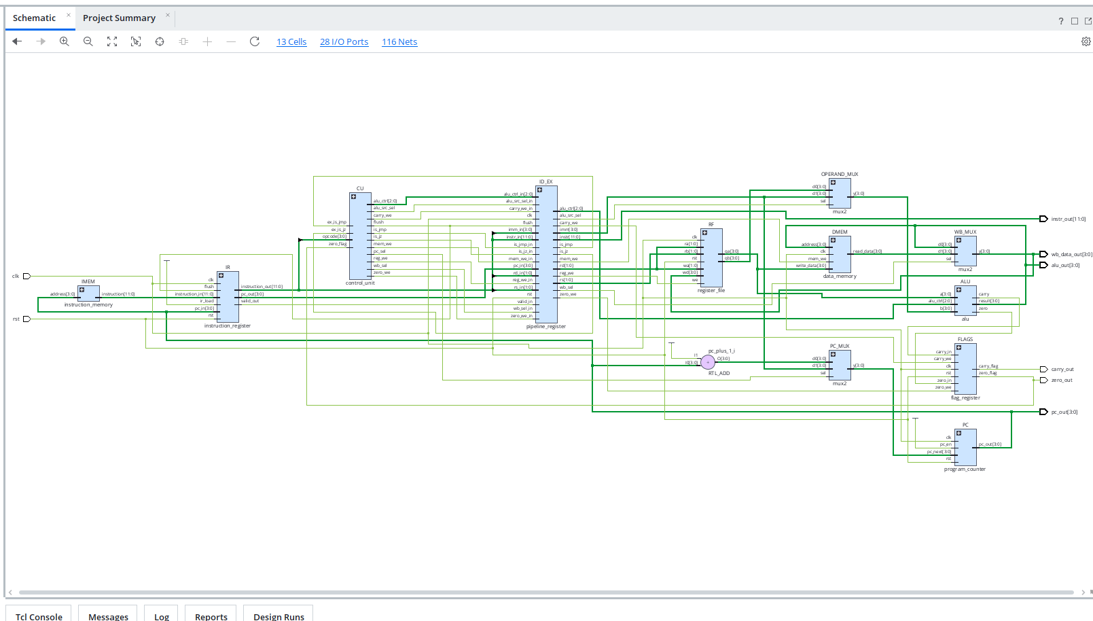
RTL Schematic & Dataflow

Slide 9
Thank You

