Slide 1
8-bit RISC CPU
with a 5-stage pipeline
Designed in Verilog · simulated and implemented in Vivado
IF
Fetch
ID
Decode
EX
Execute
MEM
Memory
WB
Write-back
Notes:
Introduce the project: an 8-bit RISC processor core with a classic 5-stage pipeline (IF, ID, EX, MEM, WB), written in Verilog and verified in simulation and synthesis with Vivado.

Slide 2
Goals and specification
Build a complete 8-bit RISC processor core that simulates, synthesizes and runs on a Xilinx FPGA.
8-bit
data, registers and ALU
16-bit
fixed instruction width
8
registers R0–R7
5 stages
IF · ID · EX · MEM · WB
16
instructions (4-bit opcode)
256 B
data RAM; instruction ROM 256 × 16 (Harvard)
Notes:
The goal is a complete 8-bit RISC core that simulates, synthesizes and can run on a Xilinx FPGA. Point out the Harvard architecture: the instruction ROM and the data RAM are separate memories, so fetch and memory access never compete.

Slide 3
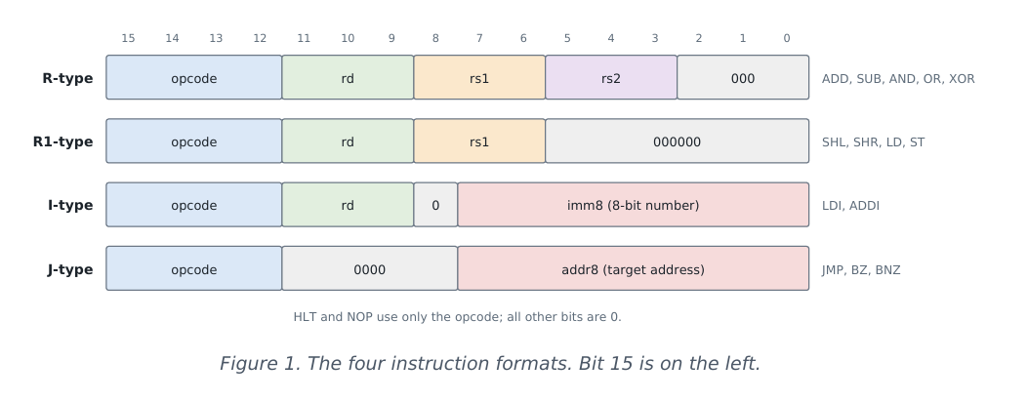
Instruction set architecture (ISA)
Encoding examples: ADD R2, R2, R1 = 0x1488 · LDI R1, 0x3C = 0x823C.
Notes:
The opcode is always the top 4 bits and rd sits in the same place in every format, so the decoder can read the fields before it even knows which instruction it is. NOP and HLT use only the opcode.

Slide 4
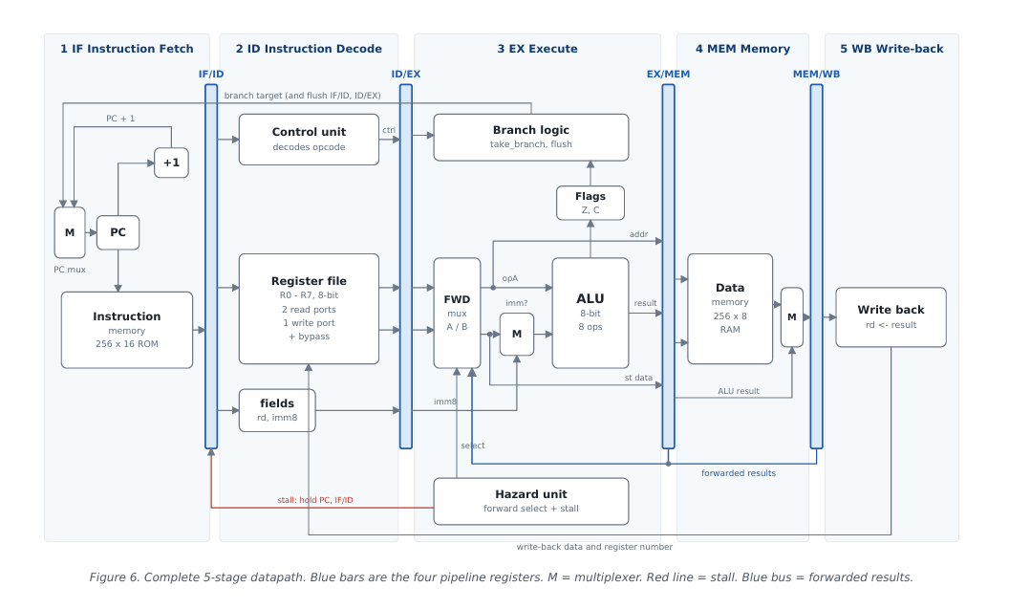
The complete datapath
Notes:
Four groups: arithmetic and logic, shifts, load and memory, and control. Z and C are updated by arithmetic, logic, shift and ADDI instructions. BZ and BNZ read flag Z, which is how loops and if-statements are built.

Slide 5
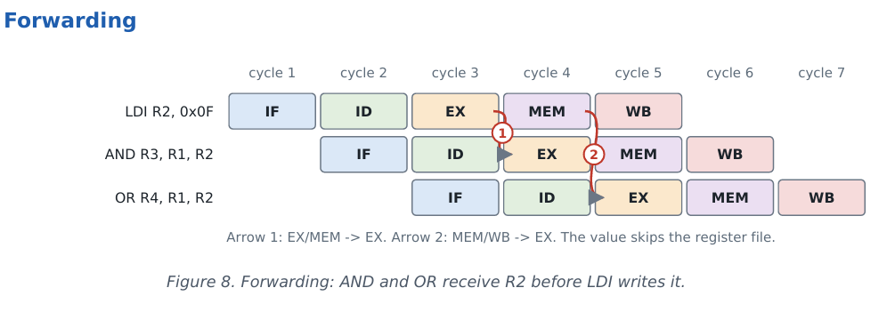
Arrow 1: EX/MEM → EX. Arrow 2: MEM/WB → EX.
1. If the instruction in MEM writes a register and is not a load → take its ALU result from EX/MEM (newest wins).
2. Otherwise, if the instruction in WB writes that register → take it from MEM/WB.
3. Otherwise use the value read in ID. The register file also bypasses for instructions three apart
Notes:
Five stages work on five different instructions, like an assembly line. From cycle 5 on, one instruction completes every cycle. The latency of one instruction is still 5 cycles, but throughput approaches one instruction per cycle.

Slide 6
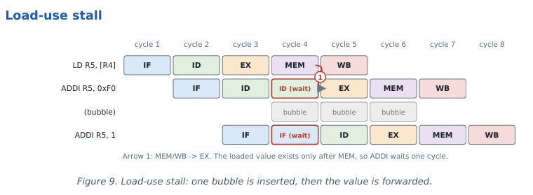
Notes:
Four pipeline registers (IF/ID, ID/EX, EX/MEM, MEM/WB) sit between the five stages. The hazard unit compares register numbers across stages to choose the forwarding source and to decide whether to stall. Branches are decided in EX, so the flags are always up to date.

Slide 7
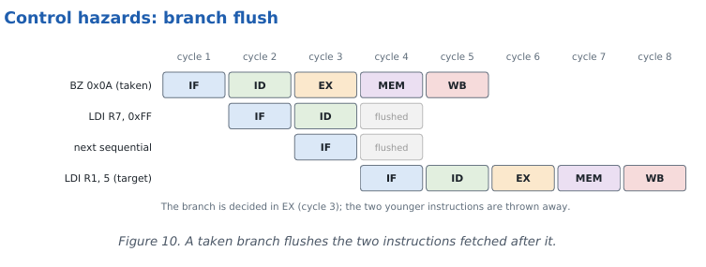
Notes:
The control unit is a pure combinational lookup table; every signal defaults to 0, which is a NOP. Signals are decoded in ID but used later, so they travel with their instruction through the pipeline registers: EX signals are used in stage 3, MEM signals in stage 4 and WB signals in stage 5.

