Slide 1
Remote data & Real-time application GROUP assignment 3 (Group 2)
Professor: ramy Mohamed

Slide 2
Agenda
About us
Problem Statement
Solution & Architecture
Solution Implementation
Results and Analysis
Key Benefits

Slide 3
About Us
Group 2 Members:
Anh Van Phan -#041006838
Duy Khanh Truong -#041171487
Hanh Tran - #041121693

Slide 4
Problem statement
The Rideau Canal Skateway, a historic and world-renowned attraction in Ottawa, needs constant monitoring to ensure skater safety. In this project, we will help the National Capital Commission (NCC) to build a real-time data streaming system that will:
Simulate IoT sensors to monitor ice conditions and weather factors along the canal.
Process incoming sensor data to detect unsafe conditions in real time.
Store the results in Azure Blob Storage for further analysis.

Slide 5

Solution & architecture
System Architecture

Slide 6
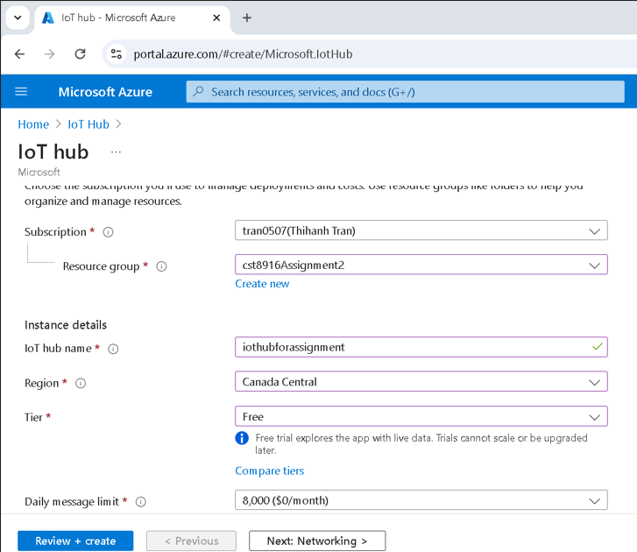
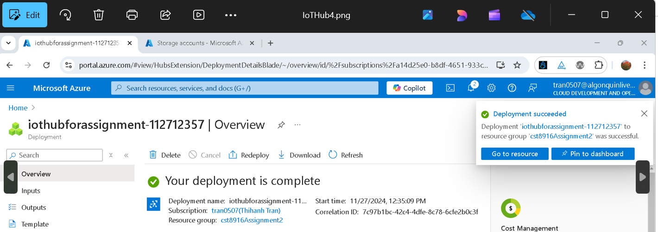
Solution implementation
Step 1: Create Azure IoT Hub and Devices

Slide 7
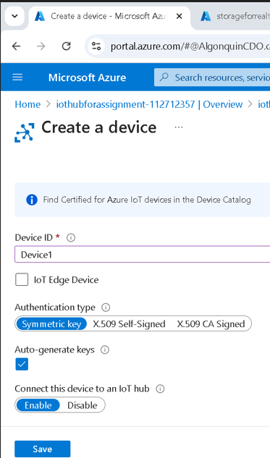

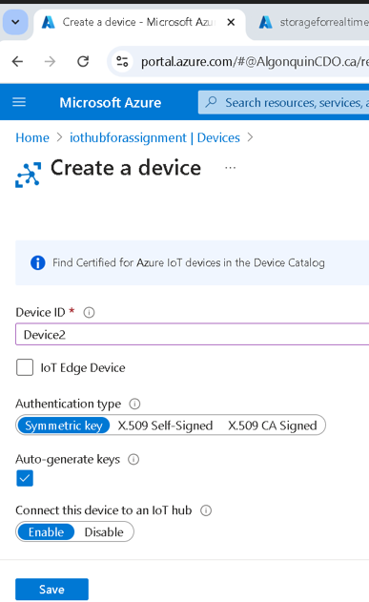
Solution implementation
Step 1(cont.)

Slide 8
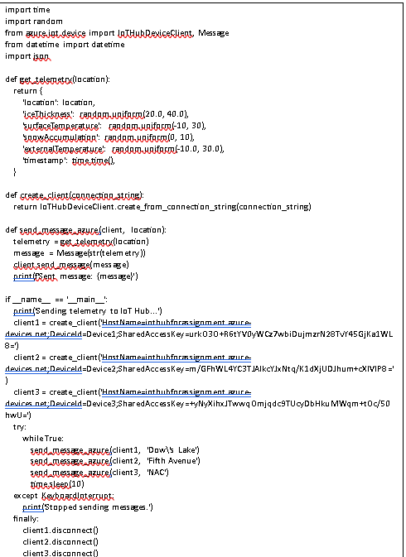
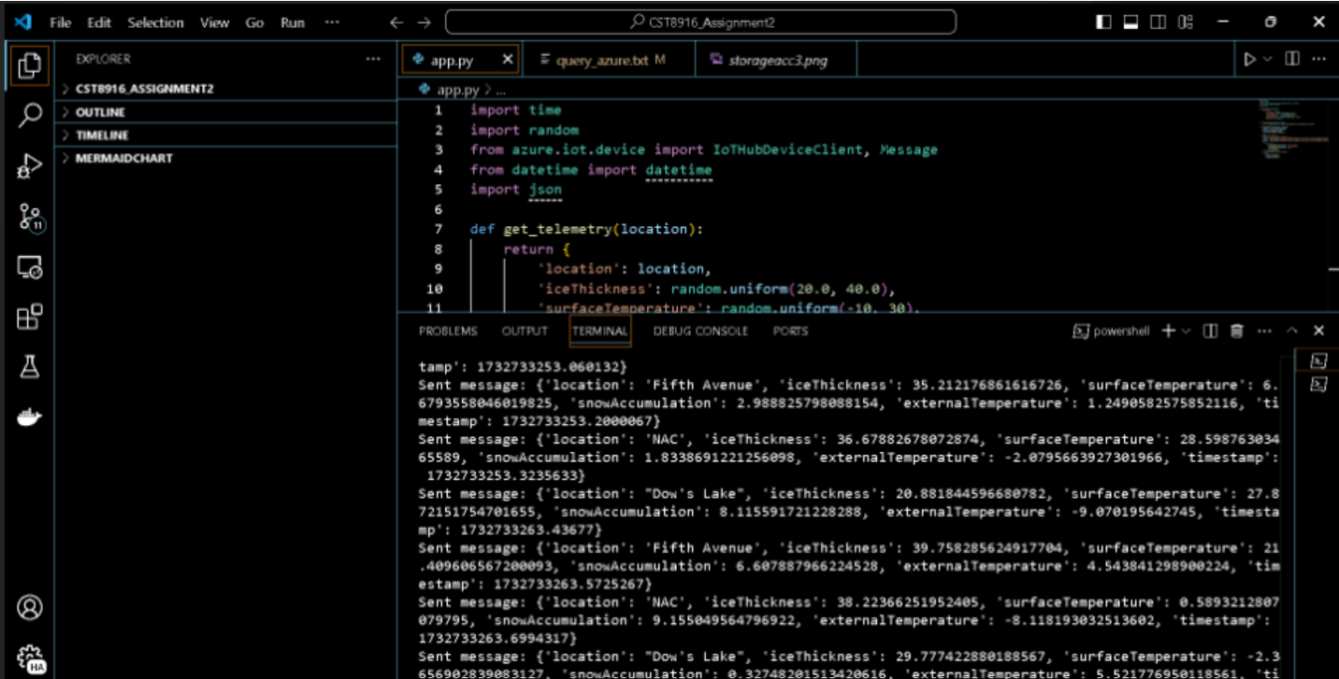
Solution implementation
Step 1 (cont.)

Slide 9
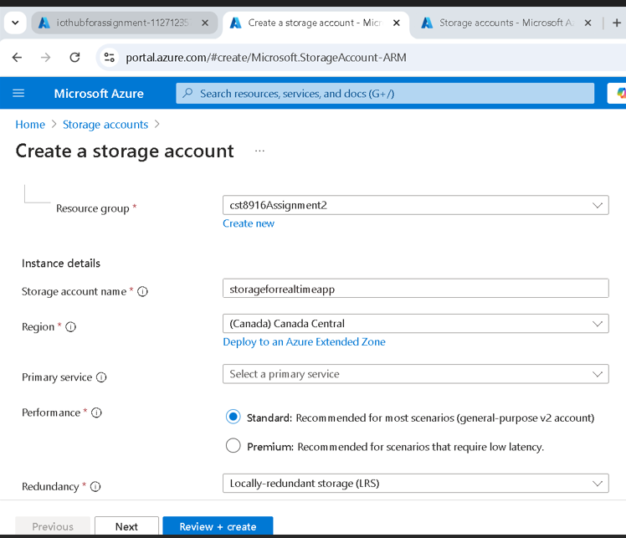
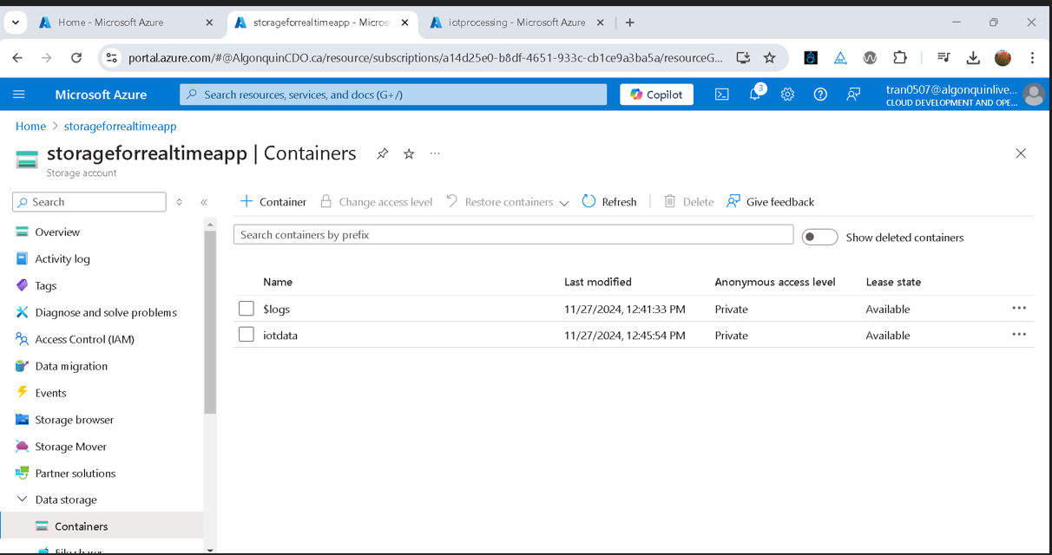
Solution implementation
Step 2: Create a storage account

Slide 10
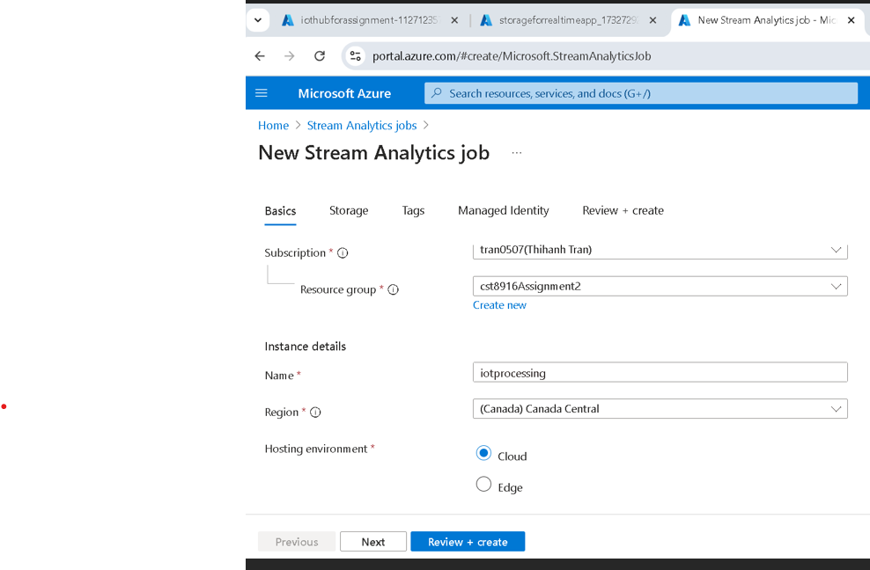
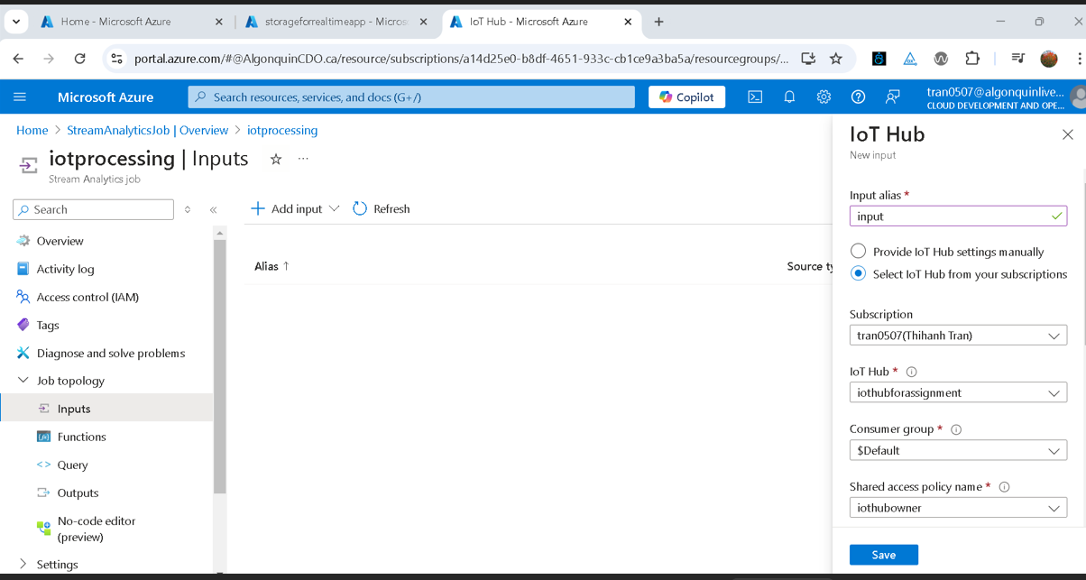
Solution implementation
Step 3: Create Stream Analytics Job

Slide 11
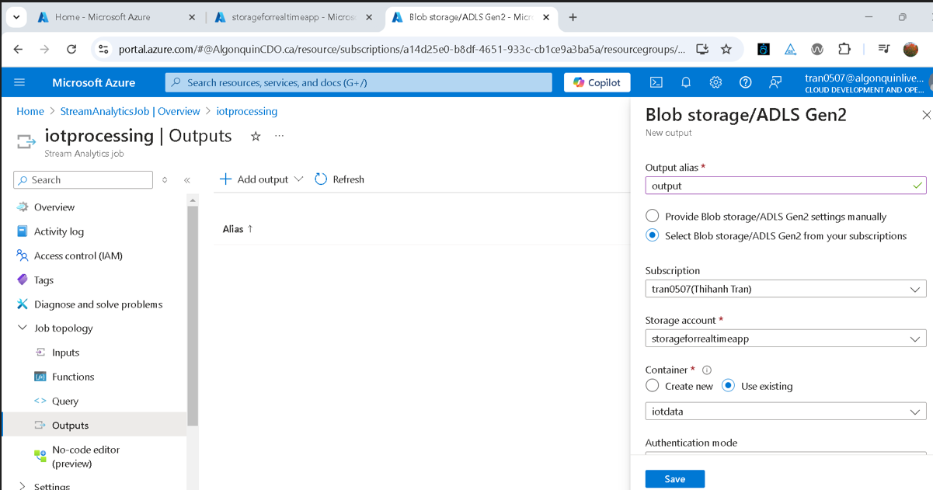
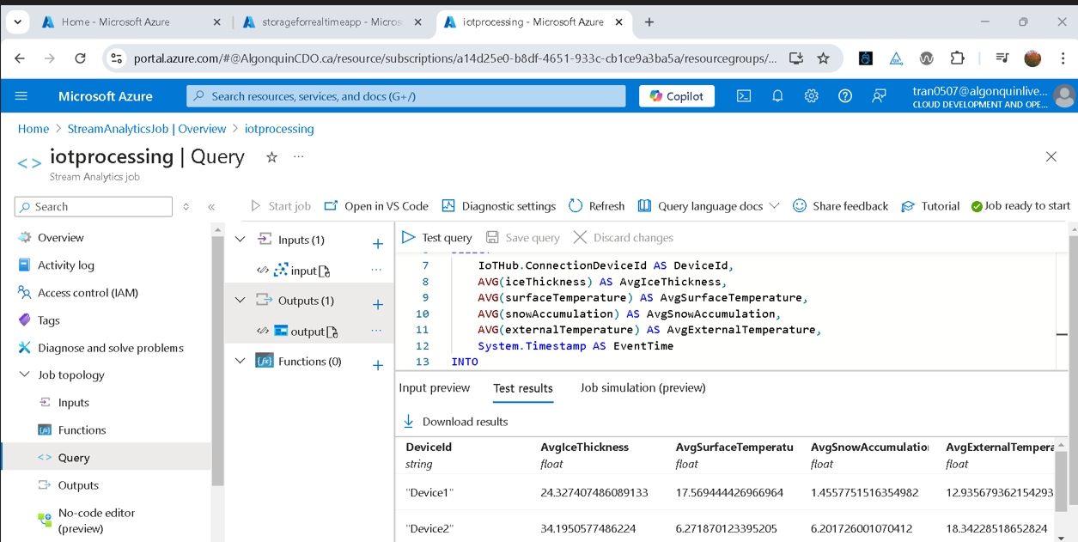
Solution implementation
Step 3: Create Stream Analytics Job (cont.)

Slide 12
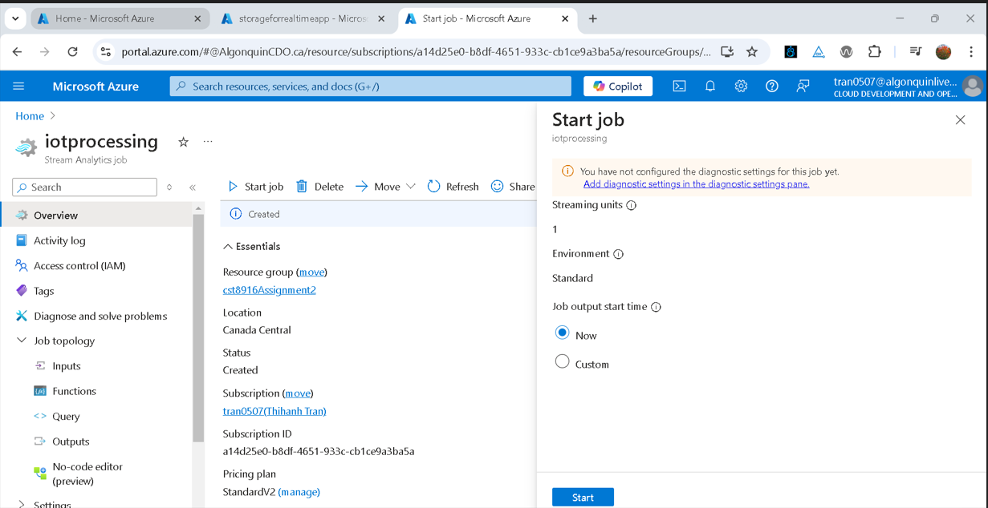
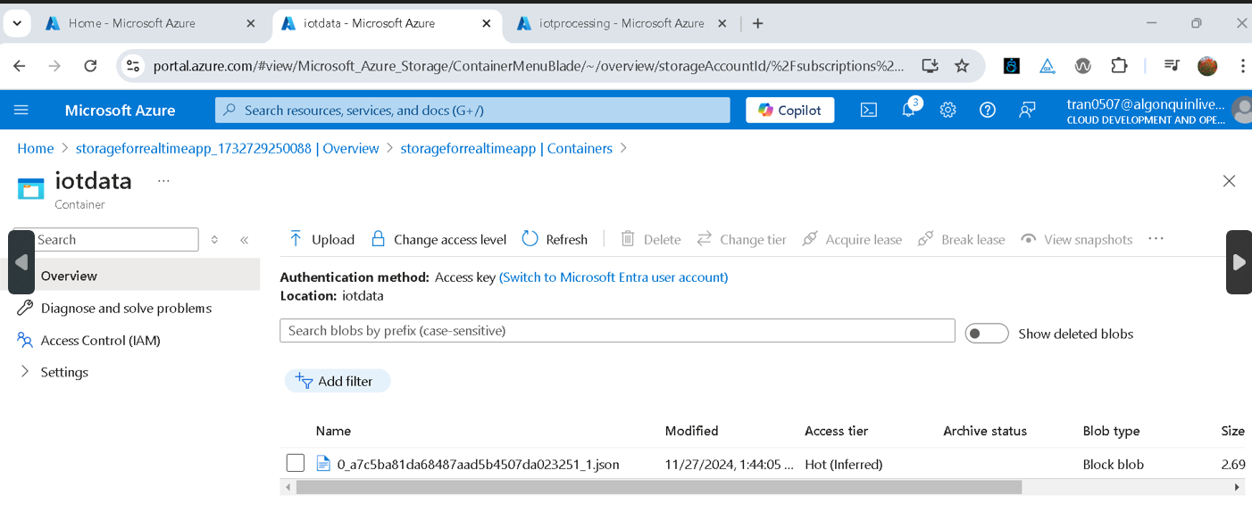
Solution implementation
Step 3: Create Stream Analytics Job (cont.)

Slide 13
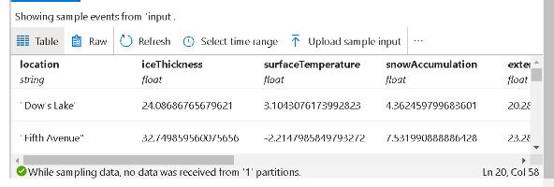
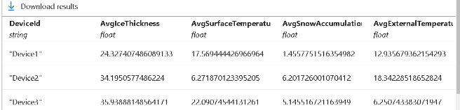
Results and analysis
Data Source: Real-time temperature readings from IoT sensors.
Average Thickness: 24.3
Average Surface Temp: 17.5°C
Average Snow Accumulation: 1.4
Average External Temperature: 12.9°C
Consistent Data: Minor fluctuations observed.
Anomalies: All readings are in the expected range
Reliable Readings: Device shows accurate average temperature.

Slide 14
Key benefits
Real-time Monitoring: Continuous tracking of temperature ensures immediate detection of fluctuations.
Data Accuracy: Average calculations help eliminate outliers and provide reliable data.
Predictive Analysis: Enables forecasting trends based on historical temperature data.
Automation: Supports automated actions or alerts when temperature thresholds are reached.
Optimized Operations: Helps maintain ideal conditions for the system/environment being monitored.

Slide 15
conclusion
The implementation of a real-time data streaming system to monitor ice conditions and weather factors along the Rideau Canal Skateway offers numerous benefits to the National Capital Commission (NCC). The proposed solution not only enhances safety but also empowers the NCC to manage and maintain the canal more efficiently, reducing risks and improving overall user experience. With the integration of advanced technologies, the NCC can confidently meet the challenges of monitoring the Skateway, providing a safer and more enjoyable experience for skaters while maintaining the canal's historic status as a world-renowned winter attraction. We strongly believe that this system will be a critical asset in ensuring the continued success of the Rideau Canal Skateway, benefiting both the community and the environment.

Slide 16
THANK YOU
Anh van Phan
Duy khanh truong
Hanh Tran

