Slide 1

Instructor Kick-off
Analyze A/B Test Results
Student Name: Minh Duy Truong
Student ID: 012312748
© 2019 Udacity. All rights reserved.

Slide 2
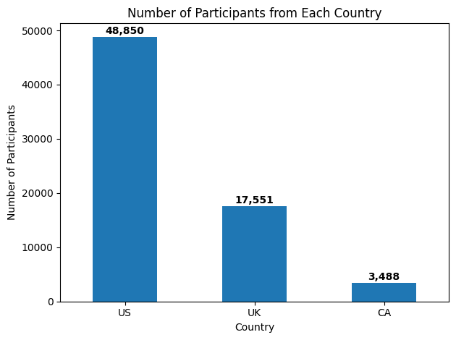
How was the Experiment Implemented?
Total Variant Visitors: 35,211 Participants
Total Control Participants:​ 34,678 Participants

Slide 3
Conversion Rates
 | U.S. | U.K. | CA
Control | 10.7% | 10.2% | 9.4%
Treatment | 15.8% | 14.9% | 15.4%
Executive Summary:
The treatment page is significantly more effective at driving conversions.
Geographic location has minimal impact on conversion rates - differences are small and not statistically significant.
Market Opportunity: No need for country-specific page variations
Business Recommendation: Implement the treatment page globally - it provides a substantial, statistically significant improvement in conversion rates across all geographic markets with minimal risk.

Slide 4
Experiment Results
Treatment Conversion Rate: 15.53%
Control Conversion Rate:​ 10.53%
Delta in Treatment vs. Control Conversion Rate:​ +5.01 percentage points
p-value:​ 0.0000 (essentially zero)
Conclusion:​ YES, there is statistically significant evidence of a difference.
The p-value of 0.0000 is far below the standard significance threshold of 0.05, providing extremely strong evidence that the treatment page performs significantly better than the control page. This suggests:
The treatment effect is not due to chance
The new page design should be implemented
The observed 5.01 percentage point improvement is statistically reliable
We can be highly confident that the treatment page will improve conversion rates

Slide 5
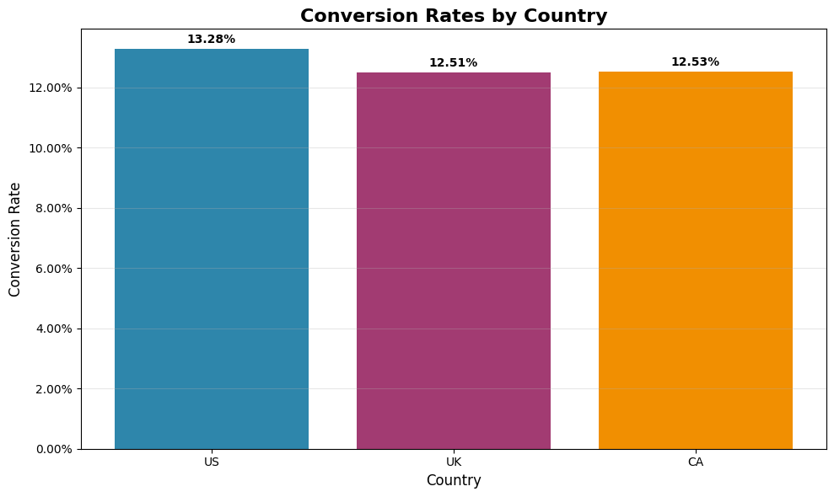
Country Results
Country Conversion Rate Results
Conversion Rates by Country:
US: 13.28%
UK: 12.51%
Canada: 12.53%
Statistical Test Results:
Chi-square statistic: 7.54
p-value: 0.0231
Significance level: 0.05
Final Model Results:
US p-value: 0.170 (not significant)
UK p-value: 0.905 (not significant)
Treatment effect: Highly significant (p < 0.001)
Model includes: ab_page + country variables

Slide 6
Conclusions
YES, there are statistically significant differences in conversion rates between countries.
Executive Summary of All Three Approaches:
1. Descriptive Analysis: Treatment group (15.53%) significantly outperforms control group (10.53%) with a 5.01 percentage point improvement.
2. Simulation-Based Testing: P-value of 0.0000 provides extremely strong evidence that the treatment effect is not due to chance.
3. Regression Analysis: Logistic regression confirms treatment significance (p < 0.001) while controlling for country effects.
Country-Specific Findings:
Chi-square test shows significant country differences (p=0.0231 < 0.05)
US leads with 13.28% conversion, UK/Canada at ~12.5%
Country effects remain significant in the final regression model when controlling for treatment
Statistical Reasoning: The chi-square test (included in Part II) confirms significant geographic differences. All three analytical approaches demonstrate both treatment effectiveness and meaningful country variations.
Practical Reasoning: The new page should be implemented globally, but geographic targeting may be beneficial. The treatment improves conversion across all countries, but the US market shows the highest potential for optimization.

