Slide 1
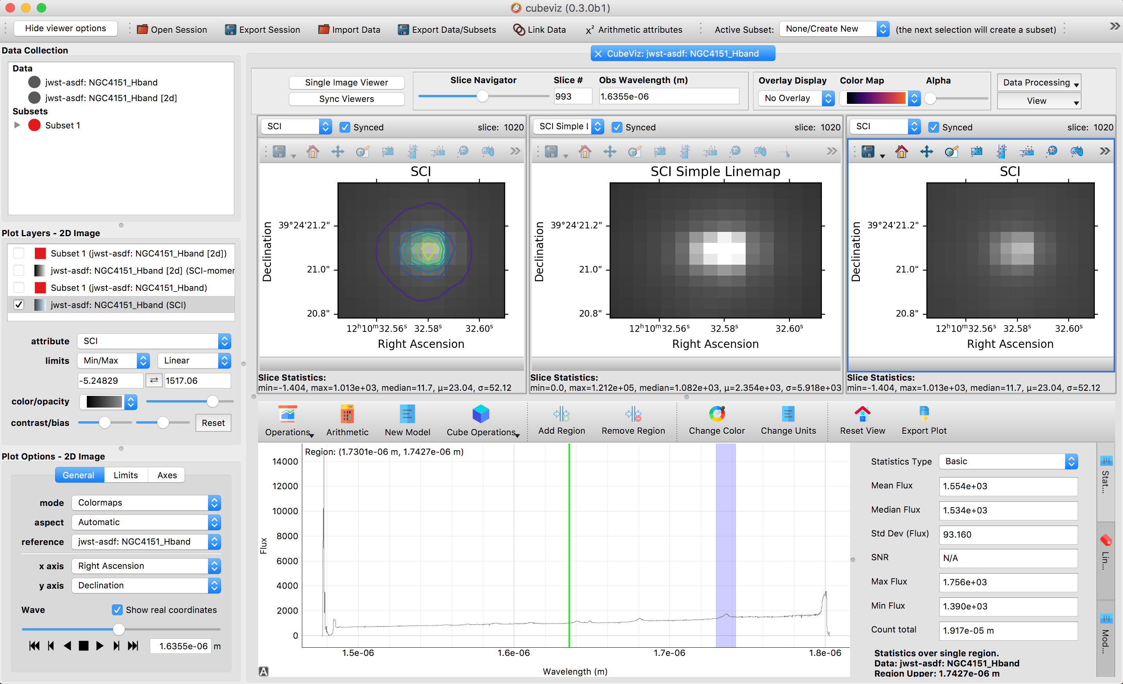
Hide & show the left panels
Data Collections
(you can delete subsets here)
Glue menu
Viewer controls
Zoom, pan,
selection
Plot layers
(toggle overlays)
Image viewers
Color & opacity adjustments
Specviz controls
SpecViz tabs: - Statistics - Line labels - Model fitting
Plot Options
SpecViz viewer
These menus change
With the mouse focus

