Slide 1
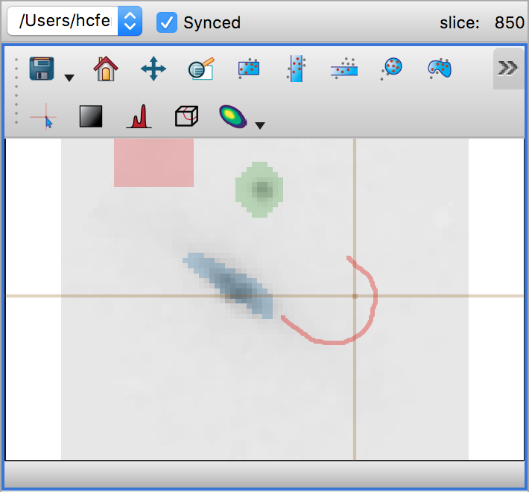

Sync the spectral slice with other viewers
Select which
data to view
Which slice is being displayed?
pan
zoom
Save this plot to a file
Select regions for extracting spectra
Revert to the default zoom and pan
Overlay contour plot
rectangles
Select individual pixels
ellipses
polygons
cursor readback
statistics
Adjust image contrast
Custom slice (2D view)

Slide 2
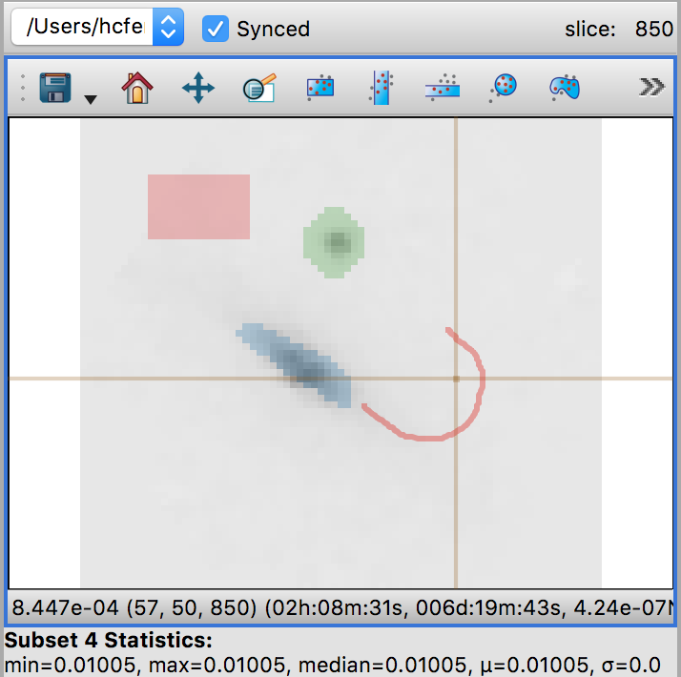
Sync the spectral slice with other viewers
Select which
data to view
Which slice is being displayed?
pan
zoom
Save this plot to a file
Select regions for extracting spectra
Revert to the default zoom and pan
Overlay contour plot
rectangles
Select individual pixels
ellipses
polygons
Cursor readback
Statistics
Adjust image contrast
Custom slice (2D view)

