Slide 1
Synthesizable Instruction Tracer for CVA6
Architecture & Spike Co-Simulation Verification Flow
instr_tracer_synth — a hardware-implementable re-creation of CVA6's simulation-only instr_tracer that reproduces the exact riscv::spikeCommitLog() commit log using only synthesizable RTL.
hardware/src/trace/ · ara · CVA6 + Ara vector unit

Slide 2
Concept: split the problem on-chip / off-chip
Hardware cannot synthesize ASCII strings or file I/O — so the chip captures + packs; the host decodes.
ON-CHIP (synthesizable)
Capture retiring instructions at the
commit stage → pack into a fixed-
layout binary record + stream out
(instr_tracer_synth.sv)
OFF-CHIP (host)
Decode the binary stream into
Spike-format ASCII commit log
(scripts/spike_trace_decode.py,
or the SystemVerilog sim sink)
binary records
Non-synthesizable construct → synthesizable equivalent
simulation tracer (NOT synthesizable) | instr_tracer_synth (synthesizable)
SystemVerilog class / new | packed struct commit_log_pkt_t
dynamic queue logic[..][$] | fixed-depth HW FIFO (fifo_v3 / addr_fifo)
string + $sformatf | fixed-layout binary record (300 bit @XLEN=64)
$fopen / $fwrite / $fclose | ready / valid streaming port
interface + clocking block | plain module ports (packed struct)
initial / forever / task | always_ff / always_comb
gp_reg_file / fp_reg_file shadow | synthesizable gp/fp_reg_file_q[32]

Slide 3
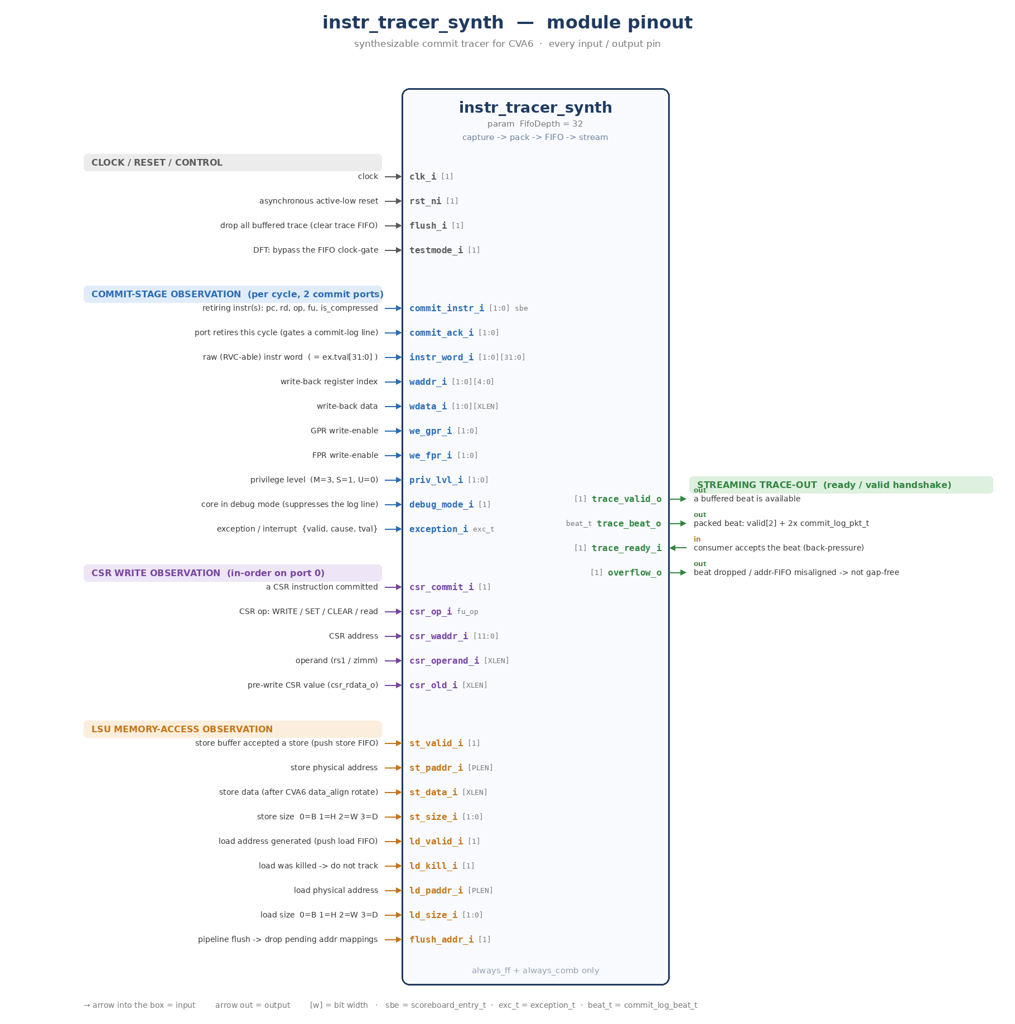
Module pinout — every input / output pin
4 input groups (left) feed the tracer; the ready/valid trace-out port (right) streams packed beats.
CLOCK / RESET / CONTROL (4 in)
clk_i · rst_ni · flush_i · testmode_i
COMMIT-STAGE OBSERVATION (10 in)
commit_instr_i · commit_ack_i · instr_word_i
waddr_i · wdata_i · we_gpr_i · we_fpr_i
priv_lvl_i · debug_mode_i · exception_i
CSR WRITE OBSERVATION (5 in)
csr_commit_i · csr_op_i · csr_waddr_i
csr_operand_i · csr_old_i
LSU MEMORY-ACCESS OBSERVATION (9 in)
st_valid/paddr/data/size_i
ld_valid/kill/paddr/size_i · flush_addr_i
STREAMING TRACE-OUT (3 out + 1 in)
trace_valid_o · trace_beat_o · overflow_o (out)
trace_ready_i (in, back-pressure)

Slide 4
Internal microarchitecture — the beat builder & its two memories
One combinational beat builder reads the live commit signals + two on-chip memories; a FIFO then streams the result out.
Write-back bus
waddr · wdata
we_gpr / we_fpr
commit-stage signals
commit_instr · instr_word · commit_ack
priv · debug · exception_i · csr_*
LSU addresses
st_valid/paddr/data/size
ld_valid/kill/paddr/size
Shadow regfile
gp / fp_reg_file_q[32]
always_ff
recovers rd's value when
it isn't on the write-back
bus this cycle
BEAT BUILDER
always_comb
per-port packet:
priv·pc·instr·rd·we·wdata
compressed · retired · mem
port-0 overrides: exception · CSR
→ commit_log_beat_t
Address FIFOs
store + load · depth 16
+ byte_ror64
realign LSU addresses
to commit order
reg[rd]
mem addr / data / size
pop @ commit
Trace FIFO
fifo_v3 · depth 32 · push = |valid & ~full
full
overflow_o
FIFO full → trace gap
Trace-out port
ready / valid · trace_valid_o · trace_beat_o · trace_ready_i
input
memory
beat builder

Slide 5
Detailed datapath — sub-blocks & signals
Same flanked-builder view, zoomed in: value recovery on the left, memory re-alignment on the right, block-by-block.
commit-stage signals
commit_instr · instr_word · priv · debug
exception_i · csr_* (→ port 0)
input
memory
logic
beat builder
BEAT BUILDER
always_comb
builds beat.pkt[p]
for both ports
+ port-0
exception / CSR
drives
st_pop / ld_pop
beat.valid =
commit_ack
Write-back bus
we_gpr_i / we_fpr_i
waddr_i · wdata_i
Shadow GP/FP regfile
gp/fp_reg_file_q[32]
always_ff
Result MUX
we ? wdata_i
: rd_fpr ? fp[rd]
: gp[rd]
result
mem
byte_ror64
undo data_align
(rotate right)
Store addr FIFO
addr_fifo · depth 16
pop 0 / 1
Store gen (LSU)
st_valid_i
st_paddr/data/size_i
reg[rd]
dout0.data
→ recovers rd's committed value when it is not on the write-back bus this cycle
Load addr FIFO
addr_fifo · depth 16
pop 0..2 · data0/1
Load gen (LSU)
ld_valid_i & ~ld_kill_i
ld_paddr/size_i
ld_dout0/1 → mem_addr
→ FIFOs realign out-of-order LSU addresses; popped at commit by st_pop / ld_pop (0..2)
Trace FIFO
fifo_v3 · depth 32
push=|valid&~full · pop=valid&ready
full
overflow_o (out)
(any_valid & full)
| st/ld of | uf
Trace-out port
trace_valid_o=~empty (out) · trace_beat_o (out)
trace_ready_i (in)

Slide 6
What goes into one trace record & the 3 packing rules
Each retired instruction becomes a packed commit_log_pkt_t; two of them form a beat (program order kept).
One beat = commit_log_beat_t
How each field is filled — 3 rules
commit_log_beat_t
valid[NR_COMMIT_PORTS] + 2 × commit_log_pkt_t (port 0 = older)
Rule 1 Result value (a 3-way mux)
we_gpr | we_fpr → wdata_i (written this cycle)
else rd is FPR → fp_reg_file_q[rd]
else → gp_reg_file_q[rd]
group | fields of commit_log_pkt_t
Identity | priv · debug · retired · compressed · rd (+rd_fpr) · pc · instr
Result | we · wdata
Exception | ex_valid · cause · tval
Memory | mem_op · mem_addr · mem_data · mem_size
CSR write | csr_we · csr_addr · csr_wdata
Rule 2 Memory token ( “mem 0x..” )
commit & STORE (non-AMO) → MEM_STORE, pop store FIFO,
data via byte_ror64
commit & LOAD → MEM_LOAD (up to 2/cycle),
addr from load FIFO
otherwise → MEM_NONE
Rule 3 Port-0-only overrides
exception.valid & !(debug & BREAKPOINT)
→ ex_valid, cause, tval
csr_commit & op ∈ {WRITE, SET, CLEAR}
→ csr_we, reconstruct csr_wdata
(both always reported on the OLDER port 0)
300 bits @ XLEN=64 · packed MSB-first in declaration order

Slide 7
commit_log_pkt_t — packed bit layout (MSB-first)
One retired-instruction record. A valid[2] mask + two records form a commit_log_beat_t.
field | bits | meaning
priv | 2 | privilege M / S / U
debug | 1 | debug-mode flag
ex_valid | 1 | exception present
retired | 1 | commit_ack → emit line
compressed | 1 | RVC 16-bit instr
we | 1 | wrote a register
rd_fpr | 1 | dest is FP register
rd | 5 | dest register index
pc | 64 | program counter (XLEN)
instr | 32 | raw instruction word
field | bits | meaning
wdata | 64 | committed result (XLEN)
cause | 64 | exception cause (XLEN)
tval | 64 | trap value (XLEN)
mem_op | 2 | NONE / LOAD / STORE
mem_addr | 64 | physical address
mem_data | 64 | value loaded / stored
mem_size | 2 | B / H / W / D
csr_we | 1 | a CSR was written
csr_addr | 12 | CSR address
csr_wdata | 64 | CSR value (pre-WARL, XLEN)
record width = 510 bits @ XLEN=64
Spike core fields priv…tval = 301 · memory +132 · CSR +77
commit_log_beat_t = valid[2] + 2 × pkt
= 1022 bits · port 0 = older instruction (program order)

Slide 8
Address-FIFO re-alignment (instr_tracer_addr_fifo)
The LSU generates addresses out of program order; bounded FIFOs realign each to the retiring instruction.
LSU
store_unit / load_unit
generates paddr
OUT of program order
store / load address FIFO (depth 16)
Beat builder
pops the oldest entry
for the retiring
load / store
push
pop @ commit
head
tail
How it works
• push — store: st_valid_i pushes {paddr, data, size}; load: ld_valid_i & ~ld_kill_i pushes {paddr, size}
• pop @ commit — STORE (non-AMO) pops 1; LOAD pops 0..2 (two loads may retire per cycle) → exposes data0_o & data1_o
• AMOs report fu == STORE but never push the store buffer → they must NOT pop (queue stays aligned)
• byte_ror64 undoes CVA6 data_align (rotate-left by addr[2:0]) so mem_data carries the natural stored value
• flush_addr_i clears the queue on a pipeline flush (branch mispredict / exception)
• depth = 2^AW = 16, a power of two → natural pointer wrap-around (no occupancy compare needed)
• over / underflow → overflow_o : a mem token may be misaligned, trace no longer address-accurate

Slide 9
Worked example — anatomy of a Spike commit-log line
How packed fields become Spike-format ASCII (printed by the sim sink or the host decoder).
0 0x0000000080002a40 (0x0007a283) x 5 0x000000000000002a mem 0x0000000080004000
3 0x0000000080000100 (0x30529073) c773_mtvec 0x0000000080000200
token | ← field(s) | rule
0 / 3 | priv | decimal: U=0, S=1, M=3
0x…2a40 | pc | 0x + 16 hex digits (zero-padded)
(0x0007a283) | instr | instr[1:0]=2'b11 → 8-hex; RVC → (0x____)
x 5 0x…2a | rd · we · wdata | 'x'/'f'+idx; printed when rd_fpr or rd≠0
mem 0x…4000 | mem_op = LOAD | load: addr only (value shown as the rd write)
c773_mtvec 0x…200 | csr_we/addr/wdata | c<dec-addr>_<name>; name via csr_name()
Formatting rules
• line emitted when retired (commit_ack)
& !debug_mode — NOT gated by exceptions
• priv printed in decimal (M=3, S=1, U=0)
• pc / values: 0x + 16 hex digits
(spikeCommitLog hardcodes logic[63:0])
• RVC if instr[1:0]≠2'b11 → (0x____)
• STORE → mem 0x<addr> 0x<data>;
LOAD → mem 0x<addr>
• reg spacing: Spike 'x 5' vs ours 'x5' —
compare_spike_log.py normalizes it

Slide 10
Integration into CVA6 — non-invasive bind
instr_tracer_synth_bind.sv attaches the tracer to every `ariane` core without editing the CVA6 submodule.
synthesizable
simulation-only
output file
module ariane (CVA6 core)
IF → ID → Issue → EX → Commit
commit_instr_id_commit commit_ack waddr/wdata_commit_id we_gpr/we_fpr priv_lvl debug_mode
commit_stage_i.exception_o csr_*_commit_* ex_stage_i.lsu_i.{i_store_unit, i_load_unit}.*
bind ariane instr_tracer_synth_tap (resolved in ariane scope; core untouched)
instr_tracer_synth_tap ( `ifndef SYNTHESIS — simulation wrapper )
instr_tracer_synth
DUT — synthesizable
capture + pack + FIFO
trace_valid / beat
instr_tracer_synth_sink
models the trace consumer
spike_commit_str() + $fwrite
trace_ready
(+ trace_hart_0.pkt.hex when EmitPktHex=1, for the real-silicon binary path)
trace_hart_0_commit.synth.log
Spike commit-log format

Slide 11
Where each signal is collected in the CVA6 pipeline
bind resolves these expressions in the `ariane` scope (instr_tracer_synth_bind.sv); the vector taps reach into Ara at the ara_system level (tb_ara_system_trace.sv).
module ariane (CVA6 core) — bind scope
fu=ACCEL
IF · PC
ID
Issue
EX
ALU · MUL · FPU
lsu_i · csr_regfile
Commit stage
commit_ack · exception_o
Ara vector unit (i_ara)
i_dispatcher · gen_lanes[L].i_lane
2
3
1
4
① COMMIT STAGE
commit_instr_id_commit → pc·instr
[p].ex.tval[31:0] → instr word
commit_ack → retired
waddr/wdata_commit_id → rd·wdata
we_gpr/we_fpr_commit_id → we·rd_fpr
priv_lvl · debug_mode → priv·debug
commit_stage_i.exception_o → trap
② CSR WRITE “c<a>_<n> 0x..”
csr_commit_commit_ex → pulse
csr_op_commit_csr → W/S/C
csr_addr_ex_csr → csr_addr
csr_wdata_commit_csr → operand
csr_rdata_csr_commit → old val
pre-WARL → --ignore-csr-val
③ LSU MEM “mem 0x.. 0x..”
ex_stage_i.lsu_i :
store_buffer_i.valid/paddr/
data/data_size_i
load_unit.req_port_o.tag_valid/
kill_req/data_size
load_unit.paddr_i
flush_ctrl_ex → flush_addr_i
④ ARA VECTOR “v<vd> 0x..”
i_dispatcher.vtype_q.vsew/
vlmul · vl_q → vsew·vl
gen_lanes[L].i_lane.vrf_wen/
addr/wdata/be
→ shadow VRF → v[vd] data
system-level taps (not bind)
Scalar taps: instr_tracer_synth_bind.sv (bind ariane). Vector taps reach into i_ara, wired at ara_system level (tb_ara_system_trace.sv / exampleinit.sv).

Slide 12
Co-simulation verification flow
Prove the synthesizable tracer reproduces the same commit log as the golden reference — instruction for instruction.
app.elf / riscv-dv program.hex
RTL simulation
make app=… simc (QuestaSim) / verilate + simv (Verilator)
ara_system + CVA6 + bound tracer
Alternative golden references
trace_hart_0_commit.log
GOLDEN — original sim tracer
(QuestaSim only)
trace_hart_0_commit.synth.log
DUT output — synth tracer sink
(Spike commit-log format)
Spike ISS co-simulation
spike --log-commits app.elf → spike.log
compare_spike_log.py
drops disasm / boot-ROM, normalizes
regs & CSRs (--ignore-csr-val …)
diff
byte-for-byte equal
PASS / FAIL
PASS / FAIL
Silicon path: pkt.hex → spike_trace_decode.py → .log → diff

Slide 13
Files, run commands & caveats
Source files
Run (fast path, machine already set up)
instr_tracer_synth_pkg.sv
make -C apps bin/hello_world
make -C hardware app=hello_world simc
cd hardware/build
diff trace_hart_0_commit.log \
trace_hart_0_commit.synth.log
binary record format (commit_log_pkt_t / beat)
instr_tracer_synth.sv
the tracer: capture, pack, FIFO, ready/valid out
instr_tracer_addr_fifo.sv
bounded store/load address-tracking FIFO
instr_tracer_synth_sink.sv
sim sink: prints Spike log directly in SV
instr_tracer_synth_tap.sv
Caveats (non-invasive tracer)
sim wrapper: tracer + sink
instr_tracer_synth_bind.sv
▸ CSR write value is reconstructed PRE-WARL mask → WARL CSRs may differ from Spike's post-WARL value (use --ignore-csr-val).
non-invasive bind into `ariane`
tb_ara_system_trace.sv
standalone ara_system + tracer testbench
▸ Store data is un-rotated (byte_ror64) to undo CVA6 data_align before slicing.
scripts/spike_trace_decode.py
off-chip binary → Spike ASCII decoder
scripts/compare_spike_log.py
▸ Exceptions/interrupts always reported on port 0; debug-mode BREAKPOINT suppressed.
compare against spike --log-commits
▸ overflow_o pulses if the trace FIFO (or an addr FIFO) over/underflows → trace no longer gap-free; raise FifoDepth.

