Slide 1
Lists
Dr. Maher Mneimneh

Slide 2

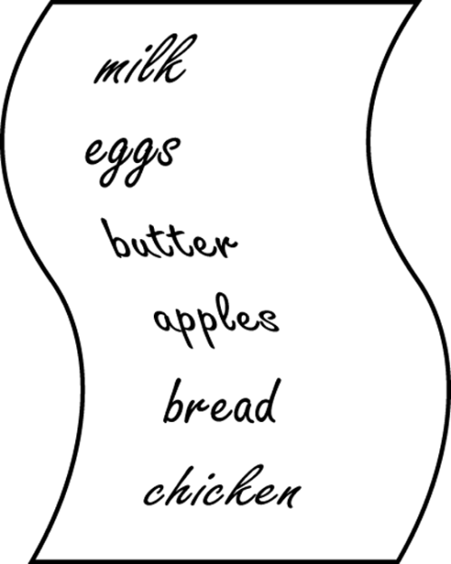
Lists
A list provides a way to organize data
E.g: to-do list, grocery list, collection
Has order which may or may not matter
First item, second item, …. , nth item
Except for the first and last items, each item has
A unique predecessor, a unique successor
Head or front does not have a predecessor
Tail or end does not have a successor
To identify a specific entry in a list, we will use its position
This allows us to describe or specify operations on list more precisely

Slide 3
List: Specification
Typical actions with lists
Add a new entry at a specific position
Remove an item (or all items)
Replace an item
Look at an item (or all items)
Search for an item
Count how many items in the list
Check if list is empty

Slide 4
List: Specification
Data
A collection of objects that have the same data type
The number of objects in the collection
Operations
add(newEntry)
Adds new newEntry to the end of the list
Input: newEntry is an object
Output: none
add(newPosition, newEntry)
Adds newEntry at position newPosition within the list
Input: newPosition is an integer, newEntry is an object
Output: none

Slide 5
remove(givenPosition)
Removes and returns the entry at givenPosition
Input: givenPosition is an integer
Output: returns the entry at givenPosition
clear()
Removes all entries from the list
Input: none
Output: none
replace(givenPosition, newEntry)
replaces the entry at givenPosition with newEntry
input: givenPosition is an integer, newEntry is an object
getEntry(givenPosition)
Retrieves entry at givenPosition
Input: givenPosition is an integer
Output: returns the entry at givenPosition

Slide 6
contains(anEntry)
checks whether the list contains anEntry
Input: anEntry is an object
Output: Returns true if anEntry is in the list, false if not
getLength()
Returns the number of entries currently in the list
Input: none
output: number of entries as an integer
isEmpty()
checks whether the list is empty
input: none
output: returns true if list is empty, false otherwise
toArray()
retrieve all the entries in the order they occur
input: none
output: a new array of entries currently in the list

Slide 7
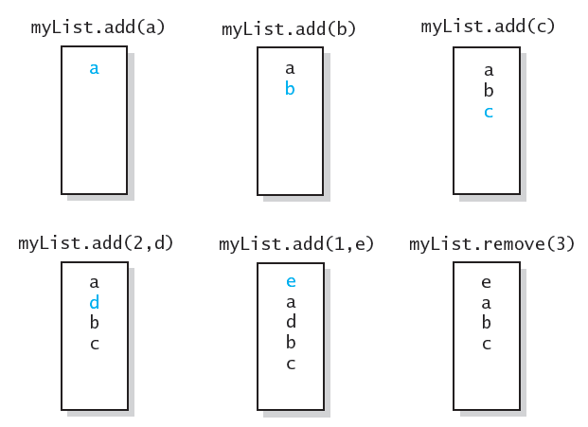
Example:
When we declare a new list it is empty
If add a,b,c in this order we get the list a b c
a is at position 1, b at position 2, and c at position 3
(We could have numbered starting at 0)
At this point myList.empty() returns false and myList.getLength() returns 3
myList.add(2,d)
adds d at position 2 within the list
moves b and c to positions 3 and 4
myList.add(1,e)
adds e to beginning of list
all other entries move 1 position higher
myList.getEntry(2)
gets the second entry (a)
myList.remove(3)
removes d from list
b and c are moved on position lower
myList.replace(3,f)
replaces b with f

Slide 8
The ADT List: Specification
Questions to be addressed:
What happens when one of the operations add, remove, replace and getEntry receive an invalid position number?
What happens when one of the operations remove, replace, getEntry is executed on an empty list?
Observation:
The first draft of an ADT specification often overlooks or ignores situations that we must consider
We must later on concentrate on the details to make the specification complete
Code:
Review ListInterface.java
We can use the ADT’s operations in a program without knowing the details of the implementation
We can hire a programmer to implement the ADT list in Java given the interface and specification
We only need to know what the ADT list does, NOT how it does it

Slide 9
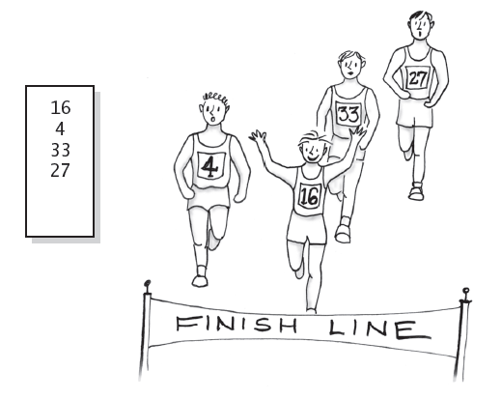
Example 1: Organizing a road race
Note the order in which the runners finish the race, we add the number to the end of the list as the runners cross the finish line
Review ListClient.java

Slide 10
Example 2:
Professor wants an alphabetical list of students that are in class
As student enters room, professor adds the student’s name to a list, making sure it is in correct position to guarantee alphabetical order
To place the names Amy, Ellen, Bob, Drew, Aaron, Carol
ListInterface<String> alphaList= new Alist<String>();
alphaList.add(1, “Amy”); // Amy
alphaList.add(2, “Ellen”); // Amy Ellen
alphaList.add(2, “Bob”); // Amy Bob Ellen
alphaList.add(3, “Drew”); // Amy Bob Drew Ellen
alphaList.add(1, “Aaron”); // Aaron Amy Bob Drew Ellen
alphaList.add(4, “Carol”); // Aaron Amy Bob Carol Drew Ellen
Key observation: client (user or class) maintained the order

Slide 11
Implementing ADTs
Choosing the data structure to represent the ADT’s data is a part of implementation
Choice of a data structure depends on
Details of the ADT’s operations
Context in which the operations will be used
Choice affects efficiency
we will do intuitive analysis for now
Implementation details should be hidden behind a wall of ADT operations
A program would only be able to access the data structure using the ADT operations
Compare/contrast to non-object oriented world

Slide 12
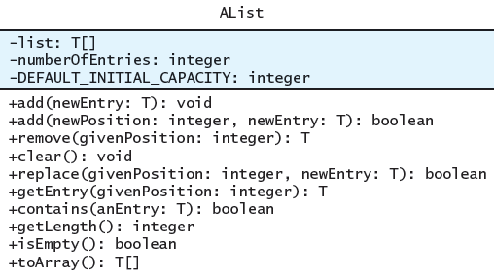
The Java Implementation

Slide 13
An Array-Based Java Implementation
Implementation details
public class Alist<T> implements ListInterface<T> {
{
private T[] list; private int numberOfEntries;
private static final int DEFAULT_INITIAL_CAPACITY = 25;
}

Slide 14
Constructor
public AList()
{
this(DEFAULT_INITIAL_CAPACITY); // call next constructor
} // end default constructor
public AList(int initialCapacity)
{
numberOfEntries = 0;
// the cast is safe because the new array contains null entries
@SuppressWarnings("unchecked")
T[] tempList = (T[])new Object[initialCapacity];
list = tempList;
} // end constructor
getLength() and isEmpty()
public int getLength() {
return numberOfEntries;
} // end getLength
public boolean isEmpty(){
return numberOfEntries == 0; // or getLength() == 0
} // end isEmpty

Slide 15
add()
public void add(T newEntry) {
ensureCapacity();
list[numberOfEntries] = newEntry;
numberOfEntries++;
} // end add
// Doubles the size of the array list if it is full.
private void ensureCapacity()
{
if (numberOfEntries == list.length)
list = Arrays.copyOf(list, 2 * list.length);
// equivalent to the following
//newList = (T[]) new Object[2*list.length];
//for(int i = 0; i < list.length ; ++i)
// newList[i] = list[i];
//list = newList;
} // end ensureCapacity

Slide 16
add(newPosition, newEntry)
If newPosition is before the end of the list we need to shift the existing entries to vacate the desired location
If addition is to end of list, no such shift is necessary
public boolean add(int newPosition, T newEntry) {
boolean isSuccessful = true;
if ((newPosition >= 1) && (newPosition <= numberOfEntries + 1)) {
ensureCapacity();
makeRoom(newPosition);
list[newPosition - 1] = newEntry;
numberOfEntries++;
}
else
isSuccessful = false;
return isSuccessful;
} // end add

Slide 17
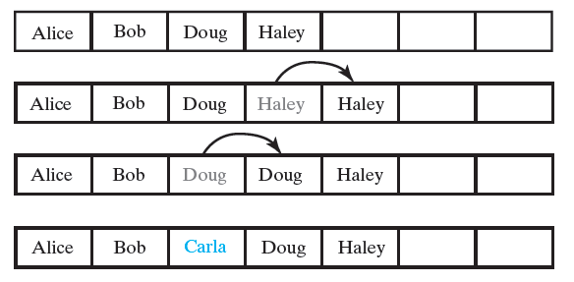
makeRoom(newPosition)
shift entries towards the end of the array
private void makeRoom(int newPosition)
{
assert (newPosition >= 1) && (newPosition <= numberOfEntries + 1);
int newIndex = newPosition - 1;
int lastIndex = numberOfEntries - 1;
// move each entry to next higher index, starting at end of
// list and continuing until the entry at newIndex is moved
for (int index = lastIndex; index >= newIndex; index--)
list[index + 1] = list[index];
} // end makeRoom

Slide 18
remove(givenPosition)
public T remove(int givenPosition) {
T result = null; // return value
if ((givenPosition >= 1) && (givenPosition <= numberOfEntries)) {
assert !isEmpty();
result = list[givenPosition - 1]; // get entry to be removed
// move subsequent entries towards entry to be removed,
// unless it is last in list
if (givenPosition < numberOfEntries)
removeGap(givenPosition);
numberOfEntries--;
} // end if
return result; // return reference to removed entry, or
// null if either list is empty or givenPosition
// is invalid
} // end remove

Slide 19
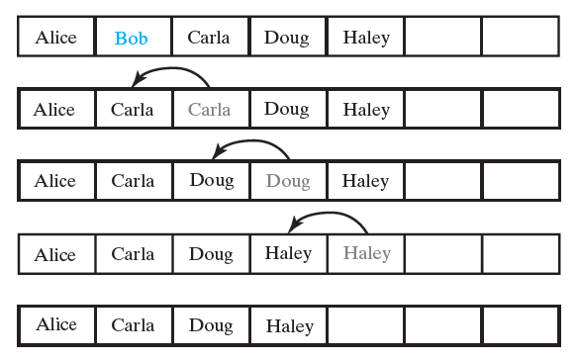
removeGap(givenPosition)
private void removeGap(int givenPosition)
{
assert (givenPosition >= 1) && (givenPosition < numberOfEntries);
int removedIndex = givenPosition - 1;
int lastIndex = numberOfEntries - 1;
for (int index = removedIndex; index < lastIndex; index++)
list[index] = list[index + 1];
} // end removeGap

Slide 20
replace
public boolean replace(int givenPosition, T newEntry)
{
boolean isSuccessful = true;
if ((givenPosition >= 1) && (givenPosition <= numberOfEntries)) // test catches empty list
{
assert !isEmpty();
list[givenPosition - 1] = newEntry;
}
else
isSuccessful = false;
return isSuccessful;
} // end replace

Slide 21
getEntry
public T getEntry(int givenPosition)
{
T result = null; // result to return
if ((givenPosition >= 1) && (givenPosition <= numberOfEntries))
{
assert !isEmpty();
result = list[givenPosition - 1];
} // end if
return result;
} // end getEntry

Slide 22
contains
public boolean contains(T anEntry)
{
boolean found = false;
for (int index = 0; !found && (index < numberOfEntries); index++)
{
if (anEntry.equals(list[index]))
found = true;
} // end for
return found;
} // end contains
clear()
public void clear()
{
for(int i = 0; i < numberOfEntries; ++i)
list[i] = null;
numberOfEntries = 0;
} // end contains
What are other possible implementations of clear()?
What are the advantages/disadvantages?

Slide 23
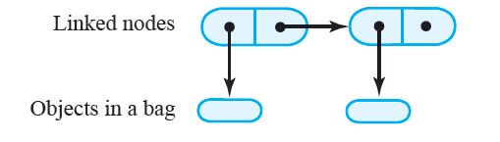
Node
Linked list
Contains nodes that are linked to one another
A node contains both data and a link to the next item
Implement a Node as a class
Access is package-private (no access specifiers provided)
Main observation: class Node contains an object next of type Node
this circular referencing is legal in Java
private class Node {
private T data; // entry
private Node next; // link to next node
private Node(T dataPortion) {
this(dataPortion, null);
} // end constructor
private Node(T dataPortion, Node nextNode)
{
data = dataPortion;
next = nextNode;
} // end constructor
} // end Node

Slide 24
Node: Adding get/set methods
private class Node {
private T data; // entry
private Node next; // link to next node
private Node(T dataPortion) {
this(dataPortion, null);
} // end constructor
private Node(T dataPortion, Node nextNode){
data = dataPortion;
next = nextNode;
} // end constructor
private T getData() {
return data;
} // end getData
private void setData(T newData) {
data = newData;
} // end setData
private Node getNextNode() {
return next;
} // end getNextNode
private void setNextNode(Node nextNode) {
next = nextNode;
} // end setNextNode
} // end Node

Slide 25
Linked Lists
Node is an example of an inner class
It will be implemented inside another class
We will declare it as private so it can’t be accessed from outside
public class LList<T> implements ListInterface<T> {
. . .
private class Node {
. . .
} // end Node
. . .
}

Slide 26
Linked Lists
How to determine the beginning of a linked list?
a head reference refers to the first node
References the list’s first node
Always exists even when the list is empty
It is initialized to null when list is created
public class LList<T> implements ListInterface<T> {
private Node firstNode; // reference to first node
private int numberOfEntries;
public LList() {
clear();
} // end default constructor
public final void clear() // note the final method
{
firstNode = null;
numberOfEntries = 0;
} // end clear
. . .
}

Slide 27
Operations on a Chain of Linked Nodes
Adding a Node at Various Positions
Case 1: Chain is empty
Case 2: Adding node at chain’s beginning
Case 3: Adding node between adjacent nodes
Case 4: Adding node to chain’s end
public void add(int newPosition, T newEntry)
{
// case 1
// case 2
// case 3
// case 4
} // end add

Slide 28
Operations on a Chain of Linked Nodes
Three steps to insert a new node into a linked list
Create a new node and store the new data in it
Determine the point of insertion
Connect the new node to the linked list by changing references

Slide 29

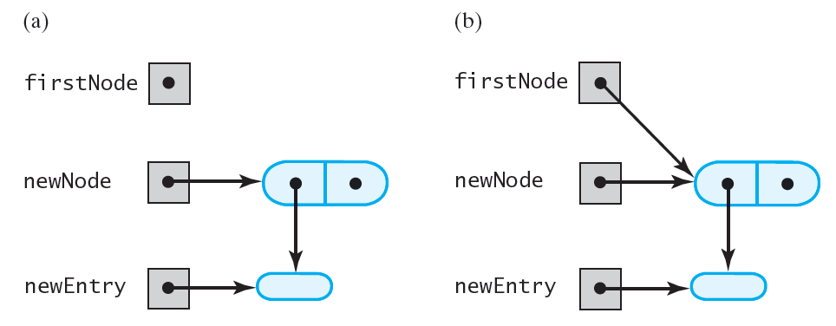
Case 1: The chain is empty
public void add(int newPosition, T newEntry)
{
} // end add

Slide 30

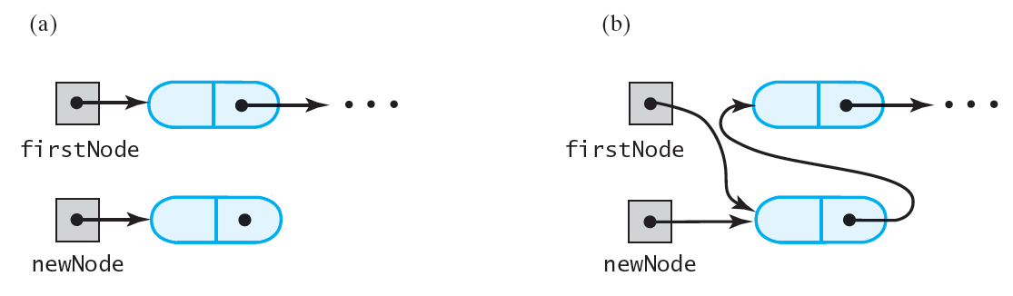
Case 2: Adding a node to the beginning of a chain
public void add(int newPosition, T newEntry)
{
} // end add
Are cases 1 and 2 different?

Slide 31
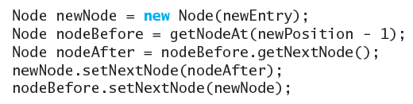
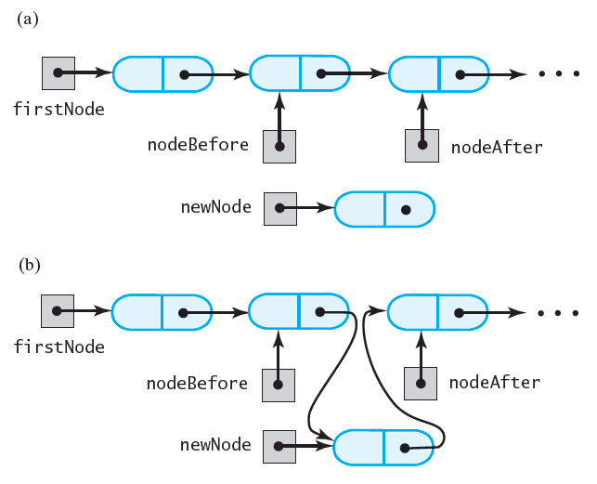
Case 3: Adding a node between adjacent nodes of a chain
public void add(int newPosition, T newEntry)
{
} // end add
We define getNodeAt later

Slide 32
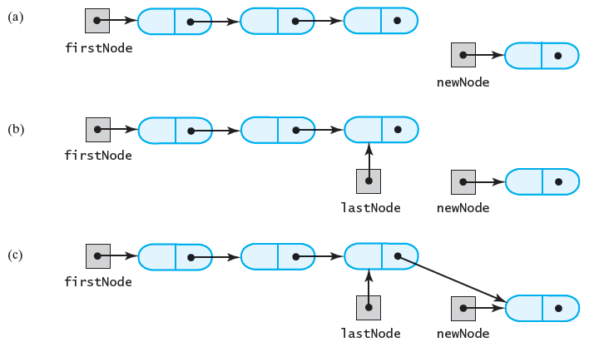

Case 4: Adding a node to the end of a chain
public void add(T newEntry)
{
} // end add

Slide 33

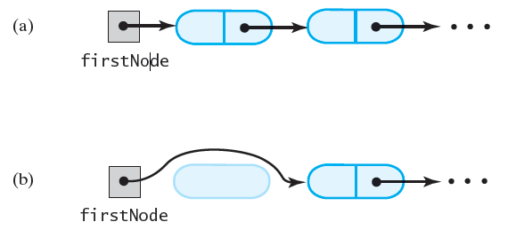
Removing a Node from Various Positions
Case 1: Removing first node

Slide 34
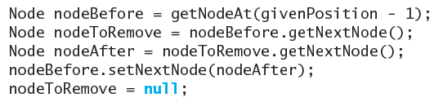
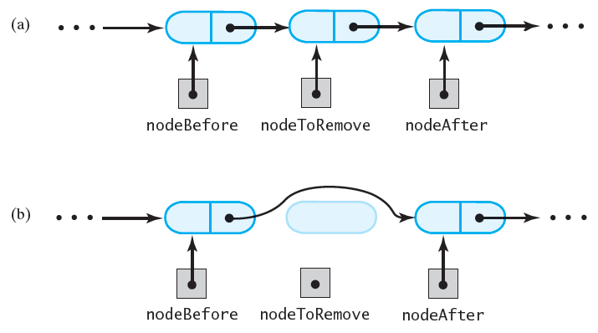
Removing a Node from Various Positions
Case 2: Removing node other than first

Slide 35
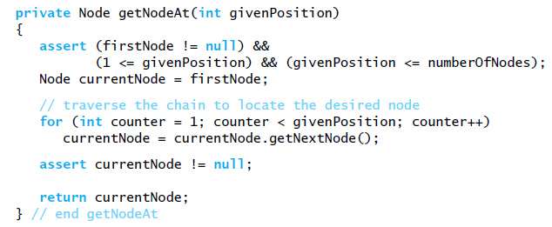
The Private Method getNodeAt
Returns reference to node at specified position
Prerequisite 1: chain is not empty
Prerequisite 2: 1 <=givenPosition <= numberOfNodes
Use temporary variable currentNode

Slide 36
Beginning the implementation
We want to implement the ListInterface from previous class using linked lists

Slide 37
Linked Lists: implementation
Why clear() is declared final?
public class LList<T> implements ListInterface<T> {
private Node firstNode; // reference to first node
private int numberOfEntries;
public LList() {
clear();
} // end default constructor
public final void clear() // note the final method
{
firstNode = null;
numberOfEntries = 0;
} // end clear
. . .
}

Slide 38
Linked Lists: Adding to the end of the list
public void add(T newEntry)
{
Node newNode = new Node(newEntry);
if (isEmpty())
firstNode = newNode;
else // add to end of non-empty list
{
Node lastNode = getNodeAt(numberOfEntries);
lastNode.setNextNode(newNode); // make last node reference new node
} // end if
numberOfEntries++;
} // end add

Slide 39
Linked Lists: Adding within list
public boolean add(int newPosition, T newEntry) // OutOfMemoryError posssible
{
boolean isSuccessful = true;
if ((newPosition >= 1) && (newPosition <= numberOfEntries + 1)) {
Node newNode = new Node(newEntry);
if (newPosition == 1) // case 1
{
newNode.setNextNode(firstNode);
firstNode = newNode;
}
else { // case 2: list is not empty and newPosition > 1
Node nodeBefore = getNodeAt(newPosition - 1);
Node nodeAfter = nodeBefore.getNextNode();
newNode.setNextNode(nodeAfter);
nodeBefore.setNextNode(newNode);
} // end if
numberOfEntries++;
}
else
isSuccessful = false;
return isSuccessful;
} // end add

Slide 40
Linked Lists: isEmpty()
public boolean isEmpty()
{
boolean result;
if (numberOfEntries == 0) // or getLength() == 0
{
assert firstNode == null;
result = true;
}
else
{
assert firstNode != null;
result = false;
} // end if
return result;
} // end isEmpty
Can we implement method without numberOfEntries?

Slide 41
Linked Lists: Testing
add methods are fundamental
We test those methods before continuing the implementation
public static void main(String[] args) {
System.out.println("Create an empty list.");
ListInterface<String> myList = new LList<String>();
System.out.println("List should be empty; isEmpty returns " +
myList.isEmpty() + ".");
System.out.println("\nTesting add to end:");
myList.add("15");
myList.add("25");
myList.add("35");
myList.add("45");
System.out.println("List should contain 15 25 35 45.");
displayList(myList);
System.out.println("List should not be empty; isEmpty() returns " +
myList.isEmpty() + ".");
System.out.println("\nTesting clear():");
myList.clear();
System.out.println("List should be empty; isEmpty returns " +
myList.isEmpty() + ".");
} // end main

Slide 42
Linked Lists: Testing
Output of previous program
Create an empty list.
List should be empty; isEmpty returns true
Testing add to end:
List should contain 15 25 35 45.
List contains 4 entries, as follows:
15 is entry 1
25 is entry 2
35 is entry 3
45 is entry 4
List should not be empty; isEmpty() returns false
Testing clear()
List should be empty; isEmpty returns true.

Slide 43
Linked Lists: implementation
public T remove(int givenPosition) {
T result = null; // return value
if ((givenPosition >= 1) && (givenPosition <= numberOfEntries)) {
assert !isEmpty();
if (givenPosition == 1) // case 1: remove first entry
{
result = firstNode.getData();
firstNode = firstNode.getNextNode();
}
else // case 2: not first entry
{
Node nodeBefore = getNodeAt(givenPosition - 1);
Node nodeToRemove = nodeBefore.getNextNode();
Node nodeAfter = nodeToRemove.getNextNode();
nodeBefore.setNextNode(nodeAfter);
result = nodeToRemove.getData();
} // end if
numberOfEntries--;
} // end if
return result;
} // end remove

Slide 44
Linked Lists: implementation
public boolean replace(int givenPosition, T newEntry)
{
boolean isSuccessful = true;
if ((givenPosition >= 1) && (givenPosition <= numberOfEntries))
{
assert !isEmpty();
Node desiredNode = getNodeAt(givenPosition);
desiredNode.setData(newEntry);
}
else
isSuccessful = false;
return isSuccessful;
} // end replace

Slide 45
Linked Lists: implementation
public T getEntry(int givenPosition)
{
T result = null; // result to return
if ((givenPosition >= 1) && (givenPosition <= numberOfEntries))
{
assert !isEmpty();
result = getNodeAt(givenPosition).getData();
} // end if
return result;
} // end getEntry

Slide 46
Linked Lists: implementation
public boolean contains(T anEntry)
{
boolean found = false;
Node currentNode = firstNode;
while (!found && (currentNode != null))
{
if (anEntry.equals(currentNode.getData()))
found = true;
else
currentNode = currentNode.getNextNode();
} // end while
return found;
} // end contains

Slide 47
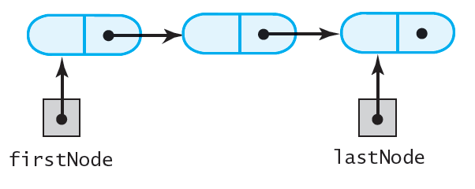
Linked Lists: A Refined Implementation
Currently we only have a head reference
To add to end of chain, we have to invoke getNodeAt to locate last node
This requires traversing the whole list
We can improve the time efficiency of add by adding a reference to the end of the chain

Slide 48
Linked Lists: A Refined Implementation
We will create a new class LList2
We have to add another private data field
public class LList<T> implements ListInterface<T> {
private Node firstNode; // reference to first node
private Node lastNode; // tail reference to last node
private int numberOfEntries;
public LList() {
clear();
} // end default constructor
public final void clear() // note the final method
{
firstNode = null;
lastNode = null;
numberOfEntries = 0;
} // end clear
. . .
}

Slide 49
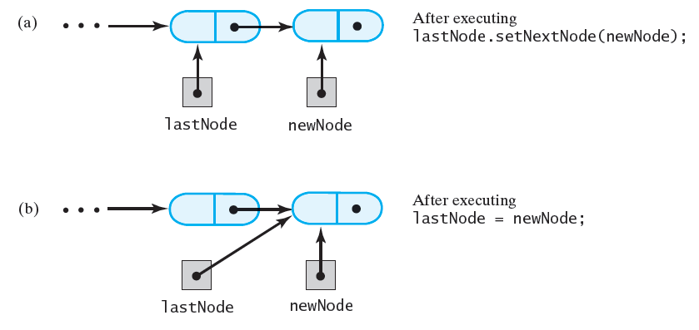
Linked Lists: A Refined Implementation
public void add(T newEntry)
{
Node newNode = new Node(newEntry);
if (isEmpty())
firstNode = newNode;
else
lastNode.setNextNode(newNode);
lastNode = newNode;
numberOfEntries++;
} // end add

Slide 50
Linked Lists: A Refined Implementation
public boolean add(int newPosition, T newEntry) {
boolean isSuccessful = true;
if ((newPosition >= 1) && (newPosition <= numberOfEntries + 1)) {
Node newNode = new Node(newEntry);
if (isEmpty()) {
firstNode = newNode;
lastNode = newNode;
}
else if (newPosition == 1) {
newNode.setNextNode(firstNode);
firstNode = newNode;
}
else if (newPosition == numberOfEntries + 1){
lastNode.setNextNode(newNode);
lastNode = newNode;
}
else {
Node nodeBefore = getNodeAt(newPosition - 1);
Node nodeAfter = nodeBefore.getNextNode();
newNode.setNextNode(nodeAfter);
nodeBefore.setNextNode(newNode);
} // end if
numberOfEntries++;
}
else
isSuccessful = false;
return isSuccessful;
} // end add

Slide 51
Linked Lists: A Refined Implementation
public T remove(int givenPosition) {
T result = null; // return value
if ((givenPosition >= 1) && (givenPosition <= numberOfEntries)){
assert !isEmpty();
if (givenPosition == 1) { // case 1: remove first entry
result = firstNode.getData(); // save entry to be removed
firstNode = firstNode.getNextNode();
if (numberOfEntries == 1)
lastNode = null; // solitary entry was removed
}
else { // case 2: not first entry
Node nodeBefore = getNodeAt(givenPosition - 1);
Node nodeToRemove = nodeBefore.getNextNode();
Node nodeAfter = nodeToRemove.getNextNode();
nodeBefore.setNextNode(nodeAfter);
result = nodeToRemove.getData(); // save entry to be removed
if (givenPosition == numberOfEntries)
lastNode = nodeBefore; // last node was removed
} // end if
numberOfEntries--;
} // end if
return result; // return removed entry, or
// null if operation fails
} // end remove

Slide 52
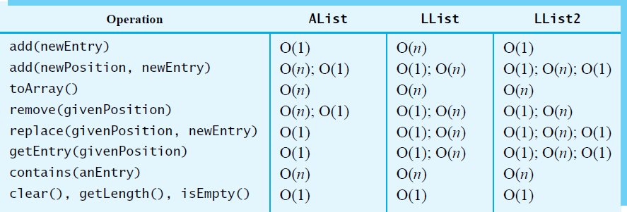
complexities of operations of list for array and linked implementation:
First: time requirement for operation at beginning
Second: time requirement for operation within list
Third: time requirement for operation at end of list

Slide 53
Design Decisions
Efficiency of execution vs. implementation time
Issues include:
Access time
add, remove, search
Memory usage
Overhead for pointers
Wasted memory for arrays

Slide 54
Comparing Array-Based and Referenced-Based Implementations
Size (MEMORY/STORAGE)
AList
Resizable array
Increasing the size of a resizable array can waste storage and time
Storage:
assume you start with array size = 50 and you double each time you want more
To store 250 elements, you have 150 wasted (50 → 100 → 200 → 400)
Time: each time we double, we copy old elements to new location
LList
Does not have a fixed size
Requires explicit reference to next item
For array, there is no need to store explicitly information about where to find the next data item
No advantage over resizable array

Slide 55
Comparing Array-Based and Referenced-Based Implementations
Access time
AList
Constant access time
LList
The time to access the i^{th} node depends on i
Insertion and deletions
AList
Require you to shift the data
If we have array of size n and we want to insert at position i, we have to do around n-i shifts. Similarly for deleting an item
LList
Do not require you to shift the data
Require a list traversal

Slide 56
Comparing Array-Based and Referenced-Based Implementations : Review
Which data structure (array vs linked list) you would pick if you want to optimize for the operations below:
You add to and remove from end of list?
Answer:
You add to and remove from the beginning of the list?
Answer:
You want to get the contents at some index?
Answer:

Slide 57
Comparing Array-Based and Referenced-Based Implementations : Review
Which data structure (array vs linked list) you would pick if you want to optimize for the operations below:
You add to and remove from end of list?
Answer: array
You add to and remove from the beginning of the list?
Answer: linked list
You want to get the contents at some index?
Answer: array

