Slide 1
Queues, Deques, Priority Queues
Dr. Maher Mneimneh
Notes:
1

Slide 2
More About Generics
The Interface Comparable
If s and t are strings s.compareTo(t) returns
Negative if s comes before t
Zero if s and t are equal
Positive if s comes after t
All classes that define the method compareTo implement the standard interface Comparable
package java.lang;
public interface Comparable<T> {
public int compareTo(T other);
}
Let’s create Circle class with compareTo()
public class Circle implements Comparable<Circle> {
private double radius;
public int compareTo(Circle other) {
int result;
if(this.equals(other))
result = 0;
else if (radius < other.radius)
result = -1;
else
result = 1;
return result;
}
Notes:
Copyright ©2012 by Pearson Education, Inc. All rights reserved
2

Slide 3
Bounded Type Parameters
compareTo doesn’t need to return -1 or 1, so another option is:
public class Circle implements Comparable<Circle> {
private double radius;
public int compareTo(Circle other) {
return radius – other.radius;
}
public class String implements Comparable<String> {
private double radius;
public int compareTo(String other) {
for(int i = 0; i < min(this.length(), other.lengt(); i++)
if(this.indexOf(i)- other.indexOf(i) != 0)
return dif;
return radius – other.radius;
}
compareTo() doesn’t belong to the class Object
Not all classes need to have a compareTo method
Notes:
Copyright ©2012 by Pearson Education, Inc. All rights reserved
3

Slide 4
More About Generics
Sometimes we want to limit classes that can be used in a generic type
public class Square <T> {
private T side;
public Square(T initialSide) {
side = initialSide;
}
public T getSide() {
return side;
}
}
We can create Square<Integer>, Square<Double>, or Square<String>
Square<Integer> intSquare = new Square<>(5);
Square<Double> realSquare = new Square<>(2.1);
Square<String> stringSquare = new Square<>(“25”);
If Square had method getArea():
public T getArea() {
return side * side;
}
An error gets generated when we create a Square<String> and we call getArea()
Notes:
Copyright ©2012 by Pearson Education, Inc. All rights reserved
4

Slide 5
More About Generics
We can impose a restriction on T by requiring it to represent a class derived from Number, the base class of Byte, Double, Float, Integer, ..:
public class Square <T extends Number > {
private T side;
public Square(T initialSide) {
side = initialSide;
}
public T getSide() {
return side;
}
public T getArea() {
return side * side;
}
}
Number is an upper bound on T
Compiler now rejects attempt to create a square whose side is a string
Notes:
Copyright ©2012 by Pearson Education, Inc. All rights reserved
5

Slide 6
More About Generics
Write a static method that returns smallest object in an array
objects might be strings, Integer, or any object that can be compared
public class MyClass {
public static <T> T arrayMinimum(T[] anArray)
{
T min = anArray[0];
for (T e : anArray) {
if(e.compareTo(min) < 0)
min = e;
}
return min;
}
}
Client could pass an array of objects that do not have compareTo()
We must bound T so that it represents class types that provide the method compareTo(): replace <T> by <T extends Comparable<T>>
Notes:
Copyright ©2012 by Pearson Education, Inc. All rights reserved
6

Slide 7
More About Generics
Example usage:
Gadget s = MyClass.arrayMinimum(myArray);
Gadget must implement the interface Comparable<Gadget>
This is more restrictive than we need
What if Gadget is derived from Widget and Widget implements Comparable<Widget>?
Gadget could use the method compareTo() it inherits from Widget without defining its own
public class MyClass {
public static <T extends Comparable<? super T>> T arrayMinimum(T[] anArray)
{
T min = anArray[0];
for (T e : anArray) {
if(e.compareTo(min) < 0)
mim = e;
}
return min;
}
}
Notes:
Copyright ©2012 by Pearson Education, Inc. All rights reserved
7

Slide 8
Queue
Waiting is a fact of life!
Waiting on the phone for a service representative
Waiting for your output to be printed
Another name for a waiting line
Used within operating systems
Simulate real world events
First in, first out (FIFO)
Double ended queue (deque)
Deque organizes data like a queue but enables you to operate on both its oldest and newest entries
Priority queue
Orders objects using priority instead of chronologically using time
Notes:
Copyright ©2012 by Pearson Education, Inc. All rights reserved
8

Slide 9
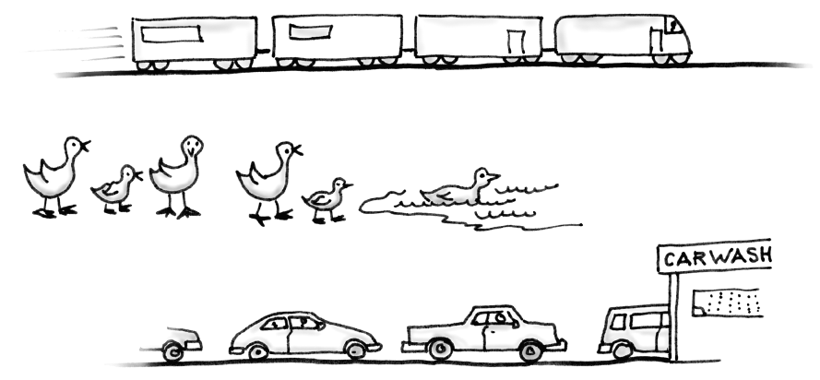
The ADT Queue
Like stack
Organizes entries according to the order in which they were added
Unlike stack:
Exhibits first-in ,first-out behavior (FIFO)
All additions to a queue are at its back
Item added most recently is at the back of the queue
The item added the earliest is at front of queue
Examples
Notes:
Copyright ©2012 by Pearson Education, Inc. All rights reserved
9

Slide 10
The ADT Queue
A client can look at or remove only the entry at the front of the queue
The only way to look at an entry that is not at the front of a queue is to repeatedly remove items until desired item is at front
Operations
enqueue(newEntry): adds a new entry to the back of the queue
dequeue(): removes and returns the entry at the front of the queue
getFront() : retrieves queue’s front entry without changing the queue in any way
isEmpty(): detects whether the queue is empty
clear(): removes all entries from the queue
Notes:
Copyright ©2012 by Pearson Education, Inc. All rights reserved
10

Slide 11
The ADT Queue
public interface QueueInterface<T> {
/** Adds a new entry to the back of this queue.
@param newEntry an object to be added */
public void enqueue(T newEntry);
/** Removes and returns the entry at the front of this queue.
@return either the object at the front of the queue or, if the
queue is empty before the operation, null */
public T dequeue();
/** Retrieves the entry at the front of this queue.
@return either the object at the front of the queue or, if the
queue is empty, null */
public T getFront();
/** Detects whether this queue is empty.
@return true if the queue is empty, or false otherwise */
public boolean isEmpty();
/** Removes all entries from this queue. */
public void clear();
} // end QueueInterface
Notes:
Copyright ©2012 by Pearson Education, Inc. All rights reserved
11

Slide 12
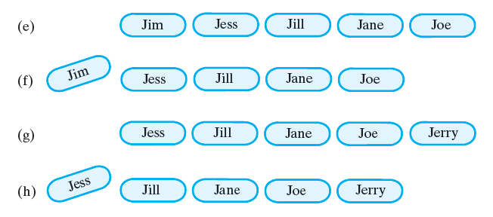
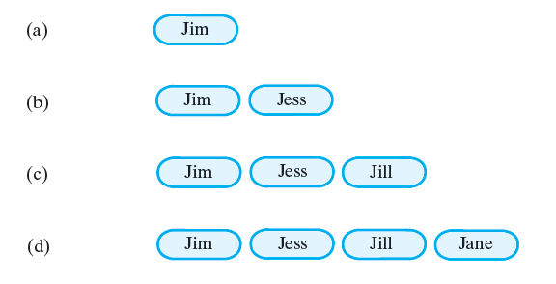
The ADT Queue
public class QueueTest {
public static void main(String[] args) {
QueueInterface<String> myQueue = new ArrayQueue<String>();
myQueue.enqueue("Jim");
myQueue.enqueue("Jess");
myQueue.enqueue("Jill");
myQueue.enqueue("Jane");
myQueue.enqueue("Joe");
String front = myQueue.getFront(); // returns “Jim”
System.out.println(front + " is at the front of the queue.");
front = myQueue.dequeue(); // removes and returns “Jim”;
System.out.println(front + " is removed from the queue.");
myQueue.enqueue("Jerry");
front = myQueue.getFront(); // returns “Jess”
System.out.println(front + " is at the front of the queue.");
front = myQueue.dequeue(); // removes and returns “Jess”;
System.out.println(front + " is removed from the queue.");
}
}
Notes:
Copyright ©2012 by Pearson Education, Inc. All rights reserved
12

Slide 13
Simulating a Waiting Line
In everyday situations, you will wait in a line
The person at the front of the line is served first
Newcomers go to the back of the line
We will perform a simulation of a waiting line
Businesses are concerned with the time customers wait for service
Short wait time: increase customer satisfaction, serve more people, make more money
A business doesn’t want to employ more people than necessary
A car wash certainly would not build an additional service bay to test its effects on customer wait in a single line
Computer simulation of a real-world situation is a common way to test various business scenarios
We will simulate one line of people waiting for service from one agent
Customers arrive at various intervals and require various times to complete their transactions
assume random arrival
assume random service time bounded by some upper bound
Figure 10-3 A line, or queue, of people
Notes:
Copyright ©2012 by Pearson Education, Inc. All rights reserved
13

Slide 14
Simulating a Waiting Line
Solution design
2 objects : waiting line and customers
class WaitLine
simulates the waiting line for a given period of time
customers enter at random intervals and leave the line after being served
class shows statistics : number of served, total wait time, average wait time, number left in line
class Customer
records and make available customer’s arrival time, transaction time, and customer number
Figure 10-3 A line, or queue, of people
Notes:
Copyright ©2012 by Pearson Education, Inc. All rights reserved
14

Slide 15
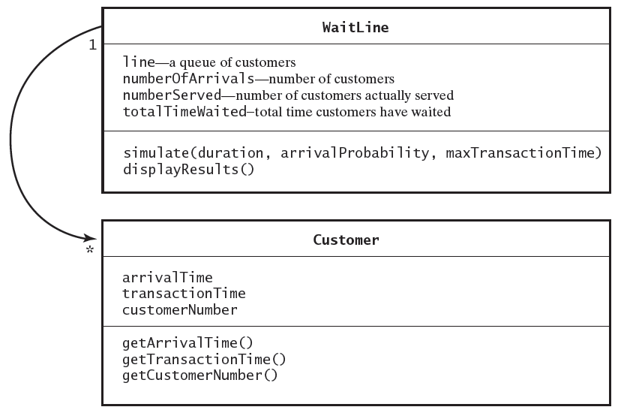
Notes:
Copyright ©2012 by Pearson Education, Inc. All rights reserved
15

Slide 16
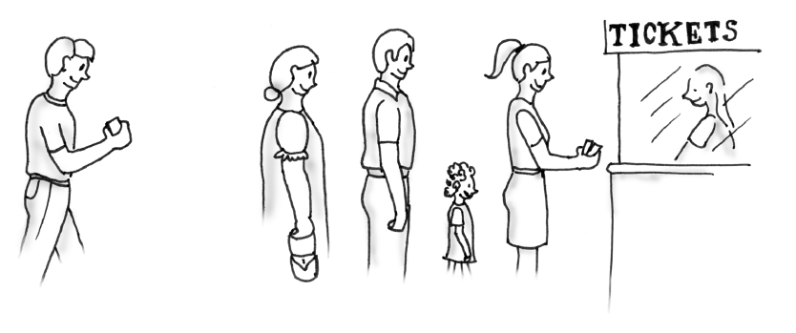
Simulating a Waiting Line
Time-driven simulation
A counter enumerates simulated units of time (minutes for example)
At each minute check:
whether the current customer is still being served
if still being served, simulation advances
if not, the customer at front of queue leaves the queue to get serviced
whether a new customer has arrived
if yes, new customer is assigned a random transaction time that doesn’t exceed certain upper bound, new customer is placed in queue
the time each customer waits in the queue is recorded
summary statistics are generated at the end
Figure 10-3 A line, or queue, of people
Notes:
Copyright ©2012 by Pearson Education, Inc. All rights reserved
16

Slide 17
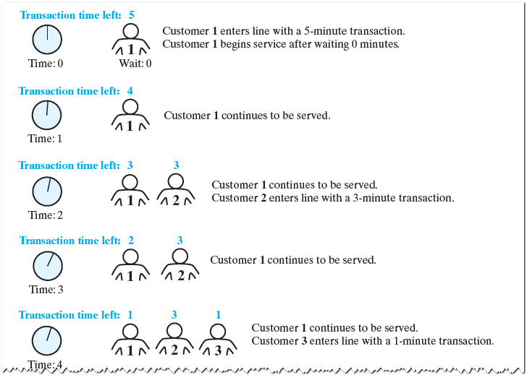
Notes:
Copyright ©2012 by Pearson Education, Inc. All rights reserved
17

Slide 18
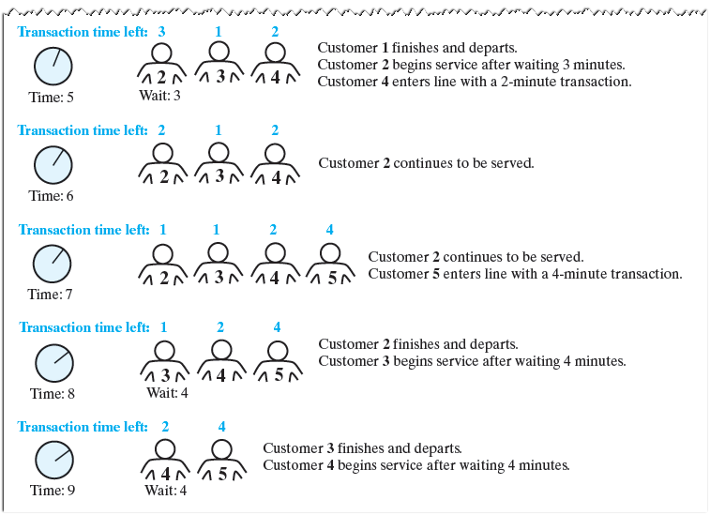
Notes:
Copyright ©2012 by Pearson Education, Inc. All rights reserved
18

Slide 19
Class WaitLine
public class WaitLine {
private QueueInterface<Customer> line;
private int numberOfArrivals;
private int numberServed;
private int totalTimeWaited;
public WaitLine() {
line = new LinkedQueue<Customer>();
reset();
} // end default constructor
/** Initializes the simulation. */
public final void reset()
{
line.clear();
numberOfArrivals = 0;
numberServed = 0;
totalTimeWaited = 0;
} // end reset
} // end WaitLine
Notes:
Copyright ©2012 by Pearson Education, Inc. All rights reserved
19

Slide 20
Class WaitLine
public void simulate(int duration, double arrivalProbability, int maxTransactionTime) {
int transactionTimeLeft = 0;
for (int clock = 0; clock < duration; clock++) {
if (Math.random() < arrivalProbability) {
numberOfArrivals++;
int transactionTime = (int)(Math.random() * maxTransactionTime + 1);
Customer nextArrival = new Customer(clock, transactionTime, numberOfArrivals);
line.enqueue(nextArrival);
System.out.println("Customer " + numberOfArrivals + " enters line at time " + clock + ". Transaction time is " + transactionTime);
} // end if
if (transactionTimeLeft > 0)
transactionTimeLeft--;
else if (!line.isEmpty()) {
Customer nextCustomer = line.dequeue();
transactionTimeLeft = nextCustomer.getTransactionTime() - 1;
int timeWaited = clock - nextCustomer.getArrivalTime();
totalTimeWaited = totalTimeWaited + timeWaited;
numberServed++;
System.out.println("Customer " + nextCustomer.getCustomerNumber()
+ " begins service at time " + clock
+ ". Time waited is " + timeWaited);
} // end if
} // end for
} // end simulate
Notes:
Copyright ©2012 by Pearson Education, Inc. All rights reserved
20

Slide 21
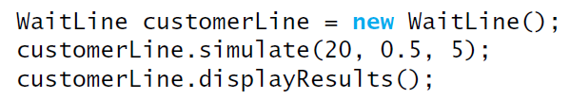
Class WaitLine
/** Displays summary results of the simulation. */
public void displayResults()
{
System.out.println();
System.out.println("Number served = " + numberServed);
System.out.println("Total time waited = " + totalTimeWaited);
double averageTimeWaited = ((double)totalTimeWaited) / numberServed;
System.out.println("Average time waited = " + averageTimeWaited);
int leftInLine = numberOfArrivals - numberServed;
System.out.println("Number left in line = " + leftInLine);
} // end displayResults
Notes:
Copyright ©2012 by Pearson Education, Inc. All rights reserved
21

Slide 22
Computing Capital Gain for Stock Sale
You buy n shares at $d, then you sell some of these shares
If sale price exceeds purchase price, profit or capital gain
If sale price is lower than purchase price, you experience a loss or negative capital gain
Example:
last year you bought 20 shares at $45 per share
last month you bought 20 additional shares at $75 per share
today, you sold 30 shares at $65 per share
What is your capital gain?
You sold shares for 30x$65/share = $1950
When computing capital gains, you must assume that you sell shares in the order purchased:
20 shares at $45/share = $900
10 shares at $75/share = $750
Total = 1650
Capital gain = $300
Design a program to
Record your investment transactions chronologically
Compute capital gain of any stock sale
Notes:
Copyright ©2012 by Pearson Education, Inc. All rights reserved
22

Slide 23
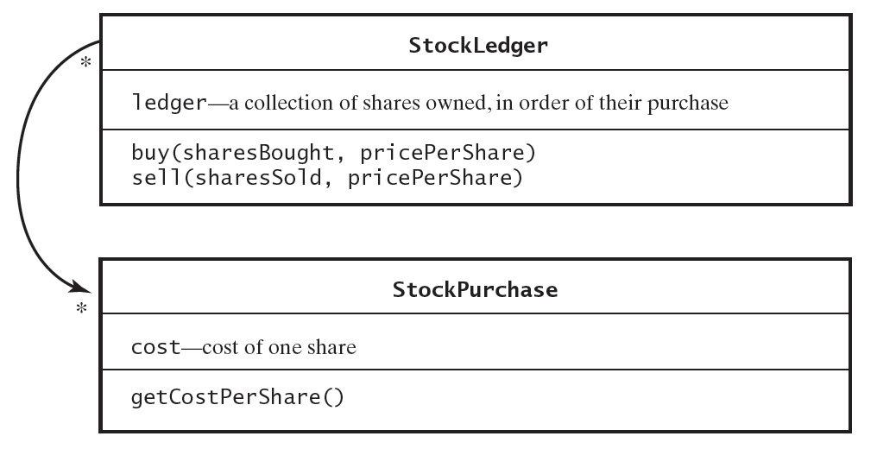
Computing Capital Gain for Stock Sale
Solution design
We assume all transactions are for stocks of a single company and that there is no commission charge for the transactions
classes: StockPurchase and StockLedger
class StockPurchase
records the cost of a single share of stock
class StockLedger
Records stock purchases in chronological order
At time of sale, computes capital gains and update the record of stocks owned
Notes:
Copyright ©2012 by Pearson Education, Inc. All rights reserved
23

Slide 24
Computing Capital Gain for Stock Sale
public class StockLedger{
private QueueInterface<StockPurchase> ledger;
public StockLedger(){
ledger = new LinkedQueue<StockPurchase>();
} // end default constructor
public void buy(int sharesBought, double pricePerShare) {
for (; sharesBought > 0; sharesBought--) {
StockPurchase purchase = new StockPurchase(pricePerShare);
ledger.enqueue(purchase);
} // end for
} // end buy
Notes:
Copyright ©2012 by Pearson Education, Inc. All rights reserved
24

Slide 25
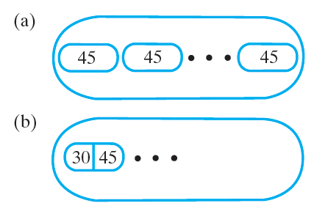
Computing Capital Gain for Stock Sale
/** Removes from this ledger any shares that were sold
and computes the capital gain or loss.
@param sharesSold the number of shares sold
@param pricePerShare the price per share
@return the capital gain (loss) */
public double sell(int sharesSold, double pricePerShare) {
double saleAmount = sharesSold * pricePerShare;
double totalCost = 0;
while (sharesSold > 0) {
StockPurchase share = ledger.dequeue();
double shareCost = share.getCostPerShare();
totalCost = totalCost + shareCost;
sharesSold--;
} // end while
return saleAmount - totalCost; // gain or loss
} // end sell
} // end StockLedger
Notes:
Copyright ©2012 by Pearson Education, Inc. All rights reserved
25

Slide 26
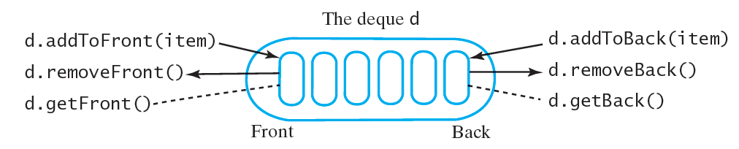
ADT Deque
At post office
When it is your turn, postal agent asks you to fill out a form
While you are filling the form, agent will serve next person in the line
After you complete the form, the person being served is done, the agent will serve you
Essentially you move to the front of the line rather than wait twice
You join a line, but immediately decide to leave it
We can’t do this with the current operations on a queue
Need for an ADT which offers
Add, remove, retrieve
At both front and back of a queue
Double ended queue
Called a deque
Pronounced “deck”
Actually behaves more like a double ended stack
Notes:
Copyright ©2012 by Pearson Education, Inc. All rights reserved
26

Slide 27
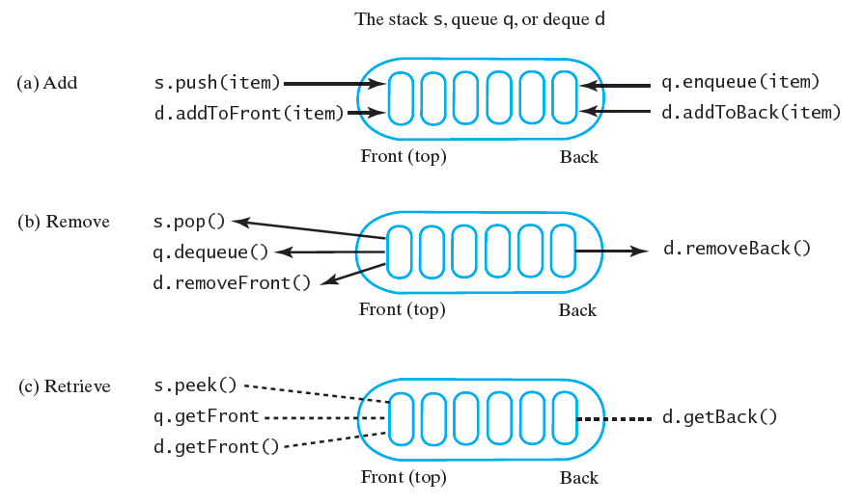
ADT Deque
public interface DequeInterface<T>
{
public void addToFront(T newEntry);
public void addToBack(T newEntry);
public T removeFront();
public T removeBack();
public T getFront();
public T getBack();
public boolean isEmpty();
public void clear();
} // end DequeInterface
Notes:
Copyright ©2012 by Pearson Education, Inc. All rights reserved
27

Slide 28
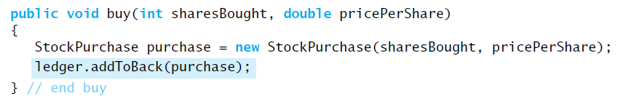
Computing Capital Gain for Stock Sale
Revise implementation of class StockLedger
Our queue contained individual shares of stock
Since a typical transaction involves more than one share, representing a transaction as one object is more natural
ledger is an instance of deque instead of a queue
Note method buy
Notes:
Copyright ©2012 by Pearson Education, Inc. All rights reserved
28

Slide 29
Computing Capital Gain for Stock Sale
Method sell
removes s StockPurchase object from the front of the deque
decides whether object represents more shares than number sold
create a new instance of StockPurchase to represent shares that remain and add it to front of deque
public double sell(int sharesSold, double pricePerShare) {
double saleAmount = sharesSold * pricePerShare;
double totalCost = 0;
while (sharesSold > 0) {
StockPurchase transaction = ledger.removeFront();
double shareCost = transaction.getCostPerShare();
int numberOfShares = transaction.getNumberOfShares();
if (numberOfShares > sharesSold) {
totalCost = totalCost + sharesSold * shareCost;
int numberToPutBack = numberOfShares - sharesSold;
StockPurchase leftOver = new StockPurchase(numberToPutBack, shareCost);
ledger.addToFront(leftOver); // return leftover shares
// Note: loop will exit since sharesSold will be <= 0 later
}
else
totalCost = totalCost + numberOfShares * shareCost;
sharesSold = sharesSold - numberOfShares;
} // end while
return saleAmount - totalCost; // gain or loss
} // end sell
Notes:
Copyright ©2012 by Pearson Education, Inc. All rights reserved
29

Slide 30
ADT Priority Queue
Priority can be based on values other than time
Banks treat customers in order in which they arrive
Emergency rooms treat patients according to urgency
hospitals assign a priority to each patient that overrides the time at which the patient arrived
ADT priority queue organizes objects according to their priorities
Priorities depend on the nature of the problem and objects
Priorities can be integers
A priority of 1 can be the highest or the lowest
Priority queue can use compareTo to compare objects by their priorities
if a.compareTo(b) == 0, a and b has the same priority
if a.compreTo(b) > 0, a has higher priority than b
if a.compareTo(b) < 0, a has lower priority than b
Notes:
Copyright ©2012 by Pearson Education, Inc. All rights reserved
30

Slide 31
ADT Priority Queue
public interface PriorityQueueInterface<T extends Comparable<? super T>> {
/** Adds a new entry to this priority queue.
@param newEntry an object */
public void add(T newEntry);
/** Removes and returns the item with the highest priority.
@return either the object with the highest priority or, if the
priority queue is empty before the operation, null */
public T remove();
/** Retrieves the item with the highest priority.
@return either the object with the highest priority or, if the
priority queue is empty, null */
public T peek();
/** Detects whether this priority queue is empty.
@return true if the priority queue is empty, or false otherwise */
public boolean isEmpty();
/** Gets the size of this priority queue.
@return the number of entries currently in the priority queue */
public int getSize();
/** Removes all entries from this priority queue */
public void clear();
} // end PriorityQueueInterface
Notes:
Copyright ©2012 by Pearson Education, Inc. All rights reserved
31

Slide 32
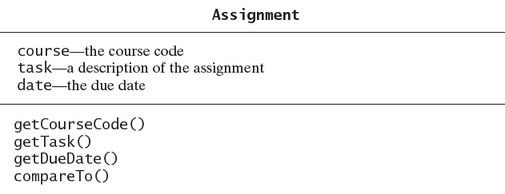
Tracking Your Assignments
Consider tasks assigned with due dates
We use a priority queue to organize in due date order
task with earliest due date will have the highest priority
class Assignment
date.compareTo(otherDate) is negative if date occurs before otherDate
class java.sql.Date
Date.valueof(“2012-02-29”) returns a date representing Feb 29,2012
Date implements the interface Comparable<Date>
Notes:
Copyright ©2012 by Pearson Education, Inc. All rights reserved
32

Slide 33
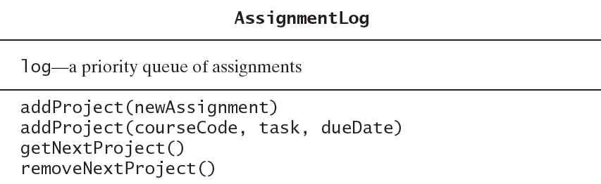
Tracking Your Assignments
class AssignmentLog
log is an instance of a priority queue that stores assignments in priority order
Notes:
Copyright ©2012 by Pearson Education, Inc. All rights reserved
33

Slide 34
Tracking Your Assignments
import java.sql.Date;
public class Assignment implements Comparable<Assignment> {
private String course;
private String task;
private Date dueDate;
public Assignment(String c, String t, Date d) {
cource = c;
task = t;
dueDate = d;
}
public int compareTo (Assignment other) {
return –date.compareTo(other.date);
}
}
Notes:
Copyright ©2012 by Pearson Education, Inc. All rights reserved
34

Slide 35
Tracking Your Assignments
import java.sql.Date;
public class AssignmentLog {
private PriorityQueueInterface<Assignment> log;
public AssignmentLog() {
log = new PriorityQueue<Assignment>();
}
public void addProject(Assignment newAssignment) {
log.add(newAssignment);
}
public void addProject(String courseCode, String task, Date dueDate) {
Assignment newAssignment = new Assignment(courseCode, task, dueDate);
addProject(newAssignment);
}
public Assignment getNextProject() {
return log.peek();
}
public Assignment removeNextProject() {
return log.remove();
}
}
Notes:
Copyright ©2012 by Pearson Education, Inc. All rights reserved
35

Slide 36
Tracking Your Assignments
import java.sql.Date;
public class AssignmentDriver {
public static void main(String[] args) {
AssignmentLog myHomework = new AssignmentLog();
myHomework.addProject(“CSC211”, “Pg 50, Ex 2”, Date.valueOf(“2015-10-21”));
Assignment pg75Ex8 = new Assignment(“CSC215”, “Pg 75, Ex 8”,
Date.valueOf(“2015-10-14”));
myHomework.addProject(pg75Ex8);
System.out.println(“Next project: “);
System.out.println(myHomework.getNextProject());
}
}
Notes:
Copyright ©2012 by Pearson Education, Inc. All rights reserved
36

Slide 37
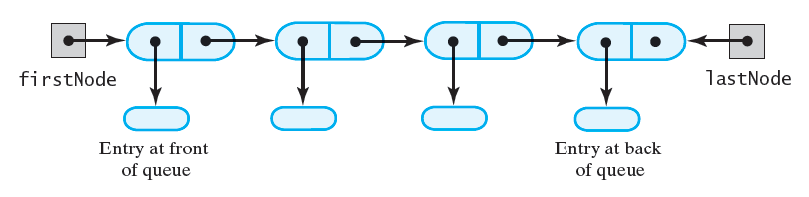
Linked Implementation of a Queue
Consider chain of linked nodes
Head reference insufficient
Must also have tail reference
Which should be front of queue?
We want to remove entry at the front of queue
If it is at beginning of chain, we can remove it easily
If it is at end of chain, removing it requires a reference to previous node (which requires traversing the chain)
Head easier to be front of queue for entry removal
Adding entries at tail/back of queue easily done
Notes:
Copyright ©2012 by Pearson Education, Inc. All rights reserved
37

Slide 38
Linked Implementation of a Queue
public class LinkedQueue<T> implements QueueInterface<T> {
private Node firstNode; // references node at front of queue
private Node lastNode; // references node at back of queue
public LinkedQueue() {
firstNode = null;
lastNode = null;
}
// < Implementations of the queue operations go here. >
// . . .
private class Node {
private T data; // entry in queue
private Node next; // link to next node
// < Constructors and the methods getData, setData, getNextNode,
// and setNextNode are here. >
// . . .
}
}
Notes:
Copyright ©2012 by Pearson Education, Inc. All rights reserved
38

Slide 39
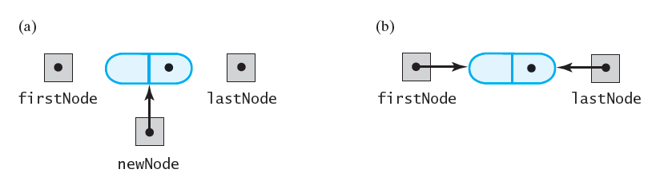
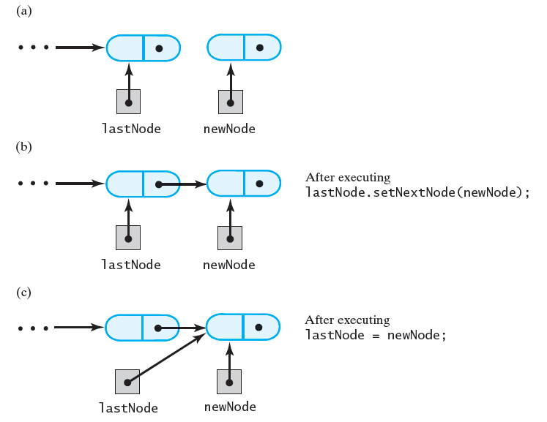
Linked Implementation of a Queue
public void enqueue(T newEntry) {
Node newNode = new Node(newEntry, null);
if (isEmpty())
firstNode = newNode;
else
lastNode.setNextNode(newNode);
lastNode = newNode;
}
Notes:
Copyright ©2012 by Pearson Education, Inc. All rights reserved
39

Slide 40
Linked Implementation of a Queue
public T getFront() {
T front = null;
if (!isEmpty())
front = firstNode.getData();
return front;
} // end getFront
Notes:
Copyright ©2012 by Pearson Education, Inc. All rights reserved
40

Slide 41
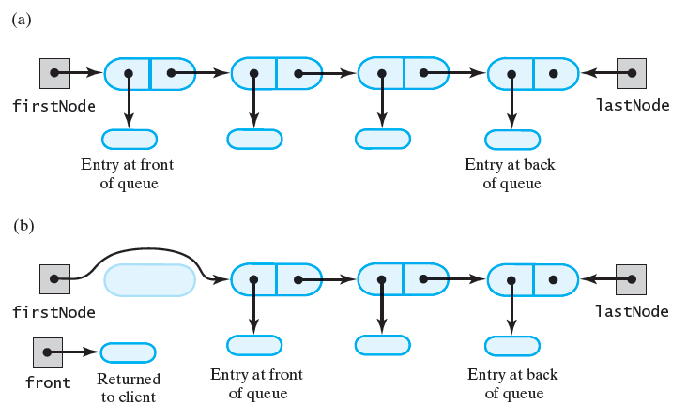
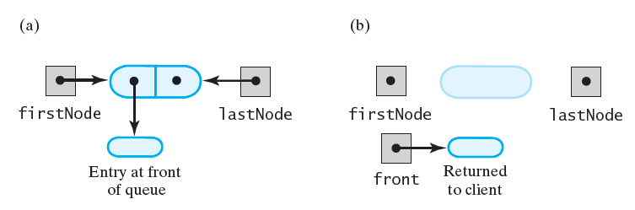
Linked Implementation of a Queue
public T dequeue() {
T front = null;
if (!isEmpty()) {
front = firstNode.getData();
firstNode = firstNode.getNextNode();
if (firstNode == null)
lastNode = null;
}
return front;
}
Notes:
Copyright ©2012 by Pearson Education, Inc. All rights reserved
41

Slide 42
Linked Implementation of a Queue
public boolean isEmpty()
{
return (firstNode == null) && (lastNode == null);
}
public void clear()
{
firstNode = null;
lastNode = null;
}
Notes:
Copyright ©2012 by Pearson Education, Inc. All rights reserved
42

Slide 43
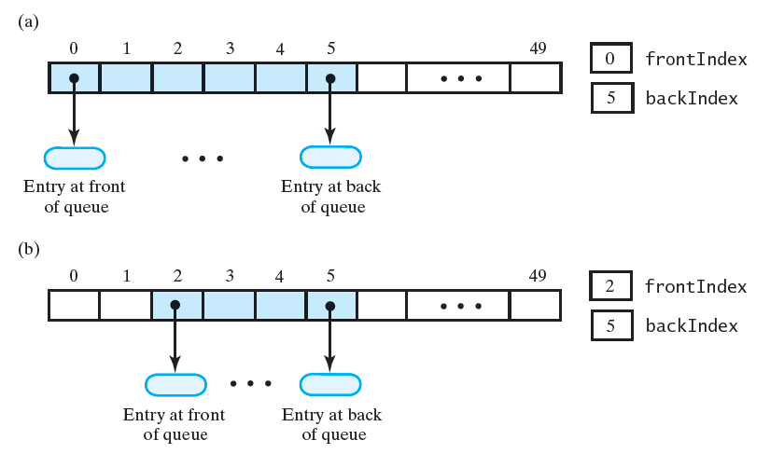
Array-Based Implementation of a Queue
Option 1
queue[0] is front
frontIndex, backIndex are indices of front and back of queue
What happens when we remove an entry?
We would need to shift each array position towards the beginning making dequeue inefficient
Option 2
Move frontIndex
If we dequeue 2 entries, frontIndex will be 2
frontIndex: index of entry at front (index of next dequeue operation)
backIndex: index of entry at back (index of last enqueue operation)
Notes:
Copyright ©2012 by Pearson Education, Inc. All rights reserved
43

Slide 44
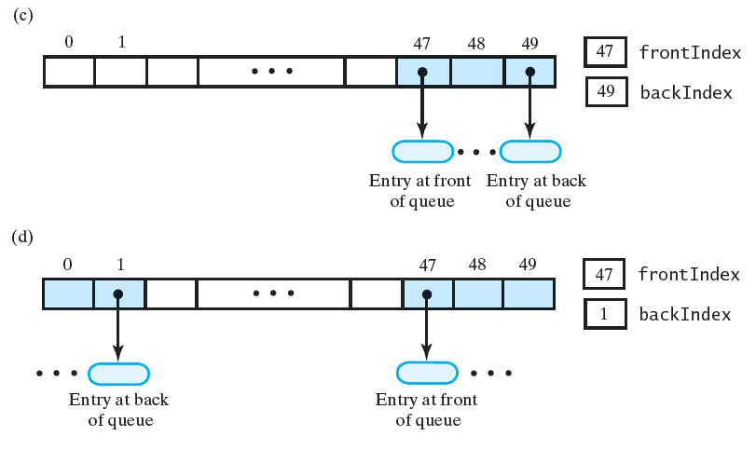
Array-Based Implementation of a Queue
At some point array will look like Figure (c) below (entries migrated to end of array)
We can expand the array at this point (by doubling the size for example)
This results in wasted space since only three locations are used
Use circular array!
Once queue reaches the end of array, we can add entries to beginning of array
We use modulo arithmetic on the indices
Example, to update backIndex on removing an entry
backIndex = (backIndex + 1) %queue.length;
Same applies to frontIndex
Notes:
Copyright ©2012 by Pearson Education, Inc. All rights reserved
44

Slide 45
Class outline
public class ArrayQueue<T> implements QueueInterface<T> {
private T[] queue; // circular array of queue entries and one unused location
private int frontIndex;
private int backIndex;
private int numElements;
private static final int DEFAULT_INITIAL_CAPACITY = 50;
public ArrayQueue() {
this(DEFAULT_INITIAL_CAPACITY);
}
public ArrayQueue(int initialCapacity) {
// the cast is safe because the new array contains null entries
@SuppressWarnings("unchecked")
T[] tempQueue = (T[]) new Object[initialCapacity];
queue = tempQueue;
frontIndex = 0;
backIndex = -1;
numElements = 0
}
// < Implementations of the queue operations go here. >
// . . .
}
Notes:
Copyright ©2012 by Pearson Education, Inc. All rights reserved
45

Slide 46
enqueue
public void enqueue(T newEntry) {
ensureCapacity();
backIndex = (backIndex + 1) % queue.length;
queue[backIndex] = newEntry;
numElements++;
}
getFront
public T getFront(){
T front = null;
if (!isEmpty())
front = queue[frontIndex];
return front;
}
Notes:
Copyright ©2012 by Pearson Education, Inc. All rights reserved
46

Slide 47
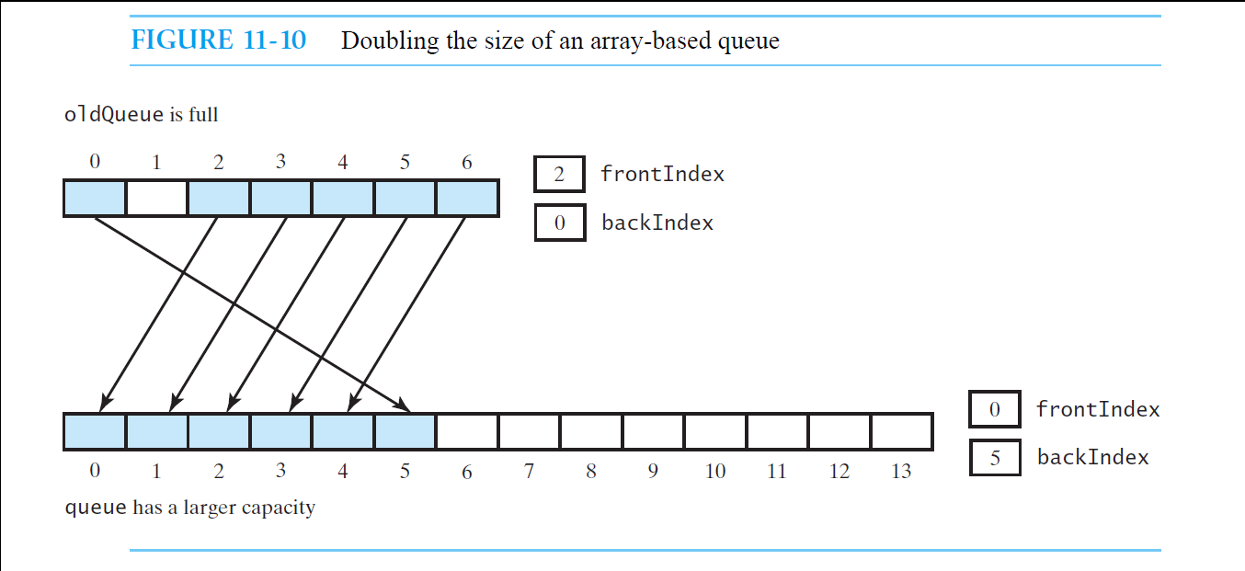
ensureCapacity
We need to be careful when copying since array is circular
private void ensureCapacity() {
if (numElements == queue.length) { // if array is full,
T[] oldQueue = queue;
int oldSize = oldQueue.length;
@SuppressWarnings("unchecked")
T[] tempQueue = (T[]) new Object[2 * oldSize];
queue = tempQueue;
for (int index = 0; index < oldSize ; index++) {
queue[index] = oldQueue[frontIndex];
frontIndex = (frontIndex + 1) % oldSize;
}
frontIndex = 0;
backIndex = oldSize - 1;
}
}
Notes:
Copyright ©2012 by Pearson Education, Inc. All rights reserved
47

Slide 48
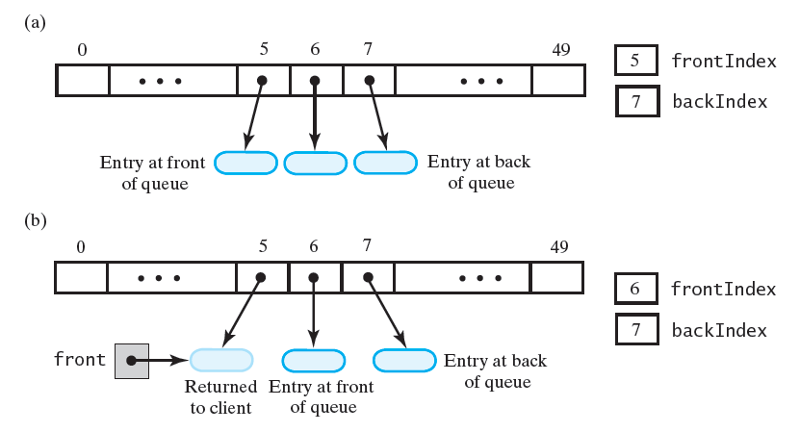
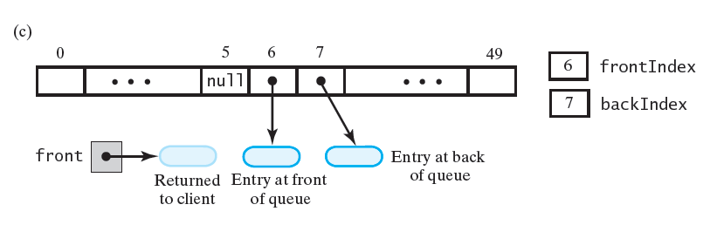
Dequeue: Option 1: just increment frontIndex
Option 2: set queue[frontIndex] = null before incrementing frontIndex
public T dequeue() {
T front = null;
if (!isEmpty()) {
front = queue[frontIndex];
queue[frontIndex] = null;
frontIndex = (frontIndex + 1) % queue.length;
numElements--;
}
return front;
}
Notes:
Copyright ©2012 by Pearson Education, Inc. All rights reserved
48

Slide 49
isEmpty
public boolean isEmpty() {
return numElements == 0;
}
clear
public void clear() {
if(!isEmpty()) {
for(int index = frontIndex; index != backIndex; index =(index+1)%queue.length)
queue[index] = null;
queue[backIndex] = null;
}
frontIndex = 0;
backIndex = -1;
numElements = 0;
}
Notes:
Copyright ©2012 by Pearson Education, Inc. All rights reserved
49

Slide 50
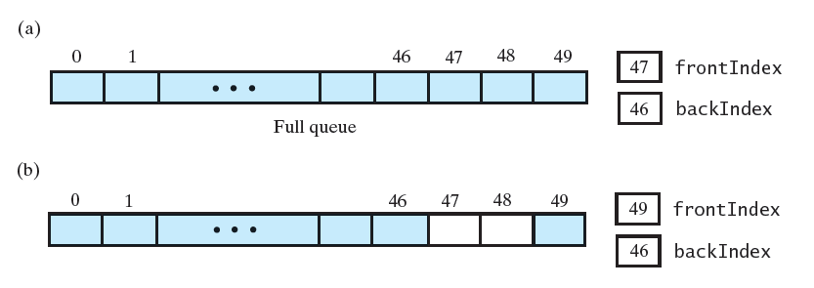
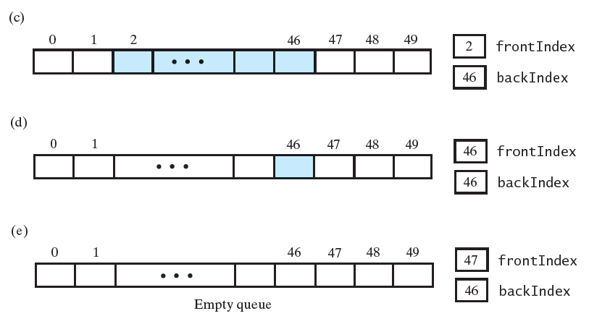
Can we optimize the implementation further?
Is it possible to derive numElements from frontIndex and backIndex?
If yes, we can remove numElements and simplify implementation
How do we detect that the array is full?
from (a) array is full when frontIndex = backIndex + 1
(b) shows array after executing dequeue twice
(c) shows array after 3 more items removed
(d) shows array after all but one item is removed
(e) shows array after removing last entry
frontIndex = backIndex + 1
In circular array, frontIndex = backIndex + 1 when the queue is empty and when the queue is full
Notes:
Copyright ©2012 by Pearson Education, Inc. All rights reserved
50

Slide 51
Possible solutions
Solution 1: Maintain a count of the items in the queue (empty when count=0, full when count=array’s capacity)
Solution 2: Leave one array location unused
Circular array with one unused location
We waste little memory by having one unused location in the array (the storage for a reference)
We will leave unused the array location following the back of the queue (we can choose a different location)
Notes:
Copyright ©2012 by Pearson Education, Inc. All rights reserved
51

Slide 52
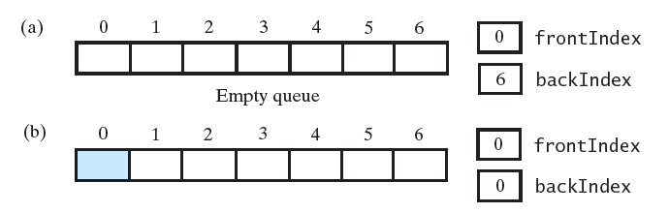
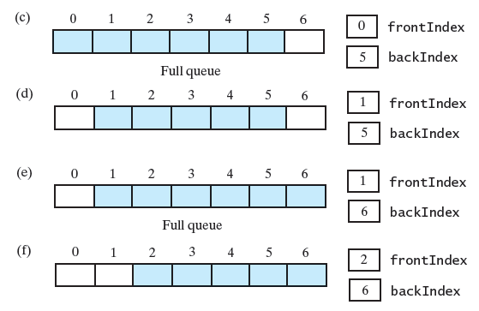
Circular Array with One Unused Element
Allows detection of empty vs. full queue
Examine frontIndex, backIndex
Example queue of at most 6 entries
(a) queue is empty (backIndex initialized to end)
(b) add one element, backIndex = 0
(c) five more additions (full)
(d) dequeue one entry
(e)enqueue one entry (full)
(f) dequeue one entry
Notes:
Copyright ©2012 by Pearson Education, Inc. All rights reserved
52

Slide 53
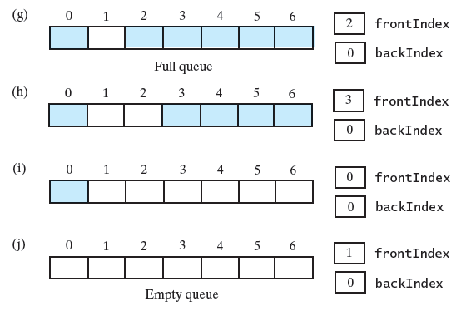
(g) enqueue one entry (full)
(h) dequeue one entry
(i) dequeue all but one entry
(j) dequeue last entry (empty)
Queue is full when
frontIndex = (backIndex + 2) % queue.length
Queue is empty when
frontIndex = (backIndex + 1) % queue.length
Notes:
Copyright ©2012 by Pearson Education, Inc. All rights reserved
53

Slide 54
Class outline
public class ArrayQueue<T> implements QueueInterface<T> {
private T[] queue; // circular array of queue entries and one unused location
private int frontIndex;
private int backIndex;
// private int numElements;
private static final int DEFAULT_INITIAL_CAPACITY = 50;
public ArrayQueue() {
this(DEFAULT_INITIAL_CAPACITY);
} // end default constructor
public ArrayQueue(int initialCapacity) {
// the cast is safe because the new array contains null entries
@SuppressWarnings("unchecked")
T[] tempQueue = (T[]) new Object[initialCapacity + 1];
queue = tempQueue;
frontIndex = 0;
backIndex = queue.length – 1;
} // end constructor
// < Implementations of the queue operations go here. >
// . . .
} // end ArrayQueue
Notes:
Copyright ©2012 by Pearson Education, Inc. All rights reserved
54

Slide 55
enqueuer – remove numElements
public void enqueue(T newEntry) {
ensureCapacity();
backIndex = (backIndex + 1) % queue.length;
queue[backIndex] = newEntry;
// numElements ++;
} // end enqueue
getFront – no change
public T getFront(){
T front = null;
if (!isEmpty())
front = queue[frontIndex];
return front;
} // end getFront
Notes:
Copyright ©2012 by Pearson Education, Inc. All rights reserved
55

Slide 56
dequeuer – no change
Option 1: just increment frontIndex
Option 2: set queue[frontIndex] = null before incrementing frontIndex
public T dequeue() {
T front = null;
if (!isEmpty()) {
front = queue[frontIndex];
queue[frontIndex] = null;
frontIndex = (frontIndex + 1) % queue.length;
// numElements --;
}
return front;
}
Notes:
Copyright ©2012 by Pearson Education, Inc. All rights reserved
56

Slide 57
ensureCapacity
We need to be careful when copying since array is circular
private void ensureCapacity() {
if (frontIndex == ((backIndex + 2) % queue.length)) {
T[] oldQueue = queue;
int oldSize = oldQueue.length;
@SuppressWarnings("unchecked")
T[] tempQueue = (T[]) new Object[2 * oldSize];
queue = tempQueue;
for (int index = 0; index < oldSize - 1; index++) {
queue[index] = oldQueue[frontIndex];
frontIndex = (frontIndex + 1) % oldSize;
} // end for
frontIndex = 0;
backIndex = oldSize - 2;
} // end if
} // end ensureCapacity
Notes:
Copyright ©2012 by Pearson Education, Inc. All rights reserved
57

Slide 58
isEmpty
public boolean isEmpty() {
return frontIndex == ((backIndex + 1) % queue.length);
} // end isEmpty
clear
public void clear() {
if(!isEmpty()) {
for(int index = frontIndex; index != backIndex; index = (index+1)%queue.length)
queue[index] = null;
queue[backIndex] = null;
}
frontIndex = 0;
backIndex = queue.length - 1;
}
Notes:
Copyright ©2012 by Pearson Education, Inc. All rights reserved
58

Slide 59
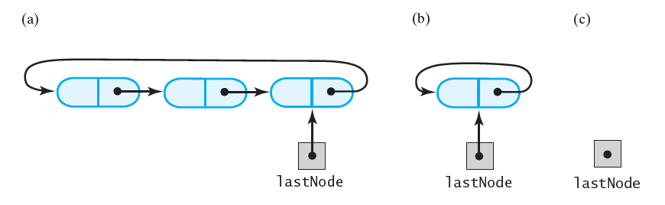
Circular Linked Implementations of a Queue
Circular linked chain
the last node has a reference to the first node
no node has a reference to null
Beginning: lastNode.next
End: lastNode
Advantage: no overhead of maintaining first node
Not necessarily better than previous linked implementation, but different
Example
Notes:
Copyright ©2012 by Pearson Education, Inc. All rights reserved
59

Slide 60
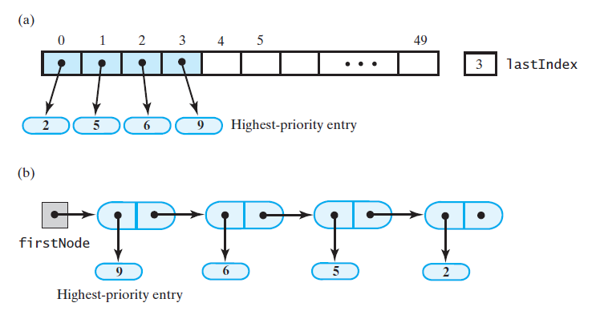
Possible Implementation of a Priority Queue

