Slide 1

4-Bit RISC CPU with a 3-Stage Pipeline
Design, Verification and FPGA Resource Analysis in Verilog HDL
Tran Duy
Student ID: SE193143
Vivado · Artix-7 xc7a35tcpg236-1
Notes:
[~20 s] Good morning. I am Tran Duy, SE193143. My project is a 4-bit RISC CPU with a 3-stage pipeline, written in Verilog, verified in simulation and implemented in Vivado on an Artix-7 FPGA. I will cover the architecture, the simulation results and the hardware cost.

Slide 2
A complete CPU, kept small enough to verify fully
Instruction format
4-bit
12-bit
opcode
[11:8]
Rd
[7:6]
Rs
[5:4]
imm / addr
[3:0]
Datapath: registers, ALU, data memory
Fixed-length instruction word
Example: ADD R1, R2 → 0000 01 10 0000 = 0x060
12 instructions, hardwired control
3-stage
4 × 4-bit
Arithmetic
ADD SUB
IF / ID / EX pipeline, CPI = 1
Register file R0–R3, 2 read + 1 write port
Logic
AND OR XOR NOT
Data move
LDI MOV LOAD STORE
Control
JMP JZ
Notes:
[~50 s] The CPU is 4 bits wide with 4 general-purpose registers and Harvard memories: 16 words of 12-bit instructions and 16 words of 4-bit data. Every instruction is 12 bits with fixed fields, so decoding is simple: 4-bit opcode, two 2-bit register fields and a 4-bit immediate or address. There are 12 instructions in four groups; the 4 unused opcodes behave as NOP. Flags are Zero and Carry.

Slide 3
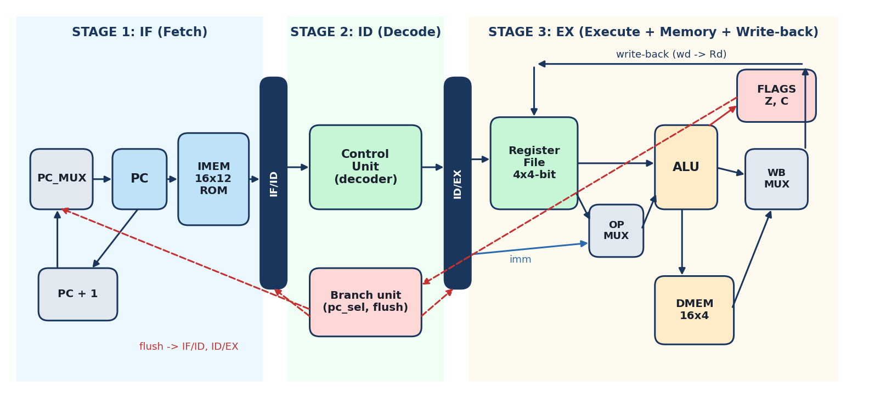
Two pipeline registers create three stages
IF
Fetch
PC addresses the instruction ROM; PC + 1 or jump target is selected by PC_MUX.
ID
Decode
Combinational decoder with safe defaults: every opcode has a defined control word, no latches.
EX
Execute
Red dashed paths: the branch unit in EX drives pc_sel and flushes both pipeline registers.
Register read, ALU, data memory, write-back, flag update and the jump decision.
Notes:
[~60 s] This is the datapath. Two pipeline registers, IF/ID and ID/EX, split it into three stages. IF: the PC reads the instruction ROM and the next PC is PC plus 1 or a jump target. ID: a purely combinational, hardwired decoder turns the opcode into control signals; every opcode has a defined output, so no latches are inferred. EX: registers are read, the ALU computes, data memory is accessed, the result is written back and the flags are updated, all in one cycle. The branch unit also sits in EX: on a taken jump it selects the jump target and flushes both pipeline registers.

Slide 4
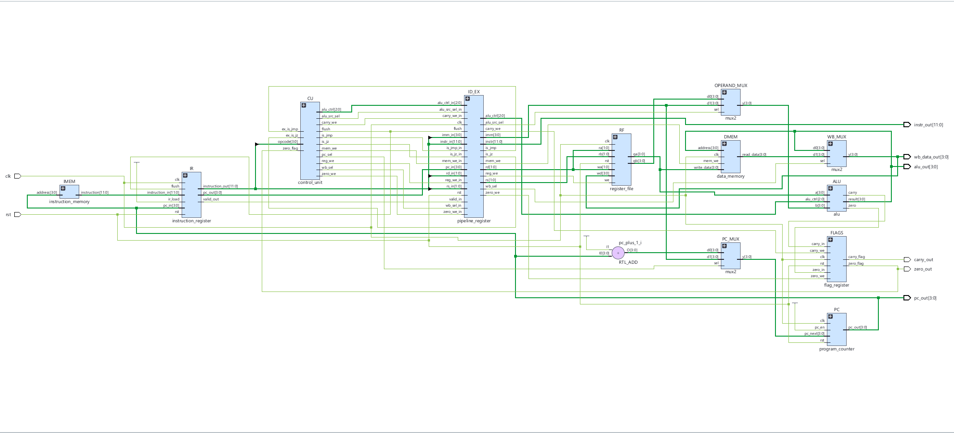
RTL schematic matches the planned datapath
13 instances
IR + ID_EX pipeline registers
Hardwired control unit
Harvard IMEM / DMEM
3 × mux2 (operand, write-back, PC)
Notes:
[~40 s] This is the elaborated RTL schematic from Vivado. From left to right: instruction memory and IF/ID register, the control unit, the ID/EX pipeline register, then the execute stage: register file, operand mux, ALU, data memory, write-back mux, flag register, and the PC with its incrementer and PC mux. The expanded schematic confirms the internals: register banks, adders, a zero detector, and only gates and comparators in the control unit, so control is fully hardwired with no state machine.

Slide 5



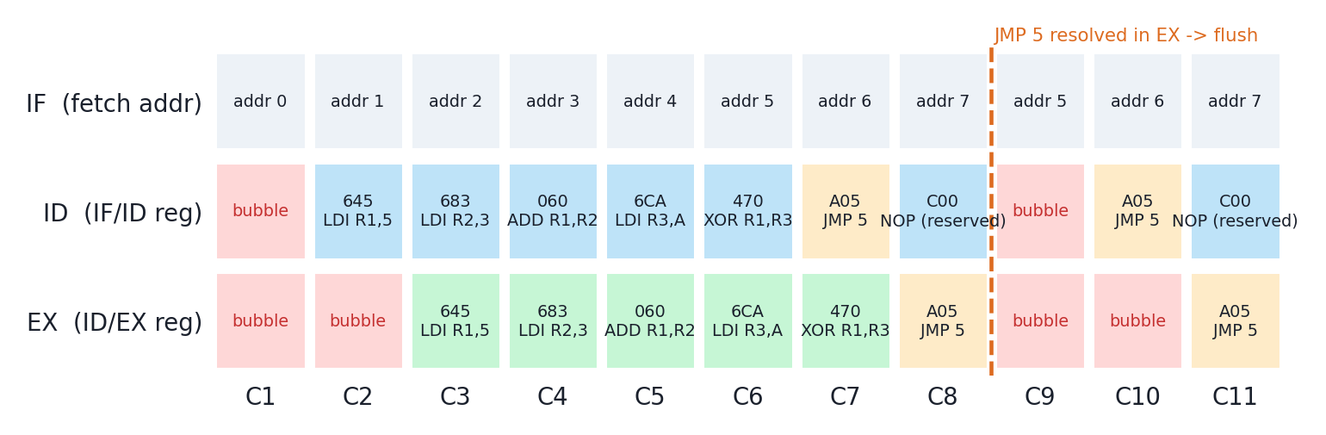
All three hazards handled by construction
Structural
0 cycles
Data (RAW)
0 cycles
Control
2 bubbles
Separate instruction and data memories (Harvard)
Registers read in EX, one cycle after the previous write
Jump decided in EX; IF/ID and ID/EX flushed
Notes:
[~55 s] Pipelines have three kinds of hazard. Structural: avoided because instruction and data memories are separate. Data: because registers are read in EX, one cycle after the previous instruction wrote them, an instruction always sees the new value, with no forwarding or stalls. Control: the jump is decided in EX, so the two instructions behind it are wrong; they are flushed. The chart shows Test 1: JMP 5 reaches EX in cycle 8, then two bubbles appear and the program loops back to address 5. The cost is exactly two cycles per taken jump.

Slide 6
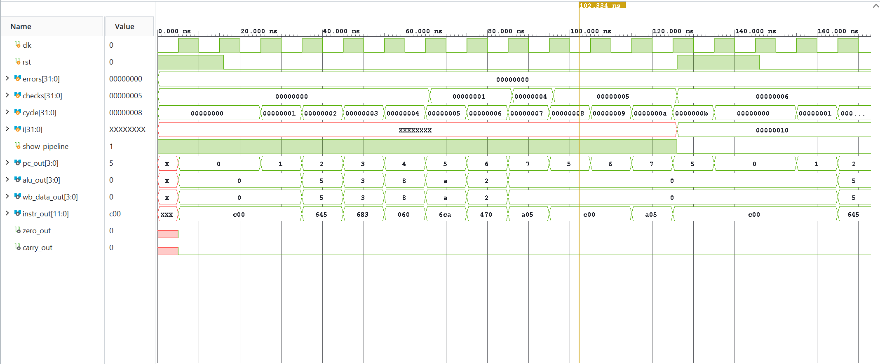
Waveform: 2-stage offset and clean flush
Pipeline fill: pc_out = 2 while 0x645 (address 0) is in EX
JMP 5: PC 7 → 5, then two 0xC00 bubbles
Scoreboard: errors = 0 for the whole run
Notes:
[~55 s] This is the simulation waveform with a 10 ns clock. After reset, all outputs leave X at the first clock edge. Watch pc_out and instr_out, which is the instruction in EX: when the PC is 2, the instruction from address 0 is executing. That two-address offset is exactly a 3-stage pipeline. The ALU output steps through 5, 3, 8, A and 2: one result every cycle. When JMP 5 executes, the PC goes from 7 back to 5 and instr_out shows two bubbles, which is the flush. The errors counter stays at zero during the whole run.

Slide 7

44 of 44 self-checks passed with zero errors
T1
Pipeline trace, ADD / LDI / XOR, JMP loop
T2
ADD, SUB, STORE, LOAD, Zero and Carry
T3
AND, OR, XOR, NOT, MOV, LDI
T4
JMP, JZ taken and not taken, flush
T5
Reset of PC, registers, flags; no X
All 12 instructions verified
Self-checking testbench, 4 programs + reset
Notes:
[~45 s] The CPU testbench is self-checking: it runs four programs and a reset test and compares registers, flags, PC and memory against expected values. All 44 checks pass with zero errors. Test 2 covers arithmetic and memory, including Carry as no-borrow after SUB. Test 3 covers logic. Test 4 covers jumps: JZ taken and not taken, and the flush. Test 5 confirms that reset clears everything and no X values remain. Every one of the 12 instructions is checked at least once.

Slide 8
Pipelining finishes one instruction every clock
CPI = 1
after a 2-cycle pipeline fill
1.4× – 1.7×
faster than the 2-cycle design
N + 2
cycles for N jump-free instructions
Notes:
[~35 s] The benefit of the pipeline: once it is full, one instruction finishes every clock. Nine instructions take 11 cycles instead of 18, and twelve take 14 instead of 24. That is a 1.4 to 1.7 times speed-up on these programs, approaching 2 times for long code without jumps.

Slide 9

The CPU uses under 0.2 % of the Artix-7 logic
41
Slice LUTs
58
Flip-flops
14
Slices
28
Bonded IOB
0.20 % of 20,800
0.14 % of 41,600
0.17 % of 8,150
26.4 % of 106
Why so small?
0 BRAM, 0 DSP: memories are tiny and a 4-bit adder fits in LUTs.
The program ROM is a constant, so Vivado folds it into logic and trims unused paths.
I/O is high only because debug buses go to pins.
Notes:
[~55 s] After implementation the CPU uses 41 LUTs, 58 flip-flops and 14 slices: less than 0.2 percent of the Artix-7. No block RAM or DSP is used, which is correct: the memories are far too small for block RAM, and a 4-bit adder fits in LUTs. The only large number is I/O, 26 percent, because I exported debug buses such as pc_out and instr_out to pins. One more point: the instruction ROM is a constant, so Vivado folds the program into the logic and removes unused paths, for example instr_out bit 8 is tied to ground. So these numbers are for the CPU with this program; the general CPU would be somewhat larger but still under 1 percent.

Slide 10


Correct from RTL to simulation to hardware
RTL
Simulation
Utilization
Clean 3-stage datapath with latch-free hardwired control
44 / 44 checks, 0 errors, CPI = 1, 2-cycle jump penalty
41 LUTs, 58 FFs, 14 slices, no BRAM or DSP
Thank you · Questions?
Notes:
[~30 s] To conclude: the RTL implements a clean 3-stage pipeline with hardwired control; simulation passes all 44 checks with one instruction per clock; and the hardware cost is tiny. Next steps would be forwarding with earlier branch resolution to remove the jump penalty, a wider PC, and new instructions. Thank you, I am happy to take questions.

