Slide 1
PROJECT PRESENTATION • RTL DESIGN & VERIFICATION
8-bit RISC Processor Core
with a 5-Stage Pipeline
Verilog HDL design, self-checking testbench and Vivado synthesis
IF
ID
EX
MEM
WB
Tran Duy (SE193143)
Semiconductor & VLSI Industry Readiness Program
Instructor: Mr Shivashish Pal
AMD Vivado 2026.1 • Artix-7 xc7a35t
Notes:
[~25 s]
Good morning everyone. My name is Tran Duy, student ID SE193143. Today I will present my project: an 8-bit RISC processor core with a five-stage pipeline, written in Verilog, verified with a self-checking testbench in Vivado, and synthesized for a Xilinx Artix-7 FPGA.

Slide 2
Project at a glance
16
8
5
100%
instructions
registers
pipeline stages
tests passed
custom 8-bit RISC ISA
8-bit, R0–R7
IF → ID → EX → MEM → WB
9 / 9 automatic checks
Project goals
Turn an instruction set into a pipelined micro-architecture in Verilog
Resolve pipeline hazards: forwarding, load-use stall, branch flush
Prove correctness with a self-checking testbench and waveforms
Synthesize in Vivado and analyse resource utilization
Notes:
[~40 s]
Here is the project at a glance. The processor has a custom 8-bit RISC instruction set with 16 instructions, eight 8-bit registers and a classic five-stage pipeline: fetch, decode, execute, memory and write-back.
My goals were: first, turn the instruction set into a pipelined design in Verilog; second, handle pipeline hazards correctly; third, prove that it works with a self-checking testbench; and finally, synthesize it in Vivado. As you can see on the right, all nine automatic checks passed.

Slide 3
Instruction set: fixed 16-bit instructions
Format | Bit layout (bit 15 → bit 0) | Instructions
R-type | opcode | rd | rs1 | rs2 | 000 | ADD SUB AND OR XOR
R1-type | opcode | rd | rs1 | 000000 | SHL SHR LD ST
I-type | opcode | rd | 0 | imm8 | LDI ADDI
J-type | opcode | 0000 | addr8 | JMP BZ BNZ
Encoding example
LDI R1, 0x3C
1000 001 0 0011 1100
opcode LDI | rd = R1 | imm8
= 0x823C
NOP and HLT use the opcode only. Opcode is always bits [15:12]; register fields never move, so they are decoded before the instruction is known.
Harvard memories: 256 × 16 ROM for code, 256 × 8 RAM for data
Arithmetic / logic
Data movement
Control flow
ADD SUB AND OR XOR SHL SHR ADDI
LDI LD ST
JMP BZ BNZ HLT NOP
Notes:
[~45 s]
Every instruction is exactly 16 bits. There are four formats. The opcode is always in the top four bits, and the register fields always stay in the same positions, which keeps the decoder very simple.
For example, LDI R1 comma 0x3C: opcode 1000 for LDI, 001 for register R1, then the 8-bit immediate 0x3C, which gives the machine word 0x823C.
The 16 instructions fall into three groups: arithmetic and logic, data movement, and control flow. Only LD and ST touch memory, which is the typical RISC load-store style.

Slide 4
Five-stage pipeline architecture
IF
ID
EX
MEM
WB
Fetch
Decode
Execute
Memory
Write-back
PC + imem
control_unit
regfile read
forward mux
ALU, branch
dmem
LD / ST
rd ← result
Pipeline registers (IF/ID, ID/EX, EX/MEM, MEM/WB) carry each instruction plus a valid bit; valid = 0 is a bubble
alu.v
combinational
regfile.v
sequential
control_unit.v
combinational
8 operations, Z & C flags
8×8-bit, 2 read / 1 write + bypass
opcode → control signals
hazard_unit.v
combinational
imem.v / dmem.v
memory
risc8_5stage_core.v
sequential
forward selects + load-use stall
program ROM / data RAM
top: PC, pipeline regs, branch
Notes:
[~55 s]
This is the architecture. The pipeline has five stages. In IF, the program counter reads the instruction memory. In ID, the control unit decodes the opcode and the register file is read. In EX, the ALU computes the result and the branch decision is made. In MEM, loads and stores access the data memory. In WB, the result is written back to the register file.
Between the stages there are four pipeline registers. Each one carries a valid bit; when the valid bit is zero, that slot is a bubble that cannot change anything. This is how the design stalls or cancels instructions.
The design is split into seven Verilog modules, shown at the bottom: the ALU, register file, control unit and hazard unit, the two memories, and the top level that connects everything.

Slide 5
Hazards and how the design solves them
0 cycles
1 cycle
2 cycles
Data hazard (RAW)
Load-use hazard
Control hazard
Problem
Problem
Problem
Next instruction needs a result that is not written back yet
Loaded value is needed by the very next instruction
A taken branch makes the already fetched instructions wrong
Solution
Solution
Solution
Forwarding from EX/MEM and MEM/WB + register-file bypass
Stall 1 cycle (hold PC and IF/ID, insert bubble), then forward
Branch decided in EX; flush the 2 younger instructions
hazard_unit.v compares the source registers in EX with the destinations in MEM and WB – newest value wins. Forwarding is gated by uses_a / uses_b, so unused fields never cause false hazards.
Notes:
[~55 s]
Because five instructions overlap, there are hazards. I handle three kinds.
First, data hazards: an instruction needs a result that has not been written back yet. The hazard unit forwards the value from the EX/MEM or MEM/WB register, and the register file has a write-through bypass. Cost: zero cycles.
Second, the load-use hazard: a load only has its data at the end of the memory stage, so if the next instruction needs it, the pipeline stalls for exactly one cycle and then forwards the value.
Third, control hazards: branches are decided in EX, so when a branch is taken the two younger instructions are on the wrong path and are flushed, costing two cycles.

Slide 6
Self-checking testbench
Clock & reset
DUT
Per-cycle monitor
Automatic checker
100 MHz clock
reset ~2 cycles
risc8_5stage_core
+ program.hex
PC, stages, WB,
flags, counters
R1–R7, MEM[0x20],
flags → PASS / FAIL
Directed test program (25 instructions, 34 executed)
Part 1
ALU ops with back-to-back dependencies, SUB → Z = 1, taken BZ over a wrong-path LDI R7, 0xFF
Part 2
Loop: sum = 5 + 4 + 3 + 2 + 1 = 15, BNZ taken four times
Part 3
ST / LD at address 0x20, load-use pair, 0xFF + 1 overflow (C = 1), JMP and HLT
Expected: R1 = 00, R2 = 0F, R3 = 01, R4 = 20, R5 = 00, R6 = 66, R7 = 00, MEM[20] = 0F, Z = 1, C = 1
Notes:
[~45 s]
To verify the design I used a self-checking testbench. It generates a 100 MHz clock and a reset, instantiates the processor, prints one line of pipeline state every clock cycle, and at the end compares every register, one memory location and the flags with the expected values, then prints PASS or FAIL automatically.
The test program has three parts. Part one tests ALU operations with back-to-back dependencies and a taken branch over a wrong-path instruction. Part two is a loop that adds five plus four plus three plus two plus one. Part three tests store and load, a load-use pair, a carry overflow, a jump and halt. The expected final values are shown at the bottom.

Slide 7
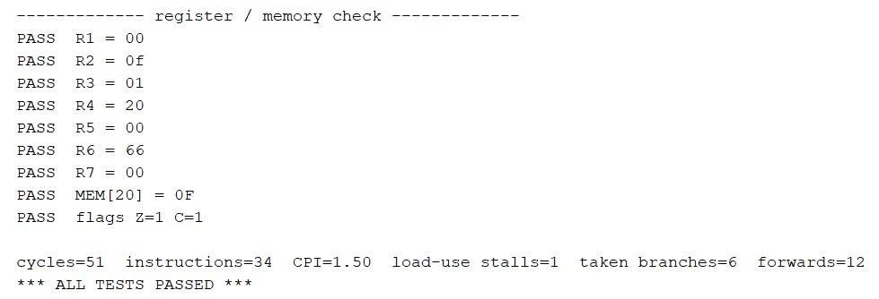
Result: all tests passed, CPI = 1.50
Tcl Console output of the testbench in Vivado XSim
51
34
12
1
cycles
instructions
forwards
stall
6 taken branches × 2-cycle flush • wrong-path instructions never change R6 or R7
CPI = 51 / 34 = 1.50
Notes:
[~40 s]
And here is the result: all nine checks pass and the console prints ALL TESTS PASSED.
The program executed 34 instructions in 51 clock cycles, so the CPI is 1.50. The chart explains every cycle: 34 cycles for the instructions themselves, 12 cycles for six taken branches at two cycles each, 4 cycles to fill the pipeline at the start, and only 1 stall cycle for the load-use pair. Forwarding was used 12 times; without it the CPI would be much higher.

Slide 8
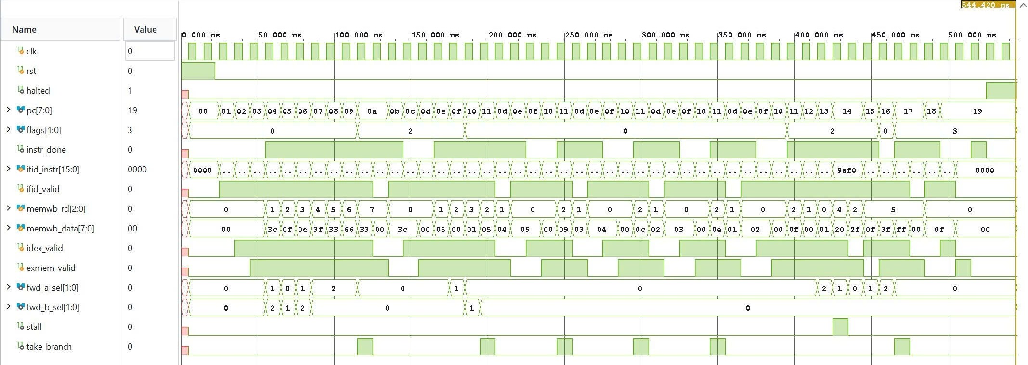
Waveform: every hazard mechanism is visible
1
Forwarding
3
fwd_a/b_sel = 1 or 2, no stall
5
2
Branch flush
6 take_branch pulses, valid bits drop
1
3
Loop × 5
PC repeats 0D–11
4
2
4
Load-use stall
Behavioral simulation, 0–545 ns, signals grouped by pipeline stage
one stall pulse near 430 ns
5
Halt
Final register file: R0–R7 = 00 00 0F 01 20 00 66 00 → matches the expected values
PC frozen at 19, halted = 1
Notes:
[~50 s]
This waveform shows the whole run, and every mechanism I talked about is visible.
Number one: at the start, the forwarding selects take values 1 and 2 while stall stays at zero, so dependent ALU instructions never wait.
Number two: take_branch pulses six times, and after each pulse the valid bits drop, which shows the two flushed instructions.
Number three: the program counter repeats 0D to 11 five times, which is the loop.
Number four: a single stall pulse for the load-use pair.
Number five: at the end the PC freezes at 19 and halted goes high.
The final register file contents match the expected values exactly, which also proves that the wrong-path instructions never changed R6 or R7.

Slide 9
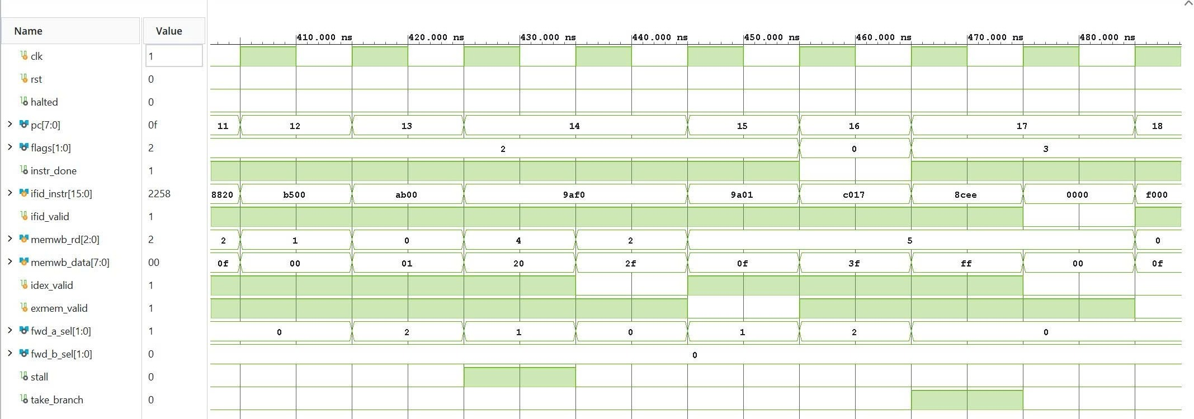
Zoom: load-use stall and forwarding
LD R5, [R4]
reads 0x0F from address 0x20
stall = 1
PC holds 0x14, ADDI (9AF0) waits in ID for 2 cycles, bubble in ID/EX
fwd_a_sel = 1
405–485 ns: ST / LD / ADDI sequence
loaded value forwarded from MEM/WB → R5 = 0xFF
fwd_a_sel = 2
ADDI R5, 1 → 0x00, flags = 3 (Z = 1, C = 1)
Cost of the load-use hazard: exactly one clock cycle
Notes:
[~40 s]
Let me zoom in on the most interesting part: the load-use hazard. LD R5 reads the value 0x0F from memory. The next instruction, ADDI R5, needs that value immediately, but it does not exist yet. So the hazard unit raises stall for one cycle: the PC stays at 14, the ADDI waits in decode, and a bubble enters the pipeline.
One cycle later the loaded value is in the MEM/WB register and is forwarded, so R5 becomes 0xFF. The next ADDI adds one, overflows to zero, and sets both the zero and carry flags. The total cost is exactly one clock cycle.

Slide 10
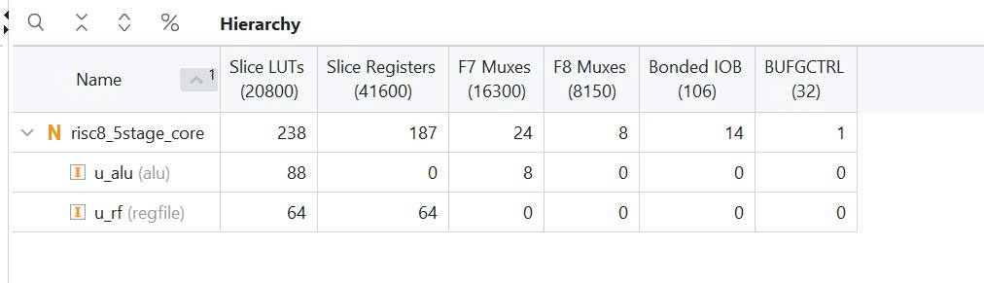
Synthesis on Artix-7 xc7a35t
238
187
14
LUTs
flip-flops
I/O pins
1.14 % of 20,800
0.45 % of 41,600
clk, rst + 12 outputs
ALU: 0 flip-flops → purely combinational
Register file: 64 FF = 8 registers × 8 bits
Top level: 123 FF = pipeline registers (111) + PC + flags + control
Data memory mapped to distributed LUT-RAM, not 2,048 FFs
Post-synthesis utilization by hierarchy (Vivado)
Notes:
[~40 s]
Finally, I synthesized the design in Vivado for an Artix-7 FPGA. The whole processor uses only 238 LUTs and 187 flip-flops, about one percent of this small device.
The numbers also confirm the design: the ALU has zero flip-flops because it is purely combinational; the register file has exactly 64 flip-flops, eight registers times eight bits; and the 123 flip-flops in the top level match the widths of the four pipeline registers plus the PC and flags. The 256-byte data memory was mapped into LUT-RAM instead of thousands of flip-flops.

Slide 11
Conclusion
1
Working 5-stage pipeline
16-instruction 8-bit RISC core in synthesizable Verilog
2
Hazards verified
Forwarding, 1-cycle load-use stall, 2-cycle branch flush, clean halt
3
Self-checking testbench
9 / 9 checks passed, CPI = 1.50 fully explained
4
Compact hardware
238 LUTs, 187 FFs on Artix-7 (about 1 %)
Thank you • Questions?
Notes:
[~25 s]
To conclude: I built a working five-stage pipelined 8-bit RISC processor in Verilog. All three hazard mechanisms are implemented and visible in the waveforms. The self-checking testbench passed all nine checks with a CPI of 1.50, and the design is compact, about one percent of an Artix-7 FPGA.
Thank you for listening. I am happy to answer any questions.

