Slide 1
S
OPEN: S
f = 0 + 7 = 7
S
OPEN: A, B
A
B
S
OPEN: B, G
REORDER OPEN: B, G
f = 4 + 1 = 5
f = 2 + 6 = 8
A
B
f = 2 + 6 = 8
S
OPEN: G, A
REORDER OPEN: A, G
G
B
A
B
f = 9 + 0 = 9
f = 5 + 6 = 11
f = 2 + 6 = 8
A
f = 3 + 1 = 4
G
G
OPEN: empty
f = 9 + 0 = 9
f = 8 + 0 = 8

Slide 2
MAX
A
4
B
C
MIN
3
4
MAX
D
E
F
G
H
3
5
5
8
4
MIN
I
J
K
L
0
5
7
8
MAX
M
N
0
7

Slide 3
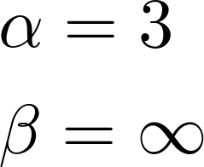
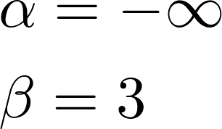
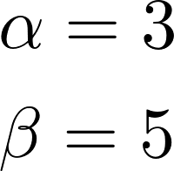
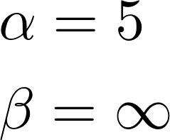
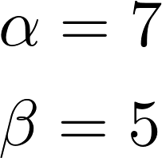
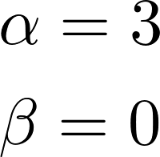
MAX
A
4
B
C
MIN
3
4
MAX
D
E
F
G
H
3
5
5
7
4
MIN
I
J
K
L
0
5
7
8
MAX
M
N
0
7

Slide 4
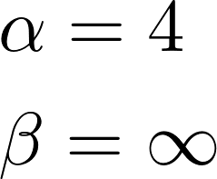
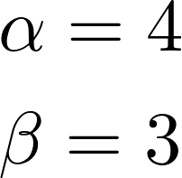
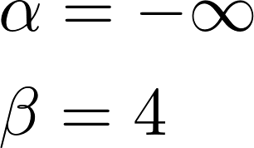
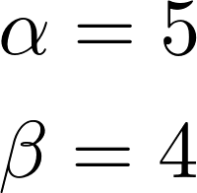
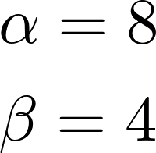
MAX
A
4
B
C
MIN
3
4
MAX
D
E
F
G
H
3
5
5
8
4
MIN
I
J
K
L
5
7
8
MAX
M
N
0
7

