Slide 1

DM project presentation
group name: random
Notes:
Hi, this is the team random project presentation.

Slide 2
1
Knowledge Discovery
Notes:
First, we have some knowledge discovery of this project.

Slide 3
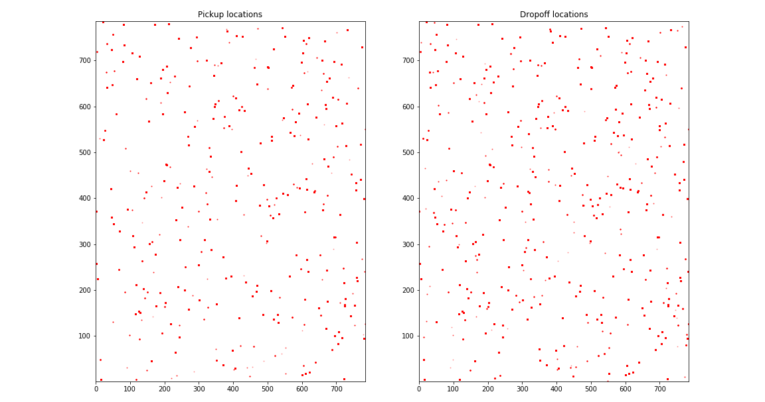
Training Set Location Distribution
Notes:
Then we draw the distribution of pickup and dropoff location in the training set and testing set.

Slide 4
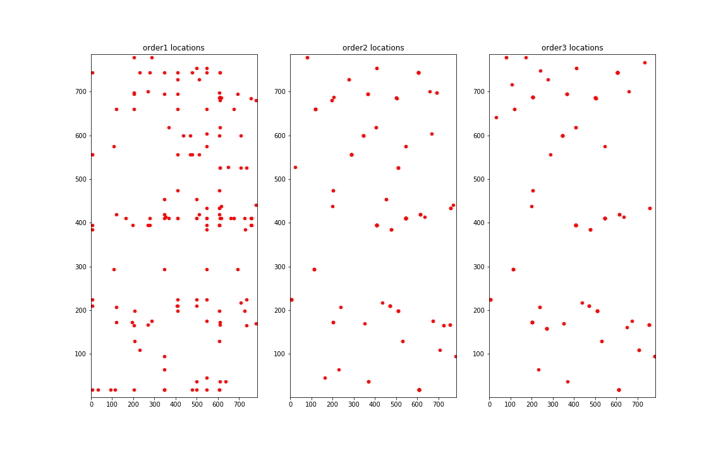
Testing Set Location Distribution
Notes:
We can see the locations are scattered and there is no obvious clustering.

Slide 5
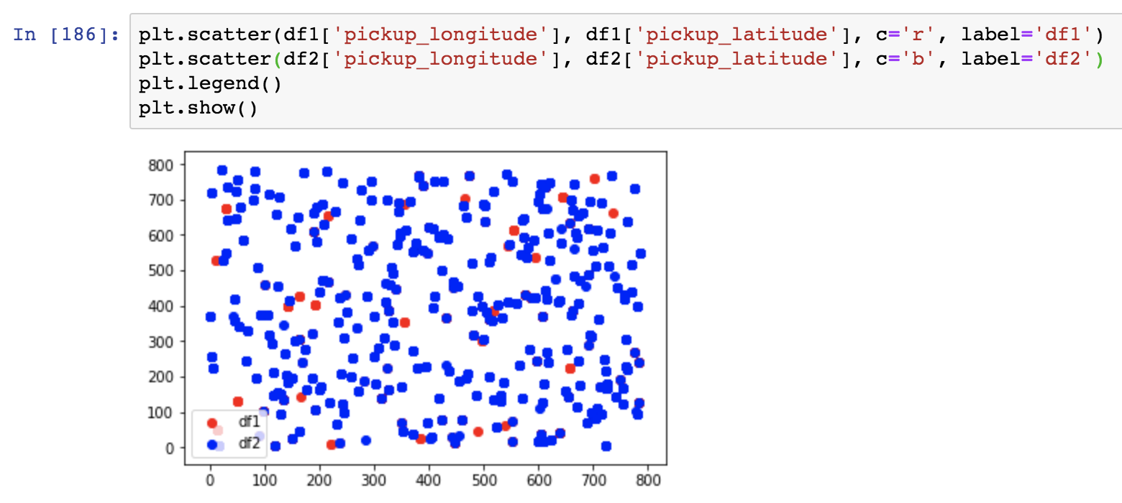
Connection
Pickup Location & Fare
lower boundary
Notes:
Fare can be treated as GMM, so we use EM algorithm to divide pickup location into 2 categories based on fare. Also scattered.

Slide 6
Correlation of Fare
Notes:
This is the relevance ranking of all related variables of fare. We can see pickup location has low relavance with fare.

Slide 7
2
Choose model & Predict
Notes:
Now, let's focus on our two tasks.

Slide 8
Task 5.1
Pickup Location -> Fare
S1
S2
S3
Decision Tree
K-means Clustering
Light Gradient Boosting Machine
Notes:
Task 5.1, we need to choose a model to predict order fare based on pickup location. According to the above knowledge discovery, we found that they are not closely related. We choose 3 models to figure it out.

Slide 9
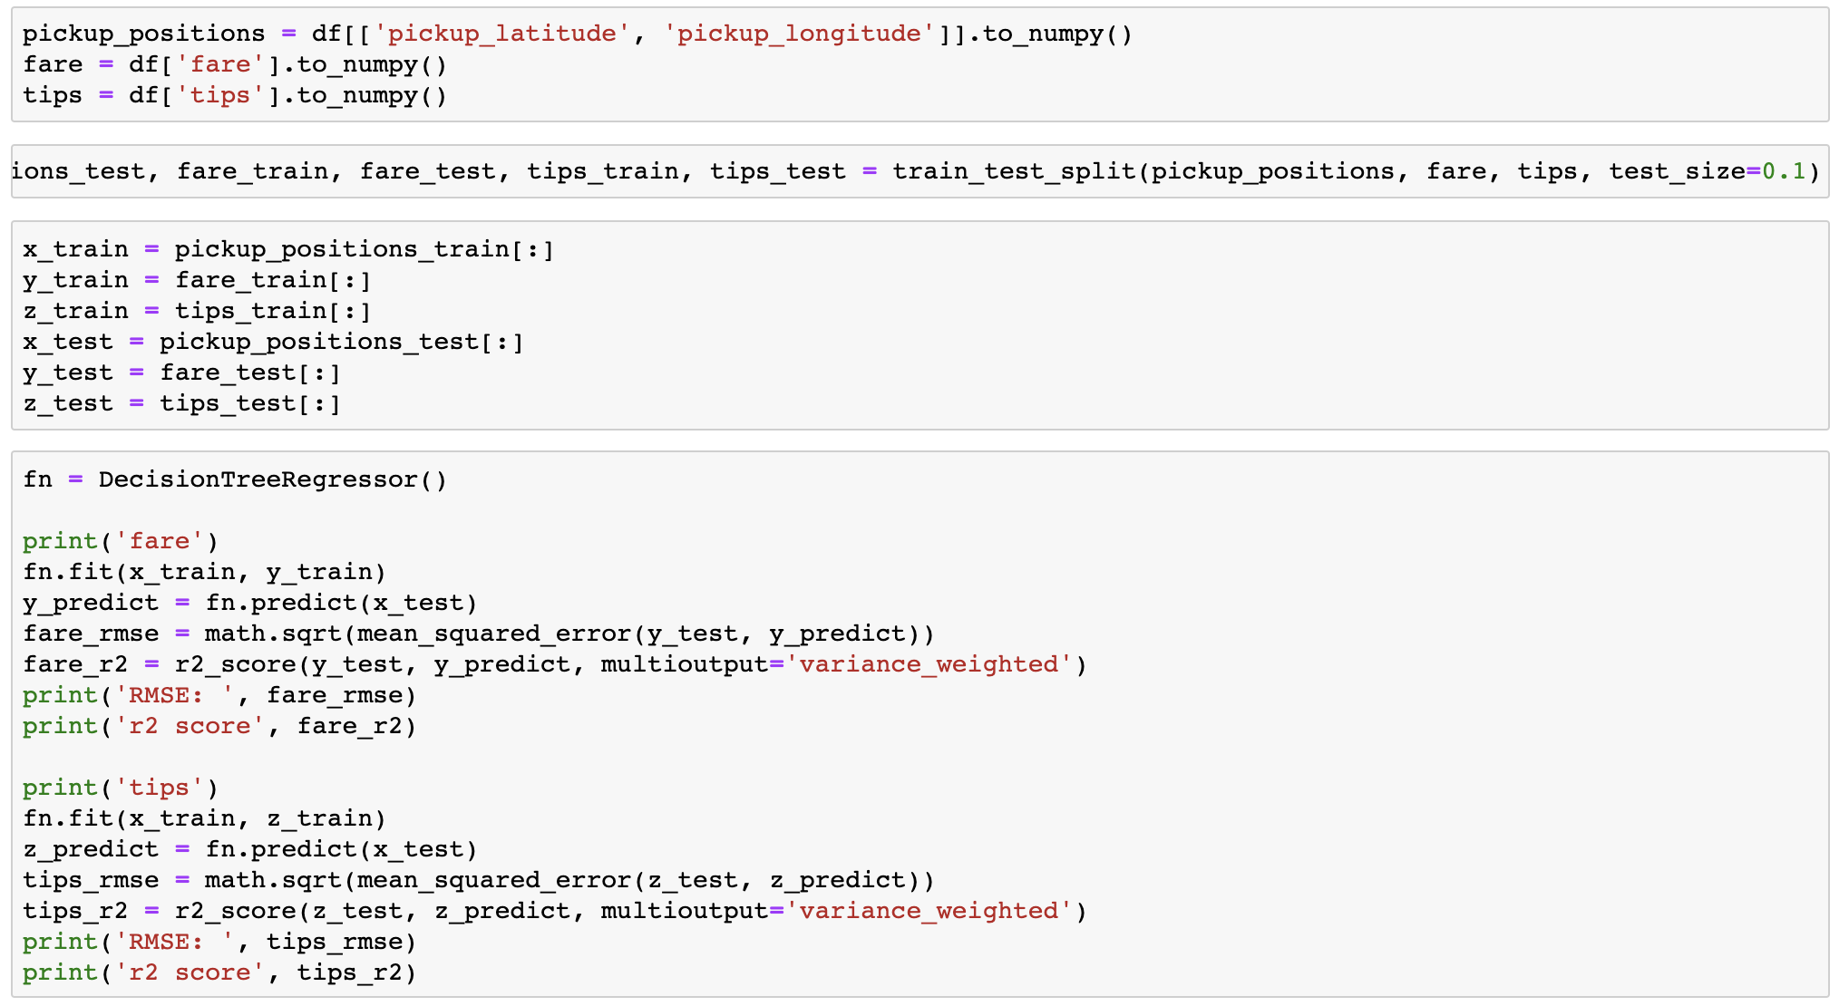
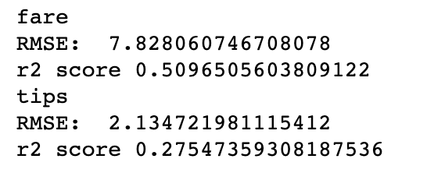
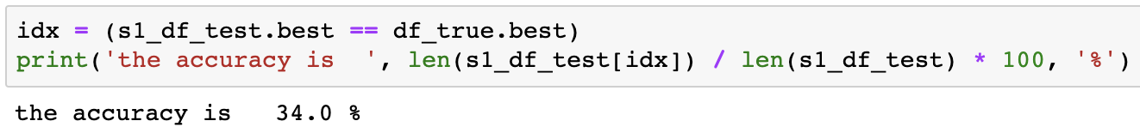
Decistion Tree
Notes:
First one is decision tree. Pick 90% data in the training set to be trained, calculate model accuracy with the remaining 10%. We use r2 score to represent the accuracy of the algorithm. Then check the ground truth, the actual accuracy is low.

Slide 10
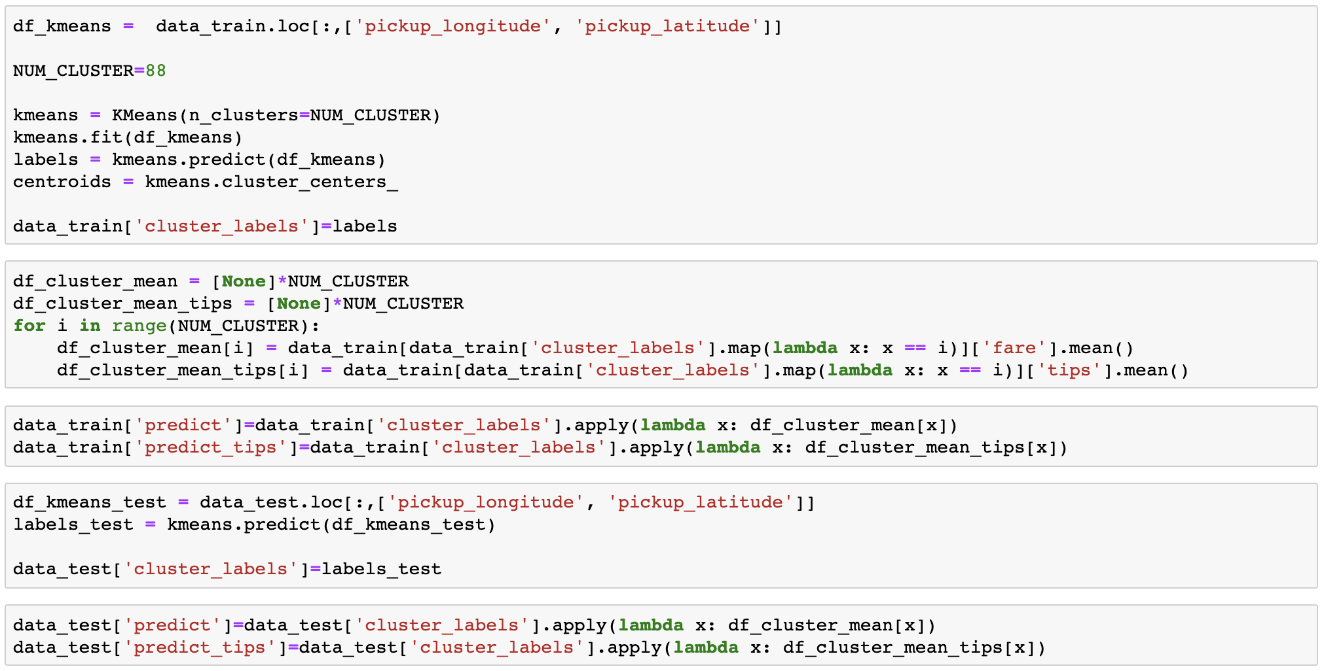
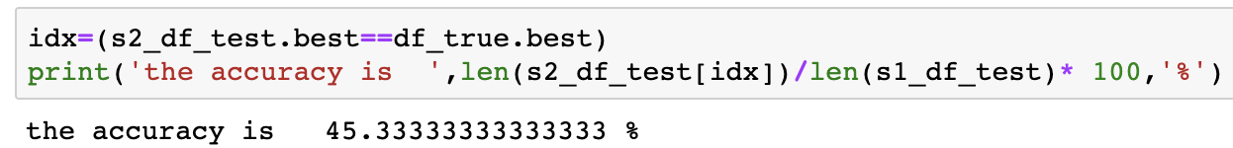
K-means
Notes:
Second model we use is k-means clustering. We found that algorithm can divide training set into up to 88 clusters. So we set n-clusters equals to 88. K-means model calculate fare and tips mean for each cluster based on pickup location. The final accuracy of this model is higher.

Slide 11
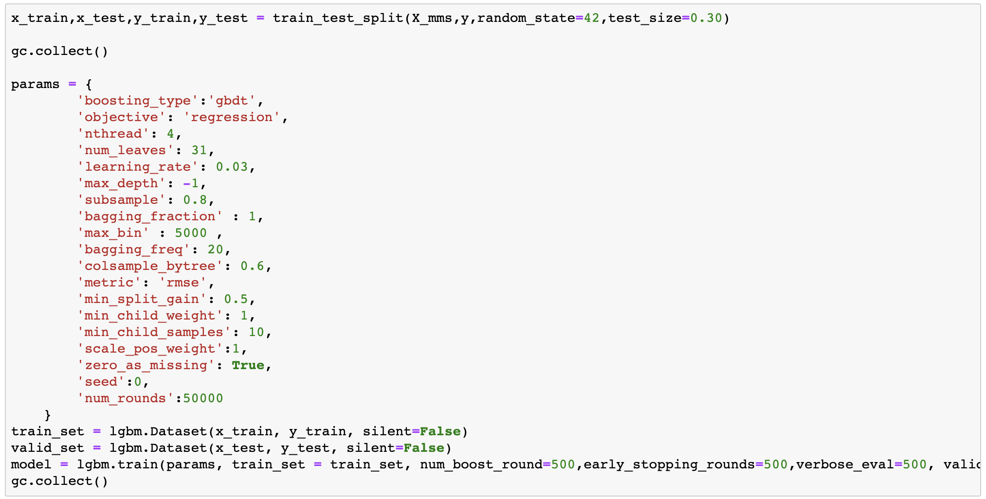
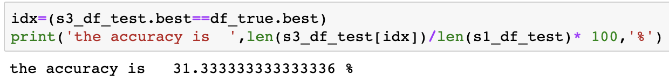
Light Gradient Boosting Machine
Notes:
Third model is we found a paper, which is light gradient boosting machine, however, the result is not quite ideal. The accuracy is 31.3%.

Slide 12
Analysis
S1
S2
S3
Decision Tree
34%
K-means Clustering
45%
Light Gradient Boosting Machine
31%
Notes:
In conclusion, k-means has the highest accuracy. We think the reason is the low relevance, it is hard to only use pickup location to predict fare. Then when using k-means, classifying the training set and take the mean value is more appropriate.

Slide 13
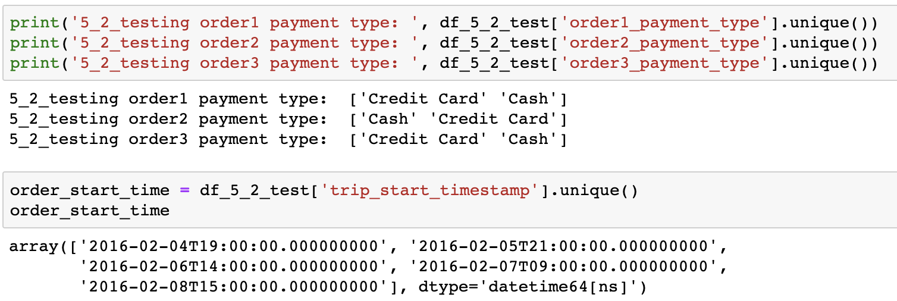
Task 5.2 Discovery
Notes:
Now we focus on task 5.2. According to our discovery and result in task 5.1, tips is not quite related to the pickup location. So, we decide to use order fare to predict tips.
There is some discovery about the testing set. There are only 2 payment types in testing set. So, we remove training data whose payment type is not 'Credit Card' or 'Cash'.

Slide 14
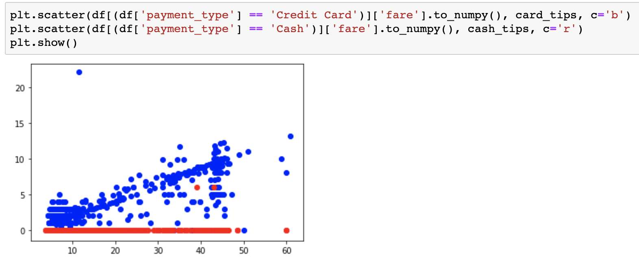
Discovery
Notes:
We also found that when payment type is 'Cash', people barely pay tips. So we decide to only use models to predict tips when people use 'Credit Card'.

Slide 15
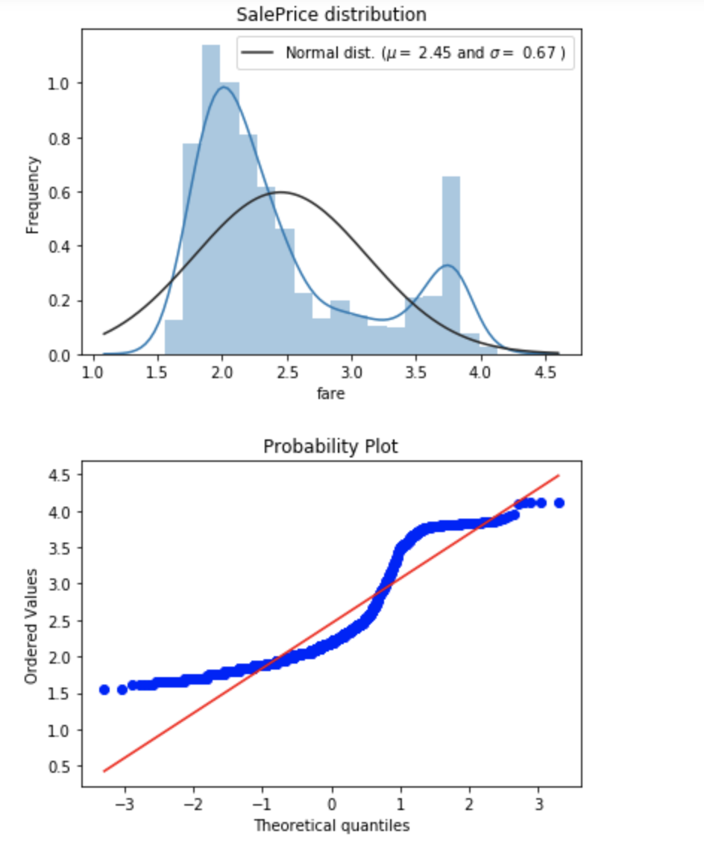
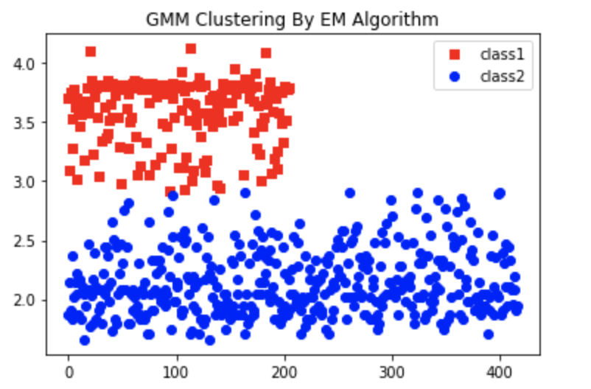
Discovery: Fare Distribution
Notes:
we found out fare distribution has 2 peaks, we can devide fare into 2 clusters by EM algorithm.

Slide 16
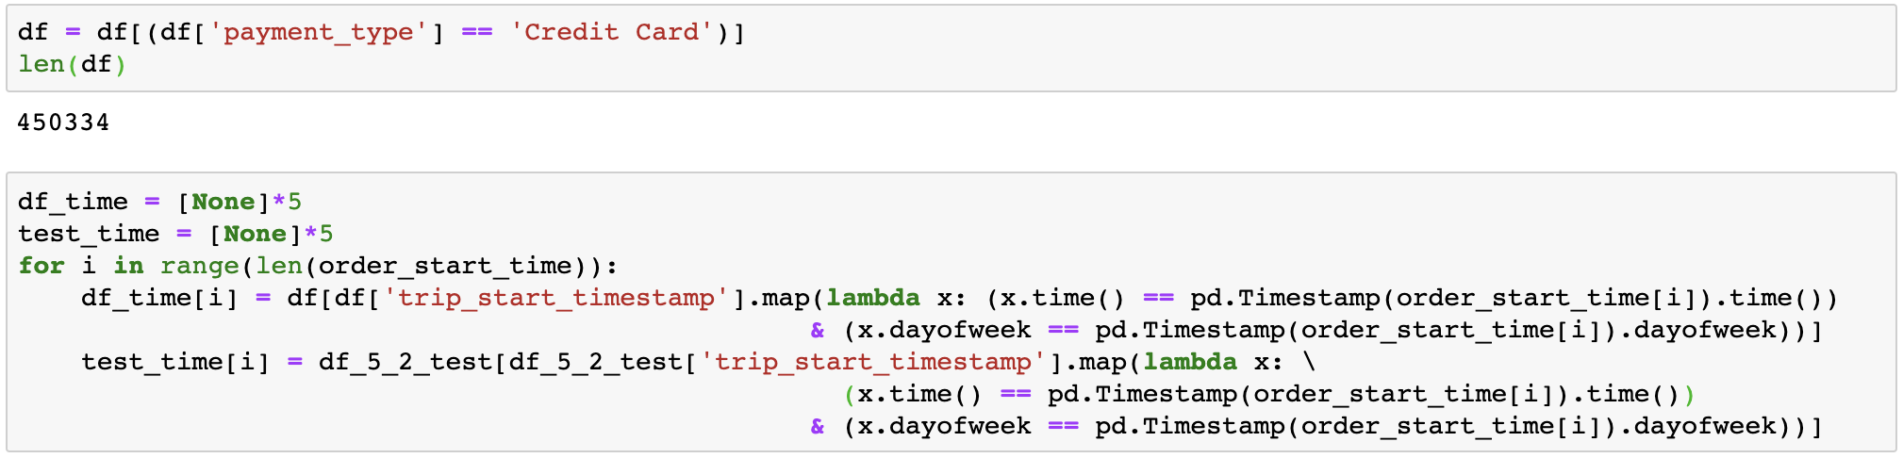
Model
Notes:
Here is the model part. We devide training set to 5 categories to make sure training data whose start time and weekday is same as testing data.

Slide 17
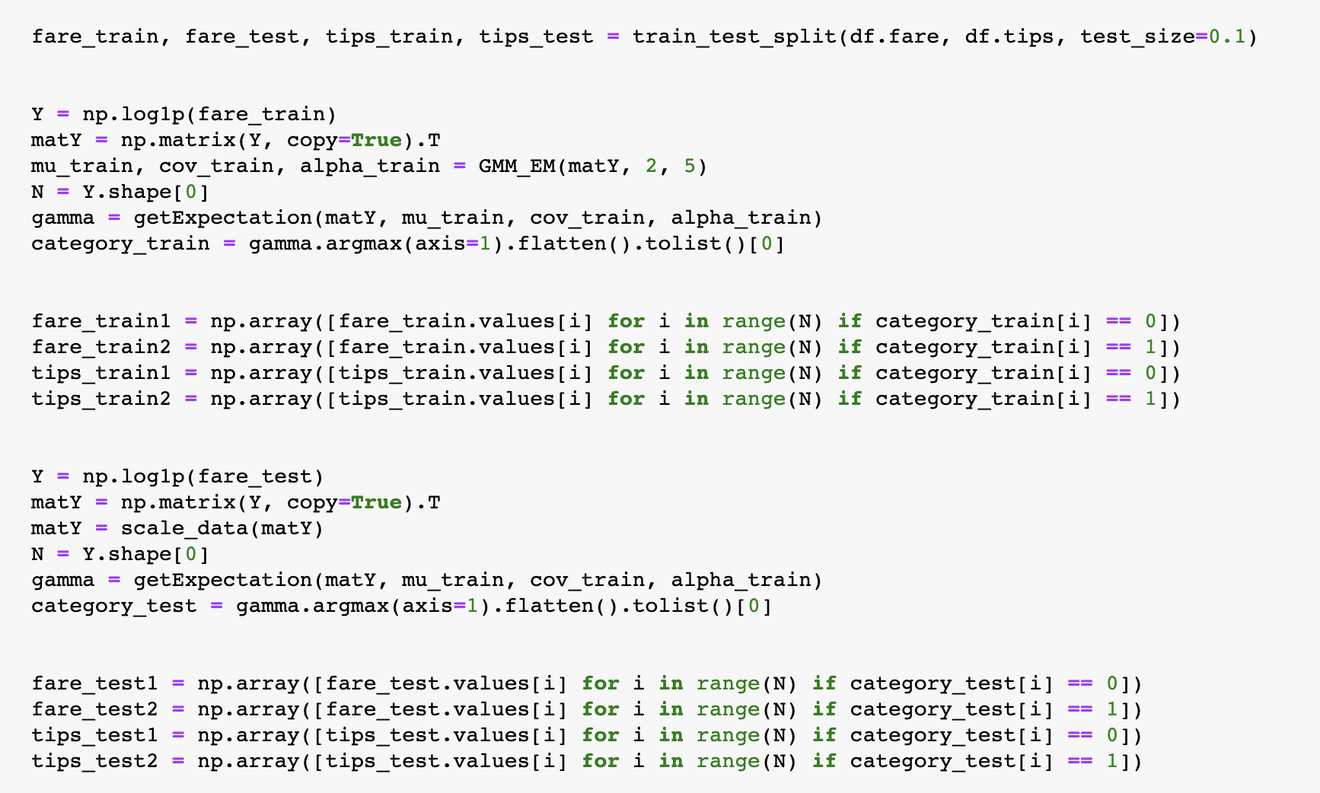
Model
Notes:
For each category, we also devide data into 2 sets by EM algorithm.

Slide 18
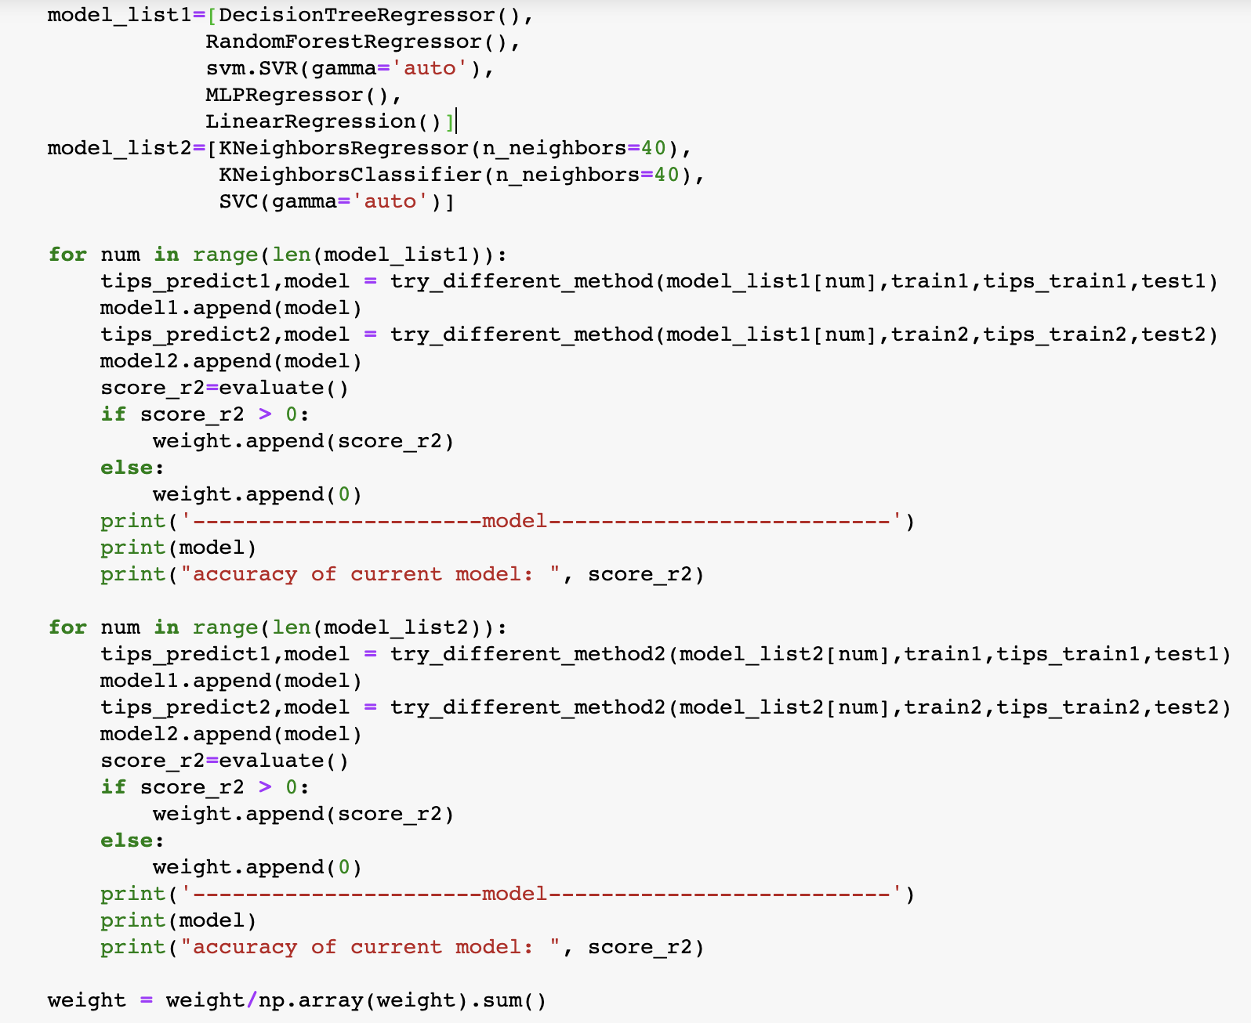
Model
Notes:
We've tried many models, the accuracy is similar between them. So we decide to use 8 algorithms to predict tips, and give every one a weight based on its r2 score.

Slide 19
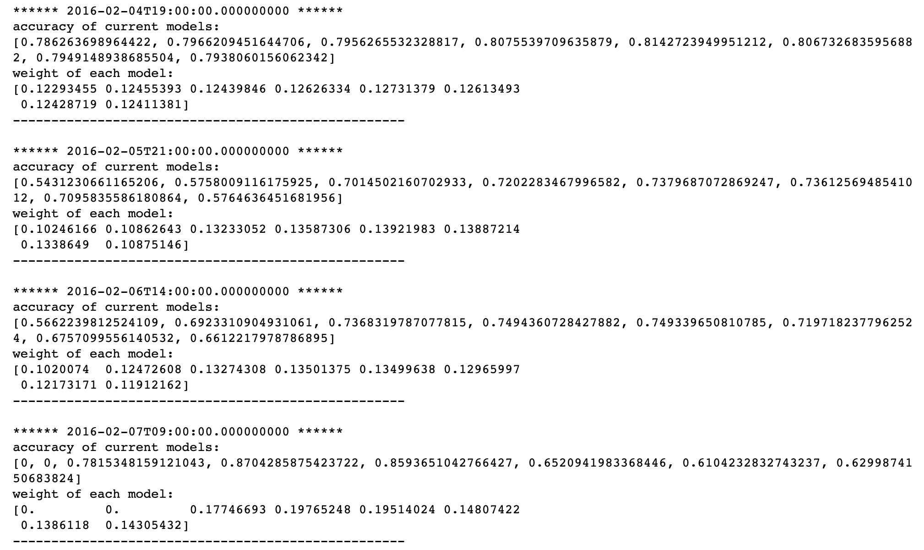
Model
Notes:
Here is the accuracy and weight of each algorithm.

Slide 20
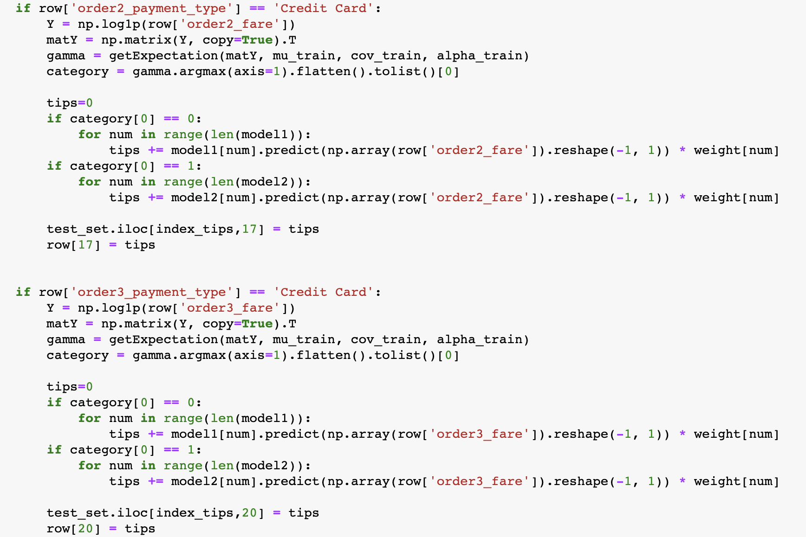
Model
Notes:
Then we got tips of each order according to the GMM cluster and weighted model.

Slide 21
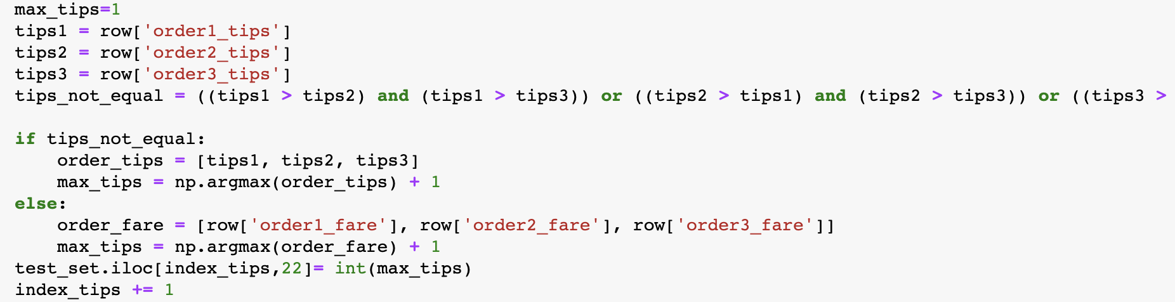
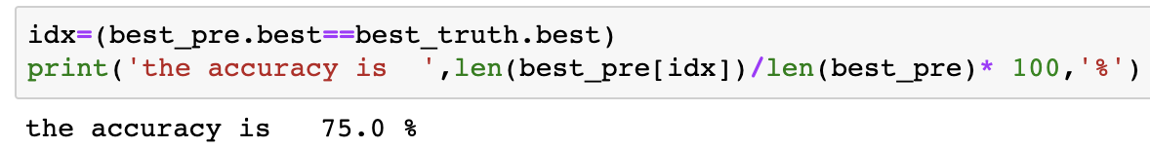
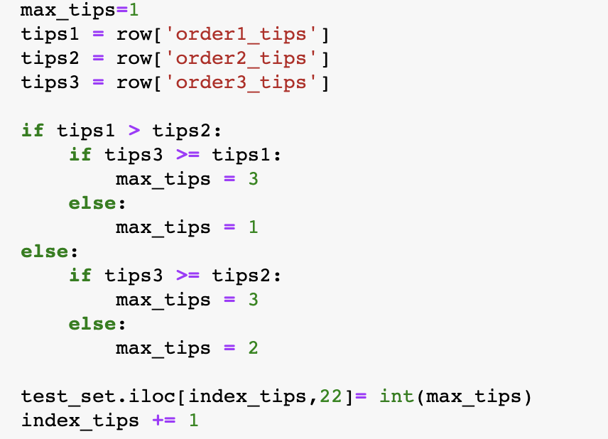
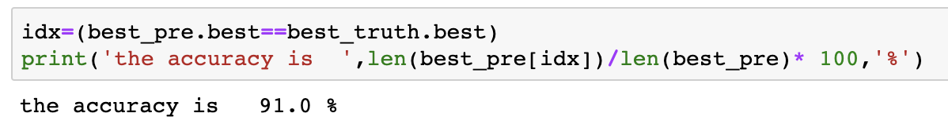
Result
Notes:
Here is the result. We change the logic to choose the best order. The older one is when tips of 3 orders are equal, choose the order which has the biggest fare. Now we choose the 3rd one if equivalence happens, the accuracy turned to 91%.

Slide 22
THANK YOU
Notes:
Thank you this is our presentation

