Slide 1
Honors Thesis Defense
Plugging Machine Learning into RSSI-based Fingerprinting for Indoor Localization

Slide 2
Outline
Introduction
Related Work
Implementation of RSSI-based Fingerprinting
Experimental Results
Conclusion and Future Work

Slide 3
What is RSSI and RSSI-based Fingerprinting？
Received Signal Strength Indicator (RSSI)
RSS stands for the actual received signal strength in a wireless environment, typically measured in decibel (dBm)
RSSI is a relative measurement of RSS that has arbitrary units
RSSI- based fingerprinting is a widely used technique for indoor localization. Wi-Fi, Bluetooth, etc.

Slide 4
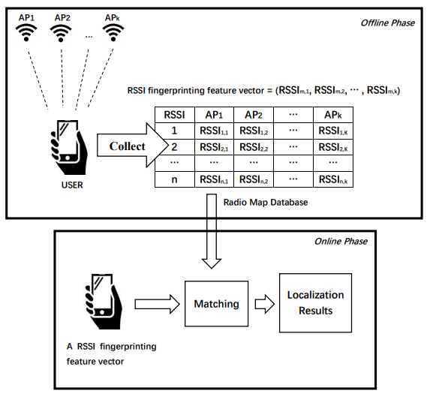
How does RSSI-based Fingerprinting work?
A radio map could link a physical location to a specific RSSI value

Slide 5
How does RSSI-based Fingerprinting work?
Employ the most appropriate match finding algorithm.
Explore the possibility of applying machine learning algorithms to RSSI-based fingerprinting, especially for the ensemble learning

Slide 6
Related Work
Abdurrahim Toktas et al.(2018) conducted a comparative survey on machine learning algorithms for RSSI–based fingerprinting
Different classification algorithms were tested:
K-Nearest Neighbors
Decision Tree
Support Vector Machine
Extreme Learning Machine
K-Nearest Neighbors was the best algorithm for RSSI-based fingerprinting in his scenario

Slide 7
Machine Learning Algorithms for RSSI Fingerprinting
We can treat RSSI based fingerprinting not only a classification problem, but also a regression problem
Decision Tree (Classification/Regression)
K-Nearest Neighbors (Classification/Regression)
Support Vector Machine (Classification/Regression)
Ridge Regression (Regression)
Gaussian Naïve Bayes (Classification)

Slide 8
Ensemble Learning
It is primarily used to improve the performance of classification and regression models
The related studies in recent years haven’t employ ensemble learning methods on RSSI-based fingerprinting
Using ensemble learning methods to further improve localization accuracy

Slide 9
What is Ensemble Learning?
Ensemble learning is a learning strategy that combines a set of models
Used for classification and regression
Goal: achieve better performance than an individual model on average
It combines weak learners to be a powerful model

Slide 10
What is Ensemble Learning?
Four widely known ensemble learning methods:
Majority voting
Bagging
Boosting
Stacking
There is no single winner among the last three methods, it is the concrete analysis of the concrete conditions (Shaohua & Hua Yang, 2013)

Slide 11
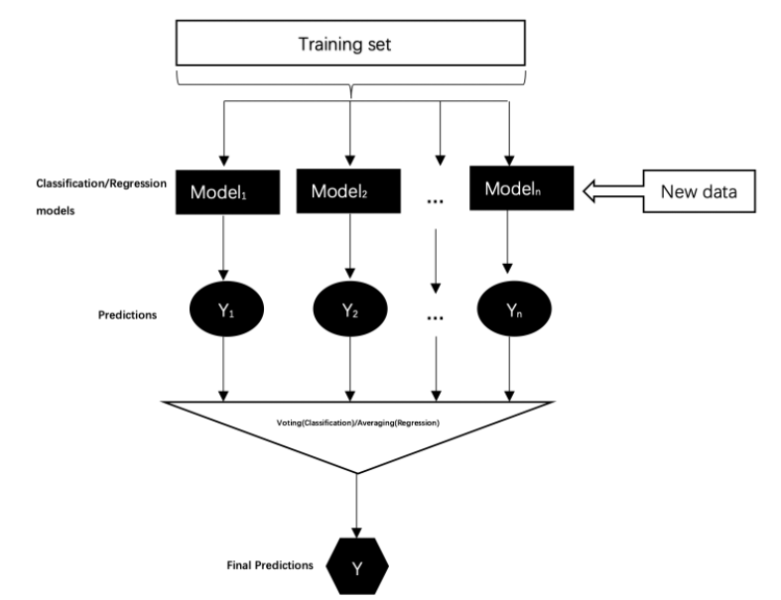
Majority Voting

Slide 12
Bagging
Also known as Bootstrap Aggregating. It is based on the statistical method of bootstrapping
Composed of multiple homogeneous weak learners (decision tree, etc.)
The idea is to reduce the variance of an estimated prediction function by averaging or voting
High variance models, such as decision tree

Slide 13
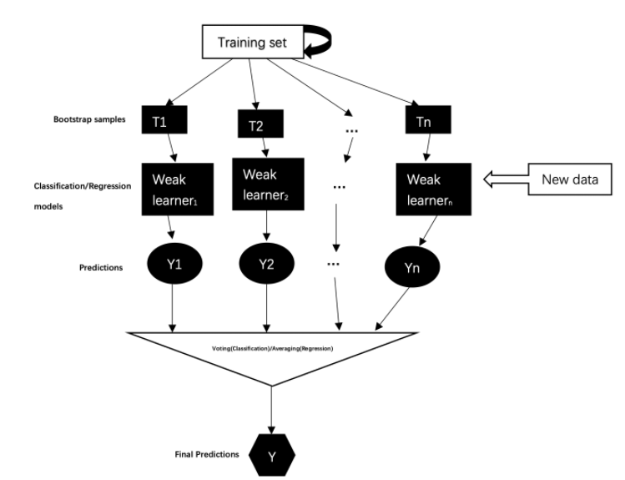
Bagging

Slide 14
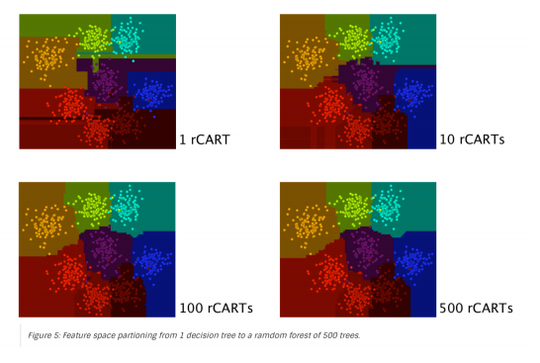
Random Forest
It uses a bagging leaning strategy that builds a large ensemble of tree models
It is a special modification of bagging, random forest also samples attributes from datasets for each tree to obtain high diversity predictions
Breiman, L. 2001

Slide 15
Boosting
Can we boost the performance of the weak learners?
In contrast with bagging strategies that used copied of instances, the idea here is able to calculate weights without explicitly making copies of data points
Boosting is an iterative procedure to adaptively change distribution of training data by focusing more on previously misclassified records.

Slide 16
Adaboost (Adaptive Boosting)
Initialize all data points with equal weight
Repeat :
Use weak learner to weighted training examples
Update the weights of training data according to weak learner’s predictions
Combine all these weighted weak learners linearly to obtain final predictions
Each weak learner is fitted with the most informative training data

Slide 17
Stacking
Unlike Bagging and Boosting, different types of learners are considered as the base learners, and the base learners are not from the same family.
An extra learner, called meta-learner, is used to combine the outputs of base learners

Slide 18
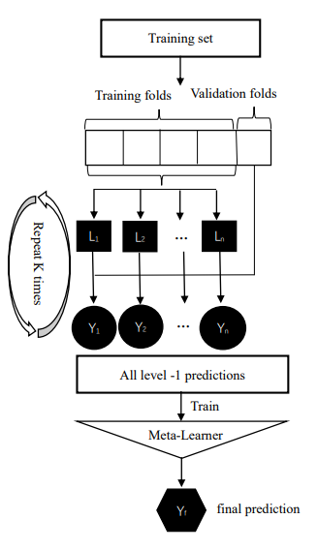
Stacking
If a base learner misclassified a record, then the meta learner may be able to correct that wrong behavior by learning other base learners’ behaviors

Slide 19

Two Questions about RSSI-based Fingerprinting
Do regression algorithms perform better than classification algorithms for RSSI-based fingerprinting?
Can we use ensemble learning to further improve the localization accuracy?

Slide 20
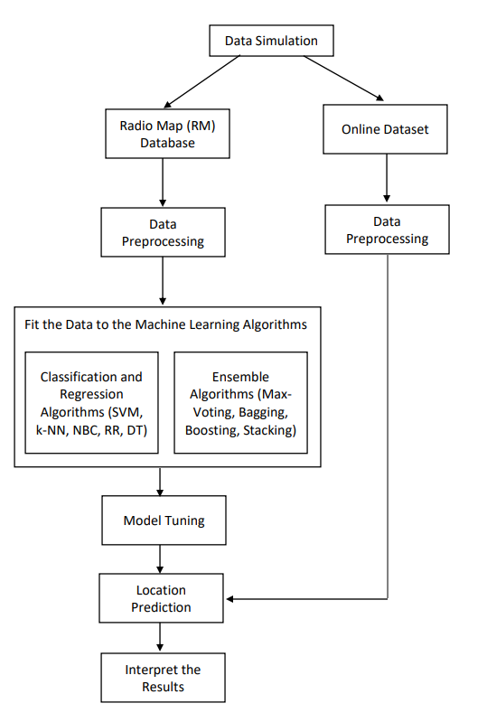
Implementation of RSSI-based Fingerprinting

Slide 21
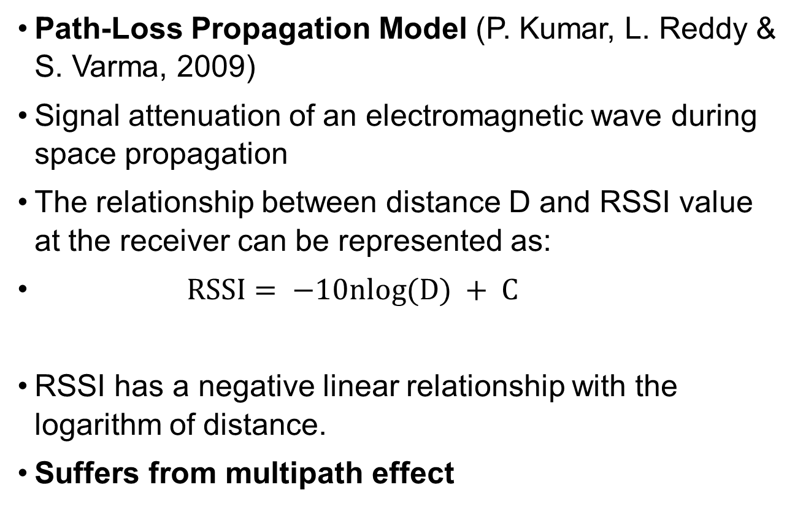
Simulation Models for RSSI Datasets
Path-Loss Propagation Model (P. Kumar, L. Reddy & S. Varma, 2009)
Signal attenuation of an electromagnetic wave during space propagation
The relationship between distance D and RSSI value at the receiver can be represented as:
$RSSI= −10nlog(D) + C$
RSSI has a negative linear relationship with the logarithm of distance.
Suffers from multipath effect

Slide 22
Simulation Models for RSSI Datasets
The RSSI and location data were simulated using MATLAB by running the ray-tracing model (Firdaus F, 2019)
Calculations take one direct path and other reflected waves from walls into consideration
The propagation paths are analyzed separately.
The process includes the calculation of signal strength and phase for multiple signal reflections or diffractions, and then the results are accumulated to get the estimated signal strength at the receiver.

Slide 23
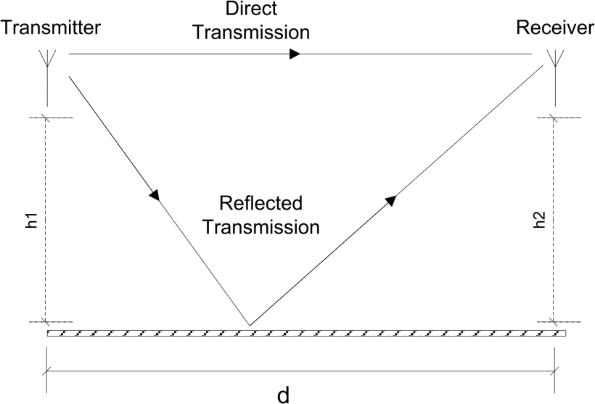
Ray-Tracing Model
The ray-tracing model with one reflection point

Slide 24
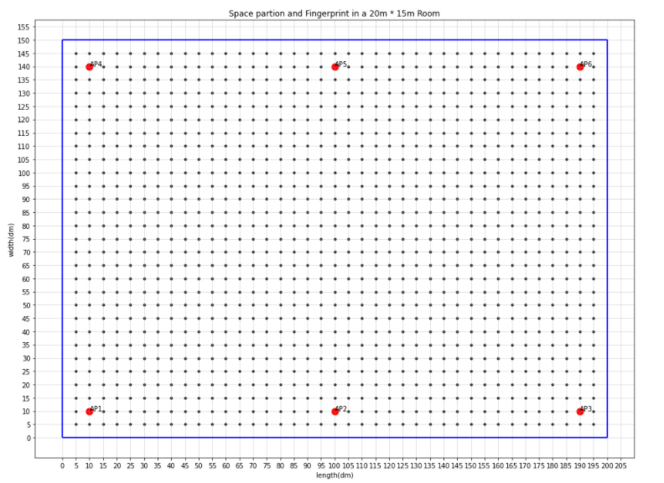
Data Simulation
Offline Phase
20*15*4 m³
No obstacles
6 AP
1m above the floor
Black point: User location (0.5m)
Red point: wireless access point

Slide 25
Attributes in the RM Database
Column | Description | Units | Values
rss1-rss6 | RSS values received by user from six wireless access points | dBm | Floating point numbers from -83.468841 to -29.606275
x | The horizontal axis in the coordinate plane. | decimeters | Integer values from 5 to 195
y | The vertical axis in the coordinate plane. | decimeters | Integer values from 5 to 145

Slide 26
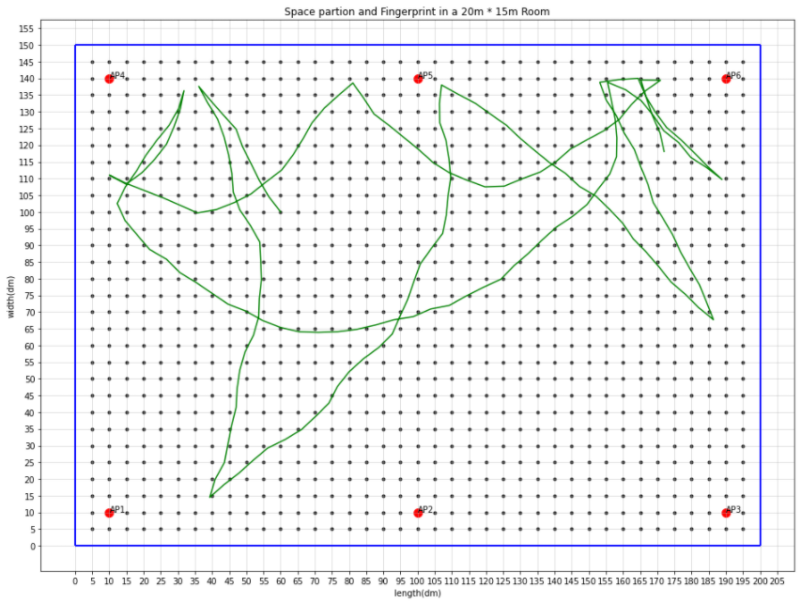
Data Simulation
Online phase: Generate random traces
This dataset is used for model evaluation

Slide 27
Implementation of RSSI-fingerprinting

Slide 28
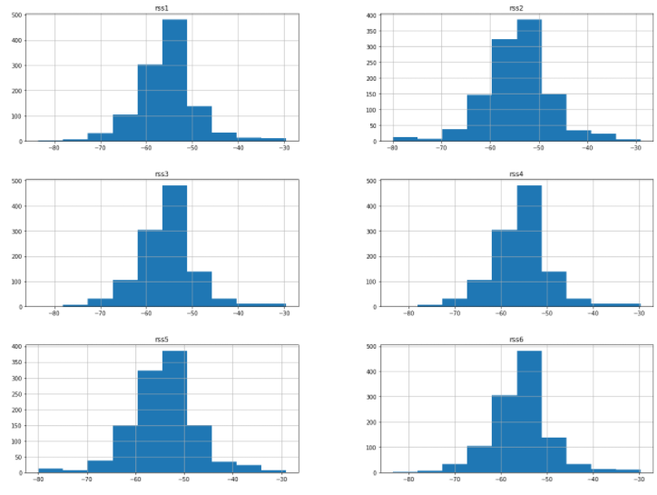
Data Visualization and Preprocessing
Since there were no missing values in the simulated dataset, we first explored the distribution of RSS values

Slide 29
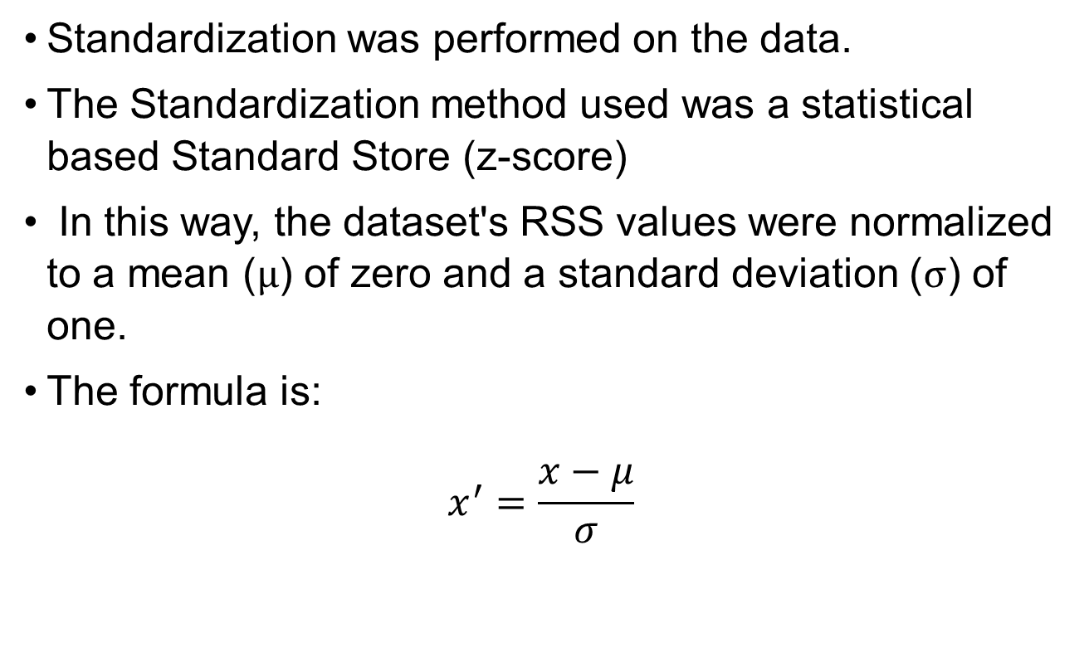
Data Visualization and Preprocessing
Standardization was performed on the data.
The Standardization method used was a statistical based Standard Store (z-score)
In this way, the dataset's RSS values were normalized to a mean ($μ$) of zero and a standard deviation ($σ$) of one.
The formula is:
$$x^{′}=\frac{x−μ}{σ}$$

Slide 30
Implementation of RSSI-fingerprinting

Slide 31
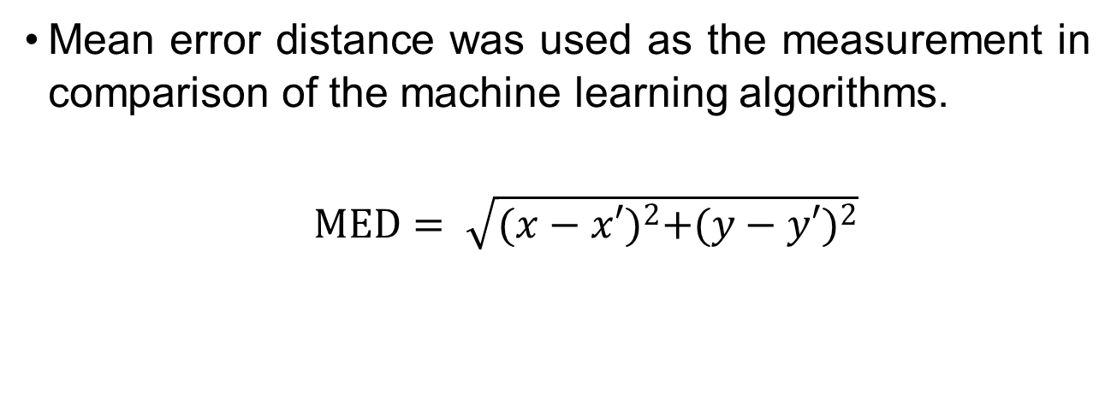
Performance Metrics
Mean error distance was used as the measurement in comparison of the machine learning algorithms.
$MED= \sqrt{{(x−x′)}^{2}+{(y−y′)}^{2}}$
where x, x’, y, y’ are actual horizontal axis, predicted horizontal axis, actual vertical axis and predicted vertical axis in the coordinate plane, respectively
It is the Euclidean distance between the actual location and the estimated location in Euclidean space

Slide 32
Classification and Regression Algorithms for Fingerprinting
Different classification and regression algorithms were compared with each other
In order to tune the machine learning models, a grid search over the hyperparameters was used with 5-fold cross-validation
The model with the highest cross-validation accuracy was chosen as the best model

Slide 33
Classification Algorithms
Results Classification Models | Mean Distance Error (m) | Hyperparameters
Gaussian Naive Bayes Classifier | 3.397
k-NN Classifier | 3.338 | n_neighbors = 9; weights = distance; metric=manhattan
Support Vector Classifier | 3.036 | kernel = rbf; C = 2
Decision Tree Classifier | 4.011 | criterion = gini

Slide 34
Regression Algorithms
Results Regression Models | Mean Distance Error (m) | Hyperparameters
Ridge Regression | 4.011 | alpha = 1
k-NN Regressor | 2.571 | n_neighbors = 9; weights = distance; metric = euclidean
Support Vector Regressor | 2.706 | kernel = rbf; C = 9
Decision Tree Regressor | 3.420 | criterion = mse

Slide 35
Comparison of Classification and Regression Methods
Regression k-NN model yields the highest accuracy (2.571 m) among the classification methods and the regression methods
Regression is more suitable for RSSI-fingerprinting in this scenario

Slide 36
How about Ensemble Methods?
Results Ensemble Methods | Mean Distance Error (m) | Hyperparameters
Majority Voting | 2.822 | estimators = k-NN, SVR, RR
Random Forest | 2.381 | n_estimators = 150;
Adaboost | 2.801 | n_estimators = 700;
Stacking | 2.452 | estimators = k-NN, SVR, RR, RF, Adaboost; final_estimator = RR

Slide 37
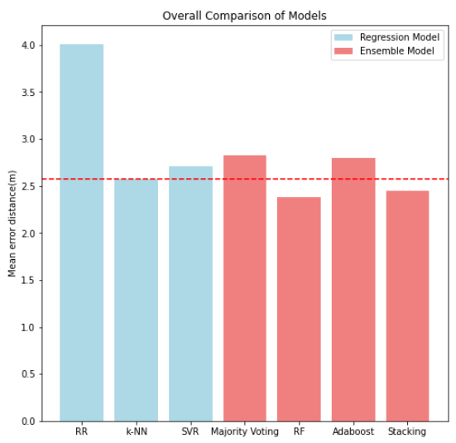
How about Ensemble Methods?

Slide 38
Conclusion
The regression methods generally perform better than the classification methods for RSSI -based fingerprinting in this scenario.
Ensemble learning is able to improve the localization accuracy in some cases.

Slide 39
Future Work
Use a real-world dataset to test the machine learning algorithms.
More types of base learners should be used for evaluating the ensemble methods.
Use more advanced algorithms, such as deep learning.

Slide 40
Thank You

