Slide 1
Information Retrieval
Chapter 1 - INTRODUCTION
Quoc Dinh TRUONG, PhD
Modified from Christopher D. Manning, Prabhakar Raghavan and Hinrich Schütze slides

Slide 2
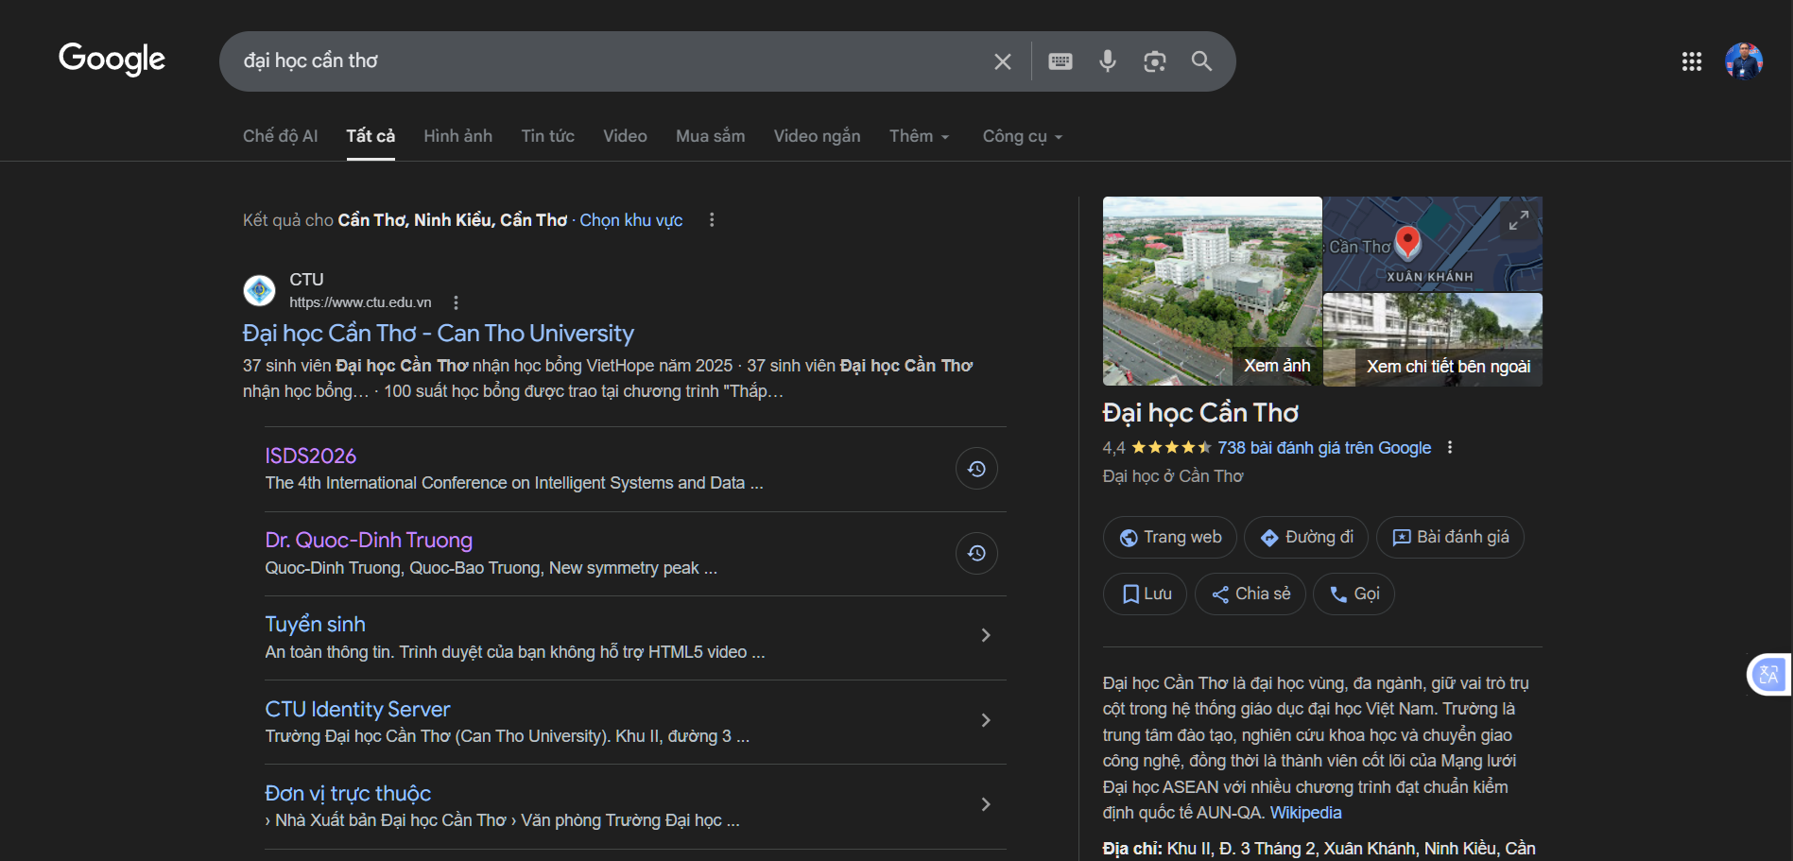
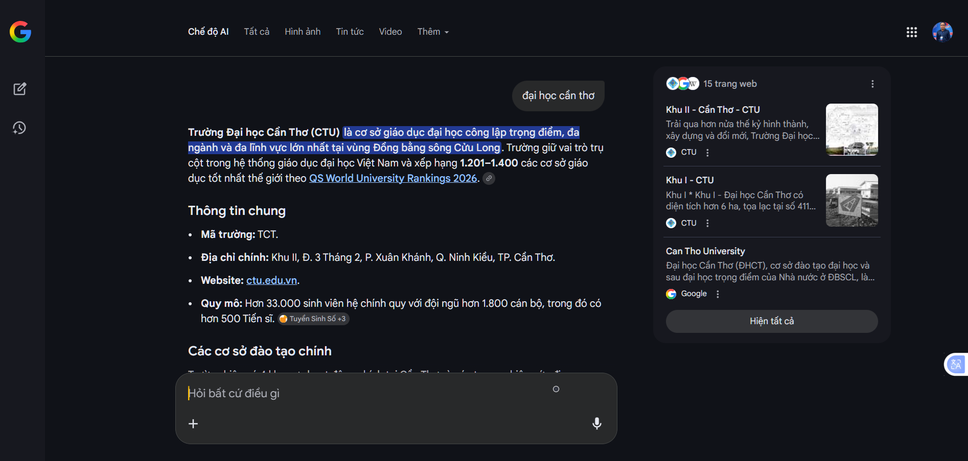
How does it work?

Slide 3
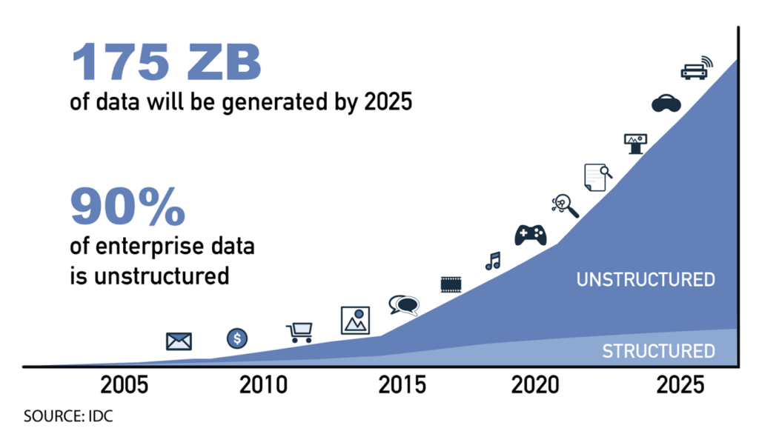
Unstructured vs. structured data
Source: Superna

Slide 4
Why Information Retrieval?
Knowledge
Pattern Evaluation
Data Mining
Task-relevant Data
Selection
Data Warehouse
Data Cleaning
Data Integration
Databases

Slide 5
Information Retrieval
Information Retrieval (IR) is finding material (usually documents) of an unstructured nature (usually text) that satisfies an information need from within large collections (usually stored on computers).

Slide 6
Unstructured data in 1620
Sec. 1.1
Which plays of Shakespeare contain the words Brutus AND Caesar but NOT Calpurnia?
One could grep all of Shakespeare’s plays for Brutus and Caesar, then strip out lines containing Calpurnia?
Why is that not the answer?
Slow (for large corpora)
NOT Calpurnia is non-trivial
Other operations (e.g., find the word Romans near countrymen) not feasible
Ranked retrieval (best documents to return)

Slide 7
Term - document incidence
Sec. 1.1
Brutus AND Caesar BUT NOT Calpurnia
1 if play contains word, 0 otherwise

Slide 8
Incidence vectors
Sec. 1.1
So we have a 0/1 vector for each term.
To answer query: take the vectors for Brutus, Caesar and Calpurnia (complemented) ➔ bitwise AND.
110100 AND 110111 AND 101111 = 100100.

Slide 9
Basic assumptions of Information Retrieval
Sec. 1.1
Collection: Fixed set of documents
Goal: Retrieve documents with information that is relevant to the user’s information need and helps the user complete a task

Slide 10

The classic search model
TASK
Get rid of mice in a politically correct way
Misconception?
Info Need
Info about removing mice
without killing them
Mistranslation?
Verbal form
Misformulation?
How do I trap mice alive?
Query
mouse trap
SEARCH ENGINE
Query Refinement
Results
Corpus

Slide 11
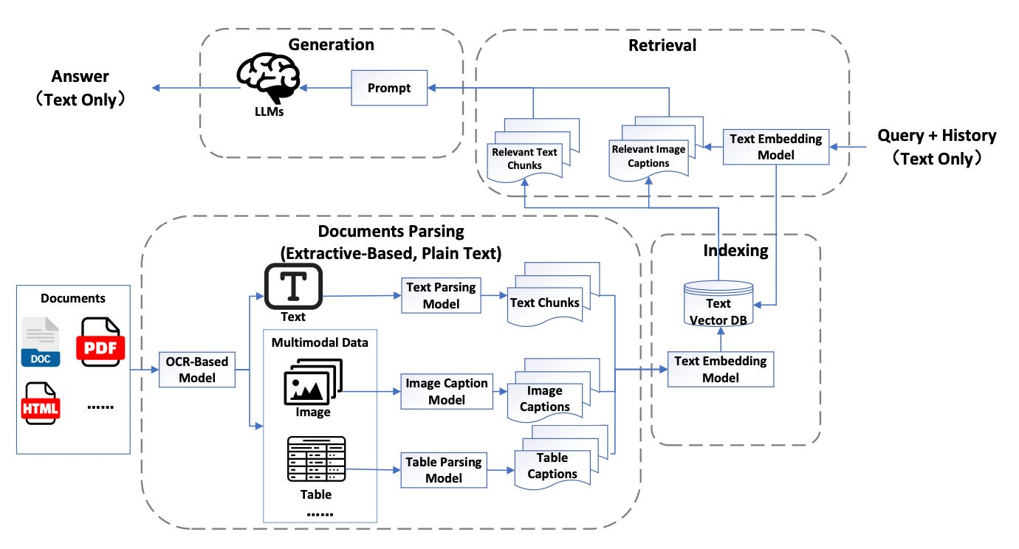
The modern search model

Slide 12
How good are the retrieved docs?
Sec. 1.1
Precision : Fraction of retrieved docs that are relevant to user’s information need
Recall : Fraction of relevant docs in collection that are retrieved.

Slide 13
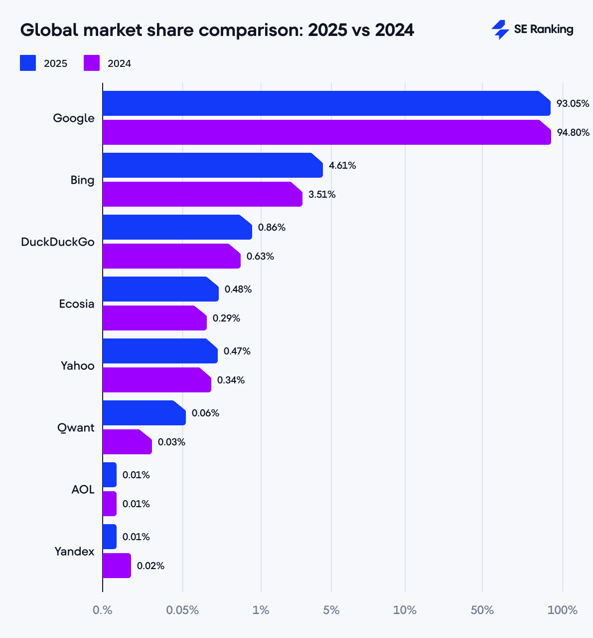
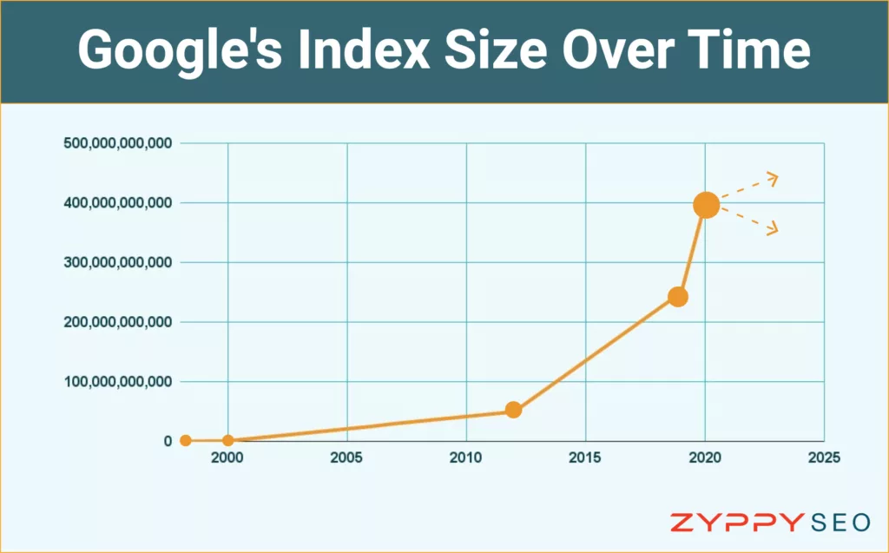
Bigger collections
Sec. 1.1
Consider N = 1 million documents, each with about 1000 words.
Avg 6 bytes/word including spaces/punctuation
6GB of data in the documents.
Say there are M = 500K distinct terms among these.

Slide 14
Can’t build the matrix
Sec. 1.1
500K x 1M matrix has half-a-trillion 0’s and 1’s.
But it has no more than one billion 1’s.
matrix is extremely sparse.
What’s a better representation?
We only record the 1 positions.
Why?

Slide 15
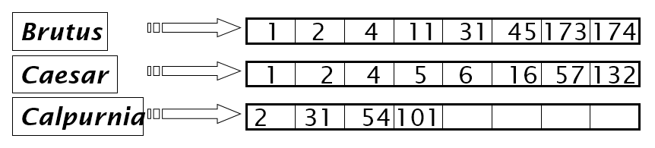
The first look of Inverted index
Sec. 1.2
For each term t, we must store a list of all documents that contain t.
Identify each by a docID, a document serial number
Can we used fixed-size arrays for this?
What happens if the word Caesar is added to document 14?

Slide 16
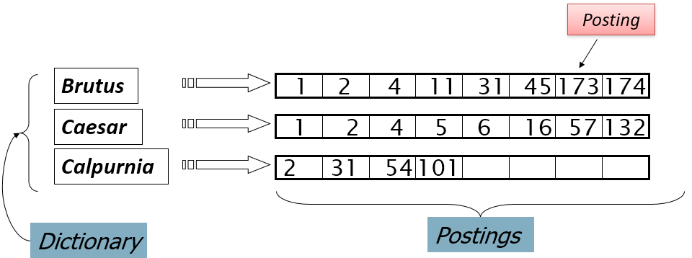
The first look of Inverted index
Sec. 1.2
We need variable-size postings lists
On disk, a continuous run of postings is normal and best
In memory, can use linked lists or variable length arrays
Sorted by docID (more later on why).

Slide 17
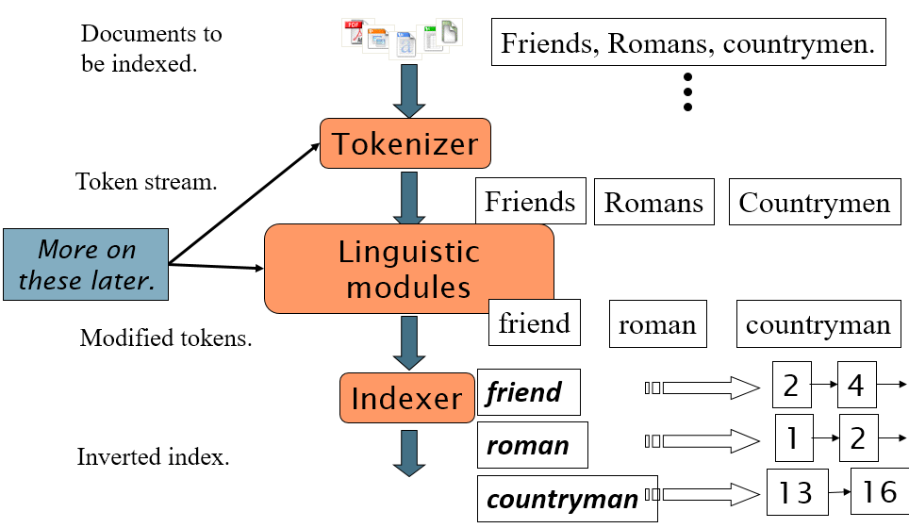
Inverted index construction
Sec. 1.2

Slide 18
Query processing: AND
Sec. 1.3
Consider processing the query: Brutus AND Caesar
Locate Brutus in the Dictionary;
Retrieve its postings.
Locate Caesar in the Dictionary;
Retrieve its postings.
“Merge” the two postings:
2
4
8
16
32
64
128
Brutus
1
2
3
5
8
13
21
34
Caesar

Slide 19
The merge
Sec. 1.3
Walk through the two postings simultaneously, in time linear in the total number of postings entries
2
4
8
16
128
2
4
8
16
32
64
128
32
64
Brutus
2
8
1
2
5
8
13
21
34
Caesar
1
2
3
5
8
13
21
34
3
If the list lengths are x and y, the merge takes O(x+y)
operations.
Crucial: postings sorted by docID.

Slide 20
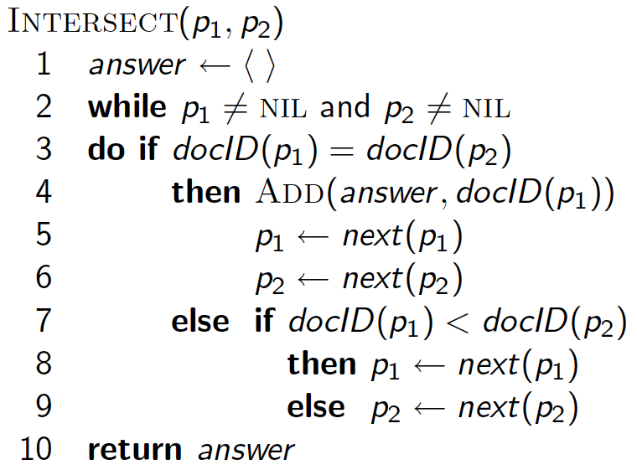
A “merge” algorithm

Slide 21
Boolean queries: Exact match
Sec. 1.3
Boolean retrieval model: being able to ask a query that is a Boolean expression.
Boolean Queries: using AND, OR and NOT to join query terms
Views each document as a set of words
Is precise: document matches condition or not.
Perhaps the simplest model to build an IR system on.

Slide 22
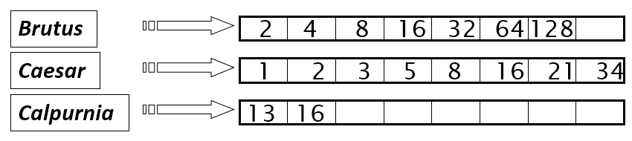
Query optimization
Sec. 1.3
What is the best order for query processing?
Consider a query that is an AND of n terms.
For each of the n terms, get its postings, then AND them together.
Query: Brutus AND Calpurnia AND Caesar
22

Slide 23
What’s ahead in IR? Beyond term search
What about phrases?
Stanford University
Proximity: Find Gates NEAR Microsoft.
Need index to capture position information in docs.
Zones in documents
Find documents with (author = Ullman) AND (text contains automata).

Slide 24
Evidence accumulation
1 vs. 0 occurrence of a search term
2 vs. 1 occurrence
3 vs. 2 occurrences, etc.
Usually more seems better
Need term frequency information in docs.

Slide 25
Ranking search results
Boolean queries give inclusion or exclusion of docs.
Often we want to rank/group results
Need to measure proximity from query to each doc.
Need to decide whether docs presented to user are singletons, or a group of docs covering various aspects of the query.

Slide 26
Semi-structured data
In fact almost no data is “unstructured”.
E.g., this slide has distinctly identified zones such as the Title and Bullets
Facilitates “semi-structured” search such as
Title contains data AND Bullets contain search

Slide 27
More sophisticated semi-structured search
Title is about Object Oriented Programming AND Author something like stro*rup
where * is the wild-card operator
Issues:
how do you process “about”?
how do you rank results?

Slide 28
The web and its challenges
Unusual and diverse documents.
Unusual and diverse users, queries, information needs.
Beyond terms, exploit ideas from social networks
link analysis, clickstreams ...
More sophisticated information retrieval
Cross-language information retrieval; Question answering; Summarization; Text mining …

