Slide 1
Information Retrieval
Chapter 2 - The term vocabulary and postings lists
Quoc Dinh TRUONG, PhD
Modified from Christopher D. Manning, Prabhakar Raghavan and Hinrich Schütze slides

Slide 2
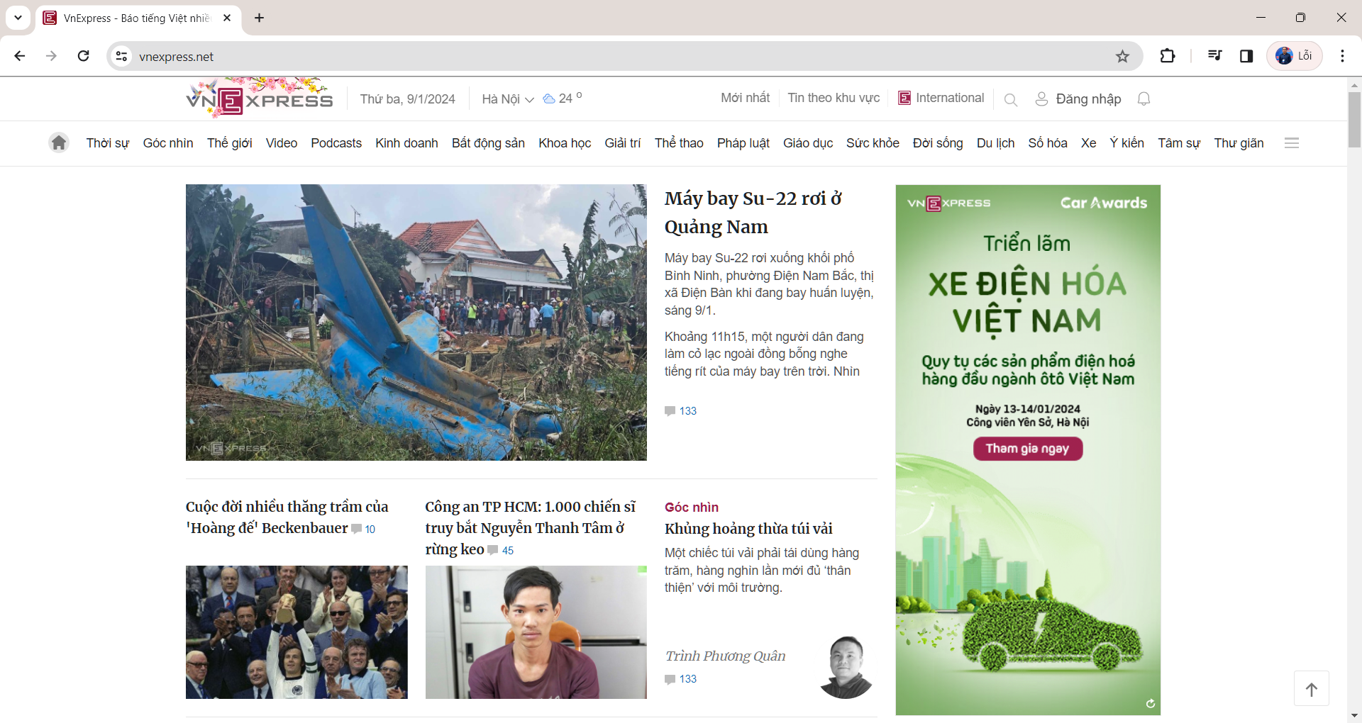
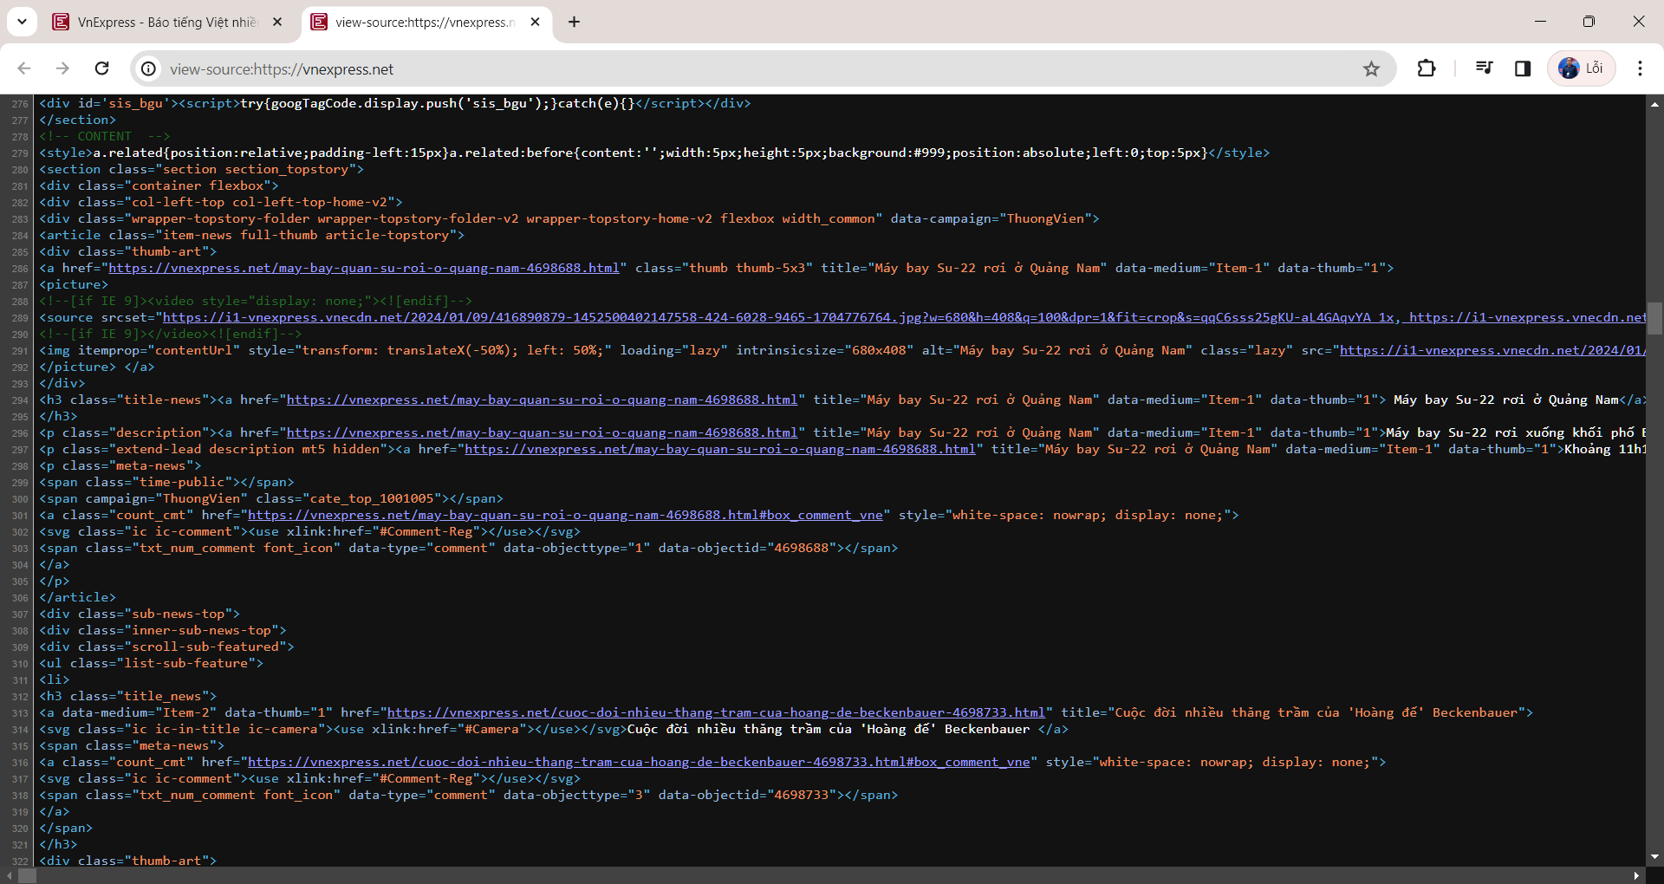
Parsing a document
What format is it in?
pdf/word/excel/html?
What language is it in?
What character set is in use?

Slide 3
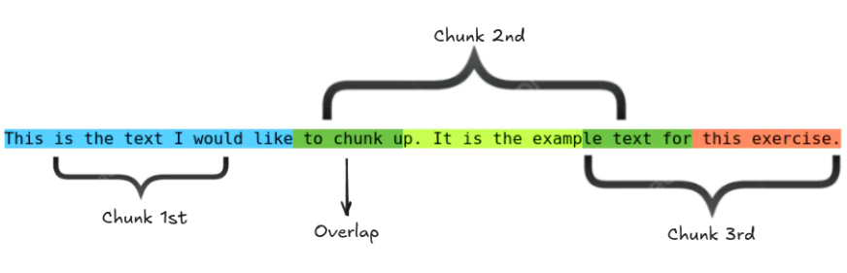
Complications: Format/language
Sec. 2.1
Documents being indexed can be written in many different languages.
A single index may have to contain terms of several languages.
Sometimes a document or its components can contain multiple languages/formats
French email with a German pdf attachment.
What is a unit document?
A file?
An email? (Perhaps one of many in an inbox.)
An email with 5 attachments?
A group of files (PPT or LaTeX as HTML pages)

Slide 4
Tokenization
Sec. 2.2.1
Input: “Friends, Romans and Countrymen”
Output: Friends Romans Countrymen
Input: “Quản lý chuỗi khách sạn của một doanh nghiệp”
Output: Quản_lý chuỗi khách_sạn của một doanh_nghiệp
A token is an instance of a sequence of characters.
Each such token is now a candidate for an index entry.
But what are valid tokens to emit?

Slide 5
Tokenization
Sec. 2.2.1
Issues in tokenization
Finland’s capital → Finland? Finlands? Finland’s?
Hewlett-Packard → Hewlett and Packard as two tokens?
San Francisco: one token or two?
How do you decide it is one token?

Slide 6
Numbers
Sec. 2.2.1
3/20/91 Mar. 20, 1991 20/3/91
My PGP key is 324a3df234cb23e
(800) 234-2333
Often have embedded spaces.
Older IR systems may not index numbers.
But often very useful: think about things like looking up error codes/stacktraces on the web.
Will often index “meta-data” separately
Creation date, format, etc.

Slide 7
Tokenization: language issues
Sec. 2.2.1
French
L'ensemble → one token or two?
Want l’ensemble to match with un ensemble
Until at least 2003, it didn’t on Google
German
Lebensversicherungsgesellschaftsangestellter (‘life insurance company employee’)
German retrieval systems benefit greatly from a compound splitter module (15% performance boost)

Slide 8
Stop words
Sec. 2.2.2
With a stop list, we exclude from the dictionary entirely the commonest words.
They have little semantic content: the, a, and, to, be
There are a lot of them: ~30% of postings for top 30 words
But we need them for
Phrase queries: “King of Denmark”
Various song titles, etc.: “Let it be”, “To be or not to be”
“Relational” queries: “flights to London”

Slide 9
Normalization to terms
Sec. 2.2.3
We need to “normalize” words in indexed text as well as query words into the same form
We want to match U.S.A. and USA
We most commonly implicitly define equivalence classes of terms by, e.g.,
deleting periods to form a term
U.S.A., USA ◊ USA
deleting hyphens to form a term
anti-discriminatory, antidiscriminatory ◊ antidiscriminatory

Slide 10
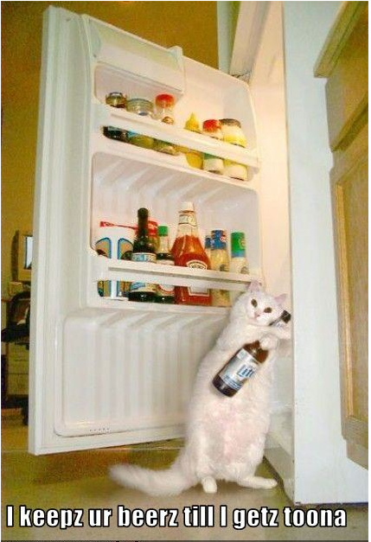
Case folding
Sec. 2.2.3
Reduce all letters to lower case
exception: upper case in mid-sentence?
e.g., General Motors
Fed vs. fed
Often best to lower case everything, since users will use lowercase regardless of ‘correct’ capitalization…
Google example
Query C.A.T.
#1 result is for “cat” not Caterpillar Inc.

Slide 11
Thesauri and soundex
Do we handle synonyms and homonyms?
car = automobile; color = colour
We can rewrite to form equivalence-class terms
When the document contains automobile, index it under car-automobile (and vice-versa)
Or we can expand a query
When the query contains automobile, look under car as well
What about spelling mistakes?
One approach is soundex.

Slide 12
Lemmatization
Sec. 2.2.4
Reduce inflectional/variant forms to base form
am, are, is → be
car, cars, car's, cars' → car
the boy's cars are different colors → the boy car be different color
Lemmatization implies doing “proper” reduction to dictionary headword form.

Slide 13
Stemming
Sec. 2.2.4
Reduce terms to their “roots” before indexing.
“Stemming” suggest crude affix chopping
language dependent
e.g., automate(s), automatic, automation all reduced to automat.
for example compressed
and compression are both
accepted as equivalent to
compress.
for exampl compress and
compress ar both accept
as equival to compress

Slide 14
Faster postings merges: Skip pointers/Skip lists

Slide 15
Recall basic merge
Sec. 2.3
Walk through the two postings simultaneously, in time linear in the total number of postings entries (O(m+n)).
2
4
8
41
48
64
128
Brutus
2
8
1
2
3
8
11
17
21
31
Caesar
Can we do better?
Yes (if index isn’t changing too fast).

Slide 16
Augment postings with skip pointers (at indexing time)
Sec. 2.3
41
128
2
4
8
41
48
64
128
11
31
1
2
3
8
11
17
21
31
Why? To skip postings that will not figure in the search results.
How?
Where do we place skip pointers?

Slide 17
Query processing with skip pointers
Sec. 2.3
41
128
2
4
8
41
48
64
128
11
31
1
2
3
8
11
17
21
31
Suppose we’ve stepped through the lists until we process 8 on each list.
We then have 41 and 11 on the lower. 11 is smaller.
But the skip successor of 11 on the lower list is 31, so we can skip ahead past the intervening postings.

Slide 18
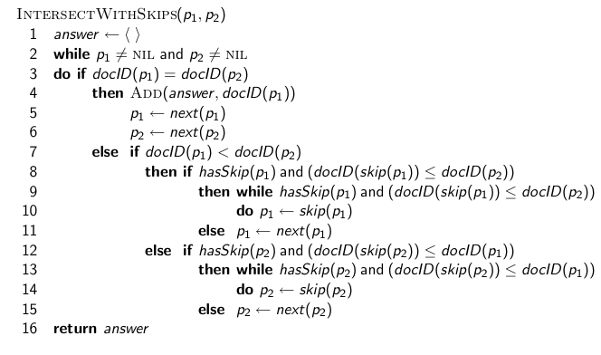
Postings lists intersection with skip pointers

Slide 19
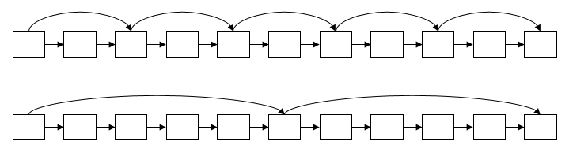
Where do we place skips?
Sec. 2.3
Tradeoff
More skips → shorter skip spans ⇒ more likely to skip. But lots of comparisons to skip pointers.
Fewer skips → few pointer comparison, but then long skip spans ⇒ few successful skips.

Slide 20
Placing skips
Sec. 2.3
Simple heuristic: for postings of length L, use √L evenly-spaced skip pointers.
Easy if the index is relatively static; harder if L keeps changing because of updates.
This definitely used to help; with modern hardware it may not (Bahle et al. 2002) unless you’re memory-based
The I/O cost of loading a bigger postings list can outweigh the gains from quicker in memory merging!

Slide 21
Phrase queries and positional indexes

Slide 22
Phrase queries
Sec. 2.4
Want to be able to answer queries such as “stanford university” – as a phrase
Thus the sentence “I went to university at Stanford” is not a match.
For this, it no longer suffices to store only
<term : docs> entries

Slide 23
A first attempt: Biword indexes
Sec. 2.4.1
Index every consecutive pair of terms in the text as a phrase.
For example the text “Friends, Romans, Countrymen” would generate the biwords
friends romans
romans countrymen
Each of these biwords is now a dictionary term
Two-word phrase query-processing is now immediate.

Slide 24
Longer phrase queries
Sec. 2.4.1
Longer phrases are processed as we did with wild-cards:
stanford university palo alto can be broken into the Boolean query on biwords: stanford university AND university palo AND palo alto
Without the docs, we cannot verify that the docs matching the above Boolean query do contain the phrase.

Slide 25
Extended biwords
Sec. 2.4.1
Parse the indexed text and perform part-of-speech-tagging (POST).
Bucket the terms into (say) Nouns (N) and articles/prepositions (X).
Call any string of terms of the form NX*N an extended biword. Each such extended biword is now made a term in the dictionary.
Example: catcher in the rye (NXXN)
Query processing: parse it into N’s and X’s
Segment query into enhanced biwords and Look up it in index.

Slide 26
Solution 2: Positional indexes
Sec. 2.4.2
In the postings, store, for each term the position(s) in which tokens of it appear.
<term, number of docs containing term;
doc1: position1, position2 … ;
doc2: position1, position2 … ;
etc.>

Slide 27
Positional index example
Sec. 2.4.2
<be: 993427;
1: 7, 18, 33, 72, 86, 231;
2: 3, 149;
4: 17, 191, 291, 430, 434;
5: 363, 367, …>
Which of docs 1,2,4,5
could contain “to be
or not to be”?
For phrase queries, we use a merge algorithm recursively at the document level
But we now need to deal with more than just equality

Slide 28
Processing a phrase query
Sec. 2.4.2
Extract inverted index entries for each distinct term: to, be, or, not.
Merge their doc:position lists to enumerate all positions with “to be or not to be”.
to: 2:1,17,74,222,551; 4:8,16,190,429,433; 7:13,23,191; ...
be: 1:17,19; 4:17,191,291,430,434; 5:14,19,101; ...
Same general method for proximity searches.

Slide 29
Proximity queries
Sec. 2.4.2
LIMIT! /3 STATUTE /3 FEDERAL /2 TORT
Again, here, /k means “within k words of”.
Clearly, positional indexes can be used for such queries; biword indexes cannot.

Slide 30
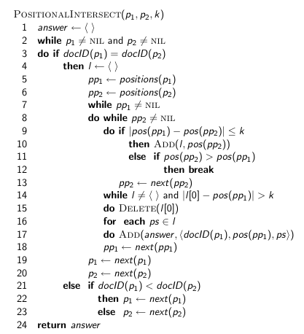
Proximity intersection

Slide 31
Positional index size
Sec. 2.4.2
A positional index expands postings storage substantially
Nevertheless, a positional index is now standardly used because of the power and usefulness of phrase and proximity queries … whether used explicitly or implicitly in a ranking retrieval system.

