Slide 1
Information Retrieval
Chapter 3 – INDEX CONSTRUCTION & INDEX COMPRESSION
Quoc Dinh TRUONG, PhD
Modified from Christopher D. Manning, Prabhakar Raghavan and Hinrich Schütze slides

Slide 2
Hardware basics
Sec. 4.1
Access to data in memory is much faster than access to data on disk.
Disk seeks: No data is transferred from disk while the disk head is being positioned.
Transferring one large chunk of data from disk to memory is faster than transferring many small chunks.
Disk I/O is block-based: Reading and writing of entire blocks (as opposed to smaller chunks).
Block sizes: 8KB to 256 KB.

Slide 3
RCV1: Our collection for this lecture
Sec. 4.2
This collection isn’t really large enough either, but it’s publicly available and is at least a more plausible example.
As an example for applying scalable index construction algorithms, we will use the Reuters RCV1 collection.
This is one year of Reuters newswire (part of 1995 and 1996).

Slide 4
Reuters RCV1 statistics
Sec. 4.2
symbol statistic value
N documents 800,000
L avg. # tokens per doc 200
M terms (= word types) 400,000
avg. # bytes per token 6
(incl. spaces/punct.)
avg. # bytes per token 4.5
(without spaces/punct.)
avg. # bytes per term 7.5
T non-positional postings 100,000,000

Slide 5
Sort-based index construction
Sec. 4.2
As we build the index, we parse docs one at a time.
While building the index, we cannot easily exploit compression tricks
The final postings for any term are incomplete until the end.
At 12 bytes per non-positional postings entry (term, doc, freq), demands a lot of space for large collections.
T = 100,000,000 in the case of RCV1
So … we can do this in memory in 2009, but typical collections are much larger. E.g. the New York Times provides an index of >150 years of newswire
Thus: We need to store intermediate results on disk.

Slide 6
Use the same algorithm for disk?
Sec. 4.2
Can we use the same index construction algorithm for larger collections, but by using disk instead of memory?
No: Sorting T = 100,000,000 records on disk is too slow – too many disk seeks.
We need an external sorting algorithm.

Slide 7
BSBI: Blocked sort-based Indexing (Sorting with fewer disk seeks)
Sec. 4.2
12-byte (4+4+4) records (term, doc, freq), these are generated as we parse docs.
Must now sort 100M such 12-byte records by term.
Define a Block ~ 10M such records
Can easily fit a couple into memory.
Will have 10 such blocks to start with.
Basic idea of algorithm
Accumulate postings for each block, sort, write to disk.
Then merge the blocks into one long sorted order.

Slide 8
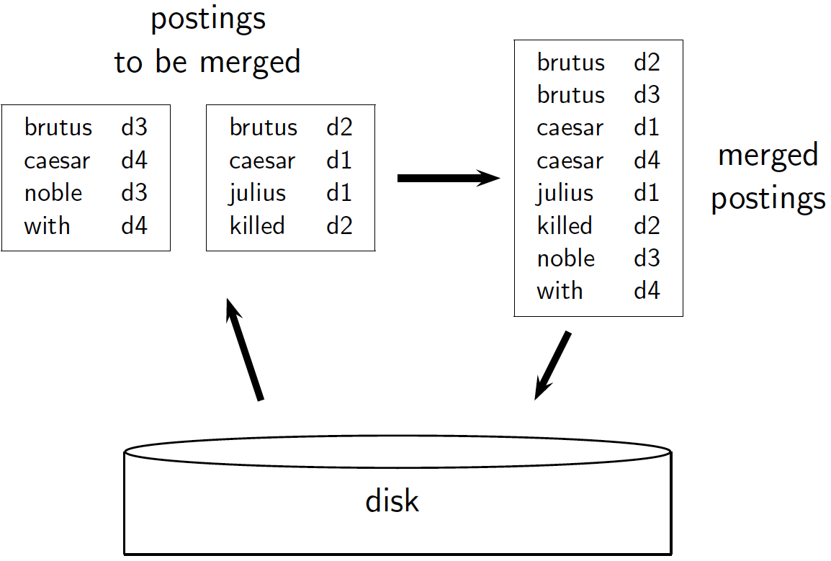
Sec. 4.2

Slide 9
Sorting 10 blocks of 10M records
Sec. 4.2
First, read each block and sort within
Quicksort takes 2N ln N expected steps
In our case 2 x (10M ln 10M) steps
10 times this estimate – gives us 10 sorted runs of 10M records each.
Done straightforwardly, need 2 copies of data on disk
But can optimize this

Slide 10
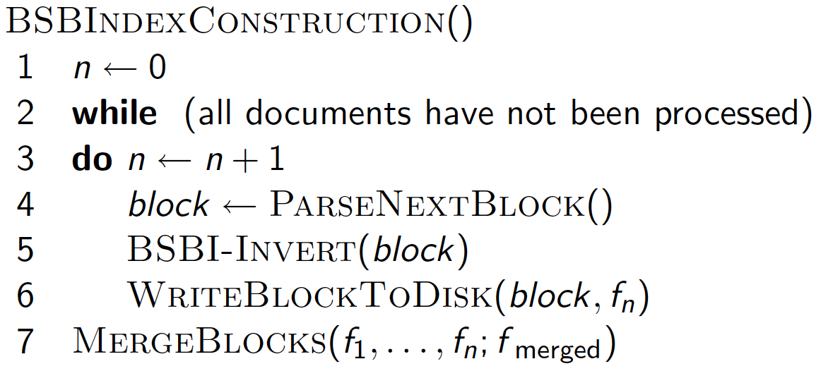
Sec. 4.2

Slide 11
Remaining problem with sort-based algorithm
Sec. 4.3
Our assumption was: we can keep the dictionary in memory.
We need the dictionary (which grows dynamically) in order to implement a term to termID mapping.
Actually, we could work with term, docID postings instead of termID, docID postings . . .
. . . but then intermediate files become very large.

Slide 12
SPIMI: Single-pass in-memory indexing
Sec. 4.3
Key idea 1: Generate separate dictionaries for each block – no need to maintain term-termID mapping across blocks.
Key idea 2: Don’t sort. Accumulate postings in postings lists as they occur.
With these two ideas we can generate a complete inverted index for each block.
These separate indexes can then be merged into one big index.

Slide 13
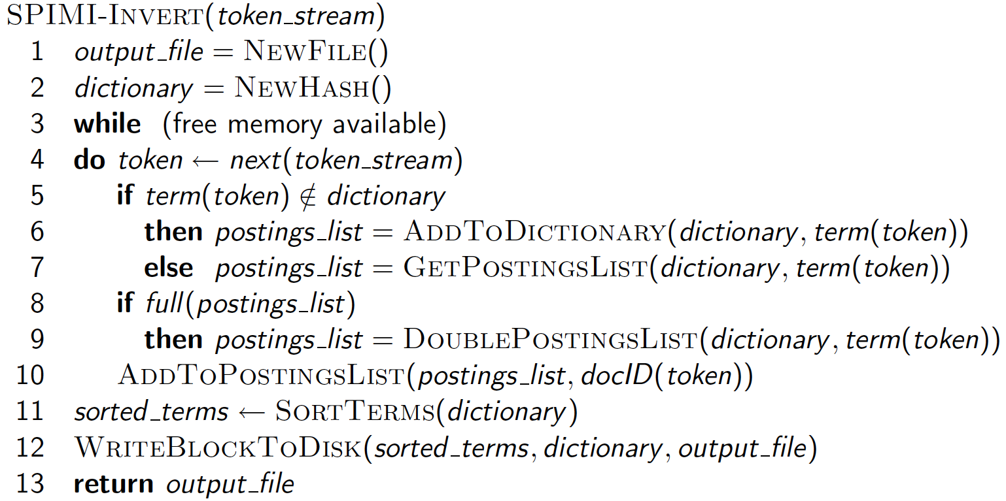
SPIMI-Invert
Sec. 4.3

Slide 14
Distributed indexing
Sec. 4.4
For web-scale indexing
Must use a distributed computing cluster
Individual machines are fault-prone
Can unpredictably slow down or fail
How do we exploit such a pool of machines?

Slide 15
Google data centers
Sec. 4.4
Data centers are distributed around the world.
Estimate: a total of 2.5 million servers.
Estimate: Google holds somewhere around 15 exabytes of data.
1 exabyte equals 1 million terabytes.
Estimate: This would be 10% of the computing capacity of the world!?!

Slide 16
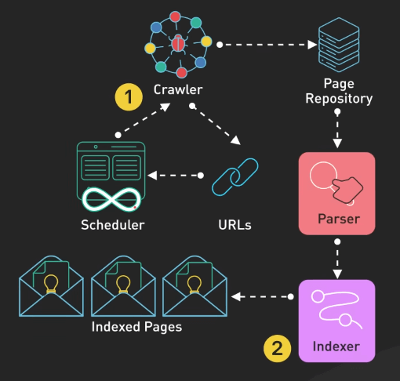
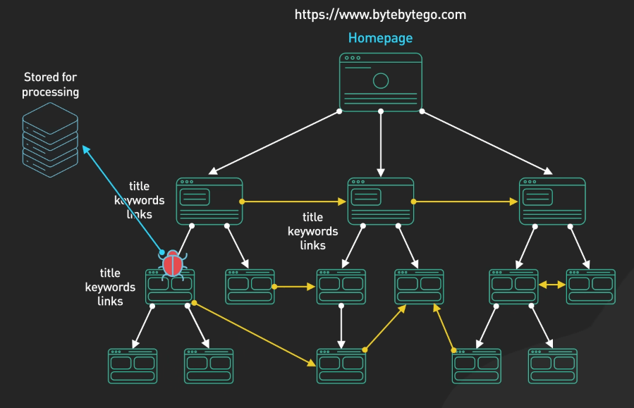
Google web crawler
Sec. 4.4

Slide 17
Distributed indexing
Sec. 4.4
Maintain a master machine directing the indexing job – considered “safe”.
Break up indexing into sets of (parallel) tasks.
We will use two sets of parallel tasks
Parsers
Inverters
Break the input document collection into splits
Master machine assigns each task to an idle machine from a pool.

Slide 18
Parsers
Sec. 4.4
Master assigns a split to an idle parser machine.
Parser reads a document at a time and emits (term, doc) pairs.
Parser writes pairs into j partitions.
Each partition is for a range of terms’ first letters
(e.g., a-f, g-p, q-z) – here j = 3.

Slide 19
Inverters
Sec. 4.4
An inverter collects all (term, doc) pairs (= postings) for one term-partition.
Sorts and writes to postings lists

Slide 20
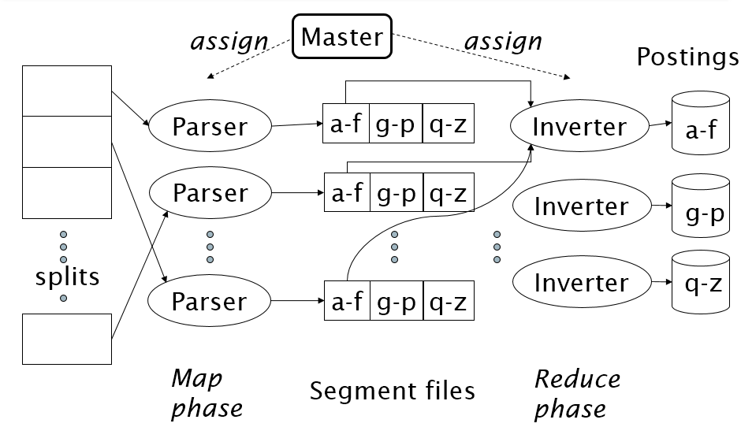
Data flow
Sec. 4.4

Slide 21
Dynamic indexing
Sec. 4.5
Up to now, we have assumed that collections are static.
They rarely are:
Documents come in over time and need to be inserted.
Documents are deleted and modified.
This means that the dictionary and postings lists have to be modified:
Postings updates for terms already in dictionary
New terms added to dictionary

Slide 22
Simplest approach
Sec. 4.5
Maintain “big” main index
New docs go into “small” auxiliary index
Search across both, merge results
Deletions
Invalidation bit-vector for deleted docs
Filter docs output on a search result by this invalidation bit-vector
Periodically, re-index into one main index

Slide 23
Logarithmic merge
Sec. 4.5
Maintain a series of indexes, each twice as large as the previous one.
Keep smallest (Z₀) in memory
Larger ones (I₀, I₁, …) on disk
If Z₀ gets too big (> n), write to disk as I₀ or merge with I₀ (if I₀ already exists) as Z₁
Either write merge Z₁ to disk as I₁ (if no I₁)
Or merge with I₁ to form Z₂
etc.

Slide 24
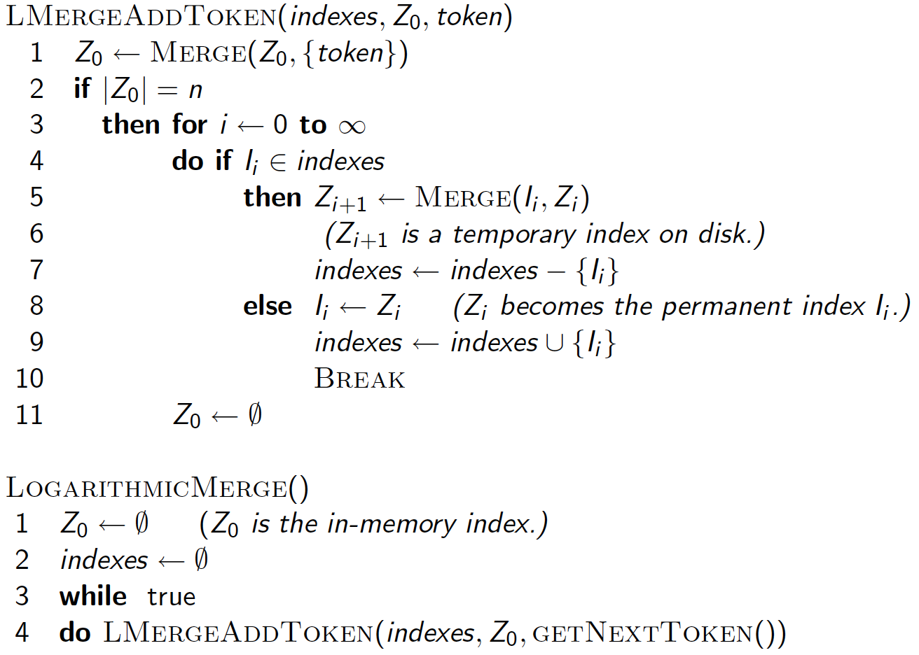
Sec. 4.5

Slide 25
Logarithmic merge
Sec. 4.5
Auxiliary and main index: index construction time is O(T²) as each posting is touched in each merge.
Logarithmic merge: Each posting is merged O(logT) times, so complexity is O(T logT)
So logarithmic merge is much more efficient for index construction.
But query processing now requires the merging of O(log T) indexes. Whereas it is O(1) if you just have a main and auxiliary index

Slide 26
Dynamic indexing at search engines
Sec. 4.5
All the large search engines now do dynamic indexing
Their indices have frequent incremental changes
News items, blogs, new topical web pages
But (sometimes/typically) they also periodically reconstruct the index from scratch
Query processing is then switched to the new index, and the old index is then deleted

Slide 27
Why compression for inverted indexes?
Ch. 5
Dictionary
Make it small enough to keep in main memory
Make it so small that you can keep some postings lists in main memory too
Postings file(s)
Reduce disk space needed, Decrease time needed to read postings lists from disk
Large search engines keep a significant part of the postings in memory.

Slide 28
Index parameters vs. what we index (details IIR Table 5.1, p.80)
Sec. 5.1
size of | word types (terms) |  |  | non-positional postings |  |  | positional postings
 | dictionary |  |  | non-positional index |  |  | positional index
 | Size (K) | ∆% | cumul % | Size (K) | ∆ % | cumul % | Size (K) | ∆ % | cumul %
Unfiltered | 484 |  |  | 109,971 |  |  | 197,879
No numbers | 474 | -2 | -2 | 100,680 | -8 | -8 | 179,158 | -9 | -9
Case folding | 392 | -17 | -19 | 96,969 | -3 | -12 | 179,158 | 0 | -9
30 stopwords | 391 | -0 | -19 | 83,390 | -14 | -24 | 121,858 | -31 | -38
150 stopwords | 391 | -0 | -19 | 67,002 | -30 | -39 | 94,517 | -47 | -52
stemming | 322 | -17 | -33 | 63,812 | -4 | -42 | 94,517 | 0 | -52

Slide 29
Lossless vs. lossy compression
Sec. 5.1
Lossless compression: all information is preserved.
What we mostly do in IR.
Lossy compression: Discard some information
Several of the preprocessing steps can be viewed as lossy compression: case folding, stop words, stemming, number elimination.

Slide 30
DICTIONARY COMPRESSION
Sec. 5.2

Slide 31
Dictionary storage - first cut
Sec. 5.2
Array of fixed-width entries
~400,000 terms; 28 bytes/term = 11.2 MB.
20 bytes
4 bytes each

Slide 32
Fixed-width terms are wasteful
Sec. 5.2
Most of the bytes in the Term column are wasted – we allot 20 bytes for 1 letter terms.
And we still can’t handle supercalifragilisticexpialidocious or hydrochlorofluorocarbons.
Written English averages ~4.5 characters/word.
Ave. dictionary word in English: ~8 characters
How do we use ~8 characters per dictionary term?
Short words dominate token counts but not type average.

Slide 33
Compressing the term list: Dictionary-as-a-String
Sec. 5.2
Store dictionary as a (long) string of characters:
Pointer to next word shows end of current word,
Hope to save up to 60% of dictionary space.
….systilesyzygeticsyzygialsyzygyszaibelyiteszczecinszomo….
Total string length =
400K x 8B = 3.2MB
Pointers resolve 3.2M
positions: log₂3.2M =
22bits = 3bytes

Slide 34
Space for dictionary as a string
Sec. 5.2
4 bytes per term for Freq.
4 bytes per term for pointer to Postings.
3 bytes per term pointer
Avg. 8 bytes per term in term string
400K terms x 19 ⇒ 7.6 MB (against 11.2MB for fixed width)
⎫ Now avg. 11
⎬ bytes/term,
⎭ not 20.

Slide 35
Blocking
Sec. 5.2
Store pointers to every kth term string (example below: k=4).
Need to store term lengths (1 extra byte)
….7systile9syzygetic8syzygial6syzygy11szaibelyite8szczecin9szomo….
⎫ Save 9 bytes
⎬ on 3
⎭ pointers.
Lose 4 bytes on
term lengths.

Slide 36
Net
Sec. 5.2
Example for block size k = 4
Where we used 3 bytes/pointer without blocking
3 x 4 = 12 bytes, now we use 3 + 4 = 7 bytes.
Shaved another ~0.5MB. This reduces the size of the dictionary from 7.6 MB to 7.1 MB.
We can save more with larger k. But why not go with larger k?

Slide 37
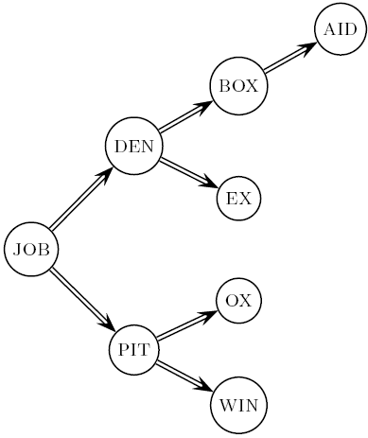
Dictionary search without blocking
Sec. 5.2
Assuming each dictionary term equally likely in query (not really so in practice!), average number of comparisons = (1+2*2+4*3+4)/8 ~2.6

Slide 38
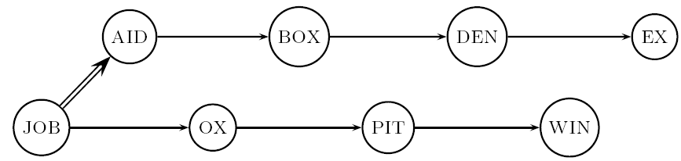
Dictionary search with blocking
Sec. 5.2
Binary search down to 4-term block;
Then linear search through terms in block.
Blocks of 4 (binary tree), avg. = (1+2*2+2*3+2*4+5)/8 = 3 compares

Slide 39
Front coding
Sec. 5.2
Front-coding
Sorted words commonly have long common prefix – store differences only
(for last k-1 in a block of k)
8automata8automate9automatic10automation
→8automat*a1◊e2◊ic3◊ion
Encodes automat
Extra length
beyond automat.

Slide 40
RCV1 dictionary compression summary
Sec. 5.2
Technique | Size in MB
Fixed width | 11.2
Dictionary-as-String with pointers to every term | 7.6
Also, blocking k = 4 | 7.1
Also, Blocking + front coding | 5.9

Slide 41
POSTINGS COMPRESSION
Sec. 5.3

Slide 42
Postings compression
Sec. 5.3
The postings file is much larger than the dictionary, factor of at least 10.
A posting for our purposes is a docID.
For Reuters (800,000 documents), we would use 32 bits per docID when using 4-byte integers.
Alternatively, we can use log₂ 800,000 ≈ 20 bits per docID.
Our goal: use a lot less than 20 bits per docID.

Slide 43
Postings: two conflicting forces
Sec. 5.3
A term like arachnocentric occurs in maybe one doc out of a million – we would like to store this posting using log₂ 1M ~ 20 bits.
A term like the occurs in virtually every doc, so 20 bits/posting is too expensive.
Prefer 0/1 bitmap vector in this case

Slide 44
Postings file entry
Sec. 5.3
We store the list of docs containing a term in increasing order of docID.
computer: 33,47,154,159,202 …
Consequence: it suffices to store gaps.
33,14,107,5,43 …
Hope: most gaps can be encoded/stored with far fewer than 20 bits.

Slide 45
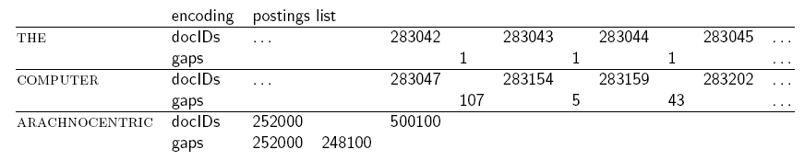
Three postings entries
Sec. 5.3

Slide 46
Variable length encoding
Sec. 5.3
Aim:
For arachnocentric, we will use ~20 bits/gap entry.
For the, we will use ~1 bit/gap entry.
If the average gap for a term is G, we want to use ~log₂G bits/gap entry.
Key challenge: encode every integer (gap) with about as few bits as needed for that integer.
This requires a variable length encoding
Variable length codes achieve this by using short codes for small numbers

Slide 47
Variable Byte (VB) codes
Sec. 5.3
For a gap value G, we want to use close to the fewest bytes needed to hold log₂ G bits.
Begin with one byte to store G and dedicate 1 bit in it to be a continuation bit c
If G ≤127, binary-encode it in the 7 available bits and set c =1
Else encode G’s lower-order 7 bits and then use additional bytes to encode the higher order bits using the same algorithm
At the end set the continuation bit of the last byte to 1 (c =1) – and for the other bytes c = 0.

Slide 48
Example
Sec. 5.3
docIDs | 824 | 829 | 215406
gaps |  | 5 | 214577
VB code | 00000110 10111000 | 10000101 | 00001101 00001100 10110001
Postings stored as the byte concatenation
000001101011100010000101000011010000110010110001
Key property: VB-encoded postings are
uniquely prefix-decodable.
For a small gap (5), VB
uses a whole byte.

Slide 49
Other variable unit codes
Sec. 5.3
Instead of bytes, we can also use a different “unit of alignment”: 32 bits (words), 16 bits, 4 bits (nibbles).
Variable byte alignment wastes space if you have many small gaps – nibbles do better in such cases.
Variable byte codes Used by many commercial/research systems

Slide 50
Unary code
Represent n as n 1s with a final 0.
Unary code for 3 is 1110.
Unary code for 80 is:
111111111111111111111111111111111111111111111111111111111111111111111111111111110

Slide 51
Gamma codes
Sec. 5.3
We can compress better with bit-level codes
The Gamma code is the best known of these.
Represent a gap G as a pair length and offset
offset is G in binary, with the leading bit cut off, for example 13 → 1101 → 101
length is the length of offset, for 13 (offset 101), this is 3.
We encode length with unary code: 1110.
Gamma code of 13 is the concatenation of length and offset: 1110101

Slide 52
Gamma code examples
Sec. 5.3
number | length | offset | γ-code
0 |  |  | none
1 | 0 |  | 0
2 | 10 | 0 | 10,0
3 | 10 | 1 | 10,1
4 | 110 | 00 | 110,00
9 | 1110 | 001 | 1110,001
13 | 1110 | 101 | 1110,101
24 | 11110 | 1000 | 11110,1000
511 | 111111110 | 11111111 | 111111110,11111111
1025 | 11111111110 | 0000000001 | 11111111110,0000000001

Slide 53
RCV1 compression
Sec. 5.3
Data structure | Size in MB
dictionary, fixed-width | 11.2
dictionary, term pointers into string | 7.6
with blocking, k = 4 | 7.1
with blocking & front coding | 5.9
collection (text, xml markup etc) | 3,600.0
collection (text) | 960.0
Term-doc incidence matrix | 40,000.0
postings, uncompressed (32-bit words) | 400.0
postings, uncompressed (20 bits) | 250.0
postings, variable byte encoded | 116.0
postings, γ−encoded | 101.0

