Slide 1
Information Retrieval
Chapter 4 – Vector space model
Quoc Dinh TRUONG, PhD
Modified from Christopher D. Manning, Prabhakar Raghavan and Hinrich Schütze slides

Slide 2
Ranked retrieval
Ch. 6
Thus far, our queries have all been Boolean.
Documents either match or don’t.
Good for expert users with precise understanding of their needs and the collection.
Not good for the majority of users.
Most users incapable of writing Boolean queries
Most users don’t want to wade through 1000s of results.

Slide 3
Ranked retrieval models
In ranked retrieval models, the system returns an ordering over the (top) documents in the collection with respect to a query.
Free text queries: the user’s query is just one or more words in a human language.
In principle, there are two separate choices here, but in practice, ranked retrieval models have normally been associated with free text queries and vice versa.

Slide 4
Scoring as the basis of ranked retrieval
Ch. 6
We wish to return in order the documents most likely to be useful to the searcher.
How can we rank-order the documents in the collection with respect to a query?
Assign a score – say in [0, 1] – to each document
This score measures how well document and query “match”.

Slide 5
Query - document matching scores
Ch. 6
We need a way of assigning a score to a query/document pair.
Let’s start with a one-term query
If the query term does not occur in the document: score should be 0.
The more frequent the query term in the document, the higher the score (should be).
We will look at a number of alternatives for this.

Slide 6
Take 1: Jaccard coefficient
Ch. 6
A commonly used measure of overlap of two sets A and B
jaccard(A,B) = |A ∩ B| / |A ∪ B|
jaccard(A,A) = 1
jaccard(A,B) = 0 if A ∩ B = 0
A and B don’t have to be the same size.
Always assigns a number between 0 and 1.

Slide 7
Issues with Jaccard for scoring
It doesn’t consider term frequency (how many times a term occurs in a document).
Rare terms in a collection are more informative than frequent terms
Jaccard doesn’t consider this information
We need a more sophisticated way of normalizing for length
We’ll use instead of |A ∩ B|/|A ∪ B|.

Slide 8
Bag of words model (BoW)
Vector representation doesn’t consider the ordering of words in a document.
John is quicker than Mary and Mary is quicker than John have the same vectors
This is called the bag of words model.
In a sense, this is a step back: The positional index was able to distinguish these two documents.

Slide 9
Term frequency tf
The term frequency tf_{t,d} of term t in document d is defined as the number of times that t occurs in d.
We want to use tf when computing query-document match scores. But how?
Raw term frequency is not what we want
A document with 10 occurrences of the term is more relevant than a document with 1 occurrence of the term butut not 10 times more relevant.
Relevance does not increase proportionally with term frequency.

Slide 10
Log-frequency weighting
Sec. 6.2
The log frequency weight of term t in d is
0 → 0, 1 → 1, 2 → 1.3, 10 → 2, 1000 → 4, etc.
Score for a document-query pair: sum over terms t in both q and d:
score
The score is 0 if none of the query terms is present in the document.

Slide 11
Document frequency
Sec. 6.2.1
Rare terms are more informative than frequent terms.
Consider a term in the query that is rare in the collection (e.g., arachnocentric)
A document containing this term is very likely to be relevant to the query arachnocentric
We want a high weight for rare terms like arachnocentric.

Slide 12
Document frequency
Sec. 6.2.1
Consider a query term that is frequent in the collection (e.g., high, increase, line)
A document containing such a term is more likely to be relevant than a document that doesn’t But it’s not a sure indicator of relevance.
For frequent terms, we want high positive weights for words like high, increase, and line But lower weights than for rare terms.
We will use document frequency (df) to capture this.

Slide 13
idf weight
Sec. 6.2.1
df_{t} is the document frequency of t: the number of documents that contain t
df_{t} is an inverse measure of the informativeness of t
df_{t} ≤ N
We define the idf (inverse document frequency) of t by

Slide 14
Effect of idf on ranking
Does idf have an effect on ranking for one-term queries, like
iPhone
idf has no effect on ranking one term queries
idf affects the ranking of documents for queries with at least two terms
For the query capricious person, idf weighting makes occurrences of capricious count for much more in the final document ranking than occurrences of person.

Slide 15
Collection vs. Document frequency
Sec. 6.2.1
The collection frequency of t is the number of occurrences of t in the collection, counting multiple occurrences.
Example:
Which word is a better search term (and should get a higher weight)?
Word | Collection frequency | Document frequency
insurance | 10440 | 3997
try | 10422 | 8760

Slide 16
tf-idf weighting
Sec. 6.2.2
The tf-idf weight of a term is the product of its tf weight and its idf weight.
Best known weighting scheme in information retrieval
Alternative names: tf.idf, tf x idf
Increases with the number of occurrences within a document.
Increases with the rarity of the term in the collection

Slide 17
Final ranking of documents for a query
Sec. 6.2.2

Slide 18
Binary → count → weight matrix
Sec. 6.3
Each document is now represented by a real-valued vector of tf-idf weights ∈ R^{|V|}

Slide 19
Documents as vectors
Sec. 6.3
So we have a |V|-dimensional vector space
Terms are axes of the space
Documents are points or vectors in this space
Very high-dimensional: tens of millions of dimensions when you apply this to a web search engine
These are very sparse vectors - most entries are zero.

Slide 20
Queries as vectors
Sec. 6.3
Key idea 1: Do the same for queries: represent them as vectors in the space
Key idea 2: Rank documents according to their proximity to the query in this space
proximity = similarity of vectors
proximity ≈ inverse of distance
Rank more relevant documents higher than less relevant documents

Slide 21
Formalizing vector space proximity
Sec. 6.3
First cut: distance between two points
( = distance between the end points of the two vectors)
Euclidean distance?
Euclidean distance is a bad idea . . .
. . . because Euclidean distance is large for vectors of different lengths.

Slide 22
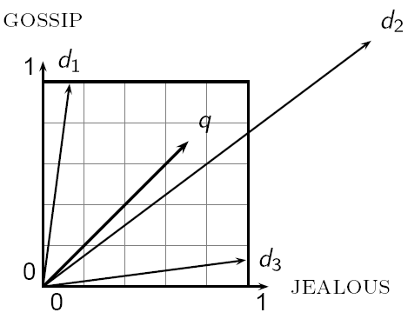
Why distance is a bad idea
Sec. 6.3
The Euclidean distance between q and d₂ is large even though the distribution of terms in the query q and the distribution of terms in the document d₂ are very similar.

Slide 23
Use angle instead of distance
Sec. 6.3
Thought experiment: take a document d and append it to itself. Call this document d′.
“Semantically” d and d′ have the same content
The Euclidean distance between the two documents can be quite large
The angle between the two documents is 0, corresponding to maximal similarity.
Key idea: Rank documents according to angle with query.

Slide 24
From angles to cosines
Sec. 6.3
The following two notions are equivalent.
Rank documents in decreasing order of the angle between query and document
Rank documents in increasing order of cosine(query, document)
Cosine is a monotonically decreasing function for the interval [0º, 180º]

Slide 25
cosine(query, document)
Sec. 6.3
Dot product
Unit vectors

Slide 26
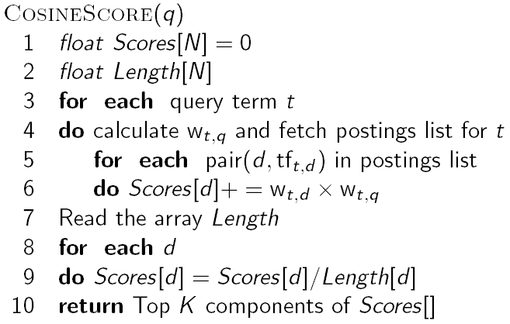
Computing cosine scores
Sec. 6.3

Slide 27
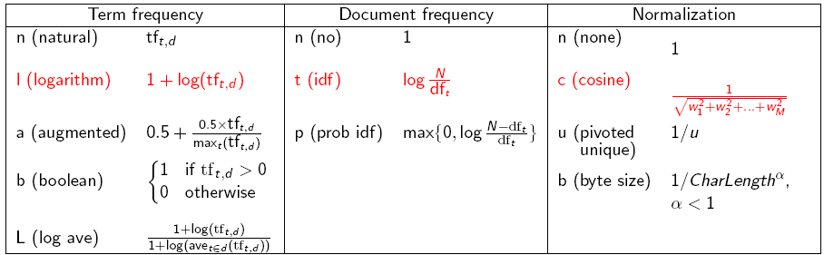
tf-idf weighting has many variants
Sec. 6.4

Slide 28
Efficient cosine ranking
Sec. 7.1
Find the K docs in the collection “nearest” to the query ⇒ K largest query-doc cosines.
Efficient ranking:
Computing a single cosine efficiently.
Choosing the K largest cosine values efficiently.
Can we do this without computing all N cosines?

Slide 29
Computing the K largest cosines: selection vs. sorting
Sec. 7.1
Typically we want to retrieve the top K docs (in the cosine ranking for the query)
not to totally order all docs in the collection
Can we pick off docs with K highest cosines?
Let J = number of docs with nonzero cosines
We seek the K best of these J

Slide 30
Use heap for selecting top K
Sec. 7.1
Binary tree in which each node’s value > the values of children
Takes 2J operations to construct, then each of K “winners” read off in 2log J steps.
For J=1M, K=100, this is about 10% of the cost of sorting.
1
.9
.3
.3
.8
.1
.1

Slide 31
Cosine similarity is only a proxy
Sec. 7.1.1
User has a task and a query formulation.
Cosine matches docs to query, thus cosine is anyway a proxy for user happiness.
If we get a list of K docs “close” to the top K by cosine measure, should be ok.

Slide 32
Generic approach
Sec. 7.1.1
Find a set A of contenders, with K < |A| << N
A does not necessarily contain the top K, but has many docs from among the top K
Return the top K docs in A
Think of A as pruning non-contenders
The same approach is also used for other (non-cosine) scoring functions

Slide 33
High-idf query terms only
Sec. 7.1.2
For a query such as catcher in the rye
Only accumulate scores from catcher and rye
Benefit
Postings of low-idf terms have many docs → these (many) docs get eliminated from set A of contenders.

Slide 34
Docs containing many query terms
Sec. 7.1.2
Any doc with at least one query term is a candidate for the top K output list.
For multi-term queries, only compute scores for docs containing several of the query terms
Say, at least 3 out of 4
Imposes a “soft conjunction” on queries seen on web search engines (early Google).

Slide 35
Champion lists
Sec. 7.1.3
Precompute for each dictionary term t, the r docs of highest weight in t’s postings
Call this the champion list for t
Note that r has to be chosen at index build time
Thus, it’s possible that r < K
At query time, only compute scores for docs in the champion list of some query term
Pick the K top-scoring docs from amongst these

Slide 36
Static quality scores
Sec. 7.1.4
We want top-ranking documents to be both relevant and authoritative.
Relevance is being modeled by cosine scores,
Authority is typically a query-independent property of a document.
Examples of authority signals
Articles in certain newspapers,
A paper with many citations,
(Pagerank)

Slide 37
Modeling authority
Sec. 7.1.4
Assign to each document a query-independent quality score in [0,1] to each document d
Denote this by g(d)
Thus, a quantity like the number of citations is scaled into [0,1]

Slide 38
Net score
Sec. 7.1.4
Consider a simple total score combining cosine relevance and authority
net-score(q,d) = g(d) + cosine(q,d)
Can use some other linear combination than an equal weighting
Now we seek the top K docs by net score

Slide 39
Why order postings by g(d)?
Sec. 7.1.4
Under g(d)-ordering, top-scoring docs likely to appear early in postings traversal.
In time-bound applications (say, we have to return whatever search results we can in 50 ms), this allows us to stop postings traversal early.
Short of computing scores for all docs in postings

Slide 40
Champion lists in g(d)-ordering
Sec. 7.1.4
Can combine champion lists with g(d)-ordering.
Maintain for each term a champion list of the r docs with highest g(d) + tf-idf_{td}
Seek top-K results from only the docs in these champion lists.

Slide 41
High and low lists
Sec. 7.1.4
For each term, we maintain two postings lists called high and low
Think of high as the champion list
When traversing postings on a query, only traverse high lists first
If we get more than K docs, select the top K and stop
Else proceed to get docs from the low lists
Can be used even for simple cosine scores, without global quality g(d)
A means for segmenting index into two tiers

Slide 42
Cluster pruning: preprocessing
Sec. 7.1.6
Pick √N docs at random: call these leaders
For every other doc, pre-compute nearest leader
Docs attached to a leader: its followers;
Likely: each leader has ~ √N followers.

Slide 43
Cluster pruning: query processing
Sec. 7.1.6
Process a query as follows:
Given query Q, find its nearest leader L.
Seek K nearest docs from among L’s followers.

Slide 44
Visualization
Sec. 7.1.6
Query
Leader
Follower

Slide 45
General variants
Sec. 7.1.6
Have each follower attached to b1=3 (say) nearest leaders.
From query, find b2=4 (say) nearest leaders and their followers.
Can recur on leader/follower construction.

Slide 46
Parametric and zone indexes
Sec. 6.1
Thus far, a doc has been a sequence of terms
In fact documents have multiple parts, some with special semantics:
Author
Title
Date of publication
etc.
These constitute the metadata about a document

Slide 47
Zone
Sec. 6.1
A zone is a region of the doc that can contain an arbitrary amount of text e.g.,
Title
Abstract
References …
Build inverted indexes on zones as well to permit querying
E.g., “find docs with merchant in the title zone and matching the query gentle rain”

Slide 48
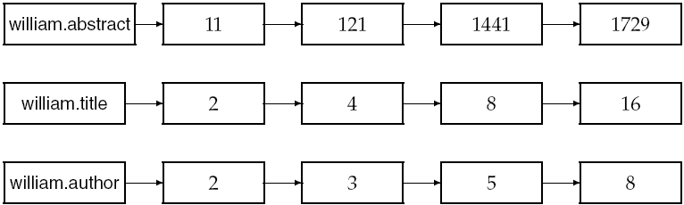
Example zone indexes
Sec. 6.1
Encode zones in dictionary vs. postings.

Slide 49
Tiered indexes
Sec. 7.2.1
Break postings up into a hierarchy of lists
Most important
…
Least important
Can be done by g(d) or another measure
Inverted index thus broken up into tiers of decreasing importance
At query time use top tier unless it fails to yield K docs
If so drop to lower tiers

Slide 50
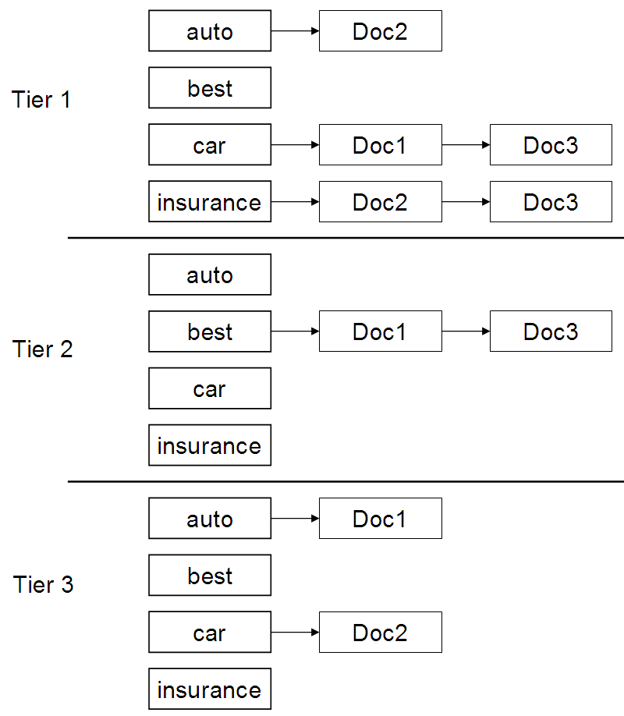
Example tiered index
Sec. 7.2.1

